Slide 1
Decay modes listed in ENSDF
John Kelley
NCSU and TUNL

Slide 2
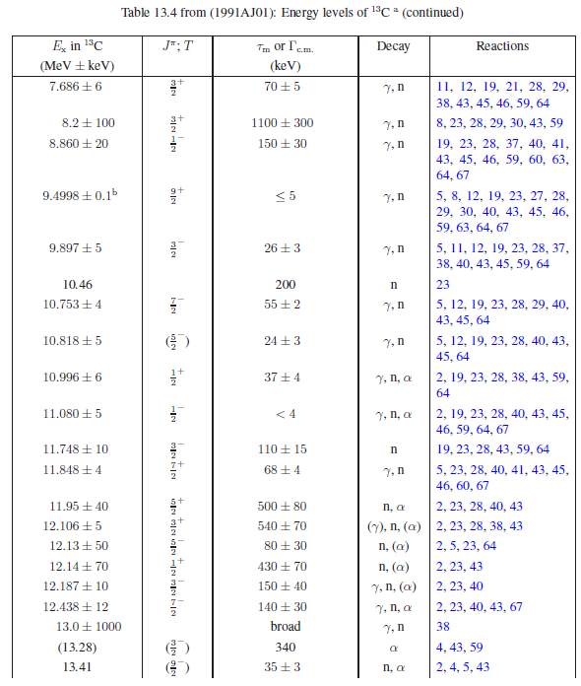
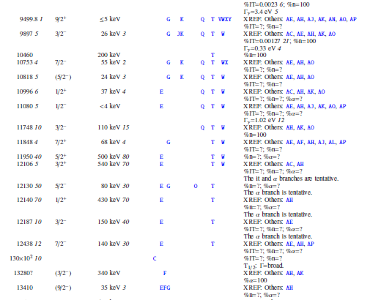
Historically: Energy Levels of Light Nuclei

Slide 3
A few general questions
Fay had a policy to list mode=γ for levels observed in (e,e’),
but this doesn’t feel right?
In light nuclei, Γγ0 and BE values often originate from (e,e’)
Caution: B(Cλ) and B(Mλ) values are often given rather than B(Eλ) and B(Mλ) values

Slide 4
A few general questions
I learned that listing “%Mode=?” is acceptable
.
- But I once heard a user joking that “?” must imply the mode is uncertain.
- ⁹Be(α,nγ)
- How best to write the decay mode?
%n>0; %a>0 is true
%n>0; %a<100 is true
%n<100; %a>0 is true
%n<100; %a<100 is true

