Slide 1
Status Report of Jilin University
Yang Dong
College of Physics, Jilin University Changchun 130012,China dyang@jlu.edu.cn
2022.10.24，Changchun

Slide 2
Status of mass chain evaluation
Members of Jilin university (JLU) data centre include: Yang Dong, and a student Chen Duo. Professor Li Jian also involves in some theoretical researches in the nuclear structure data. Jilin university group is responsible for the mass chains: A=52, 53, 54, 55, 56, and 67.
——————————————————————————————
A Status
——————————————————————————————
52 Yang Dong, Huo Junde, NDS, 128, 185 (2015)
53 Huo Junde, NDS, 110, 2689 (2009)
54 Yang Dong, Huo Junde, NDS, 121, 1 (2014)
55 Huo Junde, NDS, 109, 787-942 (2008) (under evaluation)
56 Huo Junde, Huo Su, Yang Dong, NDS, 112, 1513 (2011)
67 Yang Dong , Huo Junde (2019) (under evaluation)
——————————————————————————————

Slide 3
Other data researches of the group
1. Projects in China:
Decay data evaluation for CENDL-DDL database (finished);
Systematical study for the ground states’ spin of odd-Z nucleus (finished);
Statistical analysis of half-lives measurement uncertainty (in process).
2. Articles
‘Low-lying state investigation of odd-A Mn isotopes around N=28’, Huanyi Ye, Jian Li*, Dong Yang*, Hua Jin, Xiaolong Huang (submitted);
‘Odd-A nuclei ground state’s spin prediction using neural network’, Hufeng Wen, Tianshuai Shang, Jian Li*, Zhongming Liu, Dong Yang, Yonghe Xue, Xiang Li (submitted).

Slide 4
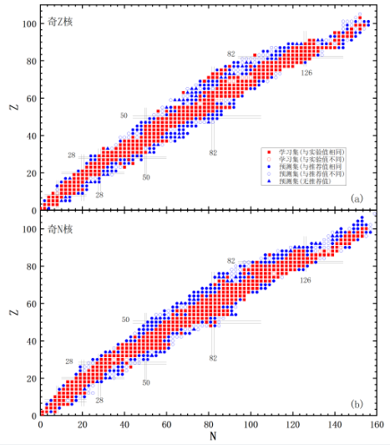
Data research by machine learning
d
Spin (discrete data):
(a): Odd-Z
(b): Odd-N
Red: training data
Blue: predicted data
Grey: inconsistent data
‘Odd-A nuclei ground state’s spin prediction using neural network’, Hufeng Wen, Tianshuai Shang, Jian Li*, Zhongming Liu, Dong Yang, Yonghe Xue, Xiang Li (submitted)

Slide 5
Data research by machine learning
EXP.
EXP.
CAL.
CAL.
Energy data predicted by Bayesian neural network

Slide 6
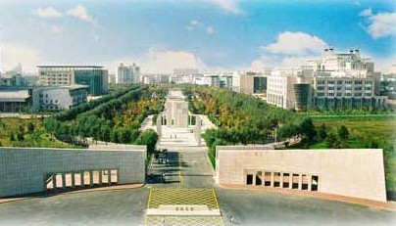
Thank you

