Slide 1
Status report of the Japanese group
Hideki Iimura and Hiroyuki Koura

Slide 2
Members of the Japanese group
Hideki Iimura Liaison of the group.
Former affiliation: Japan Atomic Energy Agency
Hiroyuki Koura Japan Atomic Energy Agency
Persons having left the group recently
Jun-ichi Katakura, Susumu Ohya, Masa-aki Kanbe

Slide 3
Mass chains for which Japanese group is responsible
Mass | Last NDS Publication |  | Status
 | Year | Evaluators
120 | 2002 | Kitao, Tendow, Hashizume | evaluating
121 | 2010 | Ohya
122 | 2007 | Tamura
123 | 2021 | Chen
124 | 2008 | Katakura, Wu | evaluating
125 | 2011 | Katakura
126 | 2022 | Iimura, Katakura, Ohya
127 | 2011 | Hashizume
128 | 2015 | Elekes, Timar,
129 | 2014 | Timar, Elekes, Singh
Because the Japanese group becomes smaller, we propose to reduce our responsible mass chains.

Slide 4
Mass chains now being evaluated
A=120 : Iimura
A=124: Koura
Candidate for next evaluation
A=122 : Iimura

Slide 5
Situation after April 2022
Iimura retired from JAEA in the end of March 2022. Then he established a private company, which made a contract with the nuclear safety research center of JAEA.
Although the official purpose of this contract is to confirm the validity of nuclear decay data of fission products, Iimura can continue the evaluation for ENSDF by using the contract money.
However, the amount of contract is too small for Iimura to devote enough time to ENSDF. It is absolutely necessary for him to find additional financial support.

Slide 6


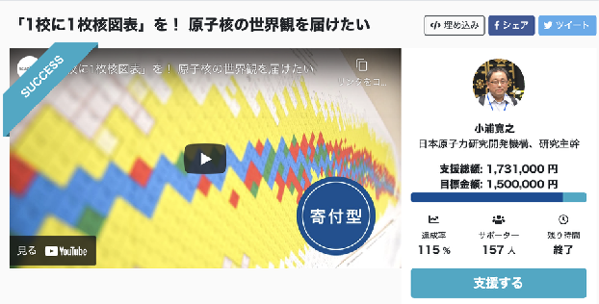
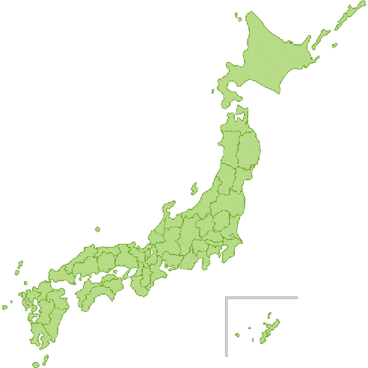

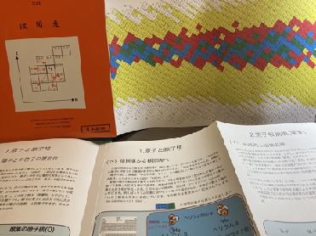
Diverse usage of of “Chart of the Nuclides”
~Crowdfunding for education~
Crowdfunding project “one nuclear chart for one high school "
FY2020
・Purpose: delivering nuclear charts to high schools in Japan
( for selected high schools)
・Projected budget: 1.5 MYen (~15,000 USD as 1USD=100Yen)
・Term of funding: Jan. 2020- Mar. 2020 (8 weeks)
・Results:1.731 MYen (~17,310 USD) by 157 supporters!
https://academist-cf.com/projects/169
FY2021
・Construction: 1,200 sheets of the chart written in Japanese
・Distribution:
Dec. 2020 : ~150 supportters
Feb. 2021 : 284 SSH + 122 Fukushima’s + 98 Ibaraki’s
Apr. 2021: 57 Colleges of National Institute of Technology
Fukushima pref.
122
Tokyo
Ibaraki pref.
98
FY2022
Visiting lectures
・ 16. Jun., 2021: Open lectures for Citizens (Kanagawa pref.)
・7. Jun., 2022: Waseda University Senior High School (SSH)
・7. Nov., 2022: (online) Graduate School of Eng., Nagoya University
…
・Super science high school (overall in Japan) : 284
・National Institute of Technology: 57
・ Supporters: ~150
Nuclear Structure and Decay Data Network (NSDD)
・Super science high school (SSH) :Special science program (3 years) for high-school approved by Ministry of Education, Culture, Sports, Science and Technology of Japan (MEXT)
Presentation in ND2022

Slide 7
Revised of “JAEA Chart of the Nuclides” in 2022FY
A revised version of JAEA chart of the nuclides is prepared.
・2022.12: Publisher will be chosen
・2023.3 : Revised version will be Released (1000-1500 sheets)
Taken from JAEA chart of the nuclides 2018

