Slide 1
Texas A&M University Cyclotron Institute
TAMU NSDD EVALUATION CENTER
Report 2021-2022
N. Nica

Slide 2
Evaluation of Nuclear Structure and Decay Data OVERVIEW
Scope:
Promote and accomplish mass-chain nuclear structure data evaluation at Texas A&M University - Cyclotron Institute as regular activity and foresee future developments.
Address gaps in data through targeted experiments
2005-2017: under contract with BNL/NNDC
67% FTE Mass Chain Evaluation
N. Nica (PI, evaluator), J.C. Hardy (scientific adviser)
2018-2022: NSDD Data Center
FY2018: 67% FTE Mass Chain Evaluation
FY2019-2022: 100% FTE Mass Chain Evaluation
N. Nica (PI, evaluator), J.C. Hardy (scientific adviser)

Slide 3
Texas A&M - Cyclotron Institute NSDD Center Contributions
Major Direct Contribution to USNDP/NSDD: Nuclear Data Evaluation
18 publications
Important Contribution to USNDP/NSDD: Precision ICC Measurements
BrIcc adopted the “Frozen Orbitals” calculations
⁹³Nb, ¹⁰³Rh, ¹²⁵Te, ¹²⁷Te, ¹¹¹Cd, ¹¹⁹Sn, ¹³⁴Cs, ¹³⁷Ba, ¹⁹¹Os, ¹⁹³Ir, ¹⁹⁷Pt
18 publications
Texas A&M Contribution to Precision Nuclear Data Production: Precision β-γ Measurements (Standard Model, CKM matrix)
T_{1/2} , Branching Ratios, Efficiency calibration
21 publications
Texas A&M Medical Radioisotopes
⁶⁷Cu, ⁹⁹Mo
3 publications

Slide 4
Mass Chain Evaluation: 300 nuclei, 20 A-chains
1. N.Nica, Nuclear Data Sheets for A = 252, Nucl.Data Sheets 106, 813 (2005)
8 nuclei: ²⁵²Cm, ²⁵²Bk, ²⁵²Cf, ²⁵²Es, ²⁵²Fm, ²⁵²Md, ²⁵²No, ²⁵²Lr
2. N.Nica, Nuclear Data Sheets for A = 140, Nucl.Data Sheets 108, 1287 (2007)
16 nuclei: ¹⁴⁰Te, ¹⁴⁰I, ¹⁴⁰Xe, ¹⁴⁰Cs, ¹⁴⁰Ba, ¹⁴⁰La, ¹⁴⁰Ce, ¹⁴⁰Pr, ¹⁴⁰Nd, ¹⁴⁰Pm, ¹⁴⁰Sm, ¹⁴⁰Eu, ¹⁴⁰Gd, ¹⁴⁰Tb, ¹⁴⁰Dy, ¹⁴⁰Ho
3. D.Abriola et al., Nuclear Data Sheets for A = 84, Nucl.Data Sheets 110, 2815 (2009)
1 nucleus: ⁸⁴Y
4. N.Nica, Nuclear Data Sheets for A = 147, Nucl.Data Sheets 110, 749 (2009)
16 nuclei: ¹⁴⁷Xe, ¹⁴⁷Cs, ¹⁴⁷Ba, ¹⁴⁷La, ¹⁴⁷Ce, ¹⁴⁷Pr, ¹⁴⁷Nd, ¹⁴⁷Pm, ¹⁴⁷Sm, ¹⁴⁷Eu, ¹⁴⁷Gd, ¹⁴⁷Tb, ¹⁴⁷Dy, ¹⁴⁷Ho, ¹⁴⁷Er, ¹⁴⁷Tm
5. N.Nica, Nuclear Data Sheets for A = 97, Nucl.Data Sheets 111, 525 (2010)
14 nuclei: ⁹⁷Br, ⁹⁷Kr, ⁹⁷Rb, ⁹⁷Sr, ⁹⁷Y, ⁹⁷Zr, ⁹⁷Nb, ⁹⁷Mo, ⁹⁷Tc, ⁹⁷Ru, ⁹⁷Rh, ⁹⁷Pd, ⁹⁷Ag, ⁹⁷Cd
6. J.Cameron, J.Chen, B.Singh, N.Nica, Nuclear Data Sheets for A = 37, Nucl.Data Sheets 113, 365 (2012)
10 nuclei: ³⁷Na, ³⁷Mg, ³⁷Al, ³⁷Si, ³⁷P, ³⁷S, ³⁷Cl, ³⁷Ar, ³⁷K, ³⁷Ca
7. N.Nica, J.Cameron, B.Singh, Nuclear Data Sheets for A = 36, Nucl.Data Sheets 113, 1 (2012)
10 nuclei: ³⁶Na, ³⁶Mg, ³⁶Al, ³⁶Si, ³⁶P, ³⁶S, ³⁶Cl, ³⁶Ar, ³⁶K, ³⁶Ca
8. N.Nica, B.Singh, Nuclear Data Sheets for A = 34, Nucl.Data Sheets 113, 1563 (2012)
11 nuclei: ³⁴Ne, ³⁴Na, ³⁴Mg, ³⁴Al, ³⁴Si, ³⁴P, ³⁴S, ³⁴Cl, ³⁴Ar, ³⁴K, ³⁴Ca
9. B.Singh, N.Nica, Nuclear Data Sheets for A = 77, Nucl.Data Sheets 113, 1115 (2012)
12 nuclei: ⁷⁷Ni, ⁷⁷Cu, ⁷⁷Zn, ⁷⁷Ga, ⁷⁷Ge, ⁷⁷As, ⁷⁷Se, ⁷⁷Br, ⁷⁷Kr, ⁷⁷Rb, ⁷⁷Sr, ⁷⁷Y
10. N.Nica, Nuclear Data Sheets for A = 148, Nucl.Data Sheets 117, 1 (2014)
16 nuclei: ¹⁴⁸Xe, ¹⁴⁸Cs, ¹⁴⁸Ba, ¹⁴⁸La, ¹⁴⁸Ce, ¹⁴⁸Pr, ¹⁴⁸Nd, ¹⁴⁸Pm, ¹⁴⁸Sm, ¹⁴⁸Eu, ¹⁴⁸Gd, ¹⁴⁸Tb, ¹⁴⁸Dy, ¹⁴⁸Ho, ¹⁴⁸Er, ¹⁴⁸Tm
11. N.Nica, Nuclear Data Sheets for A = 141, Nucl.Data Sheets 122, 1 (2014)
16 nuclei: ¹⁴¹Te, ¹⁴¹I, ¹⁴¹Xe, ¹⁴¹Cs, ¹⁴¹Ba, ¹⁴¹La, ¹⁴¹Ce, ¹⁴¹Pr, ¹⁴¹Nd, ¹⁴¹Pm, ¹⁴¹Sm, ¹⁴¹Eu, ¹⁴¹Gd, ¹⁴¹Tb, ¹⁴¹Dy, ¹⁴¹Ho
12. N.Nica, Nuclear Data Sheets for A = 157, Nucl.Data Sheets 132, 1 (2016)
15 nuclei: ¹⁵⁷Nd, ¹⁵⁷Pm, ¹⁵⁷Sm, ¹⁵⁷Eu, ¹⁵⁷Gd, ¹⁵⁷Tb, ¹⁵⁷Dy, ¹⁵⁷Ho, ¹⁵⁷Er, ¹⁵⁷Tm, ¹⁵⁷Yb, ¹⁵⁷Lu, ¹⁵⁷Hf, ¹⁵⁷Ta, ¹⁵⁷W
13. N.Nica, Nuclear Data Sheets for A = 158, Nucl.Data Sheets 141, 1 (2017)
15 nuclei: ¹⁵⁸Nd, ¹⁵⁸Pm, ¹⁵⁸Sm, ¹⁵⁸Eu, ¹⁵⁸Gd, ¹⁵⁸Tb, ¹⁵⁸Dy, ¹⁵⁸Ho, ¹⁵⁸Er, ¹⁵⁸Tm, ¹⁵⁸Yb, ¹⁵⁸Lu, ¹⁵⁸Hf, ¹⁵⁸Ta, ¹⁵⁸W
14. N.Nica, Nuclear Data Sheets for A = 140, Nucl.Data Sheets 154, 1 (2018)
17 nuclei: ¹⁴⁰Sb, ¹⁴⁰Te, ¹⁴⁰I, ¹⁴⁰Xe, ¹⁴⁰Cs, ¹⁴⁰Ba, ¹⁴⁰La, ¹⁴⁰Ce, ¹⁴⁰Pr, ¹⁴⁰Nd, ¹⁴⁰Pm, ¹⁴⁰Sm, ¹⁴⁰Eu, ¹⁴⁰Gd, ¹⁴⁰Tb, ¹⁴⁰Dy, ¹⁴⁰Ho
15. N.Nica, A =155, Nuclear Data Sheets for A = 155, Nucl.Data Sheets 160, 1 (2019)
16 nuclei: ¹⁵⁵Ce, ¹⁵⁵Pr, ¹⁵⁵Nd, ¹⁵⁵Pm, ¹⁵⁵Sm, ¹⁵⁵Eu, ¹⁵⁵Gd, ¹⁵⁵Tb, ¹⁵⁵Dy, ¹⁵⁵Ho, ¹⁵⁵Er, ¹⁵⁵Tm, ¹⁵⁵Yb, ¹⁵⁵Lu, ¹⁵⁵Hf, ¹⁵⁵Ta
17. N.Nica, A =153, Nuclear Data Sheets for A = 153, Nucl.Data Sheets 170, 1 (2020)
16 nuclei: ¹⁵³La, ¹⁵³Ce, ¹⁵³Pr, ¹⁵³Nd, ¹⁵³Pm, ¹⁵³Sm, ¹⁵³Eu, ¹⁵³Gd, ¹⁵³Tb, ¹⁵³Dy, ¹⁵³Ho, ¹⁵³Er, ¹⁵³Tm, ¹⁵³Yb, ¹⁵³Lu, ¹⁵³Hf
16. N.Nica, A =160, Nuclear Data Sheets for A = 160, Nucl.Data Sheets 176, 1 (2021)
17 nuclei: ¹⁶⁰Pr, ¹⁶⁰Nd, ¹⁶⁰Pm, ¹⁶⁰Sm, ¹⁶⁰Eu, ¹⁶⁰Gd, ¹⁶⁰Tb, ¹⁶⁰Dy, ¹⁶⁰Ho, ¹⁶⁰Er, ¹⁶⁰Tm, ¹⁶⁰Yb, ¹⁶⁰Lu, ¹⁶⁰Hf, ¹⁶⁰Ta, ¹⁶⁰W, ¹⁶⁰Re
18. N.Nica , B.Singh, Nuclear Data Sheets for A = 147, Nucl.Data Sheets 181, 1 (2022)
16 nuclei: ¹⁴⁷Xe, ¹⁴⁷Cs, ¹⁴⁷Ba, ¹⁴⁷La, ¹⁴⁷Ce, ¹⁴⁷Pr, ¹⁴⁷Nd, (¹⁴⁷Pm Balraj Singh), ¹⁴⁷Sm, ¹⁴⁷Eu, ¹⁴⁷Gd, ¹⁴⁷Tb, ¹⁴⁷Dy, ¹⁴⁷Ho, ¹⁴⁷Er, ¹⁴⁷Tm

Slide 5
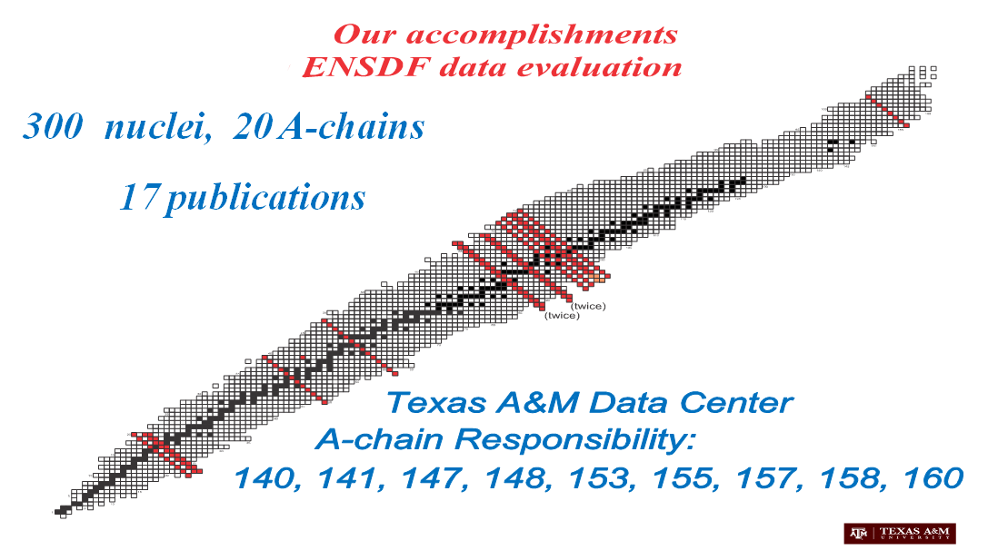
Mass Chain Evaluation: 300 nuclei, 20 A-chains 140, 141, 147, 148, 153, 155, 157, 158, 160, 154, 162
19. N.Nica, Nuclear Data Sheets for A = 141 – to be sent to Nucl.Data Sheets
17 nuclei : ¹⁴¹Sb, ¹⁴¹Te, ¹⁴¹I, ¹⁴¹Xe, ¹⁴¹Cs, ¹⁴¹Ba, ¹⁴¹La, ¹⁴¹Ce, ¹⁴¹Pr, ¹⁴¹Nd, ¹⁴¹Pm, ¹⁴¹Sm, ¹⁴¹Eu, ¹⁴¹Gd, ¹⁴¹Tb, ¹⁴¹Dy, ¹⁴¹Ho
20. N.Nica, Nuclear Data Sheets for A = 162 – after review with evaluator Aug 30, 2022 (FY21)
17 nuclei: ¹⁶²Nd, ¹⁶²Pm, ¹⁶²Sm, ¹⁶²Eu, ¹⁶²Gd, ¹⁶²Tb, ¹⁶²Dy, ¹⁶²Ho, ¹⁶²Er, ¹⁶²Tm, ¹⁶²Yb, ¹⁶²Lu, ¹⁶²Hf, ¹⁶²Ta, ¹⁶²W, ¹⁶²Re, ¹⁶²Os,
SIZE IS HUGE!
VERY COMPLX
1 A-chain/FY
140, 141, 147, 148, 153, 155, 157, 158, 160, 154, 162

Slide 6
Texas A&M - Cyclotron Institute NSDD Center 2021-2022
15. N.Nica, Nuclear Data Sheets for A =155, published in Nucl.Data Sheets 160, 1 (2019), FY2016
17 nuclei: ¹⁵⁵La,¹⁵⁵Ce, ⁵⁵Pr, ¹⁵⁵Nd, ⁵⁵Pm, ¹⁵⁵Sm, ¹⁵⁵Eu, ¹⁵⁵Gd, ¹⁵⁵Tb, ¹⁵⁵Dy, ¹⁵⁵Ho, ¹⁵⁵Er, ¹⁵⁵Tm, ¹⁵⁵Yb, ¹⁵⁵Lu, ¹⁵⁵Hf, ¹⁵⁵Ta
17. N.Nica, Nuclear Data Sheets for A = 153, published in Nucl.Data Sheets 170, 1 (2020), FY2018
16 nuclei: ¹⁵³La, ¹⁵³Ce, ¹⁵³Pr, ¹⁵³Nd, ¹⁵³Pm, ¹⁵³Sm, ¹⁵³Eu, ¹⁵³Gd, ¹⁵³Tb, ¹⁵³Dy, ¹⁵³Ho, ¹⁵³Er, ¹⁵³Tm, ¹⁵³Yb, ¹⁵³Lu, ¹⁵³Hf
16. N.Nica, Nuclear Data Sheets for A=160, published in Nucl.Data Sheets 176, 1 (2021), FY2017
17 nuclei: ¹⁶⁰Pr, ¹⁶⁰Nd, ¹⁶⁰Pm, ¹⁶⁰Sm, ¹⁶⁰Eu, ¹⁶⁰Gd, ¹⁶⁰Tb, ¹⁶⁰Dy, ¹⁶⁰Ho, ¹⁶⁰Er, ¹⁶⁰Tm, ¹⁶⁰Yb, ¹⁶⁰Lu,¹⁶⁰Hf, ¹⁶⁰Ta,¹⁶⁰W, ¹⁶⁰Re
18. N.Nica, B.Singh, Nuclear Data Sheets for A = 147, published in Nucl.Data Sheets 181, 1 (2022), FY2019
16 nuclei: ¹⁴⁷Xe, ¹⁴⁷Cs, ¹⁴⁷Ba, ¹⁴⁷La, ¹⁴⁷Ce, ¹⁴⁷Pr, ¹⁴⁷Nd, (¹⁴⁷Pm Balraj Singh), ¹⁴⁷Sm, ¹⁴⁷Eu, ¹⁴⁷Gd, ¹⁴⁷Tb, ¹⁴⁷Dy, ¹⁴⁷Ho, ¹⁴⁷Er, ¹⁴⁷Tm
19. N.Nica, A = 141, – to be sent to Nucl.Data Sheets, FY2020
17 nuclei: ¹⁴¹Sb, ¹⁴¹Te, ¹⁴¹I, ¹⁴¹Xe, ¹⁴¹Cs, ¹⁴¹Ba, ¹⁴¹La, ¹⁴¹Ce, ¹⁴¹Pr, ¹⁴¹Nd, ¹⁴¹Pm, ¹⁴¹Sm, ¹⁴¹Eu, ¹⁴¹Gd, ¹⁴¹Tb, ¹⁴¹Dy, ¹⁴¹Ho
20. N.Nica, A = 162 – after review with evaluator Aug 30, 2022, FY2021
17 nuclei: ¹⁶²Nd, ¹⁶²Pm, ¹⁶²Sm, ¹⁶²Eu, ¹⁶²Gd, ¹⁶²Tb, ¹⁶²Dy, ¹⁶²Ho, ¹⁶²Er, ¹⁶²Tm, ¹⁶²Yb, ¹⁶²Lu, ¹⁶²Hf, ¹⁶²Ta, ¹⁶²W, ¹⁶²Re, ¹⁶²Os
21. N.Nica, A = 154 – submitted to NNDC, FY2022
17 nuclei: ¹⁵⁴Ba, ¹⁵⁴La ¹⁵⁴Ce, ¹⁵⁴Pr, ¹⁵⁴Nd, ¹⁵⁵Pm, ¹⁵⁴Sm, ¹⁵⁴Eu, ¹⁵⁴Gd, ¹⁵⁴Tb, ¹⁵⁴Dy, ¹⁵⁴Ho, ¹⁵⁴Er, ¹⁵⁴Tm, ¹⁵⁴Yb, ¹⁵⁴Lu, ¹⁵⁴Hf
1. Review, A = 177, Review of full mass chain evaluation, FY2019
14 nuclei: ¹⁷⁷Er, ¹⁷⁷Tm, ¹⁷⁷Yb, ¹⁷⁷Lu, ¹⁷⁷Hf, ¹⁷⁷Ta, ¹⁷⁷W, ¹⁷⁷Re, ¹⁷⁷Os, ¹⁷⁷Ir, ¹⁷⁷Pt, ¹⁷⁷Au, ¹⁷⁷Hg, ¹⁷⁷Tl
2. Review: A = 212, Review of full mass chain evaluation, FY2020
12 nuclei: ²¹²Hg, ²¹²Tl, ²¹²Pb, ²¹²Bi, ²¹²Po, ²¹²At, ²¹²Rn, ²¹²Fr, ²¹²Ra, ²¹²Ac, ²¹²Th, ²¹²Pa
3. Review: A = 245, Review of full mass chain evaluation, FY2021
9 nuclei: ²⁴⁵U, ²⁴⁵Pu, ²⁴⁵Am, ²⁴⁵Cu, ²⁴⁵Bk, ²⁴⁵Cf, ²⁴⁵Es, ²⁴⁵Fm, ²⁴⁵Md
4. Review: A = 31, Review of full mass chain evaluation, FY2022
11 nuclei: ³¹F, ³¹Ne, ³¹Na, ³¹Mg, ³¹Al, ³¹Si, ³¹P, ³¹S, ³¹Cl, ³¹Ar, ³¹K

Slide 7
Texas A&M - Cyclotron Institute NSDD Center Mass chain evaluations: Statistics
 | A=160 Evaluation | A=147 Evaluation (-BS) | A=141 Evaluation | A=162 Evaluation | A=154 Evaluation | A=148 Evaluation | A=245 Review | A=31 Review
Number of Adopted Levels | 1242 | 1318 | 1080 | 1082 | 1256 | 1219 | 378 | 827
Number of Adopted Gammas | 2503 | 2168 | 1861 | 1704 | 2604 | 1937 | 477 | 1805
Number of nuclides | 17 | 16 | 17 | 17 | 17 | 16 | 9 | 11
Number of datasets | 78 | 81 | 97 | 84 | 85 | 92 | 24 | 108
Number of .ens lines | 22831 | 20510 | 16812 | 19364 | 24769 | 17932 | 2777 | 18358
NG/NL | 2.02 | 1.64 | 1.76 | 1.57 | 2.07 | 1.59 | 1.26 | 2.18

Slide 8
Mass chains: Review, Updates & Editorial
Mass Chain A160: FY2017
.ens database file | Number of Publications | Increment | CUT Date
A160_old | 368 |  | 1-Jun-2005
A160_new |  |  | 30-Sept-2017 (15-Aug-2018)
A160_upd.arv | 457 | +89 | 1-May-2021, 3y8m
Mass Chain A147: FY2019
.ens database file | Number of Publications | Increment | CUT Date
A147_old | 449 |  | 14-Nov-2008
A147_new |  |  | 9-Sept-2019
A147_upd.arv | 563 | +114 | 9-Mar-2022, 2y5m
Mass Chain A154: FY2022
.ens database file | Number of Publications | Increment | CUT Date
A154_old | 585 |  | 1-May-2008
A154_new | 630 | +45 | 22-Aug-2022
A154_upd.arv

Slide 9
Texas A&M - Cyclotron Institute NSDD Center, 2021-2022 Publications
2021NIZZ EPJ Web of Conferences 252, p.080032 (2021)
N.Nica
Texas A and M US Nuclear DATA Program
2021DIZZ EPJ Web of Conferences 252, p.08002, (2021)
M.R.Dias Rodrigues, V.E.Iacob, N.Nica, B.Roeder, G.Tabacaru, K.Wang, M.Yu, P.Zanotti-Fregonara, J.Mabiala, J.Romo
A novel approach to medical radioisotope production using inverse kinematics
2021MAZY EPJ Web of Conferences 252, p.080032, (2021)
J.Mabiala, M.R.D.Rodrigues, G.A.Souliotis, V.E.Iacob, N.Nica, B.Roeder, G.Tabacaru, K.Wang, J.Romo, D.Scriven
Enhanced production of ⁹⁹Mo in inverse kinematics heavy ion reactions
2021NI07 Nucl.Data Sheets 176, 1 (2021)
N.Nica
Nuclear Data Sheets for A=160
2022NI03 Nucl.Data Sheets 181, 1 (2022)
N.Nica., B.Singh
Nuclear Data Sheets for A=147

Slide 10
Texas A&M - Cyclotron Institute, NSDD Center, 2021-2022 Conferences
N. Nica, "TAMU NSDD CENTER Report 2021“, Nuclear Data Week 2021 (CSEWG-USNDP-NDAG), Brookhaven National Laboratory, National Nuclear Data Center (NNDC), Nov. 2021, Upton, NY, USA
N. Nica, "Medical Radioisotopes Production Studies: ⁶⁷Cu Case“, Nuclear Data Week(s) 2021 (CSEWG-USNDP-NDAG), Brookhaven National Institute, National Nuclear Data Center (NNDC), Nov. 2021, Upton, NY, USA
N. Nica, "TAMU NSDD EVALUATION CENTER Report 2021," Technical Meeting of the NSDD network (virtual), May 2021, Nuclear Data Services, IAEA Vienna , Vienna, Austria
N. Nica, "Texas A&M US Nuclear DATA Program" ,HINPw6 - Hellenic Institute of Nuclear Physics 6th International Workshop, Perspectives on Nuclear Physics; From Fundamentals to Applications, May 14-16, 2021, Athens, Greece
N. Nica, "About difficult evaluation decisions: a case study“, ENSDF 2021, Apr. 2021, National Nuclear Data Center, Brookhaven National Laboratory , Upton, NY, USA
N. Nica, "Texas A&M US Nuclear DATA Program", DOE Nuclear Data Program Manager's Inspection at the Texas A&M University Nuclear Data Evaluation Center, Mar," DOE Nuclear Data Program Manager's Inspection at the Texas A&M University Nuclear Data Evaluation Center, Mar 2021, TAMU Cyclotron Institute, College Station, TX, USA
N. Nica, "Texas A&M US Nuclear DATA Program“, Virtual Joint Nuclear and Astrophysics Seminar, Apr 2021, TAMU Cyclotron Institute, College Station, TX, USA
N. Nica, "Medical Radioisotopes Production Studies: ⁶⁷Cu Case“, Technical Meeting of the NSDD network (virtual), Apr 2022, Nuclear Data Services, IAEA Vienna , Vienna, Austria
N. Nica, "Miscellanea of an ENSDF evaluator (evaluation issues)“, Technical Meeting of the NSDD network (virtual), Apr 2022, Nuclear Data Services, IAEA Vienna , Vienna, Austria

Slide 11
A-Chain Evaluation Currency @Texas A&M University
Responsibility:
140, 141, 147, 148, 153, 155, 157, 158, 160, 154, 162
Status:
147 (Mar-2022)
160 (May 2021)
153 (Aug 2020)
155 (Oct-2019)
140 (Nov 2018)
158 (Feb 2017)
157 (Dec 2015)
141 (to be sent to NDS)
148 (Oct 2013)
FY2021: 162 (Mar 2007 – after review with evaluator Aug 30, 2011)
FY2022: 154 (May 2008 – submitted to NNDC, Aug. 22, 2022)
Good Standing@Texas A&M University CI
HELP NNDC

Slide 12
A-Chain Evaluation 2022-2023 @Texas A&M University
FY2023: A148 (Oct 2013)
For all the years:
Solve backlog:
-A141
-A162
-A154
Review A-chain evaluations
XUNDL (limited)
OBS.: 162, 154 (Demanding future TAMU RESPONSIBILITY)
Personnel changes
Not foreseeable
However highly desirable for developing TAMU Center
Pending on future financing/perspectives

Slide 13
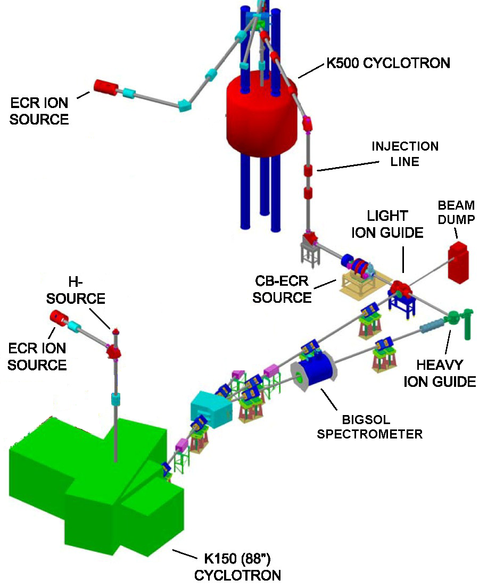
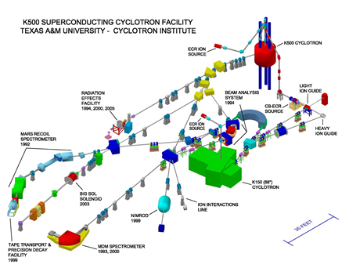
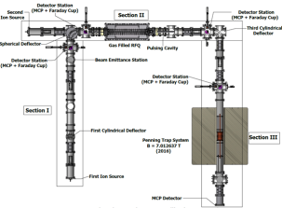
Texas A&M Evaluation Center: Data Evaluation Station at Cyclotron Radioactive Ion Beam Facility to assist experiments and pre-evaluate data
Focus on the Light-Ion Guide (LIG), the Heavy Ion Guide (HIG) and the Charge-Breeding Electron-Cyclotron-Resonance ion source (CB-ECRIS).
TAMUTRAP

Slide 14
Texas A&M NSDD Evaluation Center Strategic Priorities
Continuing ENSDF Mass Chain Evaluation
First Strategic Priority according to the Mission Statement.
All other priorities will be strictly subordinated to this purpose
Produce experimental nuclear data to aid data evaluation
Precision Internal Conversion Coefficients Measurements at Cyclotron Institute, Texas A&M University to give USDNP the best approach for ENSDF ICC-calculated values (concluding cases pending on conditions)
Precision βγ Spectroscopy for T_{1/2} and BR for Standard Model
Experimental studies of Medical Isotopes
Invers kinematics methodology, Cyclotron Institute, Texas A&M University
Reevaluation of data procedures for basic science and data evaluation
Level scheme re-concept based on Repeatability, a newly revealed experimental data evidence

