Slide 1

IAEA Technical Meeting on Back End of the Fuel Cycle Considerations for Small Modular Reactors
Fuel Cycle Scenarios and Back-end Technologies of HTGR in Japan
20th-23rd September 2022
Sector of Fast Reactor and Advanced Reactor
Research and Development
Japan Atomic Energy Agency
Yuji FUKAYA, Minoru GOTO, Taiju SHIBATA

Slide 2
Background and Objective
Background
In the previous meeting held in March, we introduced Japanese reprocessing technologies and fuel cycle scenarios for HTGR.
Basically, Japan considers the technologies for HTGR Back-end process had completed if an industrial revel demonstration is necessary in the First-of-a-Kind (FOAK) plant.
However, in some innovative fuel cycle scenarios, further Research and Development (R&D) necessary. International cooperation is expected for the R&D.
Objective
To overview of Japanese Back-end technologies for HTGR.
To introduce technological subject to improve the specification for some fuel cycle scenarios.

Slide 3
Overview of Back-end Technologies in Japan

Slide 4
History of Reprocessing Plant Development
History
Japan had developed the reprocessing technologies based on French technologies.
Time | France | Japan | Purpose
1958 | UP1 |  | Generate Pu for nuclear weapon
1966 | UP2 |  | Reprocessing Calder Hall reactor SF
1976 | UP2 |  | Update for LWR SF
1977 |  | Tokai Reprocessing Plant | Reprocessing LWR SF, Negotiation with U.S.*
1989 | UP3 |  | Reprocessing LWR SF
2006 |  | Rokkasyo Reprocessing Plant (RPP) | Reprocessing LWR SF
*Japan-U.S. reprocessing negotiation;
Japan, which is non-nuclear-weapon state, is accepted to extract Pu with same amount of U by U.S.
HTGR technologies had also been developed with assuming reprocessing in Japan.

Slide 5

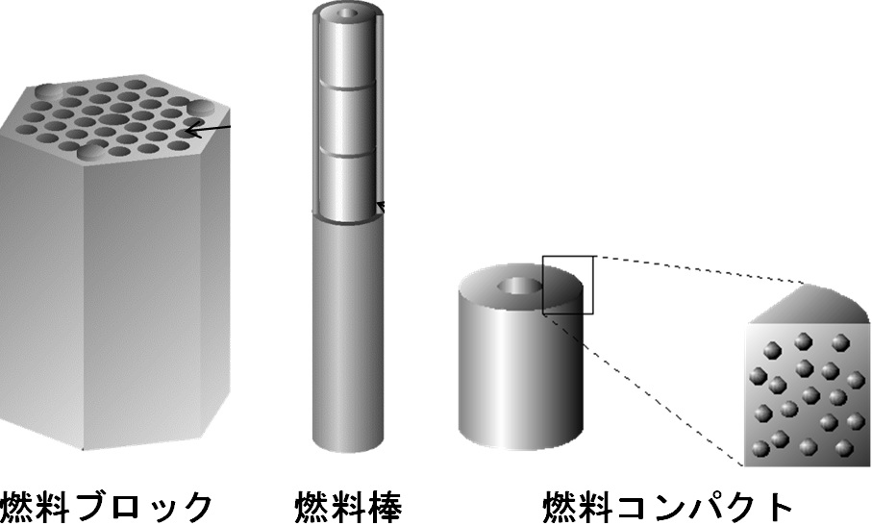
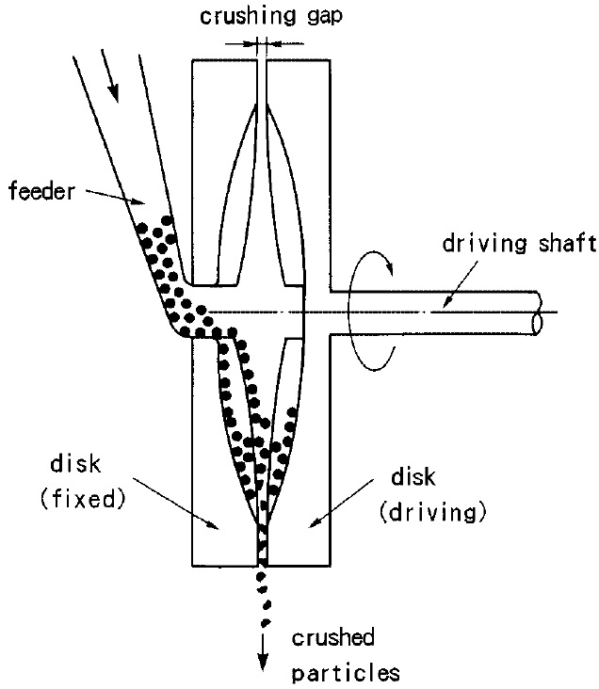
Development of Head-End Process for HTGR
Methodology
UO₂ En.=4wt% in SF
Dilution with DU
to 1.6wt%
SiC layer
Fuel block Fuel rod Fuel compact Coated Fuel Particle Kernel Solution
Technology
Rokkasyo Reprocessing Plant
Burn process
SiC layer crash process
Reburn process
SiC layer
SiC layer
is mechanically crashed.
Carbon layer is
removed by burning.
Carbon material is
removed by burning.
Nuclear Fuel Industries, Ltd. have used these technology to recover uranium
from failure products.

Slide 6
Advantage of Japanese Head-End Process
IAEA-TECDOC-1645 concludes that HTGR spent fuel reprocessing is challenging
by referring Dr. Greneche’s opinion.
Ref.: Greneche, D., Masson, M., Brossard, P., “The Reprocessing Issue for HTR Fuels: An assessment of Its Interest and Its Feasibility”, Global 2003 Conference, New Orleans, LA November, 2003.
Fuel block
He referred to Oak Ridge grinding technology, which crashes whole fuel block.
The waste amount is increase and recovery ratio become worse.
To conquer this problem,
Japan select the pin-in-
block type fuel.
Oak Ridge grinding technology
Pin-in-block type fuel
Japanese head-end process reduces waste amount with high recovery ratio.

Slide 7
History of Disposal Technologies Development
History
Japan had developed the disposal technologies based on Swedish technologies.
Time | Sweden | Japan | Remarks
1970 |  | LWR operation started. | Tsuruga (BWR), Hamaoka (PWR)
1976 |  | Disposal study started. | By government’s decision.
1983 | KBS-3 concept |  | Svensk Kärnbränslehantering AB (SKB) proposed a multiple barriers concept
1991 |  | First FS, H3 was performed. | FS for vitrified waste disposal
2000 |  | Second FS, H12 was performed. | FS for vitrified waste disposal
2000 |  | Final disposal law was decided. | NUMO, utility of disposal, was organized.
2014 |  | Full scale Engineered Barrie System (EBS) demonstration was performed in Horonobe. | If RRP started operation in 2000, the vitrified waste should be disposed of after cooling 50 years.
Japan has completed the geological disposal technologies.
For HTGR waste disposal, there is no difference when the vitrified waste is disposed of.

Slide 8
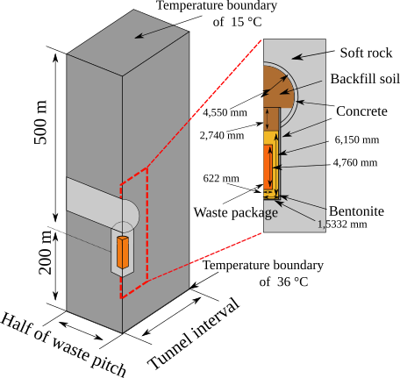
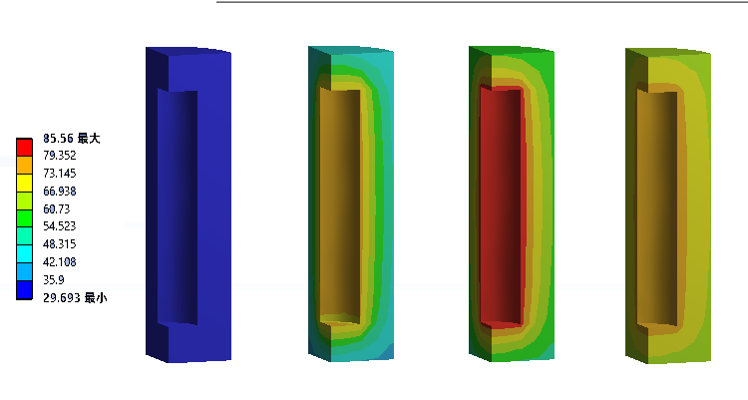
Direct disposal of HTGR Spent Fuel
The investigation of direct disposal of LWR spent fuel has been also performed as a option in Japan. Basically, there is no technical gap between the disposal of vitrified waste and spent fuel.
We investigated feasibility study of direct disposal of HTGR spent fuel with taking advantage of pin-in-block type of fuel.
Year: 0 1 10 100
Bentonite temperature
Model of thermal calculation
The bentonite temperature satisfies the limitation of 90℃.
PWR canister
HTGR canister
The canister number and its footprint per electricity generation can be reduced by 60% compared with an LWR case.
Ref.:Y. Fukaya, T.Nishihara, “Reduction on High Level Radioactive Waste Volume and Geological Repository Footprint with High Burn-up and High Thermal Efficiency of HTGR,”Nuclear Engineering. Design., 307, 188, (2016).
Maximum bentonite temperature

Slide 9
Subject to improve of the specification
of fuel cycle scenarios

Slide 10
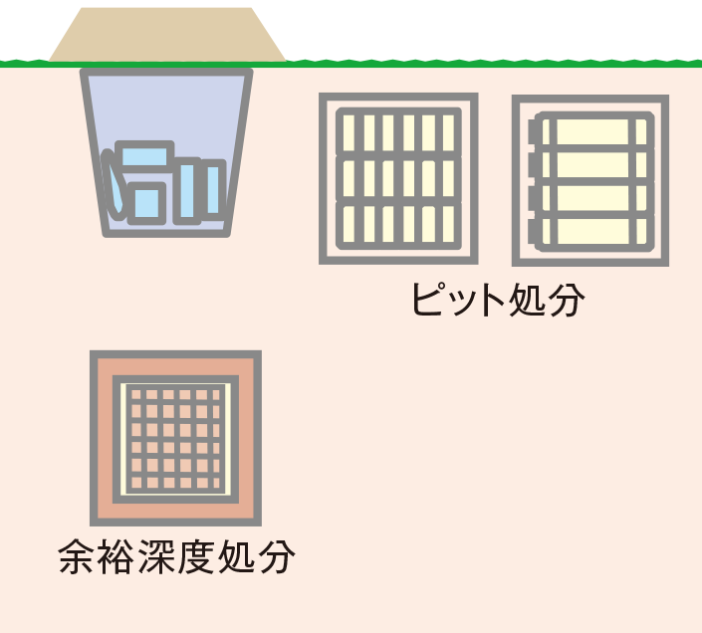
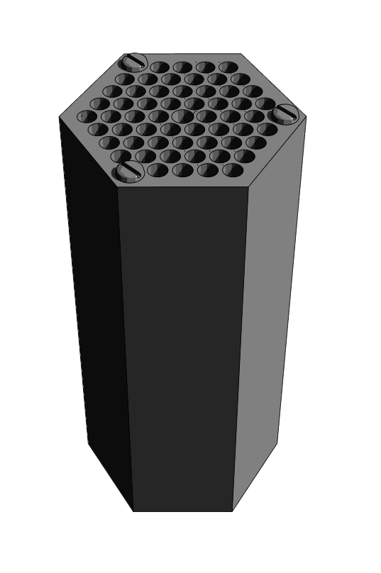
Near Fielded Model for Public Dose Evaluation from Graphite Waste
For all fuel cycle options:
The fuel block whose fuel rod is withdrawn
can be disposed of by shallow-ground pit disposal
Under reactor regulation law.
Public dose evaluation
Near field model based on partition equilibrium, in which whole waste is dissolved into ground water, is too conservative for the high water durable graphite.
Trench disposal
Pit disposal
Partition equilibrium
Subject
C=0
Subsurface disposal
To develop reasonable solubility controlled model.
Near field model
To develop solubility database especially for organic carbon.
Ref.:Japan Atomic Energy Agency, Safe and Eco-friendly Nuclear Reactor with Meltdown-proof
design: High Temperature Gas-cooled Reactor (leaflet), Japan Atomic Energy Agency, (2019).
More reasonable disposal can be applied only by evaluation.

Slide 11
Recovery Ratio Confirmation for Toxicity Reduction
For multi-recycle fuel cycle option:
Multi-recycle option can minimize the toxicity release from the fuel cycle.
Even with thermal reactor can establish multi-recycle fuel cycle by feeding fissile material.
To prevent the toxicity release from the cycle, high recovery ratio more than 99.9%.
Uranium based multi-recycling
Ref.:Y. Fukaya, M.Goto, H. Ohashi, et al. “Uranium-based TRU multi-recycling with thermal neutron HTGR to reduce environmental burden and threat of nuclear proliferation,” J. Nucl. Sci. Technol. 55[11], pp.1275-1290 (2018).
Recovery ratio head end process
Until the SiC layer crashing of head end-process of HTGR, the recovery ratio approximately 100% is confirmed.
Subject
The recovery ratio more than 99.9% should be proved including clarification process.
Toxicity from spent fuel from LWR
To achieve reducing the toxicity lower than natural uranium level in 300 years, not only P&T but also the recovery ratio more than 99.9% is necessary.
The recovery ratio should be confirmed.

Slide 12
Summary
JAEA introduced the status of R&D of back-end technologies of HTGR and future subject to improve the specification of fuel cycle options.
For R&D of back-end technologies of HTGR:
Japan had completed the reprocessing and disposal technologies for LWR.
Head-end process of reprocessing for HTGR had also completed, and applicability to RRP had been also confirmed.
The disposal technologies for vitrified waste is common for HTGR, and the feasibility for direct disposal of HTGR had been also confirmed.
For subject to improve specification of fuel cycle options:
Near filed model for graphite waste dose evaluation should be developed to performed reasonable disposal.
Recovery ration of reprocessing with HTGR head-end process should be confirmed to achieve potential toxicity reduction for multi-recycling option.

