Slide 1
Opportunities to Optimize Small Modular Reactor (SMR) Used Nuclear Fuel Management in the United States
IAEA EVT2105850
September 21, 2022
Rod McCullum
Nuclear Energy Institute

Slide 2

New Momentum
The biggest impediment to used fuel solutions is a lack of used fuel problems
Interest in decarbonization and reliability is likely to create new used fuel management opportunities

Slide 3
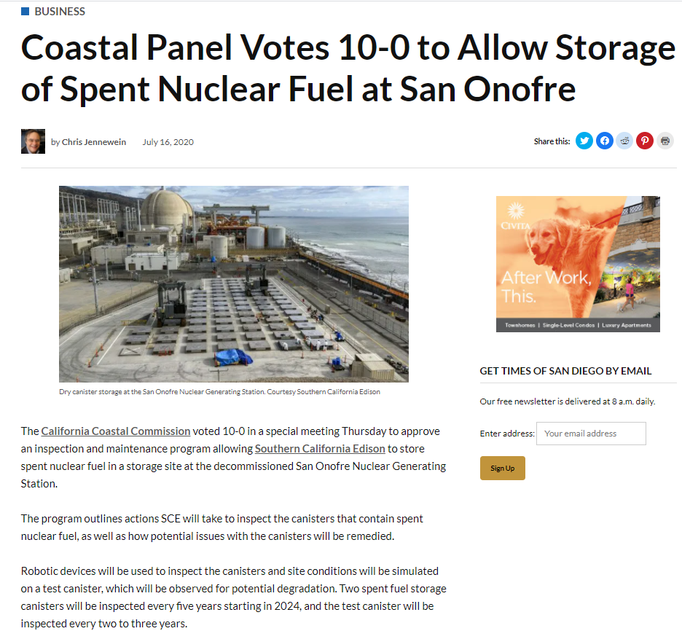
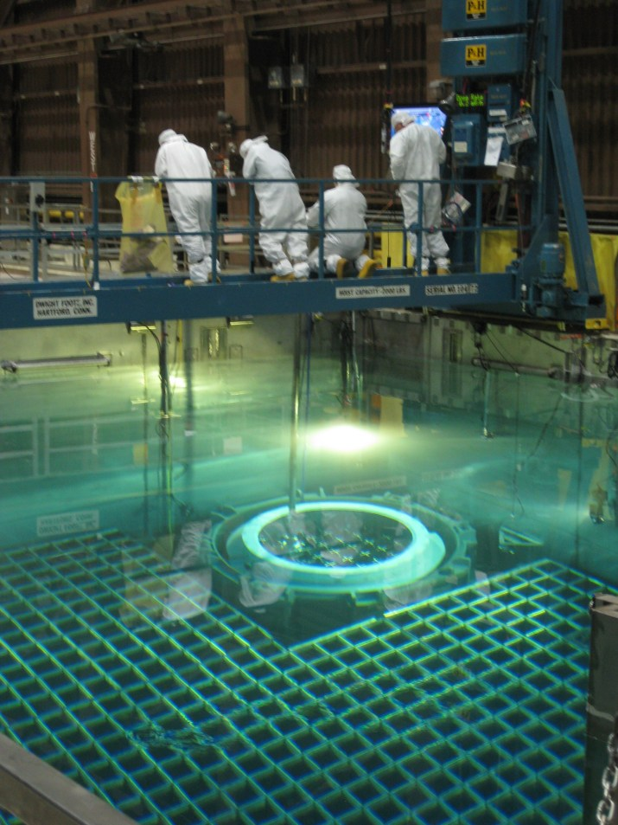
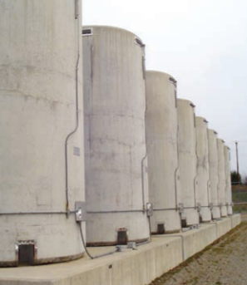

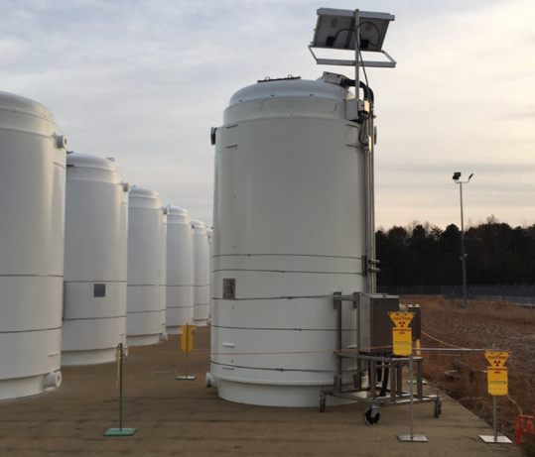
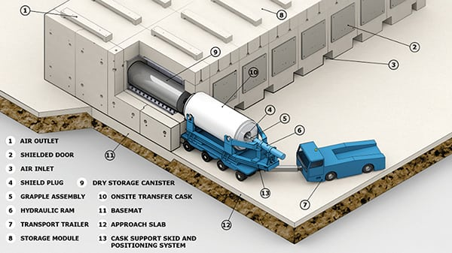
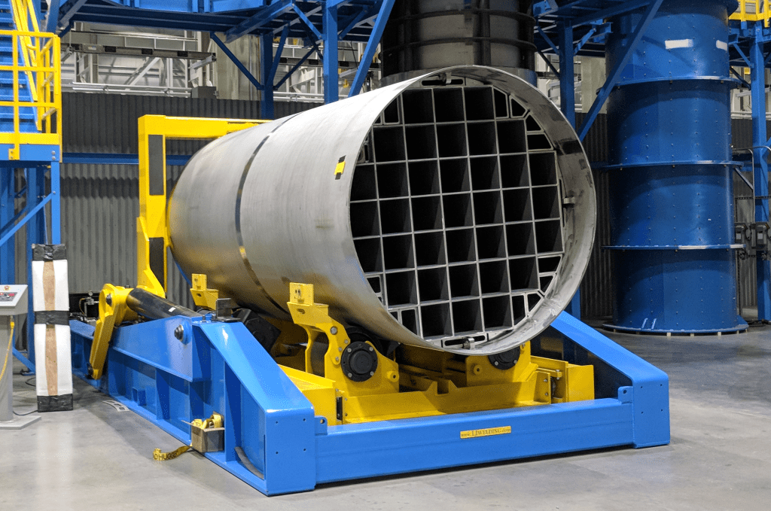
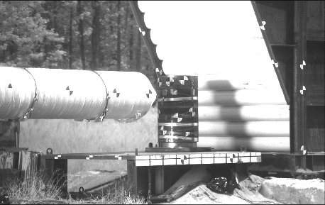
Successful used fuel management in US has been driven by a culture of innovation
Holtec Missile Test – 8/29/13, Aberdeen MD
600 MPH impact – no breach of containment

Slide 4



Innovators

Slide 5
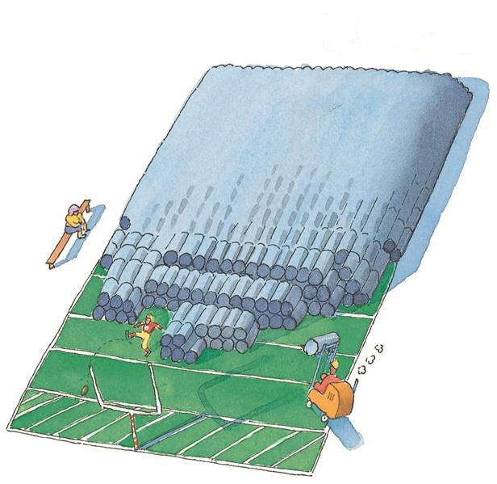
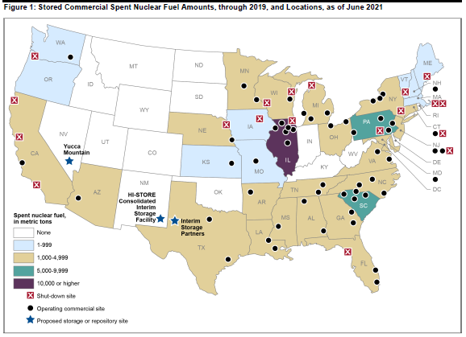
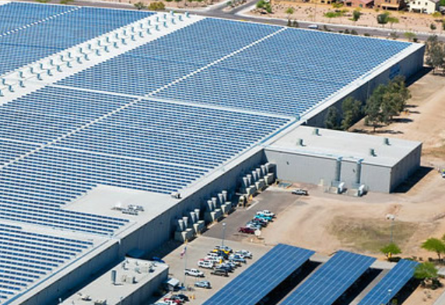
What Innovation Has Created
All the used nuclear fuel generated, if stacked, would only cover one football field ~12 yards high
Used fuel inventory*
  Approximately 88,000 MTU
  Increases 2 - 2.4k MTU annually
ISFSI** storage
  168,922 assemblies
  47,500 MTU (50%)
  3,767 casks/modules loaded
  75 Operating dry storage ISFSIs
  21 sites where reactor operations have ceased
Long-term commitment
  First Casks Loaded in 1986
  Licenses being extended to 60 years
  Licenses extensions approved at 32 sites
  Licenses renewable for additional 40 yr. periods
  NRC determined casks safe for “at least” 100 yrs
All of the pools and casks in which this fuel is stored could be comfortably arranged inside a single big box store distribution warehouse
*As of June 2022
** ISFSI = Independent Spent Fuel Storage Installation

Slide 6
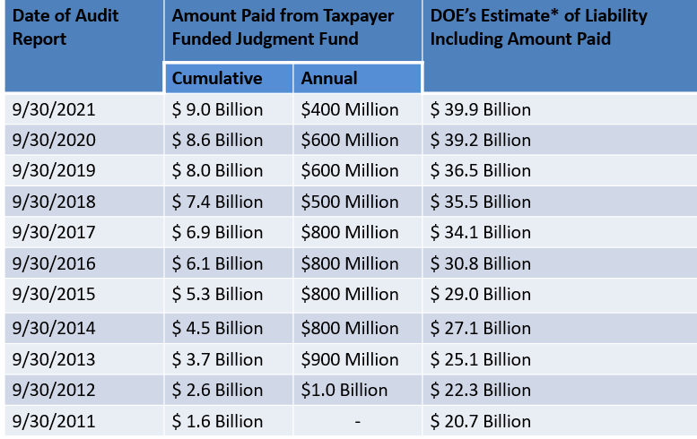
A New Incentive for Innovation
Existing US reactors are reimbursed for their used fuel storage costs by the federal government in accordance with contracts signed in 1983
Future reactor owners will have to carry all used fuel storage costs for life of plant + under amended standard contract
Cost-competitive US electricity marketplace will drive further innovation

Slide 7

Innovation Challenge – Light Water SMRs
The used fuel management marketplace for SMRs initially might not look much different that the marketplace of today. Three US light water reactor SMR suppliers (Holtec, Nuscale, and GEH) all plan to use low enriched uranium similar to what is in the cores of the current fleet. For these cases innovation is simply a matter of accommodating new configurations and perhaps higher burnups

Slide 8
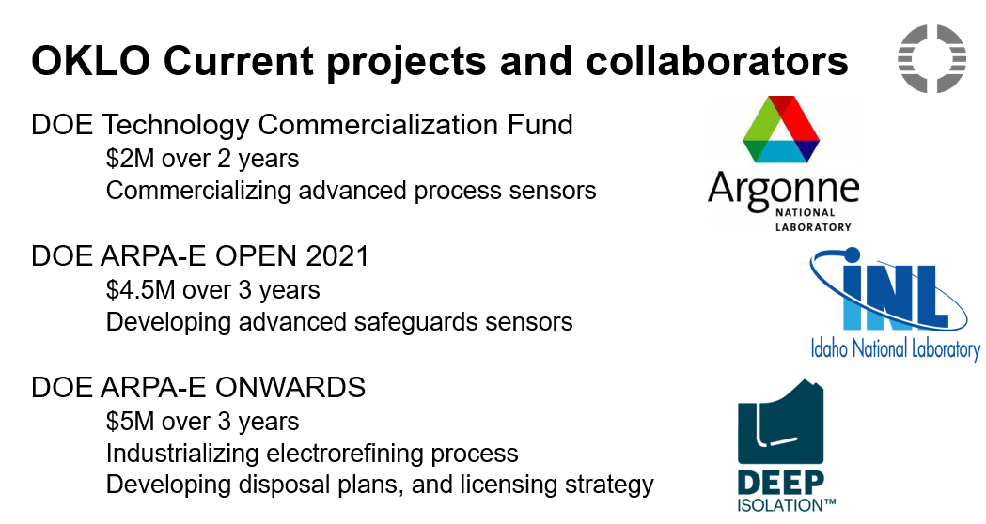
Innovation Challenge – non-LWR SMRs
Many of the designs not using light water as coolant will be using High-Assay-Low-Enriched-Uranium (HALEU) fuel [6]. Spent fuel discharges from these plants should be met with a storage innovation curve already in progress as a number of the reactors in the existing fleet are also planning to use variants of HALEU (often referred to LEU+) and will already be ordering storage systems before they will be needed by the SMRs. Fast reactors, such as Oklo, are mostly planning to use metal fuels for which there are already well-established transportation and storage technologies in use for discharges from DOE’s metal fuelled research reactors.

Slide 9
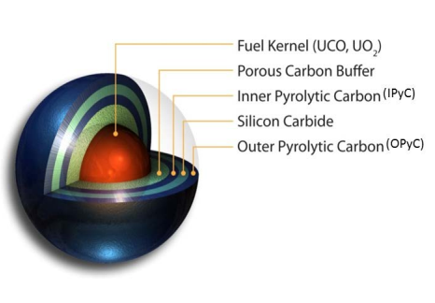
Innovation Challenge – TRISO Fueled SMRs
High Temperature Gas Reactors are planning to use TRISO fuels that, while characterized by higher enrichment and burnups, also provide a particularly robust multi-barrier containment including a stable silicon carbide layer that will last for more than a million years and graphite that does not degrade even in water [8] that should be amenable to a wide range of storage (as well as disposal) approaches

Slide 10
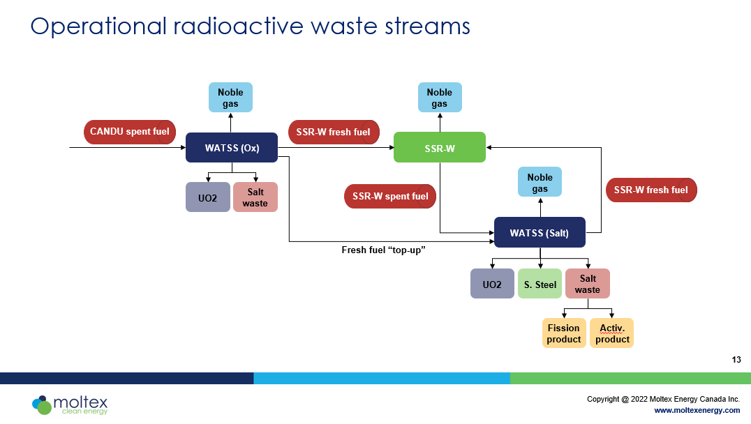
Innovation Challenge – Molten Salt Fueled SMRs
Molten salt reactors pose a unique set of materials related storage and disposal challenges. However, a significant amount of work has already been devoted to waste form and salt treatment options and scientists have expressed confidence that technical solutions are available

Slide 11
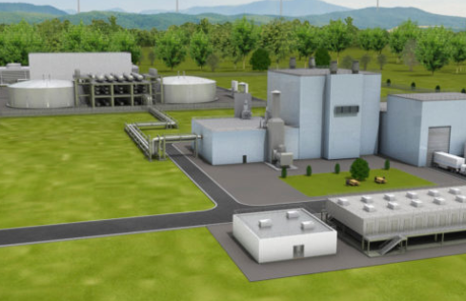


Optimizing the value of nuclear feedstock
Future reactors may economically recycle used nuclear fuel to extract even more energy from uranium already mined
Initial new reactor startups will be on new fuel
Between 6 and 9 advanced reactor suppliers may be able to power their machines with used fuel
Most envisioned recycling strategies would not separate out pure plutonium

Slide 12
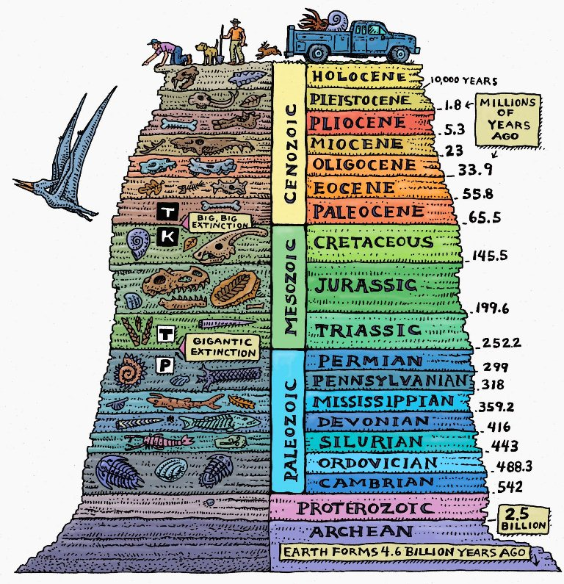
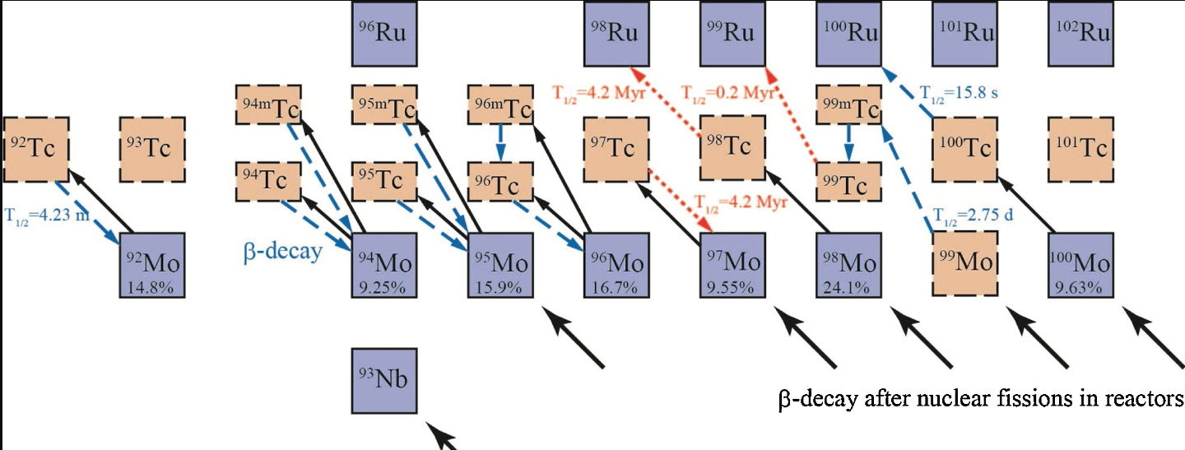

Slide 13
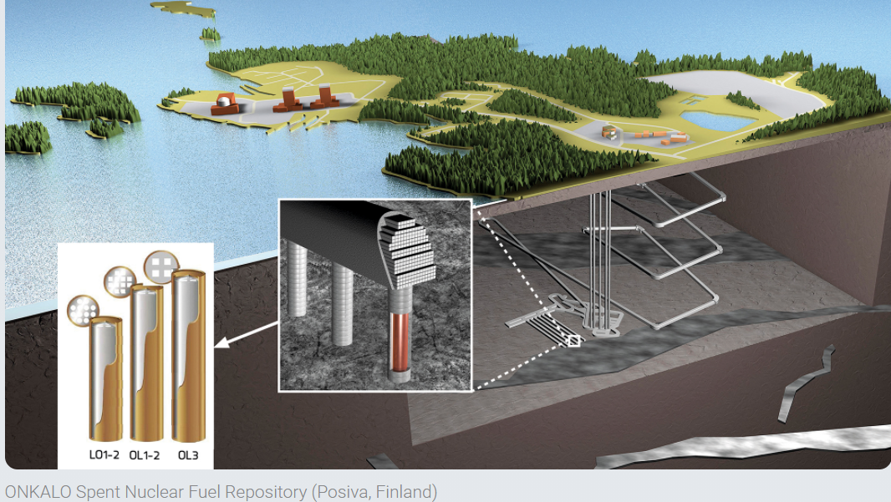
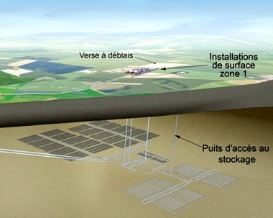
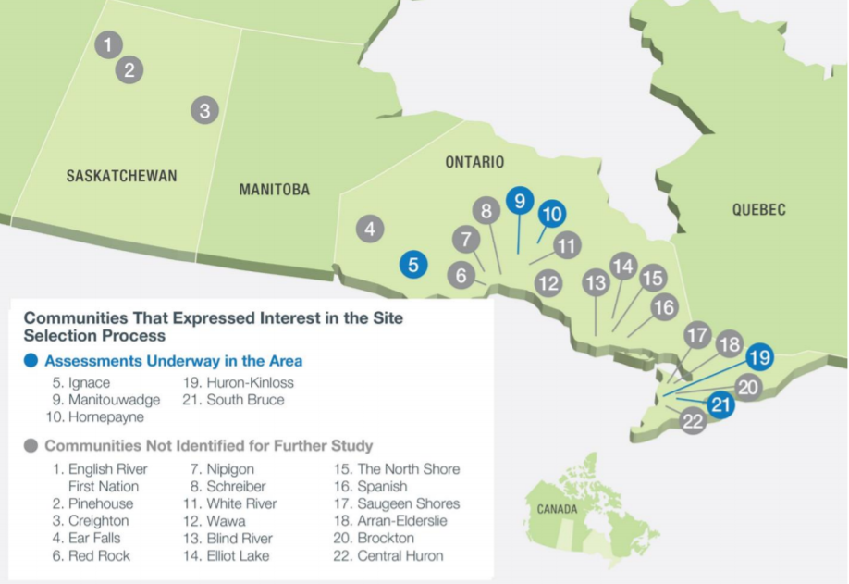
Global Context
Nations making progress on spent nuclear fuel disposal
  Finland – repository licensed and under construction
  Sweden – repository approved for constructing
  France – site identified, in public consultation toward pilot phase
  Canada – List of 22 candidate sites narrowed down to 2, geologic investigations under way
  Switzerland – recently selected a repository site
All of these are following some version of a consent-based adaptive/phased process
France, Sweden, and Switzerland all have deployed CIS
  Swedish Gov’t recently approved expansion of CIS

Slide 14
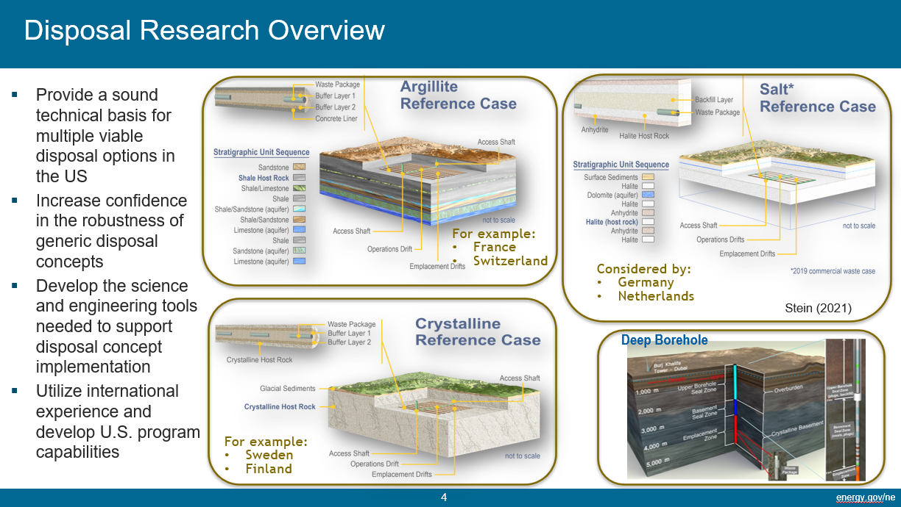
Ongoing US Repository R&D

Slide 15
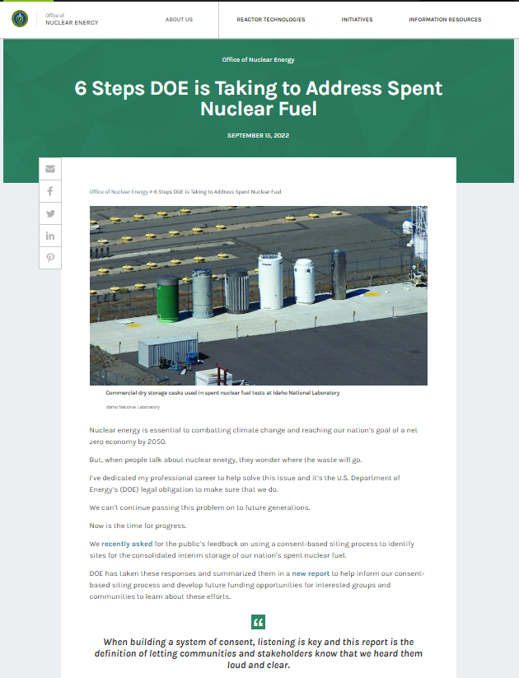
Reconfiguring the US Federal Used Fuel Management Program

Slide 16
Assembling the US SMR used fuel management infrastructure are under way
UPWARDS is a $3.6 Million, 3-year project sponsored by the US office of Advanced Research Projects Agency-Energy (ARPA-E) that will support advanced reactor development and spurs innovation by establishing a universal canister design and waste form acceptance criteria for the disposal of advanced reactor waste streams by bringing together a team with broad competencies in waste form characterization, canister design and development, and geologic disposal performance modelling.
UPWARDS
Universal Performance Criteria and Canister for Advanced Reactor Waste Form Acceptance in Borehole and Mined Repositories Considering Design Safety

