Slide 1

Application of a graded approach to the concept of fuel recycling
IAEA technical meeting on "Back end of the fuel cycle considerations for small modular reactors"
September 21, 2022
By Olivier Gregoire, Nuclear Security and Safeguards Officer, Moltex Energy
Moltex Energy ⎪ 71 Prince William Street ⎪ Unit 102 ⎪ Saint John ⎪ New Brunswick ⎪ E2L 2B2 ⎪ Canada ⎪ +1 506 214 8551 ⎪ info@moltexenergy.com ⎪ www.moltexenergy.com

Slide 2
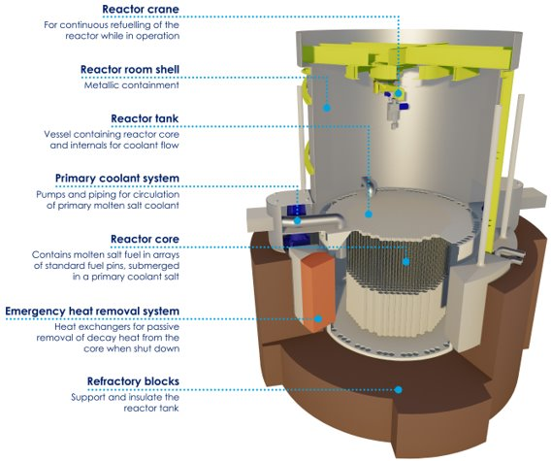
Introduction
Stable Salt Reactor – Wasteburner (SSR-W)
High temperature, fast neutron, molten salt reactor
300-500 MWe per reactor
Uses recycled nuclear waste as fuel
WAste To Stable Salt (WATSS)
High temperature, molten salt-based separation process

Slide 3
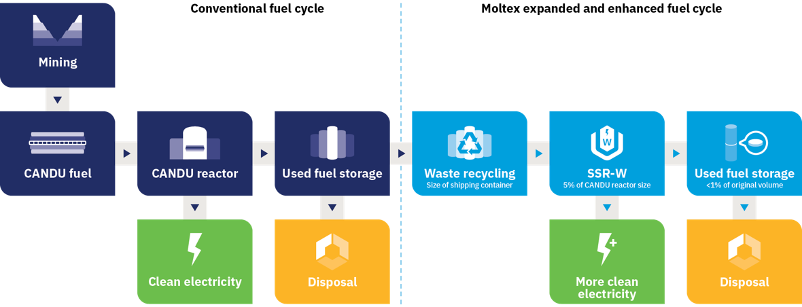
Introduction
WATSS / SSR-W synergies with legacy waste management

Slide 4
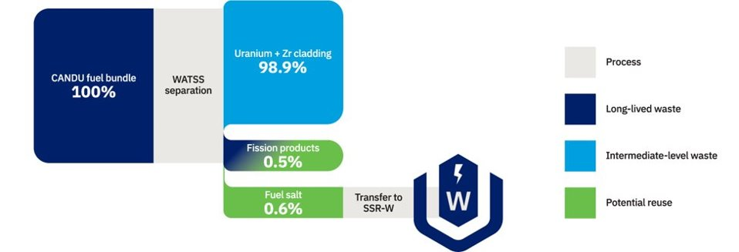
Introduction
WATSS – SSR-W synergies with legacy wastes management
Total spent fuel
Actinides
Fission products
Relative radiological toxicity
Natural uranium ore
300
Years after discharge

Slide 5
Introduction
Closing the fuel cycle important in quest for sustainable energy production
Recycling / reprocessing seen as sensitive activities due to proliferation concerns
How to reconcile these differences?

Slide 6
Historical background
Evolution of US policy involving reprocessing / recycling of spent fuel
Eisenhower (50s): Reprocessing viewed as natural and desirable part of fuel cycle
Kennedy (60s): Breeder reactors and “plutonium economy” vital over the long term
Carter (70s): Indefinite ban on reprocessing and recycling
Reagan (80s): Lifting of the ban, but no financial support
Bush (2000s): Emphasis on the desirability of avoiding “separated plutonium”
Efforts to update the reprocessing regulatory framework in the 2000’s and 2010's – Did not come to fruition, but identified key gaps

Slide 7
Definitions
Widely adopted wording for potential definitions of reprocessing / recycling
Reprocessing:
Recycling:
Separation of plutonium and uranium from intensely radioactive fission products and other transuranic elements.
Separation of the constituents of spent nuclear fuel and refabrication of fresh fuel containing plutonium, minor actinides and possibly some fission products.
Fundamental difference: level of Pu separation from other species

Slide 8
Proliferation aspects – recycled product
Proliferation-resistant aspects of non-separated Pu / technical barriers to proliferation
Radioactivity
Spontaneous neutrons emission
Heat generation
Metallurgical behaviour of plutonium metal

Slide 9
Proliferation aspects – recycled product
Relative contribution of chemical species to the identified barriers to proliferation
 | Radioactivity | Neutrons production | Heat generation | Alloying behaviour
Minor actinides | + (1) | ++ | + (1) | -
Lanthanides | ++ (2) | - | + (2) | ++
Other fission products | ++ | - | + | +
++: Important barrier to proliferation / +: significant contribution to proliferation resistance / -: negligeable impact
(1) Several decades after discharge / (2) Within first year after discharge
Relevance of the concept of “non-separated plutonium”. Framework for the application of a graded approach.

Slide 10
Proliferation aspects – recycling technologies
Limitations of the potential misuse of different recycling technologies
Could a recycling plant be converted to produce separated plutonium?
For each recycling/reprocessing technology:
Is the technology readily usable to produce separated plutonium?
Are there proven processes to bridge the gap?
Could these processes be developed based on the fielded recycling plant?
Can the required equipment be fitted in the existing plant?

Slide 11
Proliferation aspects – recycling technologies
Factors driving the potential for conversion of a recycling facility to produce separated Pu, depending on the separation technology
 | PUREX | Other water-based separation processes | Pyroprocessing using electrochemical processes | Pyroprocessing based on chemical redox potential
Facility readily useable for purified Pu production | X | - | - | -
Technologies to bridge the gap are proven | X | X | - | -
Required technologies could be developed based on recycling facility processes | X | X | (X) | -
Required equipment can be fitted in existing recycling facility | X | X | X | -
Graded proliferation resistance.

Slide 12
Concluding remarks
Legitimate interest in recycling nuclear waste in a quest for sustainability / fuel availability
Leverage needed to promote proliferation-resistant recycling technologies
  Specific definitions for the concepts of reprocessing and recycling (separated / non-separated product)
  Acknowledgement of a graded proliferation resistance
    Water / organic solvent-based liquid-liquid extraction
    Pyroprocessing using electrochemical processes
    Molten salt-based pyroprocessing relying exclusively on chemical redox potential

Slide 13
Thank you
Olivier Gregoire, Nuclear Security and Safeguards Officer
oliviergregoire@moltexenergy.com
+1 506 647 0301

