Slide 1






























Impact of O-16 on integral performance
R. Capote, A. Trkov on behalf of the INDEN collaboration
https://www-nds.iaea.org/INDEN

Slide 2
Overview of O-16
Absorption - mainly (n,a) dramatically
increased in B/VIII.0 compared to B/VII.1
Impact on selected criticality benchmarks
Impact on dosimetric response in shielding
(deep penetration benchmarks)
Currently recommended and adopted in FENDL-3.2b: - INDEN24a
https://www-nds.iaea.org/INDEN/data/O16-B8-JENDL-above20_ENDF.zip
Trial file: O-16 JENDL/HE tweaked to match ENDF/B-VIII.0 thermal (JSI + IAEA)
https://www-nds.iaea.org/INDEN/data/o16j4HE_e.zip - INDEN24b

Slide 3
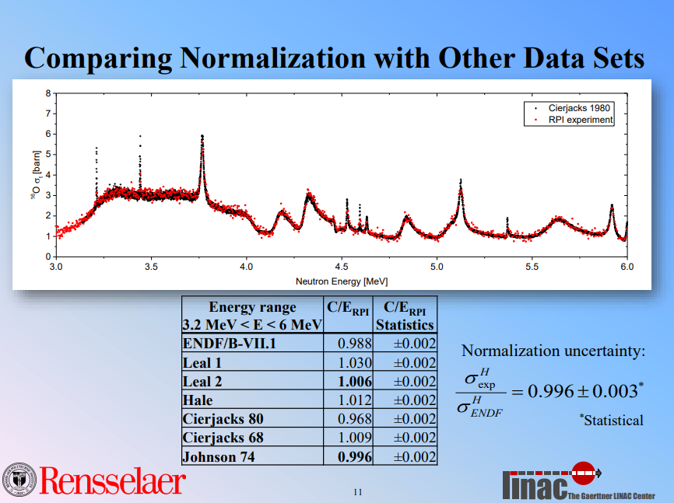
Normalization by Danon et al
https://indico.bnl.gov/event/1291/contributions/1517/attachments/1231/1399/DANON_CSEWG2015.pdf

Slide 4
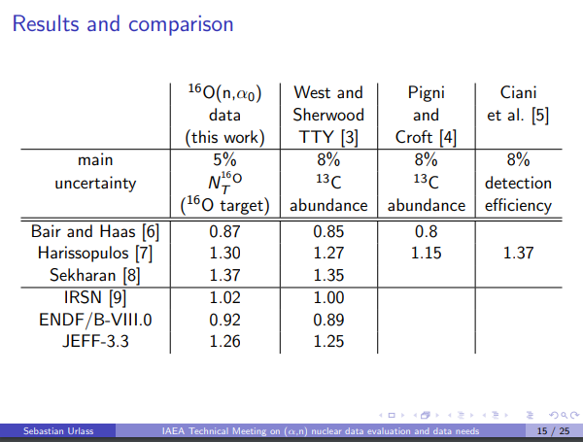
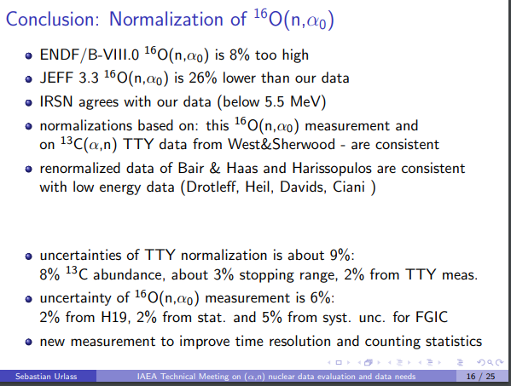
Normalization of (a,n) data by Urlass et al
https://conferences.iaea.org/event/283/contributions/20720/attachments/11137/16348/IAEA_presentation_SU.pdf

Slide 5
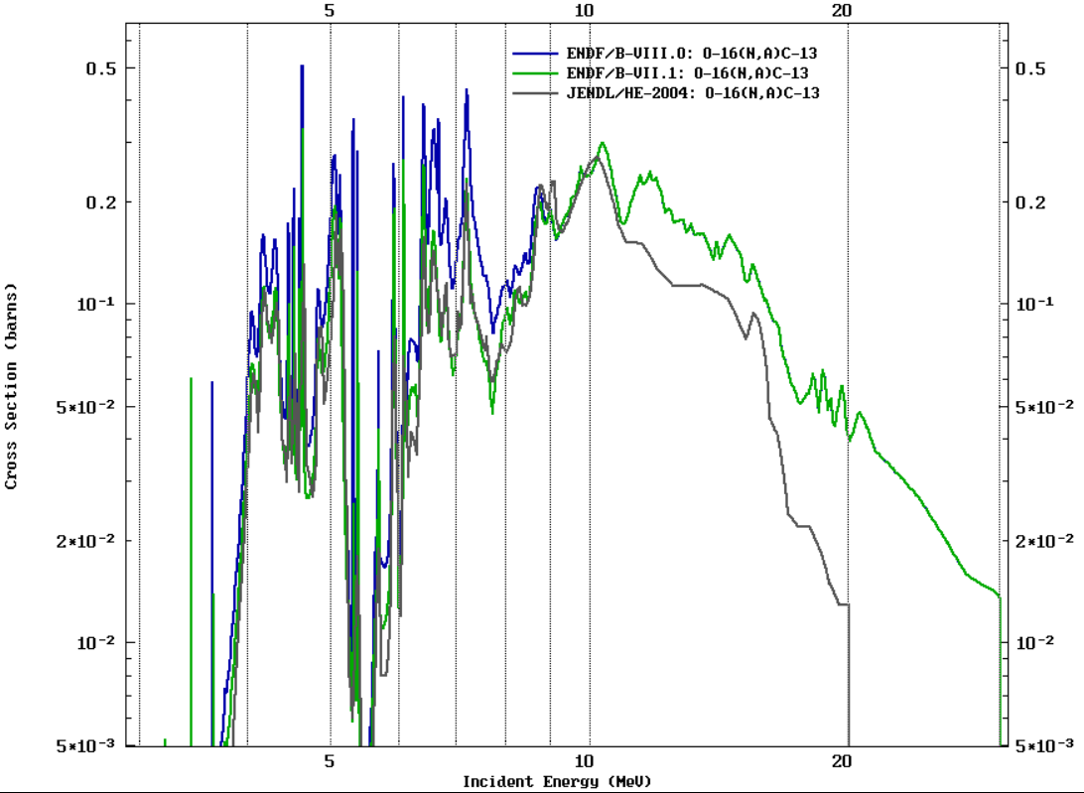
Increase from ~4 up to 9 MeV
Main issue:
account of O-17 exc. states

Slide 6
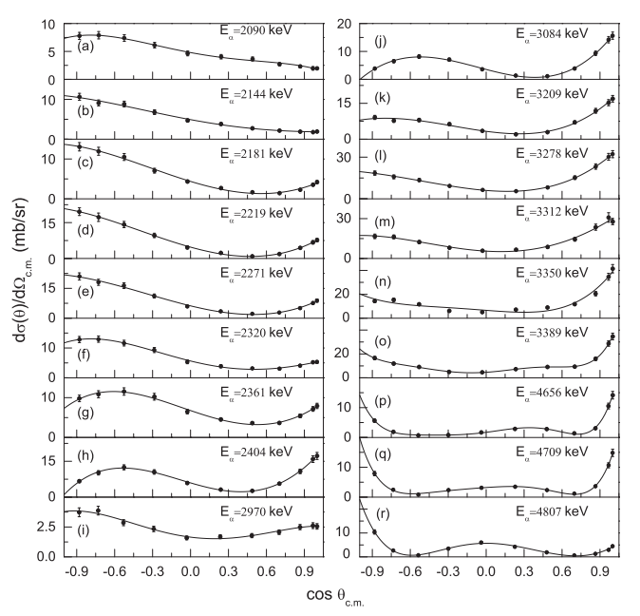
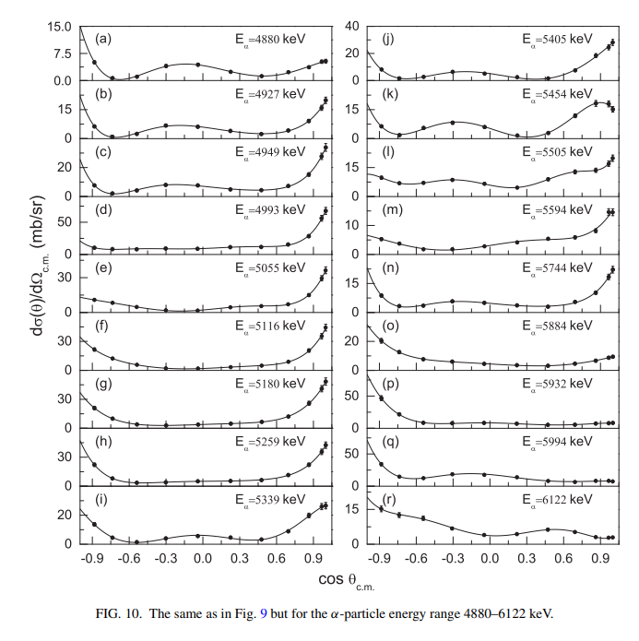
New measurement (n,α₀) supports B-VIII.0

Slide 7
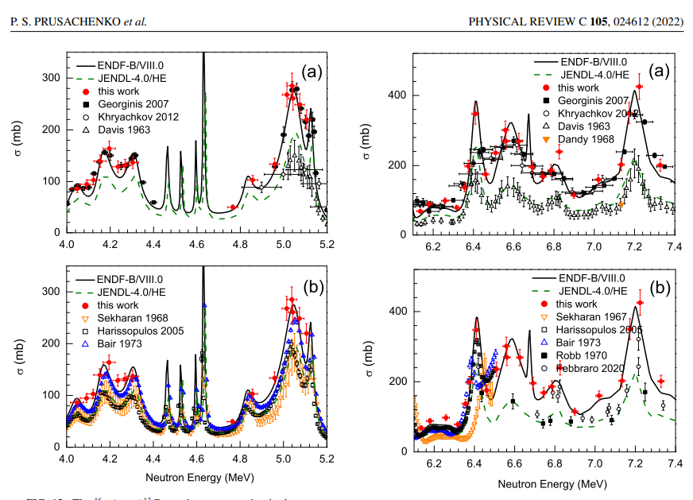
New measurement (n,α₀) supports B-VIII.0
… and the beginning of the end ☺ ?

Slide 8
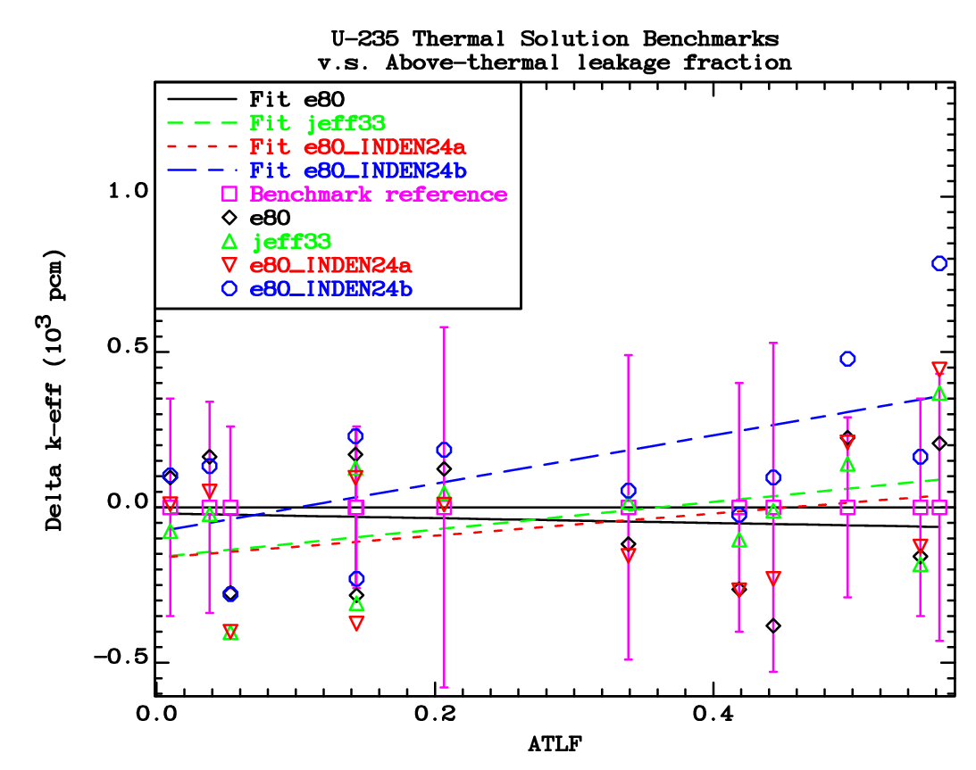
k_{eff} (Above Thermal Leakage Fraction)
HEU = U-235

Slide 9
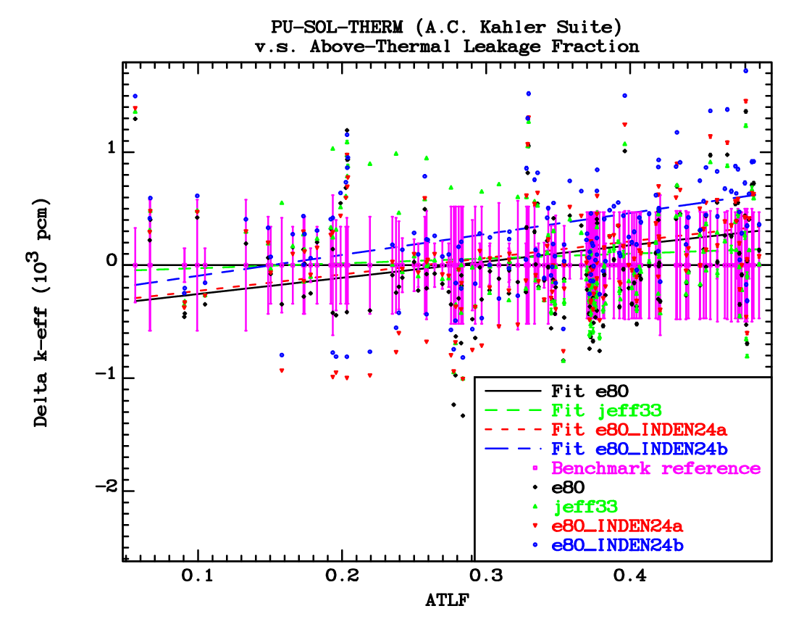
k_{eff} (Above Thermal Leakage Fraction)
Pu-239

Slide 10
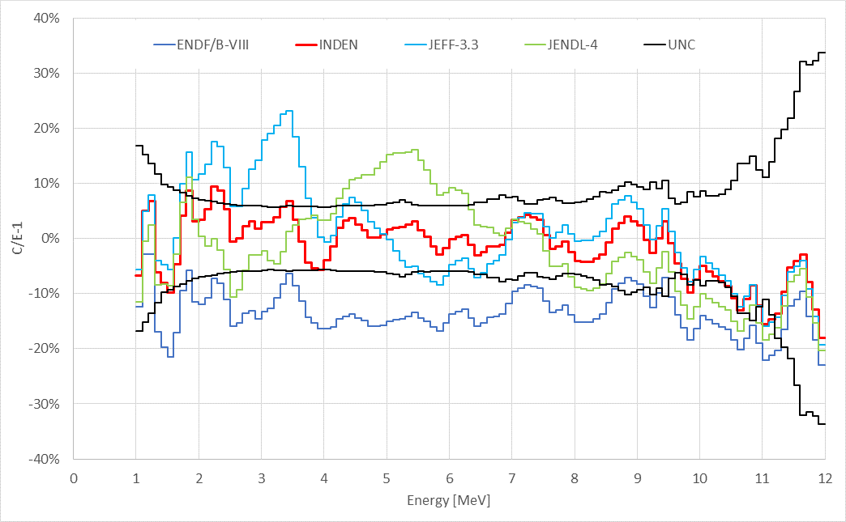
Rez SS cube (50x50x50cm)

Slide 11
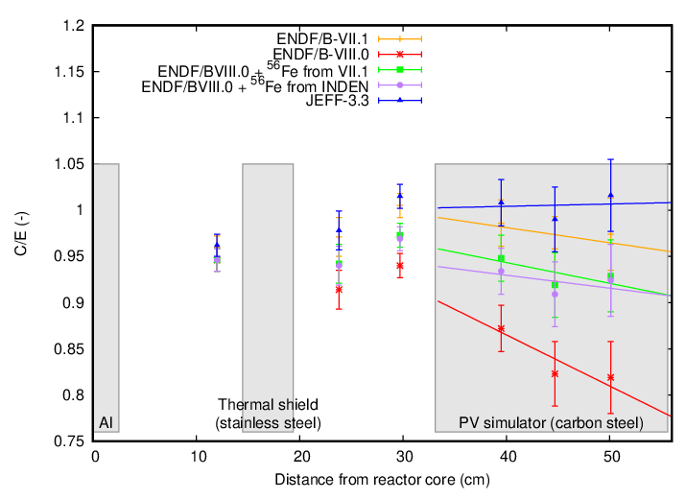
PCA shielding benchmark (SS test)
neutrons

Slide 12
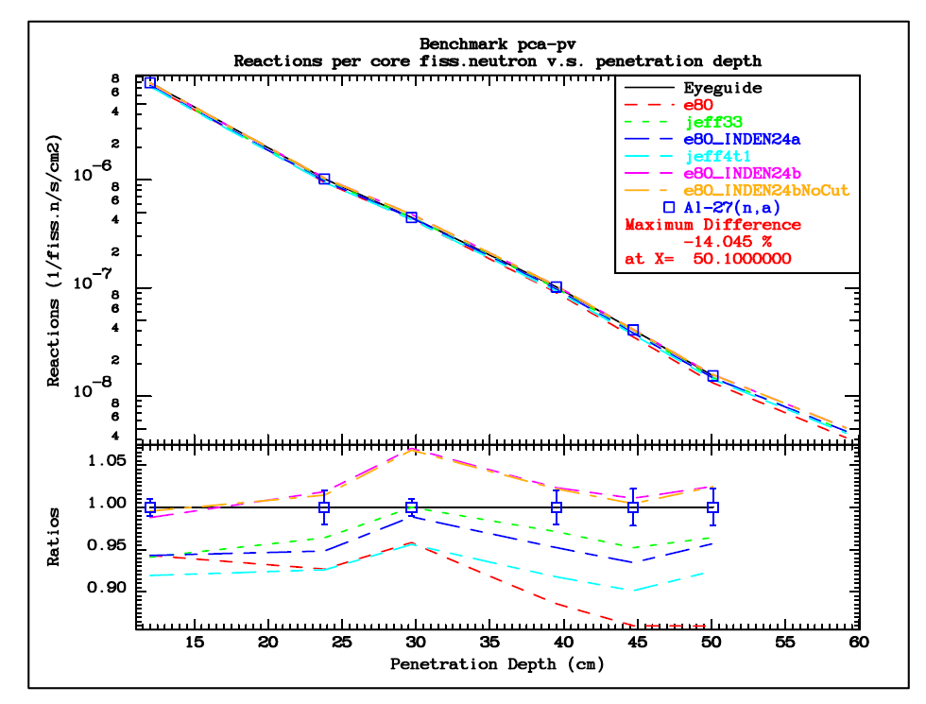
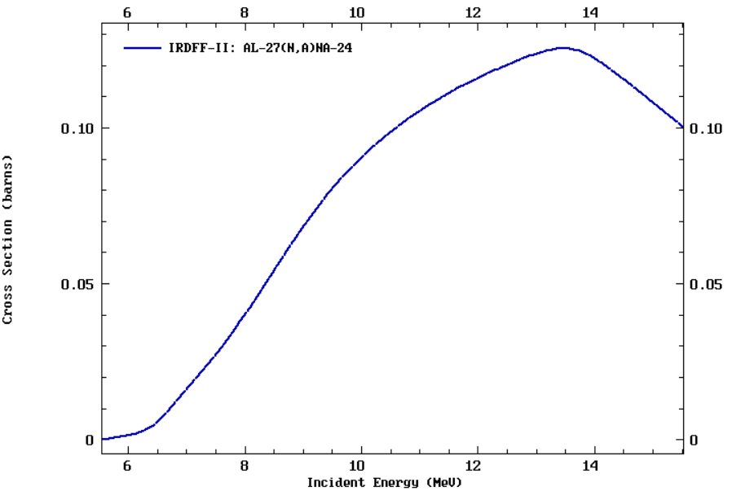
PCA shielding benchmark (SS test)
¹⁶O INDEN
¹⁶O -B/VIII.0
²⁷Al(n,α) dosim.
En>6 MeV

Slide 13
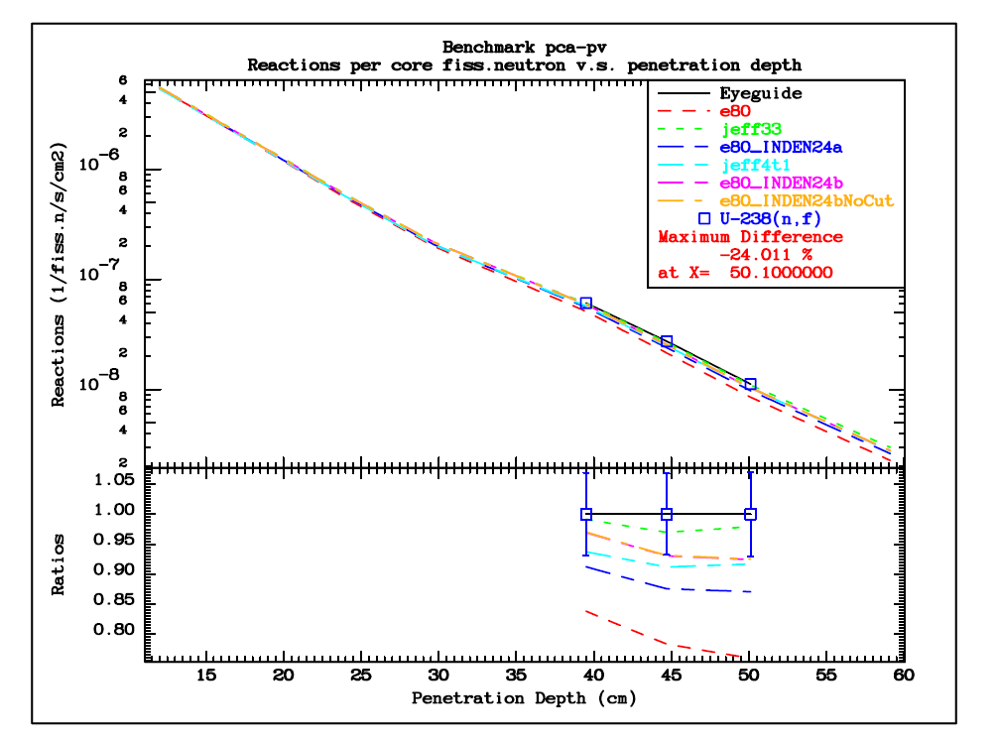
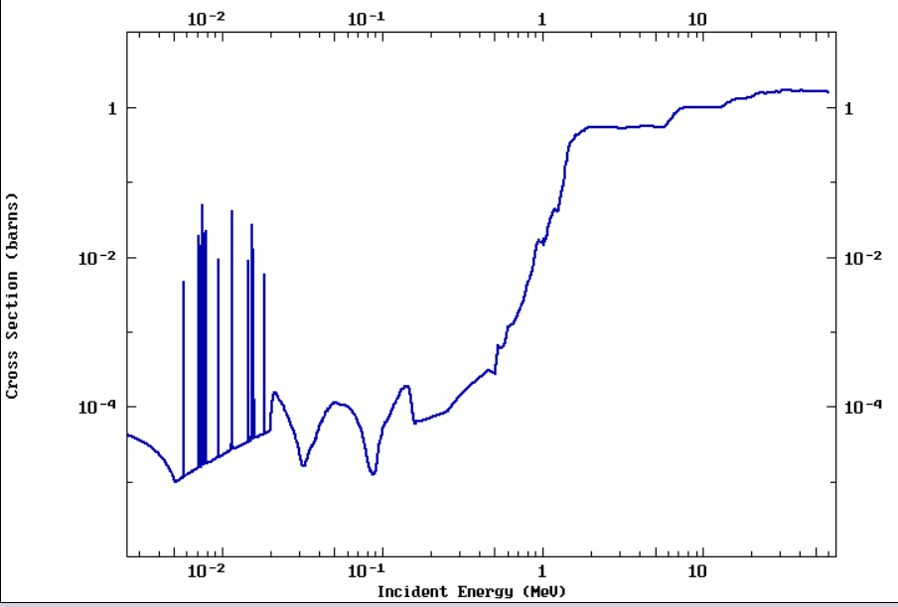
PCA shielding benchmark (SS test)
¹⁶O jendl-HE -> INDEN24a
¹⁶O -B/VIII.0 -> INDEN24b
¹⁶O INDEN
²³⁸U(n,f) dosim.
En>2 MeV
¹⁶O -B/VIII.0

Slide 14
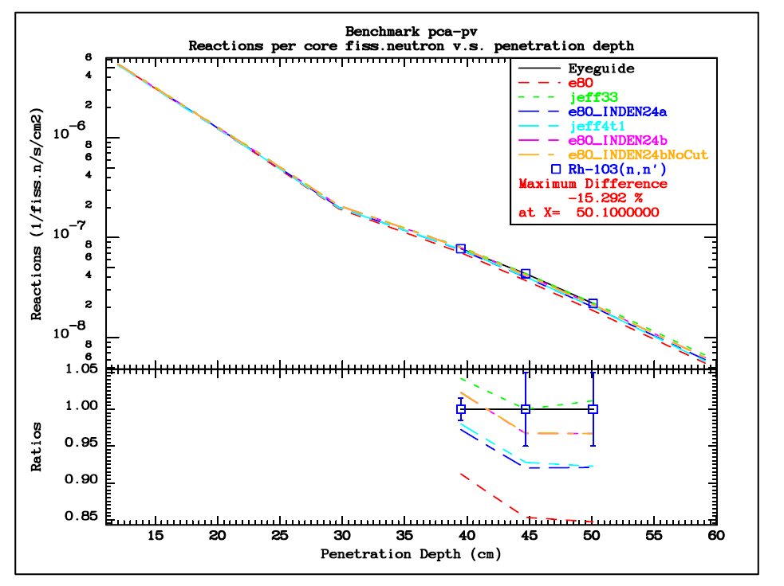
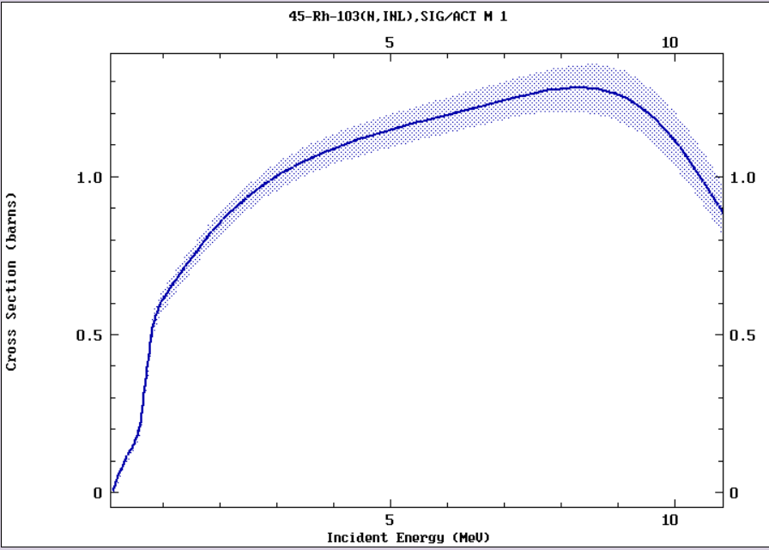
PCA shielding benchmark (SS test)
¹⁶O jendl-HE -> INDEN24a
¹⁶O -B/VIII.0 -> INDEN24b
¹⁶O INDEN
¹⁰³Rh(n,n’) dosim.
En>0.5 MeV
¹⁶O -B/VIII.0

Slide 15
Summary
There is a large impact of O-16 absorption (mainly n,a) on criticality and shielding experiments
O-16 data impacts evaluation/validation of fissiles U-235,Pu-239,U-233, and structural materials
New evaluation needed addressing issues above 5 MeV in ENDF/B-VIII.0

Slide 16
INDEN files @ nds.iaea.org/INDEN/
Updated evaluations of major actinides available from INDEN
U-238 (nds.iaea.org/INDEN/data/u238e80V02_ENDF.zip) (trial file)
U-235 (nds.iaea.org/INDEN/data/u235ib46o28t6DNcnu5ef0ST25_ENDF.zip)
U-233 (nds.iaea.org/INDEN/data/u233ornl_2b_nu12_ENDF.zip )
Pu-239 (https://nds.iaea.org/INDEN/data/pu239e80p53_ENDF.zip) INDEN+B8 n2n
Pu-239 (https://nds.iaea.org/INDEN/data/pu239e80p55_ENDF.zip) INDEN (GANDR n2n, Empire prior)
Pu-239 (https://nds.iaea.org/INDEN/data/pu239e80p54a_ENDF.zip) INDEN (GANDR n2n, LLNL prior)
Updated evaluations of structural materials Fe, Cu, Cr, Si also available from INDEN
Fe-56 (https://nds.iaea.org/INDEN/data/fe56e80X29r50_ENDF.zip)
Fe-54 (https://nds.iaea.org/INDEN/data/fe54e80p_ENDF.zip)
Fe-57 (https://nds.iaea.org/INDEN/data/fe57e80o_ENDF.zip)
Cu-63 (https://nds.iaea.org/INDEN/data/cu63ane6k09RR_ENDF.zip)
Cu-65 (https://nds.iaea.org/INDEN/data/cu65ane5k05_ENDF.zip)
Other Cr isotopes (https://nds.iaea.org/INDEN/data/chromium-v2.3.2_ENDF.zip)
Cr-52, replace the Cr-52 above (https://nds.iaea.org/INDEN/data/cr52v234c_ENDF.zip)
Si isotopes (https://nds.iaea.org/INDEN/data/si_iaea_E_ENDF.zip)
The INDEN scheme of international collaboration is working well.

