Slide 1



A Novel R-Matrix Formalism for Three-Body Channels
Atominstitut, TU Wien:
B. Raab
This work has been carried out within the framework of the EUROfusion Consortium and has received funding from the Euratom research and training programme 2014-2018 and 2019-2020 under grant agreement No 633053. The views and opinions expressed herein do not necessarily reflect those of the European Commission.
supported by the KKKÖ Matching Grant MG 2020-7 of
the Austrian Academy of Sciences is acknowledged.
B. Raab
June 20, 2022
A Novel R-Matrix Formalism for Three-Body Channels
Consultancy meeting of the International Nuclear Data Evaluation Network (INDEN) on the Evaluation of Light Elements

Slide 2
Motivation
Three- or more-body channels become important in light nuclear systems
Have a significant share on the total cross section
Importance of n+⁹Be → (⁸Be)+n+n → α+α+n+n in fusion devices as a neutron multiplier for tritium breeding
Reliable data for this reaction needed

Slide 3
Standard R-Matrix Formalism: wave function
2-particle channel: cm-system
boundary condition
at channel surface
incoming spherical wave
outgoing spherical wave
collision matrix, S-matrix
basis functions i=1,2,…
coefficients i=1,2,…

Slide 4
Three-Body Exit Channel
3-particle channel: cm-system
channel surface
not defined
Interaction
region
Interaction
region
Interaction
region
Interaction
region
interaction region
is not finite
Lane and Thomas, Rev. Modern Physics 30, 257 (1958)

Slide 5
Sequential approach

Slide 6
Limits of standard techniques
Dominant many-nucleon channels at low energies
Standard evaluation techniques are not applicable
2 body R-Matrix has to be extended to 3-body channels

Slide 7
Origin of 3 body R-matrix theory
First idea by W. Glöckle in 1974 (Z. Physik 271, 1974)
‘Channel surface’ introduced in Jacobi coordinate space
Based on the Faddeev equations in coordinate space
Theory for three identical particles
Equal two-body interactions between them
Restricted to s-waves
Extension of the formalism to general masses and interactions in my Diploma Thesis

Slide 8
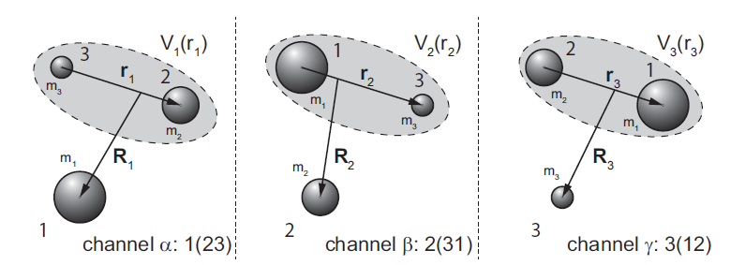
Faddeev equations
Three sets of Jacobi Coordinates
Total Hamiltonian
channel Hamiltonian

Slide 9
Faddeev equations
Full quantum mechanical description of a three particle system
Set of three coupled integral equations:

Slide 10
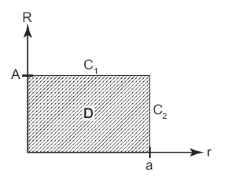
Division of Jacobi-coordinate Space
The range r₀ of the potential
determines a and A
Set of basis functions in the domain D:
,

Slide 11
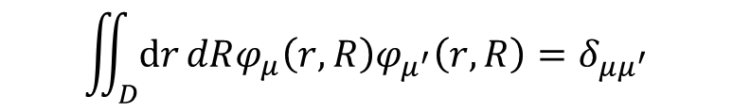
Basis states
Glöckle’s boundary conditions:
$$φ_{μ}\left(0,R_{i}\right)=φ_{μ}\left(r_{i},0\right)={\left.\frac{∂φ_{μ}\left(r_{i},R_{i}\right)}{∂r_{i}}\right|}_{r_{i}=a_{i}}={\left.\frac{∂φ_{μ}\left(r_{i},R_{i}\right)}{∂R_{i}}\right|}_{R_{i}=A_{i}}=0$$
First derivative not zero at boundary lines →
Orthogonality gets lost:
$$\iint_{D}{ⅆr}dRφ_{μ}\left(r,R\right)φ_{μ^{′}}\left(r,R\right)=δ_{μμ^{′}}$$

Slide 12
Asymptotic forms
Integral form of the Faddeev eqations:
Appropriate Green‘s function:

Slide 13
Determination of R-Matrix
equation for the
coefficients c_{µ}
and the T-matrices

Slide 14
Boundary conditions
with

Slide 15
2-body standard R-Matrix formalism
Spectral representation:
Lhs: Interior region
Rhs: Asymptotic part in the exterior region

Slide 16
T-amplitudes
Transition amplitude from channel α to β:
Elastic or rearrangement
Breakup
with

Slide 17
Calculation of cross sections
Breakup cross section:
Elastic cross section:

Slide 18
Optical theorem
Optical theorem: Flux conservation
Equal to:

Slide 19
Stability of the Algorithm
Probing the stability with a simple test system:
    Three identical splinless bosons
    Woods-Saxon interaction

Slide 20
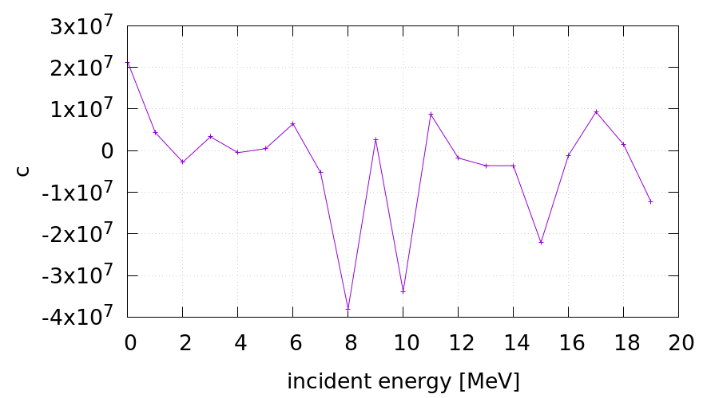
Stability of the Algorithm
System of linear equations
High dynamics of eigenvalues of matrix A (ill conditioned system)

Slide 21
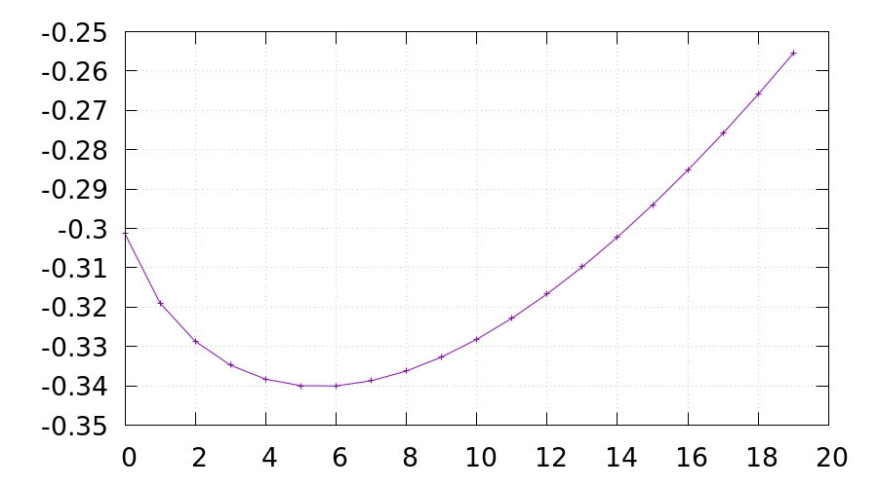
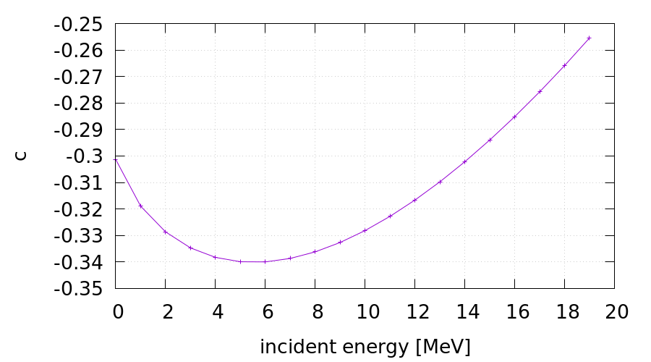
Stability of the Algorithm
Performing a regularization of matrix A in order to get rid of unphysical fluctuations

Slide 22
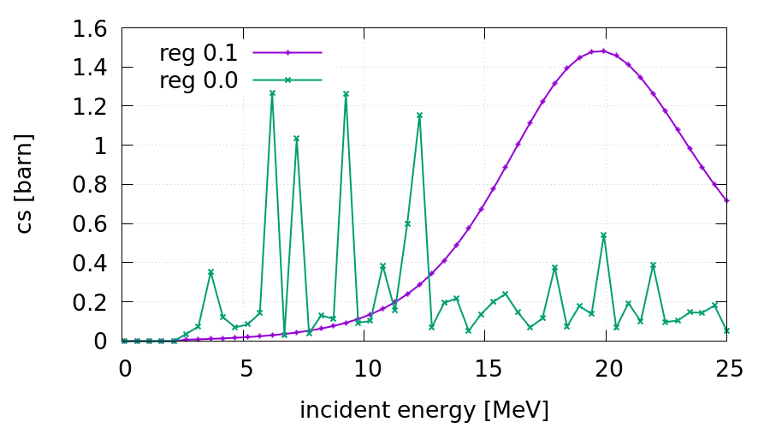
Regularization
Breakup cross section:

Slide 23
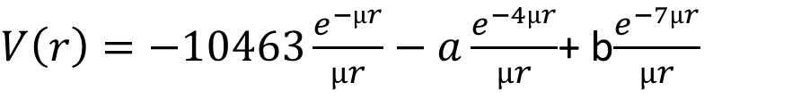
First system to be studied:
Neutron-Deuteron system
E_{b}=-2.225 MeV
Potential of Reid soft core type:
$V\left(r\right)=−10463\frac{e^{−µr}}{µr}−a\frac{e^{−4µr}}{µr}$+ b$\frac{e^{−7µr}}{µr}$
a and b determined by fitting to Nijmegen (Phys. Rev. C 48 (1993) 792) phase shift data and E_{b}
for np interaction: a=1650.6 MeV, b=5371.5 MeV
for nn interaction: a=1210.4 MeV, b=4257.5 MeV

Slide 24
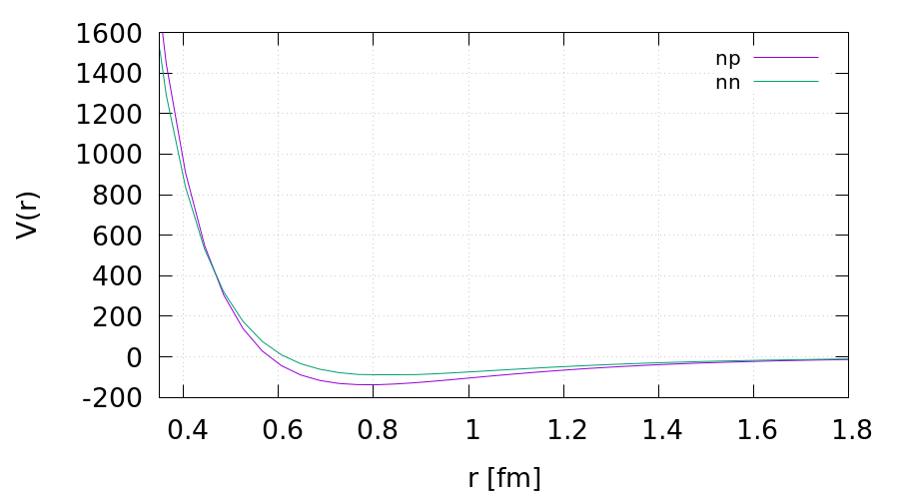
Two body interactions
Reid soft core type potential
[MeV]

Slide 25
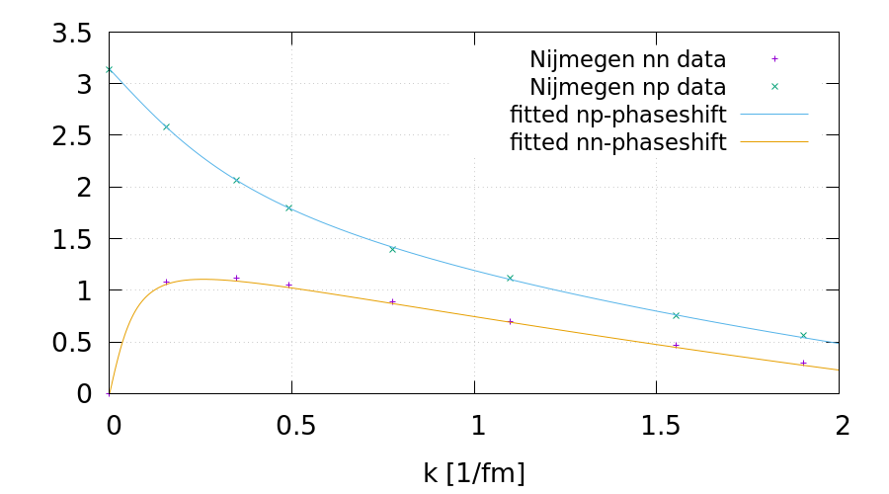
Resulting np and nn phaseshifts

Slide 26
Numerical implementation
Pauli principle:
→ Anitsymmetrization in the spin space
Spatial components 1 and 2 are identical: Reduction of dimension of the system of linear equations

Slide 27
Numerical implementation
equation for the
coefficients c_{µ}
and the T-matrices

Slide 28
Basis states
Subsystem 1:
  neutron-proton (μ₁)
  neutron-(neutron+proton) (μ₂)
Subsystem 2:
  neutron-neutron (μ₁)
  proton-(neutron+neutron) (μ₂)

Slide 29
Basis states
Product states:
with eigenenergies
Matching radii:
r_{0i} is the range of the np or nn potential
For n+deuteron: a_{i}=4 fm, A_{i}=3 fm (minimum values)

Slide 30
Basis states of the neutron-proton subsystem

Slide 31
Basis states of the neutron-neutron subsystem

Slide 32
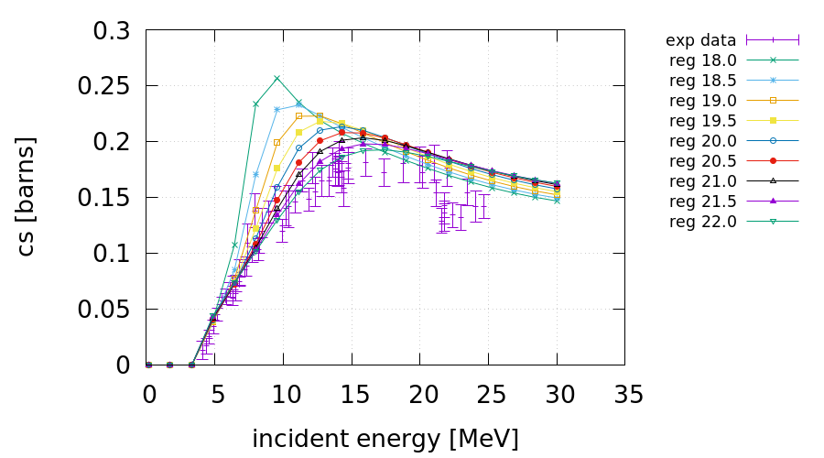
Results
Breakup cross section: a_{i}=7 fm, A_{i}=5.5 fm

Slide 33
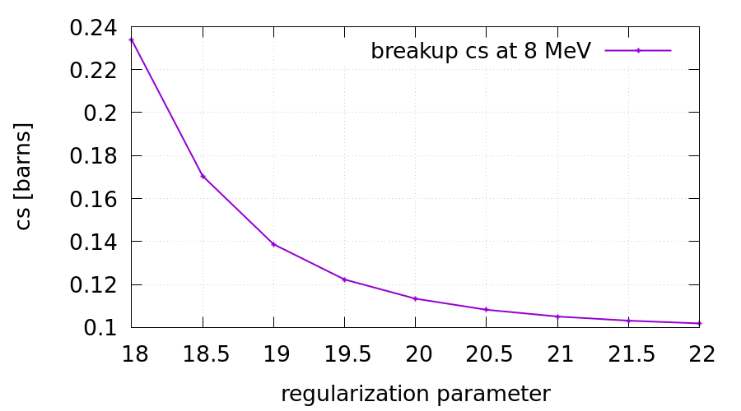
Results
Convergence of the regularization parameter

Slide 34
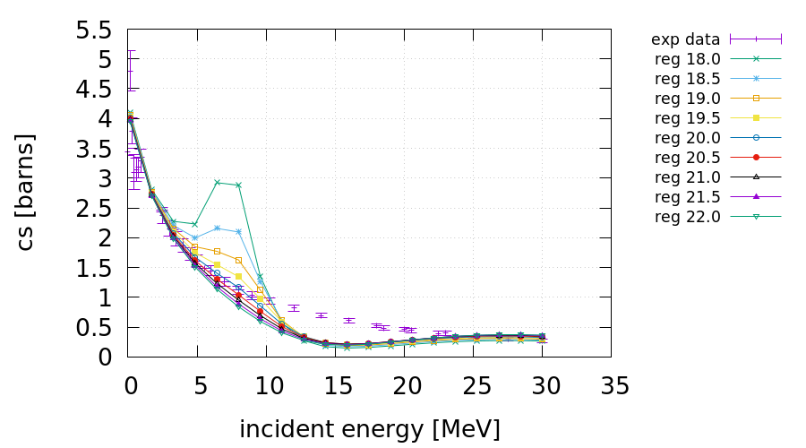
Results
Elastic cross section: a_{i}=7 fm, A_{i}=5.5 fm

Slide 35
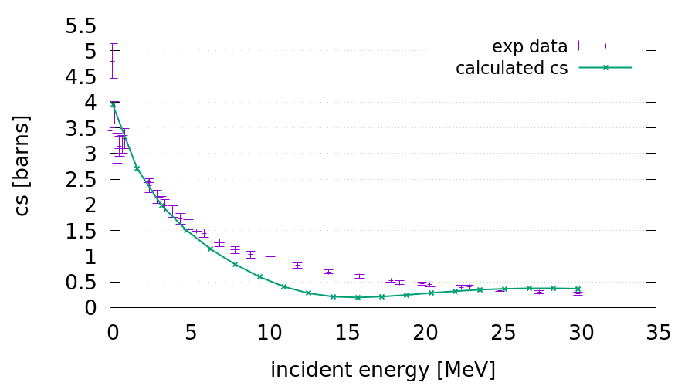
Results
Elastic cross section: Problem for E>5 MeV

Slide 36
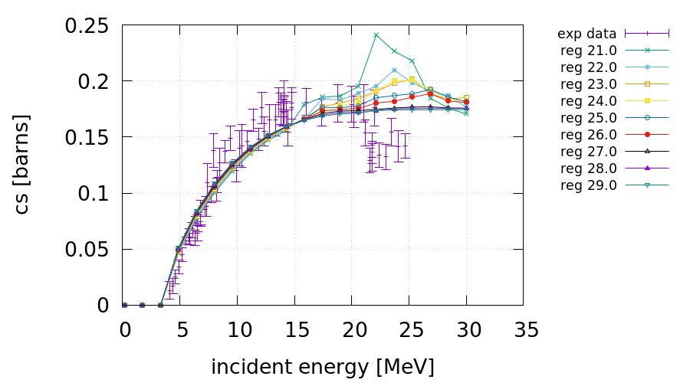
Results
Breakup cross section: a_{i}=5 fm, A_{i}=3.3 fm

Slide 37
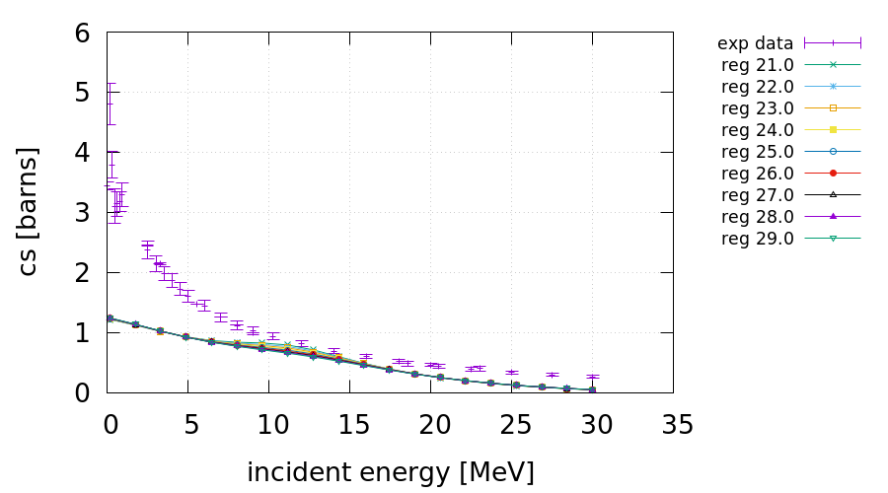
Results
Elastic cross section: a_{i}=5 fm, A_{i}=3.3 fm

Slide 38
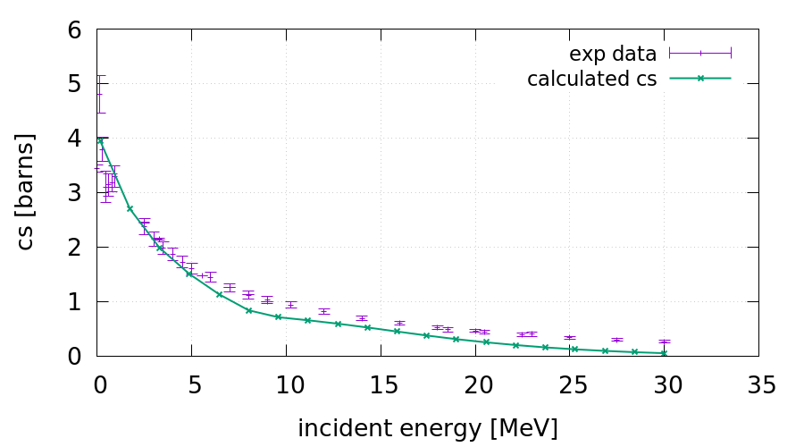
Final Results
Combinded elastic cross section: a_{i} and A_{i} depending on E

Slide 39
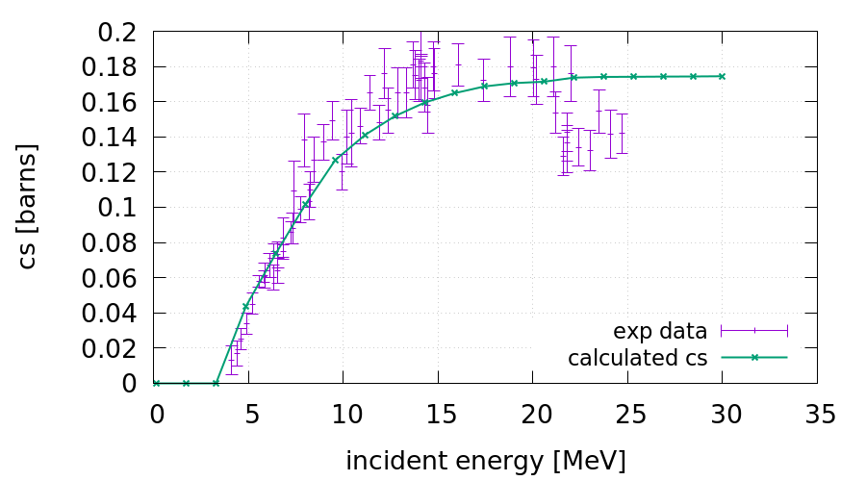
Final Results
Combinded breakup cross section: a_{i} and A_{i} depending on E

Slide 40
Matching radius A_{i}
Remember: Motion in R_{i} direction is free!!
Potentials only act in r_{i} direction

Slide 41
Determination of wave functions
The total scattering wave function splitted into components
Asymptotic solution:
Introduction of polar coordinates:
with

Slide 42
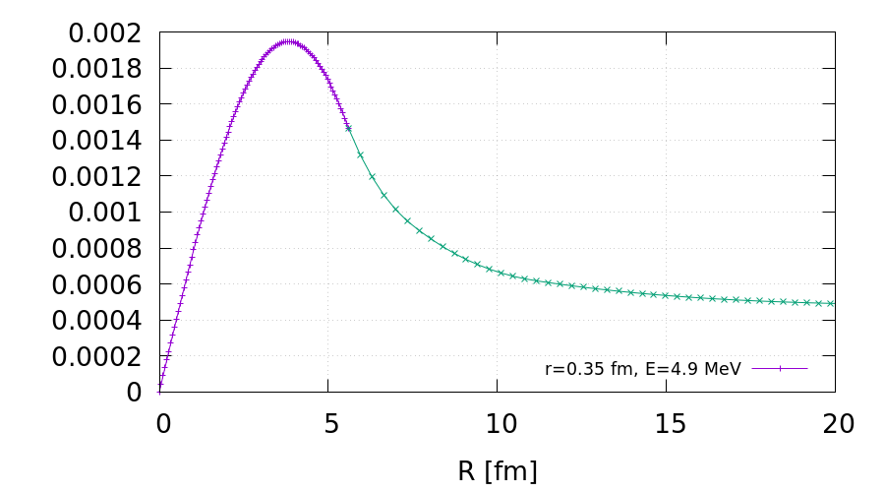
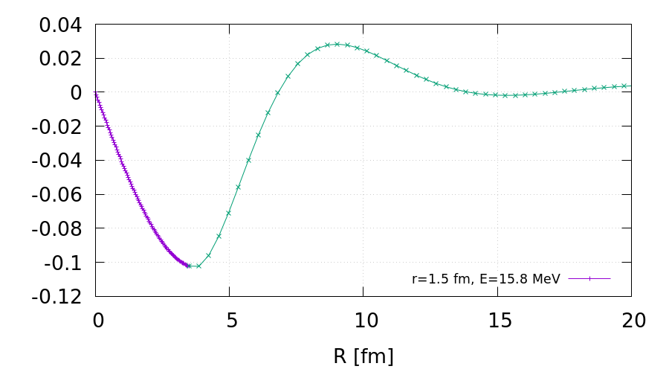

Slide 43
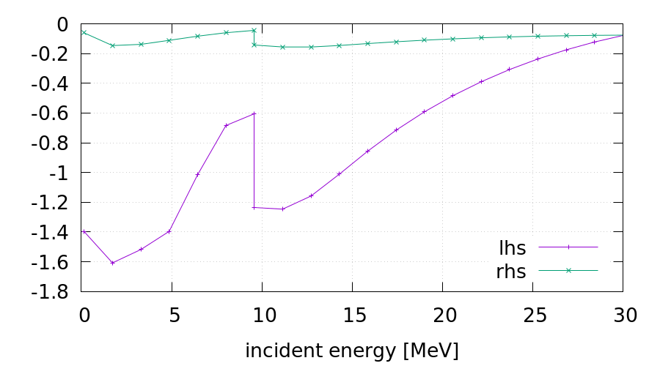
Results
Optical theorem:
Lhs and rhs of the optical theorem:

Slide 44
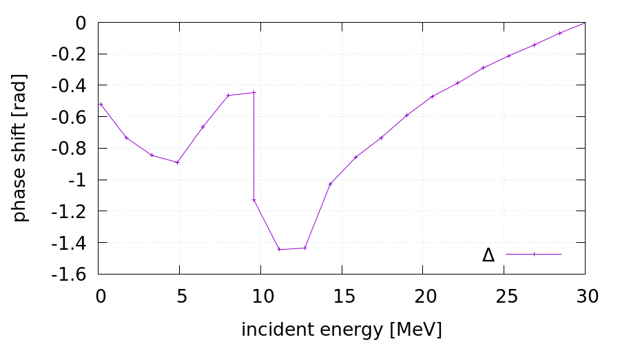
Results
Compare with:
→
Effective phase shift Δ

Slide 45
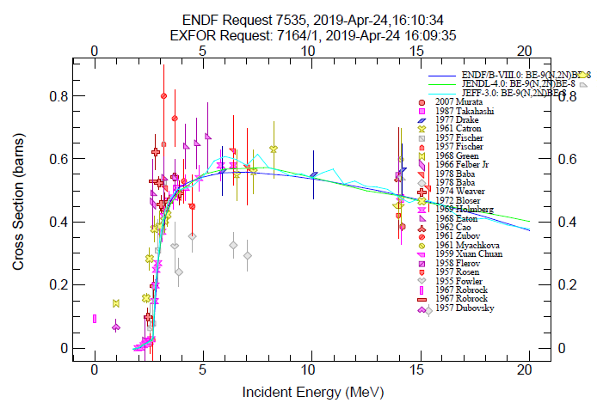
n+⁹Be system
n + ⁹Be → α + α + n + n
Energetically open
at about E_{n}=1.5 MeV
About 20% of the total
n-⁹Be cross section
at E_{n}=5 MeV
Competing channels:
n + ⁹Be → n + ⁹Be elastic scattering
n + ⁹Be → α + ⁶He
n + ⁹Be → ⁸Be + n + n → α + α + n + n

Slide 46
n+⁹Be: Channels and Q values

Slide 47
n-⁸Be subsystem
Interaction of Woods Saxon form
Parameters chosen in that way that binding state is reproduced

Slide 48
Basis states (l=1) of the neutron-⁸Be subsystem

Slide 49
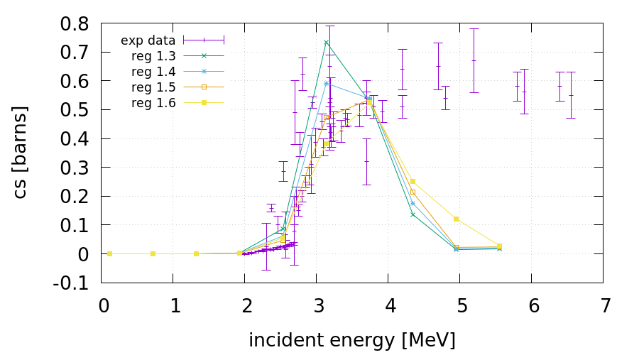
n+⁹Be: Results
Breakup cross section: a_{i}=16 fm, A_{i}=13.4 fm

Slide 50
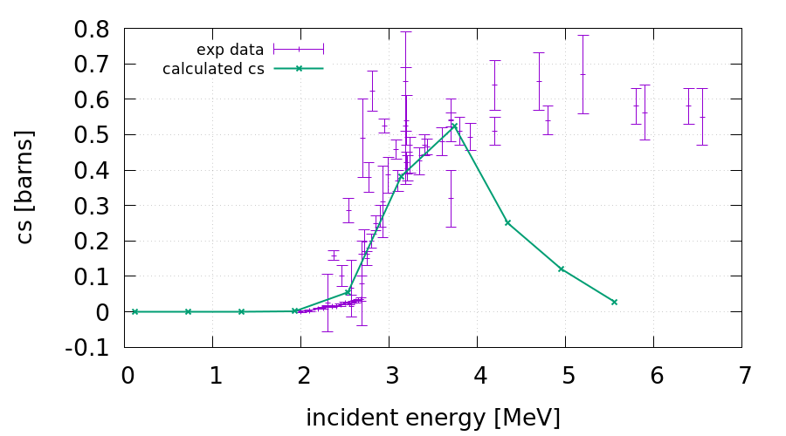
n+⁹Be: Results
Breakup cross section: a_{i}=16 fm, A_{i}=13.4 fm

Slide 51
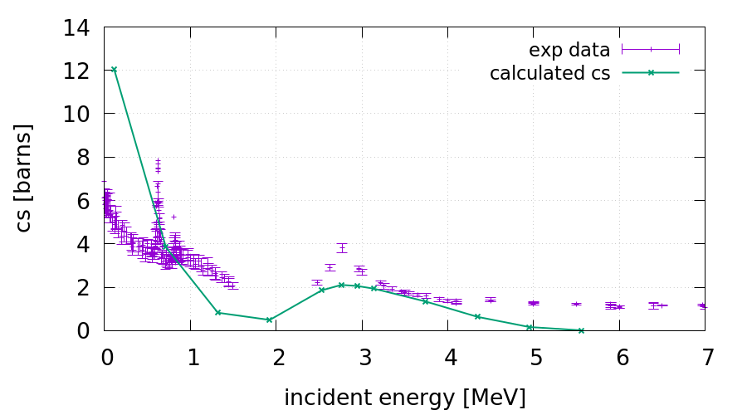
n+⁹Be: Results
Elastic cross section: a_{i}=16 fm, A_{i}=13.4 fm

Slide 52
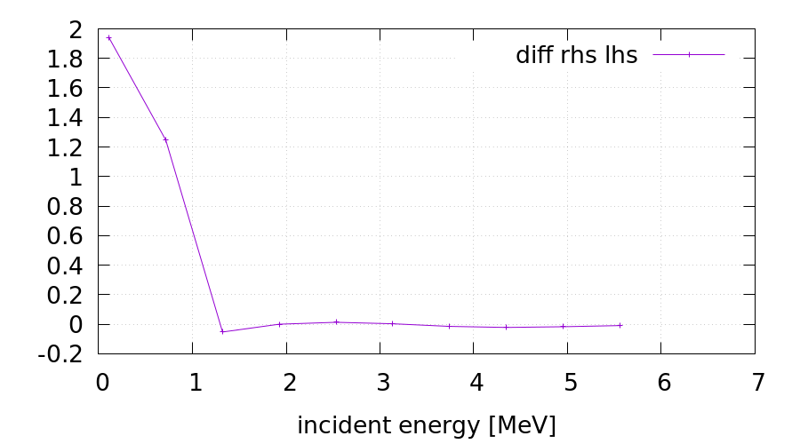
n+⁹Be: Results
Absolute deviation from the optical theorem:
Deviation much smaller than with n-deuteron →
asymptotic conditions better fullfilled at greater a_{i}, A_{i}

Slide 53
Summary and Conclusions
Generalizing and extending Glöckle’s idea a novel R-matrix
formalism based on the Faddeev equations
could be developed and implemented
It is currently the only available R-matrix theory for 3-body reactions
For the first time three-body breakup reactions in n+deuteron
and n+⁹Be system could be described in the frame of R-Matrix
theory without taking recourse to a sequential approach.
Very good reproduction of the energy dependence of the
experimental cross sections

Slide 54
Outlook
Combination of three body formalism with reduced R-Matrix theory
Inclusion of higher partial waves

Slide 55
The Nuclear Data Team at TU Wien
Helmut Leeb
Benedikt Raab
Thomas Srdinko
Thank you for your attention

