Slide 1



Progress in new reduced R-Matrix theory
Atominstitut, TU Wien:
H. Leeb, Th. Srdinko, T. Stary
This work has been carried out within the framework of the EUROfusion Consortium and has received funding from the Euratom research and training programme 2014-2018 and 2019-2020 under grant agreement No 633053. The views and opinions expressed herein do not necessarily reflect those of the European Commission.
supported by the KKKÖ Matching Grant MG 2020-7 of
the Austrian Academy of Sciences is acknowledged.
H. Leeb
June 23, 2022
Progress in new reduced R-matrix theory
TM INDEN_LE, IAEA

Slide 2
The Nuclear Data Group at TU Wien
Activities in Nuclear Data Issues
Activities of the nuclear data group at TU Wien:
Current focus is the evaluation of reactions of light nuclear systems.
Major effort:
Development of proper tools for an improved description of low energy reactions in light nuclear systems.
Status of evaluations of reaction data of light nuclear systems
The description of reaction data of several light nuclear systems are not satisfactory at present
Technological importance:
Oxygen, Carbon, Beryllium, Lithium and others play important roles in
fusion research and nuclear technology.
Major problems:
- extended resonance range,
- no quantitative microscopic models → R-matrix theory usually applied
- occurence of dominant non-binary channels at low energy
- extension of R-matrix theory to non-binary channels
H. Leeb
June 23, 2022
Progress in new reduced R-matrix theory
TM INDEN_LE, IAEA

Slide 3
R-matrix based calculations on light nuclear systems
Important Role of reaction data of several light nuclear systems
Oxygen, Carbon, Beryllium, Lithium and others play important roles for fusion and fission research
The description of reaction data of light nuclear systems are not satisfactory at present
Major problems: extended resonance range, no microscopic models, dominant many-body channels
The R-matrix theory is well suited for the description of resonant cross sections
at low energies, but is limited to binary channels. Thus the occurence of dominant non-binary channels at low energies in light nuclear systems limits the applicability of the standard R-matrix formalism.
Reduced R-matrix analysis of neutron-induced reaction cross sections of ⁹Be up to energies about 25 MeV. In this evaluation many-body breakup channels will be taken into account globally.
Application and associated extension of the modified R-matrix formalism of Glöckle to neutron-induced reaction cross sections of ⁹Be up to neutron energy of 8 MeV.
H. Leeb
June 23, 2022
Progress in new reduced R-matrix theory
TM INDEN_LE, IAEA

Slide 4
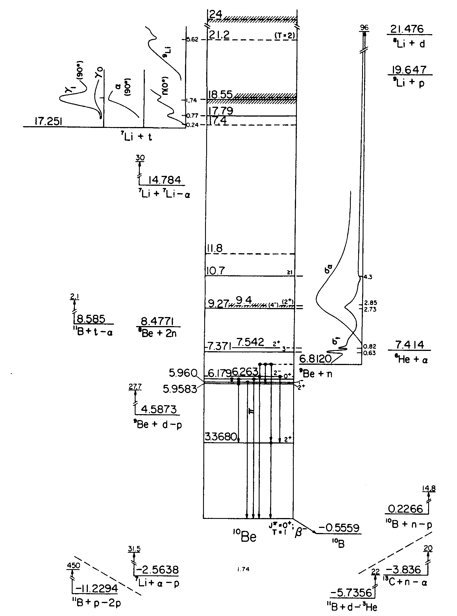
Neutron-induced Reactions of ⁹Be
level scheme of ¹⁰Be
⁹Be(n,n)⁹Be Q= 0.0000 MeV
⁹Be(n,α)⁶He Q= -0.5971 MeV
⁹Be(n,2nα)⁴He Q= -1.6636 MeV
⁹Be(n,nα)(⁵He) Q= -2.3073 MeV
⁹Be(n,n‘)⁹Be* various Q-values
⁹Be(n,t)⁷Li Q=-10.4373 MeV
⁹Be(n,p)⁹Li Q=-12.8248 MeV
⁹Be(n,tα)t Q=-12.9049 MeV
⁹Be(n,d)(⁸Li) Q=-14.6615 MeV
⁹Be(n,t)(⁸Li) Q=-14.6615 MeV
⁹Be(n,nd)⁷Li Q=-16.6932 MeV
⁹Be(n,np)(⁸Li) Q=-16.8861 MeV
⁹Be(n,nt)⁶Li Q=-17.6871 MeV
⁹Be(n,α)⁶Li Q=-19.2874 MeV
⁹Be(n,pt)⁶He Q=-20.4108 MeV
⁹Be(n,³He)(⁷He) Q=-21.5845 MeV
⁹Be(n,pα)(⁵H) Q=-23.1857 MeV
H. Leeb
June 23, 2022
Progress in new reduced R-matrix theory
TM INDEN_LE, IAEA

Slide 5
Standard R-Matrix Formalism:
Concept
2-particle channel: cm-system
channel
surface
Interaction
region
finite – well defined
Interaction region
Lane and Thomas, Rev. Modern Physics 30, 257 (1958)
H. Leeb
June 23, 2022
Progress in new reduced R-matrix theory
TM INDEN_LE, IAEA

Slide 6
Three-Body Exit Channel
3-particle channel: cm-system
channel surface
not defined
Interaction
region
Interaction
region
Interaction
region
Interaction
region
interaction region
is not finite
Lane and Thomas, Rev. Modern Physics 30, 257 (1958)
H. Leeb
June 23, 2022
Progress in new reduced R-matrix theory
TM INDEN_LE, IAEA

Slide 7
Three-Body Exit Channel frequent approach: considered as two step process
3-particle channel: cm-system
Lane and Thomas, Rev. Modern
Physics 30, 257 (1958)
1. Step
Interaction
region
Interaction
region
excited nucleus
with „long“ decay time
2. Step
H. Leeb
June 23, 2022
Progress in new reduced R-matrix theory
TM INDEN_LE, IAEA

Slide 8
Reduced R-Matrix Analysis
In general it is difficult to consider the complete system of reactions for a given
compound nucleus – scarcity of data, not accessible to experiment, many-body channels
Only a selection of open reaction channels is considered – The S-matrix associated with
The incomplete system is not unitary – equivalent to flux loss into ignored channels.
Reduced R-Matrix
R-matrix is complex, imaginary part describes flux loss into
ignored channels (Lane and Thomas,)
Open problems:
- parametrisation which accounts for thresholds of ignored states
- estimate of cross sections associated with ignored states
Reich-Moore parametrisation
used for (n,γ) reactions – no
account of thresholds
only form used:
H. Leeb
June 23, 2022
Progress in new reduced R-matrix theory
TM INDEN_LE, IAEA

Slide 9
Development of adequate reduced R-matrix parametrisation
the R_{rr}-submatrix
Maintaining the S-matrix
elements of S_{rr} equivalent
leads to the following
relationship (Lane&Thomas)
R₁₁ R₁₂ ……. R₁₅ .. R_{1n}
R₂₁ R₂₂ ……. R₂₅ .. R_{2n}
R₃₁ R₃₂ ……. R₃₅ .. R_{3n}
R₄₁ R₄₂ ……. R₄₅ .. R_{4n}
R₅₁ R₅₂ ……. R₅₅ .. R_{5n}
… … ……. … .. …
R_{n1} R_{n2} ……. R_{n5} .. R_{nn}
R =
the complete
R-matrix
R_{ee} eliminated
channels
H. Leeb
June 23, 2022
Progress in new reduced R-matrix theory
TM INDEN_LE, IAEA

Slide 10
Reduced R-Matrix Formalism
parametrisation of reduced R-matrix with correct threshold behaviour exact for one pole approximation
property of L(ka):
complex above threshold of channel 3 → R_{red}-matrix complex
real below threshhold of channel 3 → R_{red}-matrix real
H. Leeb
June 23, 2022
Progress in new reduced R-matrix theory
TM INDEN_LE, IAEA

Slide 11
Elimation of 2 Channels in the Three-Channel System
Elimination of all channels, but the first one, yields:
Threshold behaviour of L_{j}(k_{j}a)
complex above threshold of channel j → R_{red}-matrix complex
real below threshhold of channel j → R_{red}-matrix real
H. Leeb
June 23, 2022
Progress in new reduced R-matrix theory
TM INDEN_LE, IAEA

Slide 12
Reduced R-Matrix:
Exact Parametrisations
one-Pole, arbitrary number of channels:
R-matrix of complete system
c, c‘ = 1,2,…,N_{c}
Reduced R-matrix of reduced
system c, c‘ = 1,2,…,N_{e}
BA-thesis D. Kayan (TUW)
arbitrary number of poles, two-channels:
R-matrix of complete system
c, c‘ = 1,2
Reduced R-matrix of reduced
one-channel system
BA-thesis D. Kayan (TUW)
real if k_{d} is imaginary (below threshold)
complex if k_{d} is complex (above threshold)
Important:
These parametrizations derived account for the thresholds of eliminated channels
H. Leeb
June 23, 2022
Progress in new reduced R-matrix theory
TM INDEN_LE, IAEA

Slide 13
Proposed Parametrisation for
Reduced R-Matrix Analyses
Proposed parametrisation for reduced R-matrix analyses
correct threshold behaviour; assumption: valid for for well separated poles
This form is implemented in the R-matrix module of GECCCOS
H. Leeb
June 23, 2022
Progress in new reduced R-matrix theory
TM INDEN_LE, IAEA

Slide 14
Neutron-induced Reactions of ⁹Be
level scheme of ¹⁰Be
⁹Be(n,n)⁹Be Q= 0.0000 MeV
⁹Be(n,α)⁶He Q= -0.5971 MeV
⁹Be(n,2nα)⁴He Q= -1.6636 MeV
⁹Be(n,nα)(⁵He) Q= -2.3073 MeV
⁹Be(n,n‘)⁹Be* various Q-values
⁹Be(n,t)⁷Li Q=-10.4373 MeV
⁹Be(n,p)⁹Li Q=-12.8248 MeV
⁹Be(n,tα)t Q=-12.9049 MeV
⁹Be(n,d)(⁸Li) Q=-14.6615 MeV
⁹Be(n,t)(⁸Li) Q=-14.6615 MeV
⁹Be(n,nd)⁷Li Q=-16.6932 MeV
⁹Be(n,np)(⁸Li) Q=-16.8861 MeV
⁹Be(n,nt)⁶Li Q=-17.6871 MeV
⁹Be(n,α)⁶Li Q=-19.2874 MeV
⁹Be(n,pt)⁶He Q=-20.4108 MeV
⁹Be(n,³He)(⁷He) Q=-21.5845 MeV
⁹Be(n,pα)(⁵H) Q=-23.1857 MeV
H. Leeb
June 23, 2022
Progress in new reduced R-matrix theory
TM INDEN_LE, IAEA

Slide 15
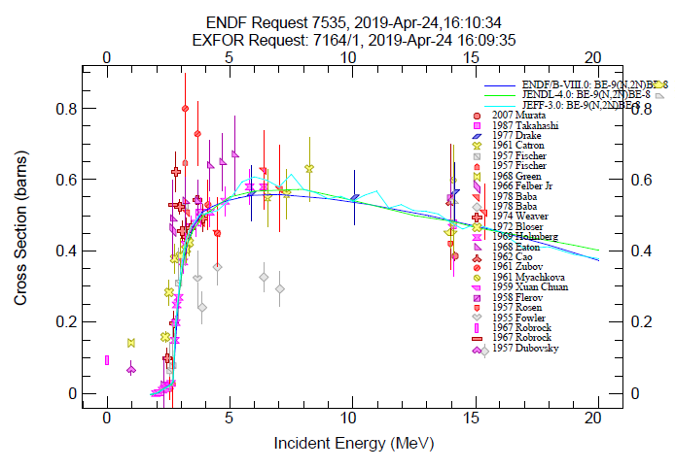
n+ ⁹Be system
n + ⁹Be → α + α + n + n
Energetically open
at about E_{n}=1.5 MeV
About 20% of the total
n-⁹Be cross section
at E_{n}=5 MeV
Competing channels:
n + ⁹Be → n + ⁹Be elastic scattering
n + ⁹Be → α + ⁶He
n + ⁹Be → ⁸Be + n + n → α + α + n + n
⁸Be is a resonance only
Lifetime ~ 10⁻¹⁷s
H. Leeb
June 23, 2022
Progress in new reduced R-matrix theory
TM INDEN_LE, IAEA

Slide 16
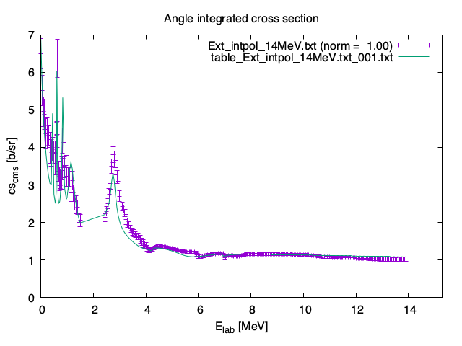
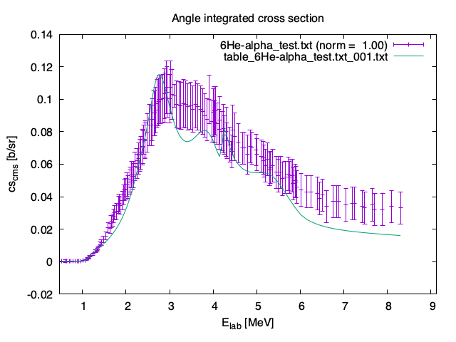
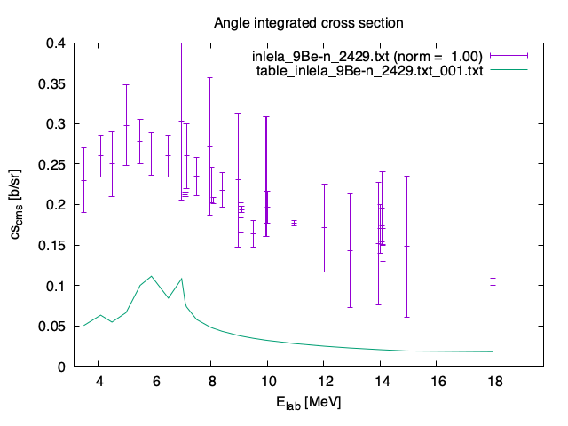
Reduced R-Matrix Analysis using one-pole formula
⁹Be(n,α)⁶He
⁹Be(n,el)
⁹Be(n,n‘)⁹Be*
H. Leeb
June 23, 2022
Progress in new reduced R-matrix theory
TM INDEN_LE, IAEA

Slide 17
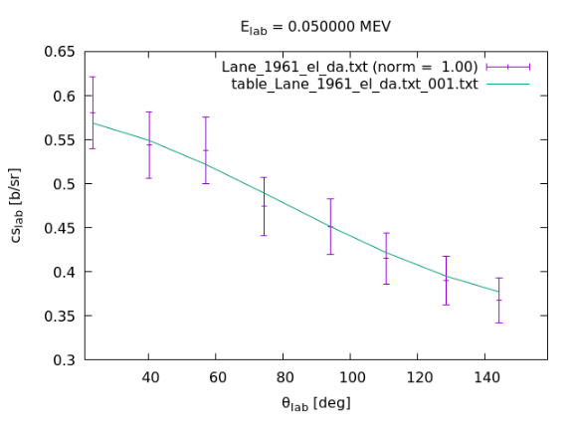
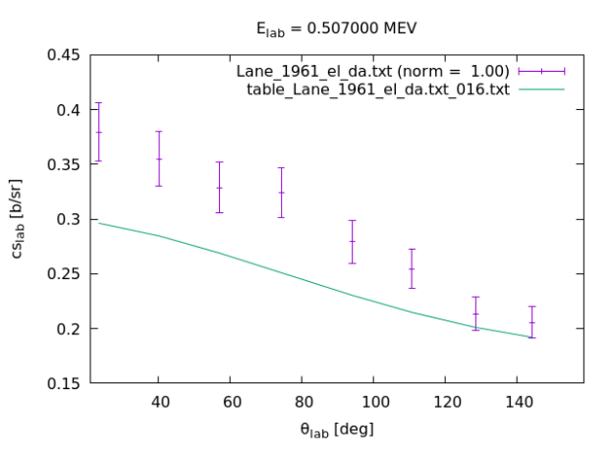
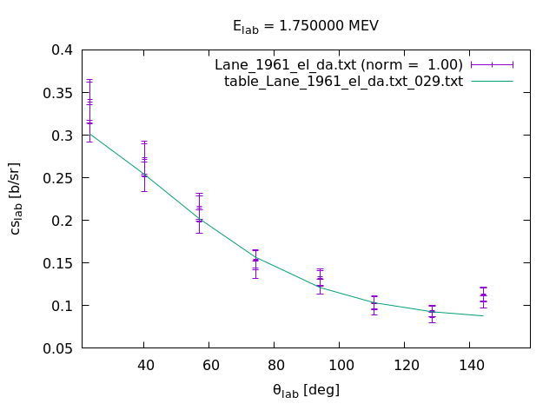
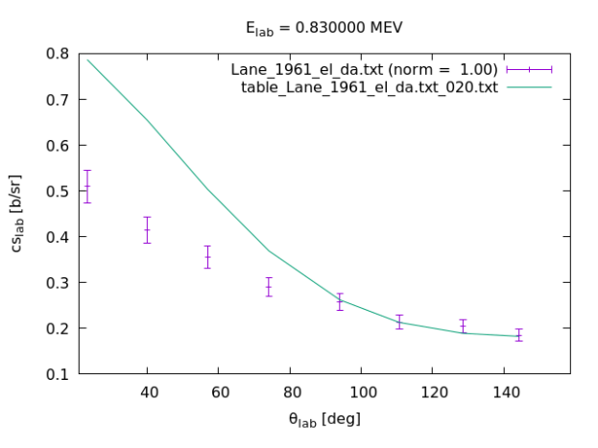
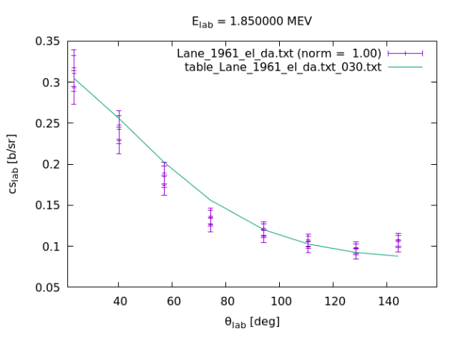
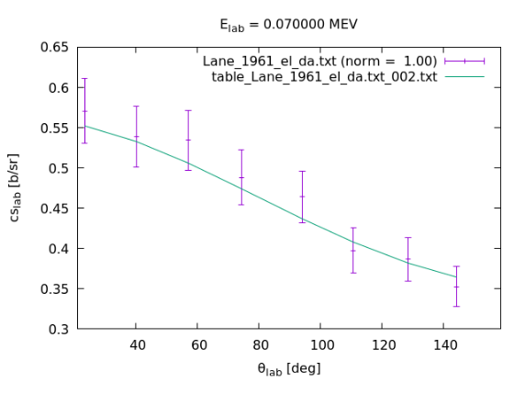
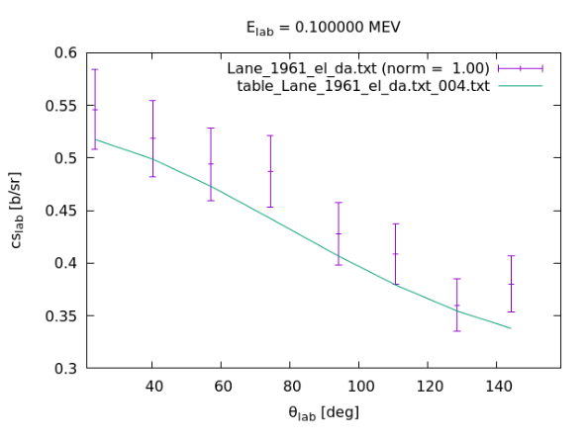
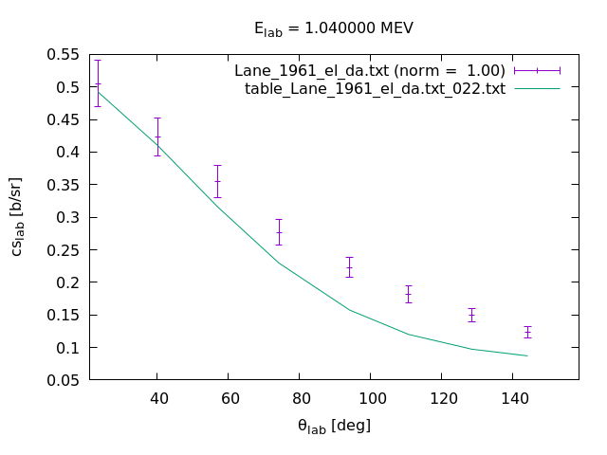
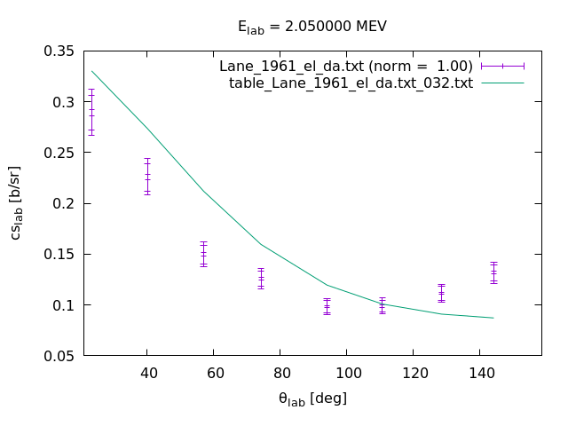
Reduced R-Matrix Analysis of elastic differential cross section data
H. Leeb
June 23, 2022
Progress in new reduced R-matrix theory
TM INDEN_LE, IAEA

Slide 18
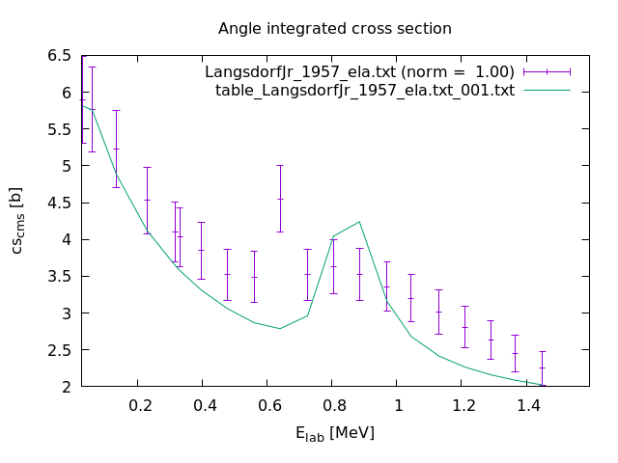
Reduced R-Matrix Analysis of elastic n-9Be cross sections
H. Leeb
June 23, 2022
Progress in new reduced R-matrix theory
TM INDEN_LE, IAEA

Slide 19
Reduced R-Matrix Analysis
Cross Section associated with ignored channels
Although not explicitly considered in Reduced R-Matrix Analyses one is able to determine
the total cross section associated with the sum of ignored channels.
Basic idea: Unitarity defect of the Collision matrix associated with the Reduced R-Matrix
Nichtelastischer
Wirkungsquerschnitt
Reduced R-Matrix formalism: Interest in the fraction of the cross sections ignored
The total reaction cross section can be additionally used in reduced R-matrix analyses
H. Leeb
June 23, 2022
Progress in new reduced R-matrix theory
TM INDEN_LE, IAEA

Slide 20
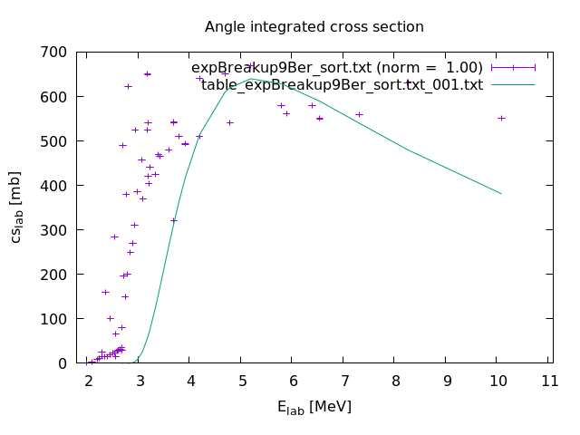
Reduced R-Matrix Analysis
Breakup cross section
sigma_{bu} (mbarn)
H. Leeb
June 23, 2022
Progress in new reduced R-matrix theory
TM INDEN_LE, IAEA

Slide 21
Reduced R-Matrix Analysis
Breakup cross section
sigma_{bu} (mbarn)
H. Leeb
June 23, 2022
Progress in new reduced R-matrix theory
TM INDEN_LE, IAEA

Slide 22
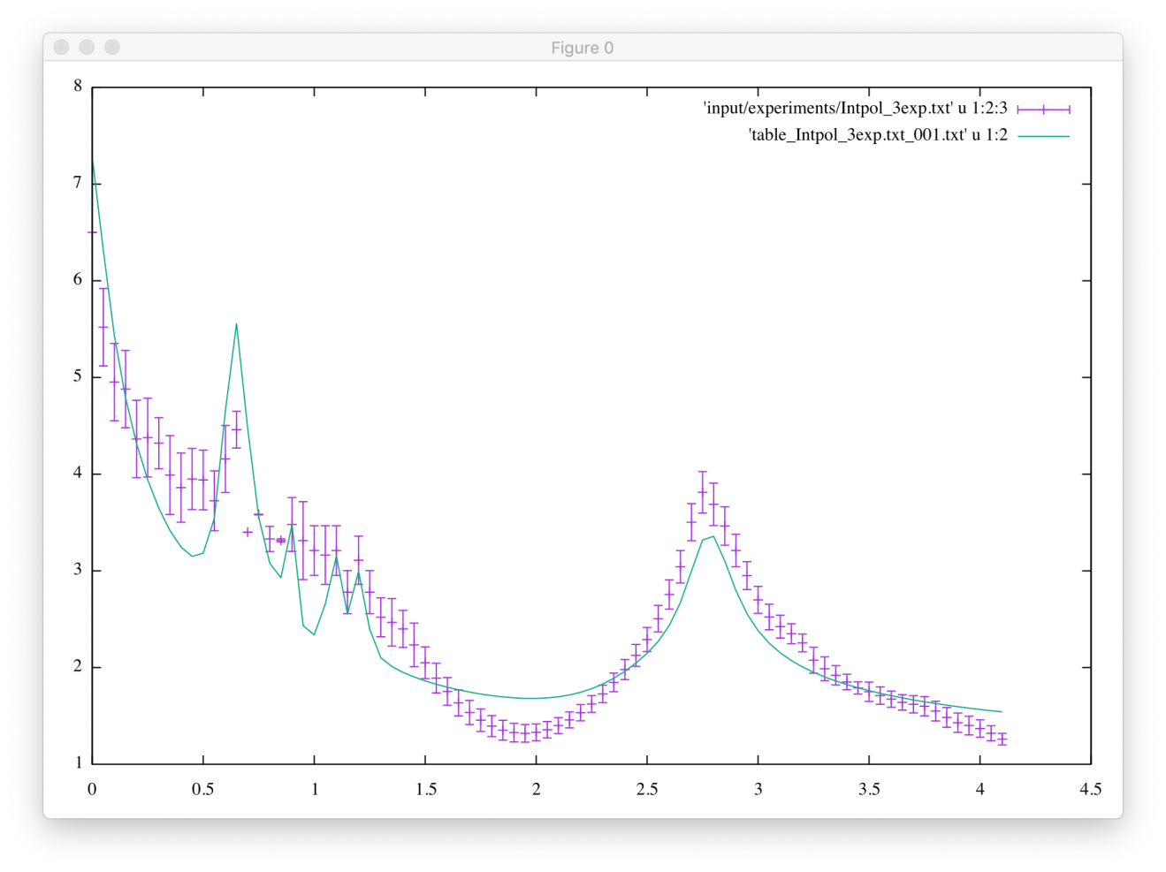
n+⁹Be total cross section
8
7
6
5
4
3
2
1
n+⁹Be σ_{tot}
σ_{tot} (mbarn)
0 1 2 3 4
E_{Lab} (MeV)
H. Leeb
June 23, 2022
Progress in new reduced R-matrix theory
TM INDEN_LE, IAEA

Slide 23
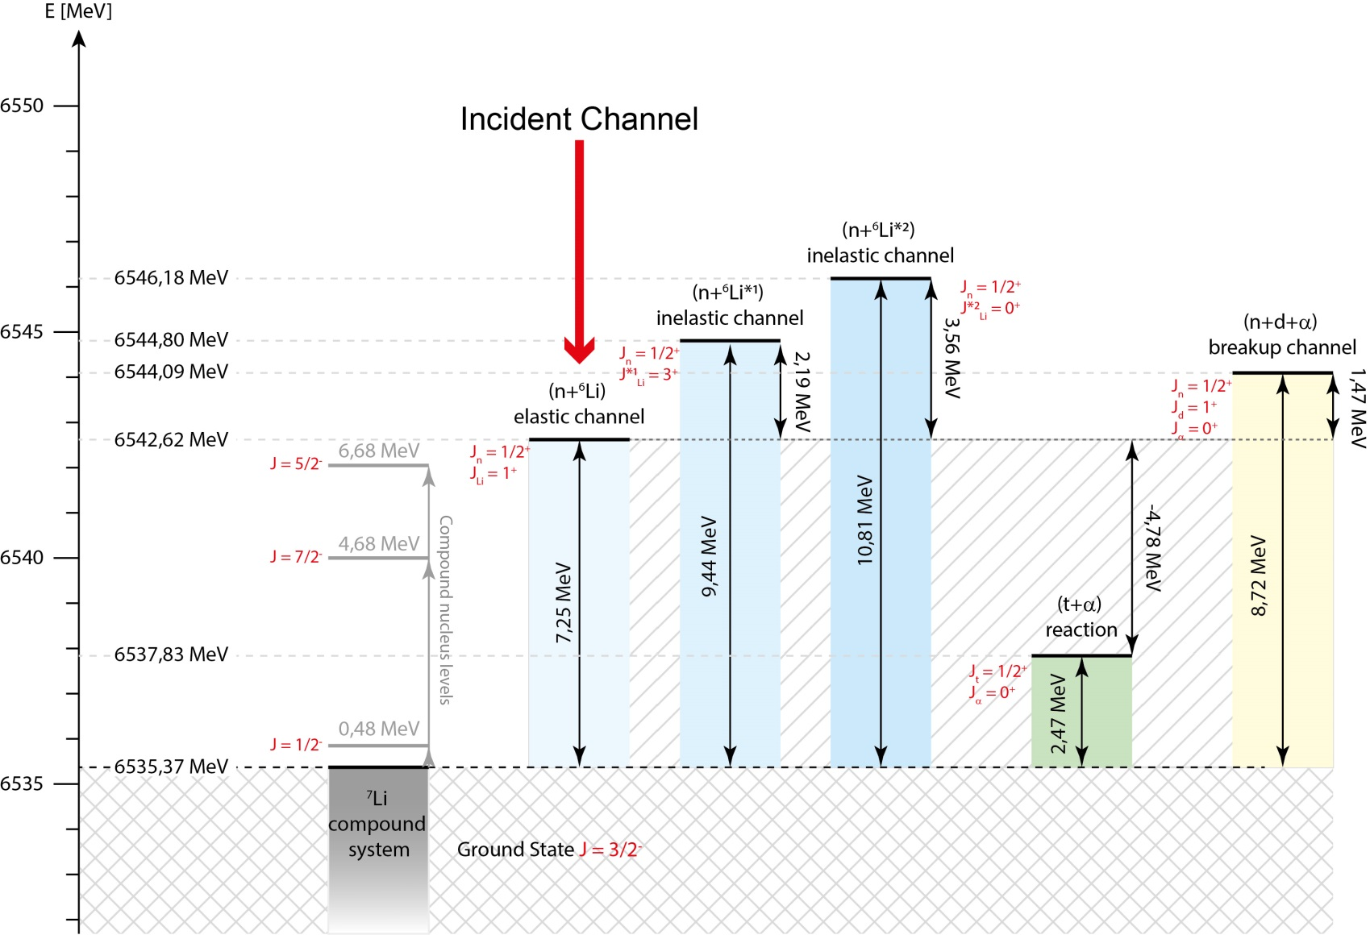
n+⁶Li System
H. Leeb
June 23, 2022
Progress in new reduced R-matrix theory
TM INDEN_LE, IAEA

Slide 24
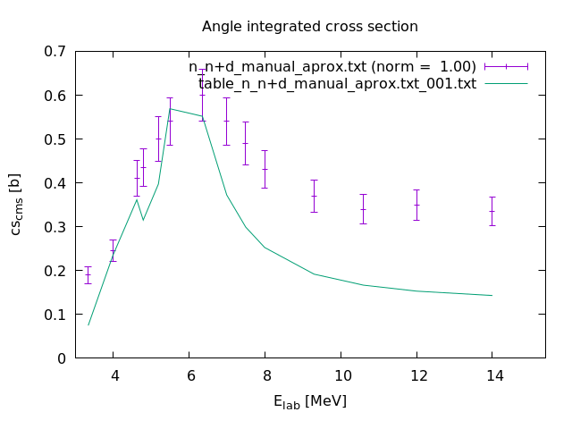
n+⁶Li→ α+n+d cross section
H. Leeb
June 23, 2022
Progress in new reduced R-matrix theory
TM INDEN_LE, IAEA

Slide 25
The Nuclear Data Team at TU Wien
Helmut Leeb
Benedikt Raab Thomas Srdinko
Tanja Stary Tobias Wojta
Thank you for your attention
H. Leeb
June 23, 2022
Progress in new reduced R-matrix theory
TM INDEN_LE, IAEA

