Slide 1
Pulsed-Neutron Die-Away Experiments at LNNL
Technical Meeting on the Compilation of Nuclear Data Experiments for Radiation Characterization
IAEA
Vienna, Austria
October 10-14, 2022
Daniel Siefman, D. Heinrichs, J. Holmes, M. Zerkle, C. Percher
Nuclear Criticality Safety Division
siefman1@llnl.gov

Slide 2
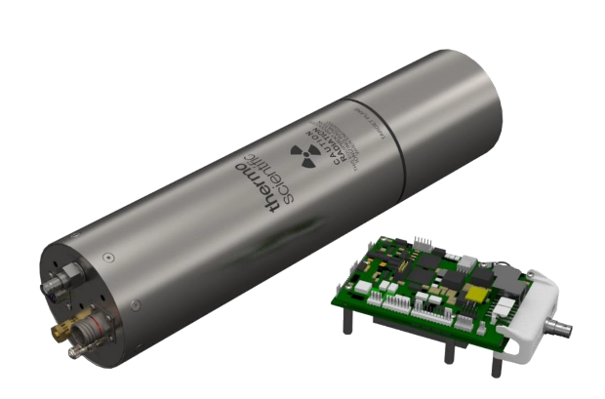
Pulsed Neutron Die Away Experiments
Inject Pulse of Neutrons
Neutrons thermalize
Neutrons spatially equilibrate
Measure exponential decay in fundamental mode
Target Material
He-3 Detector
neutrons
D-T Neutron Generator
Borated HDPE & Cd Box for well defined geometry and to reduce room return
Notes:
Each curve shows an increasing or flat neutron population until the pulse ends at ~0.6 ms. At that point without a source, the neutrons are only leaking from the system and their population has different spatial modes. After another 50-100 μs (depending on the target material and size), the flux thermalizes, and the flux shape equilibrates.

Slide 3
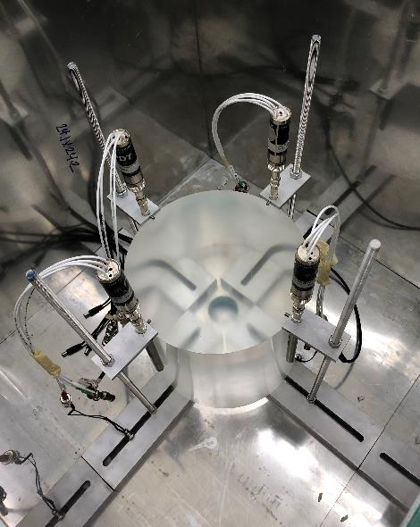
Why PNDA for TSL Validation?
Does not require fissile material
  Non-nuclear facilities, reduced costs, fewer regulations, safer
Very simple target shapes and compositions
  Reduced uncertainties in benchmarks
  Reduced material costs
  Easy to change temperature
Only sensitive to absorption and scattering of target medium
  Reduces uncertainties from other nuclear data and compensating effects
  Tune target size to vary effect of absorption vs. scattering
Well conducted experiments have uncertainties of 0.1% - 0.5%
Figure: Measurement of Lucite target

Slide 4
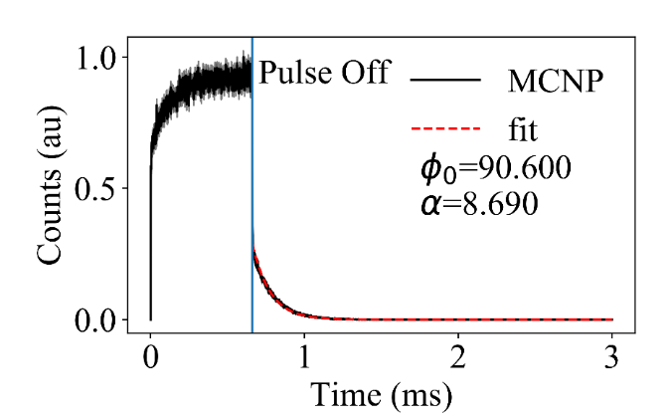
Integral Parameter: α eigenvalue
$$φ\left(t\right)= φ_{0}\exp\left(−αt\right)+R$$
$$α=\overline{vΣ_{a}}+\overline{vD_{0}} B_{0}^{2}−CB_{0}^{4}+…$$
α: flux decay-time eigenvalue [s⁻¹]
D₀ [cm²s⁻¹] is the asymptotic diffusion coefficient
C: “cooling coefficient” [cm⁴s⁻¹]
B₀²: geometric Buckling [cm⁻²]
v thermal neutron velocity (2.2 x 10⁵ cm/s)
Σ_{a} macroscopic absorption cross section [cm⁻¹]
Figure: Example of pulsed-die-away curve modeled in MCNP
Notes:
The cooling coefficient captures a geometric effect where more high-energy neutrons leak at the system boundaries, which causes the average neutron population to be at a temperature lower than thermodynamic equilibrium. C is often very small relative to the absorption and diffusion terms and has a small impact on α. The exception to this is when the geometric Buckling is very large, and the B₀⁴ term becomes very important. In most cases, α is a nearly linear function of B₀² with the slope of the function depending on the material cross sections.

Slide 5
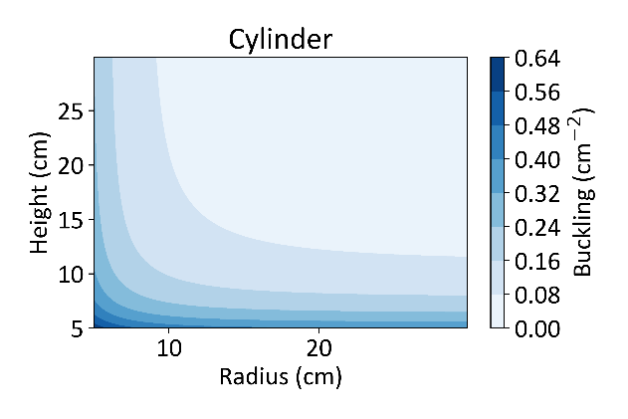
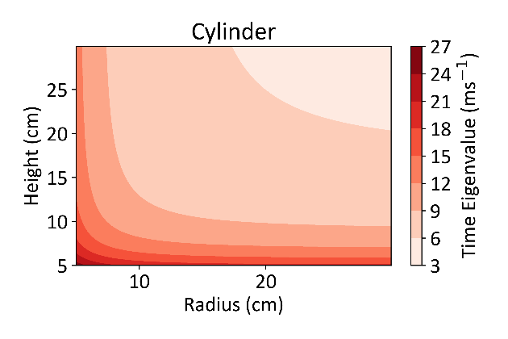

Sensitivity Depends on Target Size
Small targets (large Bucklings) are more sensitive to scattering
Large targets (small Bucklings) are more sensitive to absorption
$$B_{0}^{2}={\left(\frac{π}{H+2δ}\right)}^{2}+{\left(\frac{2.405}{R+δ}\right)}^{2}$$
$$α=\overline{vΣ_{a}}+\overline{vD_{0}} B_{0}^{2}−CB_{0}^{4}$$
Absorption
Scattering
Figure: Buckling vs. cylinder dimensions
Figure: α vs. cylinder dimensions
Notes:
For each target, B₀² can be changed by altering a certain geometric dimension, which would be done to manipulate how α is affected by different physics of the system. For instance, when the target sample is large and B₀² is small, α depends mostly on absorption (Σ_{a}), i.e. not on TSLs. When the target sample is small, B₀² is large and α depends primarily on D₀, which itself is highly influenced by the physics of thermal scattering. Fundamentally, the sensitivity of α to thermal scattering increases with B₀², or increases as the target sample size decreases.
Using one very large sample allows to nail down the absorption term in the equation $α=vΣ_{a}+B_{0}^{2}D_{0}\left(1−CB_{0}^{2}\right)$, or the y-intercept in the alpha vs. buckling curve. This then allows you to verify if the base library in MCNP is performing properly (excluding TSLs). If it is not, then you can perform a correction on all the alpha values .

Slide 6
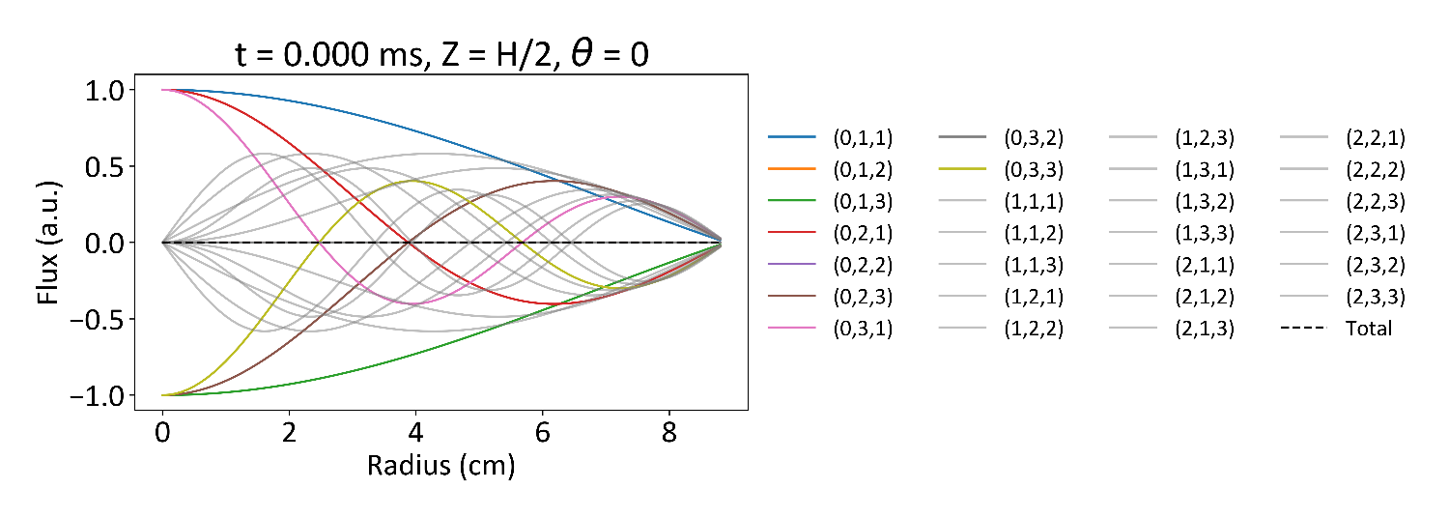


Decay to Fundamental Mode
Large Cylindrical Sample
r
$$φ\left(r,θ, z,t\right)=\sum_{l,m,n}{C_{l,m,n}\sin\left(\frac{nπ}{H}z\right)J_{l}\left(a_{l,n}r\right)\cos{lθ}\exp\left[−\left(\overline{vΣ_{a}}+\overline{vD_{0}} B_{n,m,l}^{2}\right)t\right]}$$
z
$$α_{l,m,n}$$
Focusing only on modes of Bessel function:
$$θ$$
Fundamental Mode
Spatial Modes (l,m,n)
Notes:
Here have 8cm radius, 18 cm height cylinder. L is the integer order of the Bessel function, m is the number of zeros of the Bessel function. N is repeating modes of sin/cos functions. The fundamental mode is that which each index has its lowest value (l=0, m=1, n=1).
In practice there isn’t enough time to let all the modes decay, the statistics will get too poor. The lower order modes can be particularly troublesome.
Gray modes are those that cancel out by placing the detector at the R=0. Also by putting it at R=0, will converge quicker (Blue line is the black line), By placing at H/2, all even modes of n are eliminated by symmetry concerns because sin(n*pi/H * H/2) =0

Slide 7
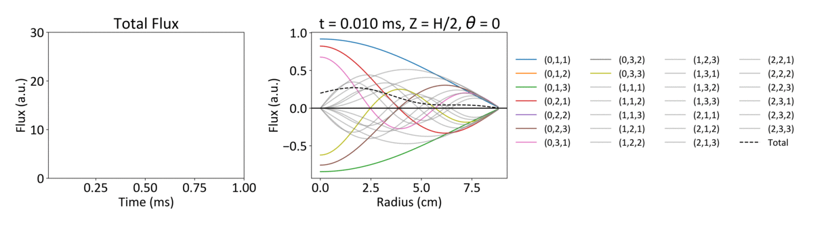
Decay to Fundamental Mode
Large Cylindrical Sample
r
$$φ\left(r,θ, z,t\right)=\sum_{l,m,n}{C_{l,m,n}\sin\left(\frac{nπ}{H}z\right)J_{l}\left(a_{l,n}r\right)\cos{lθ}\exp\left[−\left(\overline{vΣ_{a}}+\overline{vD_{0}}B_{n,m,l}^{2}\right)t\right]}$$
z
$$α_{l,m,n}$$
$$θ$$
Spatial Modes (l,m,n)
Notes:
Here have 8cm radius, 18 cm height cylinder. L is the integer order of the Bessel function, m is the number of zeros of the Bessel function. N is repeating modes of sin/cos functions. The fundamental mode is that which each index has its lowest value (l=0, m=1, n=1).
In practice there isn’t enough time to let all the modes decay, the statistics will get too poor. The lower order modes can be particularly troublesome.
Gray modes are those that cancel out by placing the detector at the R=0. Also by putting it at R=0, will converge quicker (Blue line is the black line), By placing at H/2, all even modes of n are eliminated by symmetry concerns because sin(n*pi/H * H/2) =0

Slide 8
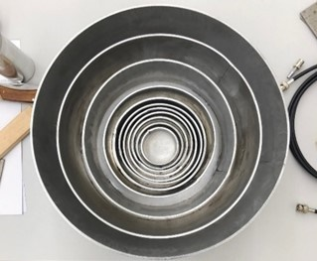
First Tests with H₂O samples
Table: Geometry of Water Targets
Simulations of historical experiments showed good performance of H₂O
Replicated good performance provides confidence in experimental setup
Test with 10 H₂O targets in Al cans
Weigh water, calculate water height with assumed density
All measured with 30-minute exposures, variable generator frequency
Height (cm) | Radius (cm) | Buckling (cm⁻²)
2.28 | 2.54 | 1.90
2.79 | 3.18 | 1.34
3.05 | 3.81 | 1.09
3.52 | 4.47 | 0.836
3.79 | 5.08 | 0.712
4.63 | 6.67 | 0.480
5.98 | 7.46 | 0.324
8.32 | 10.00 | 0.178
10.19 | 12.70 | 0.119
12.97 | 15.24 | 0.0775

Slide 9
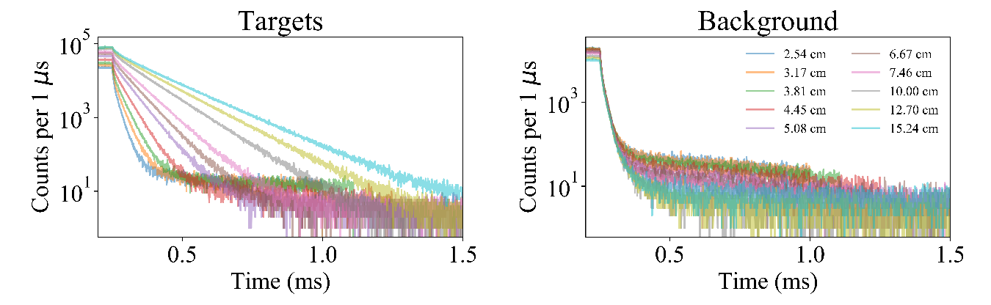
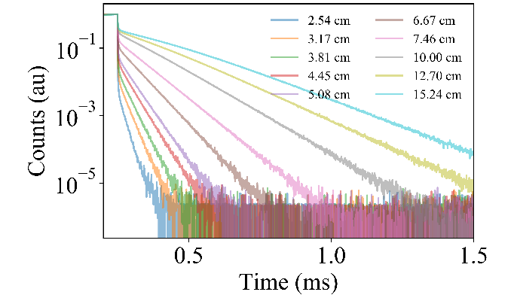
H₂O Die-Away Curves
MCNP6.2

Slide 10
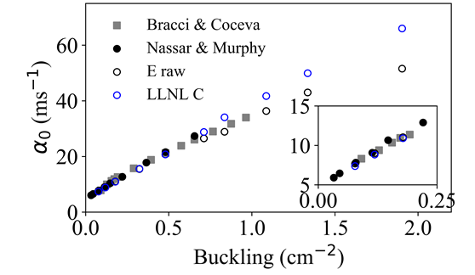
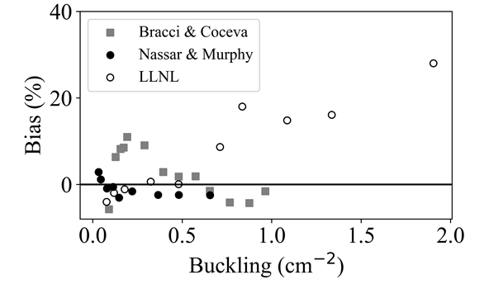
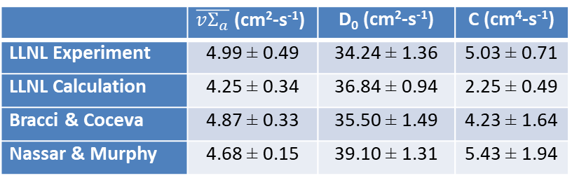
H₂O Validation & Comparison to Literature
LLNL E
 | $\overline{vΣ_{a}}$ (cm²-s⁻¹) | D₀ (cm²-s⁻¹) | C (cm⁴-s⁻¹)
LLNL Experiment | 4.99 ± 0.49 | 34.24 ± 1.36 | 5.03 ± 0.71
LLNL Calculation | 4.25 ± 0.34 | 36.84 ± 0.94 | 2.25 ± 0.49
Bracci & Coceva | 4.87 ± 0.33 | 35.50 ± 1.49 | 4.23 ± 1.64
Nassar & Murphy | 4.68 ± 0.15 | 39.10 ± 1.31 | 5.43 ± 1.94
$$α=\overline{vΣ_{a}}+B_{0}^{2}D_{0}−CB_{0}^{4}$$

Slide 11
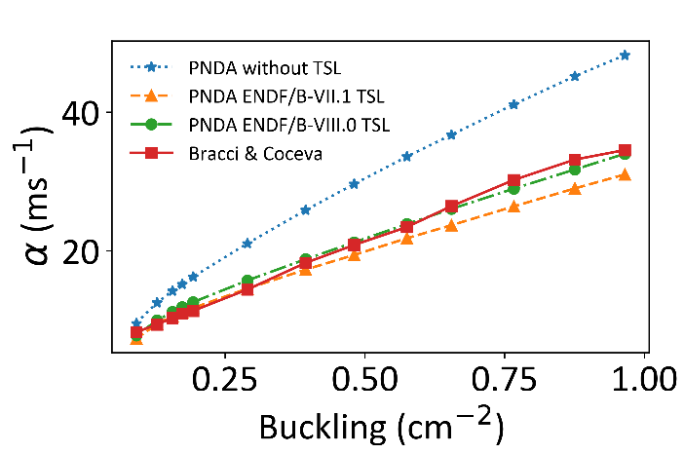
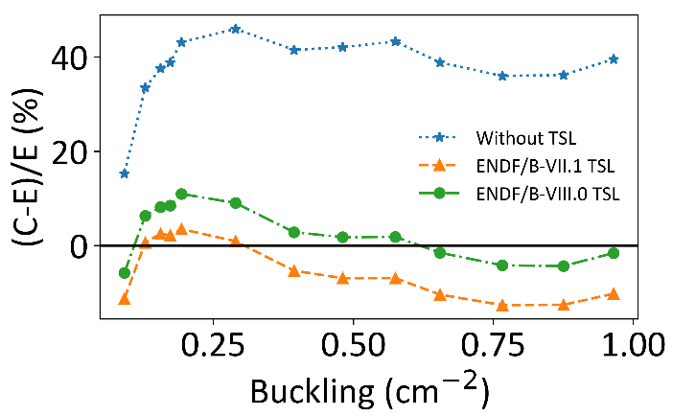
Sensitivity to TSLs
Example: Historical water experiment in cylindrical geometry
  A. Bracci & C. Coceva, “The diffusion parameters of thermal neutrons in water.” Il Nuovo Cimento, 4 (1956)
Absorption
Leakage
Figure: α vs. Buckling curve for experimental and simulated data
Figure: Bias of simulations without TSLs, with ENDF/B-VII.1, and with ENDF/B-VIII.0 TSLs

Slide 12
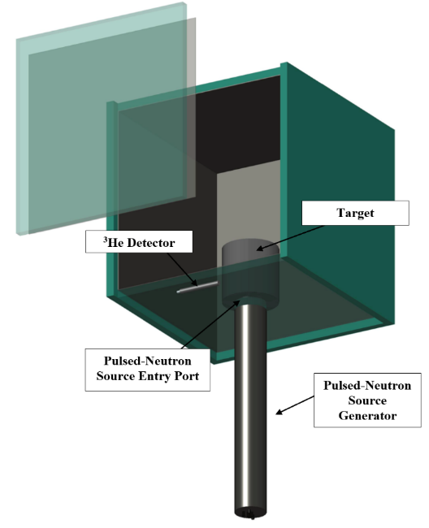
Experimental Parameters
P383 D-T neutron generator
  Maximum yield of 5 x 10⁸ neutrons/s
  Minimum frequency of 150 Hz
  Minimum pulse width of 10 μs
Four He-3 tubes
  Operated at 1100 V
  50 ns pulse width
Time-tagging electronics
  Provides time stamps of detected neutrons, generator pulse
  ALMM, CAEN shift register (10 ns resolution)
Box to limit room return
  Borated high-density polyethylene
  Cadmium lining
Figure: AutoCAD rendering of PNDA

Slide 13
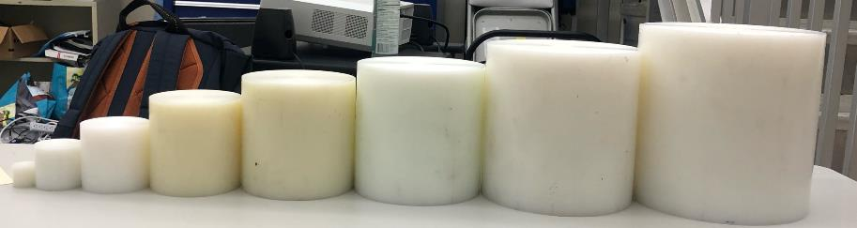
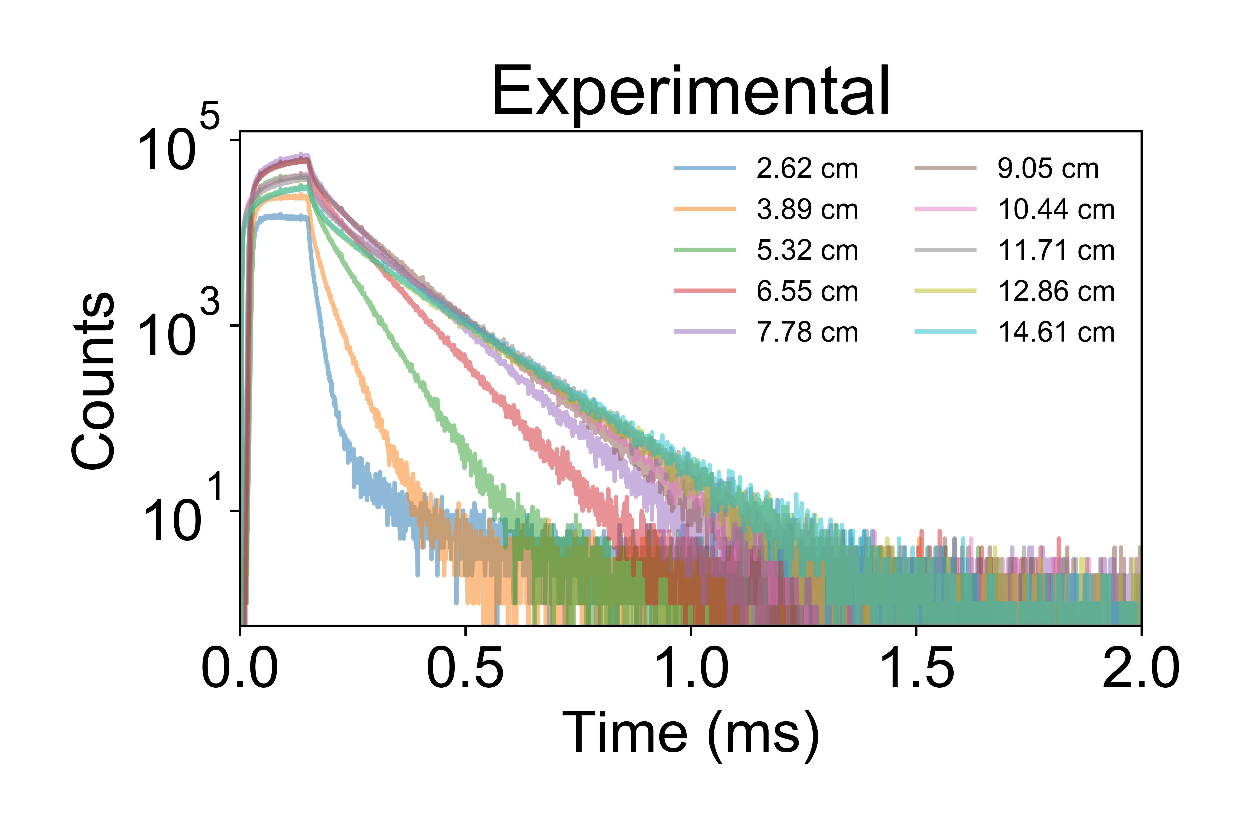
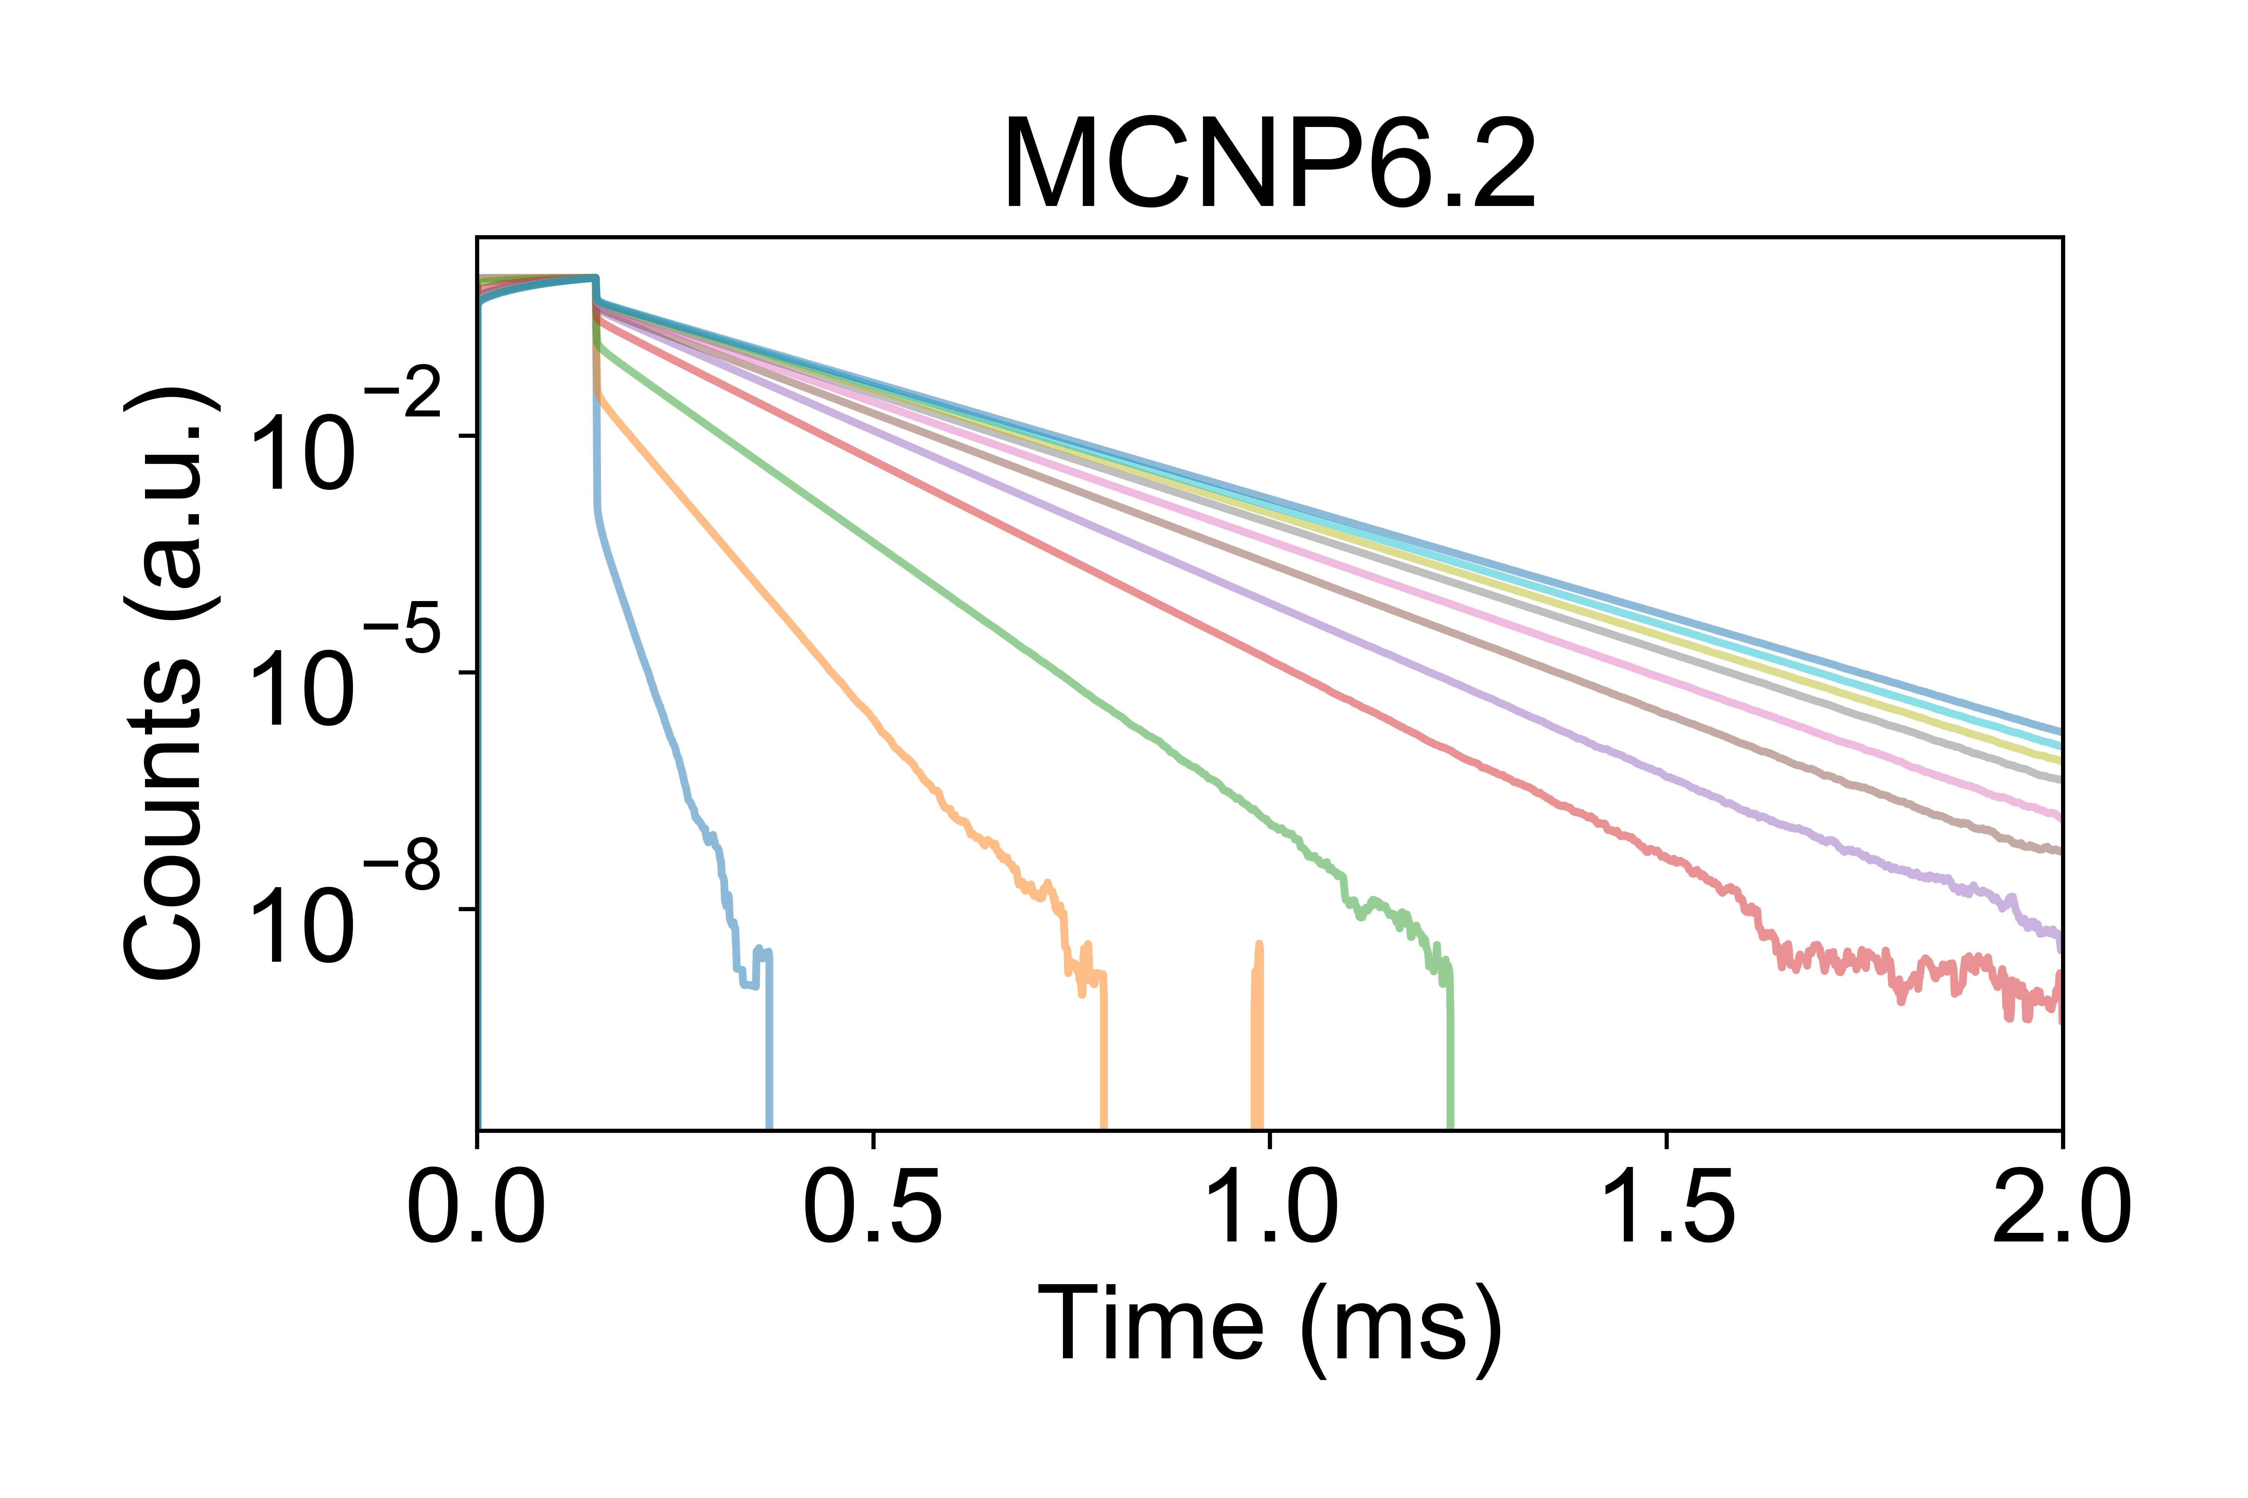
HDPE Die-Away Curves
Figure: HDPE cylinders used in PNDA experiment

Slide 14
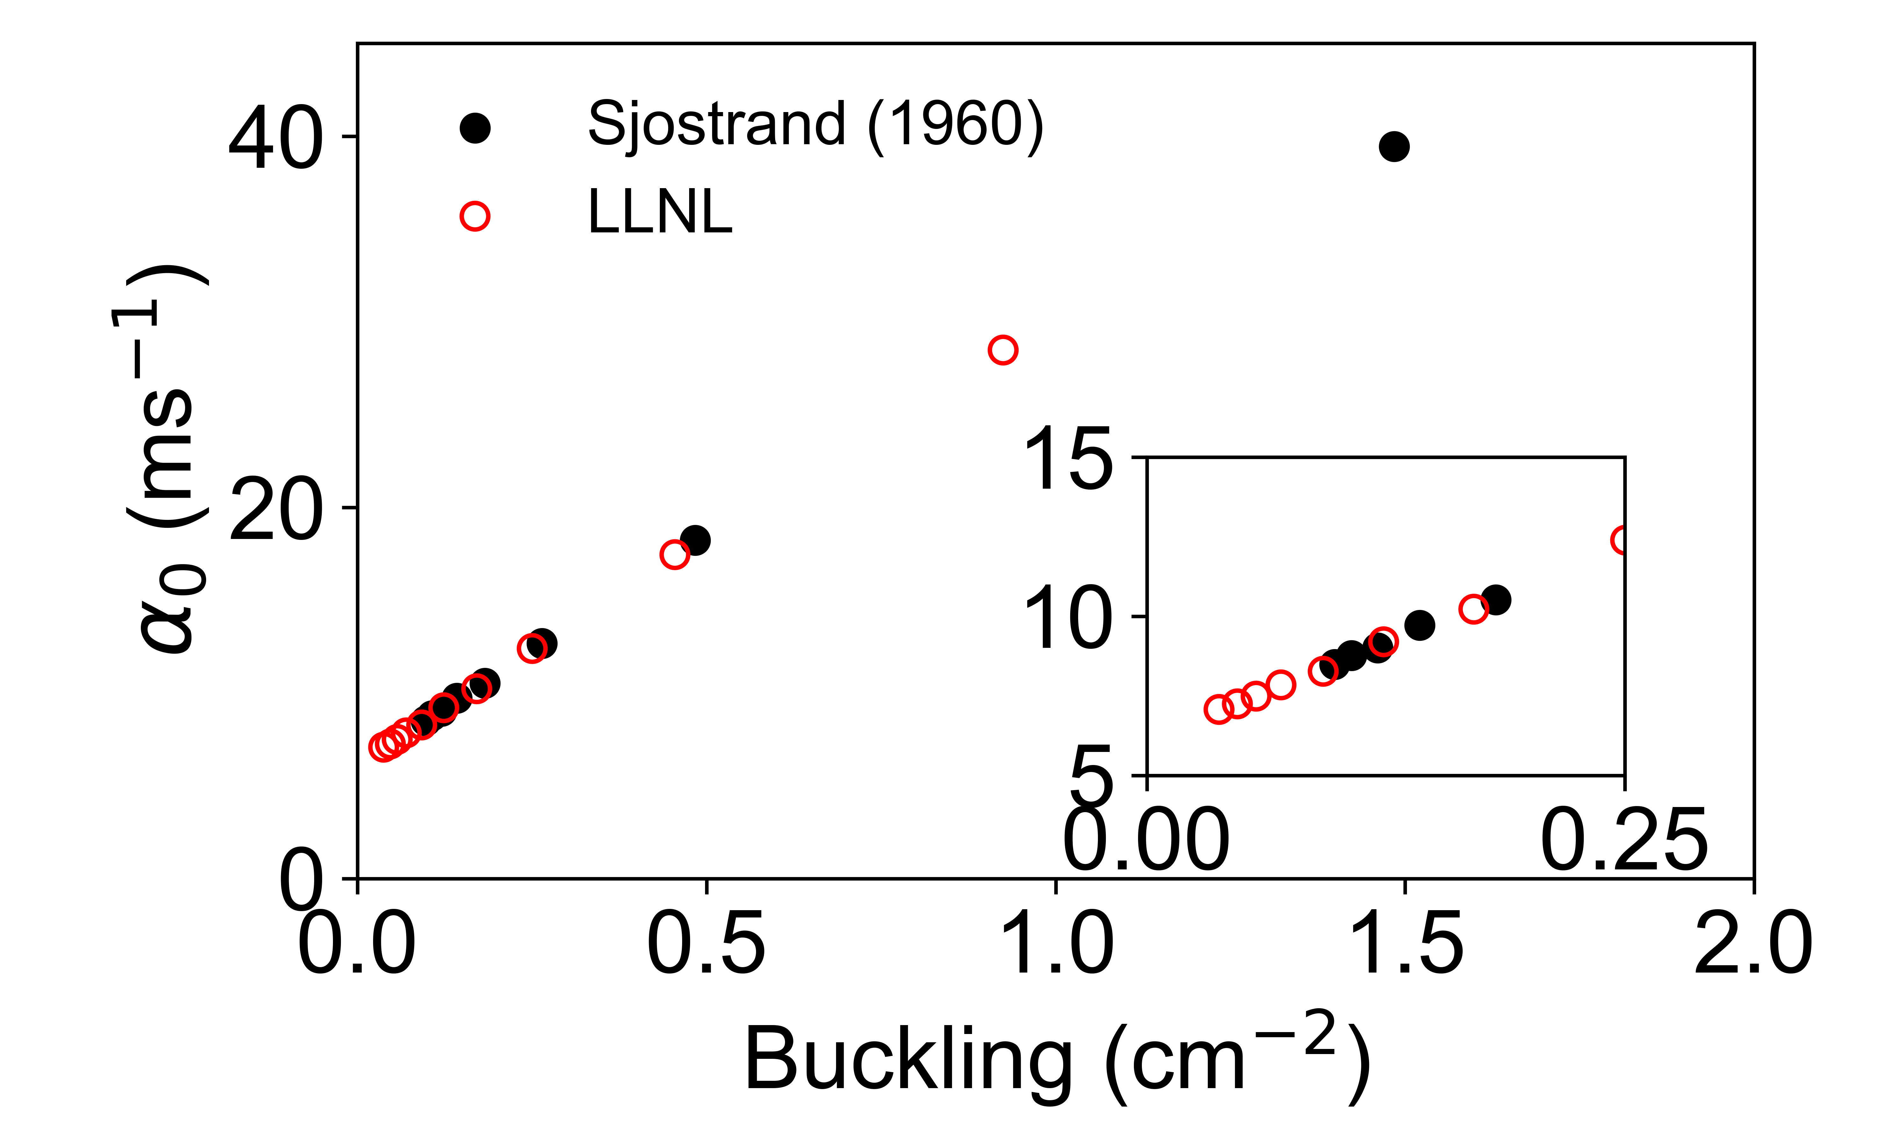
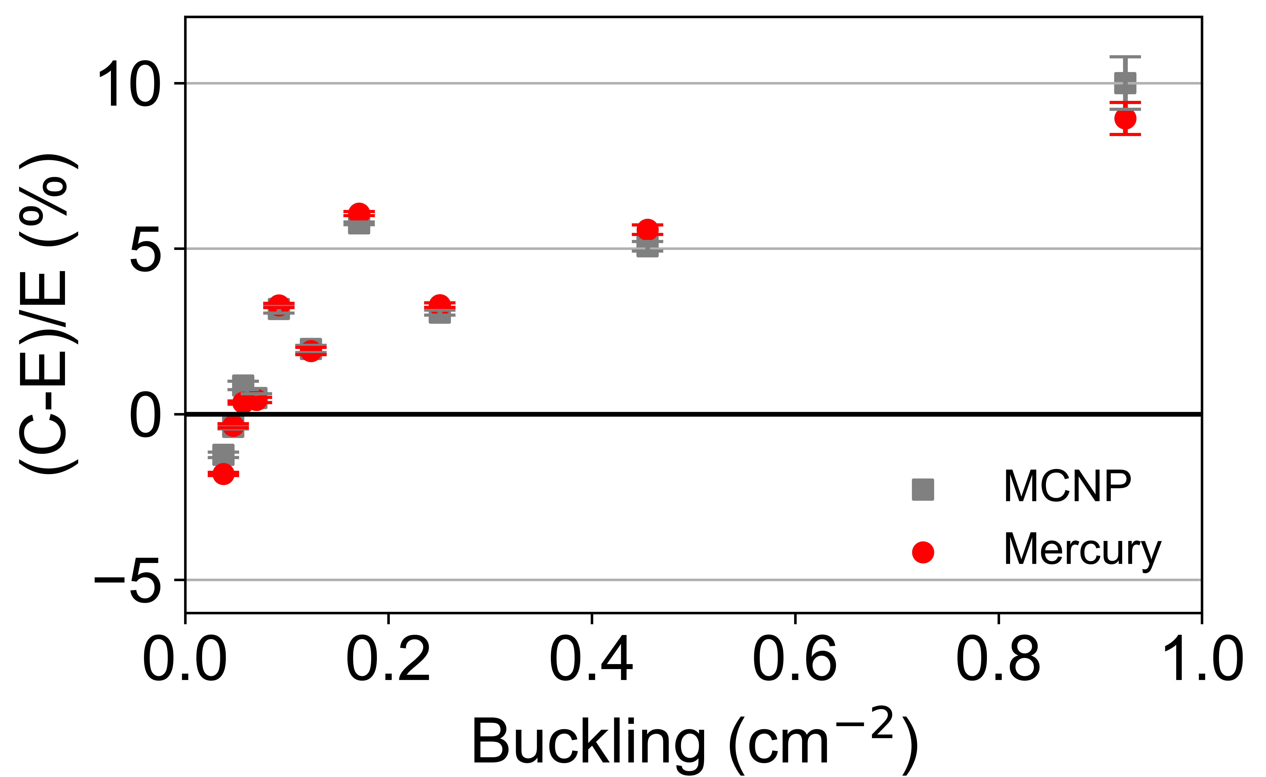
First HDPE Validation
General trend of increasing bias with smaller sampler size (larger buckling)

Slide 15
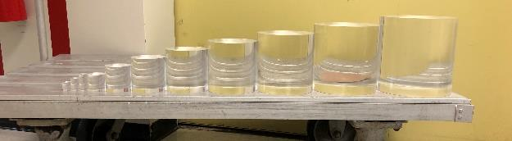
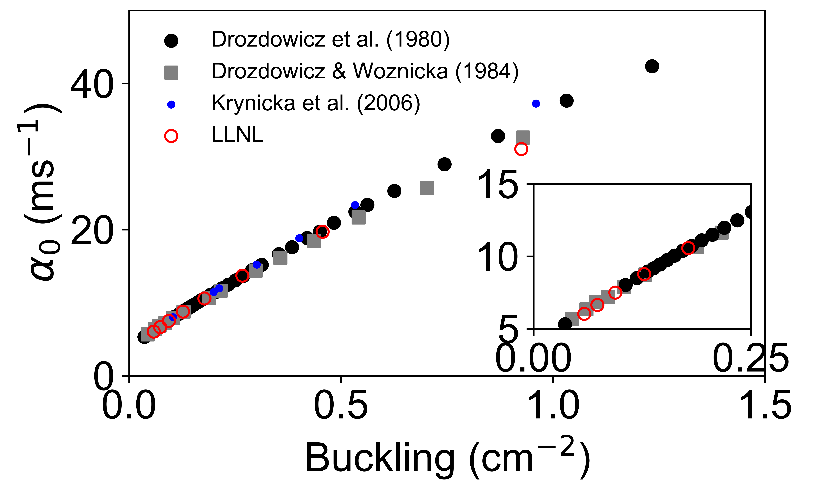
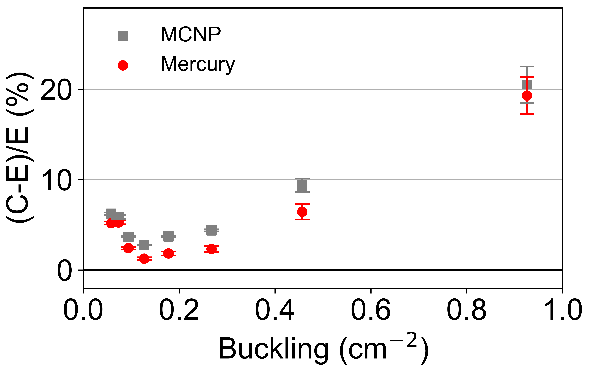
Lucite Results
Polymethyl Methacrylate
Drozdowicz, Krzysztof, et al. "Thermal neutron diffusion parameters for plexiglass." Nuclear Instruments and Methods 178.2-3 (1980): 513-516.
Krynicka, Ewa, et al. Nuclear Instruments and Methods in Physics Research Section B: Beam Interactions with Materials and Atoms 251.1 (2006): 19-26.

Slide 16
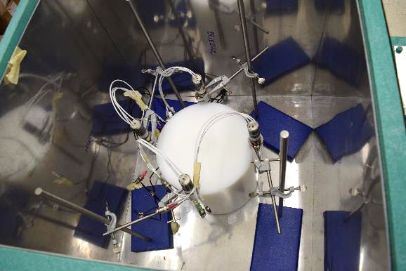
Planned Experiments & Timeline
2022/2023:
  Benchmark evaluation
  Measurements with other moderators
Benchmark uncertainty quantification especially missing mass spectrometry
October 2023: Benchmark submission to ICSBEP
2023 moderators:
  Light water, heavy water, motor oil
2024 moderators:
  Beryllium, other plastics
Figure: Measurement with HDPE.

Slide 17
Questions, Comments, Discussion
References:
  G. von Dardel and N. G. Sjostrand, "Diffusion Parameters of Thermal Neutrons in Water," Physical Review, vol. 96, no. 5, pp. 1245-1249, 1954.
  J. Holmes, M. Zerkle and D. Heinrichs, "Benchmarking a first-principles thermal neutron scattering law for water ice with a diffusion experiment," EPJ Web of Conferences, vol. 146, p. 13004, 2017.
  J. Holmes, M. Zerkle and A. Hawari, "Validation of Thermal Scattering Laws for Light Water at Elevated Temperatures with Diffusion Experiments," in PHYSOR 2020: Transition to a Scalable Nuclear Future, Cambridge, United Kingdom, 2020.
  D. Siefman, E. Heckmaier, W. Zwyiec, D. Heinrichs, “IER-501 CED-1: Preliminary Design of a New Pulsed-Neutron Die-­Away Experimental Testbed for Thermal Scattering Law Benchmarks (PNDA),” Lawrence Livermore National Laboratory, LLNL-TR-820718, 2021

Slide 18
Disclaimer
This document was prepared as an account of work sponsored by an agency of the United States government. Neither the United States government nor Lawrence Livermore National Security, LLC, nor any of their employees makes any warranty, expressed or implied, or assumes any legal liability or responsibility for the accuracy, completeness, or usefulness of any information, apparatus, product, or process disclosed, or represents that its use would not infringe privately owned rights. Reference herein to any specific commercial product, process, or service by trade name, trademark, manufacturer, or otherwise does not necessarily constitute or imply its endorsement, recommendation, or favoring by the United States government or Lawrence Livermore National Security, LLC. The views and opinions of authors expressed herein do not necessarily state or reflect those of the United States government or Lawrence Livermore National Security, LLC, and shall not be used for advertising or product endorsement purposes.

Slide 19

Interpretation of Results
Need to select data to include in the fit
Too early data:
  Flux is not fully thermalized or in fundamental spatial mode
Too late data:
  Noisy (room return) and larger uncertainty in α
Too early
N
Analyzed Time Interval
Fixed Delay Time
Variable Delay Time
Too late
$$φ_{fit}\left(t\right)= φ_{0}\exp\left(−αt\right)+R$$
0
t
Figure: Position of the analyzed time interval
$$χ^{2}=\sum_{i}{\frac{{\left(φ_{data}^{\left(i\right)}−φ_{fit}^{\left(i\right)}\right)}^{2}}{σ_{data}^{2}} }$$

Slide 20
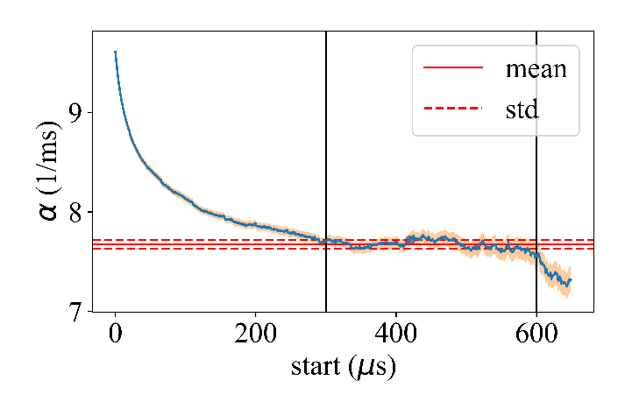
Fit Convergence
Fitted α plateaus when using data interval in fundamental mode.
  Too early data lead to overestimation
  Too late data lead to underestimation
Error propagation from fit and from population statistics in plateau
Figure: Convergence of integral parameter over fit intervals

Slide 21
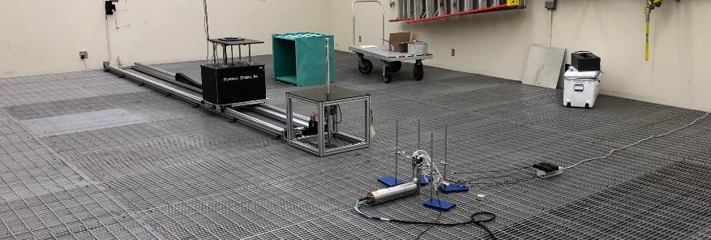
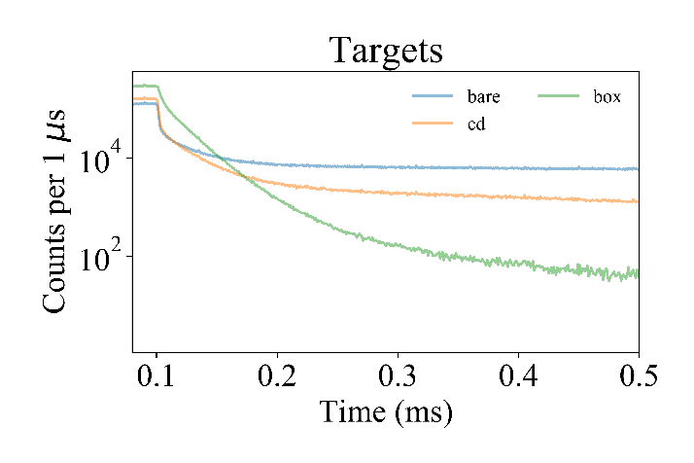
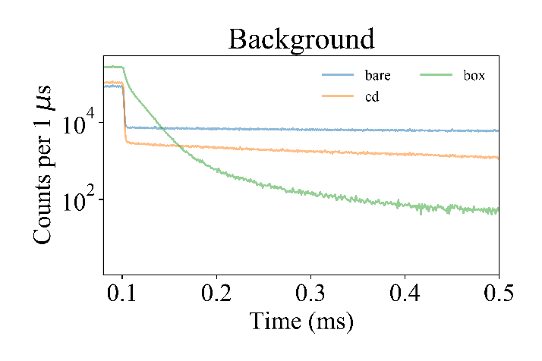
Effect of Shielding Box
Measurements in Low-Scatter Facility
Room Return

Slide 22
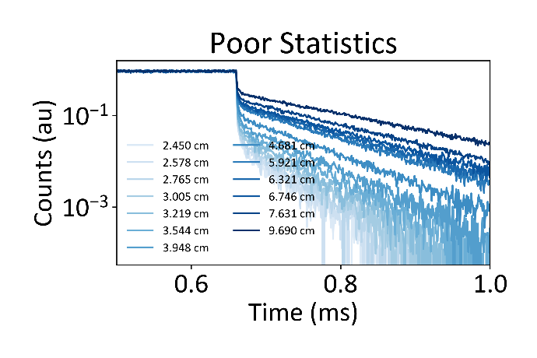
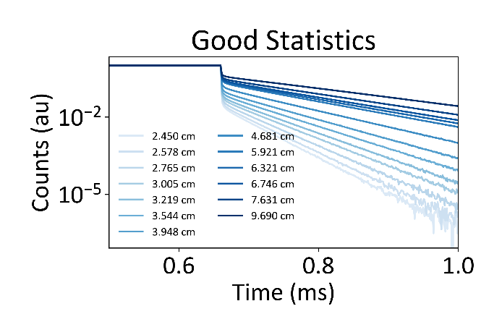

Small Targets vs. Statistics
Small targets desirable for sensitivity to TSLs
They quickly leak neutrons, leading to poor detector statistics and poor fit of exponential decay
$$φ_{fit}\left(t\right)= φ_{0}\exp\left(−αt\right)+R$$
$$χ^{2}=\sum_{i}{{\left(φ_{data}^{\left(i\right)}−φ_{fit}^{\left(i\right)}\right)}^{2} }$$
Room Return
Figure: Statistical effects on die away curves with varying target sizes
Notes:
Small targets have neutrons leak away more quickly, leading to noisier curves. The noisier curves are harder to fit and exponential to, creating more uncertainty in the data. Can observe the rate of decay, alpha, is smaller for bigger samples (dark blue).

Slide 23
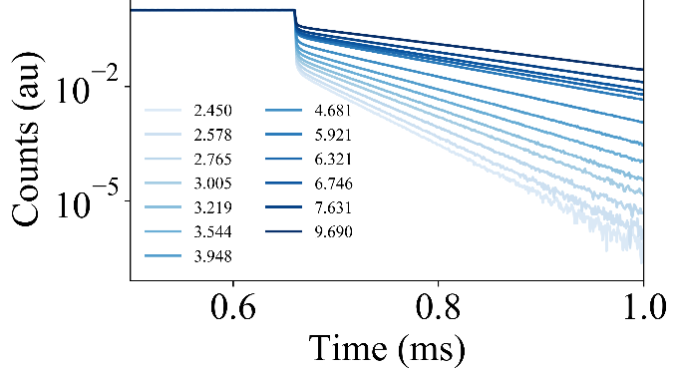
Biases
Table: Experimental and calculated integral parameters.
Radius (cm) | Mean C (ms⁻¹) | E (ms⁻¹) | (C-E)/E (%)
2.45 | 32.78 | 34.5 | -5.08
2.58 | 30.65 | 33.2 | -7.59
2.77 | 27.84 | 30.2 | -7.90
3.01 | 25.05 | 26.4 | -5.26
3.22 | 22.95 | 23.4 | -2.09
3.54 | 20.39 | 20.9 | -2.24
3.95 | 17.99 | 18.3 | -1.58
4.68 | 15.08 | 14.4 | 4.46
5.92 | 12.03 | 11.4 | 5.86
6.32 | 11.29 | 10.9 | 3.14
6.75 | 10.70 | 10.3 | 3.40
7.63 | 9.72 | 9.4 | 3.50
9.69 | 7.59 | 8.3 | -8.62
Figure: Calculated pulsed neutron die away curves.

Slide 24
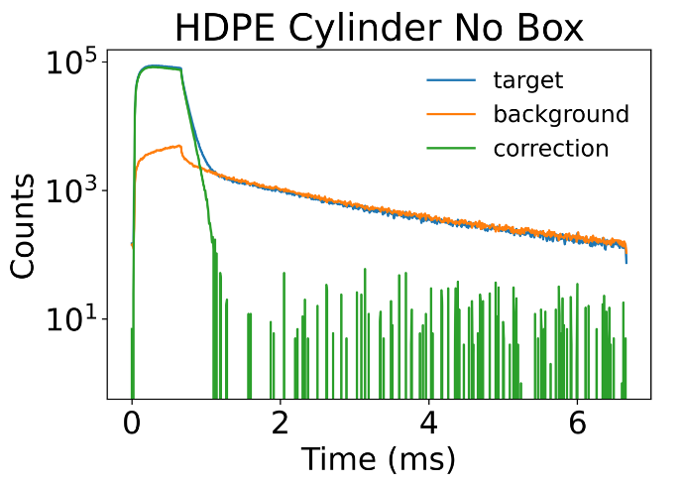
Importance of background
Measurements outside of borated HDPE box with Cd lining
After about ~1 ms, we see dominant background.
The time dependent background makes rough sense with thermal neutrons returning from the walls or floor as it starts at around ~1 ms.
If the neutrons’ velocity is 2200 m/s, and the walls are roughly 1-2 m away, we should be measuring them returning after ~1 ms.

Slide 25
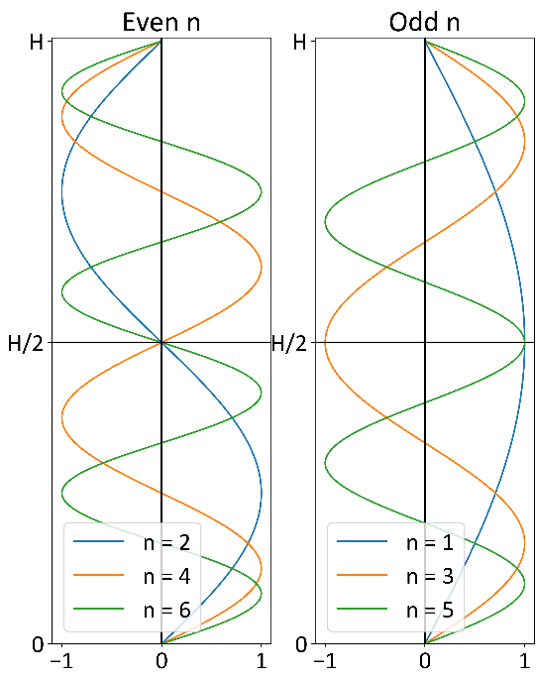
Approaches to Improve Statistics
For Cylindrical Geometry
Maximize difference between fundamental and higher order modes
Detector location
  All modes except J₀ have 0-amplitude at r = 0
Source orientation
  For cylinders, neutrons strike at H/2
  Eliminates even ordered modes of sin(nzπ/H)
  Maximizes flux along vertical axis
Target dimensions
  H/D = 0.894
  Balances (0,2,1) and (0,1,3)
Repeat measurements
  Pulse neutrons, allow for decay, repeat pulse
  Target size determines time for decay
Figure: Even and odd modes of sin(nzπ/H)
Notes:
By placing the source on the central plane, i.e . , at z = H/2, all modes are eliminated which have a node at H/2 since symmetry requires an equal number of neutron above and below this plane. That i s , all modes for which sin(nHπ/H2) are eliminated by symmetry. sin(nπ/2)for n = 2,4,6, e t c .

Slide 26
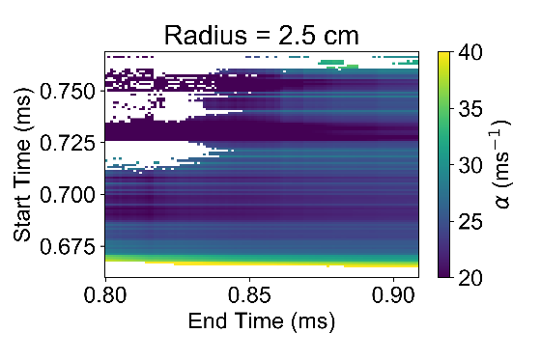
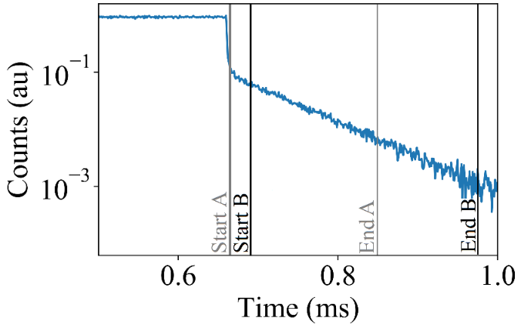
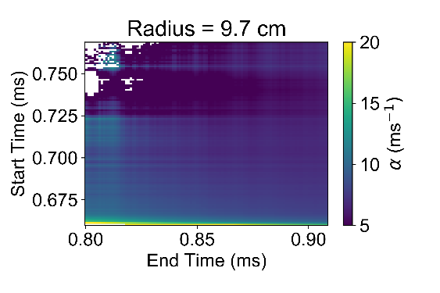
Effect of Target Size on Fit
Different Sized H₂O Cylinders
Figure: Example varying time intervals
Figure: Effect of varying time intervals on analyzed α
Notes:
Presents the challenge of selecting the data to include in the fit for two different cylinders from the previous analysis: at radii of 2.405 cm and 9.690 cm. The α values were calculated for every possible combination of start and end times from when the pulse ended to the end of the MCNP tally. At certain combinations of start and end times, the non-linear least-squares fitting algorithm did not converge and an α value could not be estimated. These occurrences are shown as white regions and happen when the start and end times are too close together and not enough data is included in the fit. Too early start times can also be seen in as yellow regions where the α values are over-estimated.
How noise affects the estimated α is apparent when comparing the estimated α values from a cylinder with a radius of 2.405 cm. The α values were extremely sensitive to the data that were selected, and very large fluctuations appeared. For that same target with better statistics (the tally on the cylinder surface) the α values had much better more stable behavior and more confident results could be found no matter the bounds of data used in the fit. The larger target with a radius of 9.690 cm had much less noise than the smaller target when the detector tally was used. This allowed for more consistent α values to be estimated across the possible data ranges used in the fit. The practical implication of this result is that while small targets may be ideal for having a large sensitivity to TSLs, at too small sizes the measured counts may have too much noise for the experimental analysis to be of high-quality.

Slide 27
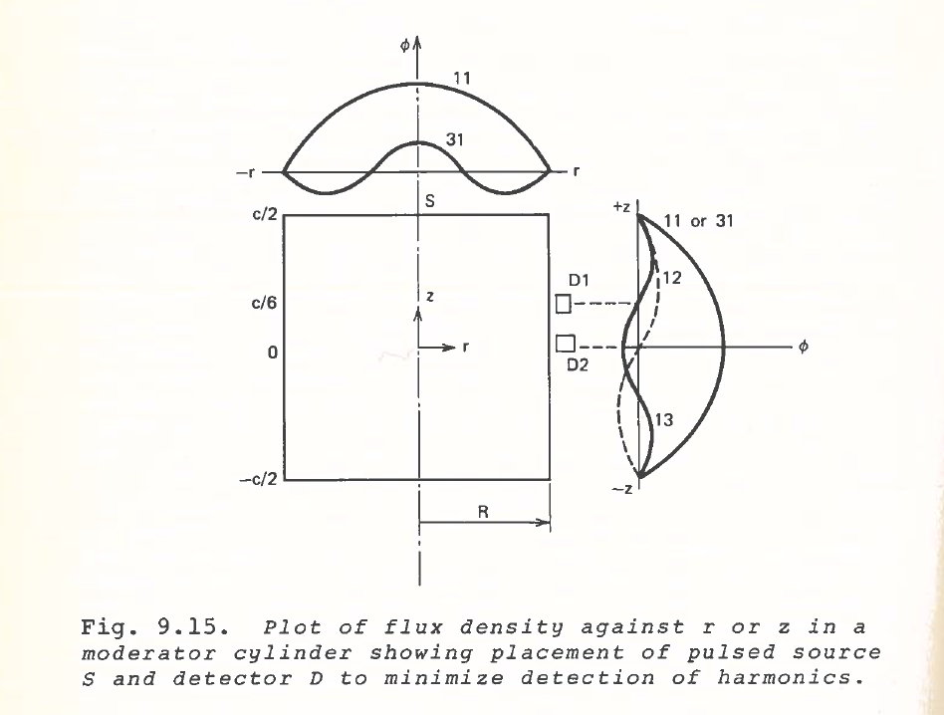
Detector placement vs. harmonics

Slide 28
Algorithm
Neutron counts and generator trigger recorded as list mode data
Few counts per pulse, but many pulses allows to reconstruct die away curve
Trigger is initiating event, t_{trigger}
Sum counts in bins on die away curve as t_{tag} – t_{trigger} in histogram
Pulse Trigger
period
counts
time

Slide 29
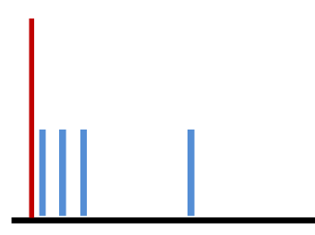
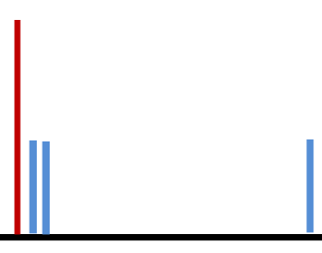
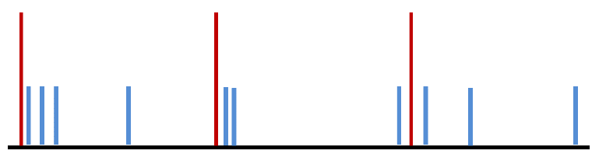
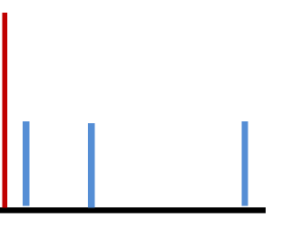
Algorithm: Sum pulse counts to construct curve
+
+

