Slide 1
Texas A&M University US Nuclear Data Program
TAMU NSDD CENTER
Medical Radioisotopes Production Studies:
⁶⁷Cu Case
N. Nica

Slide 2
Texas A&M Evaluation Center Rationale for Medical Isotopes Production: The case of ⁶⁷Cu
Medical radionuclides: central in nuclear medicine in the fields of diagnostic imaging and radioimmunotherapy (RIT):
Low-range highly ionizing radiation: β⁻, α particles, Auger or conversion electrons
New β− emitters of interest: ⁴⁷Sc (T_{1/2}=3.4 d), ⁶⁷Cu (T_{1/2}=2.6 d), ¹⁰⁵Rh (T_{1/2}=1.5 d), ¹⁶¹Tb (T_{1/2}=6.9 d), ¹⁸⁶Re (T_{1/2}=3.7 d)
⁶⁷Cu case:
Trace element copper takes part in basic biochemical processes
Can be linked to biologically important molecules as antibodies, proteins, etc.
Theranostic pairs: ⁶⁷Cu can work in conjunction with same type of radiopharmaceuticals as ⁶⁴Cu (T_{1/2}=12.7 h) or ⁶¹Cu (T_{1/2}=3.3 h)
β⁻ decay (E_{max}=577 keV); γ radiation of 185 keV (48.7%), 93 keV (16%) and 91 keV (7%).
Single-photon emission computed tomography (SPECT) : imaging the radiotracer distribution (with existing technology for the 140 keV γ rays of ^{99m}Tc)
⁶⁷Cu offers the possibility of SPECT imaging and treatment of smaller size tumors (up to 4 mm)
Main factor limiting wider preclinical and clinical use: limited availability

Slide 3
Texas A&M Evaluation Center The case of ⁶⁷Cu: Production matters
Last about 50 years: nuclear reactors
New methods based on: particle accelerators
⁶⁸Zn(p,2p)⁶⁷Cu, Ep=70–100 MeV; ⁷⁰Zn(p,α)⁶⁷Cu; ⁷⁰Zn(d,αn)⁶⁷Cu; ^{nat}Zn(d,x)⁶⁷Cu, ⁶⁴Ni(α,p)⁶⁷Cu
Accelerator-produced neutrons
Photonuclear reactions using bremsstrahlung photons from high-intensity electron linacs
New: isotope harvesting in projectile fragmentation (e.g. stopped in aqueous solutions)
All: ⁶⁷Cu produced inside expensive target materials which should be processed for separating ⁶⁷Cu and recycling the target materials
Innovative approach & advantages: Inverse-kinematics nuclear reactions
Reaction products are strongly focused along the beam direction and can relatively easily be collected for immediate use.
Use low energy beam tuned to maximize ⁶⁷Cu but reduce impurities.
Collect almost pure ⁶⁷Cu in a catcher and use it with radiochemical minimum processing

Slide 4
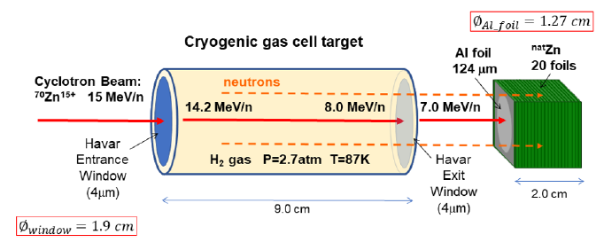
Texas A&M Evaluation Center Expanded Involvement in Applied Measurements for Medical Isotopes Production by Inverse Kinematics
Theme: Research for Medical Isotopes Production by Inverse Kinematics
Innovative method for the production of important medical radioisotopes based on the nuclear reaction in inverse kinematics, by:
Directing a heavy ion beam of appropriate energy on a light target (e.g., H, d, He) and
Collecting the isotope of interest on an appropriate catcher after the target.

Slide 5
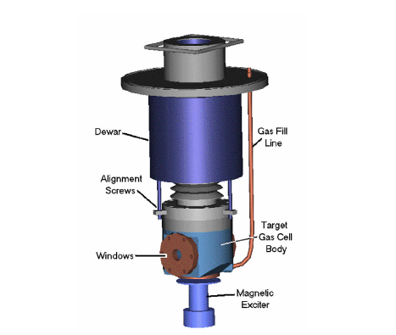
Texas A&M Evaluation Center The case of ⁶⁷Cu: Cryogenic gas target cell
Important asset: Cryogenic gas target cell

Slide 6
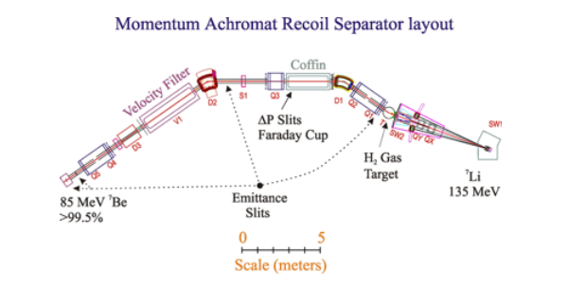
Texas A&M Evaluation Center The case of ⁶⁷Cu: MARS Spectrometer
Important asset: MARS spectrometer to be used for beam and reaction products diagnostics

Slide 7
Texas A&M Evaluation Center The case of ⁶⁷Cu: Irradiation
Beam:
6.5 h with a beam current of 0.19(5) pnA
Average equilibrium charge (LISE++): 26+
Two Faraday cups: before the gas cell and after same ladder as catcher
Suppression test run with ²¹Ne beam, 28 MeV/nucleon, 40% reduction

Slide 8
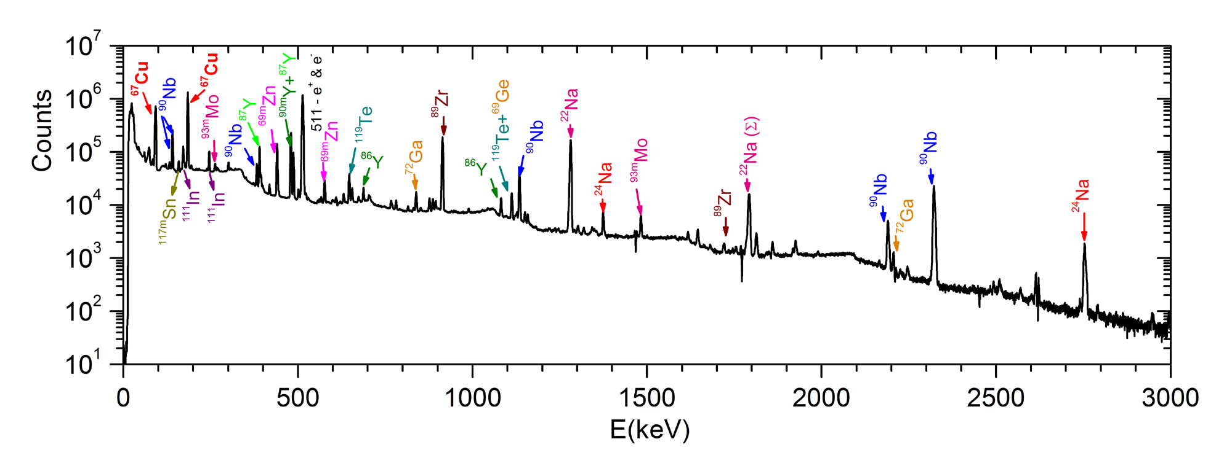
Texas A&M Evaluation Center The case of ⁶⁷Cu: Off-line γ-spectra measurement
Cooling time: 36.5 h
Catcher foil placed at 17.2(10) mm in front of HPGe γ detector, 2-3% dead time
¹⁵²Eu energy calibration
Absolute efficiency calibration done with GEANT4 and EGSnrc codes: 10% unc
Spectra acquired for 67.3 h, background-subtracted

Slide 9
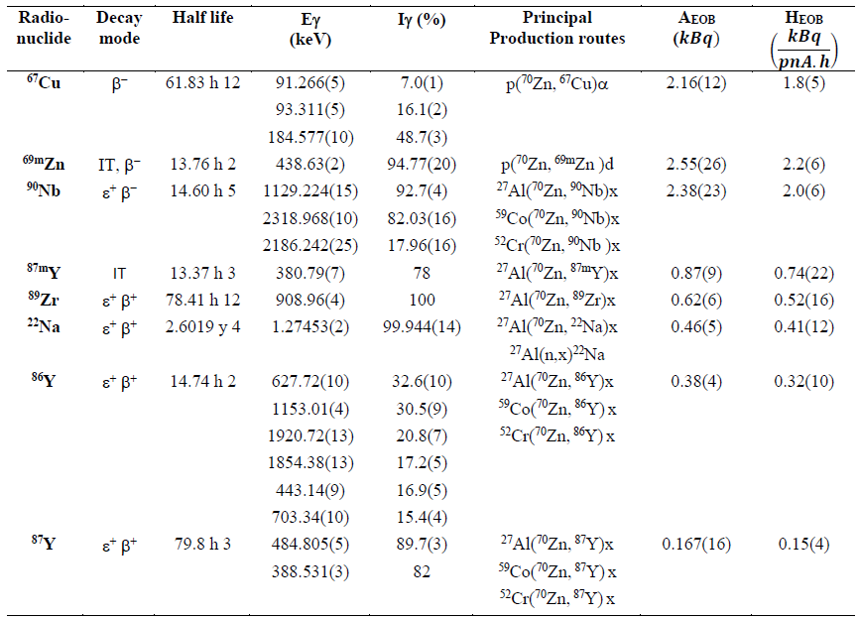
Texas A&M Evaluation Center The case of ⁶⁷Cu: Activities

Slide 10
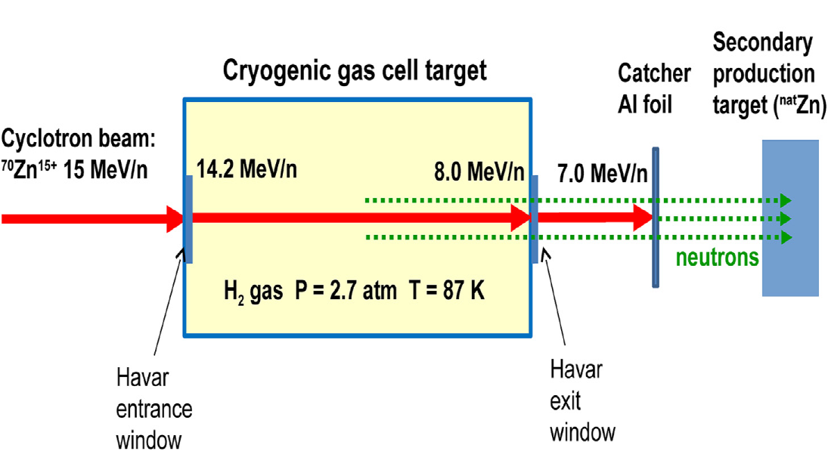
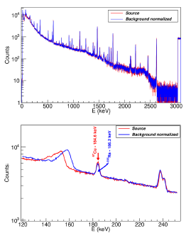
Texas A&M Evaluation Center The case of ⁶⁷Cu: Use of neutrons
Block of ^{nat}Zn 25.4×25.4×20 mm³ activated with neutrons;
Measured for 40 h starting 7.5 days after the 6.5 h beam irradiation
TALYS simulation: 1.6 neutron/reaction act on average mainly from ⁶⁷Zn(n,p)⁶⁷Cu reaction
Exerimental result: 5.3(8) Bq of ⁶⁷Cu (end of irradiation)
Still to correct for neutron ang. distribution (2% n flux collected), γ attenuation in the source (about 50%) and ⁶⁷Zn natural abundance (4.04%)

Slide 11
Texas A&M Evaluation Center The case of ⁶⁷Cu: Conclusions
Advantages of inverse kinematics and setup
Enhanced isotope collection at forward angles and easier harvesting and use of ⁶⁷Cu.
Advantage of minimizing expensive ⁷⁰Zn isotope (0.6% natural abundance) at mg/day rate as projectile instead of g/day as source (plus radiochemistry & recycling).
Minimize the production of radioimpurities arising from the main reaction by choosing the appropriate reaction channel and the subsequent cooling time of the products.
Entrance Havar Window (Co, Cr, Ni, W, etc.) :
Peripheral or semiperipheral (deep-inelastic) collisions have rather wide angular distributions and are expected to mostly miss the catcher foil
Products of complete or nearly complete fusion are forward-focused but are heavier and slower than the beam and may mostly stop in the gas.
Exit Havar Window & Catcher:
Adjust gas cell parameters (pressure, temperature, length) in order that primary beam reaches this Window & Catcher near or below the Coulomb barrier of the relevant reactions (e.g., 3.5-4.0 MeV/nucleon).
For Catcher one can use water or other material (salt, sugar, etc.) in order to collect the radioisotopes in a convenient chemical form for further processing.

Slide 12
Texas A&M Evaluation Center The case of ⁶⁷Cu: Conclusions
Advantages of inverse kinematics and setup
1 particle μA beam can produce mCi’s of ⁶⁷Cu per 24 h of irradiation.
stable isotopes (⁷⁰Zn, ⁶⁹Ga, etc) implanted in the catcher should be produced at biochemically insignificant quantities
Use cooled windows, lower pressure (1.0-1.5 atm), increase length, lower temperature (with cryo-coolers)
Can use liquid H₂ targets (1-2 mm for 8-10 mg/cm²) at 20 K (with Gifford-McMahon refrigerator)
Cyclotron Institute at TAMU, the facility houses two cyclotrons:
K150 cyclotron which can produce high-intensity heavy-ion beams (up to around Kr) with energies up to around 12–15 MeV/nucleon, suitable for the production of relatively large activities of radioisotopes
K500 cyclotron, employed in the present experiment, which can produce lower currents of heavy-ion beams (up to U) and in a broader energy range (up to 20–40 MeV/nucleon depending on the isotope).
Both the K150 and the K500 cyclotrons may be successfully used for the development and production of a variety of non-standard radioisotopes at activities appropriate for medical studies on small animals.

