Slide 1
A brief comparison of USNDP (& Canada) effort circa 2001 vs 2021
J.H. Kelley

Slide 2
2000 Nuclear Data Sheets published articles
FY2000
Nuclear Data sheets for A=163 Balraj Singh, A.R. Farhan
Nuclear Data sheets for A=107 J. Blachot
Nuclear Data Sheets for A=119 Ohya, Kitao
Nuclear Data sheets for A=110 DeFrenne, Jacobs
Nuclear Data sheets for A=142 Tuli
Nuclear Data sheets for A=148 Bhat
Nuclear Data sheets for A=52 Junde
Nuclear Data sheets for A=121 Tamura
Nuclear Data sheets for A=69 Bhat, Tuli
Nuclear Data sheets for A=267-293 Firestone, Gilat
Nuclear Data sheets for A=167 Baglin
Nuclear Data sheets for A=161 Reich, Helmer
Nuclear Data sheets for A=46 Wu
Nuclear Data sheets for 183Hg Baglin
Nuclear Data sheets for A=108 Blachot
Nuclear Data sheets for 156Er Reich
Nuclear Data sheets for A=62 Junde, Balraj Singh
Nuclear Data sheets for A=92 Baglin
US: 7+(267-293) A-chains, 2 nuclides
Canada: 1 A-chains
International: 7 A-chains

Slide 3
2001 Nuclear Data Sheets published articles
FY2001
Nuclear Data sheets for A=42 Balraj Singh, J. Cameron
Nuclear Data sheets for A=63 Erjun, Junde
Nuclear Data Sheets for 97Pd Hu
Nuclear Data sheets for A=141 Tuli, Winchell
Nuclear Data sheets for 143Tb Balraj Singh
Nuclear Data sheets for 143Dy Balraj Singh
Nuclear Data sheets for A=116 Blachot
Nuclear Data sheets for A=139 Burrows
Nuclear Data sheets for A=43 Cameron, Balraj Singh
Nuclear Data sheets for A=83 Wu
Nuclear Data sheets for 99Tc Tuli, Reed, Balraj Singh
Nuclear Data sheets for A=130 Balraj Singh
Nuclear Data sheets for A=164 Balraj Singh
Nuclear Data sheets for A=103 DeFrenne, Jacobs
Nuclear Data sheets for A=144 Sonzogni
Nuclear Data sheets for A=215, 219,223,227,231 Browne
Nuclear Data sheets for A=86 Balraj Singh
Nuclear Data sheets for A=250,254,258,262,266 Akovali
Nuclear Data sheets for A=128 Kanbe, Kitao
Nuclear Data sheets for 199Pb Balraj Singh, Reed
Nuclear Data sheets for A=41 Cameron, Balraj Singh
Nuclear Data sheets for A=143 Tuli
US: 15 A-chains, 1 nuclide
Canada: 6 A-chains, 3 nuclides
International: 5 A-chains
2000 US: 7+(267-293) A-chains, 2 nuclides
2001 US: 15 A-chains, 1 nuclide
US Average seems around 15/year
2000 Canada: 1 A-chains
2001 Canada 6 A-chains, 3 nuclides
Canada Average is around 4/year
International Average is 6/year

Slide 4
FY20-FY21 Nuclear Data Sheets published articles (fruits of heavy labor)
FY2020
Nuclear Data sheets for A=105 S. Lalkovski, J. Timar, Z. Elekes
Nuclear Data sheets for A=98 Jun Chen, Balraj Singh
Nuclear Data Sheets for A=90 S.K. Basu, E.A. McCutchan
Nuclear Data sheets for A=205 F.G. Kondev
Nuclear Data sheets for A=212 K. Auranen, E.A. McCutchan
FY2021
Nuclear Data Sheets for A=190 Balraj Singh, Jun Chen
Nuclear Data Sheets for A=153 Ninel Nica
Nuclear Data Sheets for A=233 Balraj Singh, J.K. Tuli, E. Browne
Nuclear Data Sheets for A=23 M.S. Basunia, Anagha Chakraborty
Nuclear Data Sheets for A=100 Balraj Singh
Nuclear Data Sheets for A=252 A.M. Mattera, S. Zhu, A.B. Hayes, E.A. McCutchan
Nuclear Data Sheets for A=123 Jun Chen
Nuclear Data Sheets for A=214 S. Zhu, E.A. McCutchan
Nuclear Data Sheets for A=219 Balraj Singh, Gopal Mukherjee, S.K.Basu, Srijit Bhattacharya,
Sude Bhattachary, A.Chakraborti, A.K.De, R.Gowrishankar,
A.K.Jain, Sushil Kumar, Sukhjeet Singh
US: 4 A-chains
International: 1 A-chains
US: 5 A-chains
Canada: 3 A-chains
International: 1 A-chains

Slide 5
Comparison of productivity
2000 US: 7+(267-293) A-chains, 2 nuclides
2001 US: 15 A-chains, 1 nuclide
US Average seems around 15/year
2000 Canada: 1 A-chains
2001 Canada 6 A-chains, 3 nuclides
Canada Average is around 4/year
International Average is 6/year
2020 US: 4 A-chains
2021 US: 5 A-chains
US Average seems around 5/year
2021 Canada 3 A-chains
Canada Average is around 2/year
International Average is ~1 /year
US Productivity is down by a factor of 3 since 2000/1

Slide 6
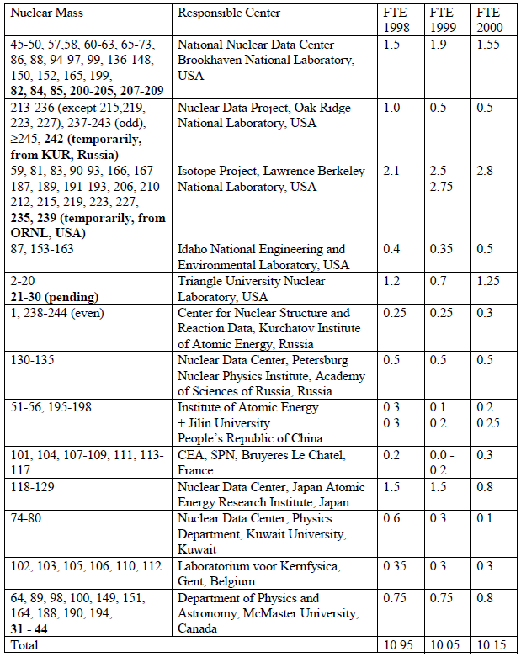
NDS 2000-01 NDS contributors
US/BNL: Bhat, Burrows, Sonzogni, Tuli
US/NDP: Akovali, (Martin)
US/Isotopes:Basunia, Baglin, Browne, Firestone, Wu (joint w/China)
US/INEL: Helmer, Reich
US/TUNL: Kelley, Tilley, (Weller)
ANL: Kondev
McMaster: J. Cameron, Balraj Singh
US FTE=6.6 FTE (+0.8 McMaster)

Slide 7
ENSDF/NDS 2020 or 2021 ENSDF/NDS contributors (FTE from FY2021 report)
NNDC: Auranen, Hayes, Mattera, McMcCutchan, Zhu (1.32+0.53(Balraj))
ORNL: Nesaraja, (1+0.15 (Martin))
LBNL: Basunia (0.85+0.625 (Tuli, Brown, ?)
TUNL: Kelley, (0.6+0.35(Sheu,Purcell))
ANL: Kondev (0.4 FTE)
MSU: Jun Chen (0.65 FTE)
Texas A&M: Nica (1 FTE)
USNDP Retired contributors: Browne, Tuli, Balraj Singh, Purcell
Total FTE=7.5

Slide 8
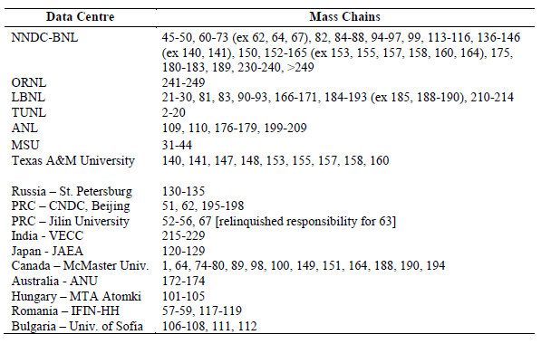
Commitments

Slide 9
Comparing US (&Canada) personnel
US/BNL: Tuli,
Burrows
Sonzogni
Bhat
US/NDP: Akovali, (Martin)
US/Isotopes: Basunia,
Baglin,
Browne,
Firestone,
Wu (joint w/China)
US/INEL: Helmer,
Reich
US/TUNL: Kelley, Tilley, (Weller)
ANL: Kondev
McMaster: J. Cameron, Balraj Singh
US/BNL: McCutchan,
Mattera,
Hayes,
Zhu,
Balraj Singh (ret.)
US/NDP: Nesaraja, (Martin ret.)
BAND: Basunia,
Tuli (ret.)
(Batchelder),
(Hurst)
Texas: Nica
ANL: Kondev
US/TUNL: Kelley, Sheu
MSU: Jun Chen
Total FTE=7.4
Total FTE=7.5

Slide 10
It is difficult to explain the drop in US productivity since supported effort remains nearly flat

Slide 11
ENSDF/NDS 2020 or 2021 ENSDF/NDS contributors
NNDC: Auranen, Hayes, Mattera, McMcCutchan, Zhu
ORNL: Nesaraja
LBNL: Basunia
TUNL: Kelley, Sheu
ANL: Kondev
MSU: Jun Chen
Texas A&M: Nica
USNDP Retired contributors: Browne, Tuli, Balraj Singh, Purcell

