Slide 1
Evaluation activities of the Bucharest NSDD Centre
Horia Hulubei National Institute for R&D in Physics and Nuclear Engineering
April 2022
A. Negret and Sorin Pascu

Slide 2
Table of contents
01
Current situation and activities
02
Future plans
03
The SANDA Project

Slide 3
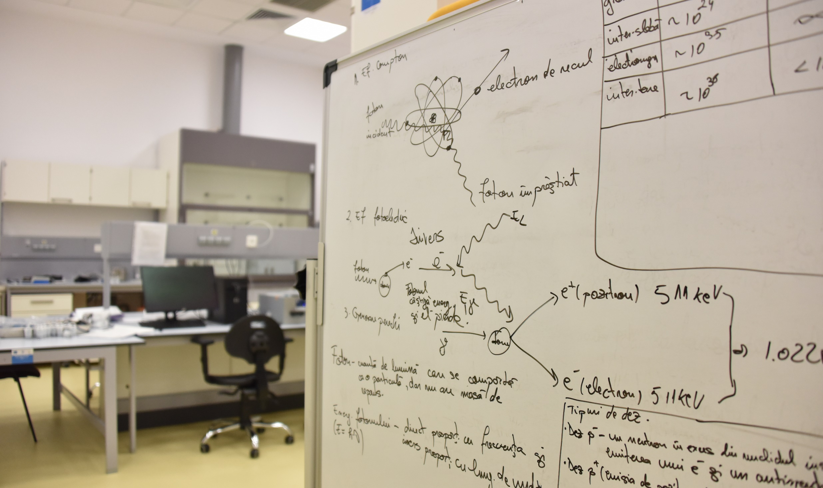
01
^{Current situation}
Horia Hulubei National Institute for R&D in Physics and Nuclear Engineering

Slide 4
Manpower
In general: 0.4 FTE: Sorin Pascu + Alexandru Negret
Temporary situation: reduced manpower caused by other obligations of both evaluators
Looking for possibilities to increase contribution

Slide 5
Responsabilities of the Bucharest Data Centre
Mass | Last published evaluation | Responsible evaluator | Status
57 | NDS 85, 415 (1998) | A. Negret | Under evaluation by A. Negret, B. Singh and R. Firestone
58 | NDS 111, 897 (2010) | A. Negret
59 | NDS 151, 1 (2018) | A. Negret
117 | NDS 95, 679 (2002) –updated 2009 | S. Pascu
118 | NDS 75, 99 (1995) | S. Pascu | Under evaluation by S. Pascu, A. Negret, and E. McCutchan
119 | NDS 110, 2945 (2009) | S. Pascu

Slide 6
Other evaluation activities
A=130: by S. Pascu, B. Singh, A. Rodionov, G. Shulyak - post review
A=101: by J. Timar, Z. Elekes, A. Negret, S. Pascu – final stage, to be submitted
CTBTO project (IAEA):
A. Negret: decay of ¹³³I – submitted for review
S. Pascu: decay of ¹⁴⁰La – work in progress

Slide 7
02
^{Plans for near future}
Horia Hulubei National Institute for R&D in Physics and Nuclear Engineering

Slide 8
Plans for the future
Obligations within the European project SANDA
A=101 – finalize evaluation, submit, perform the post-review corrections
A=86 – evaluate a few nuclei, including ⁸⁶Sr (together with B. Singh)
CTBTO project:
A. Negret: decay of ¹³³I – perform the post-review corrections
S. Pascu: decay of ¹⁴⁰La – finalize the evaluation
Other future plans
Finalize the post-review corrections for A=57 and 130 together with B. Singh
Work on A=118 together with E. Ricard-McCutchan

Slide 9
03
^{The SANDA Project}
Horia Hulubei National Institute for R&D in Physics and Nuclear Engineering

Slide 10
The H2020 project SANDA (Supplying Accurate Nuclear Data for Energy and Non-energy Applications)
Funded by: European Commission, under the Horizon2020 program,
Duration: 01. Sept. 2019 - 01. Sept. 2023 (an extension will be required caused by the COVID pandemic),
Maximum EU contribution: 4.66 Meuro,
Funding for ENSDF evaluation: ~20 kEuro/Data Centre, or 5 PM/Data Centre,
Number of partners: 35 European institutes/universities,
Work packages:
WP1: Detector development
WP2: Nuclear data measurements for energy and non-energy applications
WP3: Target preparation
WP4: Nuclear data evaluation
Task 4.2.2 Evaluation of nuclear structure and decay data
WP5: Data validation, integral measurements
WP6: Management, coordination, education, training
Notes: First time when ENSDF evaluation is financially supported at the European level. Inclusion into the ND community is essential for the participation to future similar projects.

Slide 11
Thanks
Do you have any questions?
negret@nipne.ro
https://www.nipne.ro/
Contact Us
Address: Str. Reactorului no.30, P.O.BOX MG-6, Bucharest - Magurele, ROMANIA
Phone: +(4021) 404.23.00
Fax: +(4021) 457.44.40

