Slide 1
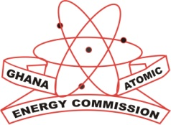
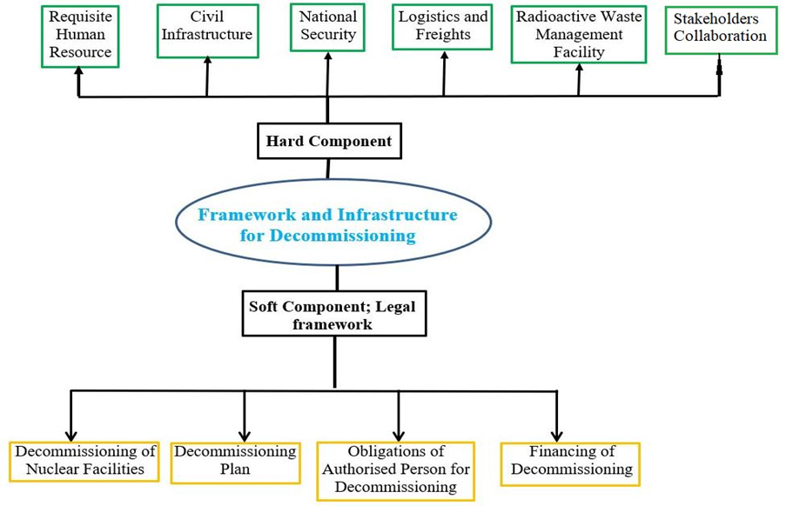
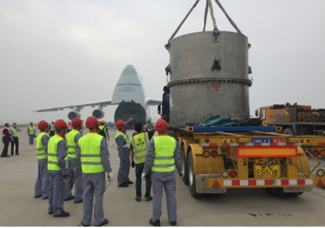
The Development Of Requisite Infrastructure And Frameworks For Effective And Efficient Decommissioning In Ghana; An Ambitious Nuclear Power Plant Implementation Country
Gustav Gbeddy, Eric T. Glover, Yaw Adjei-Kyereme, Eric Akortia, Paul Essel, Evans M. Ameho
Radioactive Waste Management Center, Radiation Protection Institute, Ghana Atomic Energy Commission gustav.gbeddy@gaec.gov.gh
ABSTRACT
DECOMMISSIONING FRAMEWORK AND INFRASTRUCTURE- Cont.
The Ghana Nuclear Regulatory Authority Bill 2014 decoupled the Nuclear Regulator from the Ghana Atomic Energy Commission (GAEC).
The Bill stipulates the fundamental regulatory framework and infrastructure requirements for effective and efficient decommissioning.
Based on the current Bill, Ghana has successfully converted her 30kW research reactor from highly enriched Uranium (HEU) fuel to low enriched Uranium (LEU) fuel with repatriation of all the relevant components to the manufacturer in China.
Ghana does not have legacies from the application of nuclear science and technology except for disused sealed radioactive sources.
This paper highlights some vital aspect of decommissioning regulatory framework and infrastructure in Ghana including decommissioning plan, financing of decommissioning, obligations of an authorized person for decommissioning, and decommissioning of nuclear facilities.
Thirdly other critical obligations that are required of the authorized person includes preparation of safety and environmental assessments as part of the decommissioning plan for approval by the Ghana EPA, maintain a human resource management and development system, maintain emergency plan etc.
Finally, the applicant shall ensure the availability of adequate financial resources to cater for all aspects of the decommissioning.
For facilities in existence before the commencement of the ACT for which financial resources are not available, proof of financial assistance shall be required before the renewal of an authorisation, for instance the US Global Threats Reduction Initiative in cooperation with the IAEA provided support to the GHARR-1 core conversion.
The hard component denotes the physical infrastructure, human resource requirements, National Security, and stakeholder collaborations.
The availability of requisite freight and logistics firms either local or foreign are crucial for the transport of heavy weight and high-risk nuclear materials or equipment as shown in FIG. 2.
DECOMMISSIONING FRAMEWORK AND INFRASTRUCTURE
This can be classified into soft and hard components as presented in FIG 1.
The soft component refers to the legal basis upon which decommissioning can be conducted safely and effectively.
Four sections in the ACT are devoted to the decommissioning of nuclear facilities in tandem with IAEA’s General Safety Requirements on the decommissioning of facilities.
The IAEA stipulates that governments shall establish and maintain a governmental, legal, and regulatory framework within which all aspects of decommissioning, including management of the resulting radioactive waste, can be planned, and executed safely [1, 2].
The four legal areas entail decommissioning of nuclear facilities which demands the applicant to perform site baseline survey for comparison after decommissioning, the Authority shall specify the decommissioning procedure by a Gazette. Secondly, decommissioning plan is required by the Authority from the applicant prior to licensing of facility construction and operation.
INTRODUCTION
Nuclear science and technology have been applied in many sectors of the Ghanaian economy since 1950 including industry, medical field, agriculture, research, and education.
Ghana currently operates a 30 to 34 kW research reactor referred to as GHARR-1 solely for research and educational purposes.
The conversion of the reactor core from highly enriched Uranium (HEU) fuel to low enriched Uranium (LEU) fuel demands the establishment of necessary infrastructure and regulatory framework akin to the conduct of any regular decommissioning exercise on a nuclear facility.
The ACT sets out the necessary legal framework to undertake decommissioning of any nuclear installation or nuclear related facilities including facilities using sealed radioactive sources [1]
CONCLUSION
Ghana with the support of the IAEA has successfully established the necessary regulatory framework for the conduct of nuclear facility decommissioning.
More governmental commitment and allocation of requisite financial resources are required in terms of meeting the infrastructure needs for decommissioning.
ACNOWLEDGEMENTS/REFERENCES
The immeasurable support extended to Ghana by the IAEA in the terms of technical support, expert missions, and training programs is highly appreciated.
References
Gbeddy, G., et al., Regulatory framework and standards for decommission and environmental remediation; a case study of Ghana, in IAEA International Conference on Advancing the Global Implementation of Decommissioning and Environmental Remediation Programmes. 2017, International Atomic Energy Agency (IAEA): Spain.
IAEA, Decommissioning of Facilities. General Safety Requirements, Part 6 (7). 2007, International Atomic Energy Agency (IAEA): Vienna, Austria.
FIG. 1. Chart of decommissioning framework and infrastructure in Ghana
FIG. 2 Trailer loaded with HEU in a TUK/145/C MNSR package
IAEA-CN269-176 International Conference on Nuclear Decommissioning: Addressing the Past and Ensuring the Future, 15–19 May 2023, Vienna, Austria

