Slide 1
Decommissioning and Clearance in Austria
Experience report of an expert
Viktoria Grill*, Christian Katzlberger, Fabian Rechberger
Austrian Agency for Health and Food Safety
Division for Radiation Protection
*viktoria.grill@ages.at

Slide 2
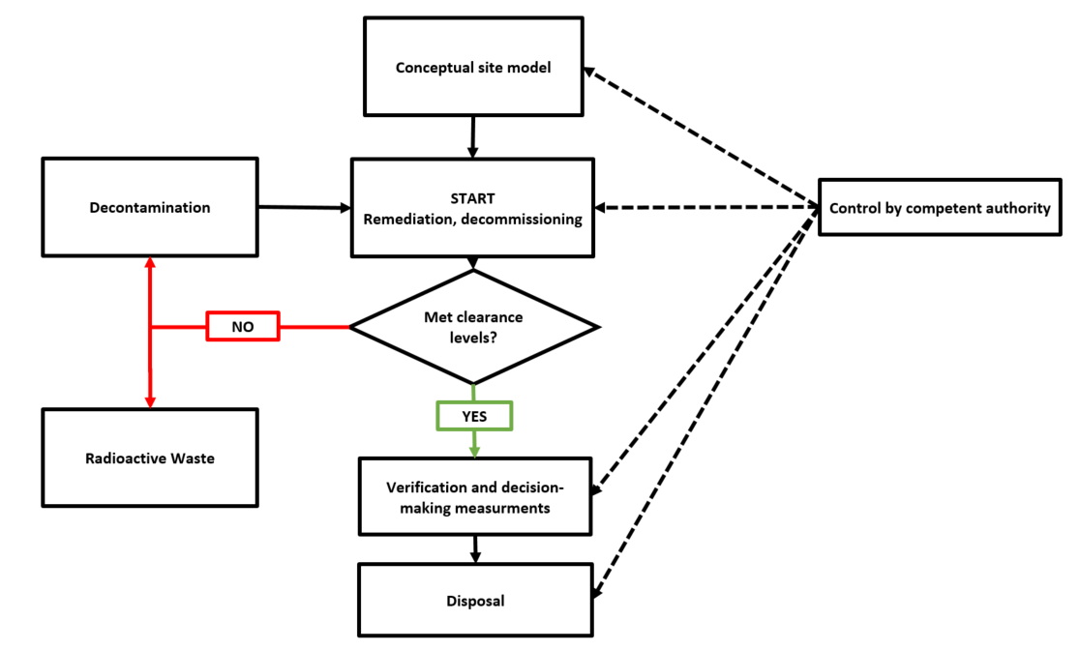
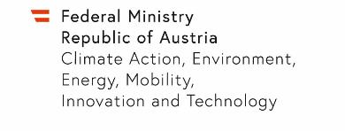
Clearance Procedure in Austria

Slide 3
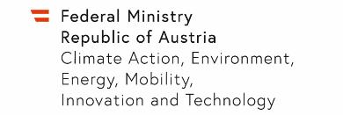
Conceptual Site Model (CSM)
Licence
framework for the performance of specified practices
Professional aspects
Technical aspects
Expert opinion
CSM
All required documents
CSM
radiological characterization
operation plan

Slide 4
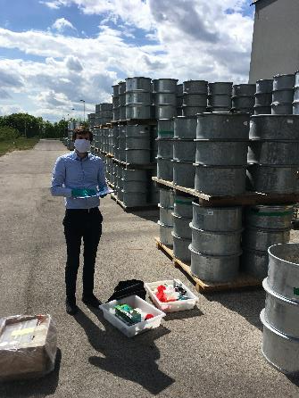
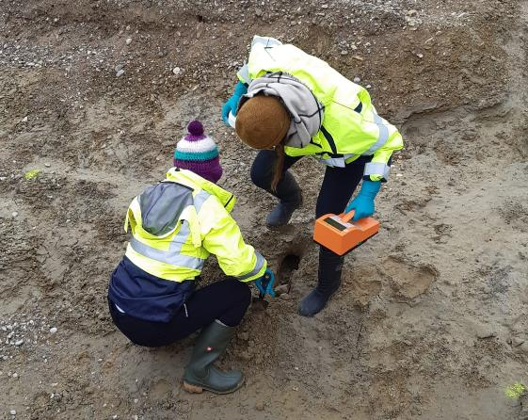
Verification & Decision-Making Measurements
?
Licence for disposal
Request of clearance
Measurement results
Reviewing
Sampling
Comparing
Expert opinion
further remediation and decontamiation

