Slide 1
Risks in Countries’ strong safekeeping of future decommissioning funds
Martin Macášek
Slovak Nuclear Society

Slide 2
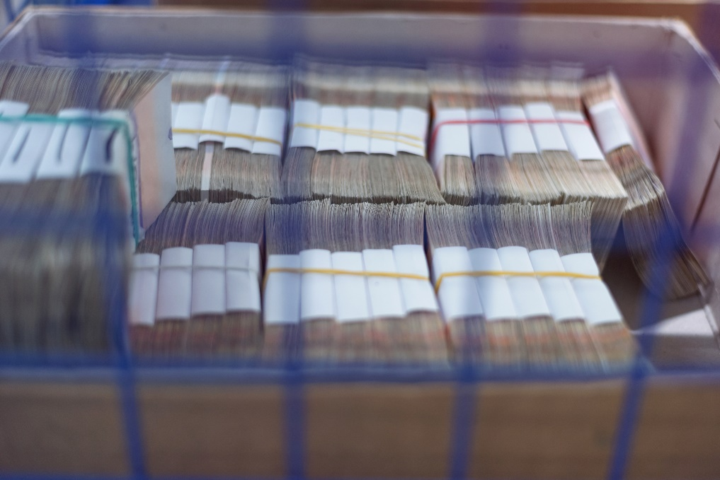
Purpose of national oversight in safekeeping of nuclear back-end cycle funds
Countries are ultimately responsible as per Joint Convention.
Fail in financing adequacy would channel the costs to the government.
Focus on prudent safekeeping measures – partially because of due administration and shield against public criticism:
Physical protection of the funds – to prevent loss or theft,
Prevention of misuse, risky operations or lending off the money
(prohibited vs. specific lending allowed), and
Ensuring low/risk-free appreciation of the funds
Focus on physical and managerial protection may lead to loss of focus on protection of monetary value of the stored funds.

Slide 3
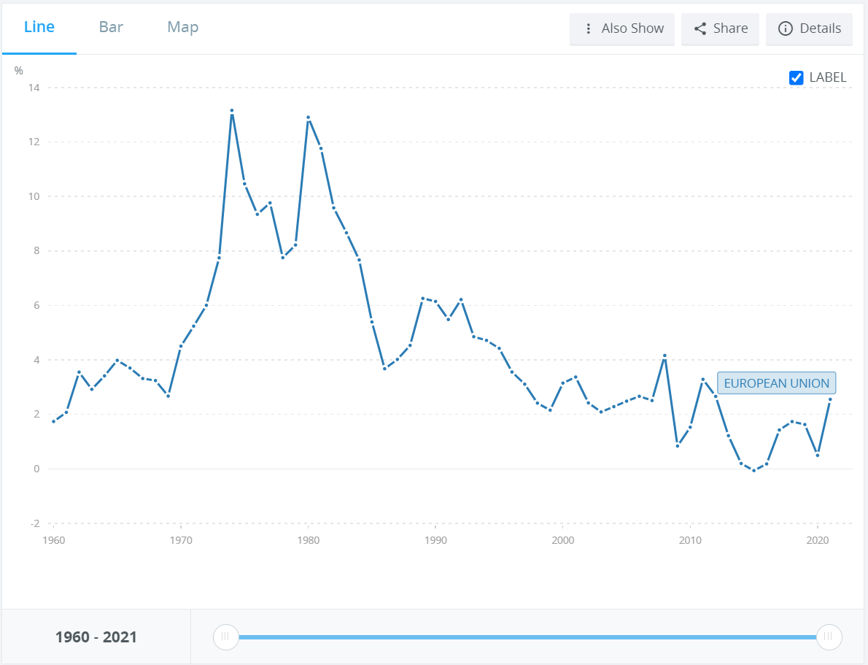
History of inflation in European Union
EU average inflation 1960-2021: 4.41%
Source: World Bank
https://data.worldbank.org/indicator/FP.CPI.TOTL.ZG?locations=EU

Slide 4
Impact of investing in risk-free fixed-term bank deposits
Annual rate of returns of the Slovak National Nuclear Fund in 2008-2021 and inflation in the Slovak Republic
Year | Net interests (after taxes) [%] | Inflation [%]
2008 | 4.11 | 4.6
2009 | 2.36 | 1.6
2010 | 0.74 | 1.0
2011 | 2.87 | 3.9
2012 | 2.94 | 3.6
2013 | 2.76 | 1.4
2014 | 2.73 | -0.1
2015 | 2.70 | -0.3
2016 | 2.60 | -0.5
2017 | 2.43 | 1.3
2018 | 2.46 | 2.5
2019 | 2.35 | 2.7
2020 | 2.26 | 1.9
2021 | 1.05 | 3.2
The industry needs:
Low risk, long term and mid-high gains compounded investments.
The low risk policy offers:
Low risk, long term, low-to-none gains compounded investments
Lack of monetary value protection
7 out of 14 years inflation beat net interests
Net interest surplus: 0.36-3.10%
Source: Slovak National Nuclear Fund
https://www.njf.sk/dokumenty/dokumenty-jadroveho-fondu/
Average | 2.45 | 1.91

Slide 5
Types of investment
Target Returns | 9 – 10% (Nominal) 6 - 7 % (Real) | 9 – 11% (Nominal) 6 - 8 % (Real) | 8 – 10% (Nominal) 5 - 7 % (Real) | 8 – 9% (Nominal) 5- 6 % (Real)
Asset Allocation
Real Assets
Cash Equiv.
Cash Equiv.
Fixed Income
Cash Equiv.
Cash Equiv.
0%
Real Assets
0-20%
Equities
5%
0%
Equities
Real Assets
Fixed Income
Fixed Income
Fixed Income
Equities
Equities
Real Assets

Slide 6
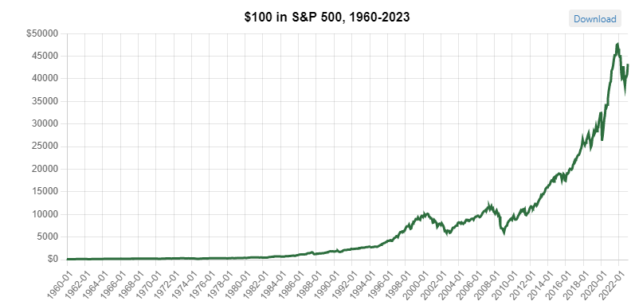
Countering inflation by compounding interest
S&P 500: Operated since (1926) 1957
Averaged annual appreciated since 1926: 10.49%
Averaged annual appreciated since 1957: 10.67%
EU inflation: 4.41%
Net difference between EU inflation and S&P 500 gains: 6.26%.
Source: https://www.officialdata.org/us/stocks/s-p-500/1960?amount =100& endYear=2022

Slide 7
Investment Reality for the new NPP EMO 3,4
Economic reality:
60 year average inflation in the EU = 4.41%
60 year average yield of S&P 500 = 10.67%
5,781,100,000 €
NPP EMO 3,4 calculated share of the Slovak National Back-End Cycle costs: 5,758.1 Million EUR₍₂₀₁₃₎
Current legislation allows to invest in:
Fixed-term deposits at the National Treasury
Average gross yield 2008-2020 = 3.16%
Average net yield 2008-2020 = 2.56%
Source: Slovak National Program for Handling of SNF and RAW in SR
https://www.njf.sk/wp-content/uploads/2020/05/The_National_Programme_for_handling_of_SNF_and_RAW_in_SR.pdf

Slide 8
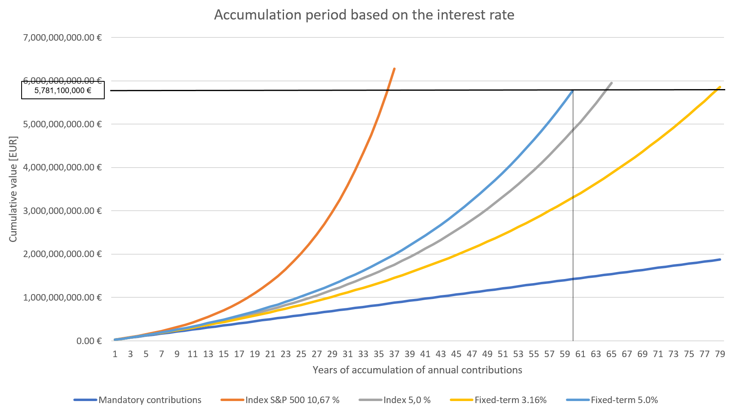
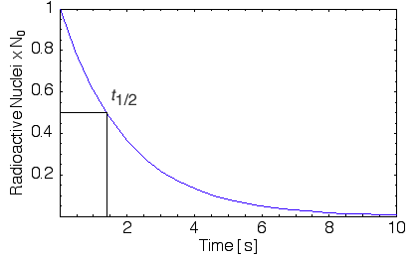
Accumulation period based on type of investment
Investing model | Average yield [%] | or | Annual contribution [EUR] | or | Period of due accumulation [years]
S&P 500 average yield | 10,67 |  | 2 648 386 |  | 37
Index fund yield equals inflation | 5,00 |  | 28 185 651 |  | 65
Fixed term deposits yield equals inflation (minus taxes) | 5,00 |  | 23 730 355 |  | 60
Fixed term deposits average yield 2008-2020 (minus taxes) | 3,16 |  | 41 363 735 |  | 79

Slide 9
Key risks of strong safekeeping of NBEC funds
Key risks of low risk investments:
Low risk financial vehicles provide interest rates often below inflation rates, resulting in
increase of original accumulation period (possibly beyond operational lifetime of a facility), or
gradual increase of annual contributions, primarily in the last periods of NPP’s operation as a result of unrealized gains from missing compound interest.
Satisfaction with Zero net inflation yield (~5%) represents exposure to a risk of not reaching the target appreciation.
Higher contributions decrease competitiveness and increase ownership costs
Key risks of higher-risk investment vehicles:
Increased volatility, with possibility of low-values periods specifically at the time of need.
Decreased liquidity.
Complex setup and/or management.
Possibly higher administration fees.
Key benefits of higher-than-minimal risk of investments:
Significant probability of low-risk sufficient-gains net of inflation.
Faster accumulation of nuclear back-end funds, or lower annual contributions.

Slide 10
Ideal investing option? (Discussion)
Various combination of financial investment models?
(Early) construction of due nuclear back-end facilities (e.g. treatment centers or repositories)?
Increased education of maths and physics in school to increase stakeholder engagement?

