Slide 1
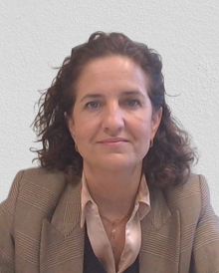
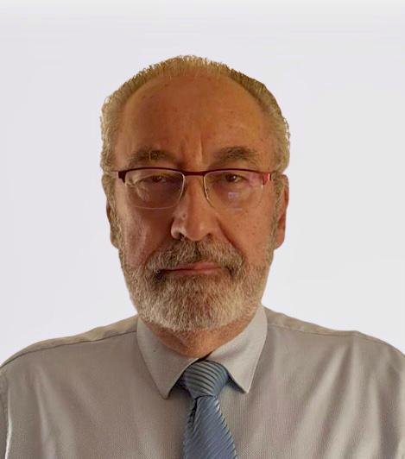
Decommissioning of José Cabrera NPP
Past, present, future and lessons learned
(regulatory issues)
Sofía Luque, Susana Solís, José Luis Revilla
Nuclear Safety Council
slh@csn.es
www.csn.es

Slide 2
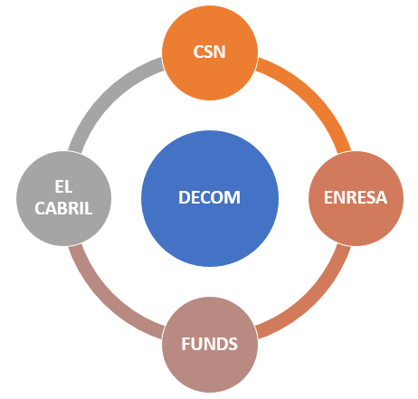
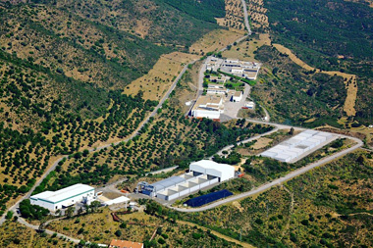
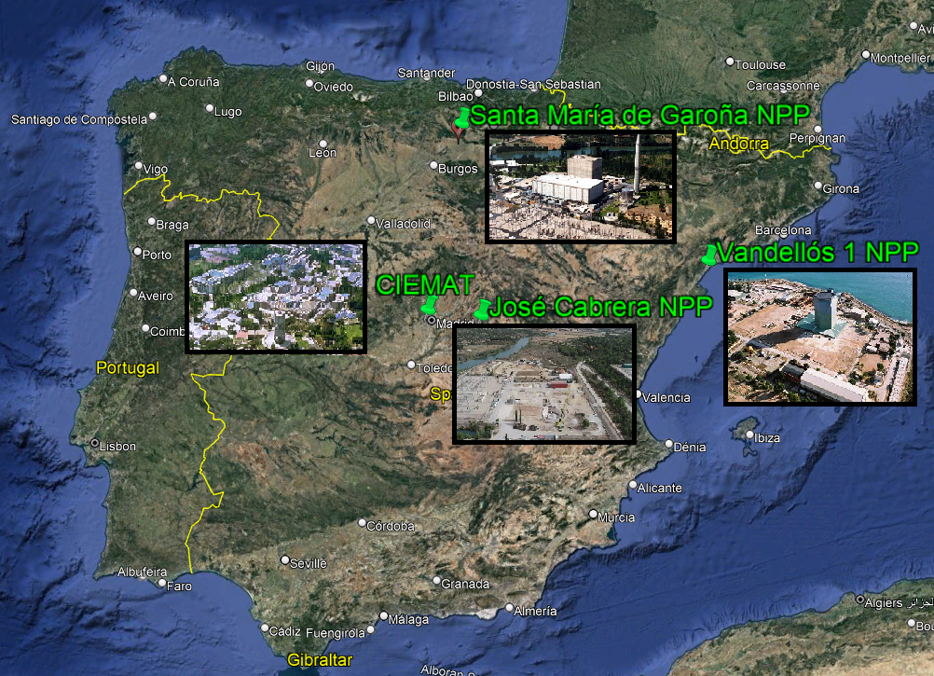
1. Spanish decommissioning fundamentals
Based on 4 main pillars:
CSN (Regulator): Responsible for Nuclear Safety & Radiation Protection
ENRESA: Responsible for Decommissioning & Radwaste management
Budget: guaranteed by law
El Cabril: radwaste (ILW, LLW & VLLW) disposal site
Decommissioning experience:
VANDELLÓS 1 NPP: Finished 2 dismantling stage in 2004. Currently in dormancy period.
CIEMAT Research reactor: dismanteled in 2009
JOSÉ CABRERA NPP: Currently under remediation.
GAROÑA NPP: Decommissioning permit granted 2023
JOSÉ CABRERA NPP WILL BE THE FIRST SPANISH NPP TO BE FULLY DECOMMISSIONED

Slide 3
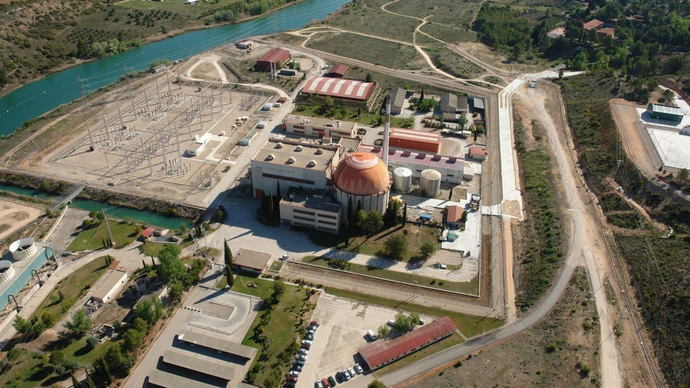
Esto es un titular a una línea de texto
38 years operating:
36.515x10E+6 Kv
≈ 300,000 houses
Waste Storage 3
Power substation
Waste Storage 2
Chimney
Workshops and offices
Waste characterization
Turbine
Waste Storage 1
Reactor
Offices
Refrigeration towers
Discharge Channel
Notes:
The José Cabrera NPP was the first Spanish NPP. It was a PWR reactor, with a power of 160 MGw, reactor (PWR) and cooling towers (Tajo river)
Building started in July, 1965 and was completed in record time in March, 1968 First criticality in June of that year.

Slide 4
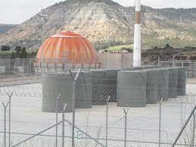
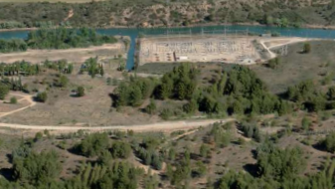
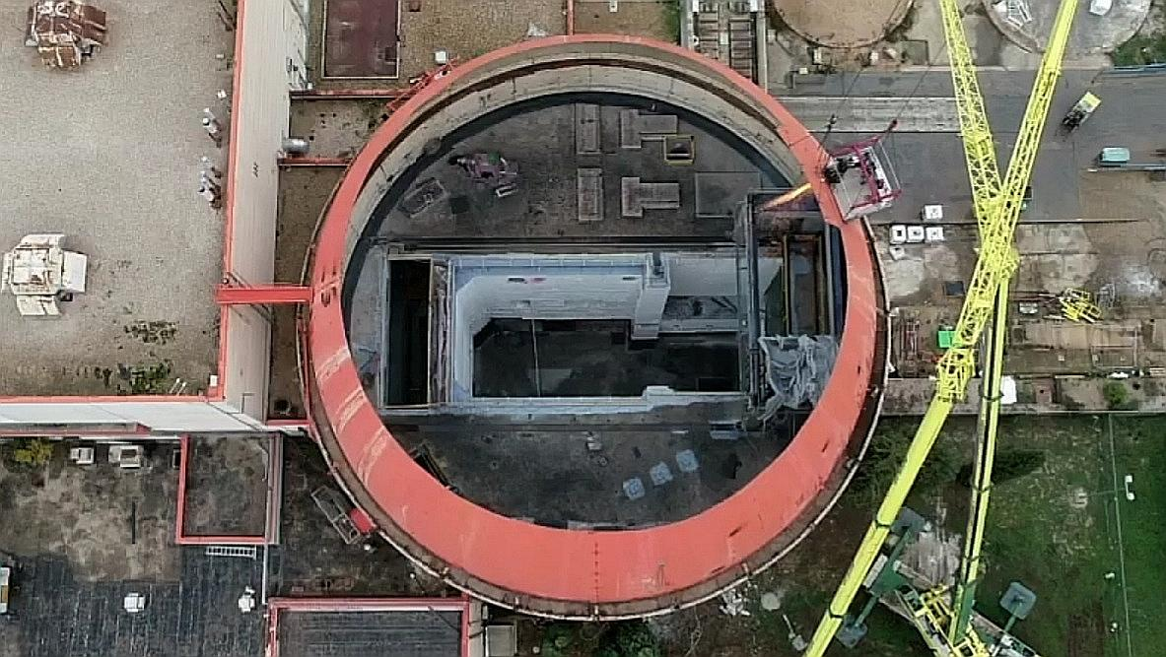
2. José Cabrera NPP post-operational stages
2006
2022
Permanent Shutdown
Decom strategy:
Immediate dismantling in one step
Partial release: IFSF remain on site after release
Industrial use of the site: release with restrictions
Site Remediation
Decommissioning
Release
2010
¿2025?
LICENSEE:
UNIÓN FENOSA
LICENSEE: ENRESA
Notes:
Final shutdown on 30 April 2006 to proceed with dismantling
A facility for interim dry storage of spent fuel has been built on site
DCOM authorization and transfer to ENRESA granted in year 2010
Restoration activities beginning in 2018
License termination in the end of 2019?

Slide 5
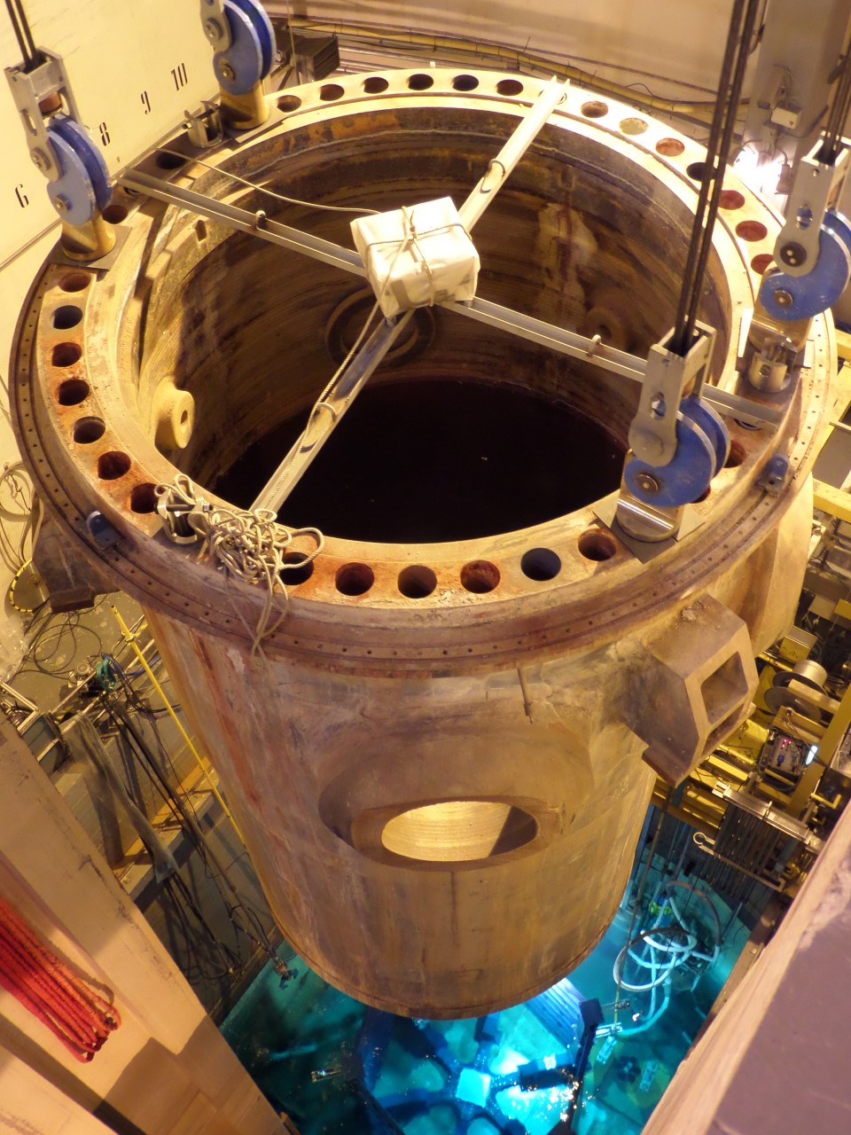
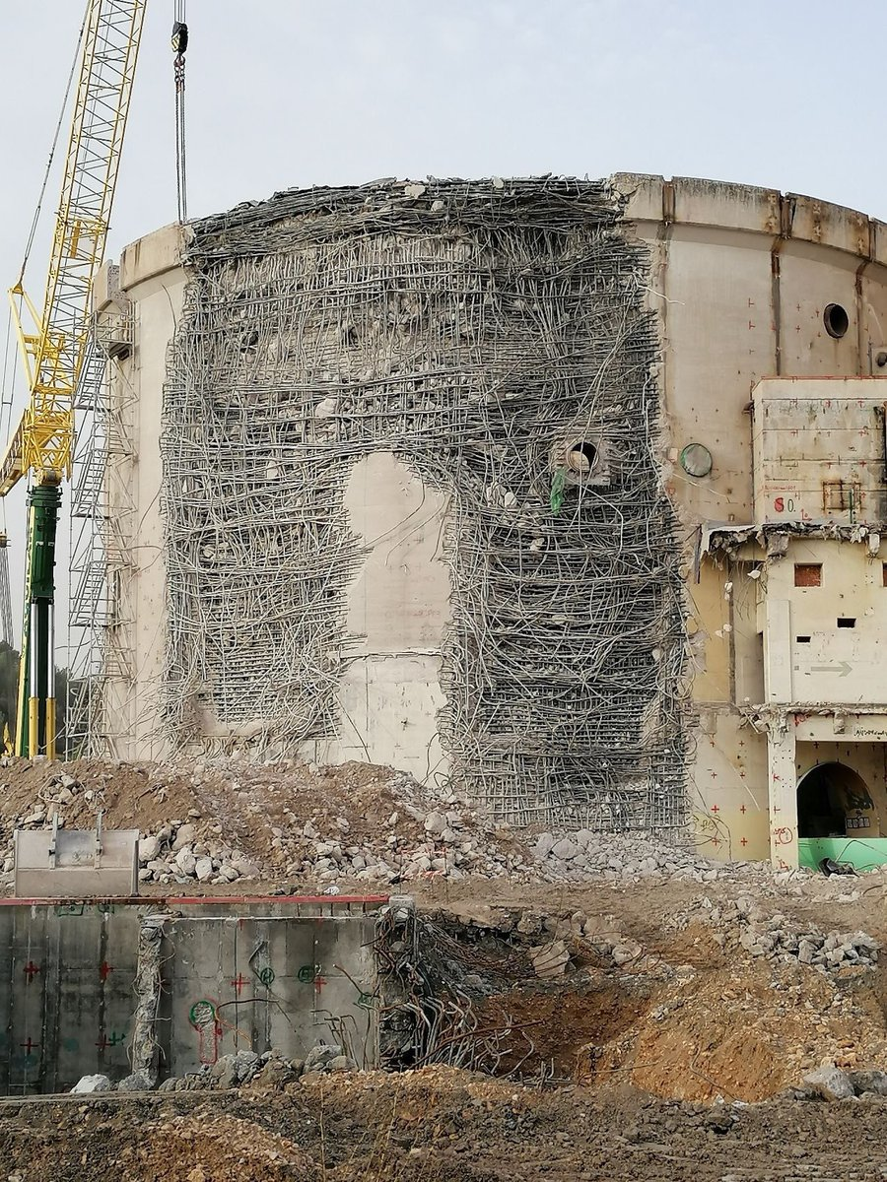
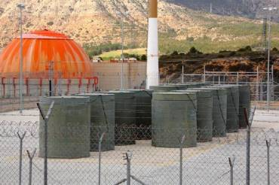
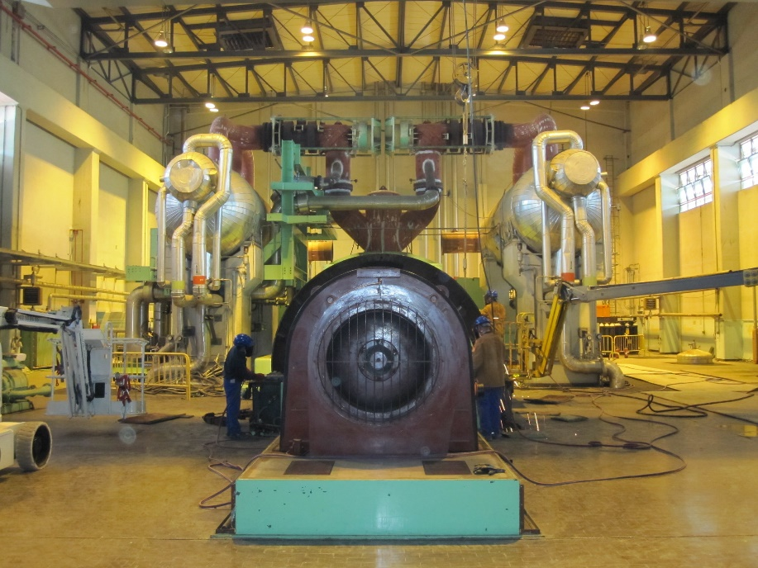
3. Decommissioning activities 2010-2022
Construction & operation of IFSF for disposal of spent fuel
Transformation of the turbine building to an auxiliary building for the treatment of radwaste (EAD)
Dismantling of radiological elements: Primary circuit.
Dismantling of conventional elements and demolition of buildings

Slide 6
NOVEMBER 22

Slide 7
4. Site restoration plan: Radiological criteria
Restricted release allowed, if:
Additional reductions of residual activity for unrestricted release cause more harm than good, or restricted release conditions are ALARA
Appropriate institutional controls and use restrictions provided to ensure dose does not exceed 0.1 mSv/y and 1 mSv/y in case IC or restrictions fail
0.1 mSv/y due to soil residual radioactivity applicable to the entire site
0.01 mSv/y due to residual radioactivity from remaining buildings, facings or structures (EU RP 113 clearance criteria)
Regulated by:
CSN Safety Instruction 13
Partial release is allowed, but:
dose limits apply for the entire site (data shall be kept until the license termination is granted)

Slide 8
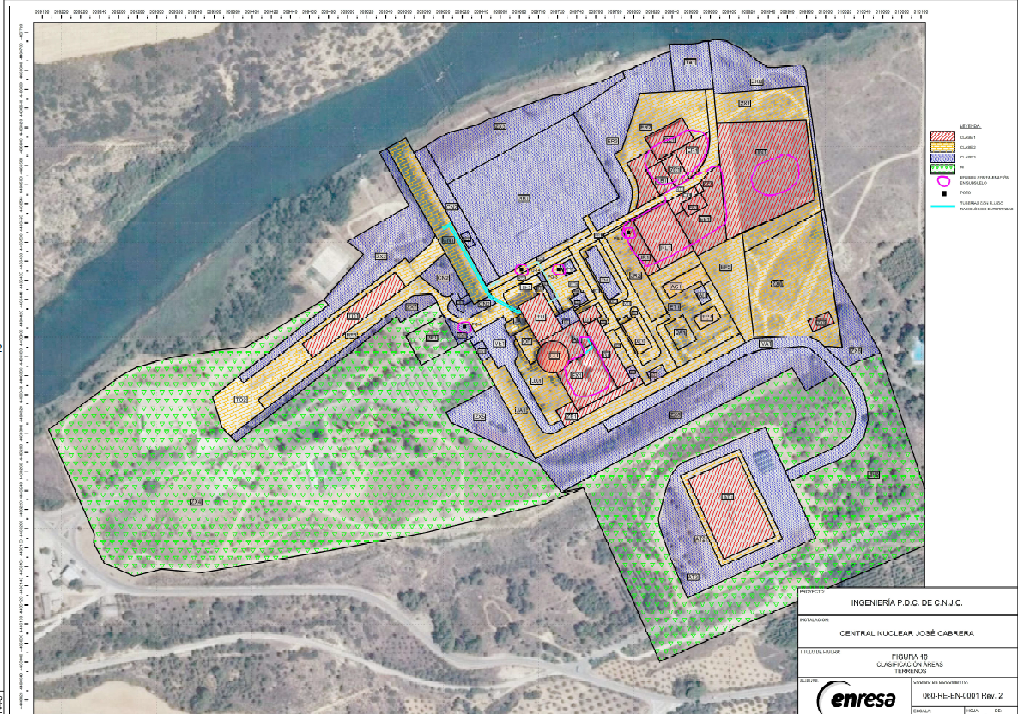
5. Site Restoration Plan: Performance
Recommendations under:
CSN Regulatory Guide 4.2 (Content)
CSN Regulatory Guide 4.3 (Methodology)
www.csn.es
Historical Site Assessment
Radionuclides of interest
Characterization
Release levels
Preliminary area classification
Remediation
Final Status Survey
(demonstrate that end point conditions have been met)
José Cabrera NPP area classification
Release

Slide 9
7. Next Goal: Licence termination
License Termination Permit
ENRESA
Restricted use
Licensee shall provide a safety case including:
long term impact assessment
appropriate surveillance regime
any proposed land use restrictions
Decommissionn
Site Restoration Plan
FINAL STATUS SURVEY
Allegations
Regional Government
MITERD
CSN
Request allegations
License Termination
Request for Report
Mandatory & Binding Report

Slide 10
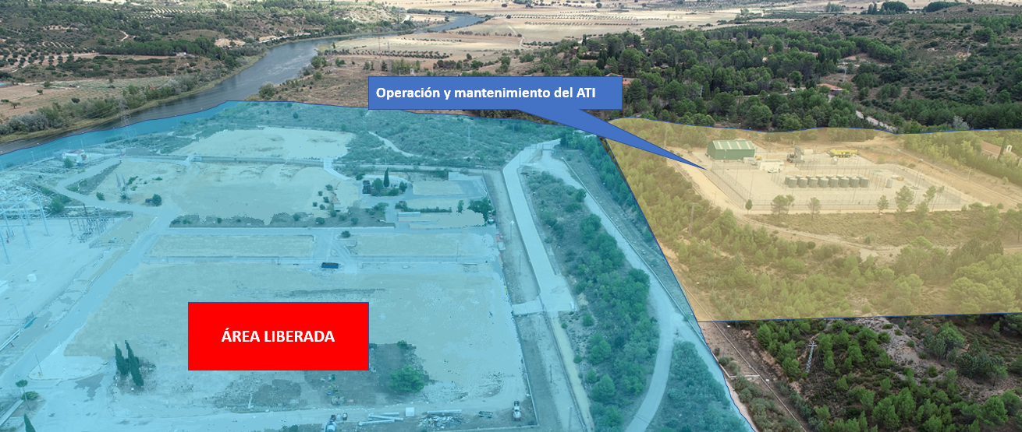
INDEPENDENT FUEL STORAGE FACILITY
RELASED AREA
RELEASED AREA

Slide 11
8. Lessons learned
Regulations must be commensurate with risk, robust & fit for purpose. Decommissioning through stages is a good option.
The transference of ownership for decommissioning needs solid agreements between parts to transfer knowledge, records, procedures and workers issues. Documentation must be clear, comprehensive, and traceable.
Project management must oversee the entire process, manage resources and ensure adherence to schedules and budgets (including unexpected challenges). Coordination and planning between licensee and regulator is essential: Failing to plan is planning to fail
Environmental considerations are a key aspect. Minimizing the possibility of release of pollutants into the environment is essential to ensure the long-term sustainability. So is long-term stewardship (ongoing monitoring, maintenance, and institutional controls) in case of restricted release.
Learning from past experiences, both successful and unsuccessful, can provide valuable insights, best practices, and lessons learned to improve future decommissioning efforts.
Culture of continuous improvement: Regularly evaluating the effectiveness of decommissioning strategies, adopting new technologies and best practices, and incorporating lessons learned from previous projects can enhance future decommissioning efforts.

Slide 12
9. Challenges
The IFSF will remain in its current place until a centralized spent fuel storage (or similar alternative) be available
For how long?
How to manage the maintenance of safe operating conditions for both the containers and the IFSF? (life management issues)
Restricted release: Industrial use of land
How to deal if a change in the land use after granting the license termination is required?
Funding & responsibilities for institutional controls have to be clearly defined

Slide 13
THANK YOU for your attention!
slh@csn.es
sss@csn.es
jlrg@csn.es

