Slide 1
DECOMMISSIONING GUIDANCE AND RESEARCH INITIATIVES IN THE UNITED STATES
C. Barr, B. Watson, and C. McKenney
United States Nuclear Regulatory Commission

Slide 2

Ms Cynthia Barr
Job/Position: Senior Risk Analyst
Organization, Country: United States Nuclear Regulatory Commission
Over 20 years experience in reviews of dose and performance assessments to support complex material and reactor decommissioning; and radioactive waste disposal
Develops decommissioning and radioactive waste disposal guidance
Develops staff training courses and conducts training both domestically and internationally on contaminant fate and transport and radiological assessment
Manages contracts to develop software tools to support radiological survey design, data visualization and analysis; and dose modeling to derive clean-up levels
Chair of the Nuclear Energy Agency’s Working Party on the Technical, Environmental and Safety Aspects of Decommissioning and Legacy Management
PROFILE
PICTURE

Slide 3
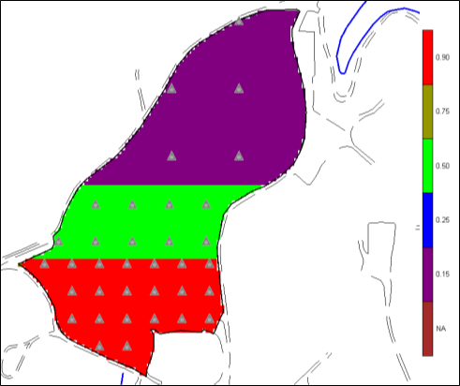
NRC Decommissioning Guidance and Related Research Initiatives
NRC published NUREG-1757, Volume 2, Rev. 2, “Consolidated Decommissioning Guidance—Characterization, Survey and Determination of Radiological Criteria” in July 2022.
Four United States federal agencies published draft NUREG-1575, Rev. 2, “Multi-Agency Radiation Survey and Site Investigation Manual, Rev. 2,” in June 2021
Additional guidance and research initiatives
  Subsurface investigations
  Discrete radioactive particles
  Continuously collected data
  Engineered covers

Slide 4
Subsurface (Problem Statement)
Surveys of the subsurface can be complex and difficult to perform
Scan survey instrumentation used at the surface to detect elevated areas cannot be used
Sampling technology is limited
Inadequate sample sizes are typically an issue
Unclear exposure scenarios complicates the dose or risk assessment

Slide 5
Subsurface (Guidance)
Phase | Products | Potential Tools
Preparation | CSM and initial CCM | GIS software
Scoping | Initial Survey Design (locations and number of samples) | Check and Cover Bayesian ellipgrid
 | Update to CCM | Markov Bayes, cokriging* Probability of exceedance map
Characterization | Boundary delineation Remedial volumes Uncertainty estimates | Area of Concern Map AOC Boundary Sampling Design Threshold Radial
Remediation | Remedial volume | See previous MrDM, MrsDM
Compliance support phase | Compliance decision at various scales | See previous
*If disparate data sources are available, then multivariate geostatistical methods such as cokriging and Markov-Bayes can be used to combine methods.
Develop a methodology to optimize subsurface survey design and data analysis
  Work was initiated in NUREG/CR-7021 using a contamination concern map which evolved over the various stages of investigation
  Decision quality was emphasized with the leveraging of less expensive field measurements
NUREG/CR-7021 is being updated considering a multi-scale approach to assess risk from various volumes of residual radioactivity
Geospatial analysis (modeling) and simulation are used surrogates for scanning at the surface

Slide 6
Subsurface (Tools)
Develop tools to assist with data visualization
Develop tools to implement proposed methodology in updated NUREG/CR-7021
Initial 2023 work in Visual Sample Plan (VSP)
  Extend from 2D to 3D capabilities
  Will consider anisotropy in variogram fitting
Longer term work to study the potential benefit of AI/ML to subsurface problems (variogram model identification and subsurface predictive modeling)

Slide 7
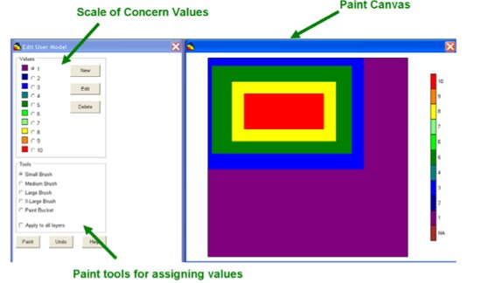
Subsurface
(Technical Challenges)
How important are elevated areas in the subsurface?
  Exposure scenarios that need to be considered that can bring residual radioactivity to the surface.
What is optimal for decision units—series of 2D layers or 3D analysis (considering need for multiple DCGLs)
Lack of consideration of spatial autocorrelation which can lead to an increase in decision error
Consideration of multiple DCGLs and analytes
Geostatistical analysis has been used to facilitate subsurface investigations but is potentially difficult to apply and understand
Uncertainty is inherent in the decision-making process and may also be difficult to explain to interested stakeholders (e.g., agreeing on an acceptable probability of a decision unit exceeding the applicable DCGL)

Slide 8
Discrete Radioactive Particles (DRPs)
DRPs have been an issue at some decommissioning power reactors
NRC hosted a workshop in November 2022 to discuss exposure scenarios, survey and dosimetry considerations
NRC is developing an Information Notice on DRP contamination control, reporting and documentation, and survey requirements for Decommissioning Reactor Sites
NRC is considering the need for guidance on calculation of scan minimum detectable activities (MDA), good practices associated with surveys, and internal dosimetry considerations for DRPs

Slide 9
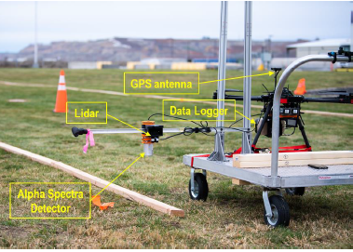
Continuously Collected Data
NRC licensees are increasingly using more modern data logging systems with integrated survey and location data
NUREG-1507 provides a methodology for calculation of scan MDCs for surveys with a surveyor listening to audible counts
A priori methods for calculation of scan MDCs for continuously collected data surveys conducted without the surveyor listening to the audible counts are being developed
A posteriori methods for post processing of data and identification of areas for follow-up investigation are also being developed and implemented in the Visual Sample Plan computer code

Slide 10
Engineered Covers
Engineered surface covers can be a risk-significant barrier at many disposal sites
Engineered covers can
  Serve as an infiltration barrier
  Limit dose from surface pathways (external and inhalation dose)
  Provide isolation and stability (e.g., clay barrier to mitigate radon releases from uranium mill tailings)
Various degradation mechanisms have been observed at uranium mill tailings sites (e.g., erosion, deposition, pedogenic processes, subsidence and differential settlement)
NRC has sponsored many projects and activities to study the long-term performance of engineered surface covers
NRC is developing draft guidance for designing, constructing, and monitoring evapotranspiration covers (ET covers)

Slide 11
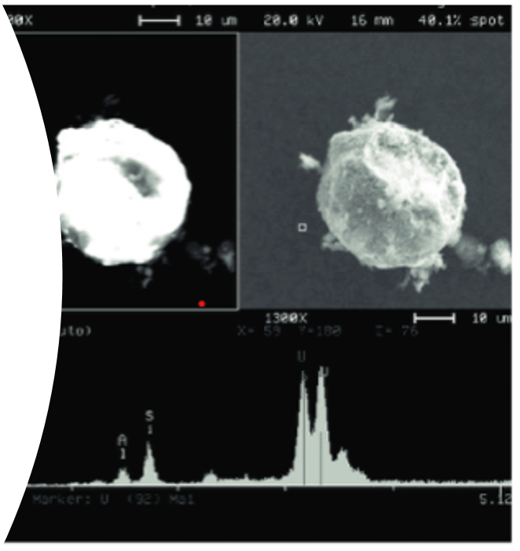
Outreach
Public meetings
Conferences and workshops
Draft documents for comment (final document revisions with comment responses)
Workshops
  Two workshops on subsurface investigations
  One workshop on discrete radioactive particles
Industry pre-submittal meetings
https://www.nrc.gov/waste/decommissioning/whats-new.html

Slide 12
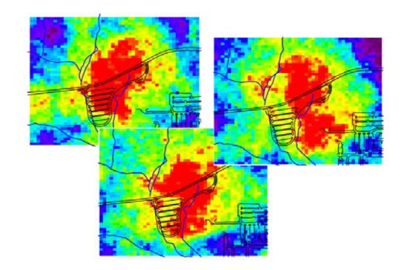
Conclusions
NRC is addressing stakeholder comments on the need for additional guidance in two key technical areas
  Subsurface surveys
  Discrete radioactive particles
NRC has sponsored research related to long-term performance of engineered surface covers
NRC is staying ahead of the curve with focus on calculation of scan MDC and processing of data collected using modern data logging systems
NRC is sponsoring update to key decommissioning codes to implement proposed methodologies in guidance

