Slide 1
Challenges on Security Infrastructure for Decommissioning of Nuclear Facilities in Indonesia #50
Bambang Tri Purnomo
Nuclear Energy Regulatory Agency of Indonesia
(BAPETEN)

Slide 2
1. Introduction
2. IAEA Guidance for the security of decommissioning
During decommisioning process, there is probability that the threat on the theft of nuclear material and the sabotage of nuclear installation still exist.
Therefore, a security system or physical protection system is still needed during the decommissioning stage.
Unfortunately, the attention on how to ensure the adequacy of security infrastructure on every steps of decommissioning in Indonesia is still low.
It is important to evaluate and improve the decommissioning security infrastructure.
IAEA guidance on the security of decommissioning can be found in the IAEA Nuclear Security Series (NSS) No. 35-G Security during the Lifetime of a Nuclear Facility,
the main publication for decommissioning, General Safety Requirement (GSR) Part 6 Decommissioning of Facilities, mostly discuss about the safety requirement.
4. Comparison Between IAEA Guidelines & Indonesia Regulations On Security Of Decommissioning
3. Regulatory framework in indonesia
IAEA Guidelines | Indonesia Regulations
NSS No. 35-G: Operator should revise the security plan prior to the transition to decommissioning stage, using graded approach. The operator should also revise the security measures for protection of the sensitive information asset, computer security, sustainability, contingency planning, emergency preparedness, incident reporting, trustworthiness, quality assurance, nuclear security culture and nuclear materials accounting and control, as applicable. | GR No. 54/2012: The licensee should ensure the physical protection of nuclear installations, special equipment, and nuclear related materials. GR No. 2/2014: Technical requirements for obtaining Decommissioning permits includes: decommissioning program; radiation protection and safety program; nuclear preparedness program; and document management system. BR No. 4/2009 and BR No. 6/2011: the decommissioning program should includes nuclear security and safeguards programs. the security programs for the decommissioning is an adaptation from the existing physical protection plan during operation stage.
The requirement related to decommissioning nuclear installation in Indonesia are mentioned in some regulations below:
Since there is no further explanation on the security during decommissioning stage, and considering that the security aspect in decommissioning is no less important than the safety aspect, the national policy regarding security in decommissioning need to be emphasized more.

Slide 3
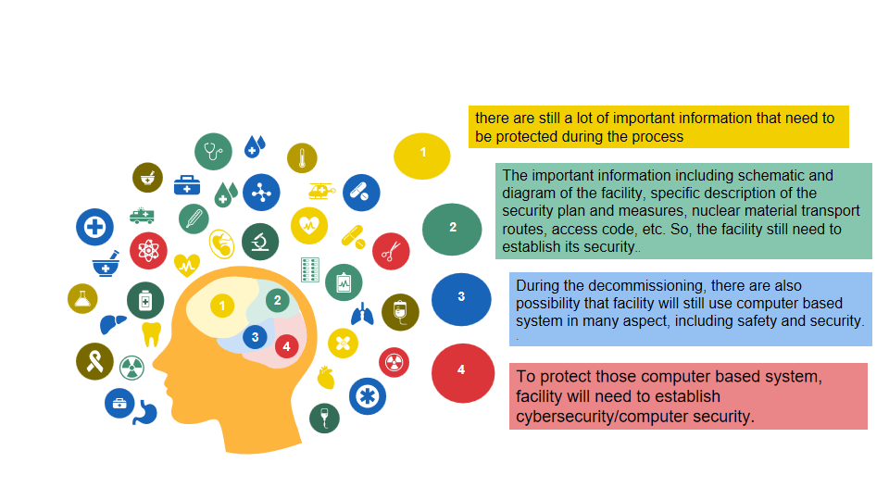
Provisions or guidelines that need to be added to the regulations
1. Provision or guideline on the establishment of proper security plan based on every decommissioning steps using graded approach
4. Provision or guideline on ensuring information security and cybersecurity
5. Provision on the requirement of financial guarantee of security infrastructures on long decommissioning.
2. Provision or guideline on how to prevent insider threat
3. Provision on the requirement on maintaining security culture
Conclusion
Indonesia already has adequate regulations regarding decommissioning, but most of them only focus on the safety aspect.
Provisions related to security on decommissioning need to be revised in Indonesian regulations.
Several provisions that need to be added on Indonesian regulations on security of decommissioning including establishment of proper security plan using graded approach, prevention against insider threat, information security and cybersecurity, maintaining security culture, and financial guarantee of security infrastructures.

