Slide 1
REGULATORY INSPECTION STRATEGY DURING DECOMMISSIONING ACTION OF RESEARCH REACTORS IN INDONESIA
Helen Raflis, Rizal Palapa, and Lukman Hakim
Directorate of Inspection for Nuclear Installation and Materials, BAPETEN
Jakarta, Indonesia

Slide 2
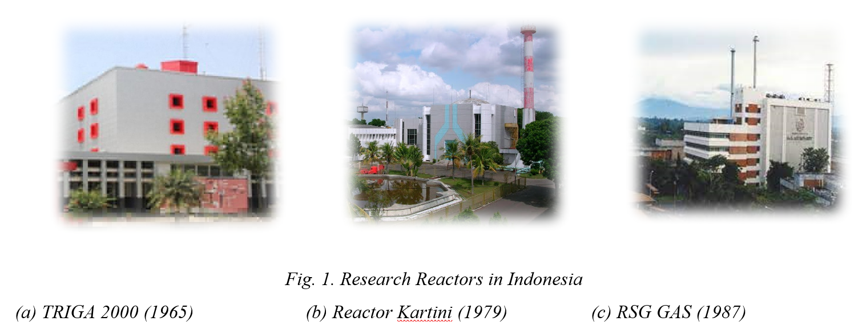
RRs in Indonesia

Slide 3
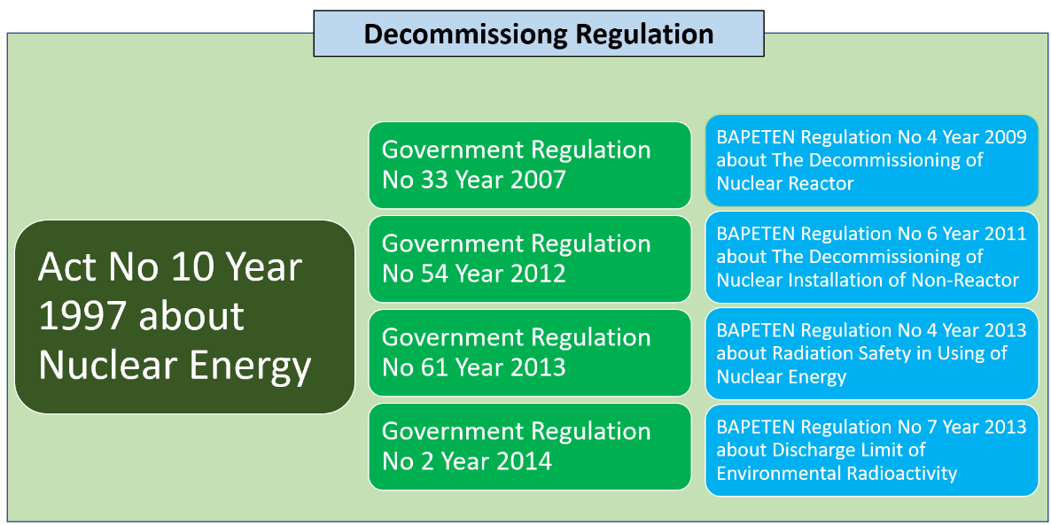
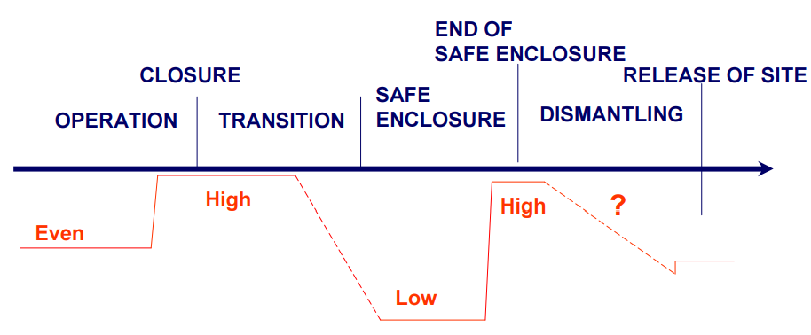
REGULATORY INSPECTION STRATEGY DURING DECOMMISSIONING
 | Operation | Decommissioning
Hazard Profile | Stable, well characterized, focus: radiological effects | Changing, less well-characterized, changeable working environment, industrial safety issues
Hazard Analysis | Operation-oriented, generally stable, focus on off-site | Dynamic, mainly task-oriented, changeable, focus on-site
Work Control and Planning | Routine operation and maintenance, short tasks | Task-/job-oriented, new tasks, work planning for workplace safety critical
Workforce Experience | Facility familiarity operation and work according to design | New mission, limited experience, contractors with little facility experience
Staff | Permanent | Changeable (tasks and phases)
Permanent Structures | Constant with maintenance | Interim facilities and degradation of structures
Publics and Involved Parties | Routine channels | Dynamic & changing (contractors)
COMPARISON OF OPERATION AND DECOMMISSIONING
No | Operation | Decommissioning
1. | Operational Safety | Handling Nuclear Fuel
2. | Maintenance and Aging Management | Dismantling of SSCs
3. | Radiation Protection | Decontamination
4. | Management System | Physical Protection
5. | Nuclear Emergency
6. | Environmental Management and Monitoring
Level of regulatory inspection

