Slide 1
Reframing Sustainability Considerations in Nuclear Decommissioning
S. CARROLL and D. OUGHTON
Vattenfall and the Norwegian University of Life Sciences

Slide 2
Key messages
Sustainability in nuclear decommissioning
Valuable approaches already today -> continue & deepen these!
…although…
Current D&D concept inherently limited, wider framing needed
Limited possibilities to fundamentally change approach to D&D for current facilities
…nonetheless…
Current projects can:
be used to develop, test and refine circular economy approaches, and
inform design choices for new facilities, enabling a new approach to decommissioning
… and …
There is an opportunity now to develop a more sustainable and circular approach to nuclear decommissioning already at the design stage for new reactor designs (ANRs/SMRs)

Slide 3
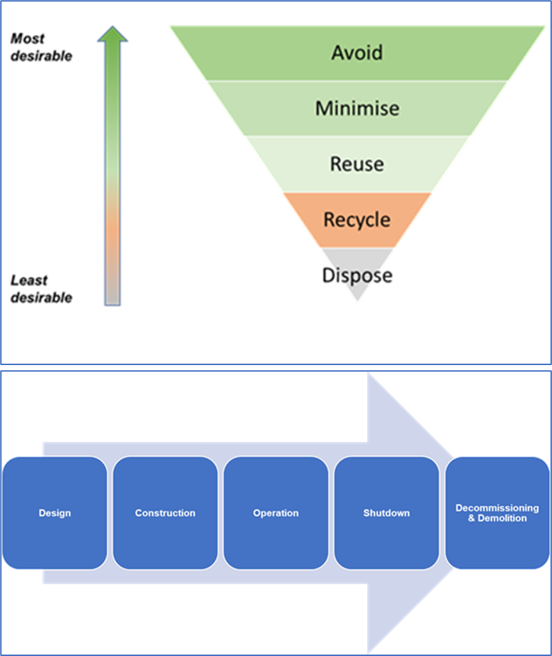
Addressing sustainability of decommissioning
Protection of the environment is well-established in nuclear decommissioning
Waste hierarchy applied to the management of radioactive wastes in the nuclear sector generally
Decommissioning is generally seen as the final stage of a linear nuclear facility life-cycle model
Wider sustainability issues are gaining increasing attention
Weaknesses in the waste hierarchy and linear life-cycle frameworks are seen in the context of increased focus on sustainability, including circular economy

Slide 4
From waste hierarchy towards circular economy
Replace a stepped pyramid by a hierarchy of “loops”
Reduce system inputs and minimize residual waste
Go beyond waste management to address design
Notes:
There are a number of differing definitions of circular economy
In general, they aim to manage resources better by reusing, rethinking, and reducing unnecessary consumption
Goals include retaining materials and resources circulating in a system at their highest value
It aims to reduce the need for additional system inputs and minimize residual waste leaving the system
Applied to the products of decommissioning, a more circular economy style approach would consider a hierarchy of “loops”, with the aim of optimizing recirculation of resources

Slide 5
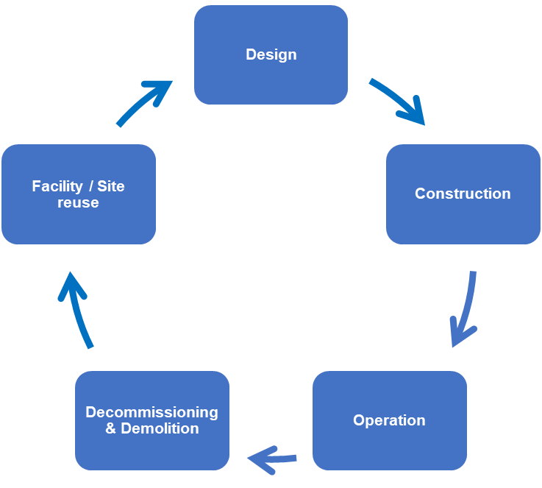
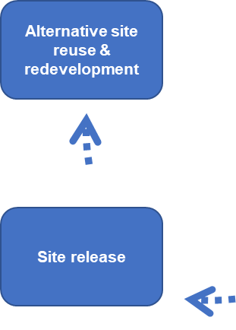
A circular lifecycle
Would it be possible to use a more circular approach to transform the linear nuclear facility life-cycle?
What might it mean …
For decommissioning?
For facility and site reuse after decommissioning?
Encourages genuine integration of decommissioning from the outset and throughout
Encourages the integration of consideration of the future uses of a facility or site
Notes:
Buildings embody a large amount of resource use in their pre-use lifecycle stages, i.e., from raw material extraction, manufacture, transportation, and construction
Lifetime extension is a critical strategy for sustainability, as keeping structures in use for as long as possible avoids unnecessary additional resource extraction, energy use and waste generation associated with replacing them
Reuse of an existing industrial site, also offers additional potential overall reduced environmental impacts compared to development of new sites.
Facility and equipment reuse in a cyclical model, e.g., through refurbishment and renovation, offers potential benefits, especially when associated with material “re-looping” as part of an overall circular economy approach

Slide 6
The imperative to move to a more circular approach
Increased extraction for construction
To 78 Gt per year
Raw materials in building construction
3 Gt per year
Waste from building demolition
293 Gt solid waste in 20th century
Construction and demolition waste (CDW) accounts for more than a third of all waste generated in the EU

Slide 7
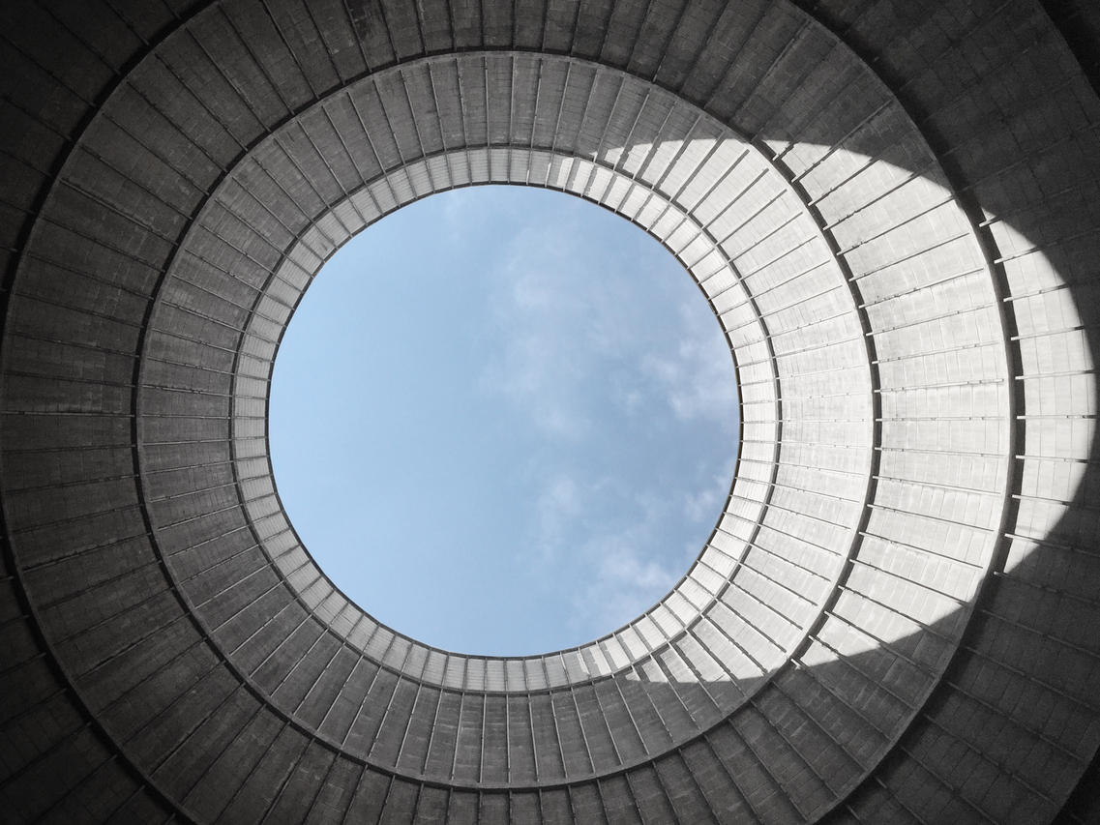
A design workflow for a circular approach
Design for Adaptability
Design for Deconstruction
Circular Material Selection
Overall Resource Efficiency
Notes:
A circular economy design workflow summarises principles which should be considered to maximize circularity, provides details of each principle & justifies their order of consideration
Design for Adaptability – extend the facility’s lifespan, allow refurbishment and renewal with the least additional resource and new material inputs
Design for Deconstruction – reuse of the components and materials inbuilt, if necessary recycle
Circular Material Selection – what you select, how you procure it, options such as leasing and buyback
Resource Efficiency – incorporating the above steps most efficiently when implementing the brief, even incorporates reuse and recycled materials and components in new build
THIS EXPLAINS IN PART WHY CAN ONLY BE IMPLEMETED SO FAR FOR EXISTING FLEET

Slide 8
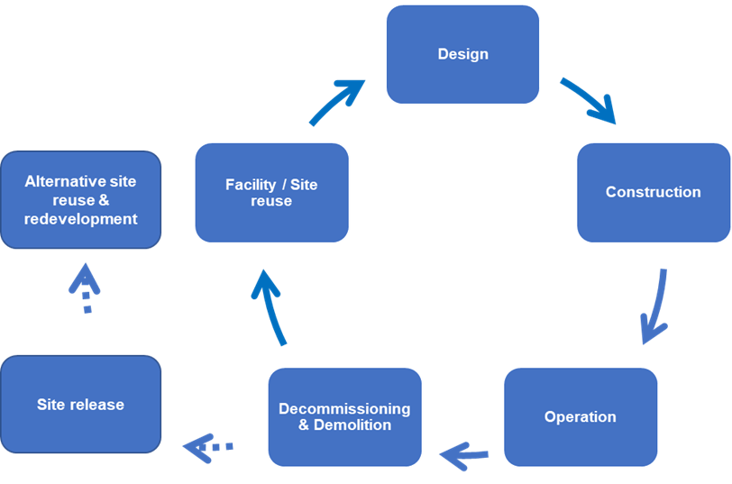
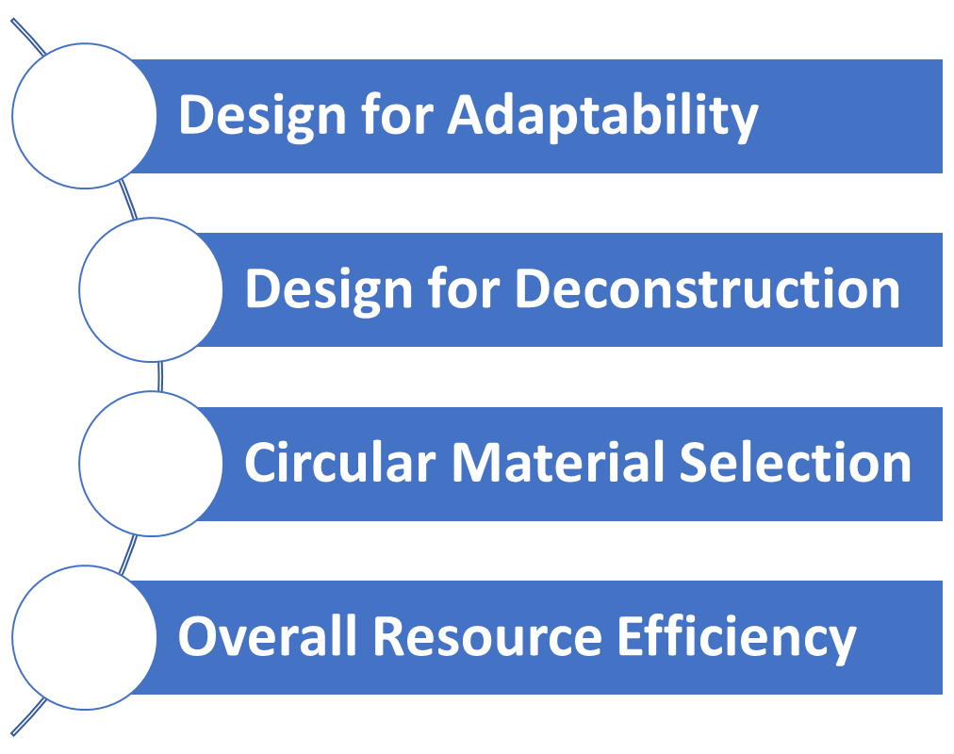
Towards a more circular framework
Continue
Strengthen
Adapt
Develop
Notes:
Continue with current approaches to reducing the environmental footprint of decommissioning activities
Strengthen these by integrating circular economy considerations through the facility life-cycle
Adapt the design workflow and apply to the design of nuclear facilities
Continue to develop sustainability initiatives in current decommissioning projects with the aim of testing and further refining circular economy approaches

Slide 9
Thank you!
Simon Carroll
Senior Adviser
BU Nuclear Decommissioning
Vattenfall AB
simon.carroll@vattenfall.com
Dr. Deborah Oughton
Professor
Center for Environmental Radioactivity (CERAD)
Norwegian University of Life Sciences (NMBU)
deborah.oughton@nmbu.no
and
Associated Scientist
Center for Environmental Radioactivity (CERAD)
Norwegian University of Life Sciences (NMBU)
simon.roy.carroll@nmbu.no

