Slide 1
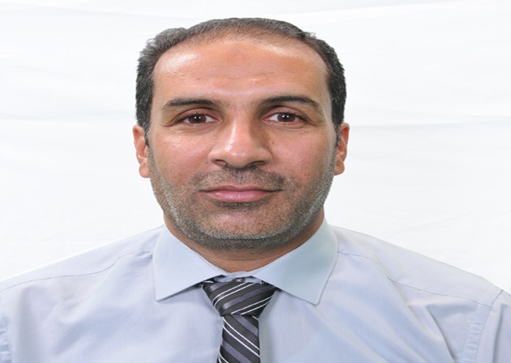
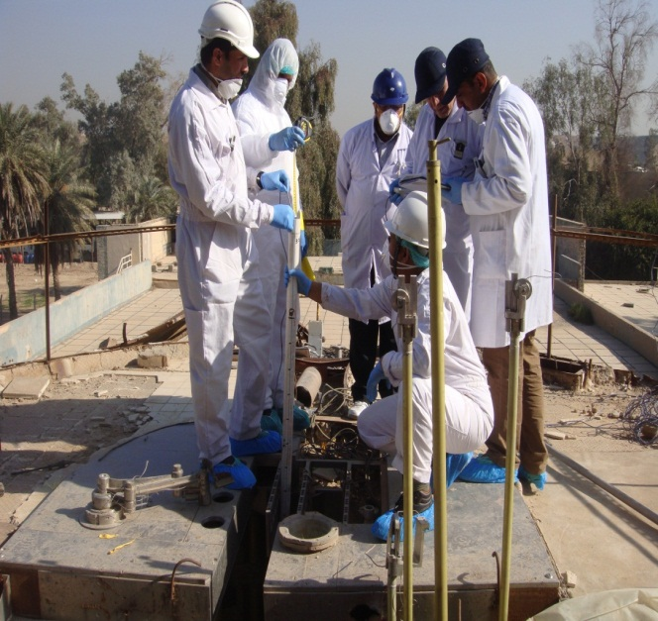
Mr Saad J.Kadhum Guardh M.Sc. in Nuclear Physics
Job/Position: chief physicist / Director of the Directorate of Decommissioning Nuclear Facilities and Sites
Organization, Country: Directorate of Decommissioning Nuclear Facilities and Sites/ Iraq Atomic Energy Commission
…, …
PROFILE PICTURE
Director of the Directorate of Decommissioning Nuclear Facilities and Sites
Manager of radiological field measurement department in Iraqi decommissioning program
Specialist in field radiological measurements, radiological characterization and preparation of radiological characterization plans according to the standards of the IAEA.
Member of the Ministry of Science and Technology Commission to prepare the plan for response to the radiological and nuclear accidents.
Member of the ministerial work team assigned with the tasks of supervising the treatment of all destroyed nuclear and radiological sites and facilities
Preparing a plan and report for the radiological characterization of IRT-5000 reactor for decommissioning purpose and leading the radiological characterization teams for the building and pool of the IRT-5000 reactor.
EXTRA PICTURE IF NEEDED (project, robot, reactor, team…)

