Slide 1
LESSONS LEARNED AND CHALLENGES IN THE
DECOMMISSIONING OF FORMER IRAQI
NUCLEAR FACILITIES
Saad Kadhum
Decommissioning Directorate of nuclear sites and facilities/Iraq Atomic energy Commission
Baghdad/Iraq
Email: saadrgt@yahoo.com

Slide 2
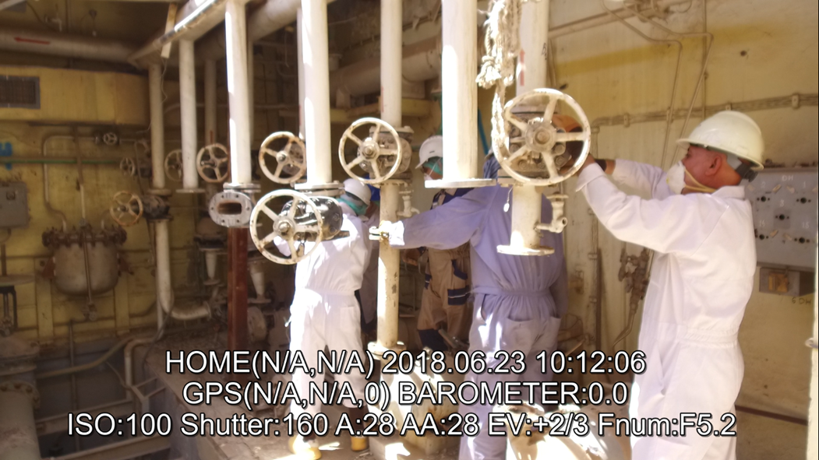
LESSONS LEARNED AND CHALLENGES IN THE DECOMMISSIONING OF FORMER IRAQI NUCLEAR FACILITIES_Decom2023_#14_ORA

Slide 3
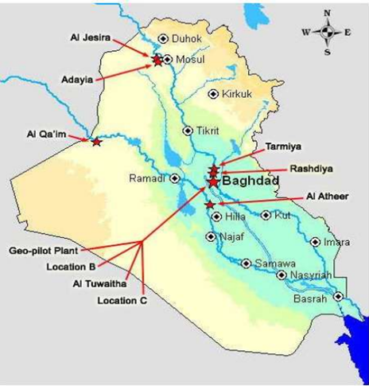
  Introduction:
There are many nuclear sites in Iraq that were previously used for nuclear activities and contain large amounts of radioactive waste. Al-Tuwaitha nuclear site is the largest and oldest of these sites.
All of these nuclear facilities and sites were bombed and destructed during the Gulf War in 1991.
Location map of the nuclear sites in Iraq

Slide 4
Cont.
During the events of 2003 and because the looting of many radioactive materials from nuclear sites and facilities which cause the increasing of the problem of the spread radioactive waste resulting from previous nuclear activities in Iraq.

Slide 5
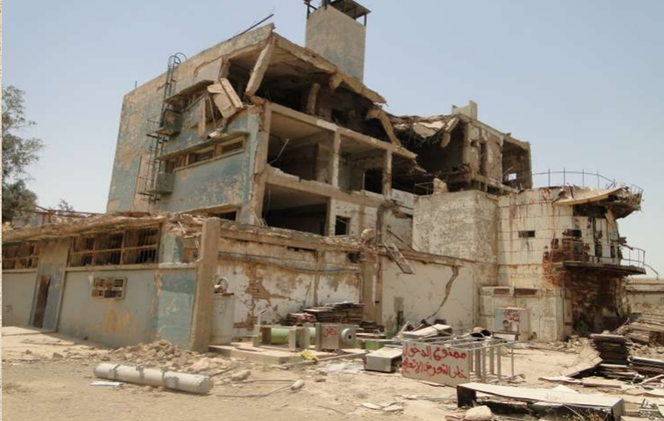
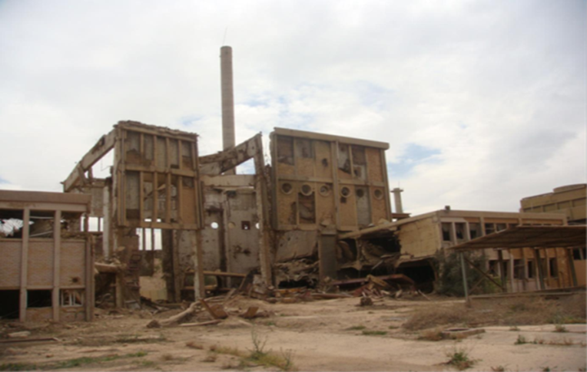
The situation of the Tammuz 2 reactor and IRT-5000 reactor before the decommissioning process

Slide 6
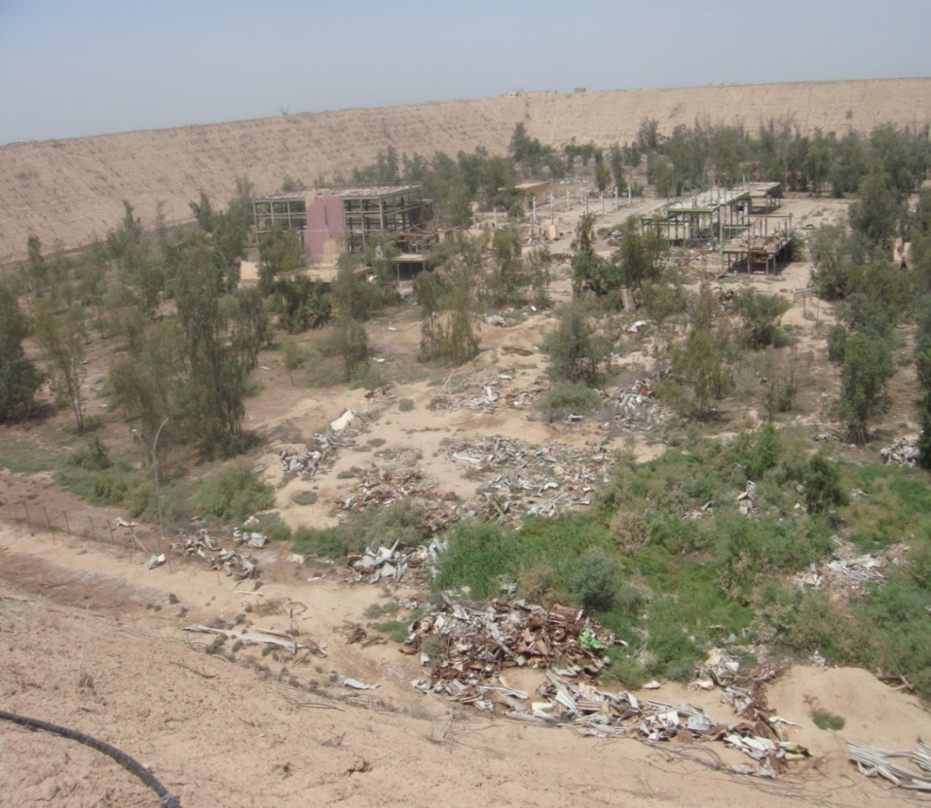
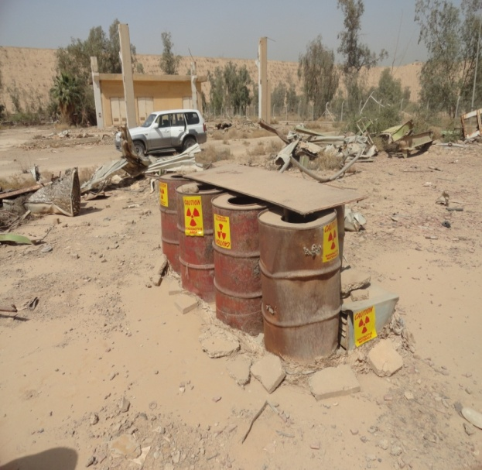
ITALIAN FUEL FABRICATION LABORATORY SITE( 2005)

Slide 7
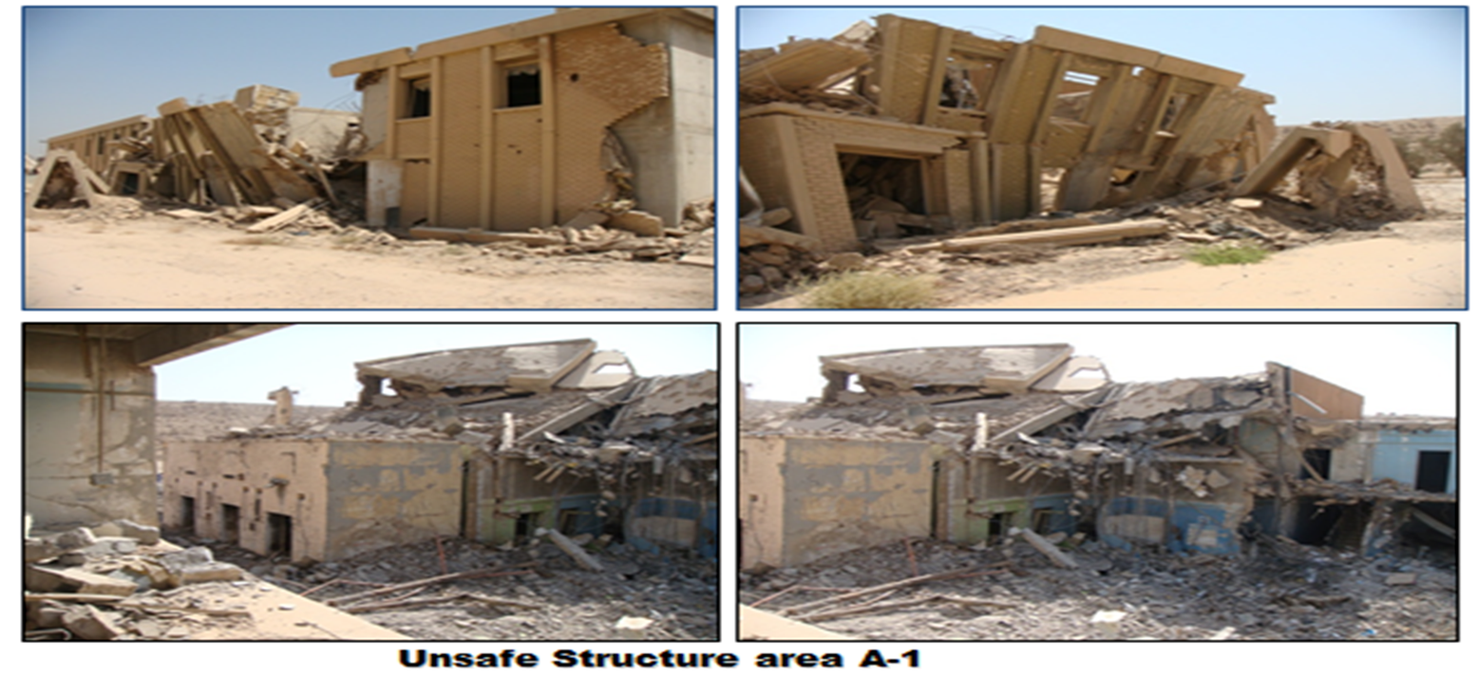
Active Metallurgy Testing Laboratory(Lama facility)

Slide 8
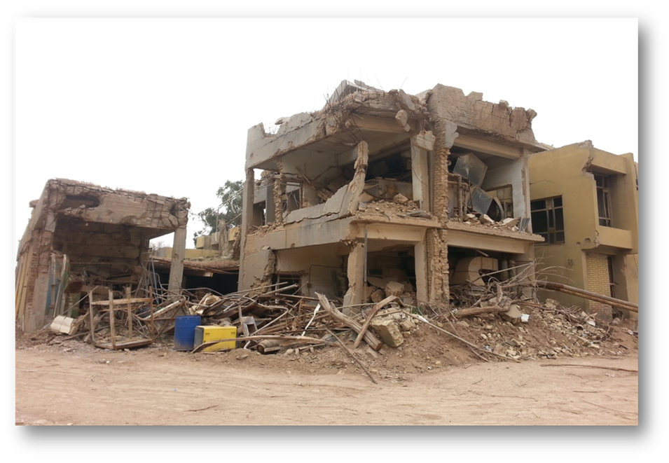
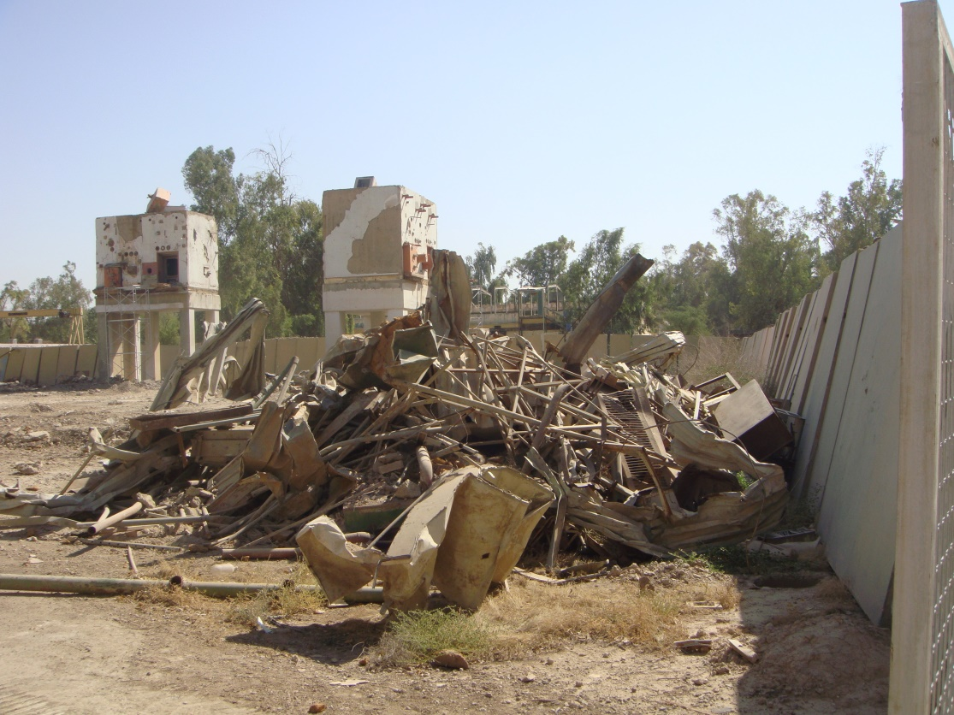
Radiochemistry Laboratories
Italian Radioisotops Production Laboratory

Slide 9
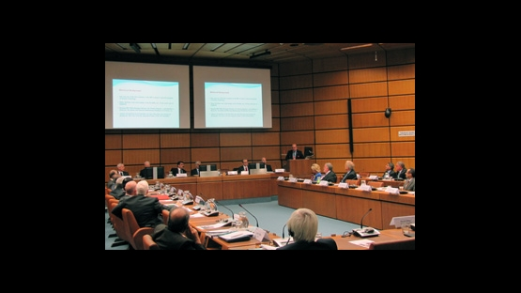
  Cont.
The Iraqi Government has requested assistance to prepare plans and programs to decommission contaminated facilities in the country. The project´s groundwork was set at an IAEA meeting in Vienna in February 2006, attended by the Iraqi Minister for Science and Technology, representatives from sixteen countries, including the US, and the European Commission.

Slide 10
  DECOMMISSIONING PROGRAM IN IRAQ
The strategic plan to decommission all former nuclear facilities and sites in Iraq included three phases.
These phases were developed based on many key factors including the lack of decommissioning experience, the lack of radioactive waste treatment and storage, and the lack of operational history of nuclear facilities
the first phase (2008-2010) to decommission three low radiological risk facilities to build the staff capacity and experience
the second phase (2011-2015) to decommission five high radiological risk facilities using the experience gained in phase-1
third phase (2016-2025) to decommission the remaining nuclear facilities and sites based on radiological risk prioritization scheme.

Slide 11
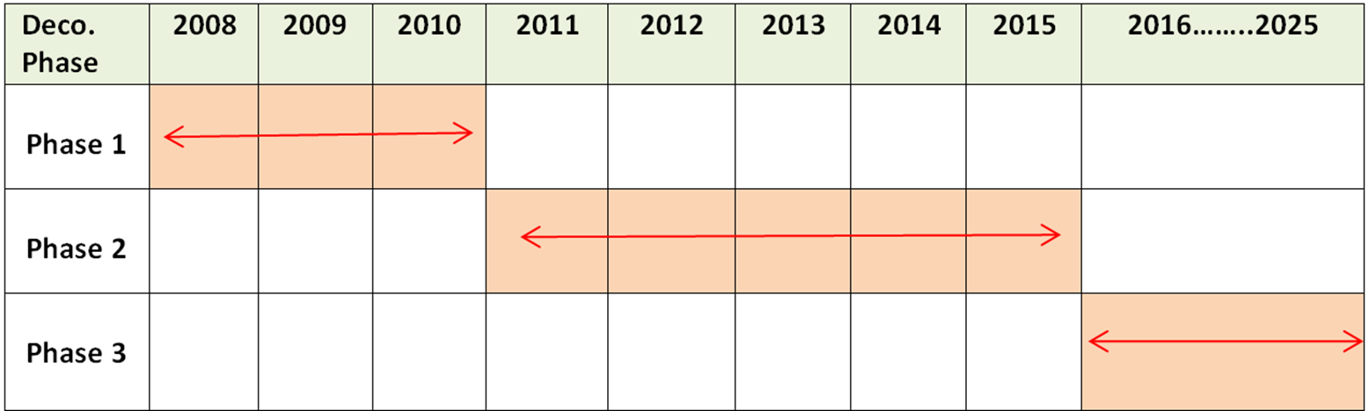
Decommissioning schedule time of all nuclear facilities and sites in Iraq

Slide 12
  CHALLENGES
Lack of experienced personnel
Absence of information about the exact operating period and accidents during the operating period
Looting of sites and facilities during the events of 2003
Iraq has never had a radioactive waste disposal facility
The security situation in Iraq.
a high dose rate within the reactor pool of the IRT-5000 reactor up to 2 Sv/hr ( measured in 2018).

Slide 13
Lessons learned
It is very necessary to seek the assistance of the IAEA to assist in any decommissioning program
In phase 1, three low risks projects were chosen to be decommissioned
The assessment of risks needs to be performed in all phases
Documentation and information of exact operating period and accidents facilities are very important
the safe enclosure strategy had chosen for dismantling the IRT-5000 research reactor(Iraq has never had a radioactive waste disposal facility)
The priority of decontaminated areas should given to the areas located near public living

Slide 14
Cont.
Improve radiological characterization methods, according to the case, for example we performed a local collimator to perform additional measurements for this purpose and according to the recommendations of the IAEA experts and in order to find out the cause and position of the high radiation dose.
It is very necessary to benefit from the information of retired workers who worked in nuclear facilities

Slide 15
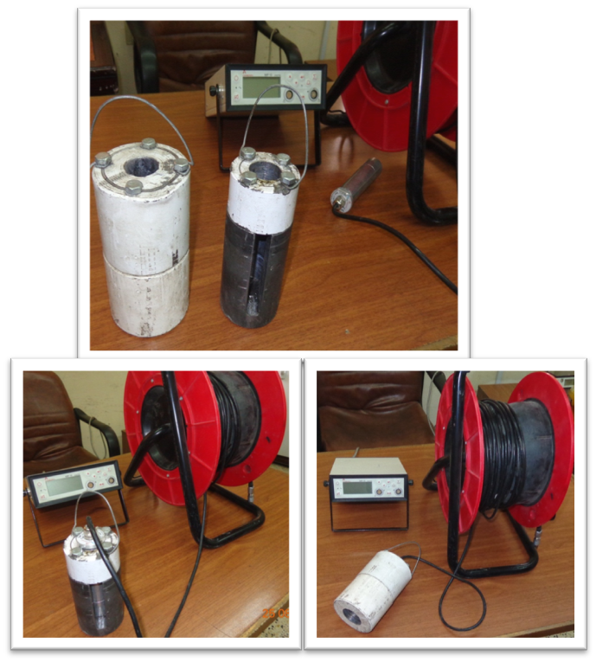
local collimator to improve radiological characterization

Slide 16
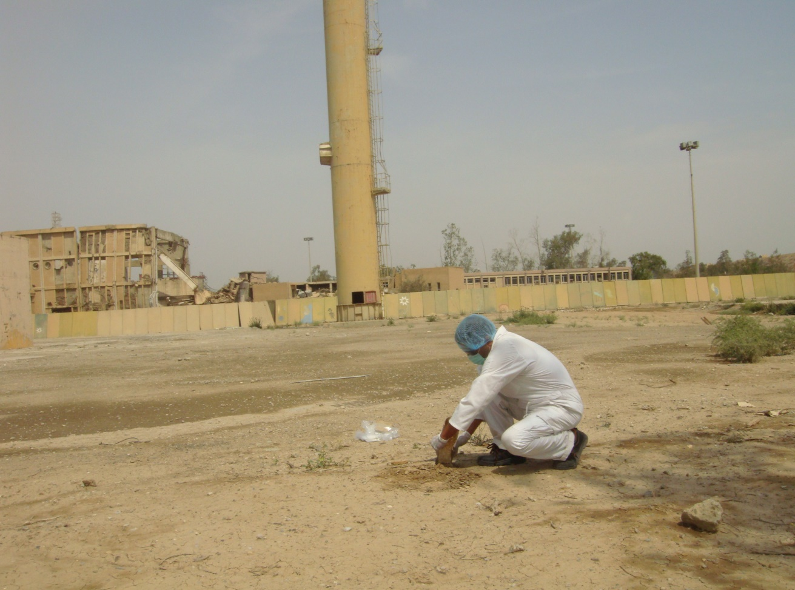
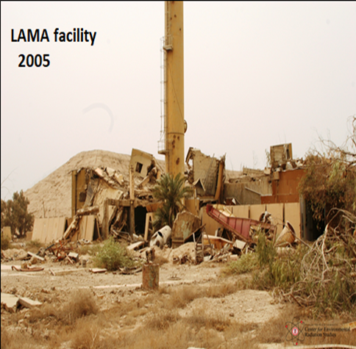
Lama facility before and after decommissioning

Slide 17
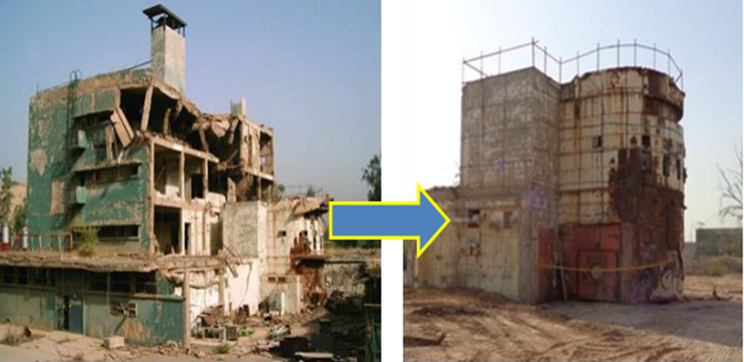
IRT-5000 reactor decommissioning Phases

Slide 18
  CONCLUSION
The process of decommissioning destroyed nuclear facilities is a complex and difficult process
many challenges and lessons learned from this experience
IAEA has a very important and effective role in helping Iraq to overcome most of the challenge.

Slide 19
REFERENCES
Bibi, A., Al-Musawi, F., Jassim, H., & Abd Alhadi, Q. "Decommissioning Challenge of Destroyed Nuclear Facilities and Sites in Iraq." Revue Générale Nucléaire 4 (2013): 37-41.‏
Cochran, J. R., Danneels, J. J., Phillips, C., & Chesser, R. "Iraq nuclear facility dismantlement and disposal project." Proceedings from Waste Management'07 (2007)

Slide 20
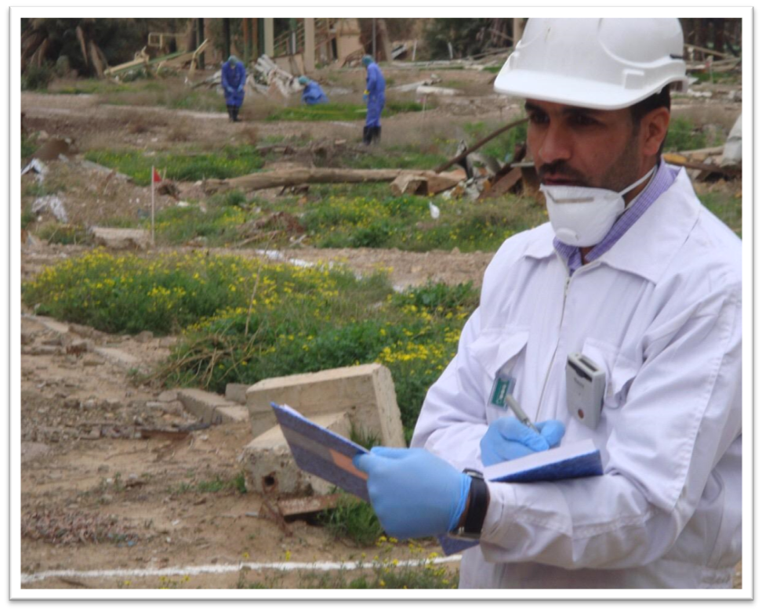
thank you for your listening
Questions?

