Slide 1
TERMINATION AND RENEWAL of CHORNOBYL NPP DECOMMISSIONING LICENSE (No 13)
Tamara SUSHKO
State Nuclear Regulatory Inspectorate of Ukraine (SNRIU)
E-mail address: tv.sushko@snriu.gov.ua

Slide 2
TERMINATION AND RENEWAL of CHORNOBYL NPP DECOMMISSIONING LICENSE
The only nuclear facility in Ukraine that has decommissioning license is Chornobyl NPP. License No 000040 issued on March 22, 2002
From February 24 to March 31, 2022, Chornobyl exclusion zone and Chornobyl NPP site were occupied by Russian military formations
Regulatory control over state of nuclear and radiation safety at Chornobyl NPP site and in exclusion zone was impossible
In Ukraine there was no experience in safety regulation of nuclear facilities that were under occupation of military formations, as well as after de-occupation. There is also no world experience or international recommendations on safety regulation under similar conditions
Shutdown Stage
Final Shutdown and Preservation Stage
Safe Exposure stage
Dismantling stage
2002
2015
2028
2045
2065

Slide 3
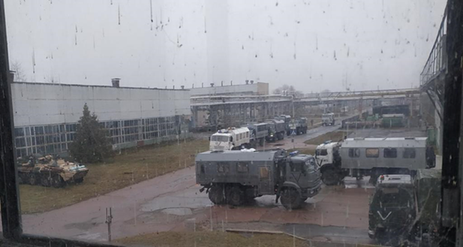
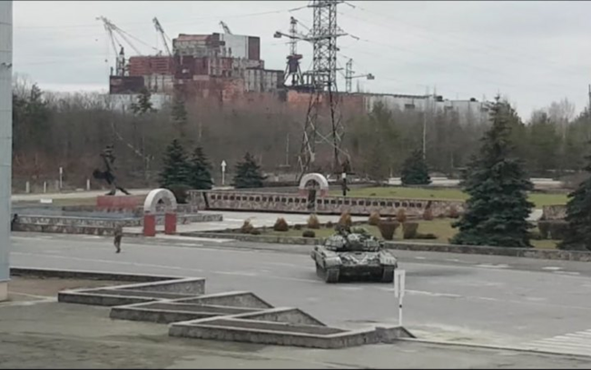
TERMINATION AND RENEWAL of CHORNOBYL NPP DECOMMISSIONING LICENSE
On April 26, 2022, SNRIU made decision to terminate the validity of Chornobyl NPP decommissioning and radwaste management licenses.
Reason for termination of licenses was inability of Chornobyl NPP to carry out activities in connection with occupation of exclusion zone and ChNPP site by Russian military formations:
probability of mining territory
lack of safe connections (bridges, roads)
violation of physical protection system
need to check presence of radioactive waste and nuclear materials at site
sufficiency of personnel at Chornobyl NPP to carry out licensed activities

Slide 4
TERMINATION AND RENEWAL of CHORNOBYL NPP DECOMMISSIONING LICENSE
SNRIU, technical support organization (SSTC NRS) with support of Norwegian Radiation and Nuclear Safety Authority (DSA) developed two recommendation documents:
“Recommended approach to state regulation of safety of nuclear and radiation facilities located in Chornobyl exclusion zone, which was affected by military actions”
defines approach regarding scope and specifics of application of principles, general provisions and relevant safety requirements, as well as procedures for licensing and state supervision
“Recommended procedure for restoring level of safety of nuclear and radiation facilities located in Chornobyl exclusion zone, which was affected by military actions”
establishes recommended procedure, in particular, regarding inspection of presence and condition of spent fuel, radwaste and other radioactive materials, possibilities of safe operation of facilities, radiation monitoring, licensees' ability to carry out activities in accordance with safety requirements, identification of safety deficiencies, development and implementation of measures to eliminate identified safety deficiencies, others

Slide 5
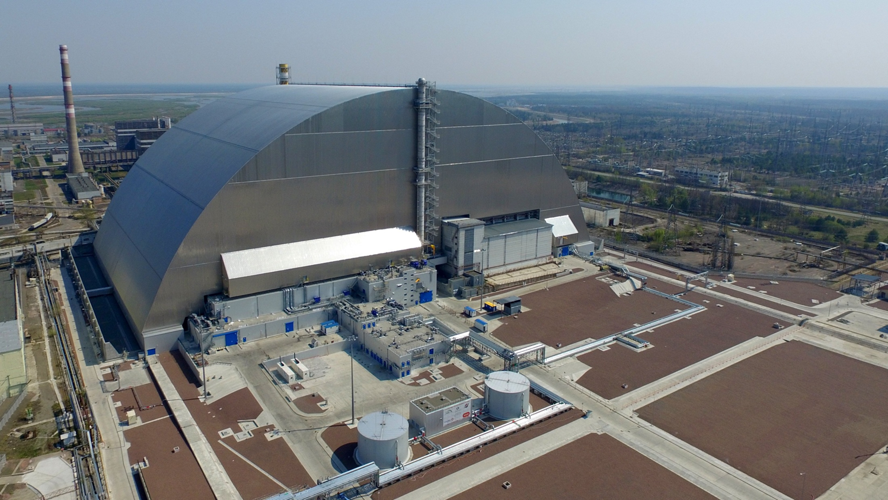
TERMINATION AND RENEWAL of CHORNOBYL NPP DECOMMISSIONING LICENSE
SNRIU made request to Chornobyl NPP to provide supporting documents regarding possibility of continuing activities, in particular, regarding:
provision of necessary number of qualified personnel to perform work at sites
ability to perform work provided for by regulations, instructions, programs
conducting radiation-dosimetric monitoring, individual dosimetric control
presence of accounting quantity of nuclear and radioactive materials
state of physical protection system
provision of measures for emergency preparedness
availability of reporting documentation, databases
Chornobyl NPP has provided confirmation of the ability to continue its activities in accordance with conditions of licenses
On August 11, 2022, validity of ChNPP licenses were renewed by SNRIU.

Slide 6
TERMINATION AND RENEWAL of CHORNOBYL NPP DECOMMISSIONING LICENSE
CONCLUSION
Recommendation documents of safety regulation of activities at Chornobyl NPP after de-occupation of exclusion zone were developed
Documents establish recommended approaches to application of legal framework and procedure for facilities safety restoring
Chornobyl NPP performed necessary inspections and surveys of equipment, premises, presence of accounting quantity of radioactive and nuclear materials and databases. Licensee introduced a new scheme for delivery and stay of personnel at site
Results of inspections and surveys were the basis to made regulatory decision on renewal of license for decommissioning of Chornobyl NPP and licenses for radioactive waste management

