Slide 1
R-matrix evaluations of (𝛂,n)
IAEA Technical Meeting on (alpha,n) nuclear data evaluation and data needs
G. Hale & M. Paris (LANL/T-2)
2021-11-11
LA-UR-21-31247

Slide 2
Outline
Motivations
  Nuclear security
  Nonproliferation
  Criticality safety
  Energy
  Basic science
R-matrix formalism & EDA_{f90} code
Overview of (𝜶, z) evaluations [z = n, p, d, t, 3He, 𝜶]
¹⁷O system evaluation progress report:
  ¹³C(𝜶,n) evaluated data
Myriad, high-impact; but we
won't talk about these today

Slide 3
Light-element R-matrix evaluation
Overview
Main objective
  Provide continuous (energy, energy-angle) representations of nuclear scattering and reaction cross section data
Theoretical basis [Wigner&Eisenbud ’47]
  Quantum theory: unitary; causal; analytic
  Unitarity: exp’l QA/UQ
  Causal: ensures resonance parameter fidelity
  Analyticity: threshold physics is right
  Relativistic kinematics
Why do “evaluation”?
  Correlate observables for processes coupled to particular compound system
    ~10⁵ data points (0, ~10) MeV < ~10² pars
  Adjust for systematics in different experiments: e.g. resolution; norm; etc.
High-fidelity data descriptions
  ~30 compound systems
    NN, ³H, ³He, ⁴He, ⁵He, ⁶Li, ⁷Li,
    ⁸Li, ..., ¹⁷O, ..., ²⁹Si

Slide 4
Light-element R-matrix evaluation
R-matrix formalism

Slide 5
Light-element R-matrix evaluation
Evaluation process
EDAf90 code handles all types of data [sources: EXFOR/CSISRS; publications; priv. comm.]
  total, integrated, diff’l, polarized, unpolarized; neutron- and CP-induced: (n,z), (p,z), (d,z), (t,z), (𝜶,z), ...
EDAf90 handles all the compound system (e.g.: ¹⁷O) data simultaneously
Optimization over parameters simultaneously fits all the data with the same parameters
EDAf90 → ENDF-6 formatted ENDF/B libraries for processing to CE & MG libraries
Testing & evaluation by hand; future: automate

Slide 6
Light-element evaluations
Overview
All compound systems A<20 (and a few above)
Recent work in 2020/2021 (Charged-particle transport libraries FY20 L2 Milestone)
¹¹B (α+⁷Li, α+⁷Li*, ⁸Be+t, n+¹⁰B); ¹¹C (α+⁷Be, p+¹⁰B)
¹²C (⁸Be+α, p+¹¹B)
¹³C (n+¹²C, n+¹²C*)
¹⁴C (n+¹³C)
¹⁵N (p+¹⁴C, n+¹⁴N, α+¹¹B)
¹⁶O (γ+¹⁶O, α+¹²C)
¹⁷O (n+¹⁶O, α+¹³C)
¹⁸Ne (p+¹⁷F, p+¹⁷F*, α+¹⁴O)

Slide 7

¹⁷O Preliminary evaluation
Preliminary results
Configuration: channels, R-matrix parameters
Observed data in data deck
  Channels: (n,n₀), (n,n₂), (𝜶,n₀), (𝜶,n₁), (𝜶,n)
  Types: total, integrated, differential, polarization [A_{y}, P_{n}]
New data
  Ciani et al. (2021) (𝜶,n₀)
  Brandenburg & Meisel (2021) (𝜶,n)
  Febbraro, DeBoer et al. (2020) (𝜶,n₀), (𝜶,n₁)
17O system channel/pars
# channels: 45
  J^{𝝅}=1/2±, ..., 11/2±
# parameters
  E_{𝜆}: 81 level energies
  𝛾_{𝜆,c}: 322 reduced widths
# Normalizations
  n_{M}: 95 norm scales
  $Δ$E_{M}: 4 shift factors

Slide 8
¹⁷O Preliminary evaluation
Preliminary results: (𝜶,n₀)
preliminary
preliminary
preliminary
preliminary

Slide 9
¹⁷O Preliminary evaluation
Preliminary results: (𝜶,n₁)
preliminary
preliminary
preliminary
preliminary

Slide 10
¹⁷O Preliminary evaluation
Preliminary results: low energy

Slide 11
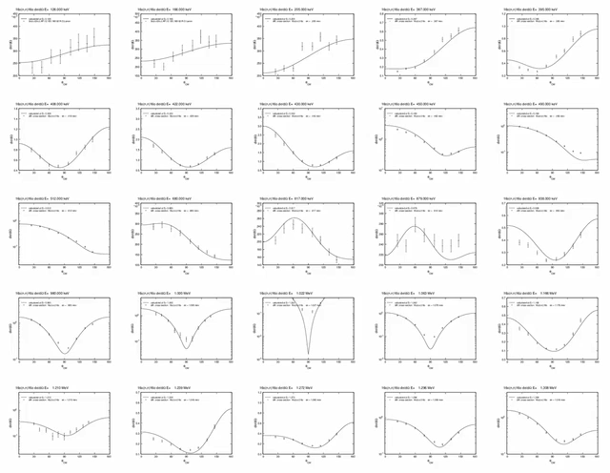
¹⁷O Preliminary evaluation scope
Preliminary results

Slide 12
Conclusion
Main task in CY2021
  complete ¹⁷O evaluation for E_{n} ~ 10 MeV
    Check for additional low-energy (< 7 MeV) data
    Incorporate (n,𝜶) data
    Check consistency of included data with normalization/energy-shift factors
    Provide low-energy extrapolation for (𝜶,n)
    Publish R-matrix parameters (level energies, reduced widths, channel radii and BC)
Ongoing work on (𝜶,n) evaluations
  2→2 body reactions
    ³H(𝜶,n)⁶Li [E_{𝜶} ~ 11 MeV]
    ⁷Li(𝜶,n)¹⁰B [E_{𝜶} ~ 4.5 MeV]
    ⁶He*(𝜶,n)⁹Be [Q>0]
    ⁸Li*(𝜶,n)¹¹B [Q>0] (no ¹²B system evaluation yet)
    ⁹Be(𝜶,n)¹²C [Q>0]
Future capabilities
  Larger A > 20 compound systems
    ¹⁹F(𝜶,n)²²Na(2.3 MeV); ¹⁴N(𝜶,n)¹⁷F(6 MeV); ¹⁵N(𝜶,n)¹⁸F(8 MeV)
  2→3 body reactions
    ¹³C(𝜶,n𝛾)¹⁶O
    ²H(𝜶,np)⁴He [E_{𝜶} ~ 6 MeV]
    ⁹Be(𝜶,n)3⁴He [E_{𝜶} ~ 2.2 MeV]

