Slide 1
2nd IAEA Technical Meeting on Disruptions and their Mitigation 19–22 July 2022 Closure

Slide 2
General Discussion
Meeting format: Keep it? Improvements?
Meeting date: September?

Slide 3
Meeting Output
All presentations (talks and posters) are now available on INDICO
Short summary paper with an outlook to R&D of the next 2 years is a possibility (options will be discussed with IAEA)

Slide 4
Many Thanks …
Chairs
Fabio Villone
Matthias Hölzl
Local support team
Ana Maria Rosa Castaneda
IAEA
Matteo Barbarino
Programme Committee
And to everyone who participated in person and remotely!
Carlo Sozzi
Cristina Rea
Gabriella Pautasso
Valerie Izzo
Brendan Lyons
Eric Nardon
Celine Rossini
All tour guides
Ruben Gomez Zaragoza

Slide 5
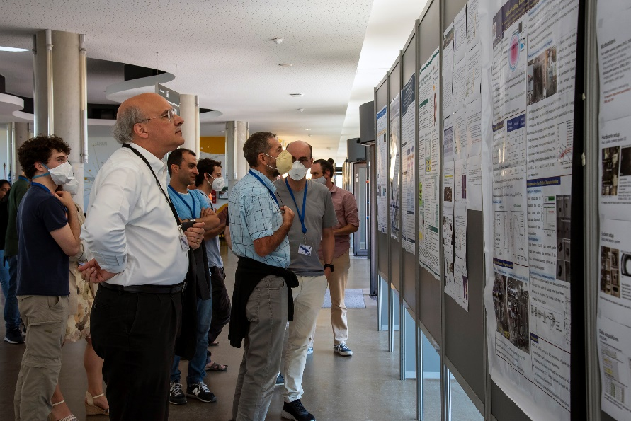
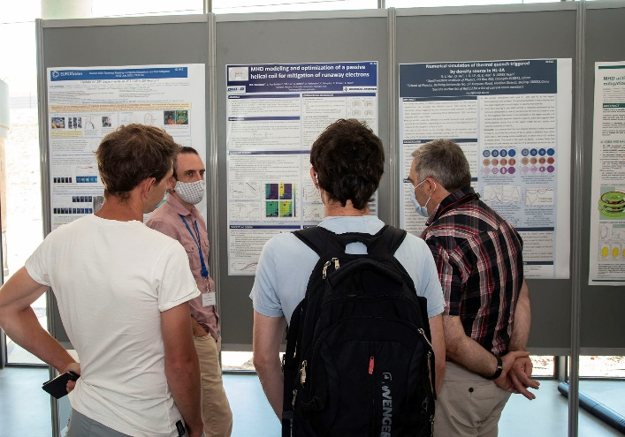
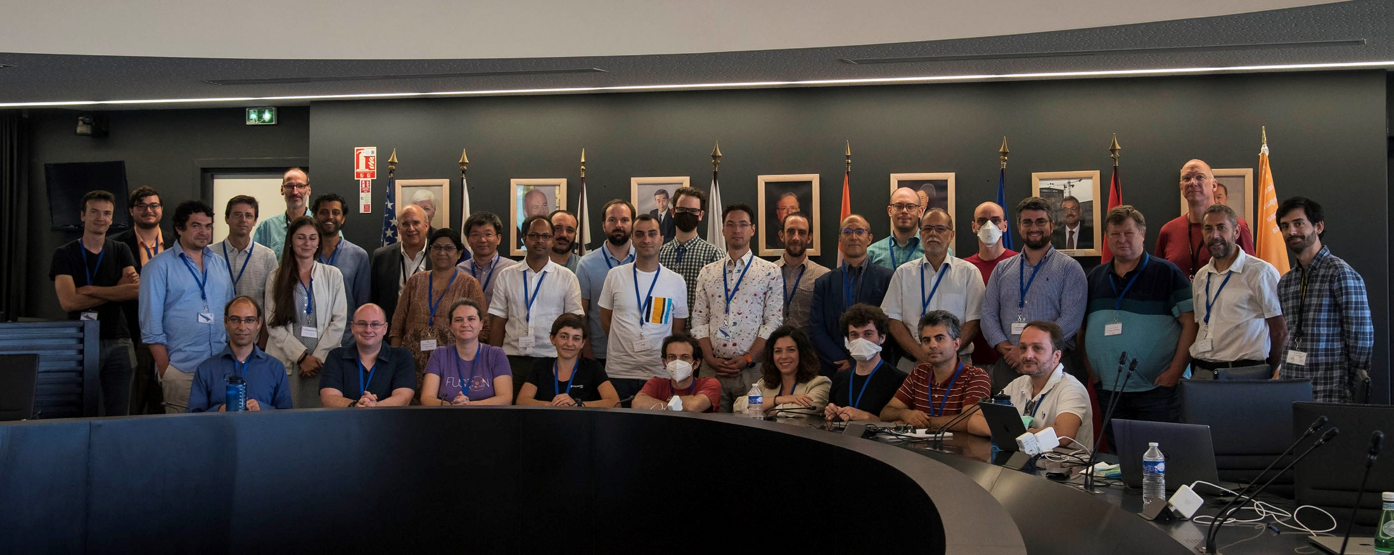
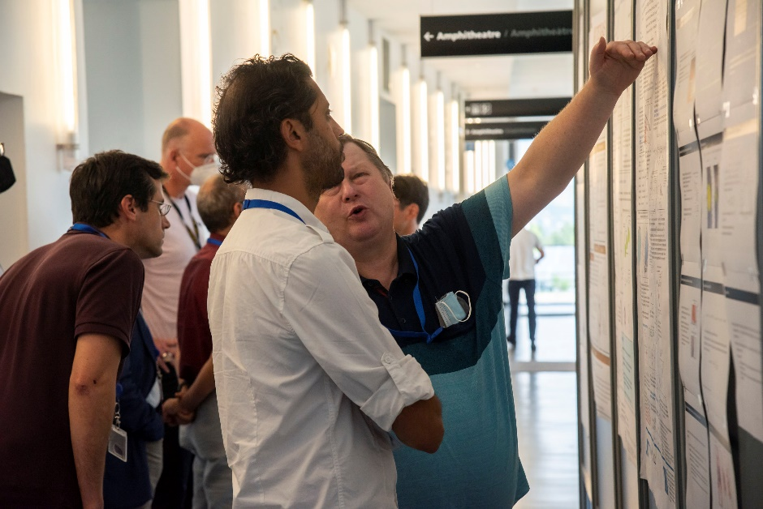
Photos
Can be found on Indico when logged in

Slide 6
Meeting in 2023
Theory and Simulation of Disruptions Workshop at PPPL
Exact date tbd
Organized by Amitava Bhattacharjee
Previous TSD workshops: https://pppltsdw.princeton.edu/

