Slide 1
Disruptions in ITER
2nd IAEA Technical Meeting on Disruptions and their Mitigation
19–22 July 2022
Michael Lehnen
ITER Organization, Route de Vinon-sur-Verdon – CS 90 046,
13067 St Paul Lez Durance Cedex – France
ITER is the Nuclear Facility INB no. 174. This presentation explores physics processes during the plasma operation of the tokamak when disruptions take place; nevertheless the nuclear operator is not constrained by the results presented here. The views and opinions expressed herein do not necessarily reflect those of the ITER Organization.

Slide 2
Introduction / Outline
Disruptions in ITER STAC meetings since last IAEA TM:
  Plasma-facing component behaviour under transient loads and impact on the ITER research plan (R. Pitts)
  Progress on the status of the Disruption Mitigation System (DMS) design activities including the experimental basis for its design and use (U. Kruezi, M. Lehnen)
This talk gives a short summary along these topics
(focusing on disruptions)
DMS design and technology work will be presented by S. Jachmich on Friday

Slide 3
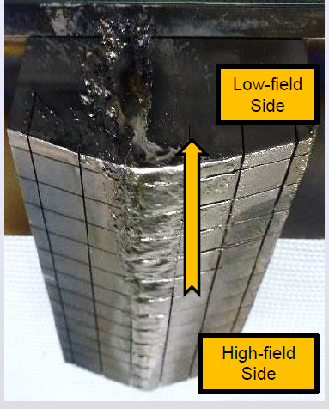
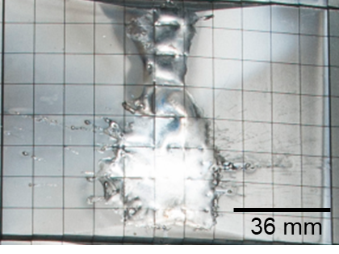
Disruption Heat Loads
Most critical for PFC lifetime:
  Current quench heat loads
  → long events ~1s in limiter configuration
  → melt motion can cause strong surface erosion
  Runaway Electrons
  → very fast and localised bulk energy deposition
  → strong erosion and risk of water leaks
JET
Transient damage does not always mean lifetime is compromised
→ Depends on where the damage occurs
I. Jepu et al., NF 59 (2019) 086009
G. F. Matthews et al., Phys. Scr. T167 (2016) 014070

Slide 4
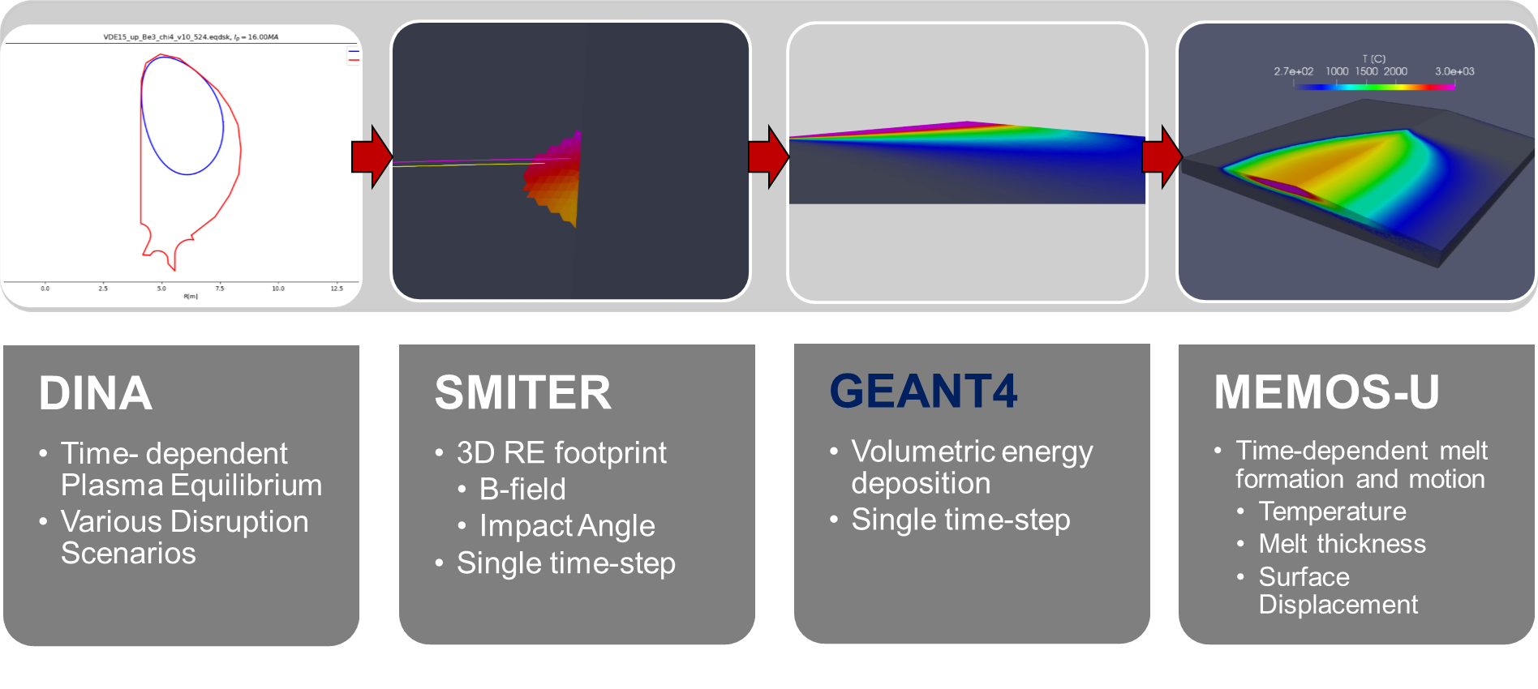
Disruption Heat Loads
Simulation workflow developed at IO to assess CQ and RE heat loads
(RE)
RE impact and CQ heat loads on
  Outer divertor baffles
  Upper first wall panels
J. Coburn et al 2022
Nucl. Fusion 62 016001
L. Chen et al, AAPPS–DPP 2021, APS-DPP 2021, PSI 2022

Slide 5
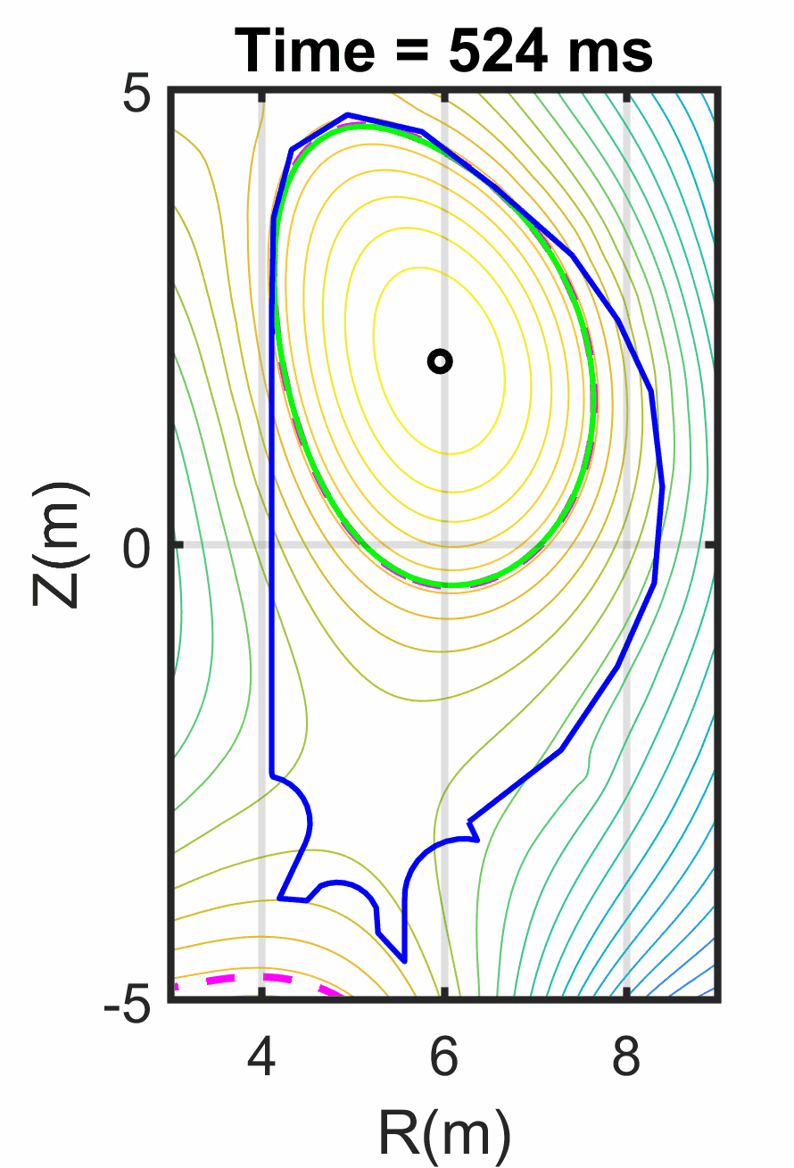
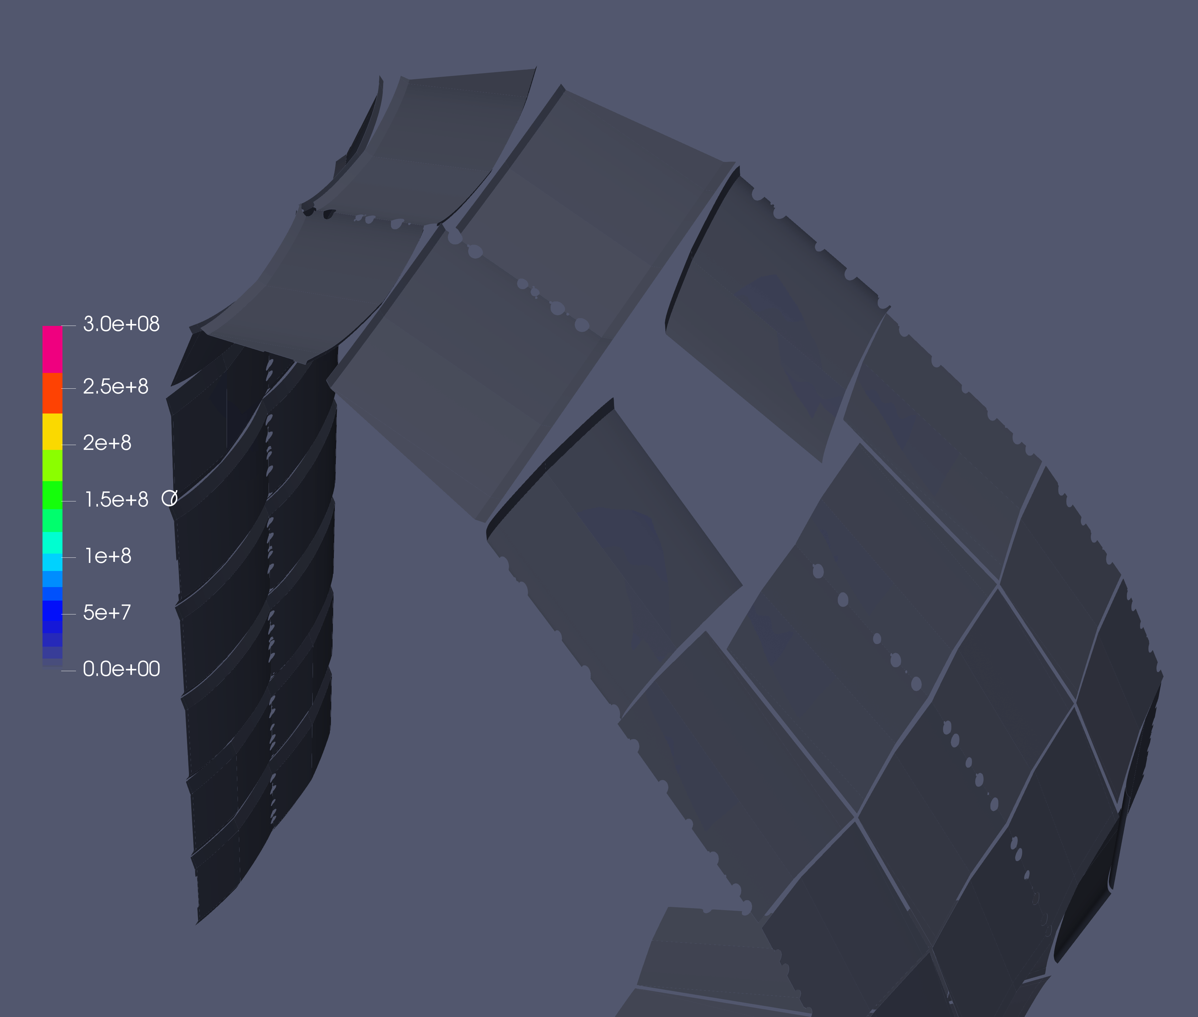
Upward VDE/MD CQ at 15 MA
J. Coburn et al 2022
Nucl. Fusion 62 016001
Deposits ~600 MJ of magnetic energy over
~400 ms
Peak I_{halo} ~5.5 MA
I_{halo}/I_{p} ~ 0.4 → Cat II
FWP #8
FWP #9
FWP #7
FWP #10
q⊥ (Wm⁻²)
VDE_15MA_up_Be3_chi4
15 MA/5.3 T, n_{Be} = 1x10¹⁹ m⁻³

Slide 6
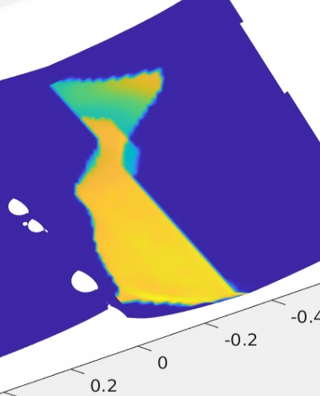
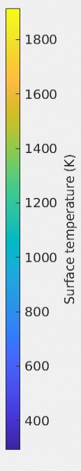
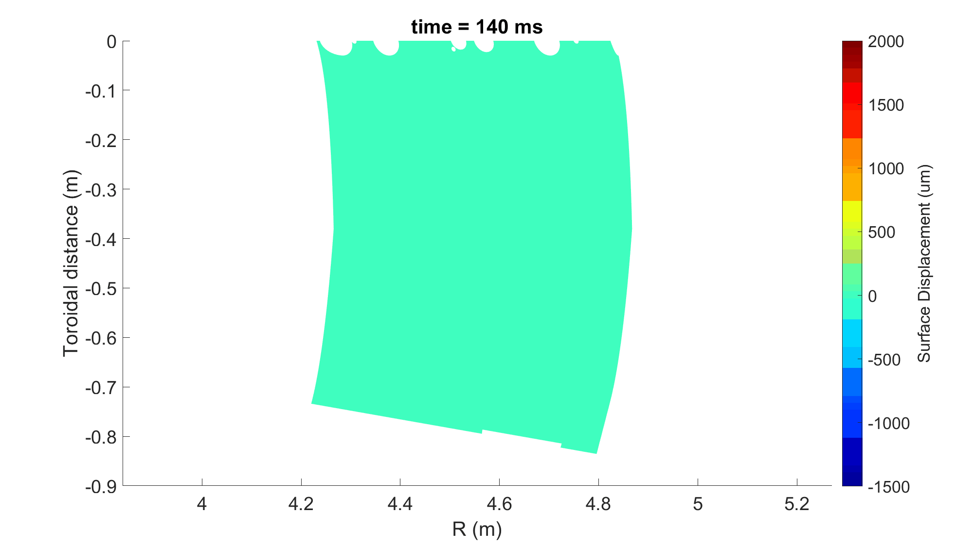
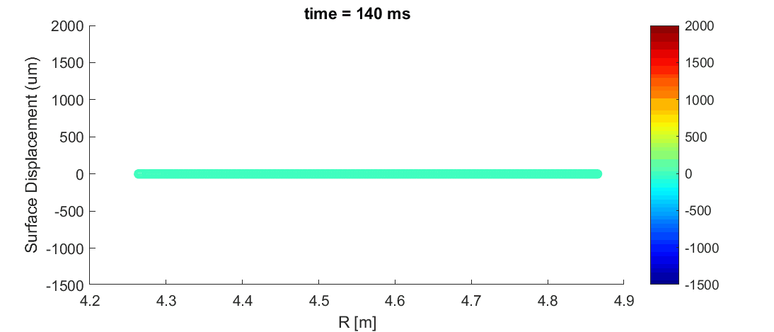
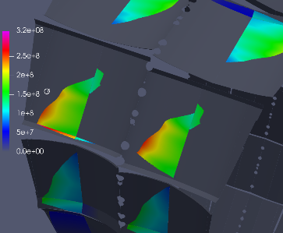





Upward VDE/MD CQ at 15 MA
J. Coburn et al 2022
Nucl. Fusion 62 016001
Max. erosion depths of ~2 mm over wide area
FWP end-of-life after only a few events
Be finger toroidal gap bridging can cause large EM loads in subsequent events
FWP melt extent and severity much reduced at 7.5 MA
NB: No baffle or FWP melting at 7.5 MA for downward VDE
FWP #8
Melt Buildup
$${\vec{J}}_{halo}$$
$$\vec{J} x \vec{B}$$
$${\vec{B}}_{φ}$$
Melt Excavation
$$\vec{J} x \vec{B}$$
$$\vec{J} x \vec{B}$$

Slide 7
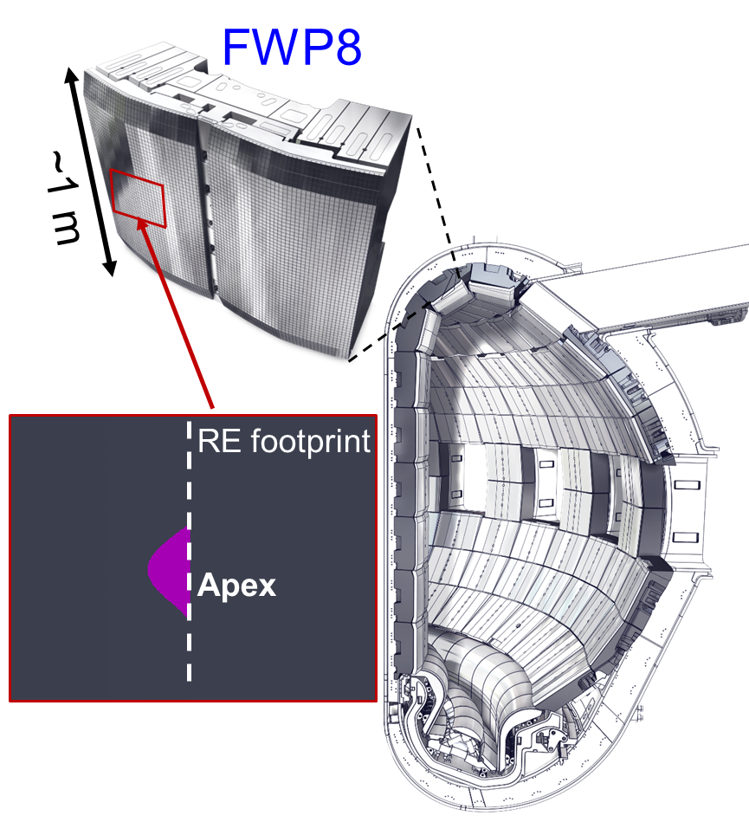
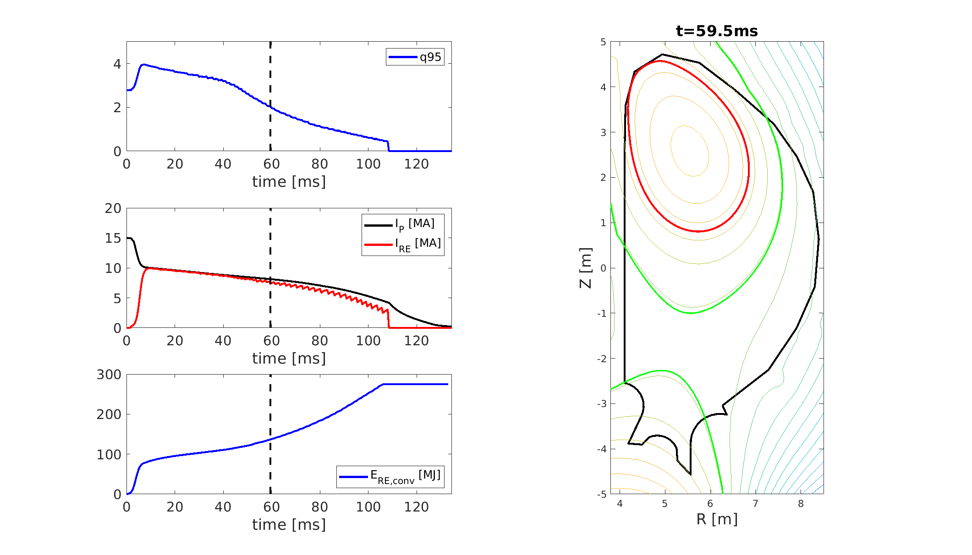
RE impact on ITER’s upper panels
DINA 10 MA RE scenario
L. Chen et al PSI 2022

Slide 8
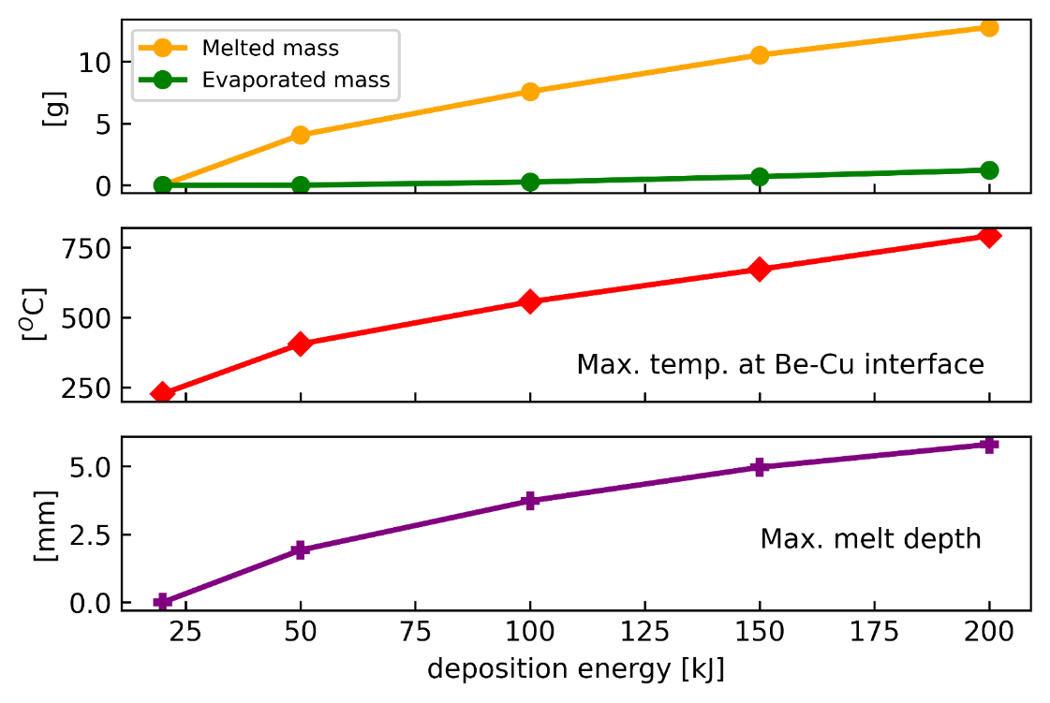
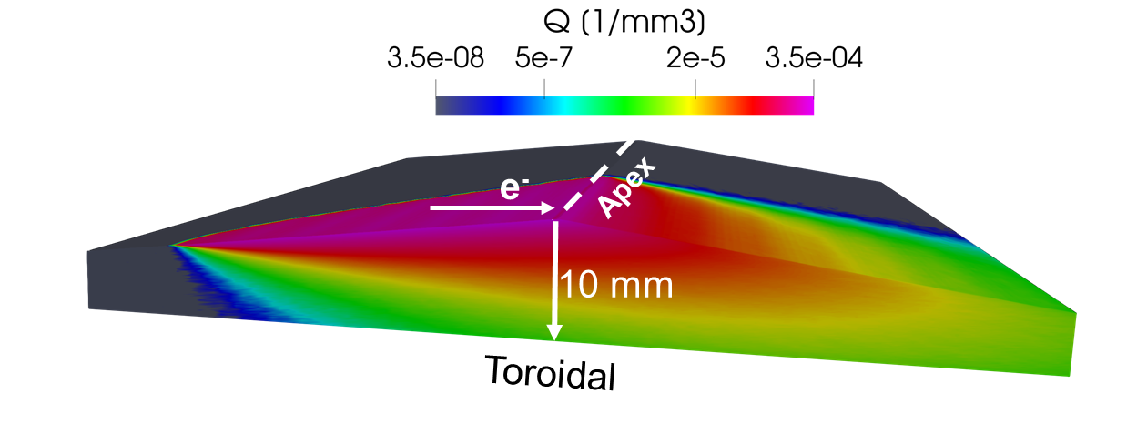
RE impact on ITER’s upper panels
L. Chen et al PSI 2022
Radial deposition depth:
∆r_{RE} = 4 mm
Energy Distribution:
f(E)~exp(-E/E₀)
with E₀ = 15 MeV, E = 1-50 MeV
Deposition energy per apex:
5 to 500 kJ
Deposition time:
1 ms
Workflow benchmarked with JET RE impact data
(see L. Chen, AAPPS-DPP 2021)

Slide 9
Disruption Mitigation System – Requirements
Disruption Load Categories are defined for these loads:
ITER Load Specifications ITER_D_222QGL
DMS Heat Load Mitigation Targets ITER_D_57VT5Y
DMS functional requirement
The DMS action must target to result in disruptions with
category I EM loads and HL-I heat loads.
→ System specific requirements to fulfil this function have been defined before the Preliminary Design Review ITER_D_BEJQWA
DMS task force to validate these through experiments and modelling

Slide 10
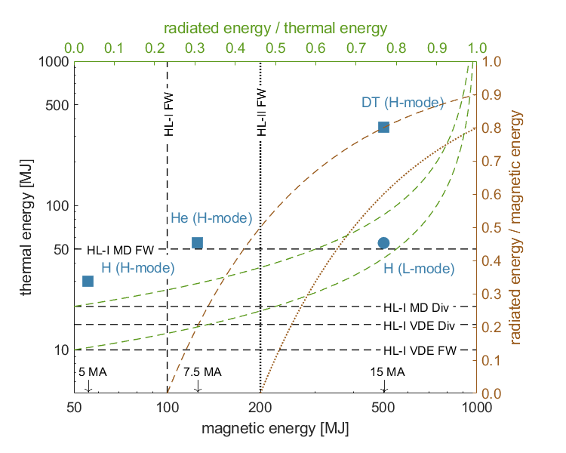
Disruption Mitigation Targets
TQ and CQ heat loads
RE impact
Threshold for bulk melting
(T = 800°C @ cooling channel)
Deposition on one apex:
E_{RE}~200 kJ or I_{RE}~100 kA
Uniform deposition over 36 apexes:
E_{RE}~7.2 MJ or I_{RE}~3.6 MA
Unmitigated MDs
Uniformity of E_{RE} deposition is critical
and depends on
PFC alignment
the nature of the MHD event
Unmitigated VDEs

Slide 11
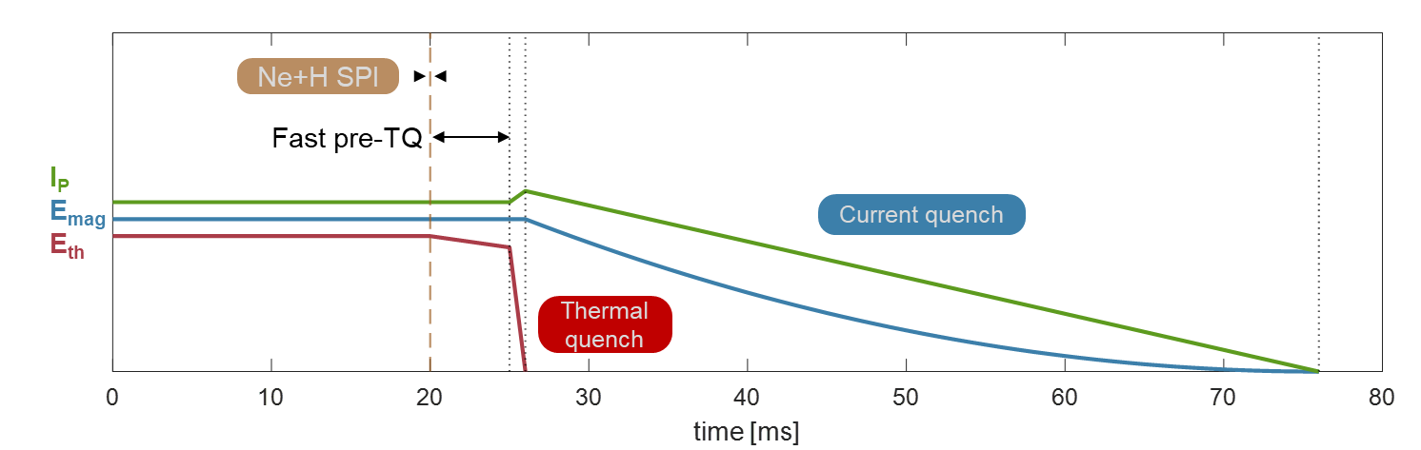
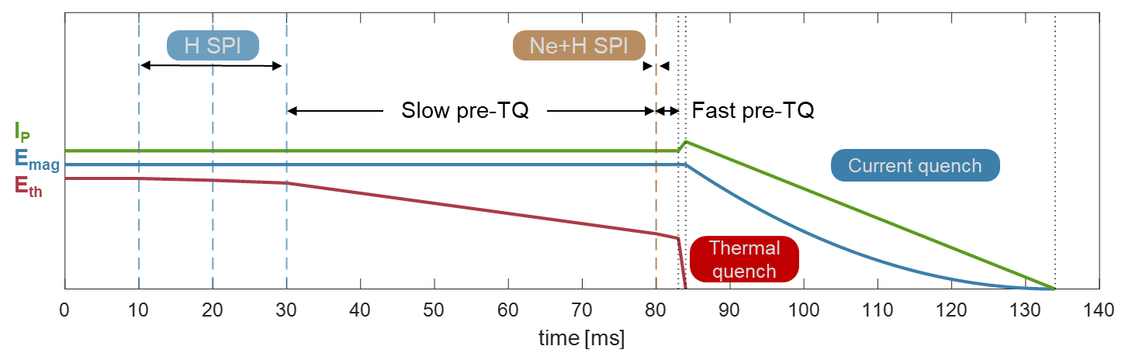
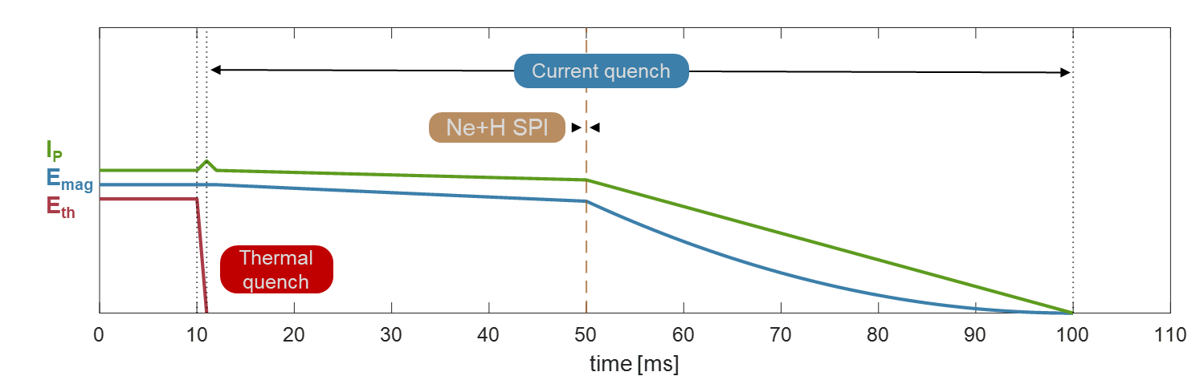
ITER Injection scenarios
Mixed Ne/H Shattered Pellet Injection (SPI)
Fast pre-Thermal Quench (TQ) of a few milliseconds
Arrival time critical for multiple SPI
Staggered SPI
Slow pre-TQ (several 10 ms) after H SPI
Significant pre-TQ energy loss
Dilution cooling aids Runaway Electron (RE) avoidance (T_{e} < 1 keV)
Post-TQ SPI
DMS trigger upon TQ or Δz detection
SPI not triggered pre-TQ
Thermal & EM load mitigation during Current Quench (CQ) for I_{P} > 7 MA

Slide 12
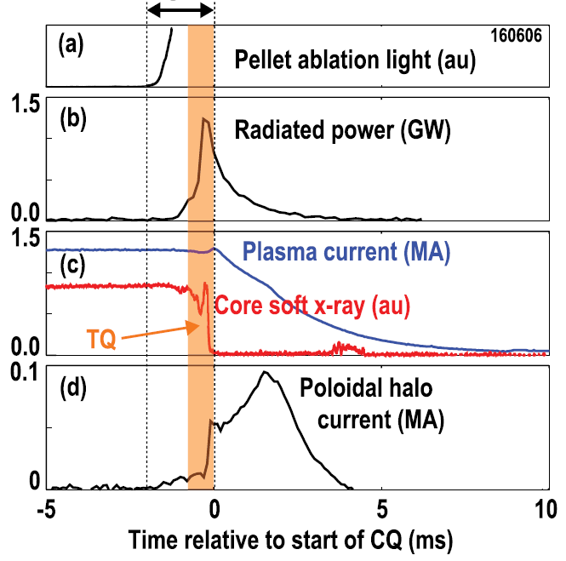
Mixed Ne/D Injection
pre-TQ + TQ
DIII-D
Fast TQ initiation ≤ 2 ms
High radiation fraction
quantification difficult due to unknown toroidal emission distribution during TQ
Current Quench control
D. Shiraki et al. PoP 2016

Slide 13
Pure D Injection
JET
Delay to TQ varies but can be long
(> 70 ms)
Thermal energy loss before TQ
Broken but ‘compact’ arrival
Pellet broken in two pieces
S. Jachmich et al. NF 2021

Slide 14
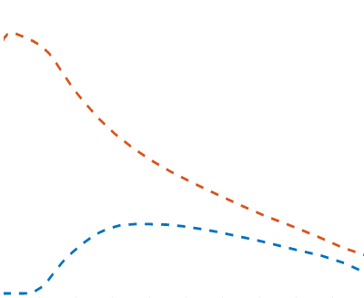
Pure D SPI – Mass assimilation
DIII-D profile measurements
Density rise limited to the plasma edge
Limited plasma cooling
TQ long after end of injection
Simple pellet ablation model predicts deeper and larger mass deposition
Plasmoid drift model explains deposition profile
cooling
Pre-TQ
Pellet ablation simulation with drift
t-t_{Dis}
Pellet ablation simulation
Edge deposition
-11.3 ms
-10.3 ms
Pre-TQ and density rise
→ see results from ASDEX Upgrade
(P. Heinrich on Thursday)
186586
TS: N. Eidietis, D. Shiraki, A. Lvovskiy (ITER_D_7KP28M)
INDEX: A. Matsuyama, to be published

Slide 15
Post-TQ injection
JET
Slow unmitigated CQ in ITER allows late SPI to be still effective
CQ accelerated and radiation increased to levels of pre-TQ SPI
Fragment sizes small
Similar sizes as in JET will be achieved in ITER’s Upper Ports with 60˚ bend for
v = 150 – 400 m/s (100% Ne – 100% D)
S. Jachmich et al. NF 2021

Slide 16
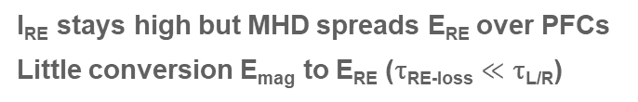
ITER RE Impact Mitigation Scenarios
Ne multiple SPI
Ne SPI
I_{RE} reduced at RE loss but > 0
Conversion E_{mag} to E_{RE} (τ_{RE-loss} ≈ τ_{L/R})
I_{P}
E_{mag}
I_{RE}
Δz
τ_{RE-loss}
τ_{L/R}
τ_{RE-loss}
H multiple SPI
H SPI
τ_{L/R}
I_{RE} stays high but MHD spreads E_{RE} over PFCs
Little conversion E_{mag} to E_{RE} (τ_{RE-loss} $≪$ τ_{L/R})
I_{P}
E_{mag}
I_{RE}
Δz
0
10
20
30
40
50
60
70
80
90
time [ms]

Slide 17
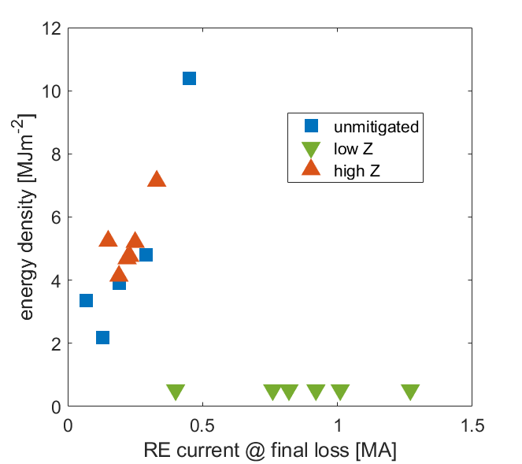
RE Impact Mitigation
JET
Ne SPI*
Reduced I_{RE} at instability
→ reduced but finite heat load
D SPI
Increased I_{RE} at instability
→ but fully suppressed heat load
*Ar not used in ITER (equivalent efficiency per pellet because of low density of solid Ar)
Ne/Ar
SPI
D SPI
IR sensitivity threshold
C. Reux et al., PRL 2021
C. Paz-Soldan et al., NF 2021

Slide 18
DMS Task Force – Experiments in 2022
ASDEX Upgrade: 9 experimental days completed in June
(in collaboration with IPP and EUROfusion)
- Impact of fragment size, velocity and shatter plume geometry
- Data for D SPI size scaling in all-metal devices
KSTAR: 3 days performed in May/June, option for +1 in July
- New shatter units with 12.5˚ angle allowing high velocity fragment injection
- Focus on staggered injection and radiation distribution (opposite SPIs)
DIII-D: 2.5 experimental days in 2022 (2023)
- Exploitation of TS measurement capabilities for ITER-like SPI schemes
JET: 45 session Nov 2022 – Apr 2023 (in collaboration with EUROfusion)
- 2 identical barrels (2 x 10 mm + 8.1 mm), reduced velocity w/o punch
- TS upgrade by CCFE: 12 channels with low T_{e} capability
- High current / energy SPI schemes (single/dual), RE mitigation schemes
Talk by P. Heinrich
Poster by JH. Kim
Talk by J. Herfindal (previous Exp’s)

Slide 19
DMS Task Force – Modelling tasks 2022/23
INDEX 1D simulations
- Further benchmarking with experimental data
- Updating of the physics model and final ITER SPI simulations
DREAM RE simulations
- ITER SPI simulations with sophisticated RE seed model and TQ transport
- coefficients derived from 3D MHD simulations
JOREK, NIMROD, M3D-C1 3D MHD simulations
- Accompanying simulations for KSTAR and ASDEX Upgrade
- ITER SPI simulations with various injection parameters
- Input for refinement of 1D simulations
- RE fluid model to assess RE mitigation schemes
Talk by A. Matsuyama
Talks by D. Hu, B. Lyons
Posters by M. Hoelzl, V. Bandaru
Plus loads of work in domestic programmes (see regular DMS TF modelling meetings, contact Eric Nardon or Akinobu Matsuyama for more information)

Slide 20
Concluding Remarks
PFC lifetime can be strongly affected by CQ and RE loads
→ PFC erosion assessed and mitigation targets defined based on results from DINA-SMITER-GEANT4-MEMOS workflow
DMS system specifications defined, DMS Task Force continues validating these
→ Next DMS milestone: June 2023 - Final Design Review
Many ITER SPI experiments in 2022, analysis before the FDR is challenging (also task of ITPA MDC-24 and other JEXs)
System performance validation is part of the DMS Task Force programme on technology → Friday session

