Slide 1
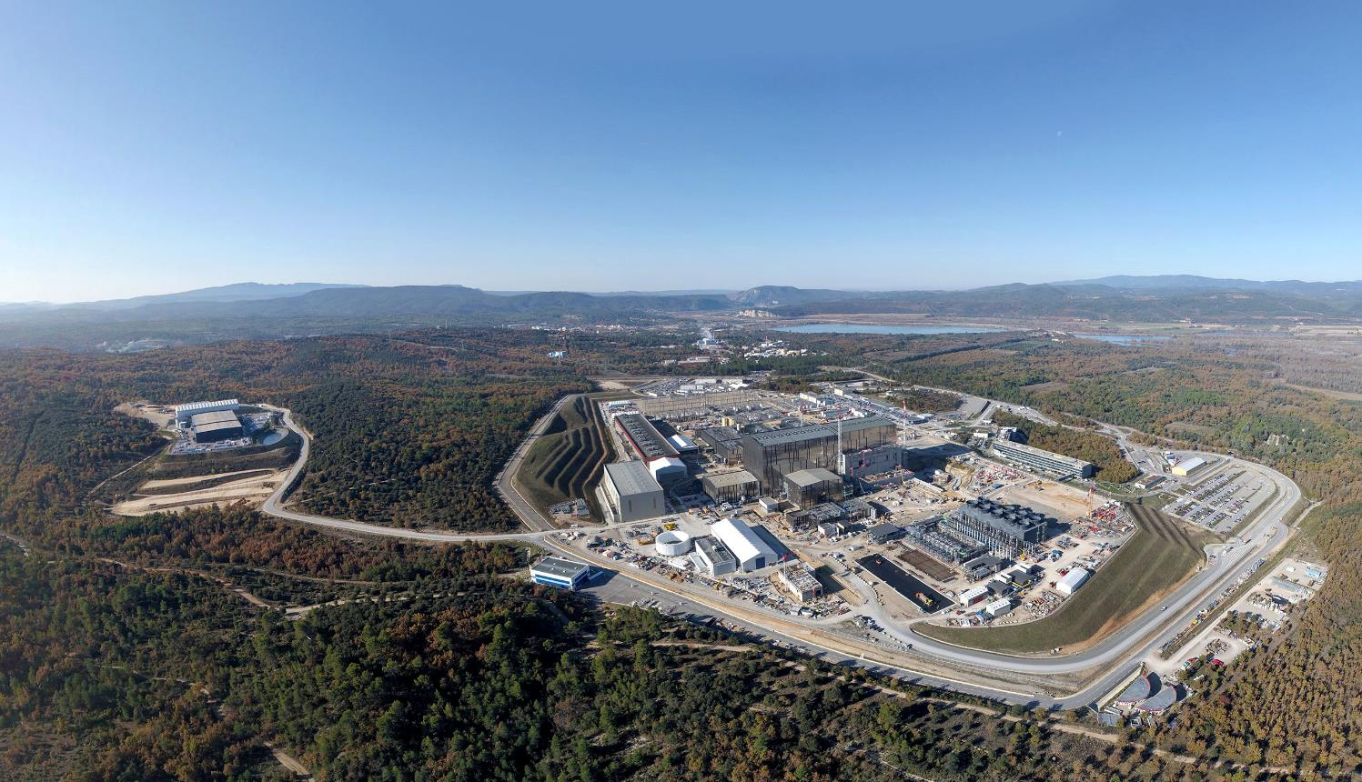
Status of the ITER Project
Alberto Loarte
Science Division
Science, Controls, and Operation Department
ITER Organization
The views and opinions expressed herein do not necessarily reflect those of the ITER Organization.

Slide 2
Outline of talk
ITER Objectives, Design and Project Status
ITER Research Plan (IRP)
Conclusions

Slide 3
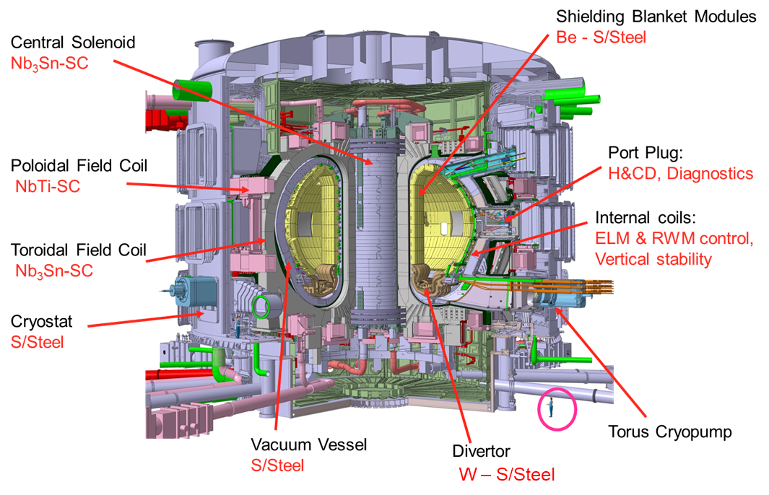
ITER Objectives
To demonstrate the scientific and technological feasibility of fusion power for peaceful purposes
  Pulsed operation:
  Q ≥ 10 for burn lengths of 300-500 s inductively driven current
  → Baseline scenario 15 MA / 5.3 T
  P_{α} ≥ 2 P_{external-heat}
  Long pulse operation:
  Q ~ 5 for long pulses up to 1000 s
  → Hybrid scenario ~ 12.5 MA / 5.3 T
  Steady-state operation:
  Q ~ 5 for long pulses up to 3000 s, with fully non-inductive current drive
  → Steady-state scenario ~ 10 MA / 5.3 T
R=6.2 m, a=2.0 m

Slide 4
ITER Site Construction Status

Slide 5
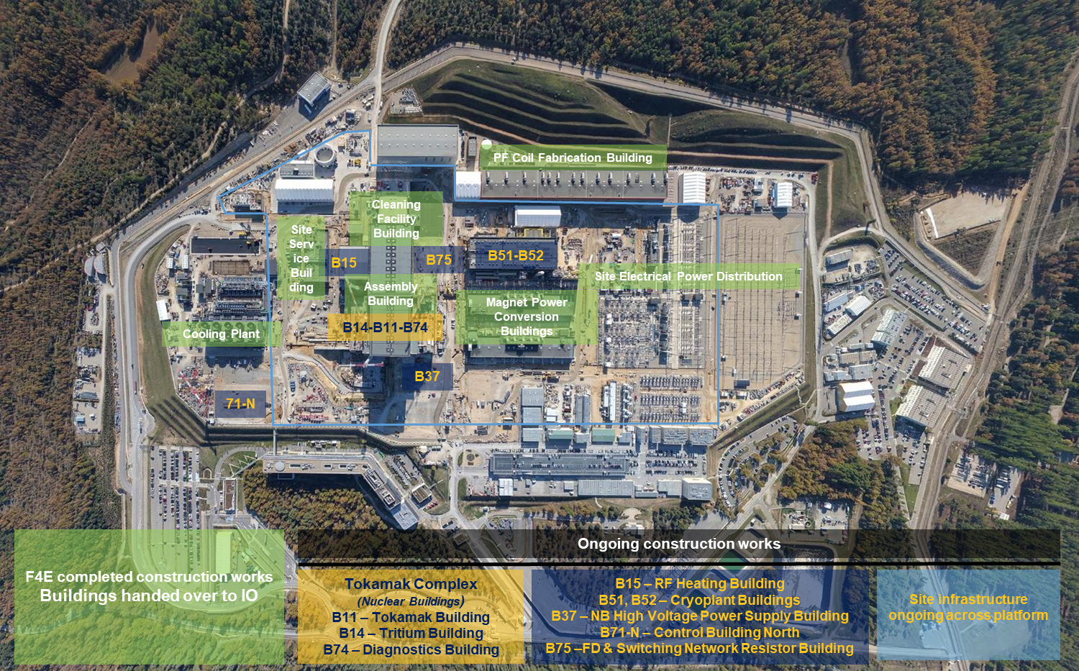
Progress in major areas (as of December 2021)

Slide 6
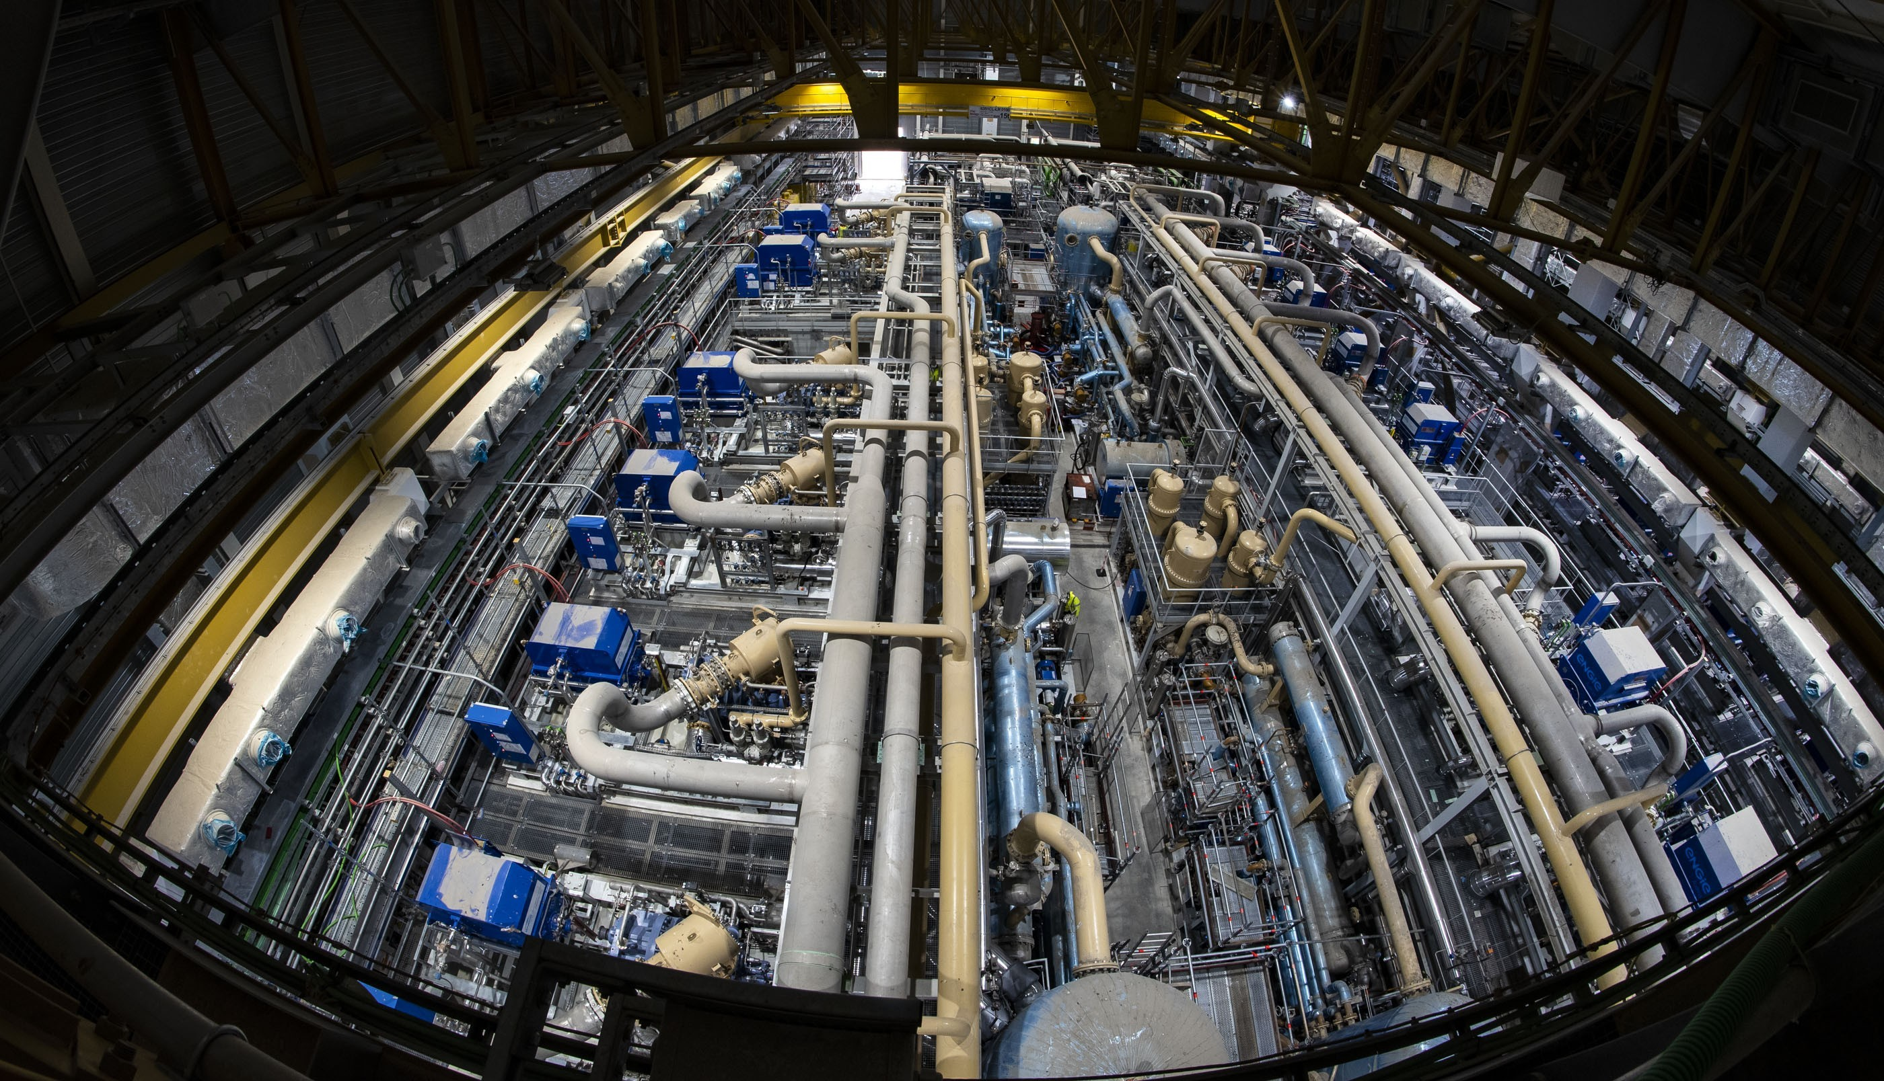
LHe: 25 t
Cooling Power:
75 kW at 4.5 K (Helium)
1300kW at 80 K (Nitrogen)
25 November 2021
Over 5000 t of equipment installed in the cryoplant in 3.5 years → 2 year commissioning period started
Notes:
tanks, compressors, piping, valves, electrical motors, gas bags

Slide 7
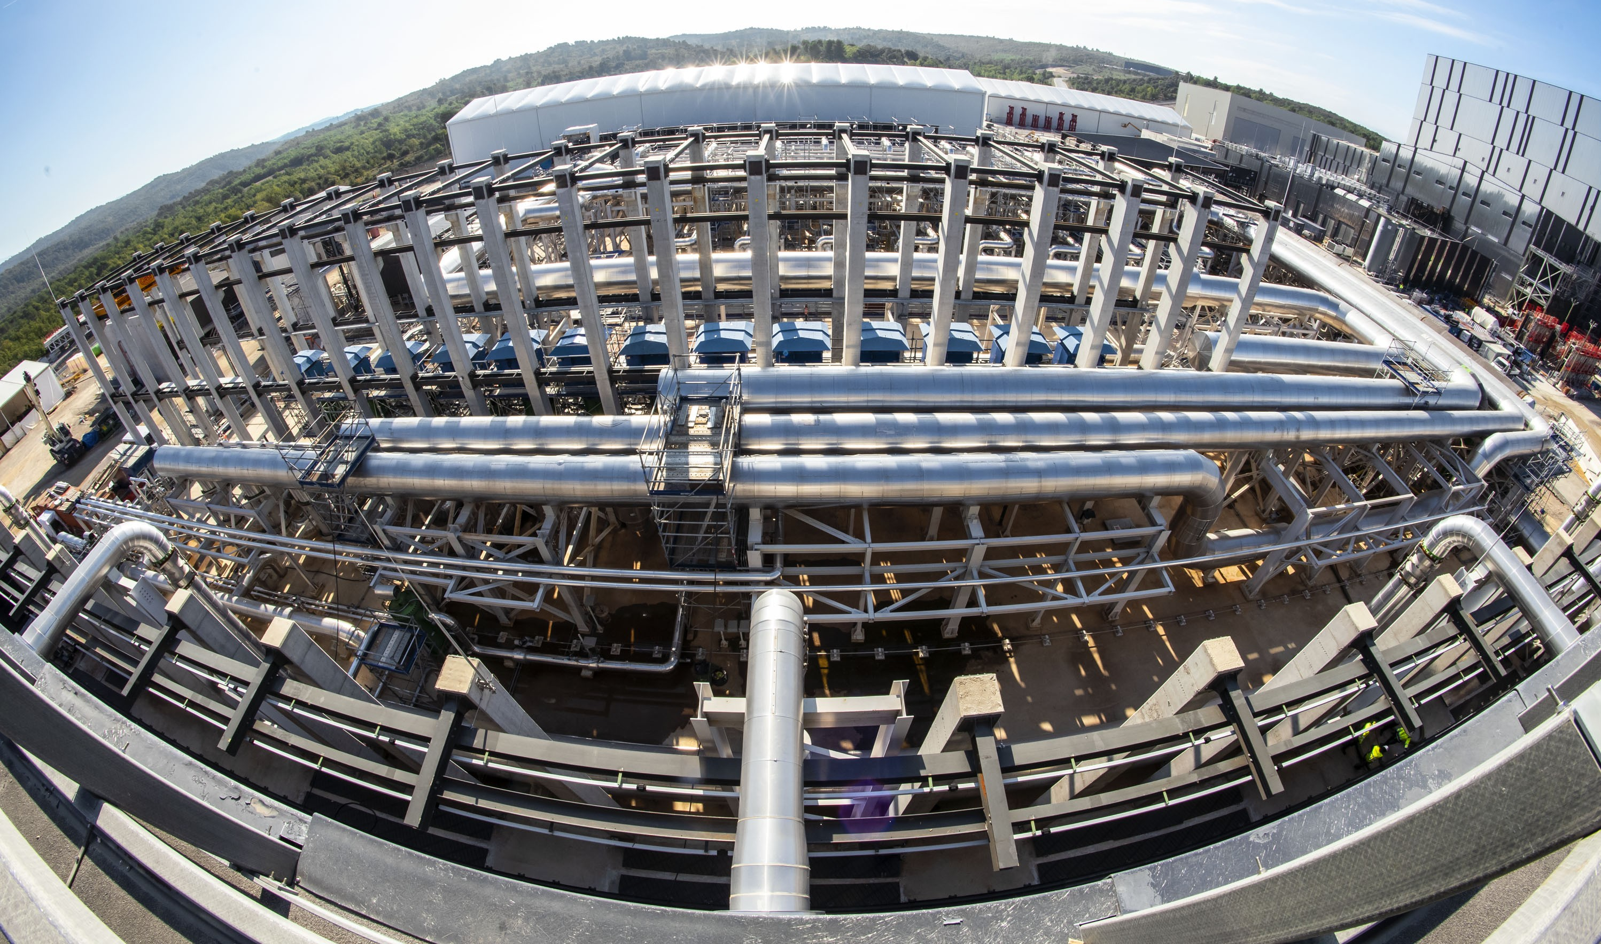
Heat exchange
Peak → 1145 MW
Between Plasmas → 160 MW
15 October 2021
About 6000 t of equipment supplied by India for the cooling plant → plant commissioning now started

Slide 8
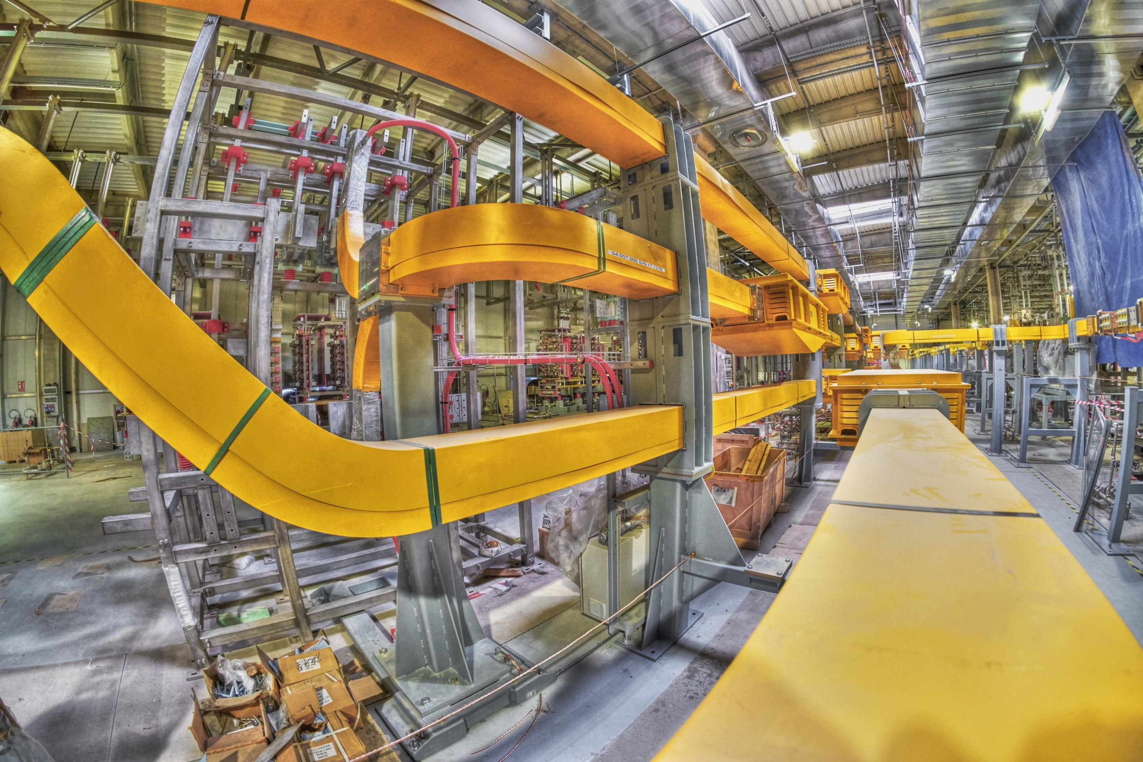
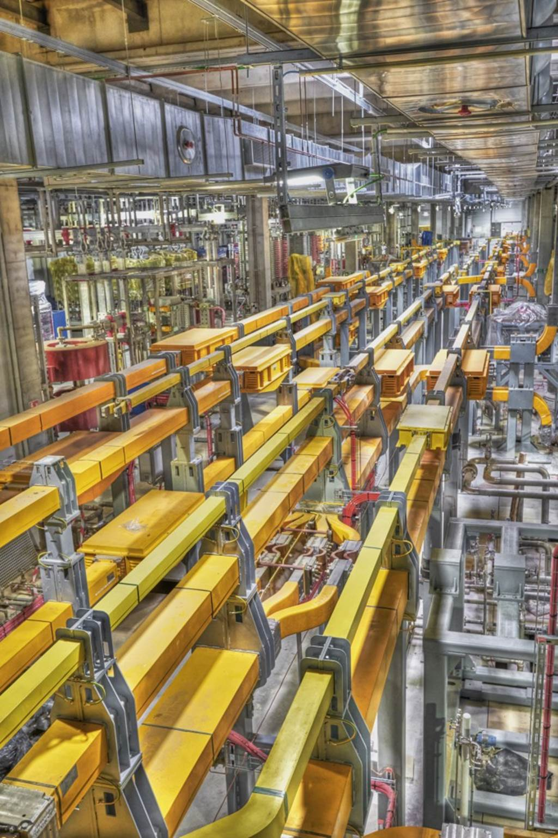
~ 5 km of water cooled busbars
100 % equipment for First Plasma Installed
25 March 2021
Magnet conversion buildings filling up with DC busbars for superconducting coils

Slide 9
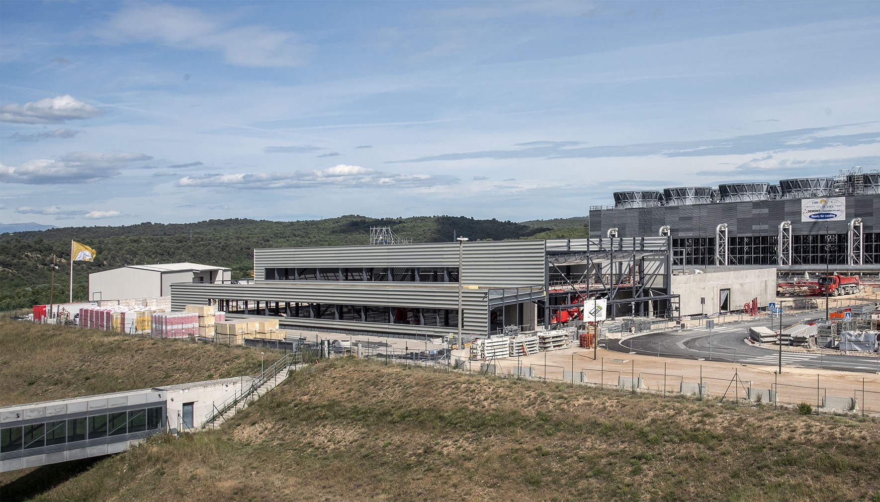
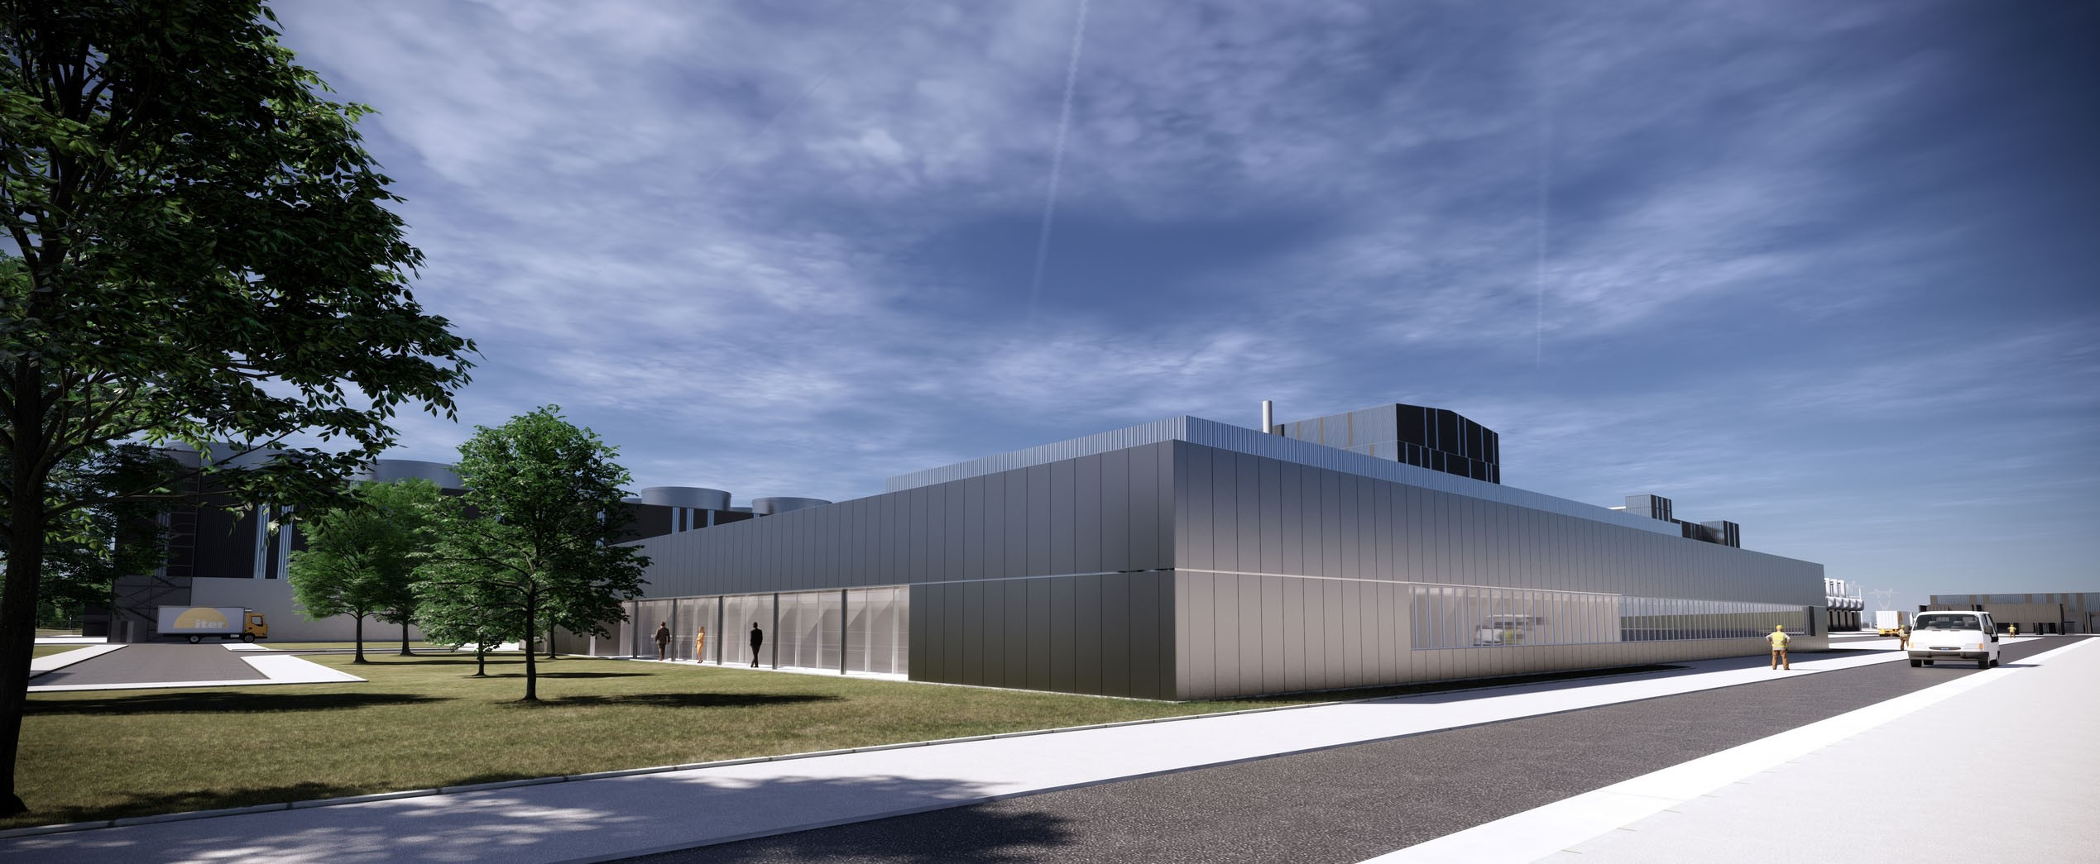
14 June 2022
Control Building going up → Complete by end of 2022

Slide 10
ITER Tokamak Construction Status

Slide 11
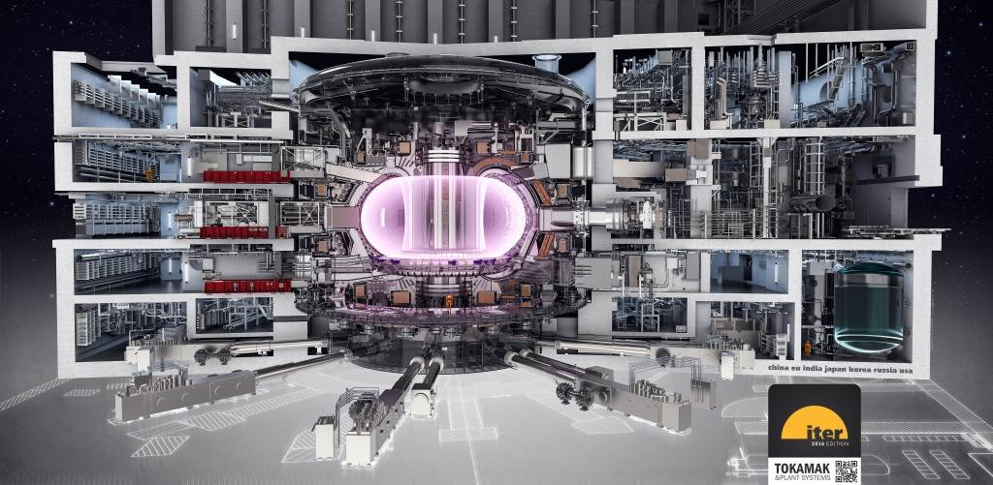

Slide 12
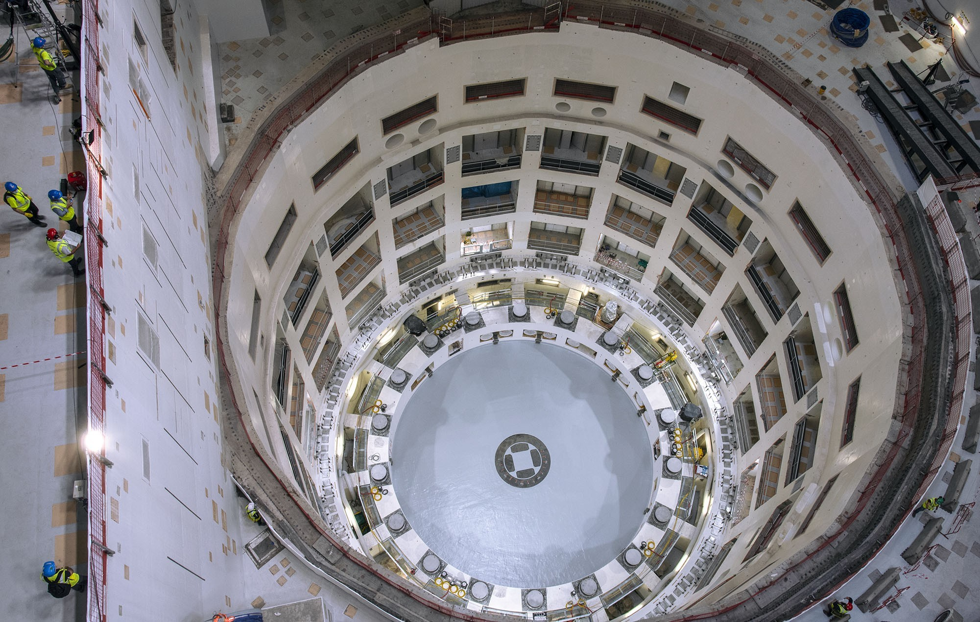
26 May 2020
Temporary bioshield lid removed: Tokamak Pit painted up and ready for first major components

Slide 13
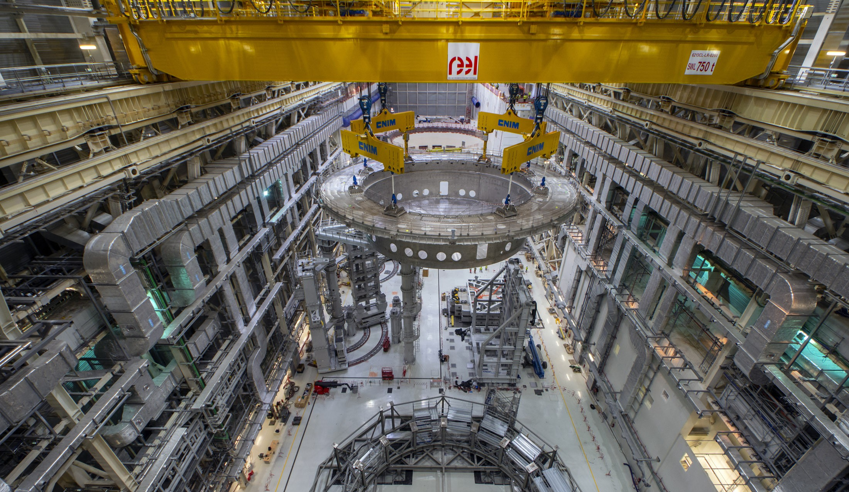
26 May 2020
The big lift: 1250 tonne, 30 m diameter cryostat base on its way to the pit

Slide 14
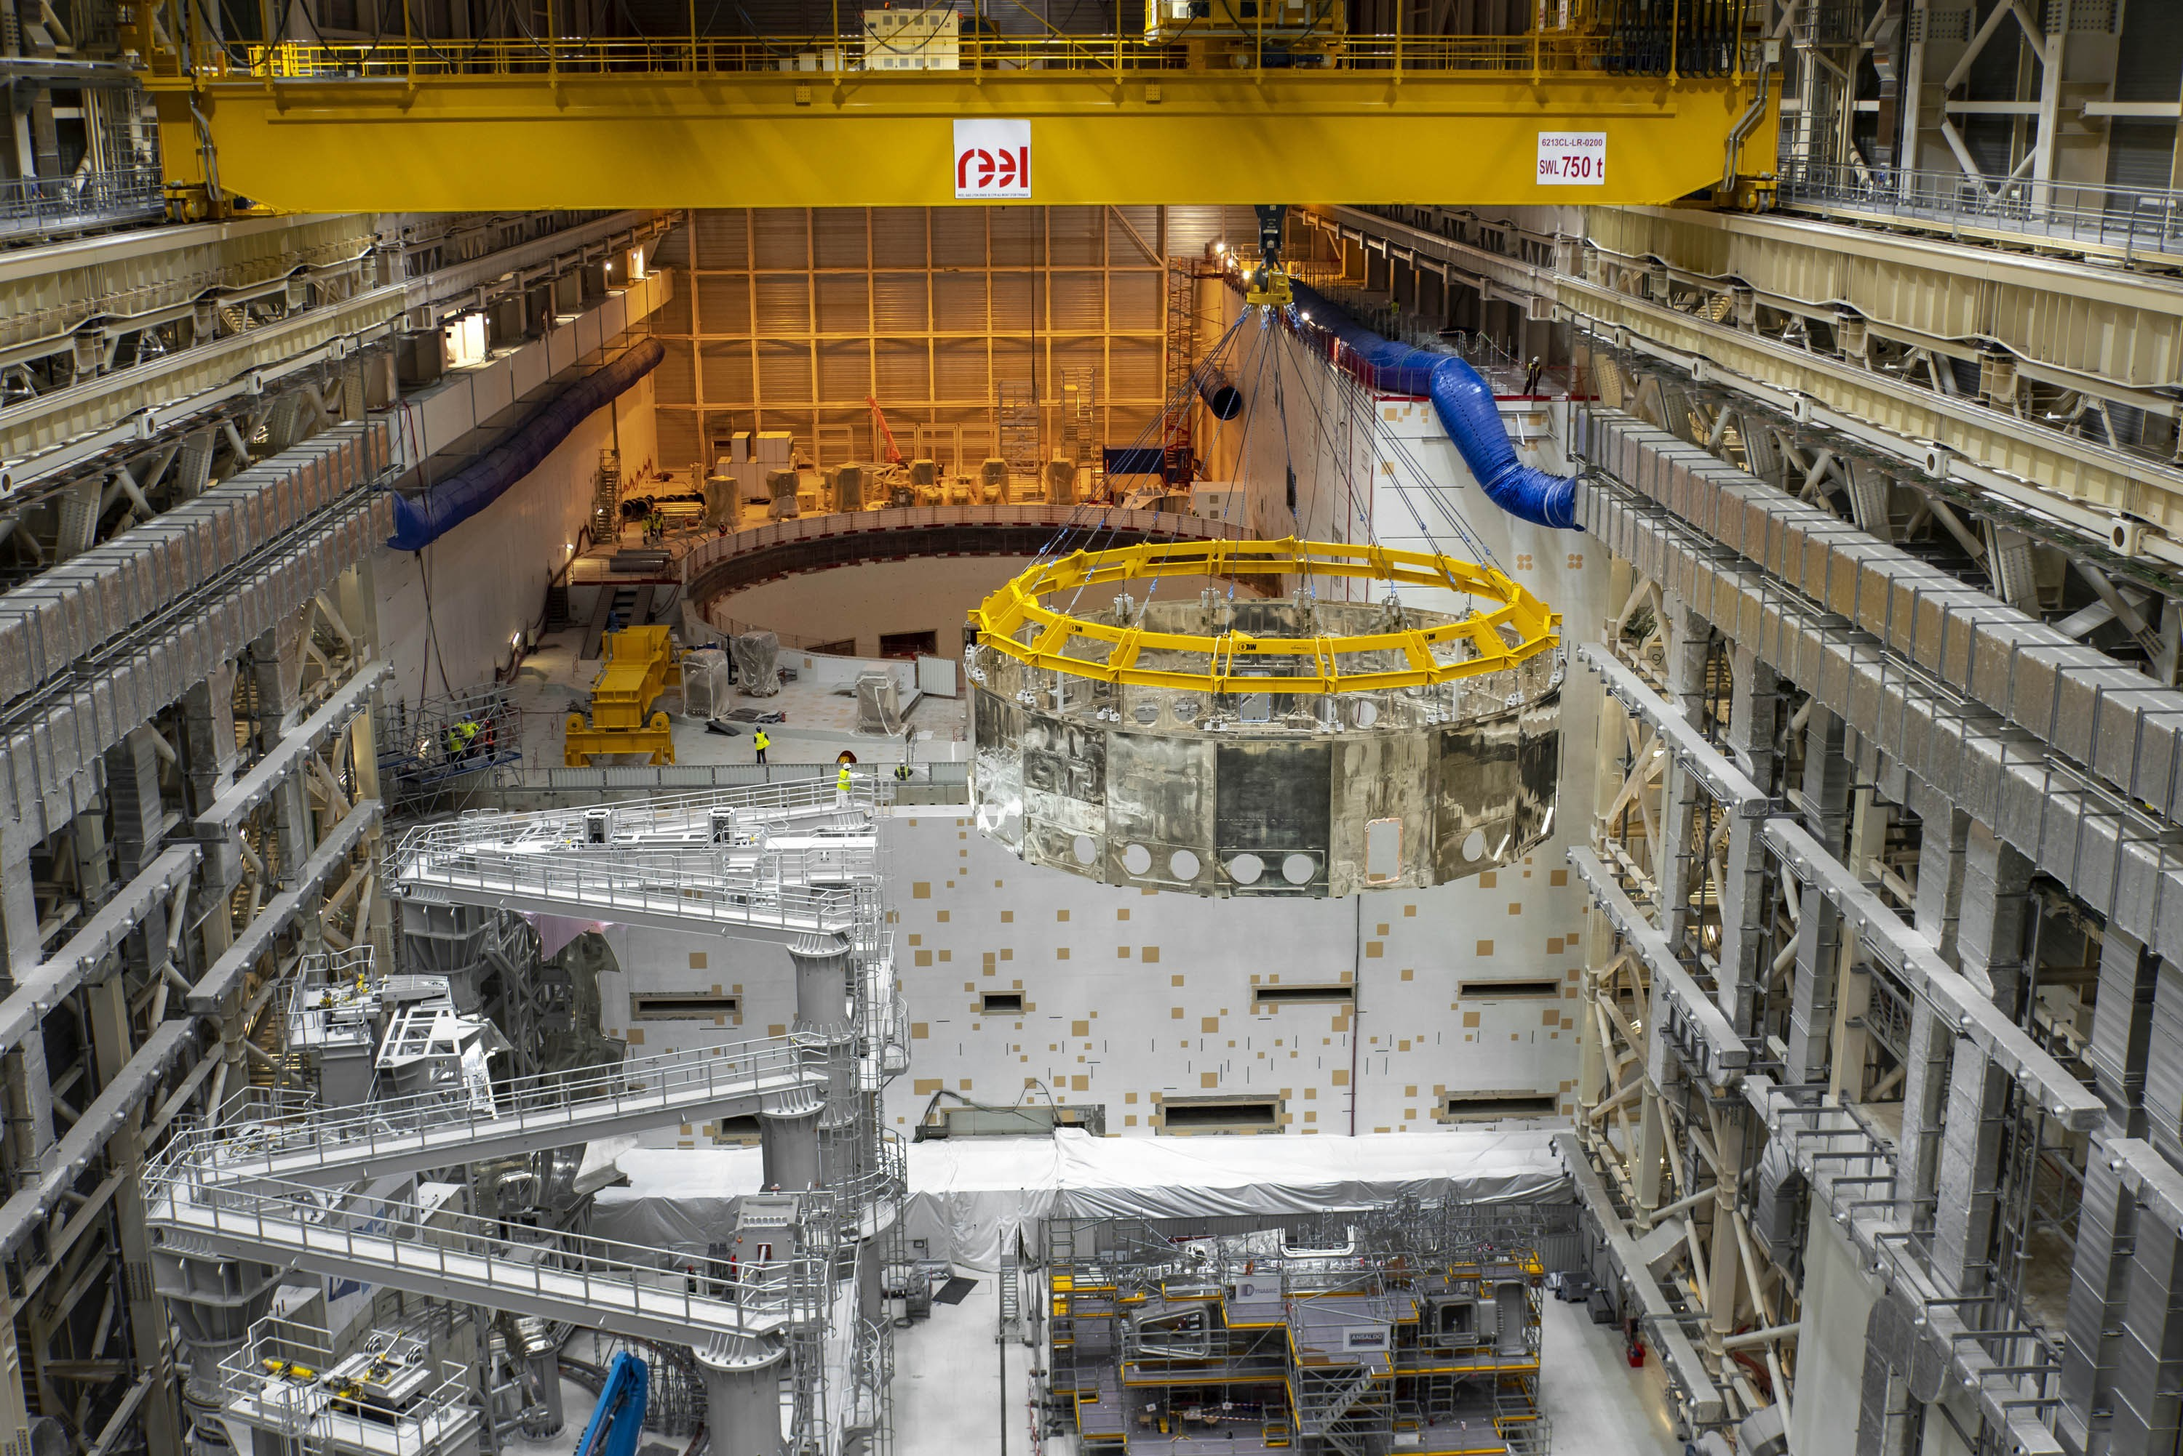
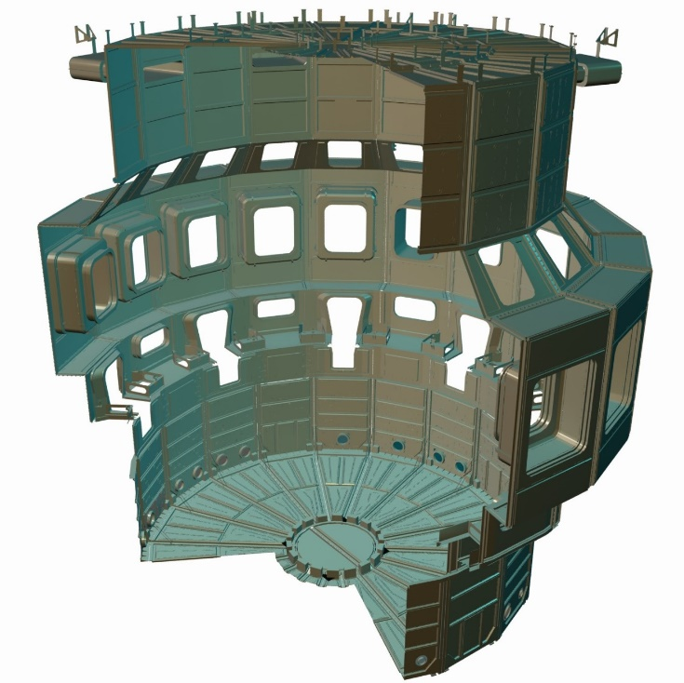
14 January 2021
Lower cylinder thermal shield on its way

Slide 15
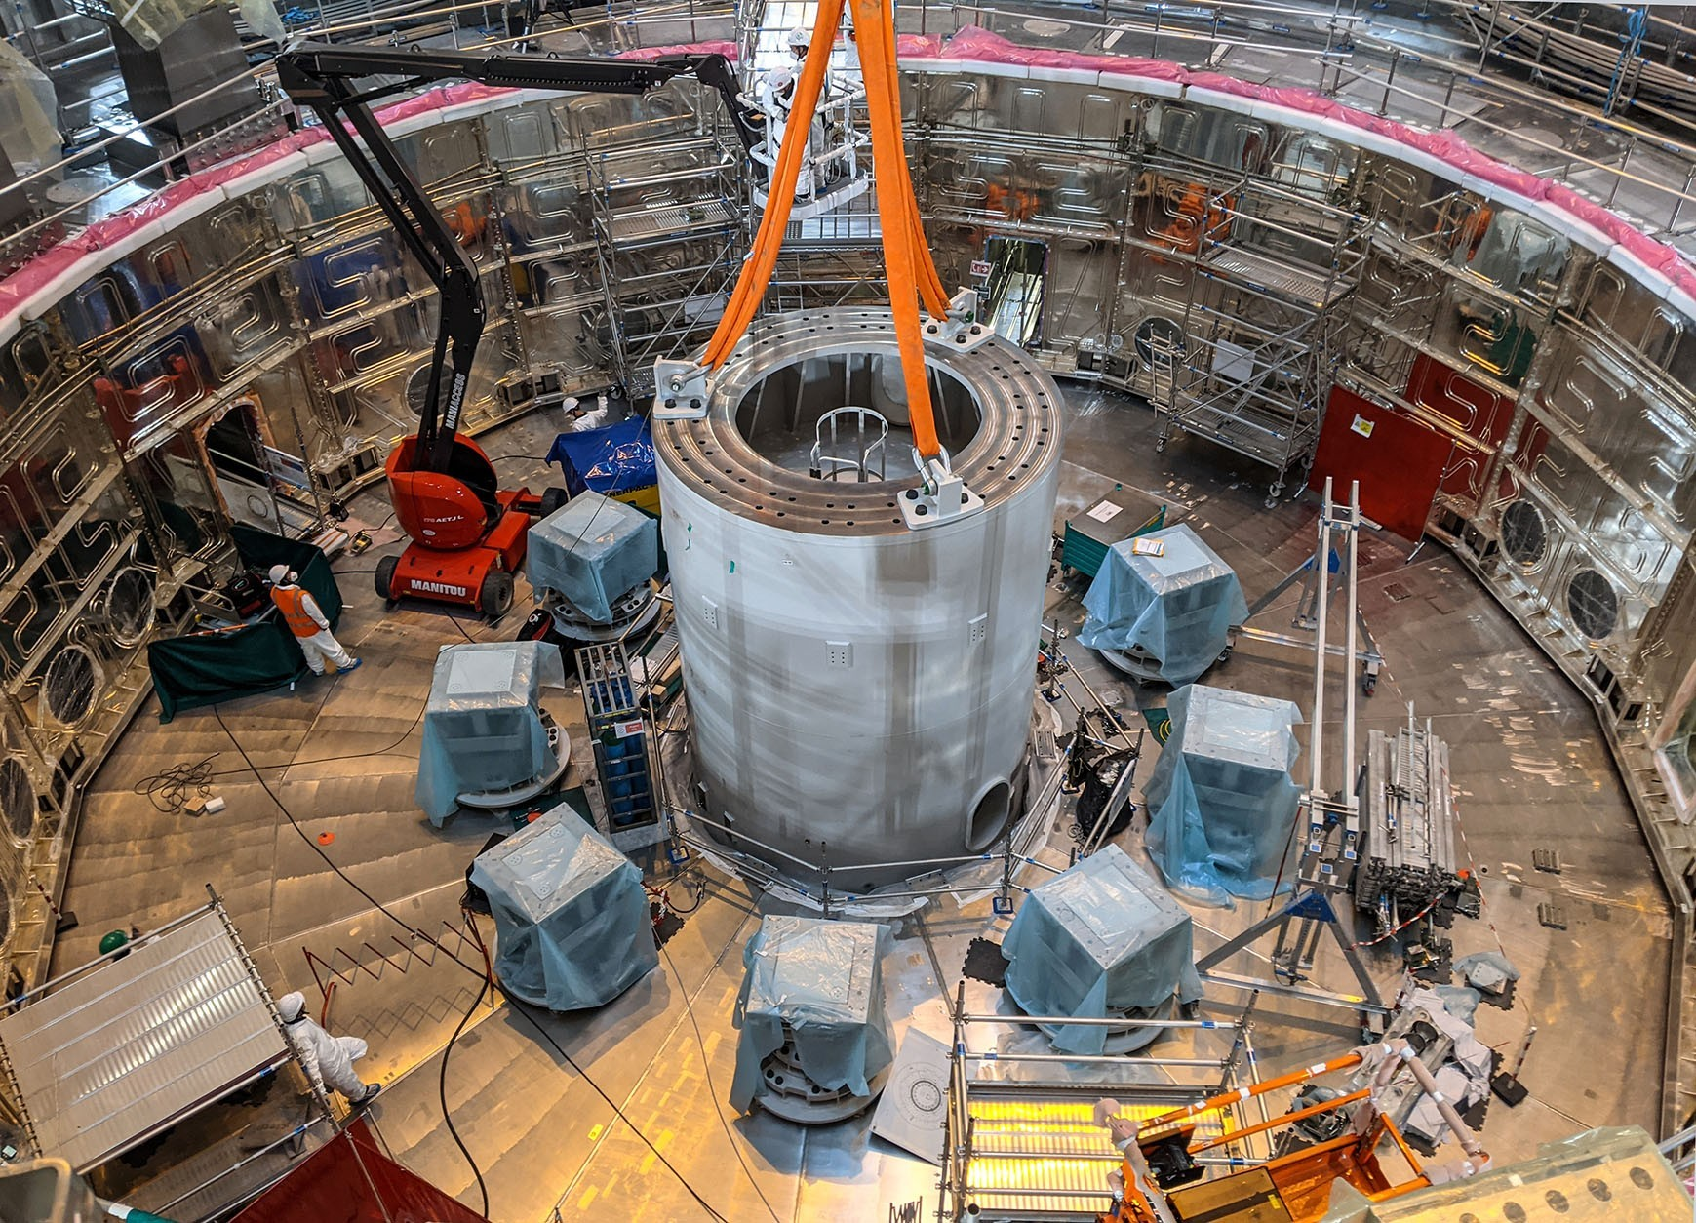
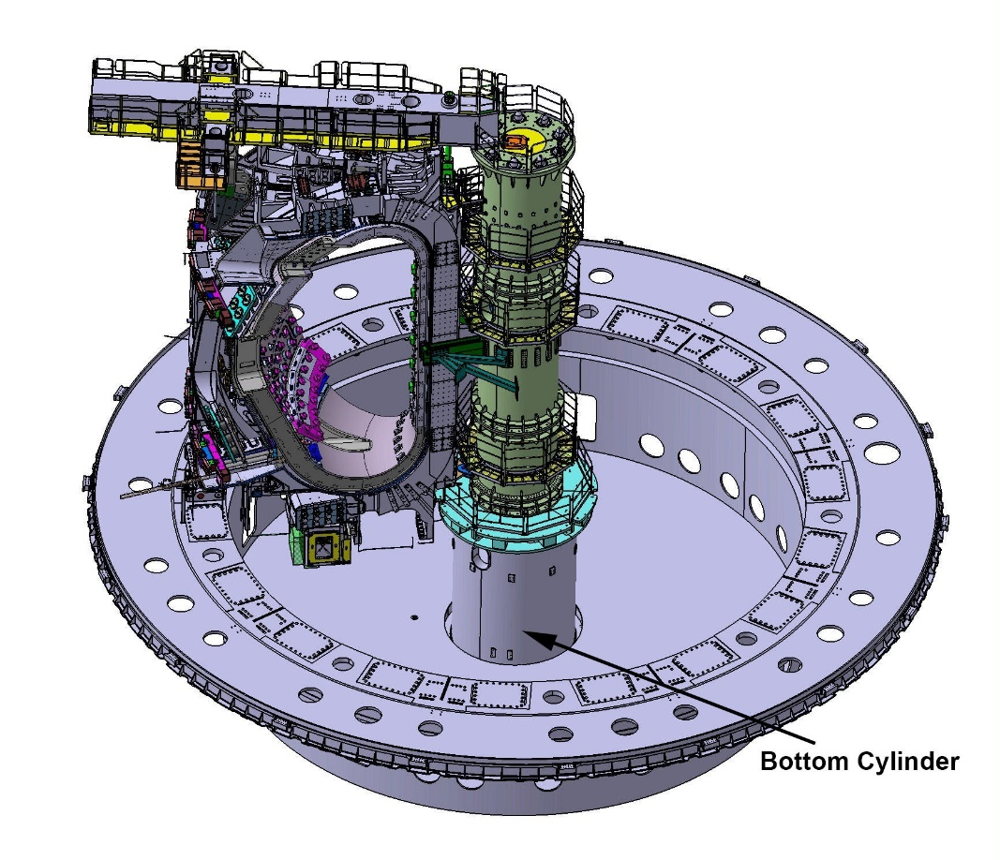
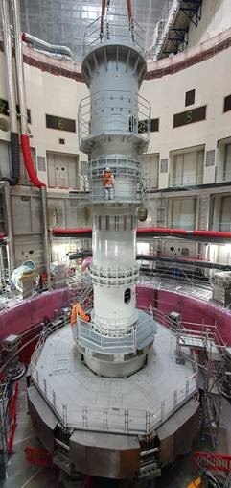
27 March 2021
17 August 2021
Full assembly
Lower cylinder of in-pit Assembly Tool

Slide 16
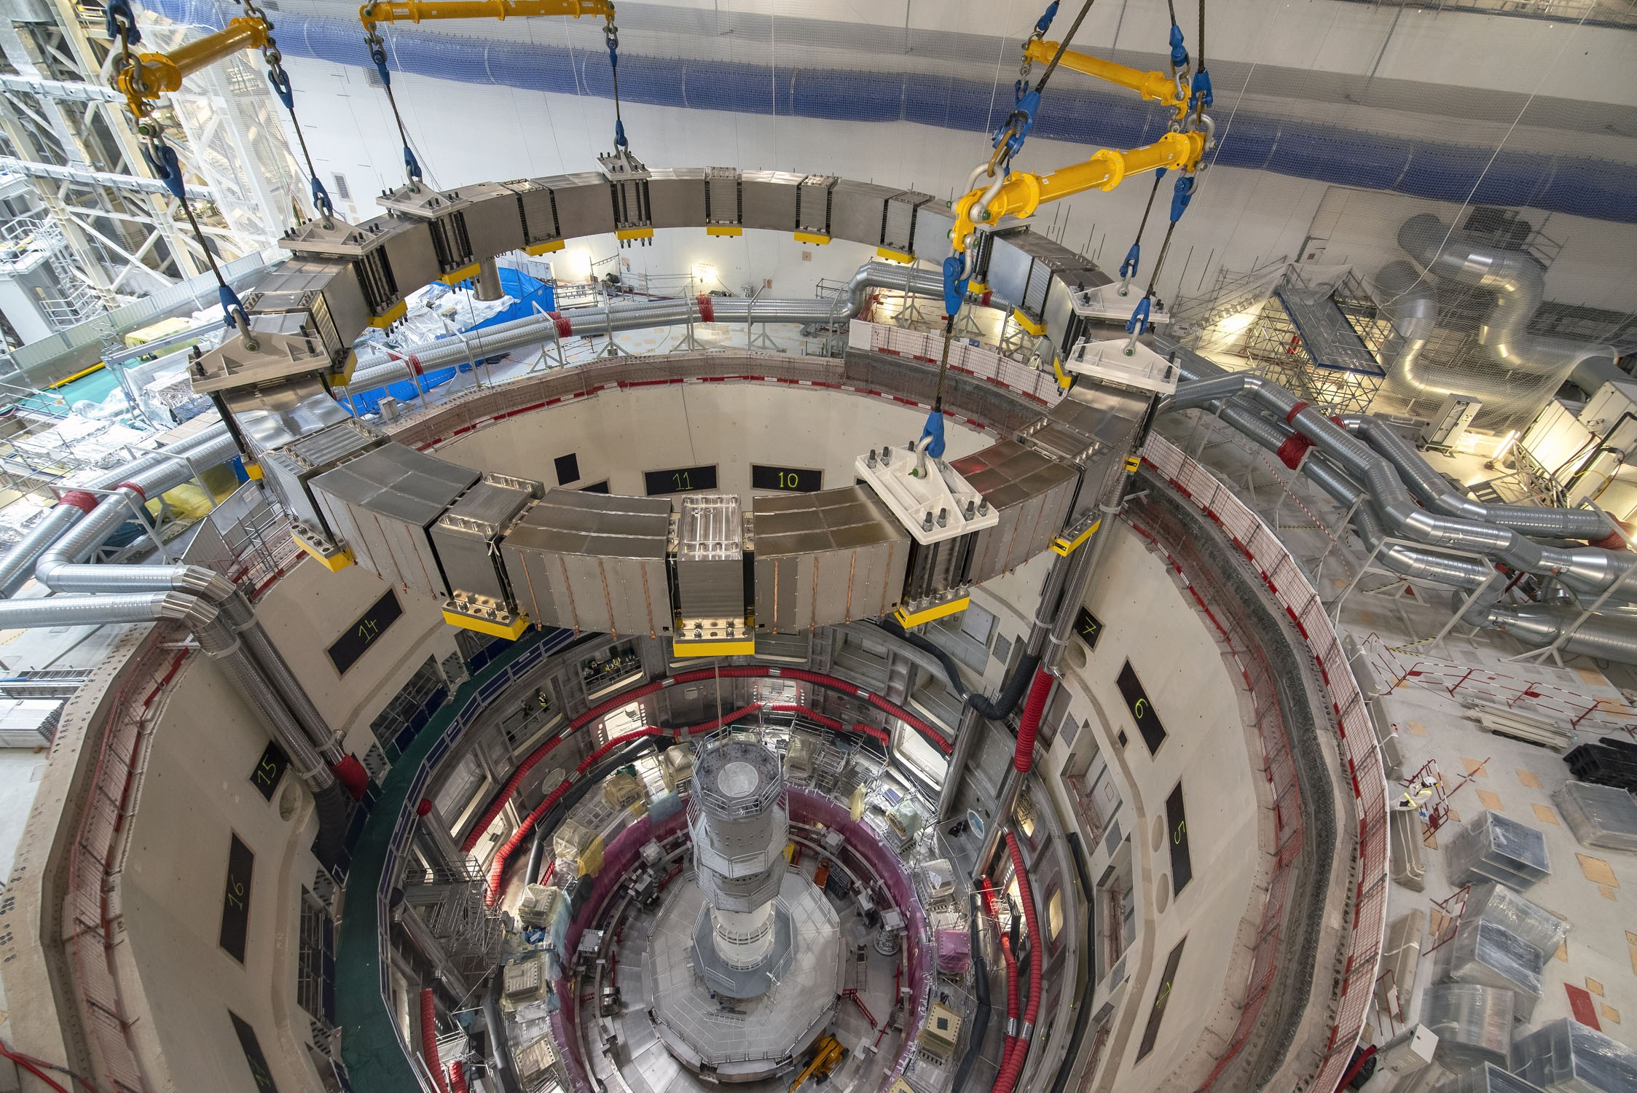
15 September 2021
PF 5 coil lifted into the tokamak pit

Slide 17
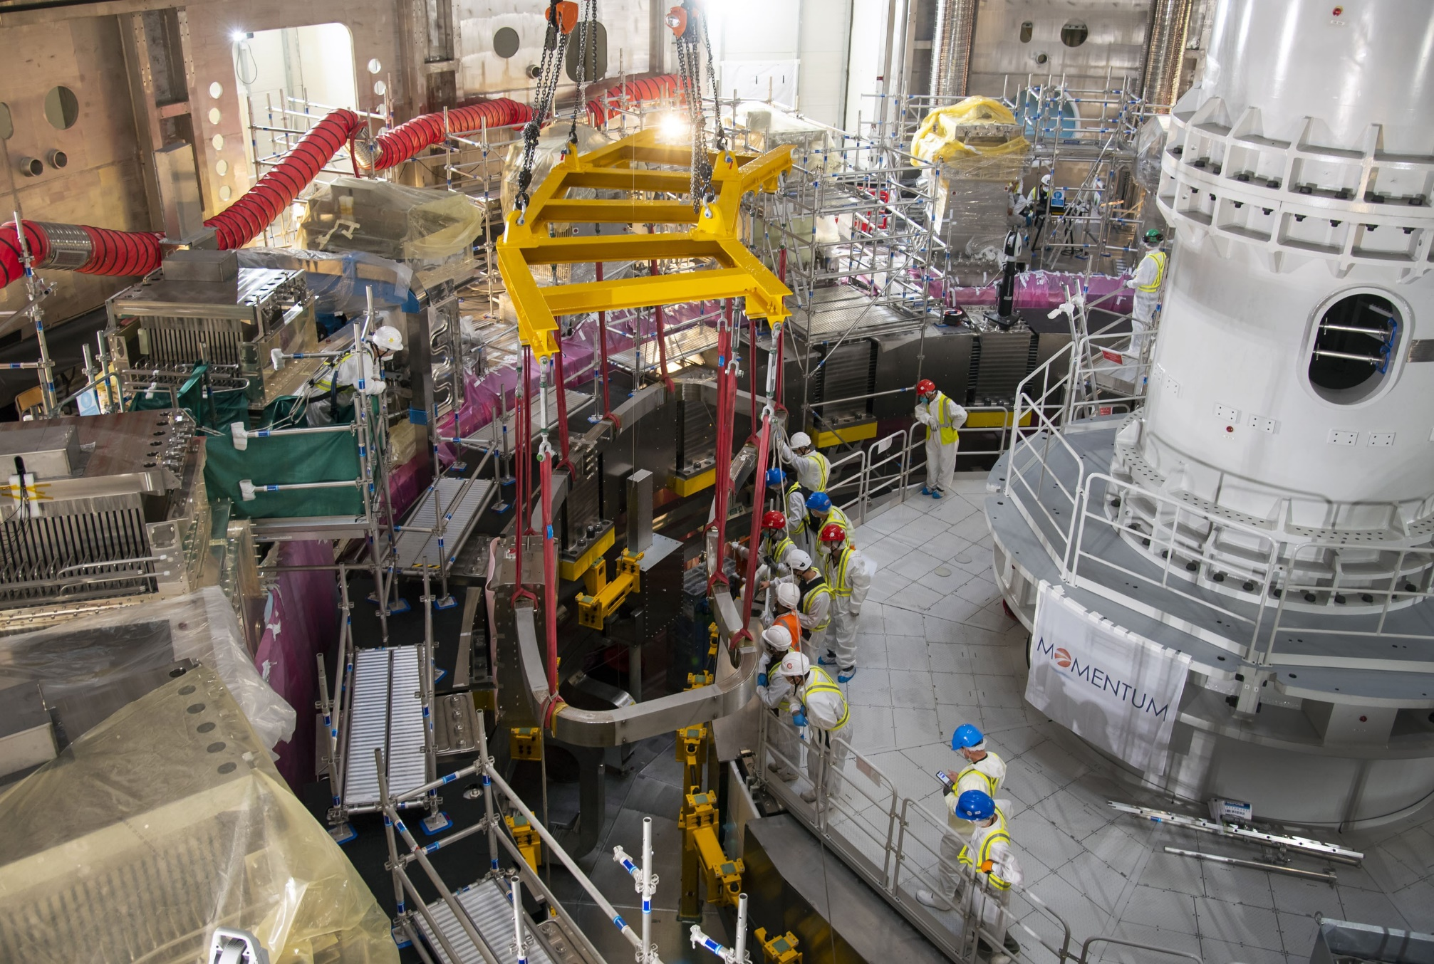
21 October 2021
Installation of one of the lower (bottom) correction coils (BCC)

Slide 18
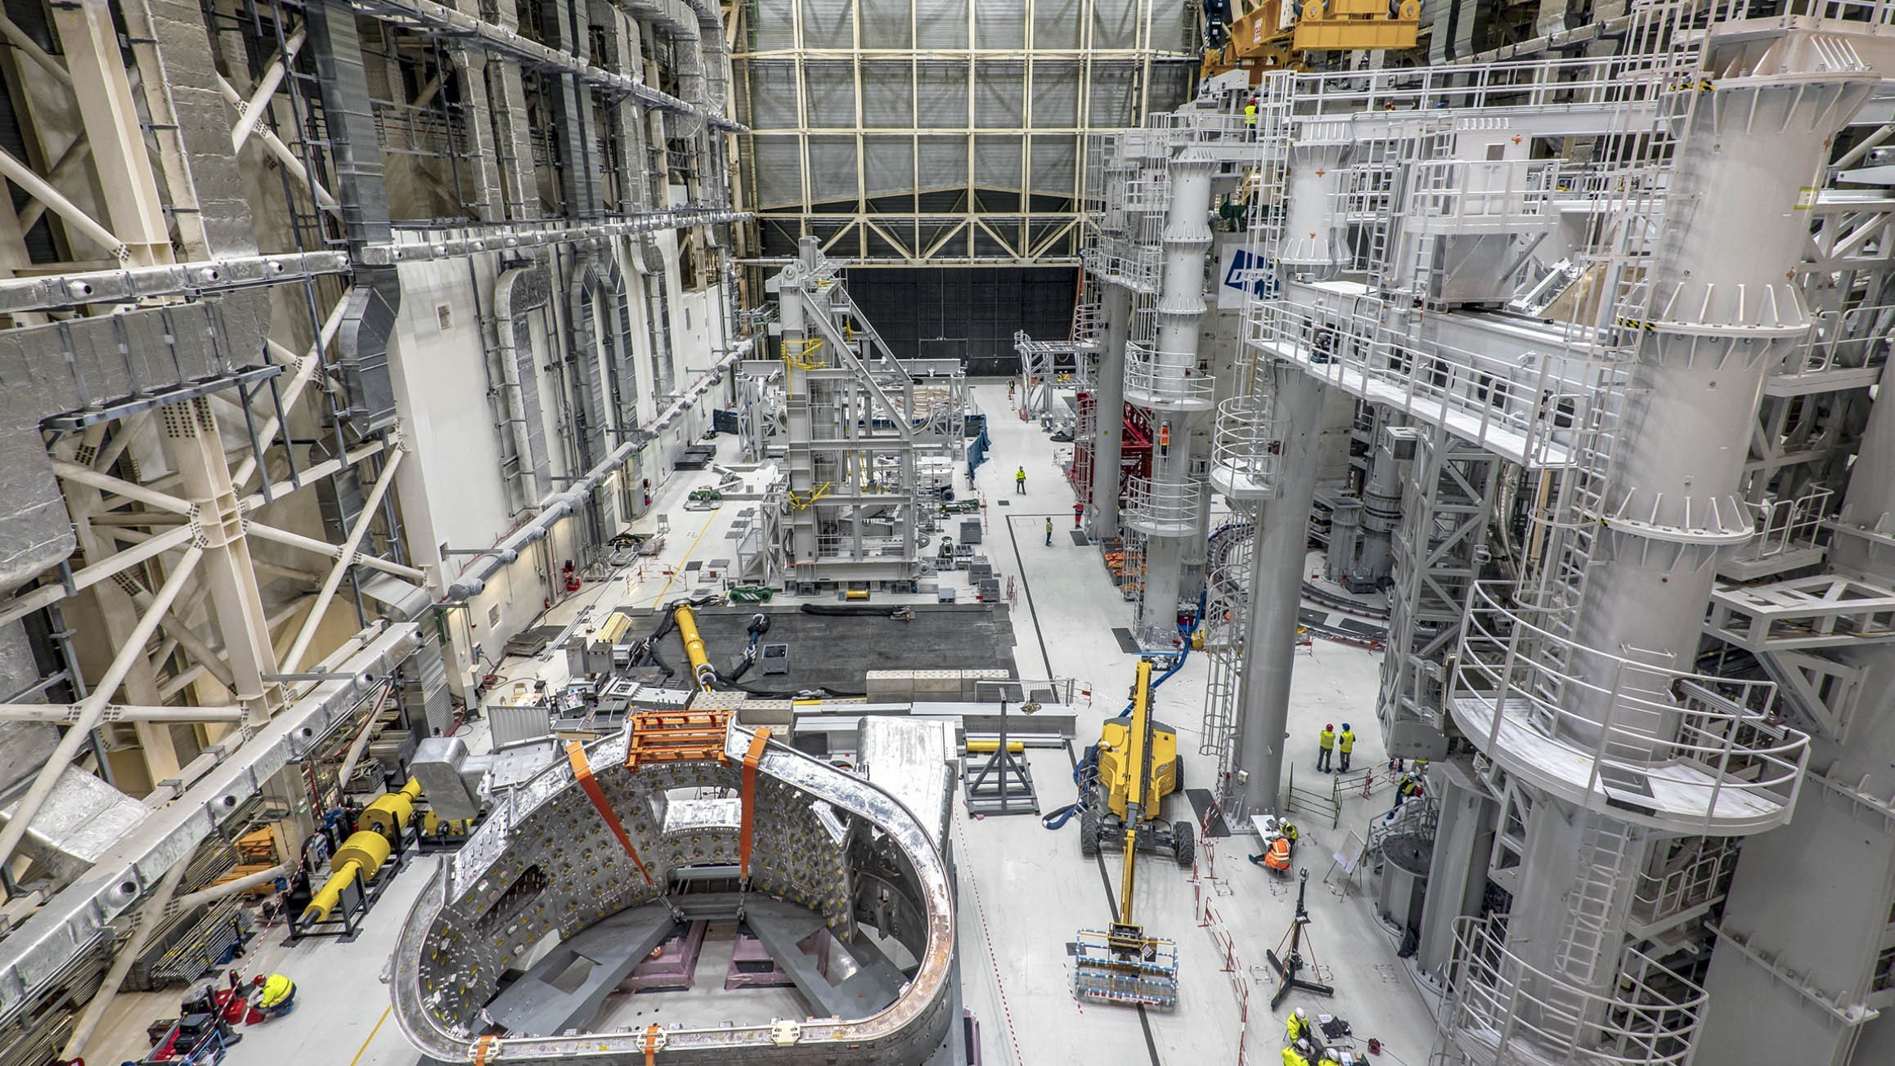
28 February 2021
SSAT-1
Tools to assemble tokamak sector = VV sector + 2 TF coils ~ 1400 Tons
ITER is made up of 9 sectors
SSAT-2
In February 2021, Assembly Hall being prepared for first VV Sector upending

Slide 19
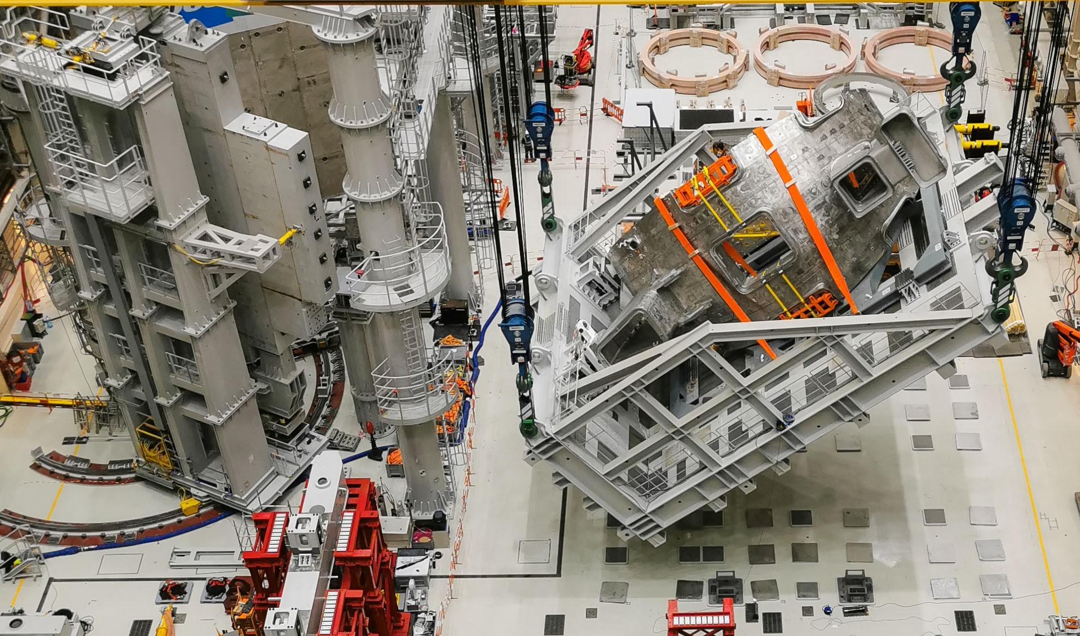
26 March 2021
Start of upending sequence to place Sector 6 into the vertical position

Slide 20
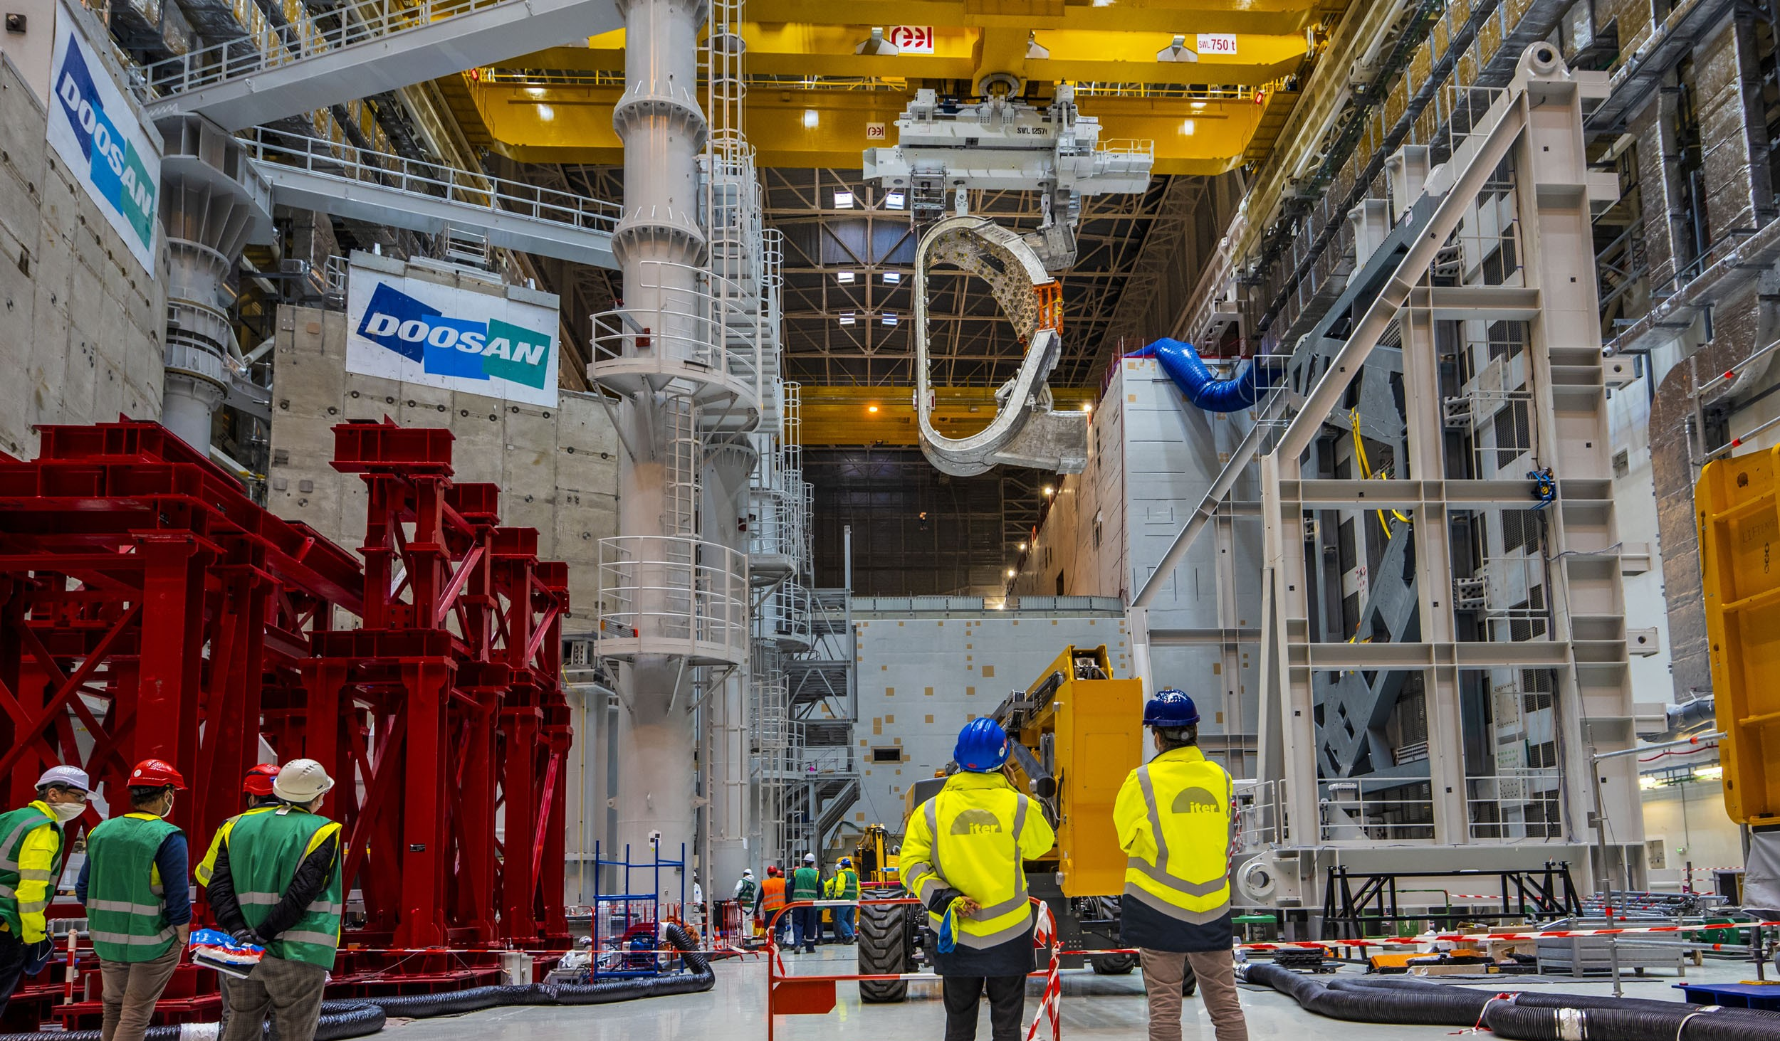
6 April 2021
Rail transport structure is the same system used to hold the sector in place for in-pit installation
Final step: transfer to the SSAT

Slide 21
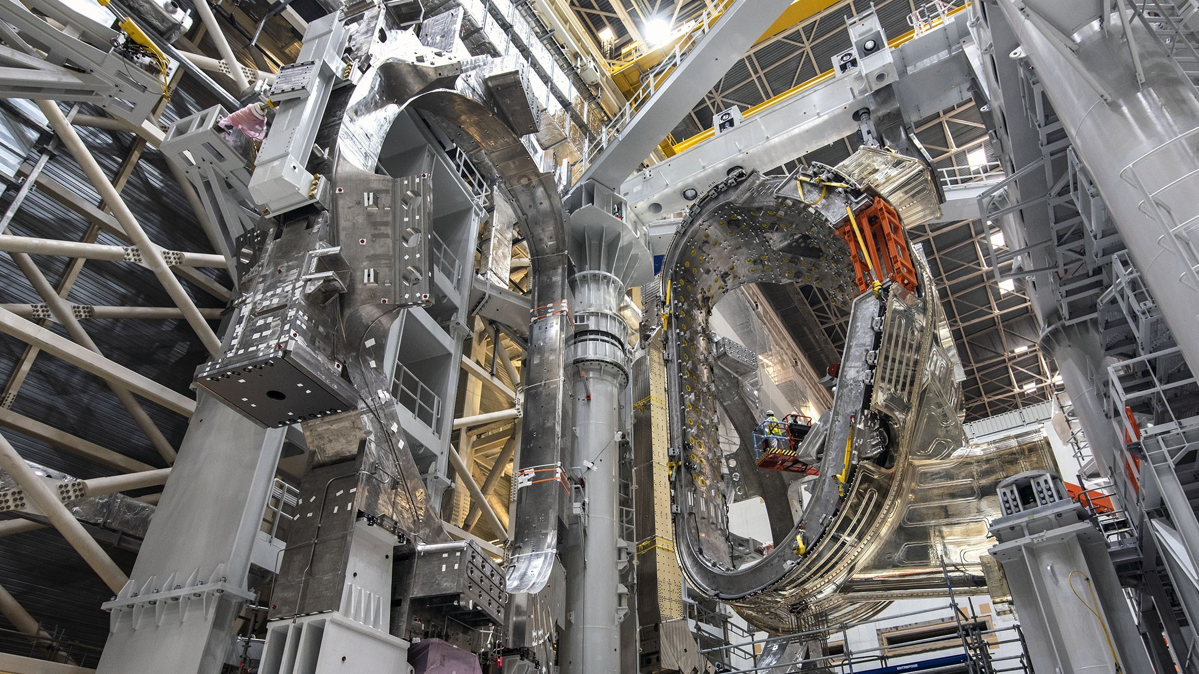
30 August 2021
Just prior to final positioning of TF coils

Slide 22
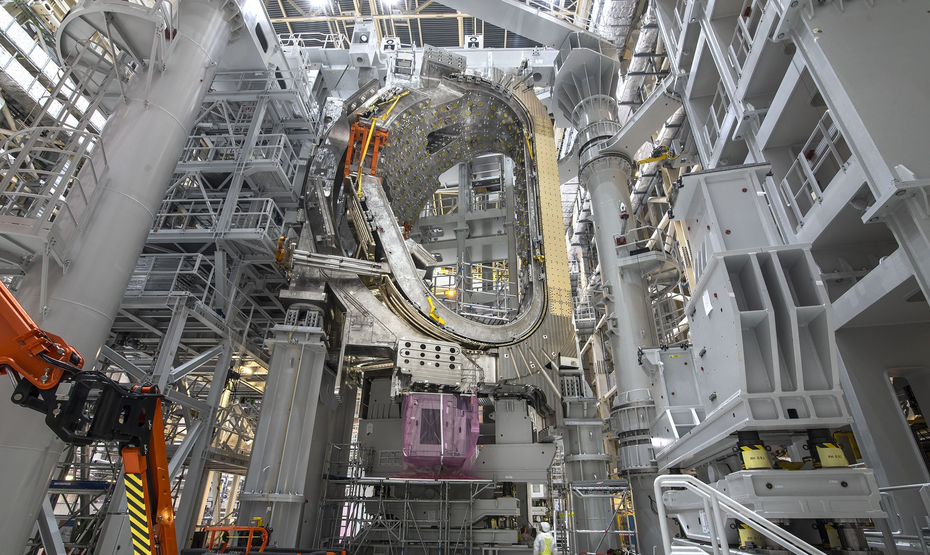
15 November 2021
Inner Leg Inter-coil Structure (ILIS) plates now visible → special plates added to ensure as uniform as possible inter-TF coil gaps for final assembly → uniformity of toroidal field structure

Slide 23
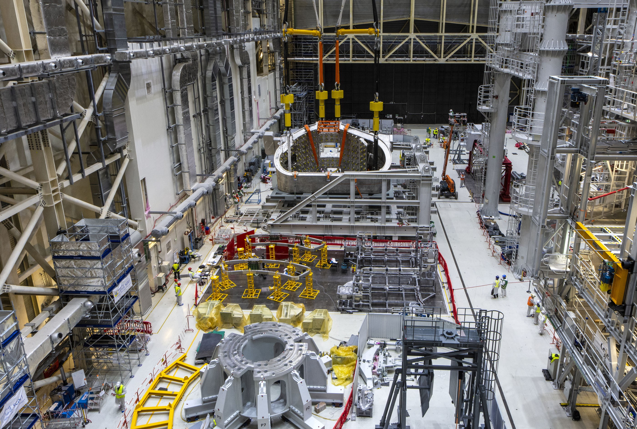
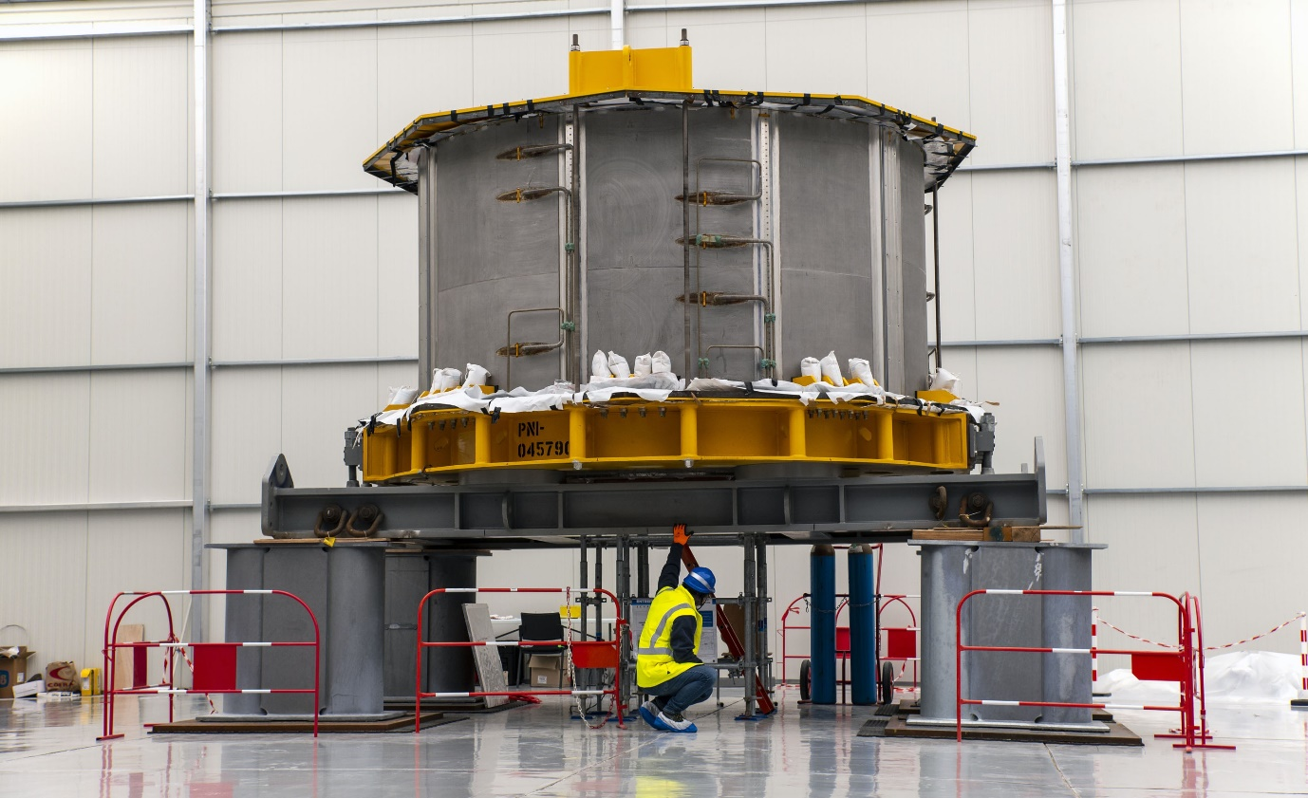
December 20221
VV Sector 7 being inserted into Upending Tool
Two Bottom Correction Coils being prepared for installation
1st CS Module delivered to IO on 9th Sept. 2021
(2nd arrived on 9th December)
Central Solenoid Assembly Platform ready for first module

Slide 24
The “big lift” → First ITER Sector at final location

Slide 25
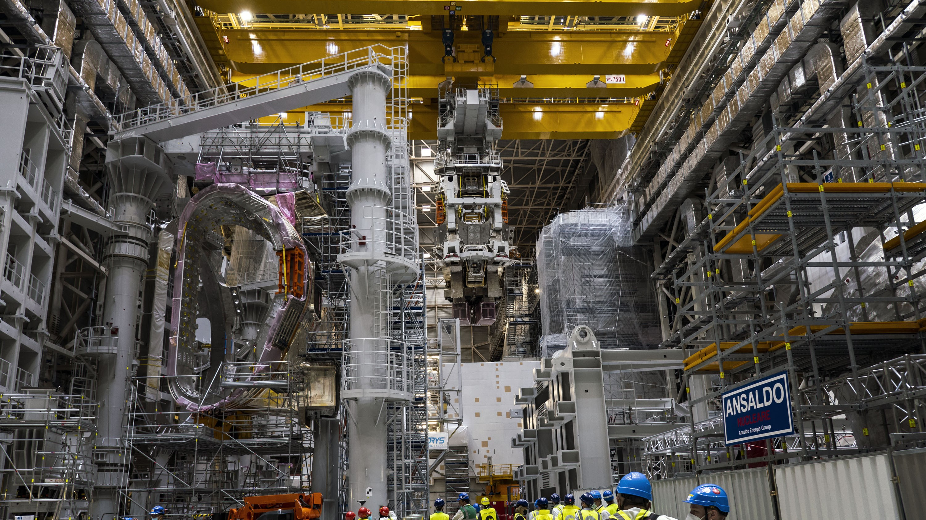
11 May 2022
Sector 6 fully lifted out of SSAT-2 and rotated 90°

Slide 26
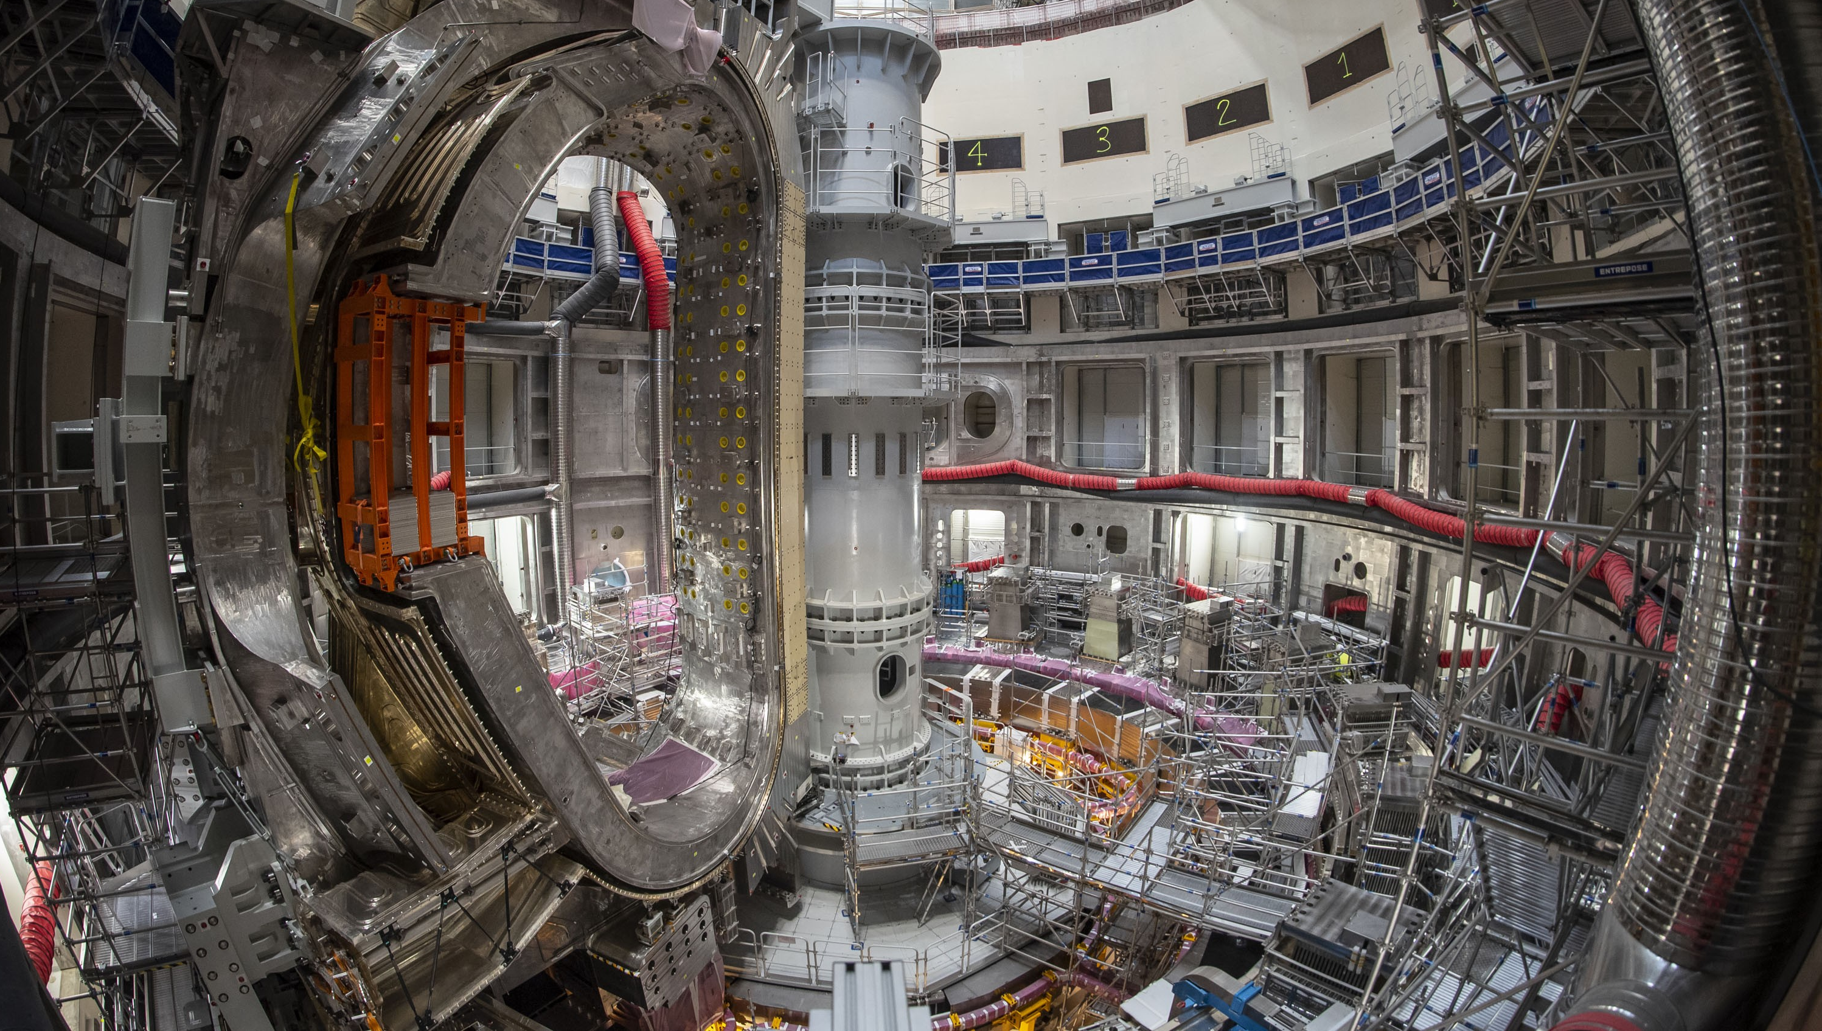
14 June 2022
In-place and alignment procedure underway

Slide 27
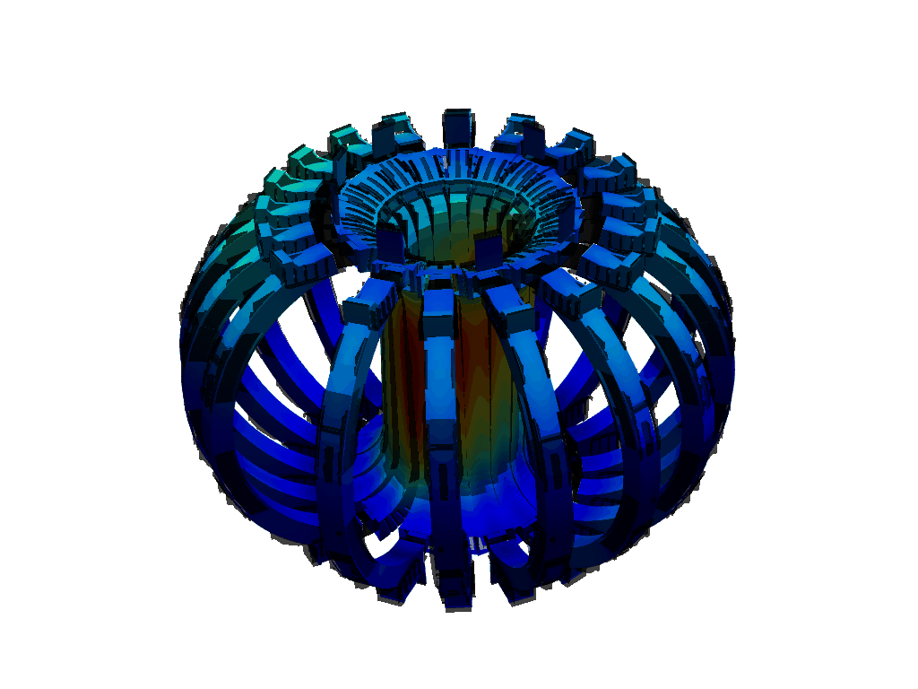
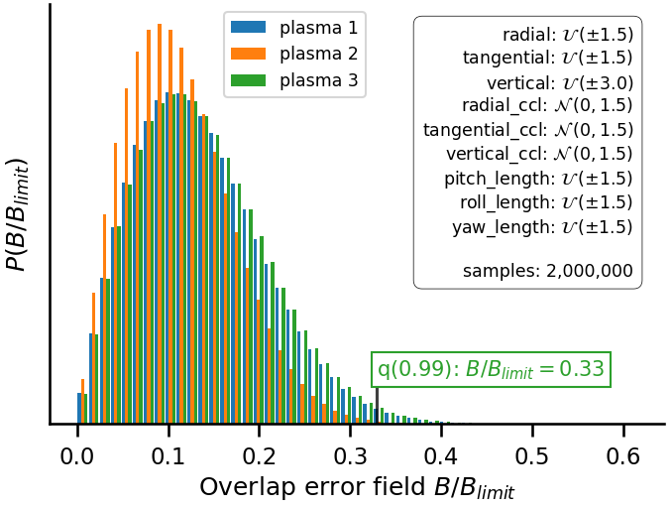
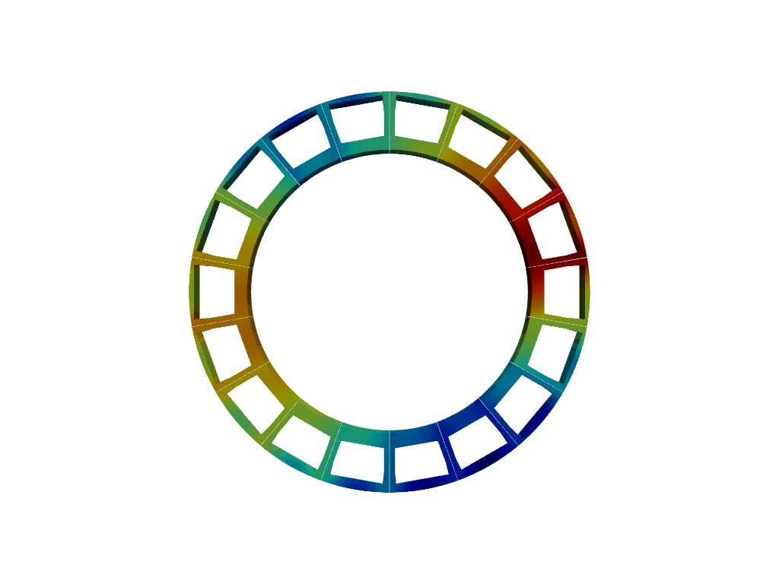
Alignment Criteria Physics Basis
TF assembly alignment criteria (22ºC) based on real coil configuration after cool-down and energization
  Field line excursions at High Field Side (power loads on FW during ramp-up)
  Minimization of error fields (Overlap n = 1 field)
S. McIntosh and Y. Gribov

Slide 28
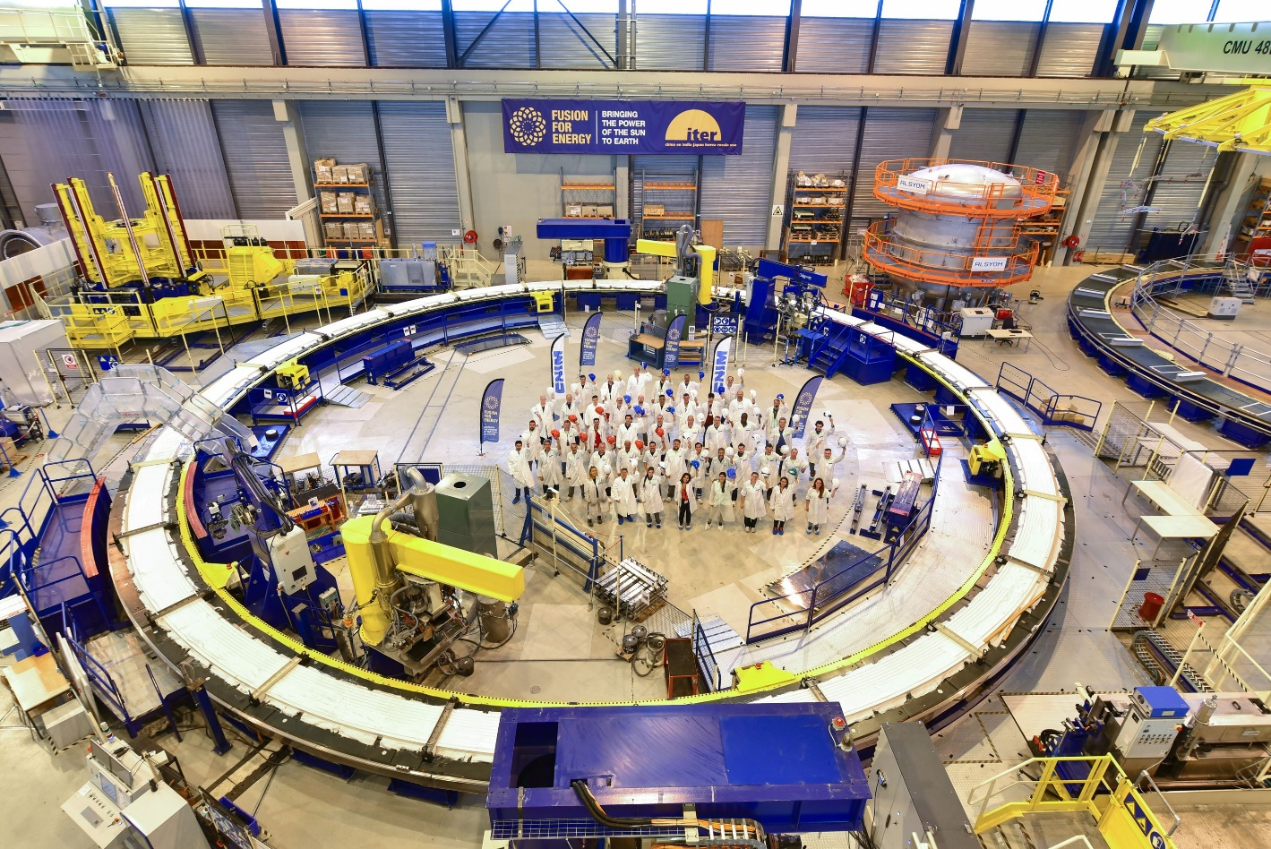

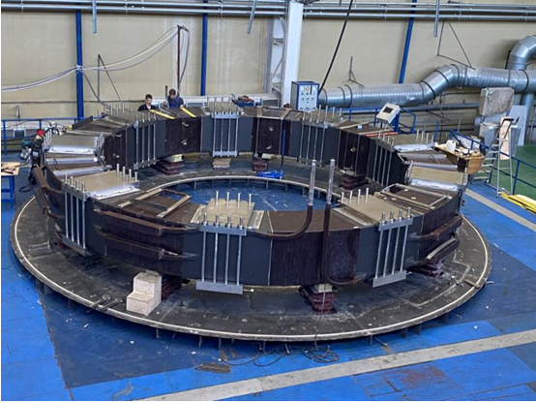

Poloidal field coil progress
EU: PF6 (CN), PF5: complete and in-pit
PF2: complete and in storage
PF4: last stages, PF3: Last DP complete
RF: PF1
Factory Acceptance Test (FAT) complete pending document reception
Expected at IO in 2022
24 June 2022
Last double pancake completed for PF3

Slide 29
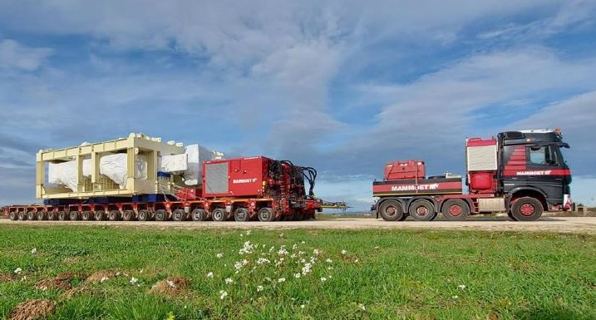
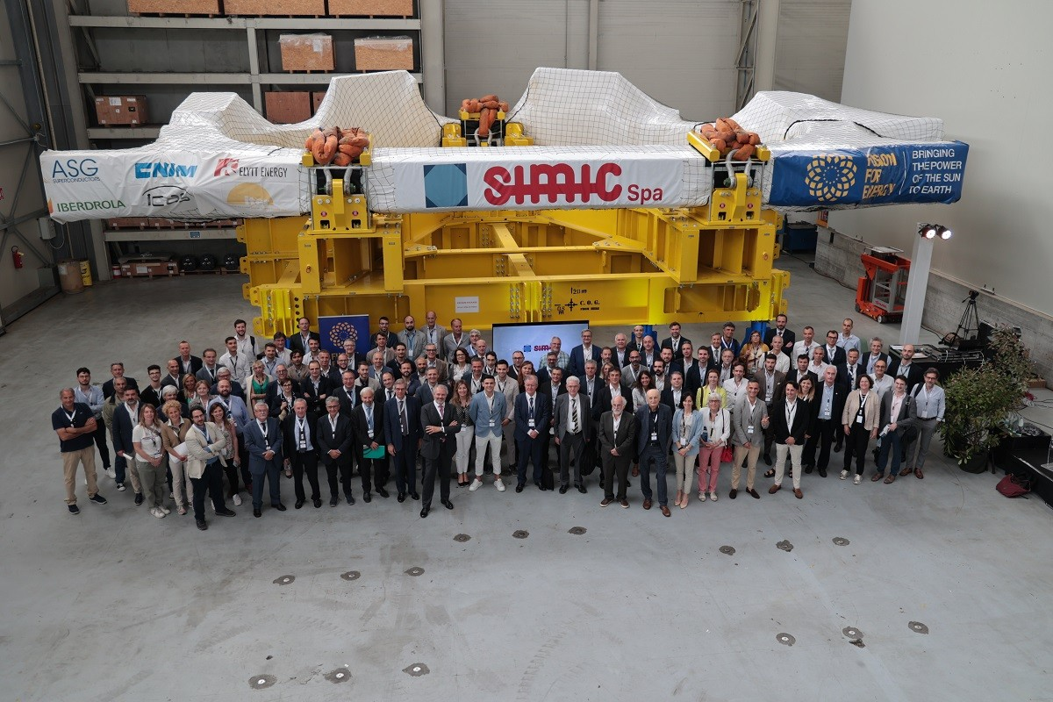
Toroidal field coil progress (July 2022)
JA: 9 coils
6 delivered to IO (TF 12,13 already on VV Sector 6, TF 8 on VV Sector 7)
1 for delivery in Aug. 2022, 1 in Jan 2023
EU: 10 coils, 7 delivered to IO
TF 14 just completed (delivery this week)
TF 18 (delivery Feb 2023)
TF 1 (delivery Oct. 2022)
JA DA TF #2: en route to IO
8th coil complete at SIMIC in Italy

Slide 30
Overview of ITER Research Plan (IRP) and staged approach

Slide 31
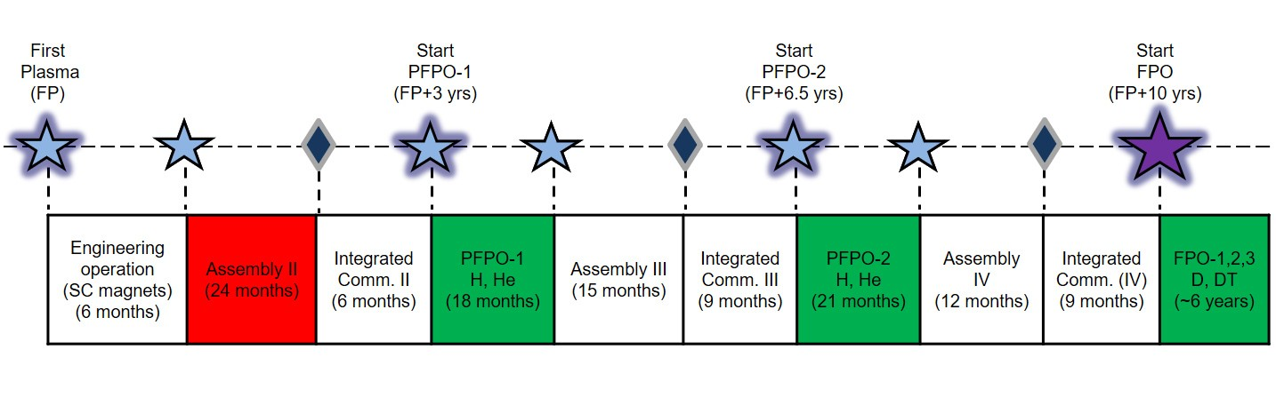
ITER Research Plan (IRP)
R&D Strategy to achieve project’s goals with distinct phases :
  Integrated Commissioning, First Plasma, Engineering Operation
  Pre-Fusion Operation phase (H/He)
  Fusion Power Operation (D and DT) → Achievement of high Q goals

Slide 32
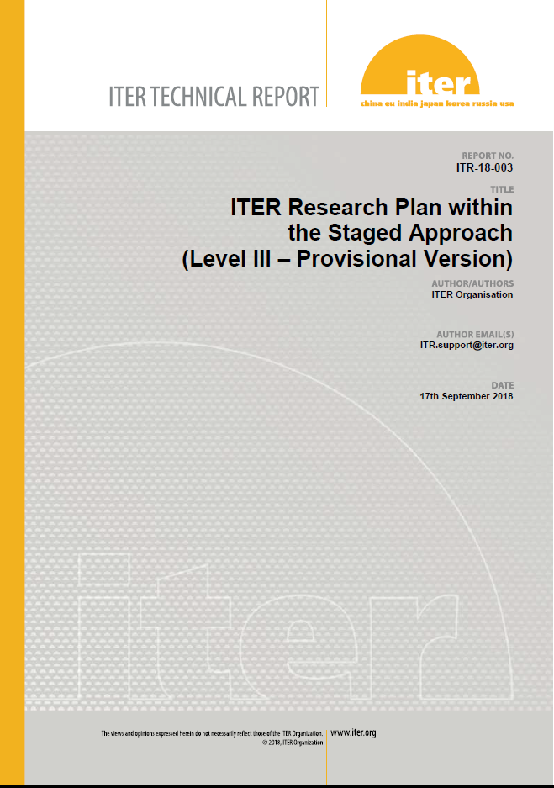
ITER Research Plan and Supporting R&D
ITER Research Plan made publicly available in 2018 (available as Technical Report (ITR-18-003) → now ITER baseline document
R&D topics to support effective execution of Research Plan made accessible to fusion community (ITR-20-008) → used to focus R&D programmes (e.g. ITPA)

Slide 33
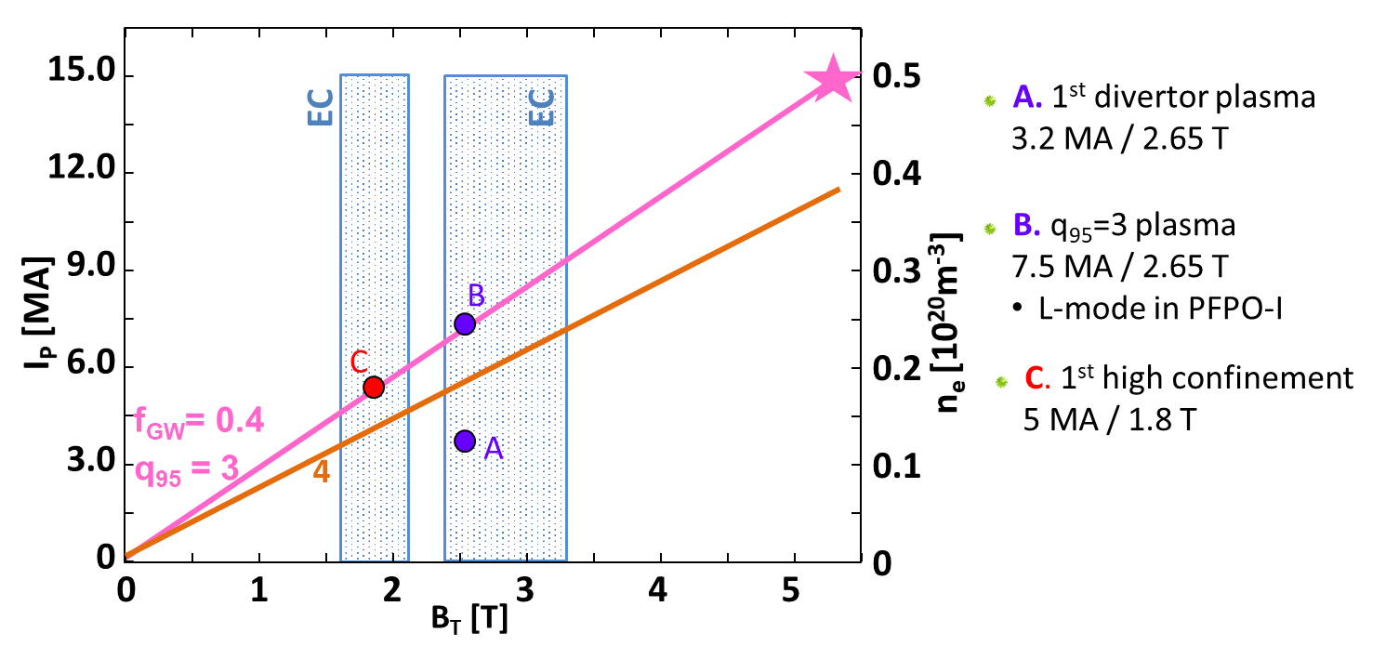
PFPO-I
Main elements of experimental programme:
  Development of plasma control capability, demonstration of interlocks and commissioning of ECH to 20 MW
  Development of scenarios (L-mode) → at least 7.5 MA/2.65 T
  Characterization of Disruption Loads
  Demonstration of Disruption Mitigation System
  Option to explore H-mode plasmas 5 MA/1.8T H-mode

Slide 34
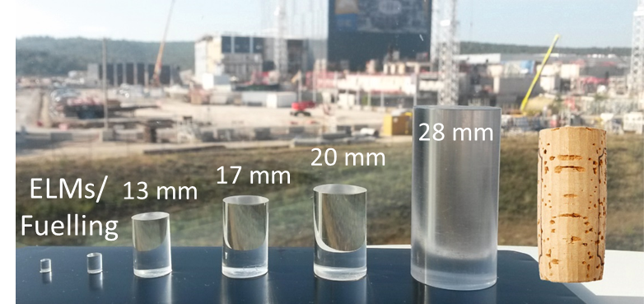
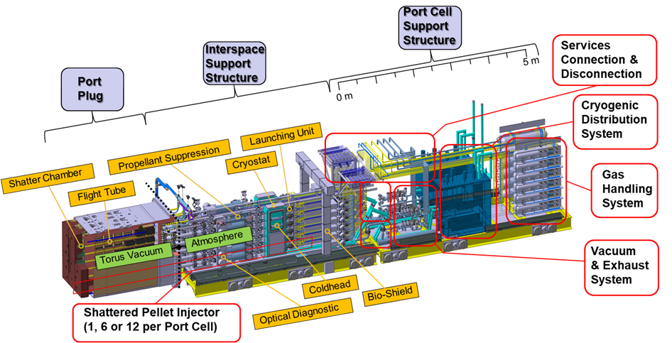
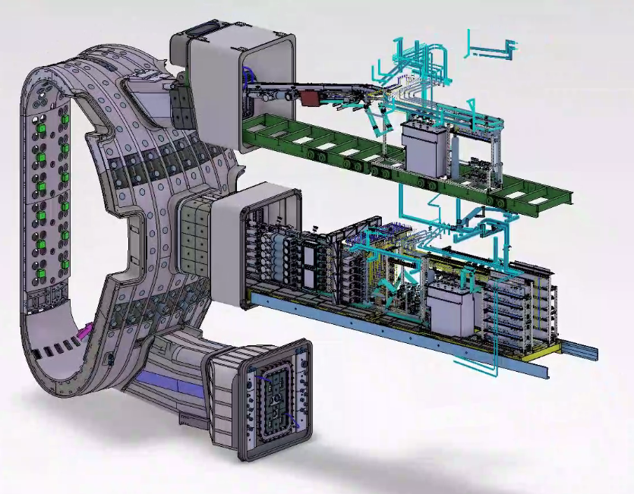
ITER Disruption Mitigation System
M. Lehnen presentation today
S. Jachmich presentation on Friday
JET

Slide 35
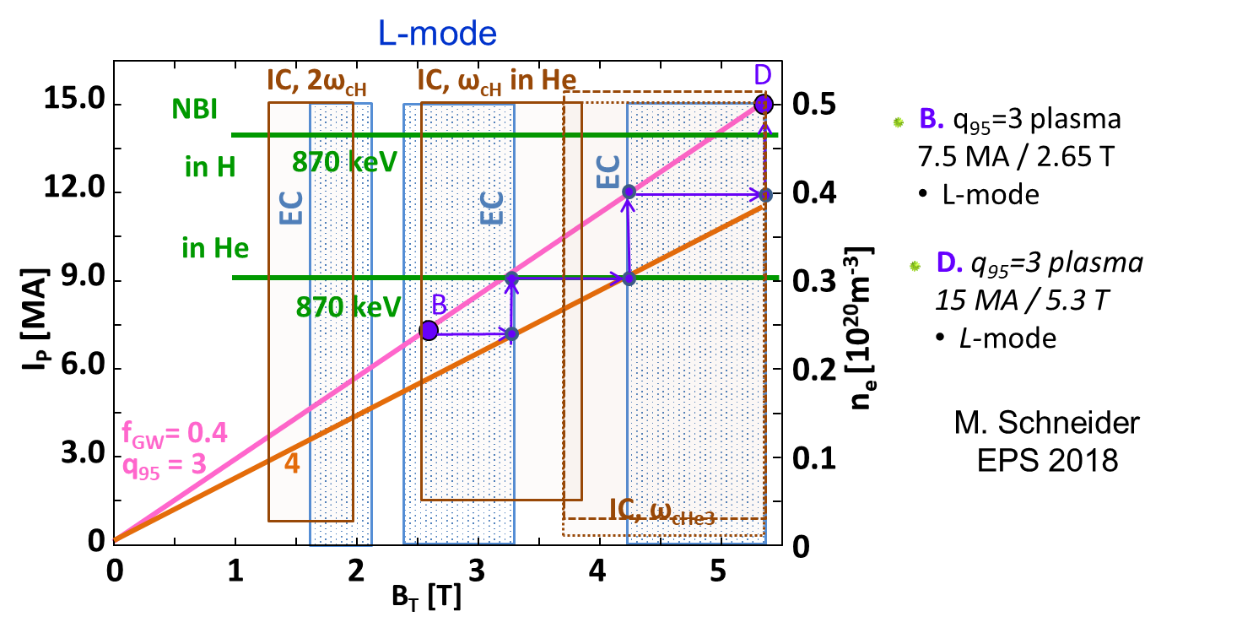
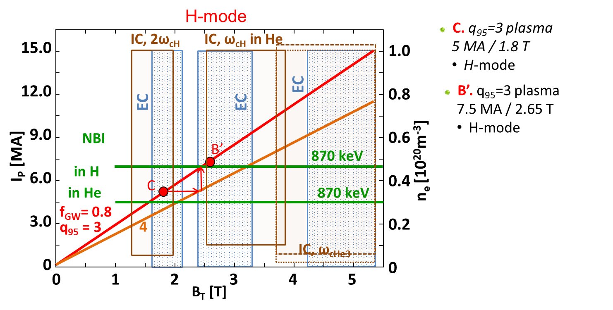
PFPO-II

Slide 36
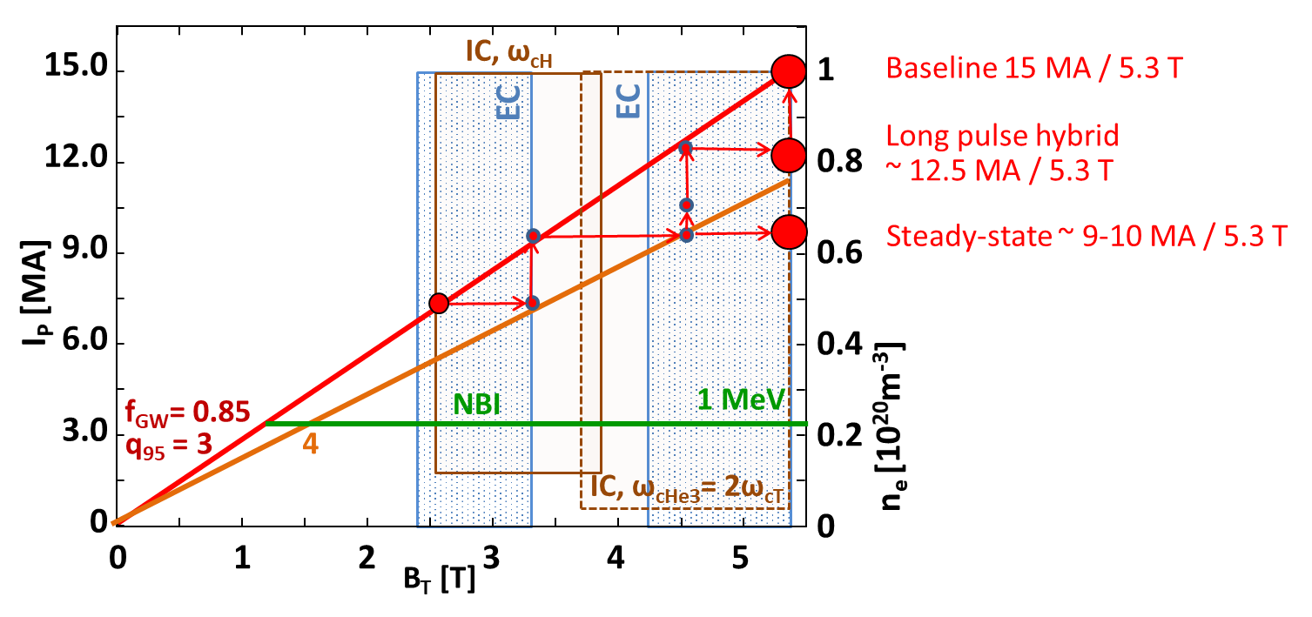
Fusion Power Operation (D/DT)

Slide 37
Conclusions
ITER construction is progressing well despite challenges of present pandemics → commitment from ITER Organization and its Members
ITER Research Plan provides experimental strategy to progress from First Plasma through to achievement of Project’s goals: Q = 10 (300-500 s), Q = 5 (1000 s) & Q = 5 steady-state consistent with the Staged Approach
Details of the IRP are subject to refinement following results of R&D
  Understanding of disruptions and validation of the ITER DMS scheme are essential for the success of the Research Plan
  In parallel, schemes to predict disruptions and avoid them or to minimize their effects when unavoidable are required
  Experimental, theory/modelling and model validation R&D are essential to address the outstanding issues

