Slide 1
2nd IAEA Technical Meeting on
Disruptions and their Mitigation
19–22 July 2022
Organisation

Slide 2
Meeting Goals
Coordinate/discuss experimental, theoretical and modelling work with special emphasis on developing a solid basis for possible mitigation strategies in ITER and next generation fusion devices
Three areas:
  Consequences (Heat loads, EM load, Runaway Electrons)
  Prediction & Avoidance (Mitigation Trigger, Proximity control, Machine learning)
  Mitigation (Physics basis for SPI, Alternative methods, SPI technology)
Output: NF article summarizing the discussion in each area, including R&D needs for the next 2 years

Slide 3
Agenda
Tuesday
Wednesday
Thursday
Friday
9:00-10:10
Welcome Session
9:00-10:55
Prediction&Avoidance (1)
9:00-11:00
ITER worksite tour
9:00-11:45
Mitigation Technology
Chair: M. Barbarino
Chair: C. Sozzi
Chair: M. Lehnen
10:50-12:50
Consequences (1)
11:15-12:45
Prediction&Avoidance (2)
11:10-13:05
Mitigation (1)
11:45-12:45
General discussion
Meeting closure
Chair: F. Villone
Chair: C. Rea
Chair: V. Izzo
Lunch
Lunch
Lunch
Lunch
13:00-14:00
Poster session
13:55-15:25
Prediction&Avoidance (3)
14:05-15:35
Mitigation (2)
14:00-15:30
Consequences (2)
Chair: G. Pautasso
15:25-16:55
Poster & Coffee session
Chair: B. Lyons
For the detailed agenda see INDICO page
https://conferences.iaea.org/event/281/timetable/#all.detailed
Chair: M. Hölzl
15:55-17:55
Mit (3) + Discussion
15:50-17:00
Cons (3) + Discussion
16:55-17:40
P&A Discussion
Chair: F. Villone
Chair: C. Rea
Chair: E. Nardon

Slide 4
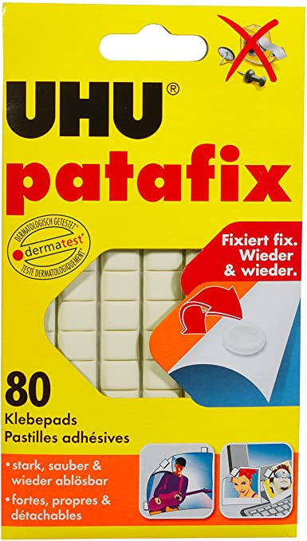
Poster Sessions
Tuesday, 13:00-14:00
Wednesday, 15:25-16:55 (incl. coffee)
All posters on display on both days!
Please put up your posters in the entrance lobby
(left and right of the main entrance)
Important: only use patafix for attaching the posters
→ available in the council room
Coffee (Wed)
Poster
Canteen

Slide 5
Lunch
Tables reserved for meeting participants (go to the left from the cashier)
Cash or credit cards accepted
Choice of starters, main dishes (vegetarian, grill, sea food, meat), desserts
soup
meat
grill
fish
Coffee (Wed)
starters
vegetarian
Poster
Canteen
starters
dessert

Slide 6
Discussion Sessions
Discussion sessions should consider all material: talks + posters
Not all poster presenters can participate in person
  Material is available through INDICO and can also be brought up during the discussion sessions
  Posters have been printed and are also on display during the poster sessions
  Please use email contacts to directly interact with remote participants
Discussion topics to be prepared by the session chairs
Objectives:
  Identify gaps in present understanding (in view of next step devices)
  Discuss progress with respect to conclusions from 2020 IAEA TM
  Address priorities for R&D within the next 2 years

Slide 7
Presentation Material
If not yet done, please upload your presentation or poster as soon as possible, before your presentation slot.
The material presented at this meeting is made available to the community through INDICO
Remote participants: please go to INDICO to listen to poster presentations (and orals you may have missed)
Note that the INDICO page has open access

Slide 8
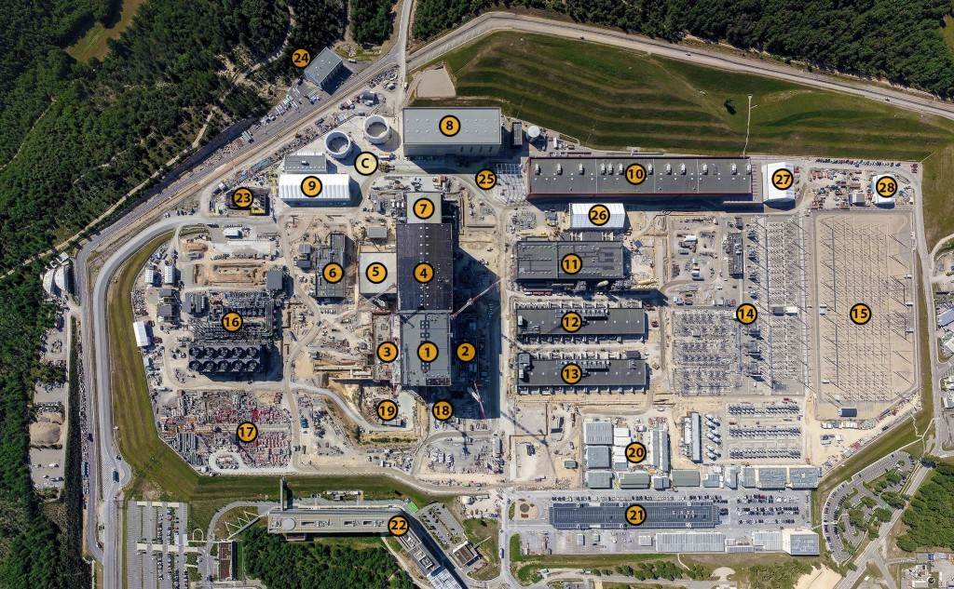
Worksite Tour
Thursday, 9:00-11:00
PPE pick-up at 8:40 on HQ ground level
(direction canteen, right hand side and opposite to BNP bank)
Skirts, shorts, open shoes or high heels are not permitted on the ITER worksite.

Slide 9
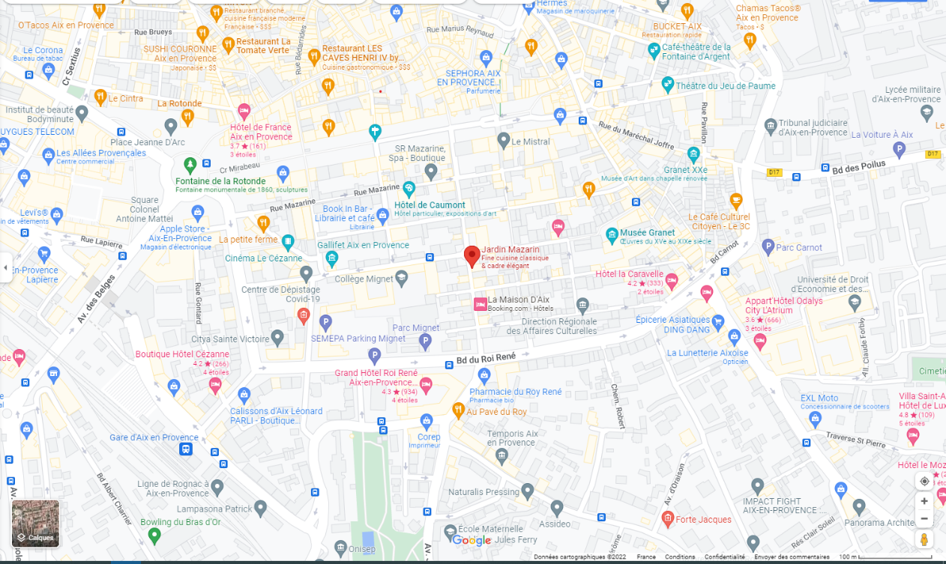
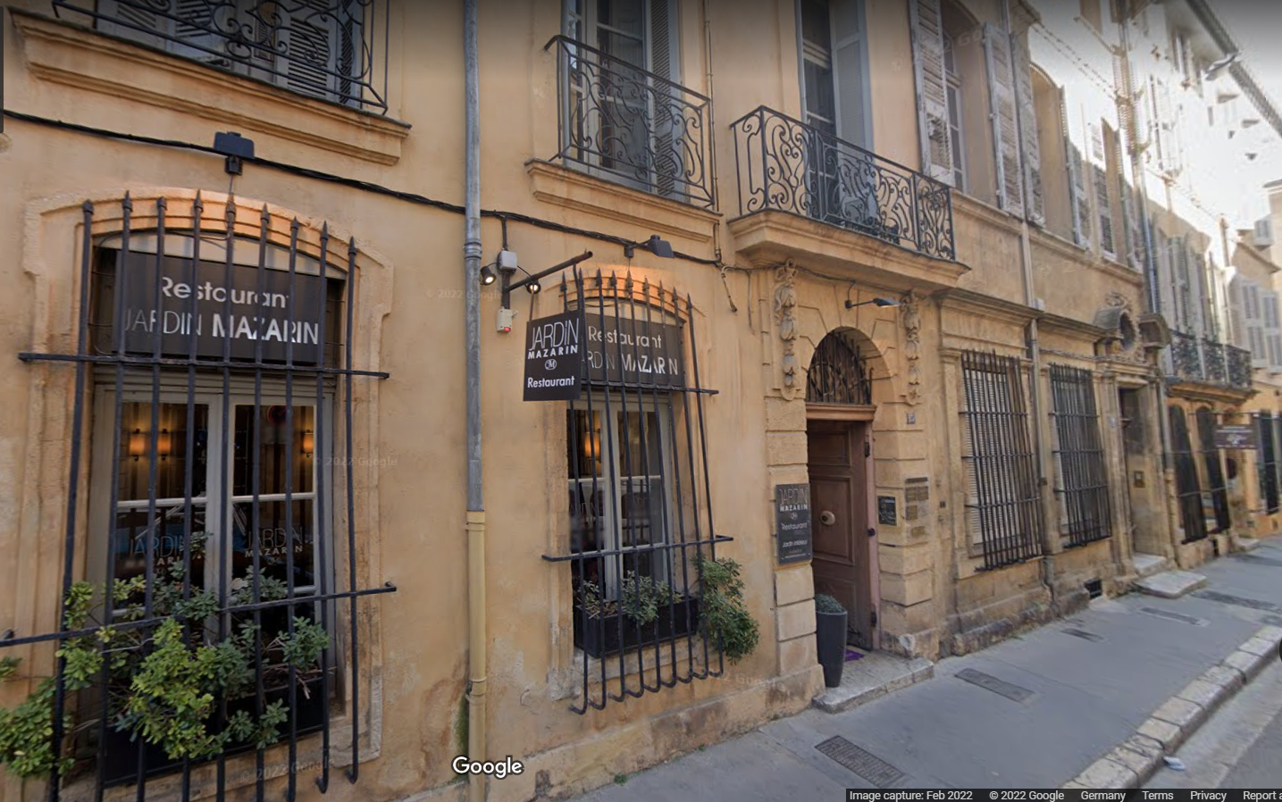
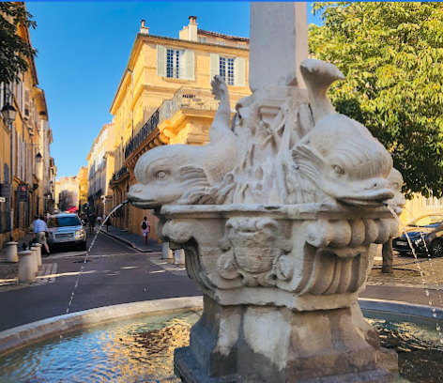
Social Dinner
Jardin Mazarin
15 RUE DU 4 SEPTEMBRE
Wednesday, 20:00

Slide 10
COVID
ITER premises: wearing masks is not mandatory (but it is recommended when you are in close proximity to others for a prolonged period)
France: masks not mandatory (incl. public transport) except in health care facilities (hospitals, etc.)

