Slide 1
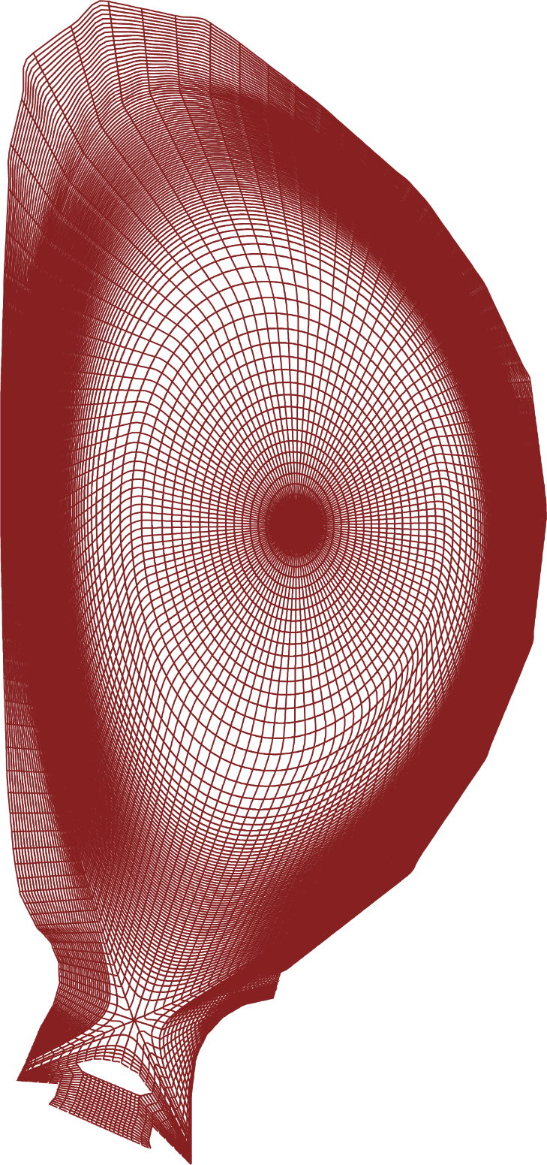
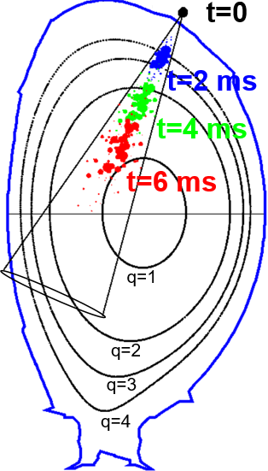
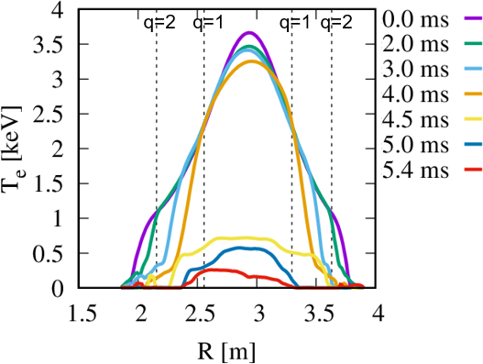
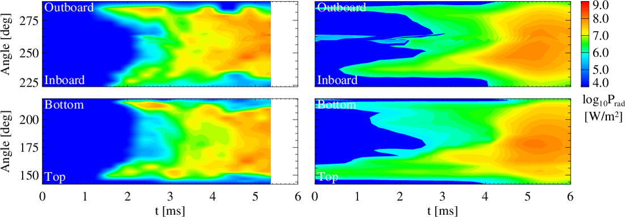
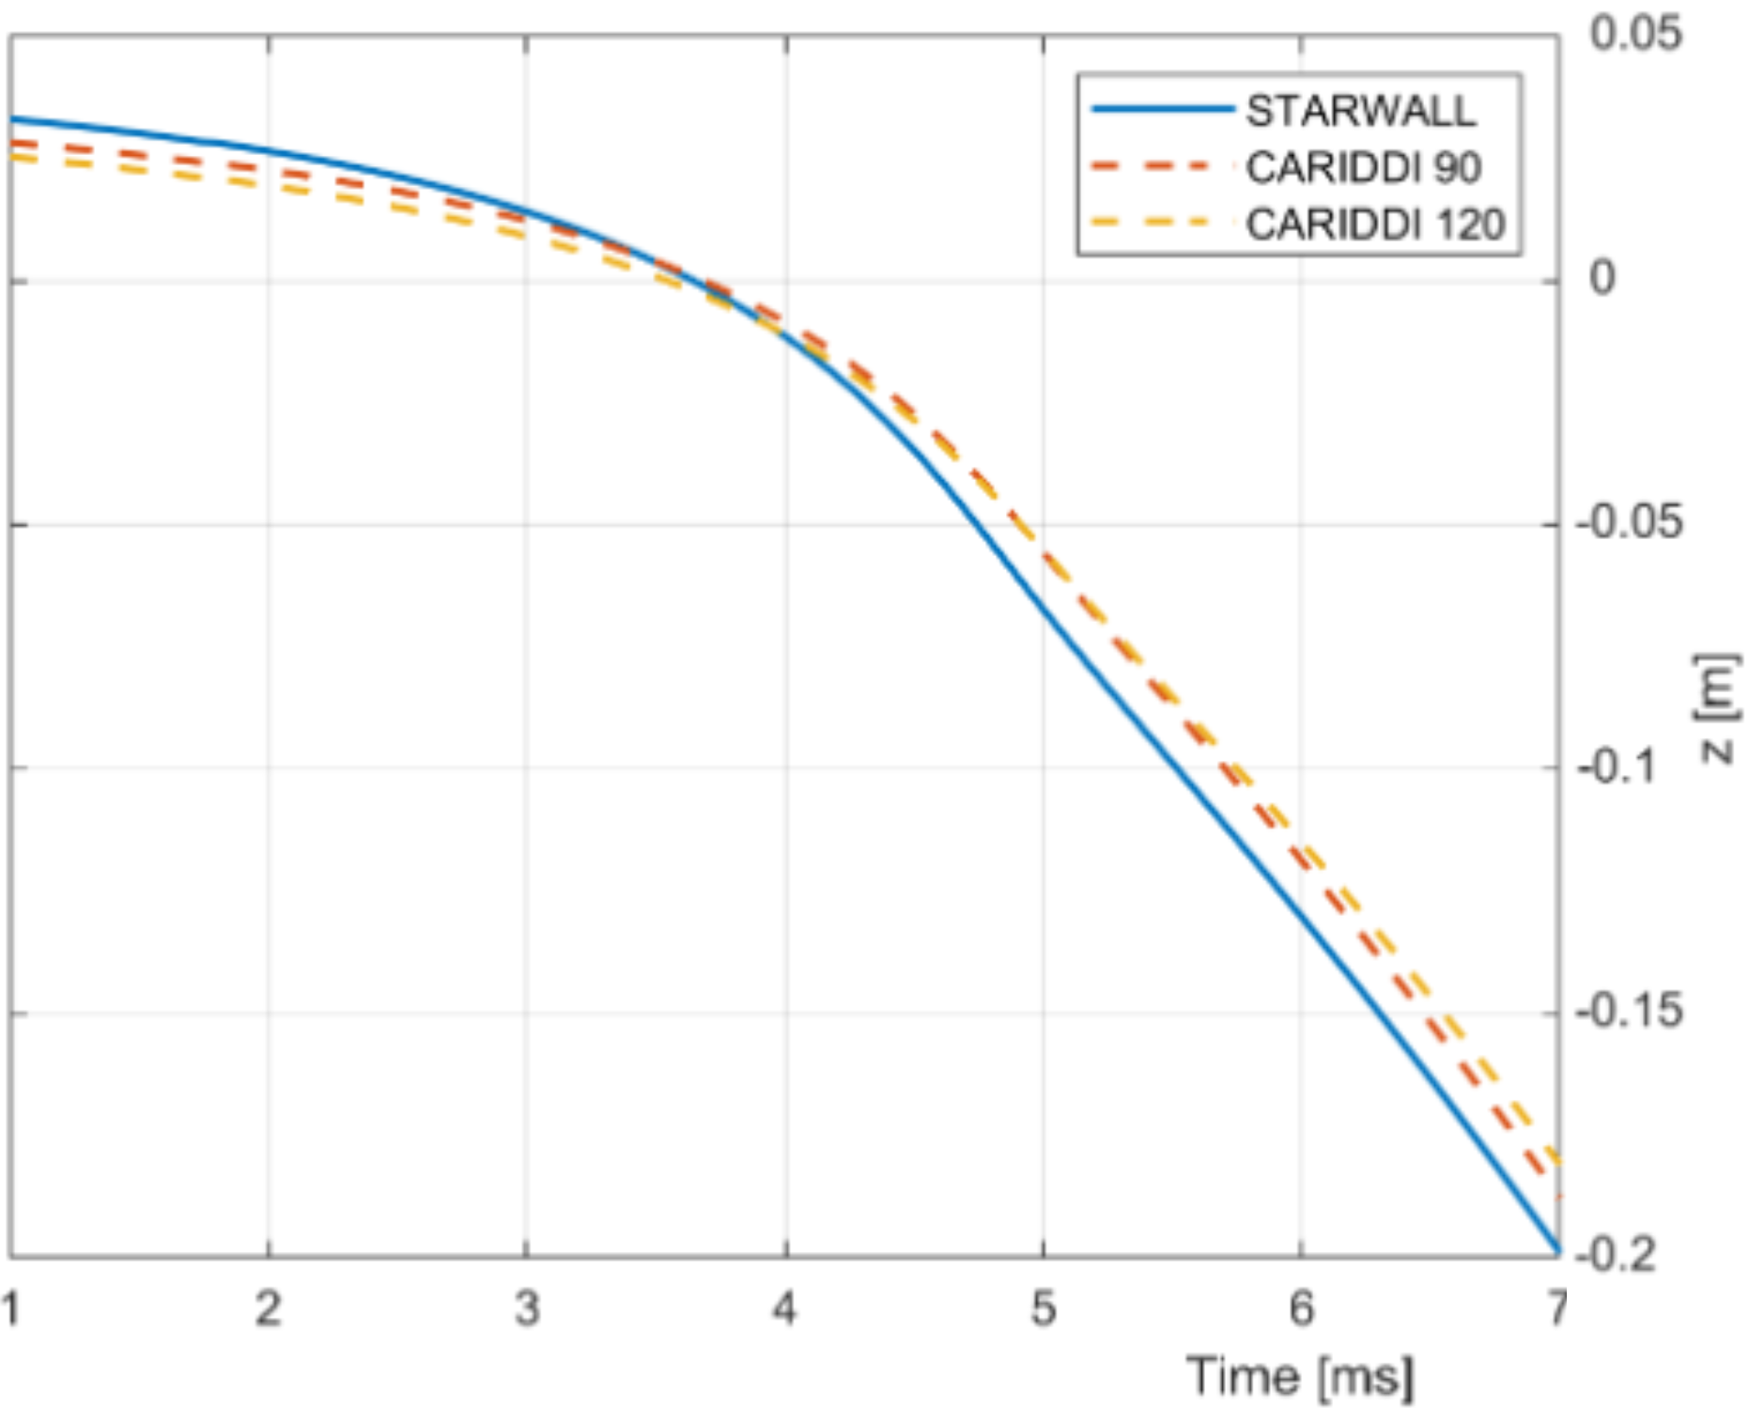
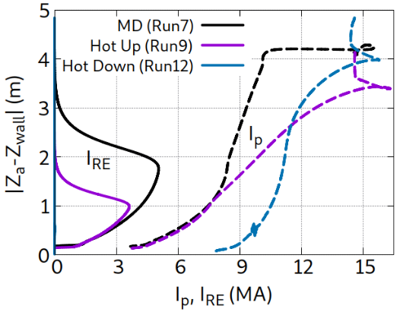
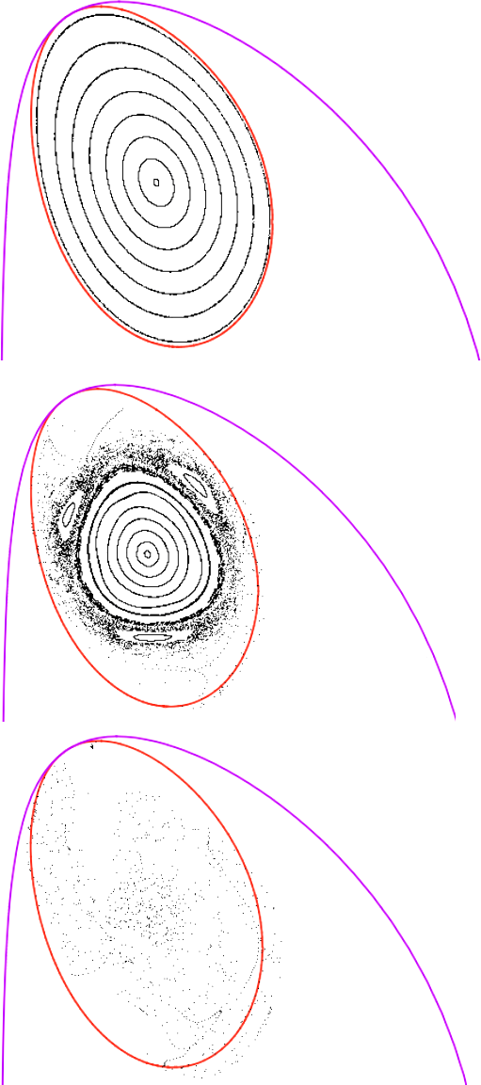
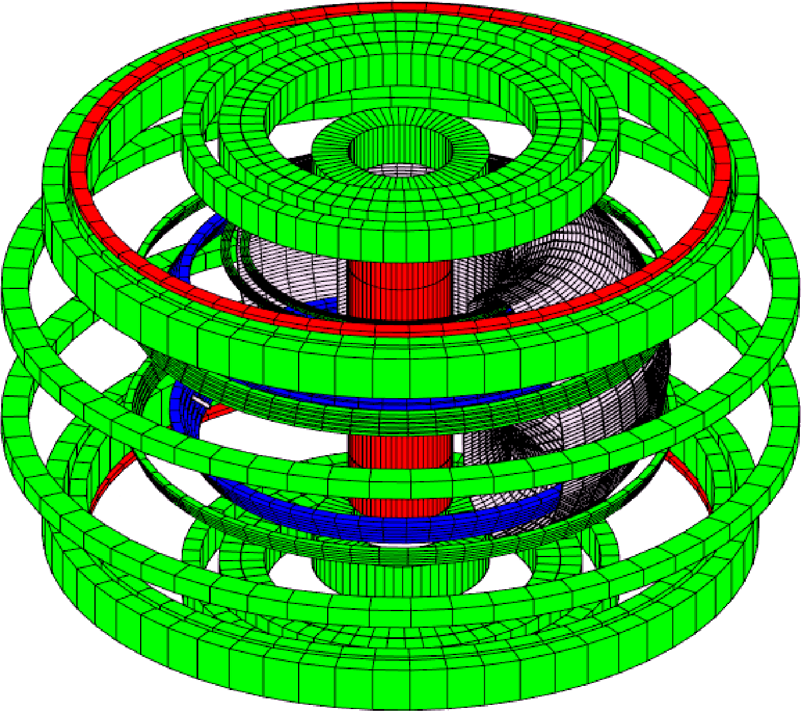
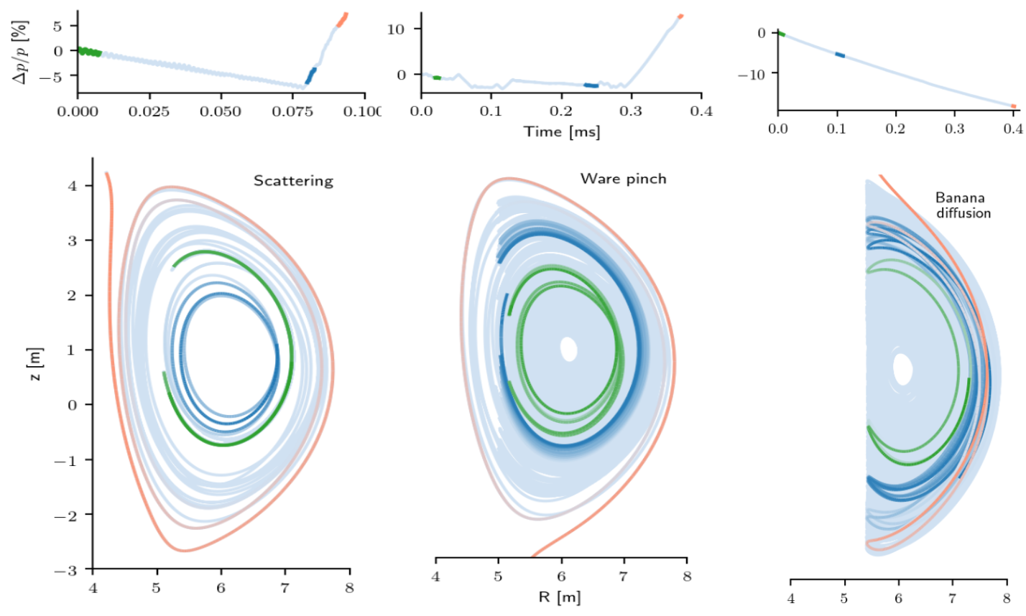
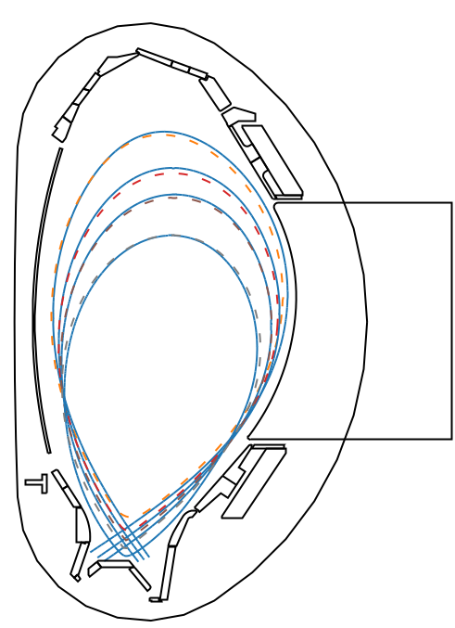
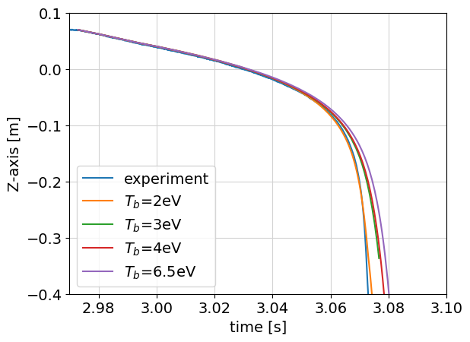
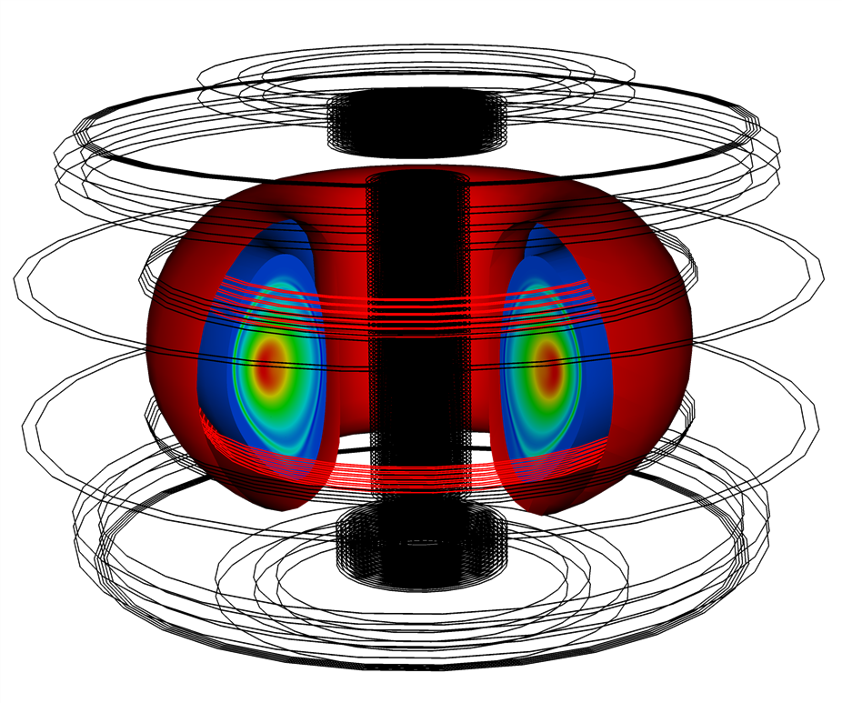
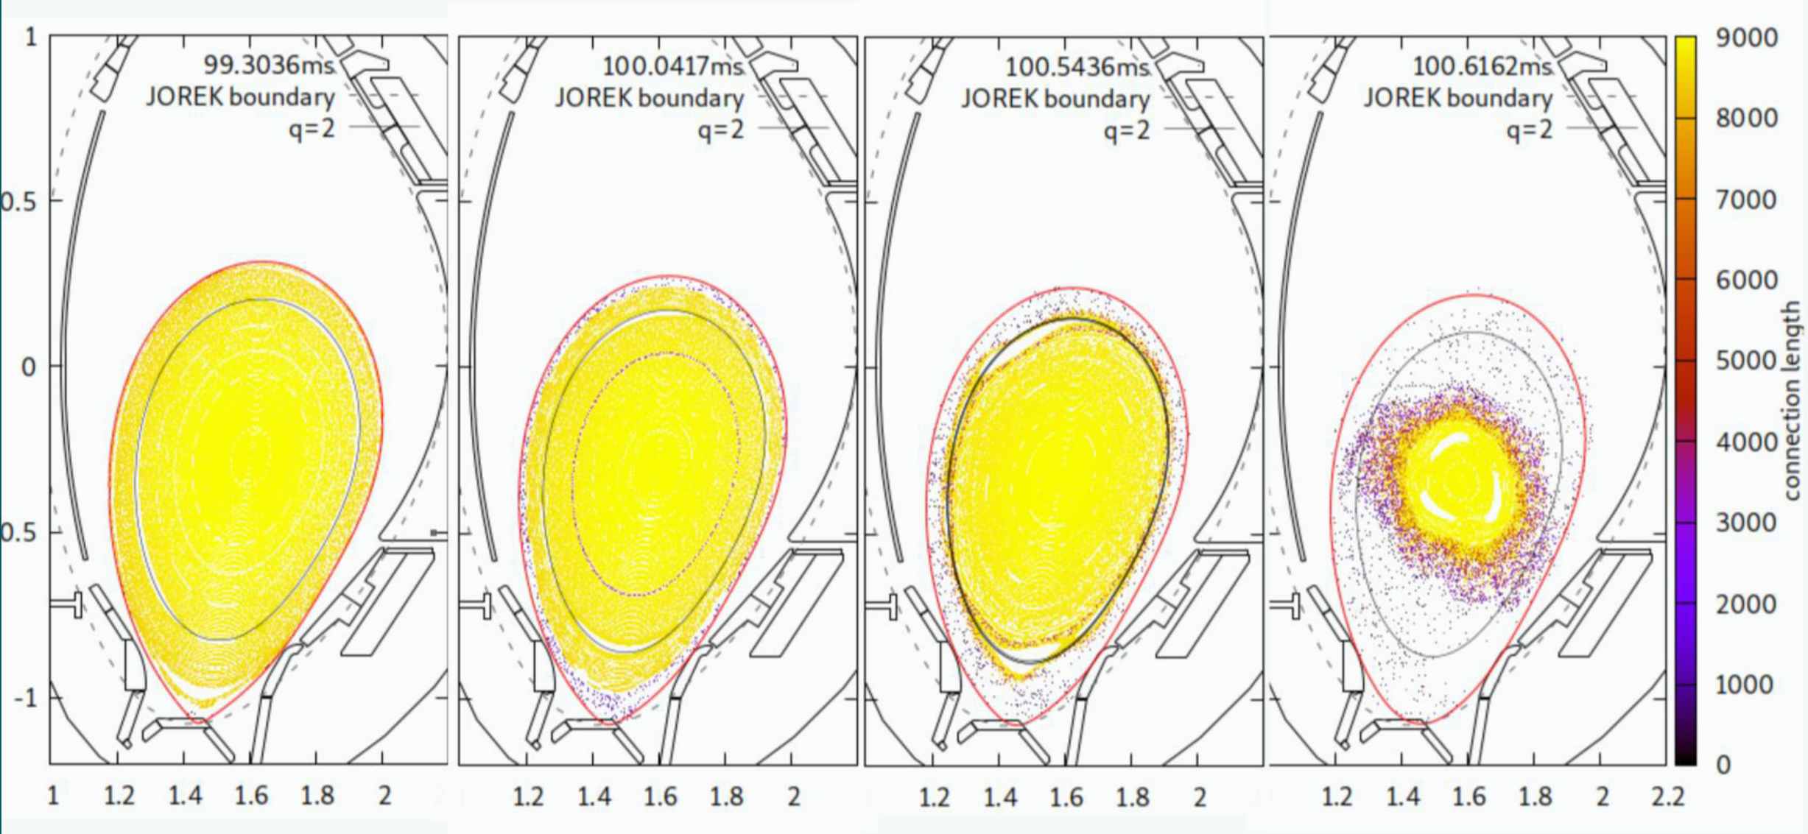
MHD activity during disruptions and disruption mitigation: Recent insights from JOREK
M Hoelzl¹, FJ Artola², V Bandaru¹, A Bhole³, D Bonfiglio⁴, T Driessen², N Isernia⁵, D Hu⁶, GTA Huijsmans^{7,8}, M Kong⁹, S-J Lee¹⁰, E Nardon⁷, S Pamela¹¹ S Sadouni⁷, K Särkimäki¹, N Schwarz¹, C Sommariva¹², K Strien⁸, F Wieschollek¹, JOREK Team⁺, JET contributors* ¹Max Planck Institute for Plasma Physics, Germany; ²ITER Organisation, France; ³Nice University, France; ⁴Consorzio RFX-CNR, ENEA, INFN, Univ. di Padova, Italy; ⁵Universita degli studi di Napoli Federico II, Italy; ⁶Beihang University, China; ⁷CEA/IRFM, France; ⁸Eindhoven University, The Netherlands; ⁹UKAEA, UK; ¹⁰Seoul National University, Korea; ¹¹UKAEA, UK; ¹²EPFL, SPC, CH-1015 Lausanne, Switzerland ⁺See the author list of Hoelzl M., Huijsmans G.T.A., Pamela S.J.P., Becoulet M., Nardon E., Artola F.J., Nkonga B. et al. Nuclear Fusion 61, 065001 (2021) *See the author list of J. Mailloux et al. Nuclear Fusion 62, 042026 (2022)
+ more partners involved
Abstract
1) The JOREK Code
JOREK [1,2] is a versatile hybrid MHD code for studying disruptions in realistic geometry. Relevant models are explained including recent and planned extensions.
Validations against experiments and ITER predictions regarding vertical plasma motion, halo currents and wall forces are discussed. The ongoing coupling to CARIDDI for capturing detailed 3D wall effects is shown.
Modelling of disruption mitigation by shattered pellet injection (SPI) is presented including detailed experiment validation and ITER predictions. Radiative collapse and current spike physics are compared to experiment and theory.
ITER predictions for runaway electron (RE) mitigation modelled by a fluid RE treatment as well as trapped RE loss mechanisms modelled by a kinetic test particle approach are discussed.
Reduced and full MHD with various extensions
Resistive walls, pellets, etc.
Fluid & kinetic models for neutrals, impurities, REs
2D flux surface aligned FE grid with extension to true first wall [3] (→ Figure 1)
Higher order FEs [4]
Fully implicit time stepping & iterative solver with physics based preconditioner: optimized for non-linear scenarios [5]
Development coordinated by EUROfusion TSVV project on MHD transients
Strong international community and involvement of the ITER Organisation
Figure 1: ITER FE grid
2) VDEs and halo currents
3) disruption mitigation
4) Runaway electrons
3D VDE benchmark of JOREK-STARWALL with M3D-C1 and NIMROD shows good agreement [6]
JOREK-CARIDDI coupling ongoing to capture detailed 3D wall effects [7] (→ Figure 2)
Ion saturation current needed for self-consistent halo current evolution as shown on COMPASS [8]
Experiment validation (→ Figure 3)
Dedicated hot VDE experiments on AUG; repeated also with SPI showing mitigated forces; first simulations reproduce vertical motion, halo current amplitude, forces, and time of TQ onset [9]
ITER predictions
3D mitigated CQ simulation shows continuous MHD activity and moderate forces [10]
Hot VDE simulations with scaled parameters ongoing → FJ Artola, this conference
Figure 4: Validation on JET
RE fluid model captures mutual interaction of REs and MHD, but does not resolve momentum space
Recently extended for partially ionized impurity effects and benchmarked against GO and DINA
Key experimental features & time scales reproduced for benign beam termination in JET [22]
RE mitigation in ITER by multiple massive material injections studied in 2D and 3D [21] (→ Figure 5)
Kinetic REs capture detailed trajectories, momentum space dynamics and loss mechanisms; coupling to MHD planned in a PhD project starting in summer
Stochastic RE transport is energy dependent [23]
Assessment of RE losses [24] including trapped REs in the ITER CQ of [10] (→ Figure 6)
Virtual camera diagnostic in development [25]
JET Ne SPI cases with realistic shard cloud reproduce bolometry signals quantitatively
JOREK JET
KB5H KB5V
Figure 2: JOREK-CARIDDI coupling
Figure 5: ITER RE mitigation (Re fluid model)
Deuterium SPI prior to the TQ proposed to reduce RE hot tail seed by plasma dilution [11]
Investigated on JET [12]: Ad-hoc model for small-scale plasmoid drift needed to match experimental density evolution. Background impurity radiation plays an important role.
Impurity seed in D pellets could mitigate drifts?
Pre-existing MHD causes premature TQ for single D-SPI depending on injection phase w.r.t. island [13]
Impurity or mixed SPI to get CQ time in acceptable range for ITER of 50…200 ms (Blanket, re-heating)
Two-temperature coronal equilibrium model [14]
Pseudo particles to track charge states [15]
Kinetic impurities tested in 2D successfully [16]
Full MHD also applicable [17], but reduced MHD sufficient in most scenarios
Experiment validation on JET [18] (→ Figure 4), KSTAR [19] and AUG (soon)
ITER predictions → D Hu, this conference
Comparison of up and downward VDEs shows pronounced differences
→ VK Bandaru, this conference
RE beam termination due to MHD activity (preliminary)
Important milestone reached: Eddy current coupling of JOREK-CARIDDI benchmarked successfully for tearing modes and for an AUG VDE
Figure 6: Kinetic Res in ITER 3D CQ
Stochastic losses of REs in 3D ITER CQ were studied. Analyzed the loss mechanisms of trapped REs (low to high energy from left to right)
Figure 3: AUG HOT VDE simulations
JOREK-STARWALL simulations of hot VDEs in AUG. Vertical plasma motion and halo current amplitude are reproduced in 2D. Onset of TQ reproduced in 3D.
AUG JOREK
Current spike as proxy for fast magnetic reconnection
Current spike reproduced quantitatively in JET Ar simulations [20]. Results suggest a combination of shear Alfvén waves and macroscopic ExB flow in the region q<2 as origin
Double tearing mode case based on [21] is studied to investigate reconnection and MHD relaxation dynamics at a fundamental level
5) ConclusionS
JOREK has models to describe all aspects of disruptions. This contribution can only provide an overview without going into details
Validation e.g. for hot-VDEs, mitigation by SPI, current spikes (and a lot more) reaches quantitative agreement
JOREK-CARIDDI coupling on the way to capture detailed 3D wall effects
Kinetic treatment of neutrals, impurities and REs advances to production
ITER predictions for disruptions and disruption mitigation become increasingly reliable regarding forces, heat loads and runaway electrons
[1] GTA Huysmans and O Czarny, Nuclear Fusion 47, 659 (2007) [2] M Hoelzl, GTA Huijsmans, SJP Pamela, M Becoulet, E Nardon, FJ Artola, B Nkonga et al, Nuclear Fusion 61, 065001 (2021) [3] SJP Pamela et al, Computer Physics Communications 243, 41 (2019) [4] SJP Pamela et al, Journal of Computational Physics 11101 (2022) [5] I Holod et al, Plasma Physics and Controlled Fusion 63, 114002 (2021) [6] FJ Artola, CR Sovinec, SJ Jardin et al, Physics of Plasmas 28, 052511 (2021) [7] N Isernia, N Schwarz et al, EPS 2022 [8] FJ Artola et al, Plasma Physics and Controlled Fusion 63, 064004 (2021) [9] N Schwarz et al, in preparation [10] FJ Artola et al, Nuclear Fusion 62, 056023 (2022) [11] E Nardon et al, Nuclear Fusion 60, 126040 (2020) [12] M Kong et al, in preparation [13] F Wieschollek et al, Physics of Plasmas 29, 032509 (2022) [14] D Hu et al, Nuclear Fusion 61, 026015 (2021) [15] D Hu et al, Plasma Physics and Controlled Fusion 63, 125003 (2021) [16] K Strien et al, in preparation [17] A Bhole, in preparation [18] D Bonfiglio et al, in preparation [19] S-J Lee et al, in preparation [20] E Nardon et al, Plasma Physics and Controlled Fusion 63, 115006 (2021) [21] VK Bandaru et al, in preparation [22] VK Bandaru et al, Plasma Physics and Controlled Fusion 63, 035024 (2021) [23] K Särkimäki et al, Nuclear Fusion 60, 126050 (2020) [24] K Särkimäki et al, Nuclear Fusion 62, 086033 (2022) [25] C Sommariva et al, in preparation
Contribution ID 11
2nd IAEA TM on Plasma Disruptions and their mitigation
*Corresponding author: mhoelzl@ipp.mpg.de

