Slide 1
Non-equilibrium JOREK simulation of ITER L-mode SPI process
D. Hu, E. Nardon, F.J. Artola, M. Lehnen, D. Bonfiglio,
M. Hoelzl, G.T.A. Huijsmans, S.-J. Lee and A. Matsuyama

Slide 2
Contents
Introduction to JOREK non-equilibrium impurity model
Target equilibrium & SPI configurations
Characteristic behavior – a reference case
The MHD response & density transport
Comparison with CE assumption
Edge cooling, $T_{e}$ hole & localization effect
Impact of assumptions and injection parameters
Mixture ratio & injection velocity
“Non-local” ablation & magnetic funneling
Artificial toroidal spread
Conclusion & discussion

Slide 3
Introduction
Massive Material Injection (MMI) is fundamental for disruption mitigation in ITER and future high performance devices. Both for thermal quench and current quench.
Massive Gas Injection (MGI), Shattered Pellet Injection (SPI), Dispersive Shell Pellet Injection (DSPI)……
Significant neutral source, timescale of reaching Coronal Equilibrium (CE) comparable with timescale of density rise, strong non-equilibrium behavior close to the source.
Significant line radiation contribution from lowly charged states, CE assumption underestimate radiation.
We present two-T non-CE simulations of ITER L-mode SPI.

Slide 4
Introduction
Marker-particle approach was used to enable description of non-equilibrium impurities.
Marker particles simply flow along with the fluid velocity field (strong CX or friction), instead of being pushed according to its own momentum equation.
Instead of a given charge, each super-particle could have a distribution of charge state.
Project charge information, ionization power and radiation power onto the fluid evolution.
Using open ADAS data.
D Hu et al 2021 Plasma Phys. Control. Fusion 63 125003

Slide 5
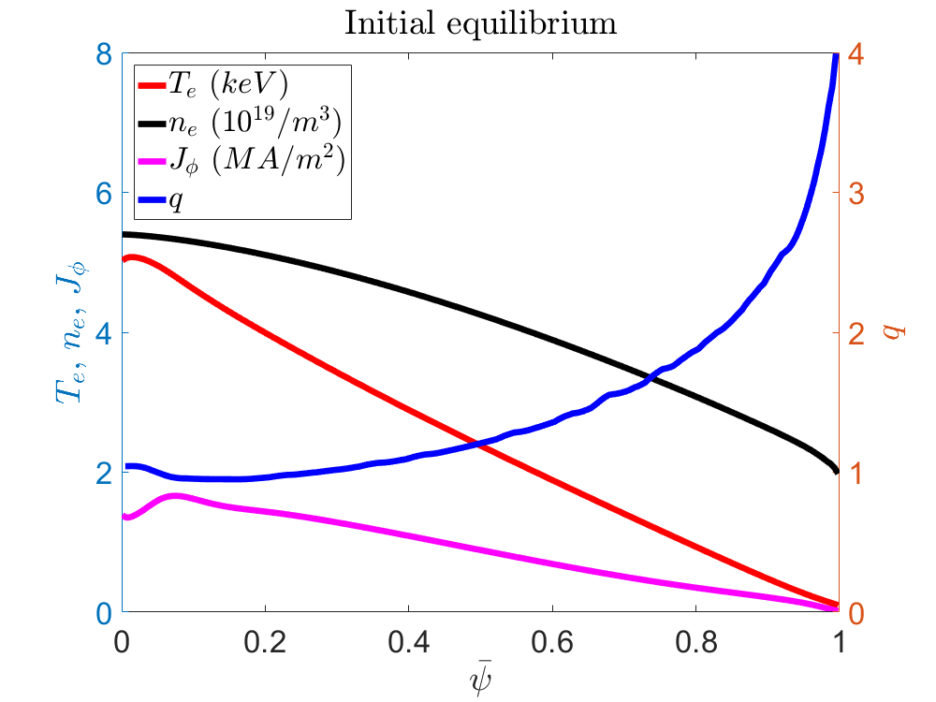
Target equilibrium
ITER L-mode H26. $B_{T}=5.3T$, $I_{p}=15MA$. $W_{th}=34.9MJ$.

Slide 6
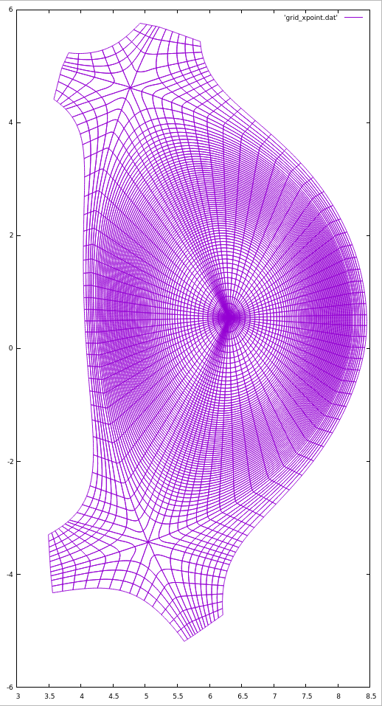
SPI configuration & setup
Reference injection quantity: $5×{10}^{22}$ neon atoms and $1.8×{10}^{24}$ hydrogen atoms.
The reference velocity is $200\sim 500m/s$. Flat velocity distribution. Vertex angle 30 degree.
The relative velocity spread ($±40\%$).
Background impurity Beryllium and Tungsten, $3.5×{10}^{17}/m^{3}$ and $3.5×{10}^{11}/m^{3}$ respectively.
The perpendicular particle diffusion coefficient is $2m^{2}/s$, the heat diffusion coefficient is about $3m^{2}/s$ in the core (depends on density). Viscosity $30m^{2}/s$ initially.
Spitzer resistivity and Braginskii conduction.
300 fragments, all mass to solid fragments.
SPI

Slide 7
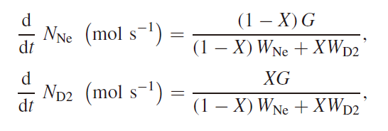
SPI configuration & setup
Statistical Fragmentation model (Parks, GA report 2016)
The Neutral Gas Shielding (NGS) model with magnetic funneling is used to describe the ablation rate
$$G\left[g/s\right]=ζ_{B}λ\left(X\right){[\frac{T_{e}(eV)}{2000}]}^{5/3} {[\frac{r_{p} (cm)}{0.2}]}^{4/3}n_{e}{({10}^{14}{cm}^{−3})}^{1/3}$$
J. Zhang and P. B. Parks, Nucl. Fusion 60 066027 (2020);

Slide 8
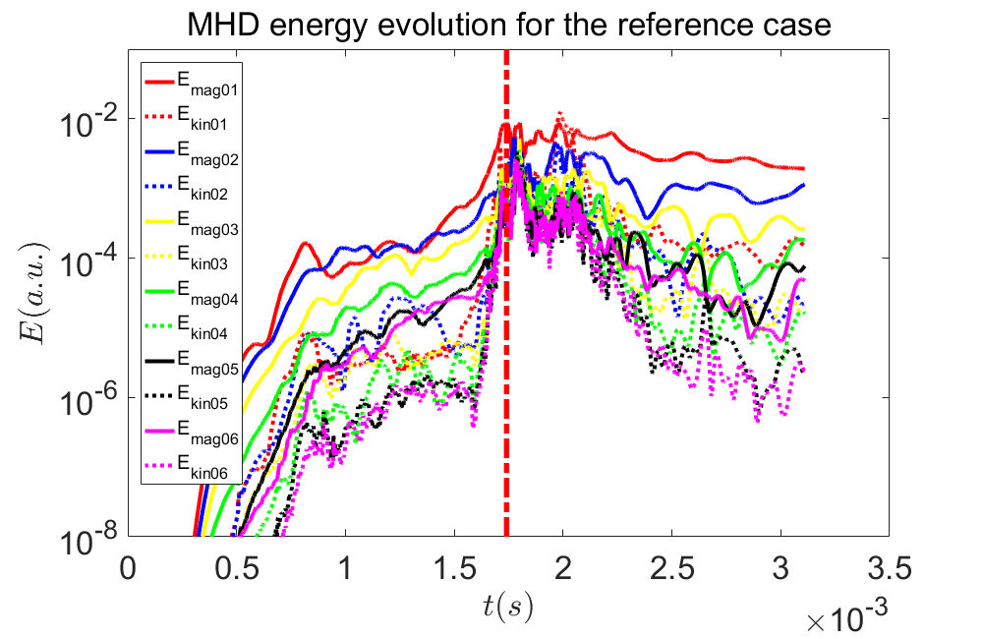
Characteristic behavior - MHD
The reference case: $500m/s$, $n=1$ dominant.

Slide 9
Characteristic behavior - $T_{e}$

Slide 10
Characteristic behavior - $n_{e}$

Slide 11
Comparison with CE
The non-equilibrium model primarily was capable of capturing the early phase low-change-state radiation.
Overestimation of ionization power from the CE model
Overtime, the radiative power tends to converge.

Slide 12
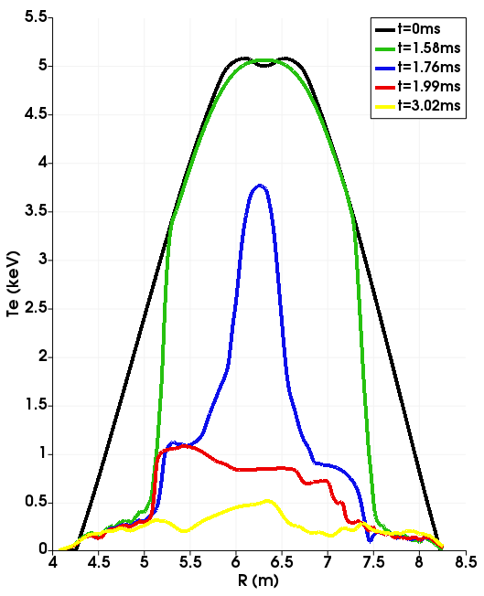
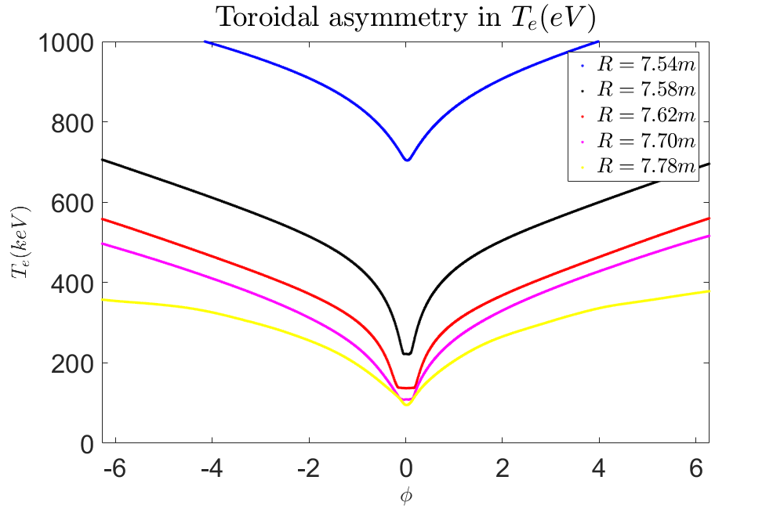
Warm edge & $T_{e}$ hole
Surprisingly, the edge kept warm even in the wake of the vanguard fragments. Unrelaxed $T_{e}$ along field line.

Slide 13
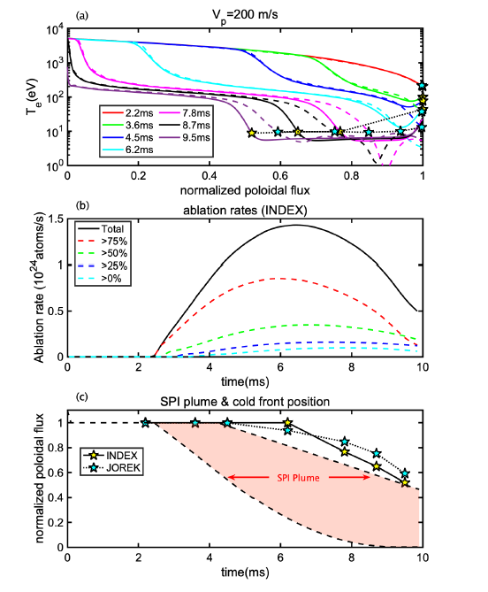
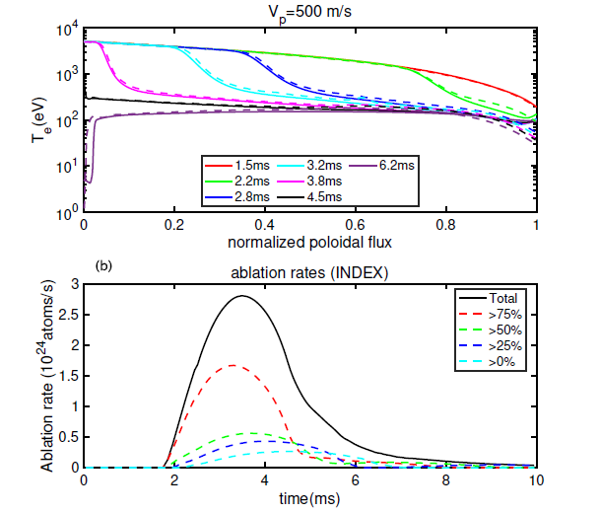
Warm edge?
The warm edge is in consistence with 1.5D and 2D investigations done by INDEX & JOREK.
A. Matsuyama et al submitted to PPCF

Slide 14
Warm edge & current response
The warm edge is simply due to a lack of time until the radiation could deplete the thermal reservoir.
The warm edge has profound impact on MHD dynamics: minimal current contraction, less current perturbation.
Volume effect: $τ_{η}\sim \frac{δ^{2}}{η}$.
Consequently, the 2/1 mode plays a minor role in this case.

Slide 15
$T_{e}$ hole & localization effect
Strong density peak at the $T_{e}$ hole
Competition between local cooling and parallel relaxation under Braginskii which goes down as $T_{e}^{5/2}$.
Is Braginkskii still appropriate?
Non-local effect?
Note: weak dependence on $n_{e}$ but strong on $T_{e}$ for the ablation rate.
Localization effect (radiation) vs. non-local effect (ablation)?

Slide 16
Collisional or not?
The effective collisional cross-section is
$${\left\langle σ\right\rangle }^{−1}\sim \left\langle λ_{e}\right\rangle \left\langle n_{e}\right\rangle ∝{\left\langle n_{e}\right\rangle }^{0}$$
We have ${\left\langle σ\right\rangle }^{−1}≈2.5×{10}^{21}/m^{2}$.
The line integrated density along half of the the characteristic density peak width is approximately $\int{n_{e}dl}≈2.8×{10}^{21}/m^{2}$, more or less comparable.
The electron temperature hole is on the threshold between a local, collisional case and a non-local, free streaming case.
Non-local consideration might be needed for the ablation rate calculation!

Slide 17
Impact of mixture ratio
We consider three different mixture ratio.
Pure H2: no neon, $2×{10}^{24}$ hydrogen atoms.
$2.7\%$ neon: $5×{10}^{22}$ neon atoms and $1.8×{10}^{24}$ hydrogen atoms.
$21.7\%$ neon : $5×{10}^{23}$ neon atoms and $1.8×{10}^{24}$ hydrogen atoms.
We calculate the ablation rate only from local plasma parameters around the fragments in each case.
The overall MHD behavior and the density transport are similar between the cases. But higher neon ratio result in slightly earlier triggering of the core temperature collapse.
Some self-regulated behavior: ten time mixture ratio does not automatically guarantee ten time radiative power.

Slide 18
Impact of mixture ratio

Slide 19
Impact of mixture ratio

Slide 20
“Non-local” ablation scheme
To account for the barely collisional plasma “seen” by the fragments, we calculate the ablation rate using the NGS model but with the flux-averaged plasma parameters instead of the local plasma parameters around the fragments. We call this “non-local” scheme.
Caveat: The average is not really done by field-line tracing, but rather by taking the flux-average considering the n=0 component of the poloidal flux.
Localization vs. non-local effect:
2D case: no $T_{e}$ hole, no local radiation peak
3D case: $T_{e}$ hole, local radiation peak
3D “non-local” case: $T_{e}$ hole circumvented in ablation calculation, local radiation peak.

Slide 21
“Non-local” ablation scheme

Slide 22
“Non-local” ablation scheme

Slide 23
Artificial toroidal spread
Due to numerical consideration, the density source around each fragment are artificially elongated toroidally.
Gaussian shape density source profile
Lessen the radiation peaking effect.
In the reference case, $∆φ_{NG}=0.5$ radian.
As an example, we hereby compare the $∆φ_{NG}=0.5$ and the $∆φ_{NG}=0.3$ result.

Slide 24
Artificial toroidal spread

Slide 25
Artificial toroidal spread

Slide 26
Injection velocity effect
With slower injection, the fragments stays on a flux tube longer and has more time to cool it down, more easily pushing towards a local radiative collapse before the fragments reach the core.
The slow case: reference velocity $200m/s$.
Compare the radiated power and energy and the total ablated particles for a given penetration to better compare the fast and the slow cases.
Very little difference in assimilation for a given penetration of fragment plume.
Significantly stronger radiation for the same penetration.

Slide 27
Injection velocity effect

Slide 28
Injection velocity effect

Slide 29
Injection velocity effect

Slide 30
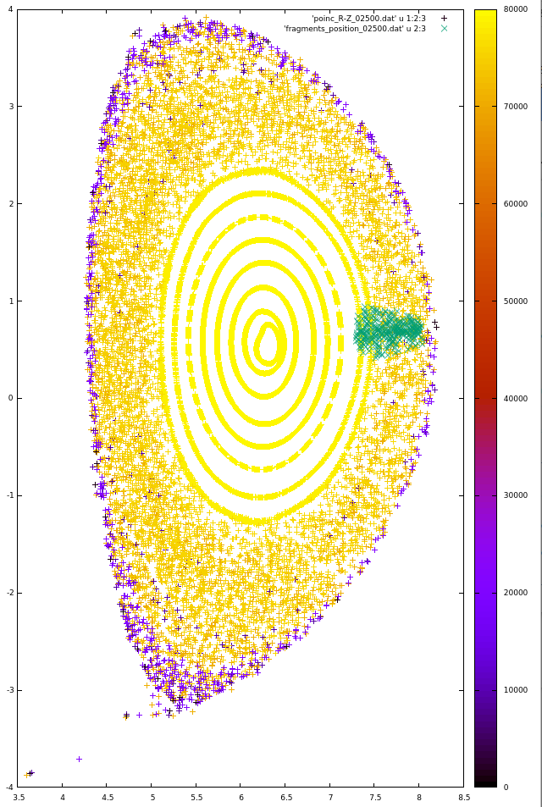
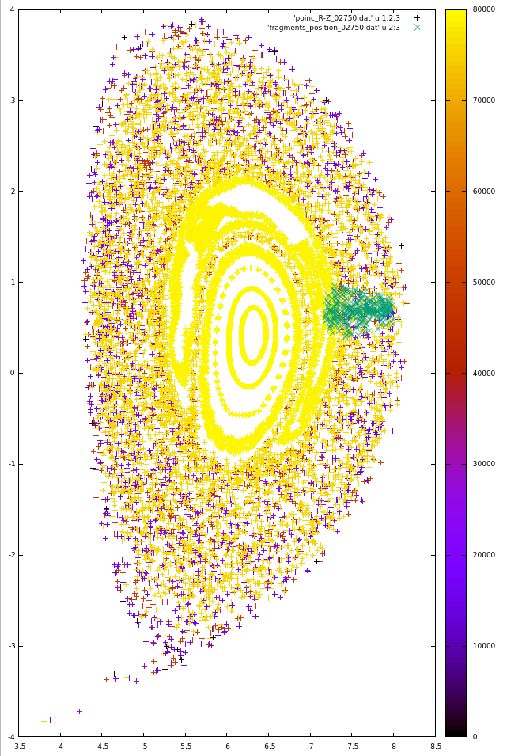
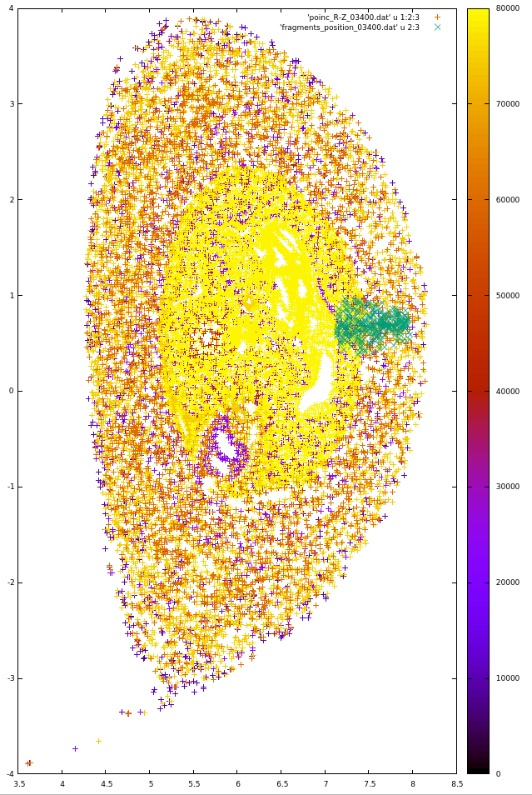
Slow case Poincare plot
Color bar represents field line length after 2000 toroidal turns, non-yellow Poincare points indicate open field lines.

Slide 31
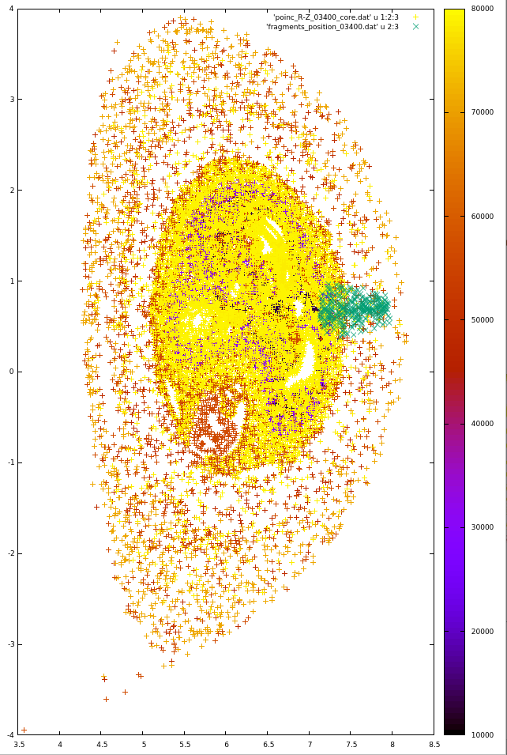
Poincare plot from core
Some transport barrier persists despite global stochastisation.
However, the plasma core indeed is connected to the edge at the onset of TQ.
Generating 15 field line tracers from R=6.0m to R=6.4m with Z=0.6m.
Significant concentration of Poincare points within q=1. Connection to the edge with connection length $5×{10}^{4}m$.
Millisecond time scale for thermal electrons to travel such distance!

Slide 32
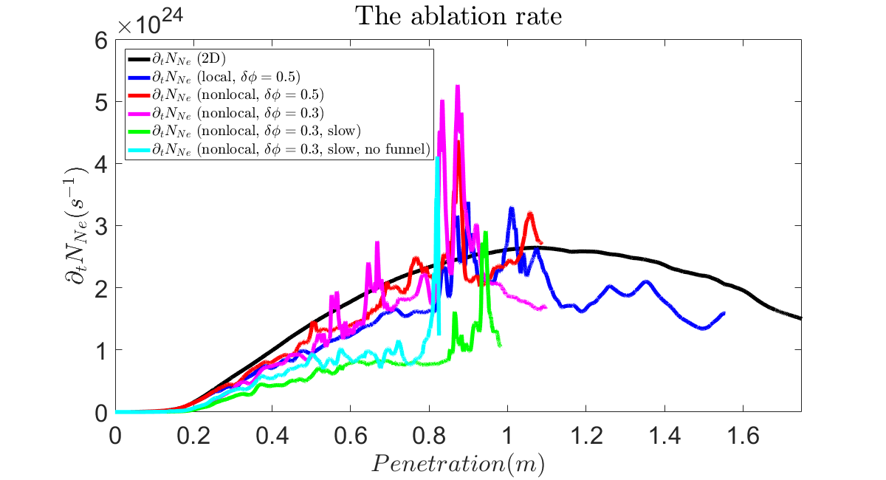
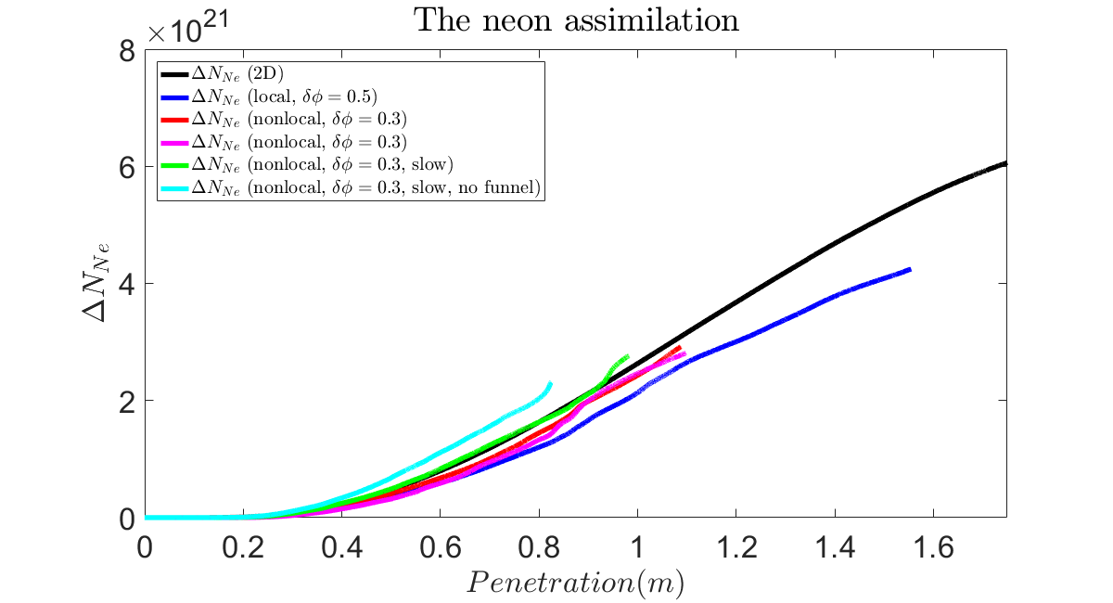
The magnetic funneling effect
The full current ITER cases have $B_{T}\sim 5.3T$, resulting in significant decrease in ablation compared with existing machines due to $ζ_{B}$ factor in our NGS model used.

Slide 33
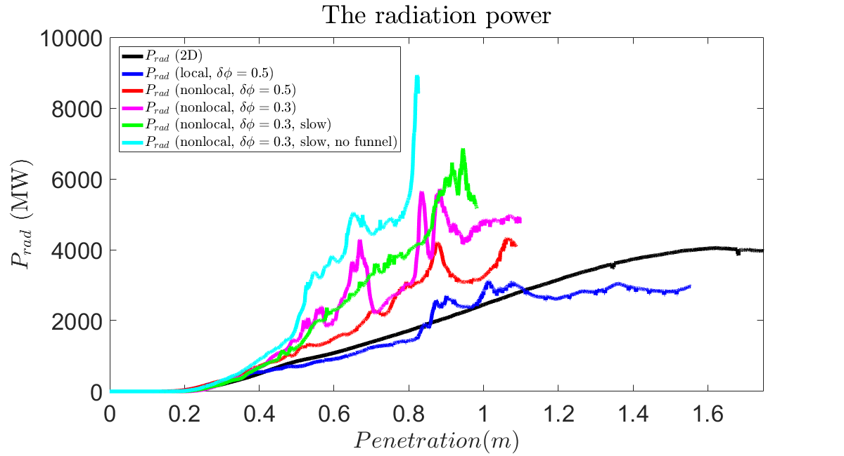
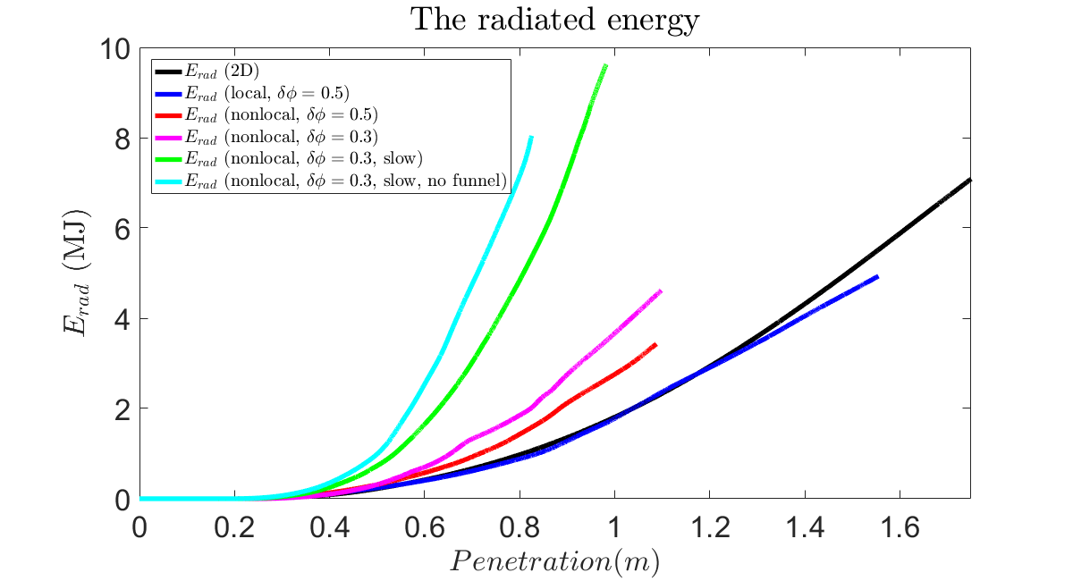
The magnetic funneling effect
With un-funneled NGS law, the total assimilation somewhat increase (self-regulated).
The radiative power significantly increase as the plasma is further cooled down by increased ablation.

Slide 34
The magnetic funneling effect
Somewhat increase in MHD amplitude due to stronger cooling, but more or less the same dynamics.

Slide 35
Conclusion & discussion
Non-equilibrium neon mixed SPI simulations carried out for ITER L-mode H26.
The MHD dynamic is dominated by a strong 1/1 kink motion which is responsible for core temperature relaxation within the q=1 surface and inward density convection.
Some transport barrier at q=1 when TQ occur, characteristic thermal transport time scale on milliseconds.
Significant un-relaxed parallel profile along the field line, prompting non-local calculation of fragment ablation.
Toroidal elongation tends to underestimate radiation.

Slide 36
Conclusion & discussion
For the cases considered, ranging neon mixture ratio from 0% to 20% does not fundamentally change the MHD. The neon assimilation shows some self-regulated behavior.
“Non-local” ablation scheme result in increased assimilation and radiation.
Slower injection velocity result in significantly enhanced radiation but almost no difference in assimilation for a given penetration.
Without the magnetic funneling effect in ablation law, stronger radiation and assimilation.
The MHD dynamics are quiet robust.

Slide 37
Conclusion & discussion
The q=1 transport barrier result in a warm core after the initial temperature relaxation due to the 1/1 mode.
With the warm core and finite $β$, reduced MHD is found to underestimate the growth rate of the 1/1 resistive kink mode. The reduced MHD and full MHD result tends to converge towards the high resistivity regime, but we are not yet sure if we have already reached such regime here.
The 1/1 kink result should be considered as a conservative estimation of the realistic response.
With the warm core, possibility of further fragment assimilation exists. Expensive to run toward late TQ……

Slide 38
Backup Slides

Slide 39
Slow case Te collapse

