Slide 1
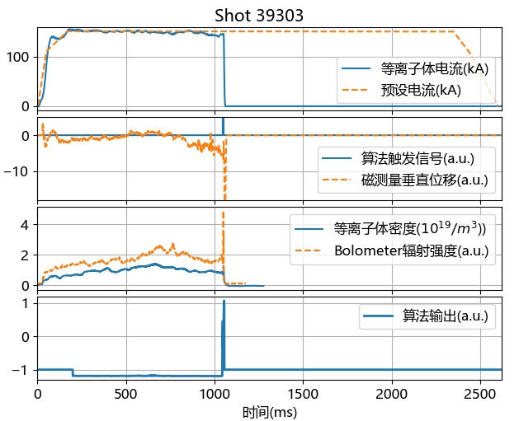
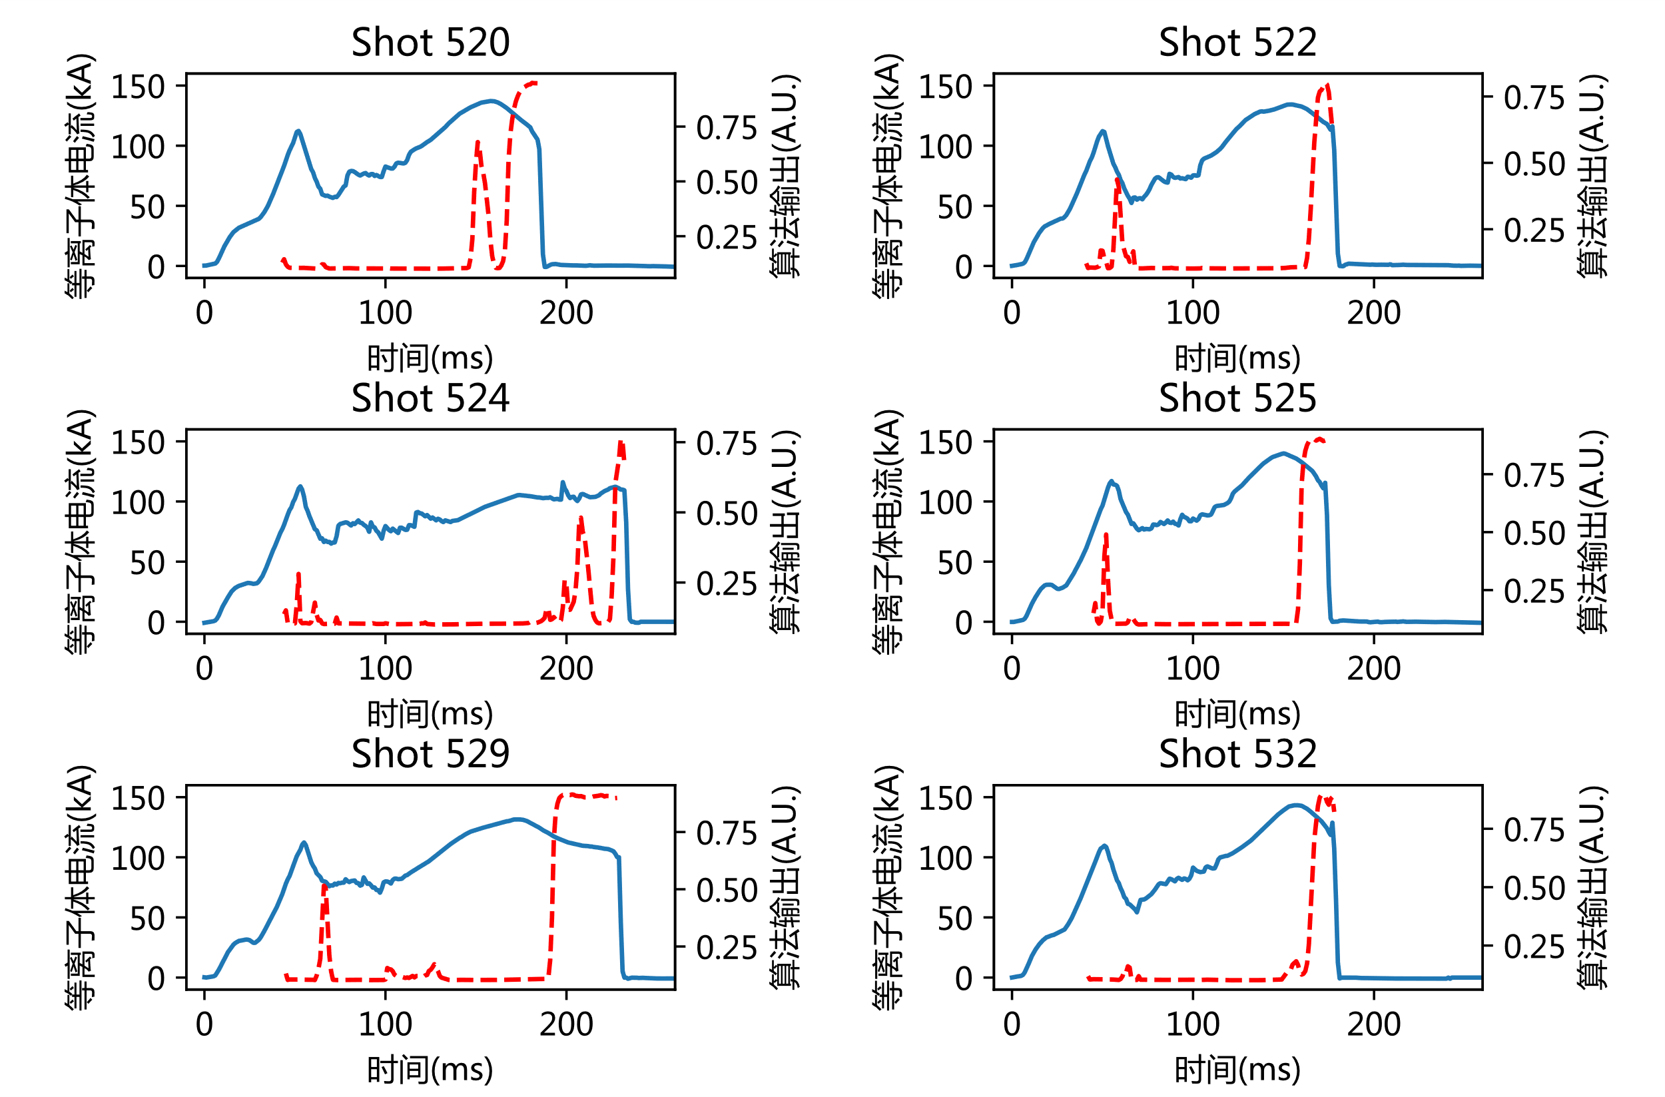
基于深度学习的HL-2A破裂预测算法
核心版本
  25个破裂相关信号作输入
  5081非破裂炮+3142破裂炮构成开发数据集集
  使用1.5D CNN+LSTM作核心算法
  实现提前30ms，96.1%正确率的预测
  关键贡献：验证了针对聚变数据特性设计专门的神经网络结构的重要性
全面突破三项前沿瓶颈问题
  可解释性：实时计算输入信号与破裂的相关性大小，并识别5种不同的破裂原因
  实时在线运行：382次开环测试，正确率89.0%，5次闭环测试中实时预警并成功缓解破裂
  跨装置预测：使用跨装置数据集与领域自适应方法开发算法，可在仅有几十炮训练数据的HL-2M上实现初步的破裂预测效果
算法在破裂炮和非破裂炮期间的典型输出
辐射破裂前，软X射线与Bolometer热辐射的信号相关性增加
等离子体垂直位移引发的破裂被算法预测到并成功得到缓解
HL-2M破裂预测效果示例

Slide 2
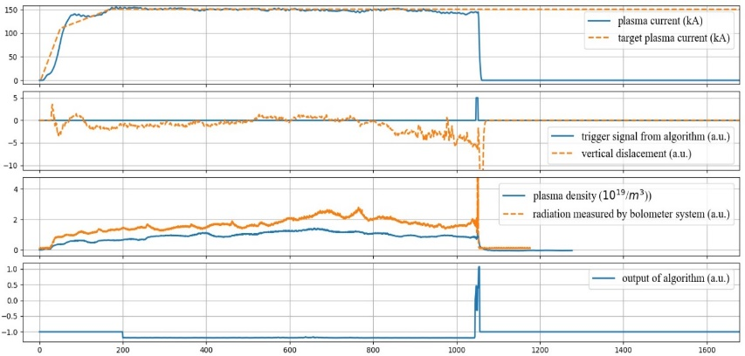
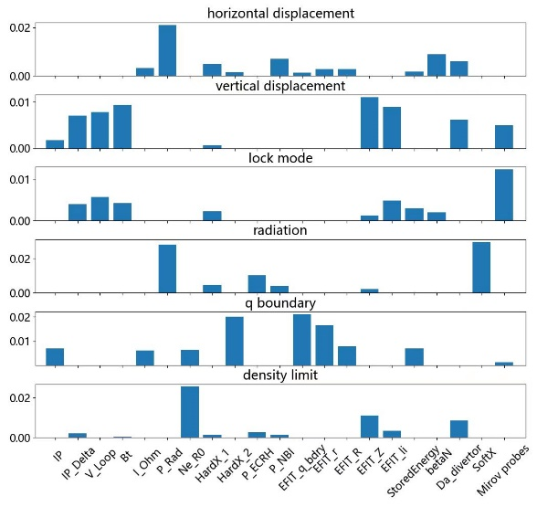
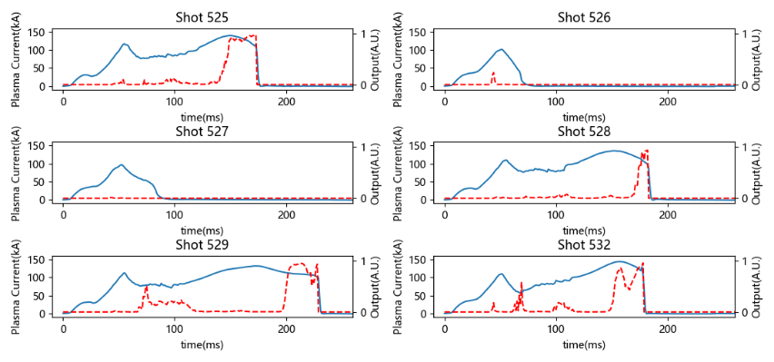
An interpretable, transferable and real-time disruption predictor in HL-2A based on deep learning
Algorithm backbone
  Input: 25 disruption-related parameters
  Dataset: 5081 non-disruptive and 3142 disruptive shots
  NN structure: 1.5D CNN+LSTM
  Performance: 96.1% accuracy with 30ms in advance
  Key contribution：the NN structure needs to be designed with considerations about the characteristics of fusion data and physical knowledge of disruptions
Three breakthroughs in one framework
  Interpretability：Real-timely evaluating the importance of input parameters and recognizing 5 disruption causes.
  Real-time capacity：An accuracy of 89.0% is obtained during open-loop online testing for 382 shots. Five demo shots are obtained during closed-loop online testing
  Cross-tokamak disruption prediction：A preliminary disruption predictor is developed with only 31 shots of training data in newly-built tokamak HL-2M, with the help of data from HL-2A/J-TEXT and domain adaptation strategy.
Output of HL-2A’s disruption predictor during a disruptive shot and a non-disruptive shot
Vertical displacement induced disruption mitigated by SMBI during closed-loop online testing
The averaged distribution of input parameter importance for 6 disruption causes in HL-2A
Output of HL-2M’s disruption predictor

