Slide 1
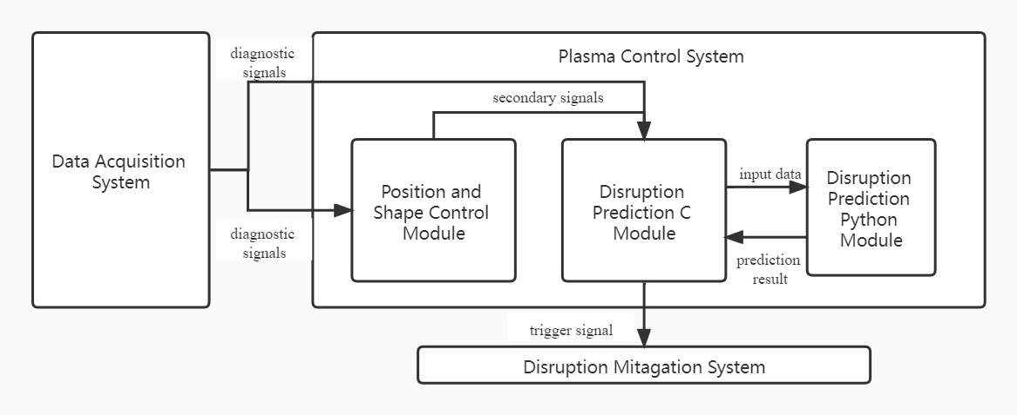
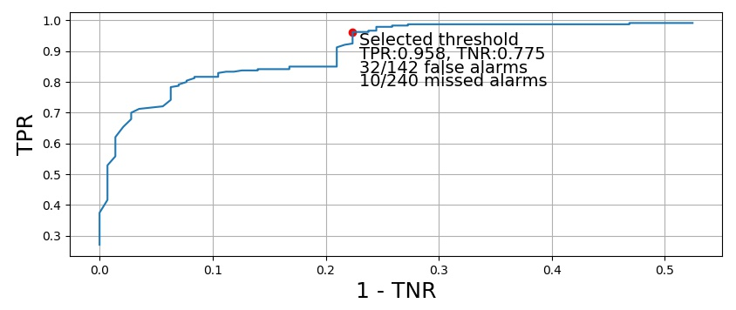
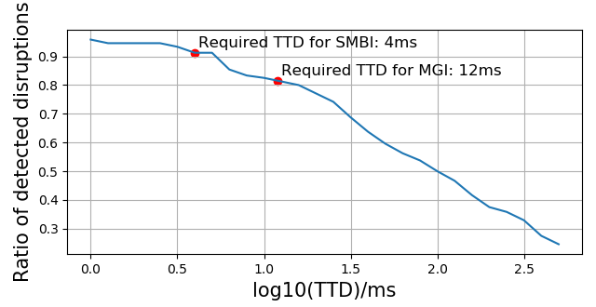
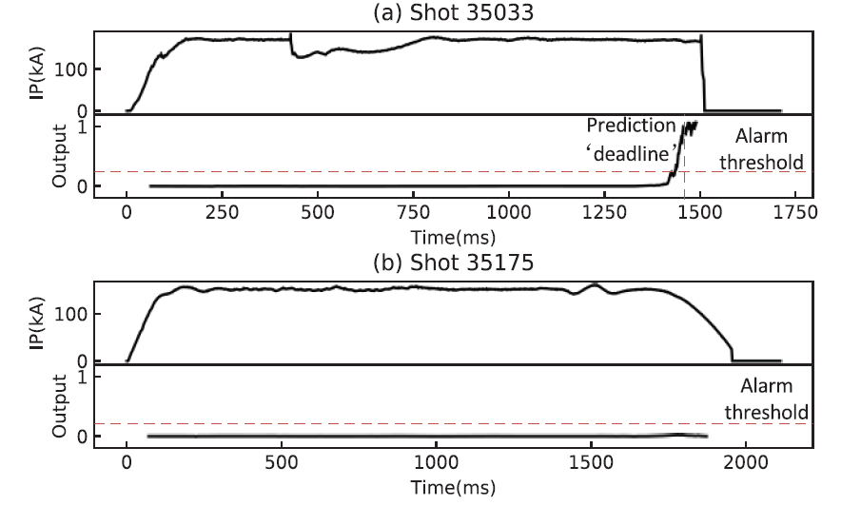
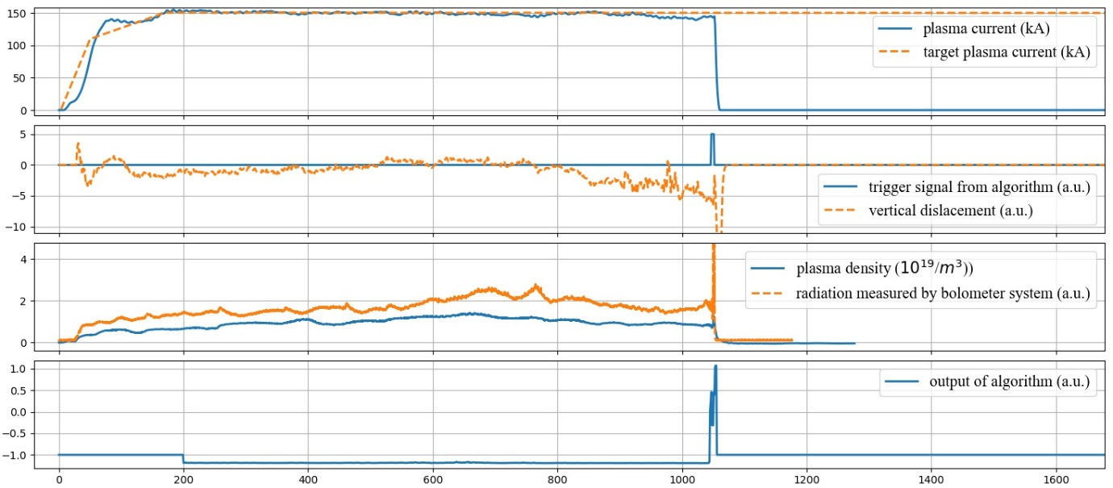
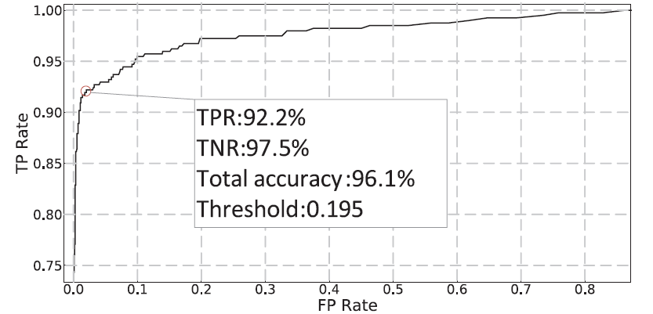
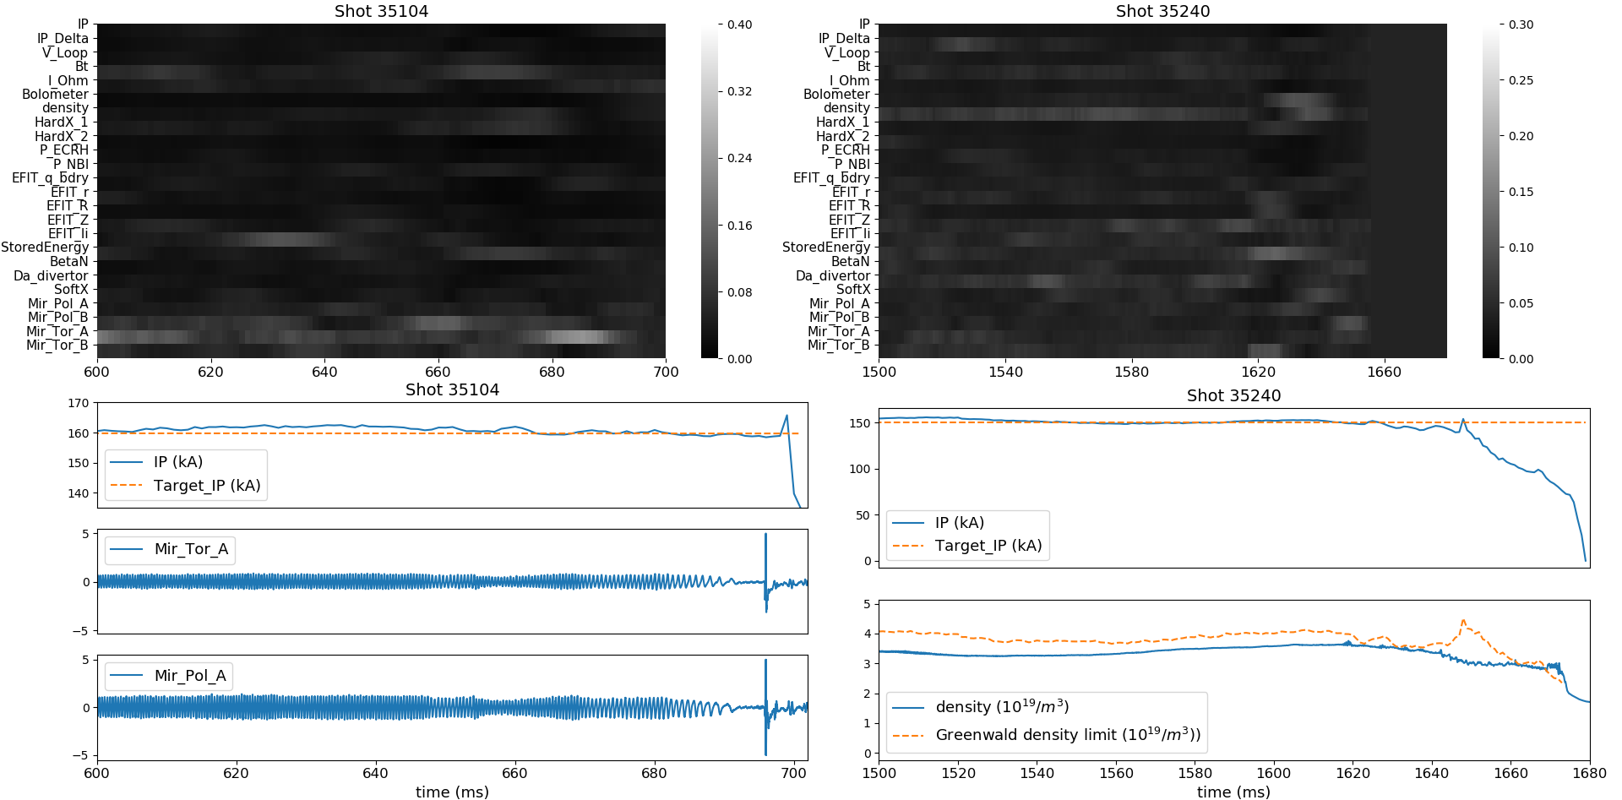
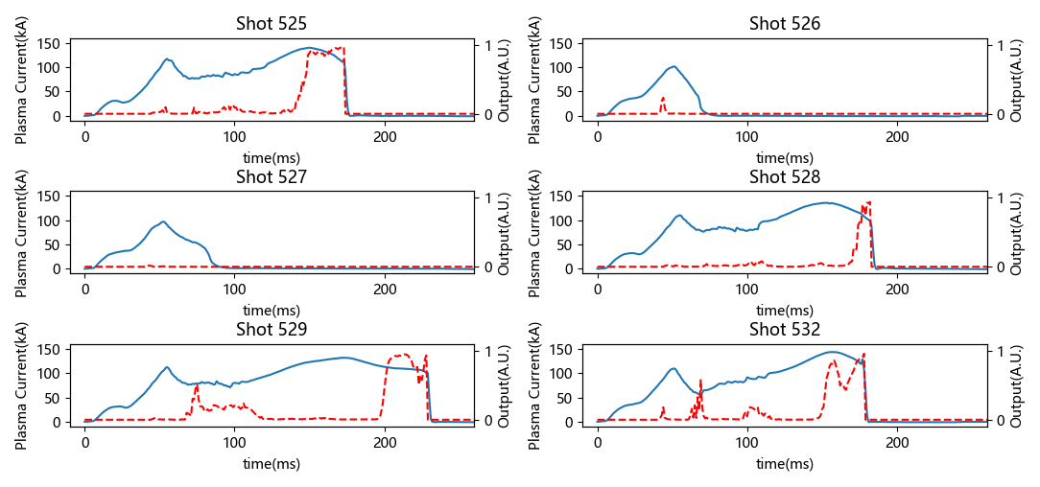
Second Technical Meeting on Plasma Disruptions and their Mitigation
An interpretable, transferable and real-time disruption predictor in HL-2A based on deep learning
Z. Y. Yang^{1&2}, F. Xia¹, X. M. Song¹, Z. Gao², W. L. Zhong¹, Y. X. Li¹, Y. B. Dong¹, Y. P. Zhang¹, W. Zheng³, S. Wang¹, B. Li¹, X. Q. Ji¹, Z. Y. Chen³ and X. B. Zhu¹
¹ Southwestern Institute of Physics, Chengdu, China
² Tsinghua University, Beijing, China
³ Huazhong University of Science and Technology, Wuhan, China
Introduction
Disruption prediction algorithm plays an important role in the software components of disruption protection system in future tokamaks. It predicts the coming disruptions based on the parameters of plasma and tokamak in order to reserve enough response time for the disruption prevention and mitigation techniques.
A disruption predictor based on deep learning is developed in HL-2A. It has an accuracy of 96.1% on Shot Nos. 32000-36000. Novel 1.5-D CNN + LSTM structure is used to get such a high accuracy. [1]
Further researches are implemented on the basis of this algorithm to solve three key problems.
Interpretability: an interpretation method is proposed to evaluate the importance of each input signal when deciding the model’s output. Furthermore, the cause of disruption can be recognized from the distribution of input channel’s importance. [2]
Real-time capacity: a real-time version of this algorithm, which takes only 0.3ms to analyze an input slice, is successfully implemented into the HL-2A tokamak’s plasma control system. An accuracy of 89.0% is obtained during online testing of 382 shots. Several closed-loop demo shots for real-time disruption prediction and mitigation are also realized.
Transferability: a preliminary disruption prediction algorithm is obtained on newly developed HL-2M tokamak with very limited training shots, with the help of a mixed dataset from HL-2A, J-TEXT and HL-2M.
Real-time implementation
Figure 4 Design of the integrated system
Performance
Accuracies in open loop online testing: TPR0.958/TNR0.775
ROC Curve: as shown in Figure 5
Prediction advance time: as shown in Figure 6
Closed loop online testing: vertical displacement induced disruption mitigated by SMBI (Figure 7)
Other details can be found in Ref. 3
The disruption predictor of HL-2A
Dataset
Train: Shot Nos. 20000-29999 in HL-2A, 3157 non-disruptive shots and 1134 disruptive shots
Validation: Shot Nos. 30000-31999 in HL-2A, 721 non-disruptive shots and 284 disruptive shots
Test: Shot Nos. 32000-36000 in HL-2A, 1271 non-disruptive shots and 475 disruptive shots
Input signal: 25 disruption related signals
Algorithm
1.5D CNN + LSTM
Performance
Example shot: as shown in Figure 1
Accuracies: TPR0.922/TNR0.975/AUC0.979
ROC Curve: as shown in Figure 2
Other details can be found in Ref. 1
Figure 5 ROC curve of disruption predictor during open loop online testing
Figure 6 Distribution of prediction advance time
Figure 1 Output of HL-2A’s disruption predictor during a disruptive shot (a) and a non-disruptive shot (b).
Figure 2 ROC curve of disruption predictor on testing set.
Interpretable disruption prediction
A special node is found in the 1.5D CNN structure. On this node each input channel of algorithm can be evenly disturbed by a gaussian noise and the corresponding offset of the algorithm’s output will indicate the importance of each input channel.
The result of interpretation shows good coherence with the causes of disruption, see Figure 3
A Bayes classifier is developed to recognize the cause of disruption based on the interpretation algorithm’s output. This classifier has an accuracy of 71.2% on the labelled dataset, which contains 5 disruption causes. and 605 disruptive shots.
Other details can be found in Ref. 2
Figure 7 Vertical displacement induced disruption mitigated by SMBI
Cross-tokamak disruption prediction
Dataset (disruptive shots/ non-disruptive shots)
Train : HL-2A(1532/4317), J-TEXT(1477/4091), HL-2M(25/6)
Validation: HL-2A(364/470), J-TEXT(415/1221), HL-2M(17/6)
Test: HL-2M(18/9)
Input signal: 8 common signals of the 3 tokamaks, see Table 1.
Algorithm
1.5D CNN + TCN
Performance
Example shot: as shown in Figure 8
Confusion Matrix: as shown in Table 2
Tricks for cross-tokamak algorithm
Train on a multi-device dataset
Balancing the dataset size of 3 tokamaks.
Domain adaptation
Detailed label for data from target device (HL-2M)
Table 1 Input signal list of the cross-tokamak disruption prediction algorithm
Signal name | Sample rate(kHz) | Physical meanings | HL-2M signal tag | J-TEXT signal tag | HL-2A signal tag
I_{p} | 1 | plasma current | IP_2M | ip | IP
Target_I_{p} | 1 | target plasma current | ccIP_2M | oh_set | ccIP
B_{t} | 1 | toroidal magnetic field | BT1_2M | bt | Bt
Density | 1 | density of electrons at the centre of plasma | AMW_INT1_02 | LIN_DEN_CH06 | Density1
Dh | 1 | horizontal displacement measure by electromagnetic coils | dh_2M | dx | FluxDh
Bolometer | 1 | power of radiation measured by bolometer | DBOL_10 | AXUV_CA_08 | BOLU10
Mir_Probe_A | 10 | a pair of poloidal probes located at symmetric position | Mpol_17_24 | MA_POL_CA01T | Mpol_04
Mir_Probe_B | 10 |  | Mpol_17_51 | MA_POL_CA19T | Mpol_13
Table 2 Confusion matrix obtained on HL-2M testing set. Alarm threshold is selected as 0.3. Prediction advance time is larger than 10ms
Figure 3 Result of the interpretation method and related input signals of example shots.
Confusion Matrix | Predict: 0 | Predict: 1
Label:0 | 7 | 2
Label:1 | 1 | 17
Real-time implementation
A reduced version of the disruption predictor, as described in Ref. 2, is implemented into the plasma control system of HL-2A.
Design of the integrated system (Figure 4)
The data acquisition system gathers all the needed diagnostic signals and sends them to the PCS
C-based disruption prediction module of PCS will call the deep learning algorithm to deal with the input data via cross-language interaction.
According to the prediction result, trigger signal might be sent to the disruption mitigation system
Figure 8 Output of HL-2M’s disruption predictor
Reference
【1】Zongyu Yang et al, Nuclear Fusion 60, 016017
【2】Zongyu Yang et al, Nuclear Fusion 61, 126042
【3】Zongyu Yang et al, Fusion Engineering and Design 182, 113223

