Slide 1
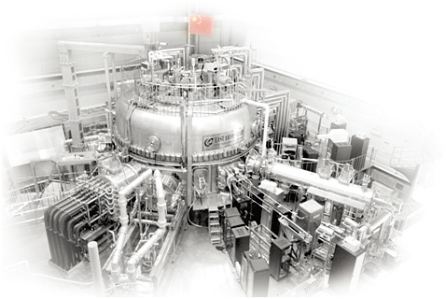
Disruption Prediction with different wall conditions based on multi-scale deep hybrid neural network on EAST
Reporter: B.H. Guo¹
With D.L. Chen², Y Huang², C. Rea³, R S Granetz³, B. Shen², B. J. Xiao²
1, College of Physics and Optoelectronic Engineering, Shenzhen University, Shenzhen
2, Institute of Plasma Physics, Chinese Academy of Sciences, Hefei, Anhui, China
3, MIT Plasma Science and Fusion Center, Cambridge, MA, USA
Email: bhguo@ipp.ac.cn
Second Technical Meeting on Plasma Disruptions and their Mitigation

Slide 2
Outline
1
Disruption on EAST
Multi-scale deep hybrid neural network
with different wall condition
2
3
Convolution-attention deep hybrid neural network
4
Summary

Slide 3
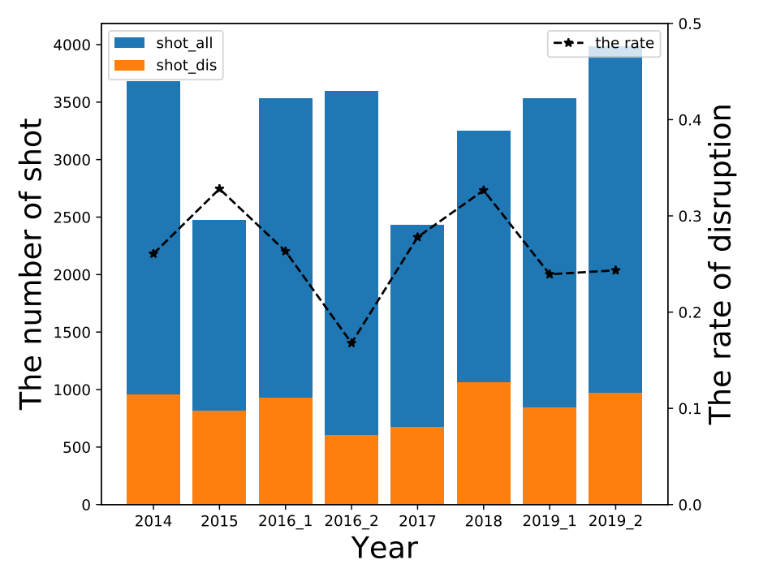
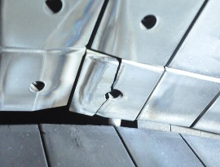
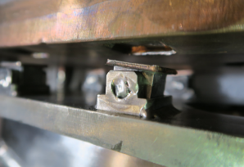
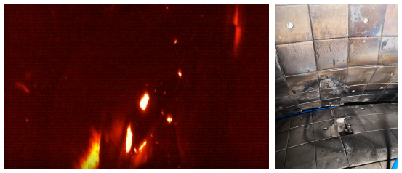
Disruption on EAST
The database has the ∼10⁴ discharges (disruption and non-disruption).
Disruption has caused some damage to the EAST.
Disruptions need to be predicted and then mitigated or avoided.
[1] B H Guo et al 2021, Plasma Phys. Control. Fusion 63 025008

Slide 4
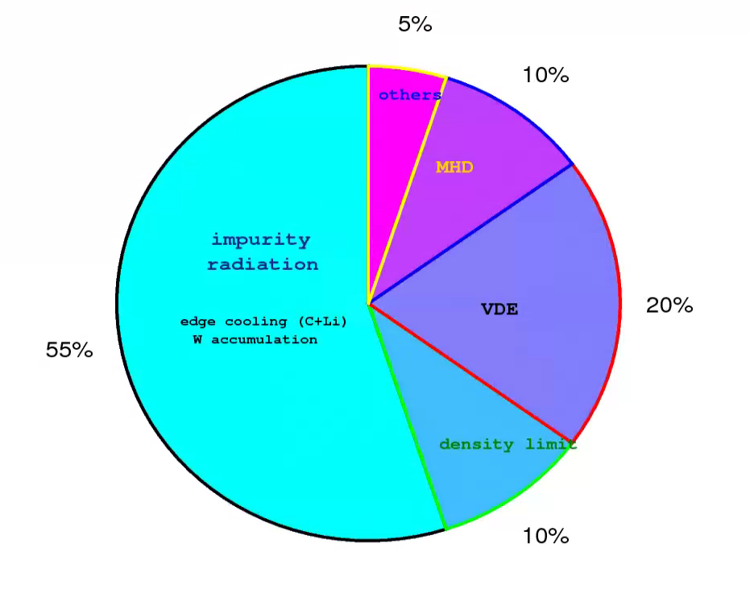
Disruption on EAST
The database has the ∼10⁴ discharges (disruption and non-disruption).
Disruption main cause: impurity radiation, VDE, Density limit，MHD [1].
[1] B H Guo et al 2021, Plasma Phys. Control. Fusion 63 025008

Slide 5
Outline
1
Disruption on EAST
Multi-scale deep hybrid neural network
with different wall condition
2
3
Convolution-attention deep hybrid neural network
4
Summary

Slide 6
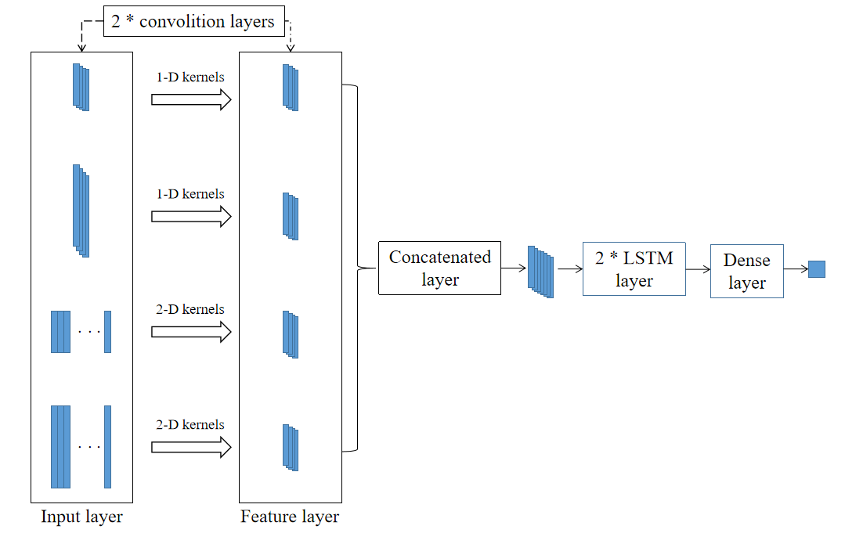
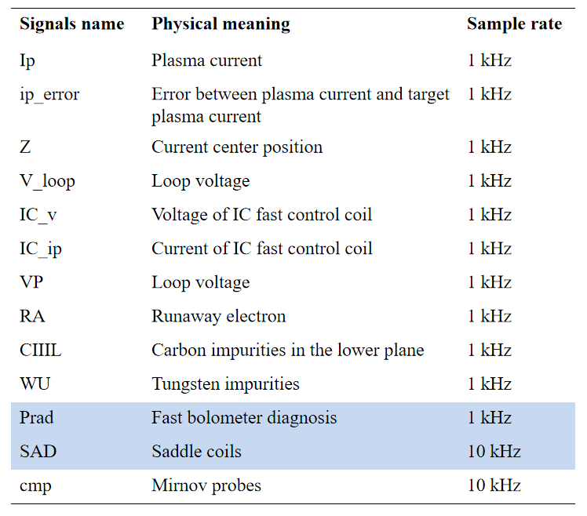
Multi-scale deep hybrid neural network
Model structure
Input signals
Parallel 1-D convolution is used for feature extraction of 12 1-D signals (1k) and 2 1-D high frequency signal (10k).
2-D convolution is used for feature extraction of two array signals.
After Feature Combination, LSTM is used for prediction.

Slide 7
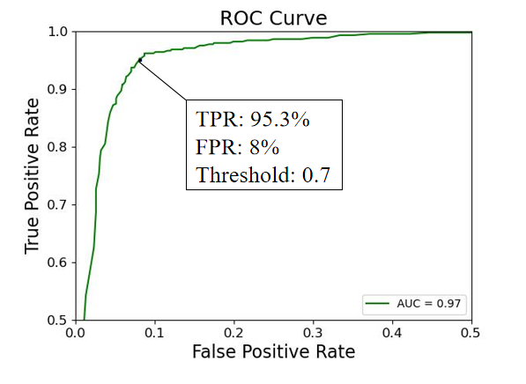
Non-all-metal wall
Non-all metal-wall dataset (9149 shots).
 | Train Set | Validation set | Test Set | ALL
Dis | 1973 | 430 | 432 | 2835
No-dis | 4544 | 969 | 801 | 6314
All | 6516 | 1399 | 1233 | 9149
test result of Multi-scale hybrid model: TPR (95.3%), FPR (8%).
confusion matrix
 | Label (1) | Label (0)
Prediction (1) | 425 | 21
Prediction (0) | 63 | 721

Slide 8
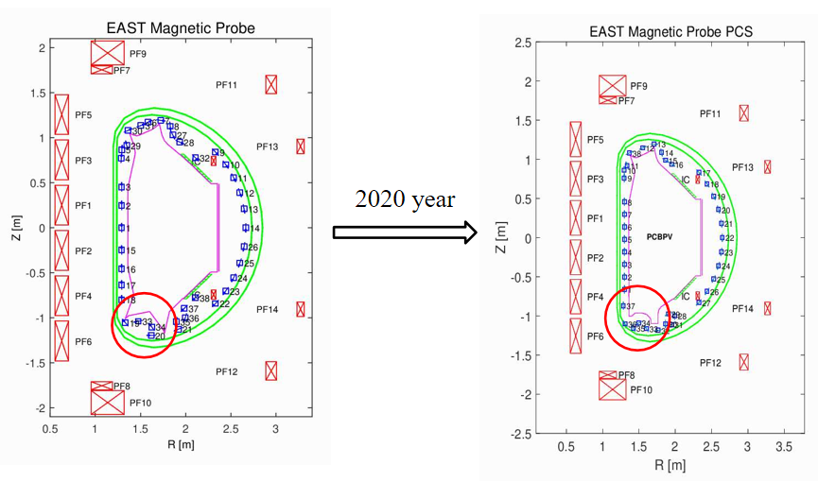
EAST upgraded
The lower divertor upgraded (material: carbon --> tungsten-copper).
Partial diagnosis is updated (ex: the new mirnov probe has been installed, installation position has a slight change)

Slide 9
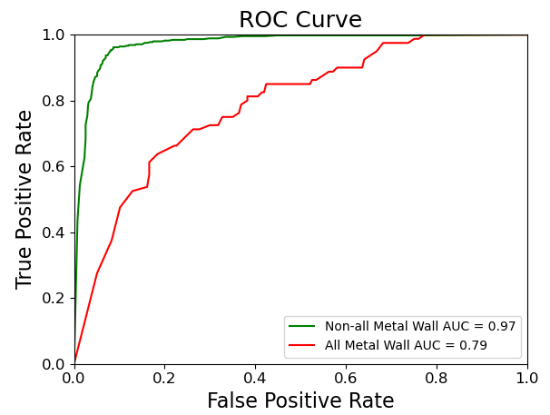
All-metal-wall
The predictive performance of the all-metal wall experiment data decreased significantly, and the AUC was only 0.79.
The disruption data distribution changes greatly after upgraded of EAST.

Slide 10
Outline
1
Disruption on EAST
Multi-scale deep hybrid neural network
with different wall condition
2
3
Convolution-attention deep hybrid neural network
4
Summary

Slide 11
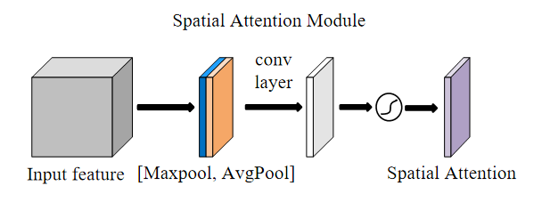
Convolution-attention
Convolution-attention: Channel Attention Module & Spatial Attention Module [2].
Channel Attention Module: focus on "what" of the input features is meaningful.
Spatial Attention Module: focus on "where" is an information section that complements the channel attention.
[2] Woo S, Park J, Lee J Y, et al. CBAM: Convolutional Block Attention Module[J]. 2018. ECCV2018

Slide 12
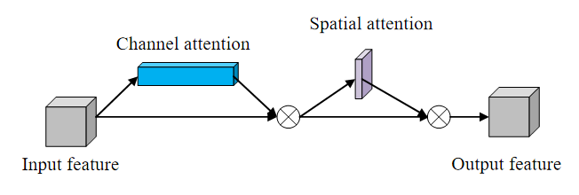
Convolution-attention
Convolution-attention Block is used in the first two convolutional layers of multi-scale deep hybrid neural network.
Convolution-attention Module adopts serial and passes Channel attention Module and Spatial attention Module successively.
[2] Woo S, Park J, Lee J Y, et al. CBAM: Convolutional Block Attention Module[J]. 2018. ECCV2018

Slide 13
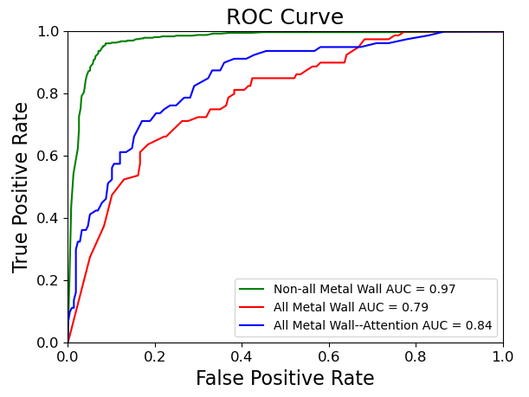
All-metal wall (convolution attention module)
Through the convolution attention module, the model pays more attention to the features highly related to disruption during training.
The convolutional attention module improved the prediction performance of the model on the all-metal wall experimental data, the AUC increased to 0.84.

Slide 14
Outline
1
Disruption on EAST
Multi-scale deep hybrid neural network
with different wall condition
2
3
Convolution-attention deep hybrid neural network
4
Summary

Slide 15
Summary
Multi-scale deep hybrid neural network is built according to the characteristics of disruption on EAST.
The non-all-metal wall experimental data are used to train and test multi-scale deep hybrid neural networks, the AUC is 0.97, TPR is 95.3%, the FPR is 8%.
Partial all-metal wall data are used to test the performance of model (trained on non-all-metal wall conditions), the AUC is only 0.79.
Convolution-attention block improved the prediction performance, after the same training of non-all-metal wall data and testing of all-metal wall data, the AUC is increased to 0.84.
Future work:
The cross-device predictive performance of multi-scale deep hybrid neural networks will be test and improved by combining other tokamak devices.

Slide 16
Thank you

