Slide 1
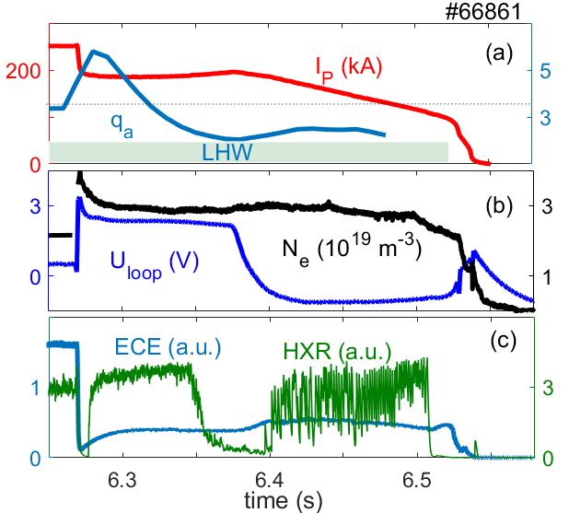
Summary
We have observed the RE-related relaxation phenomena during different phase of disruptions in the EAST tokamak:
Runaway electron formation phase
Electrostatic fluctuations observed at the beginning of the current quench
Mode frequency are correlated with amount of gas injection;
Related to strong RE losses, mode structure m, n=1, 0;
Runaway plateau phase
Burst-like relaxations during the RE plateau phase;
Two types of instabilities clearly divided by δB;
Combination of m/n=0 and m/n=3/1 modes

