Slide 1




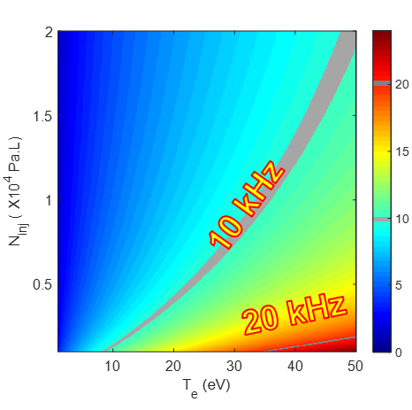
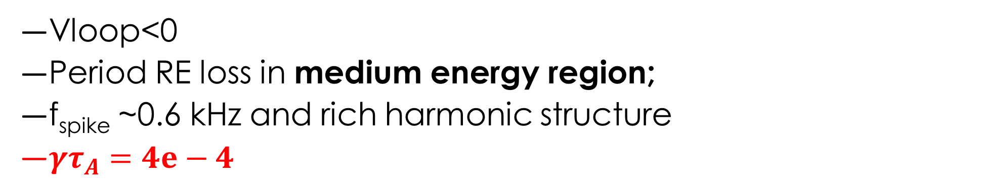
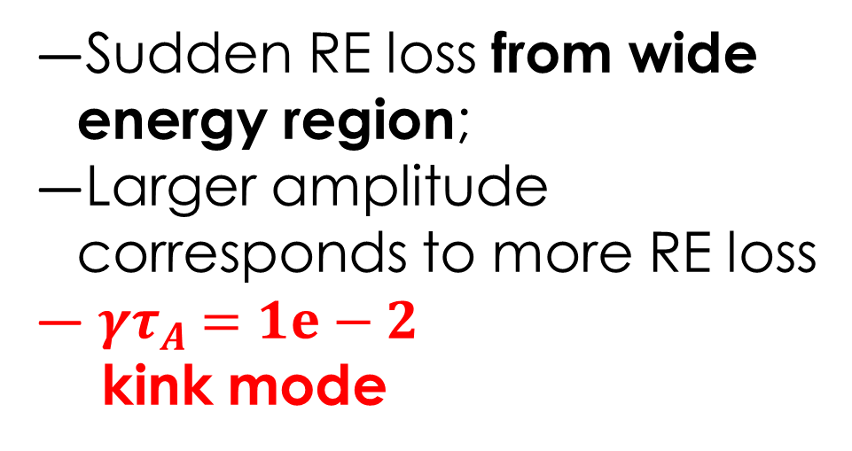
Runaway electron related relaxation phenomena in EAST disruptions
T. Tang^{1,2}, L. Zeng¹, D. Chen¹, Y. Sun¹, Z. Qiu³, X. Zhu⁴, S. Lin¹, C. Luo^{1,2}, Y. Duan¹,
S. Mao¹, R. Zhou¹, H. Zhao¹, T. Zhou¹, A. Ti¹, J. Qian¹, H. Liu¹, Y. Jie¹, Y. Liang⁵, X. Gao¹
¹Institute of Plasma Physics, Chinese Academy of Sciences, 230031 Hefei, China
²University of Science and Technology of China, Hefei, 230031, China
³Zhejiang University, Hangzhou, 310027, China
⁴Shenzhen University, Shenzhen 518060, China
⁵Forschungszentrum Jülich GmbH, IEK-4, 52425 Jülich, Germany
Email: tian.tang@ipp.ac.cn
Introduction
Abnormal RE loss during RE plateau
RE-related relaxation phenomena have been observed in different phase in EAST disruptions:
  Uncontrolled RE loss to plasma facing component may cause serious damage
  Advance understanding of RE loss and support further research in RE mitigation .
Formation phase
Plateau phase
Abnormal RE loss during RE plateau in unintended disruption
  Negative loop voltage causes RE current decay;
  Abnormal RE-loss event confirmed by intense HXR signal
RE Current
LHW
Electrostatic fluctuations during RE formation phase
Electrostatic fluctuations observed in MGI triggered disruption
  After the TQ phase;
  By radiation-related diagnostics, but not in Mirnov coils;
Directly correlated with REs:
Argon: 10-40 kHz
Neon: Two separated modes, (10-20kHz, 30-40 kHz)
Helium: No REs and fluctuations
Mode frequency increases with argon injections and finally saturated
  Not in cases with neon injection
Two types of instabilities clearly divided by δB:
  Both instabilities are identified as combination of m/n=0 and m/n=3/1 modes
External kink mode (large-scale)
Sudden RE loss from wide energy region;
Larger amplitude corresponds to more RE loss
${ γτ}_{A} =1e−2$
kink mode
Kinetic instability (small-scale)
Vloop<0
Period RE loss in medium energy region;
f_{spike} ~0.6 kHz and rich harmonic structure
${γτ}_{A}=4e−4$
E// < 0
Significant RE loss based on HXR fluctuations
  Amplitude of RE loss increases with fluctuation frequency.
Change the energy spectrum
Excite the energetic- electron mode
f_{E}
E// > 0
Mode structure:
m, n=1, 0
SVD based on poloidal SXR arrays
E// = 0
E// < 0
E
Conclusion
Discussion for candidate instabilities
We have observed the RE-related relaxation phenomena during different phase of disruptions in the EAST tokamak:
  RE formation phase:
    Electrostatic fluctuations observed at the beginning of the current quench
    Mode frequency are correlated with amount of gas injection;
    Related to strong RE losses, mode structure m, n=1, 0;
  RE plateau phase:
    Burst-like relaxations during the RE plateau phase;
    Two types of instabilities clearly divided by δB;
    Combination of m/n=0 and m/n=3/1 modes
  GAM captures characteristics of electrostatic fluctuations;
  barely-trapped/passing electrons can contribute to excitation;
  Positive velocity space gradient of RE distribution function can provide free energy to excite instabilities
  Second Technical Meeting on Plasma Disruption and their Mitigation, 17-22 July 2022

