Slide 1
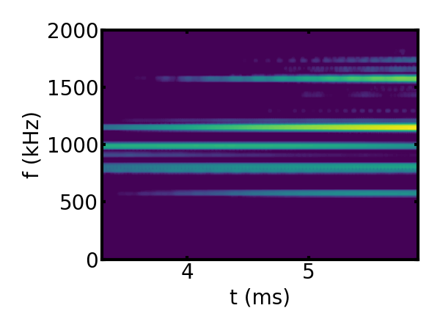
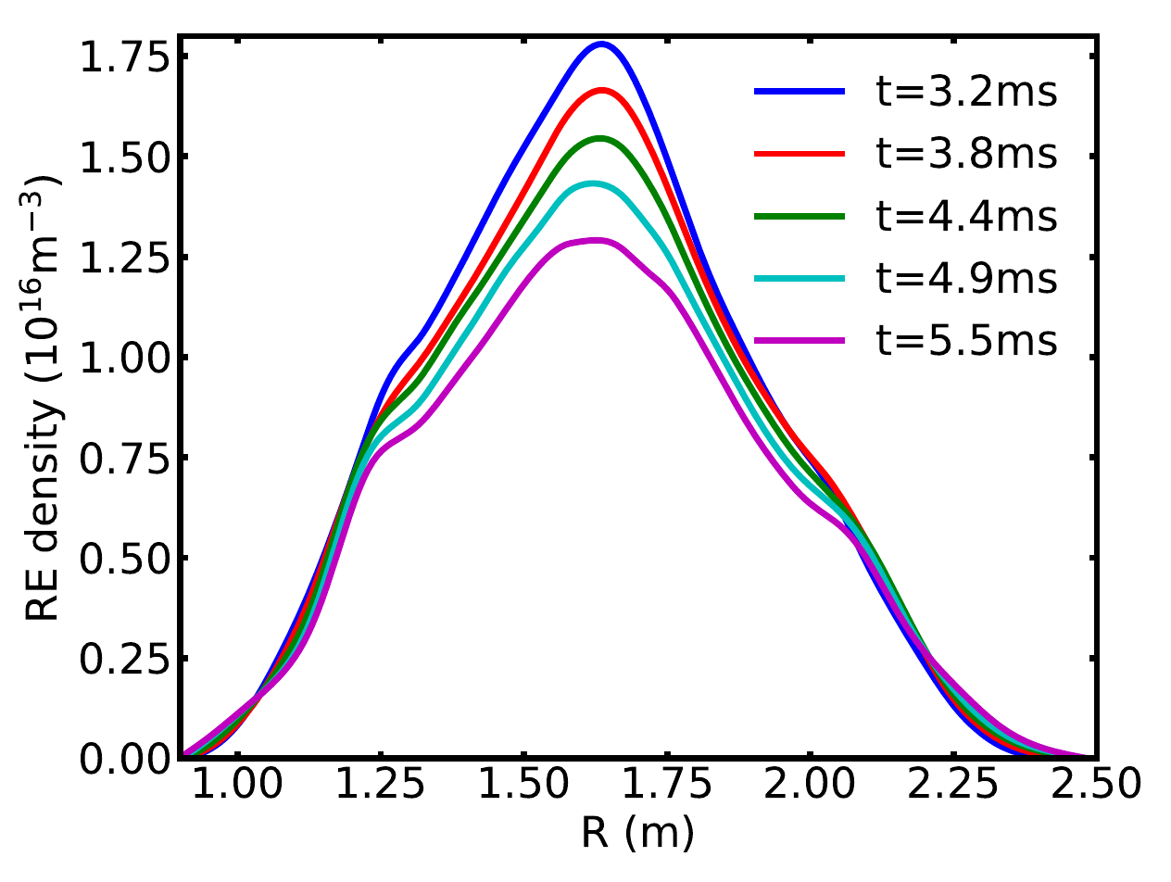
Kinetic-MHD simulation of compressional Alfvén eigenmodes excited by runaway electrons in current quench
Excitation of CAEs in M3D-C1 simulation with n=1
By doing kinetic-MHD simulation using M3D-C1-K, we get the excitation of CAEs (B∥>>B ⟂) with multiple frequencies for n=1 using REs with a wide energy spectrum, which is consistent with DIII-D experiments.
When modes are strongly excited (δB⟂~10⁻²B₀), they can lead to diffusion of both resonant and nonresonant REs in timescale of a few milliseconds.
Evolution of RE density profile due to CAE diffusion

