Slide 1
Insights on disruption physics in MAST using high speed visible camera data
Christopher Ham (Christopher.ham@ukaea.uk)
James Harrison and the MAST Team

Slide 2
Overview
MAST
High speed visible camera data
Eulerian Video Magnification
Three MAST shots
Disruptions caused by filamentary eruptions
Summary and future work

Slide 3
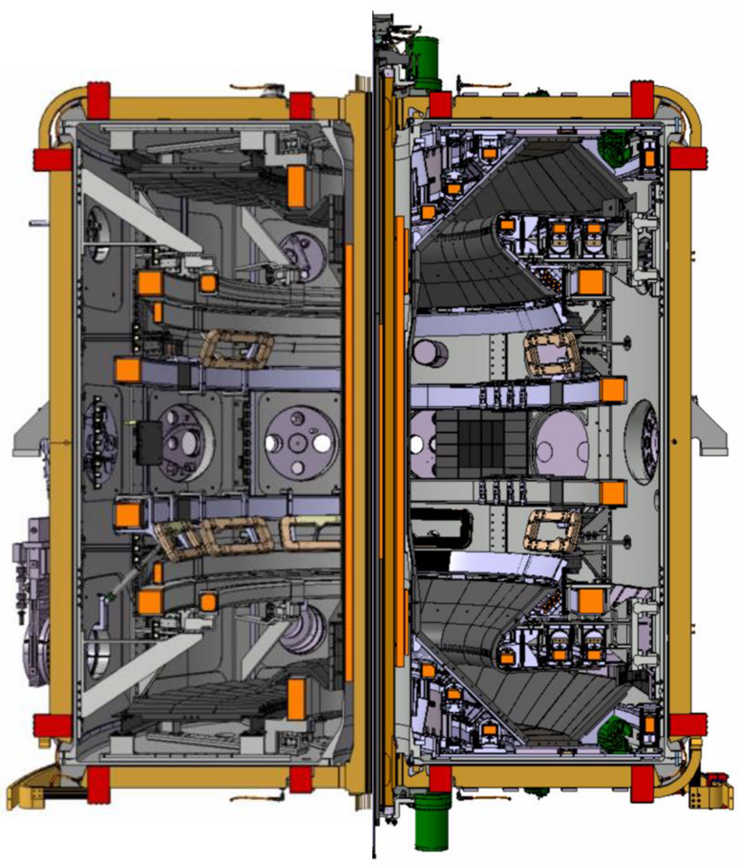
MAST
MAST operated at UKAEA (Culham, UK) from 2001 to 2013.
MAST had an open internal structure (no close fitting wall) allowing exceptional visible camera views.
MAST had a full set of diagnostics including high frequency magnetics and high speed video (on certain shots).
MAST Upgrade had its first campaign in 2021. The upgrade included Super-X divertors.
MAST
MAST-U

Slide 4
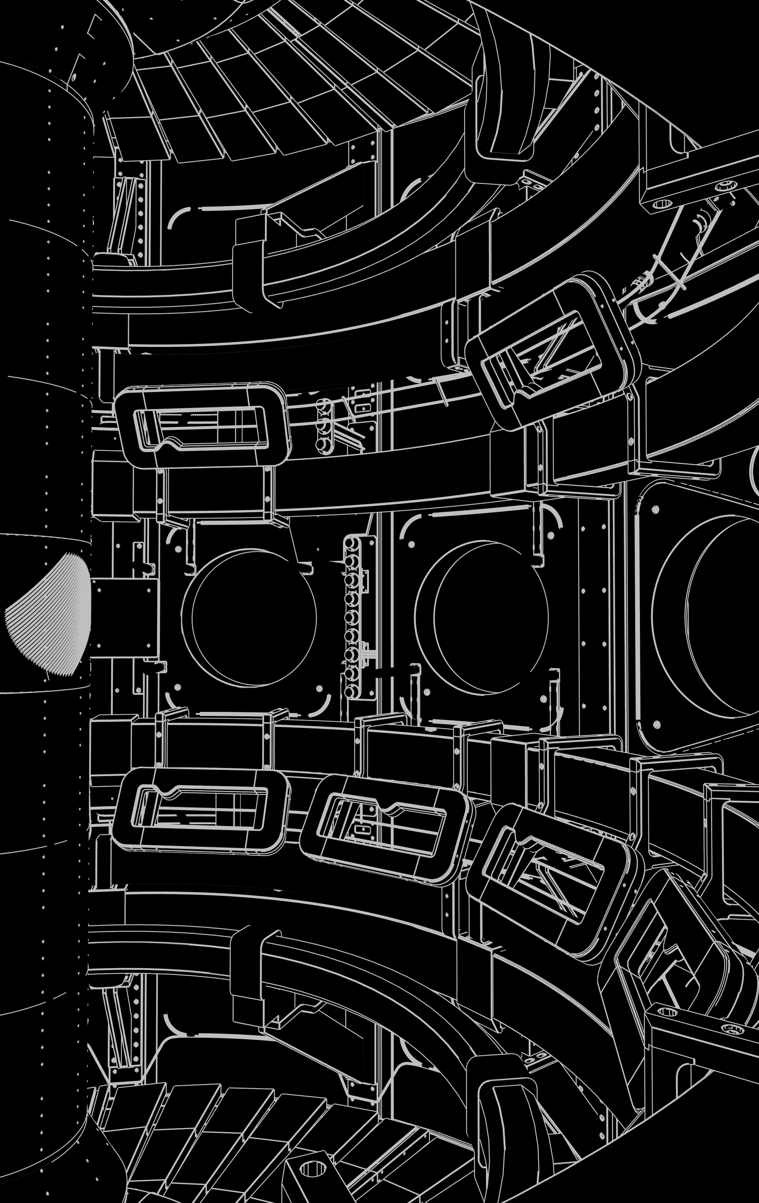
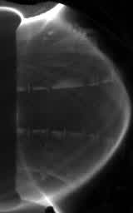
High speed visible camera data
High speed visible camera data was taken from a midplane port at between 90kHz and 100kHz using a Photron SA1 camera.
Seeing light from the plasma edge due to neutral interaction
Upper divertor
Poloidal field coils
Centre column
Lower divertor

Slide 5
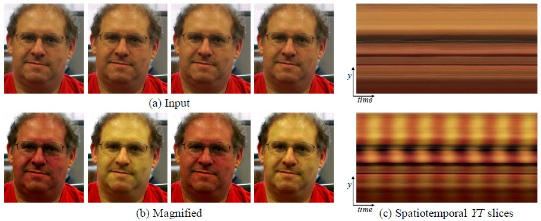
Eulerian Video Magnification
Eulerian Video Magnification was developed at MIT in 2012
It is a video processing technique that can magnify subtle periodic variations.
For example, subtle changes in facial colour can reveal a person’s pulse
There has been previous work applying this to MAST plasmas (David Ryan)
Hao-Yu Wu, Michael Rubinstein, Eugene Shih, John Guttag, Fredo Durand, and William T. Freeman
‘Eulerian Video Magnification for Revealing Subtle Changes in the World’ (2012)
ACM Transactions on Graphics (Proc. SIGGRAPH 2012) 31 (4)
D Ryan ‘Amplification of Plasma Edge Phenomena with Eulerian Video Magnification’ (2014)
University of York MSc thesis

Slide 6
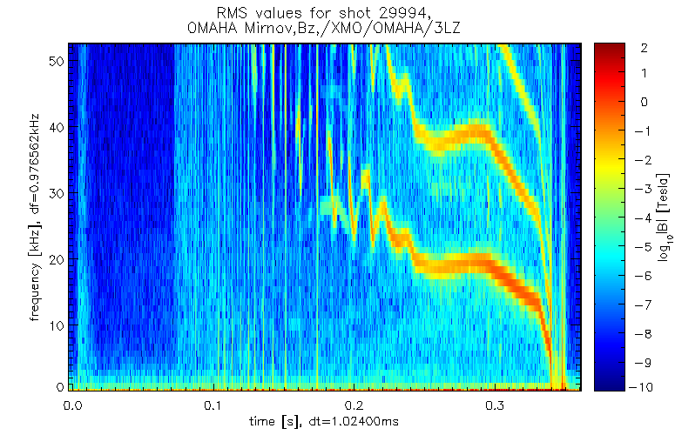
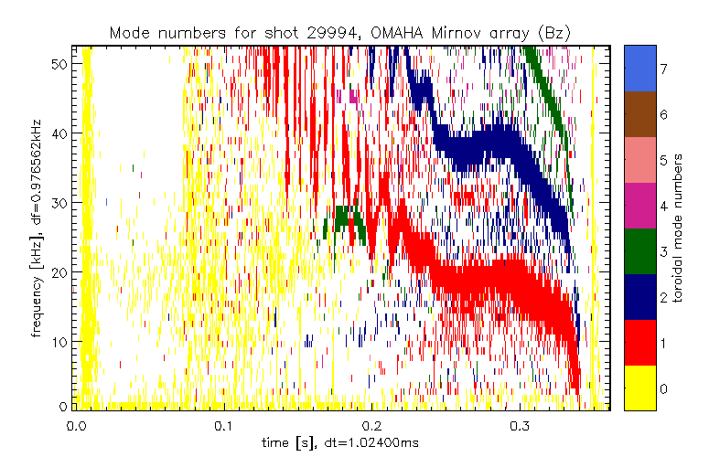
MAST shot 29994
Ip = 920kA, double null, one beam (~2MW), M9 campaign
H-mode at 250ms
This shot contains a long lived mode and no strong evidence of tearing modes.
Magnetics spectrograms below
7
6
5
4
3
2
1
0
Frequency, kHz
40
20
0
0.0
0.1
0.2
0.3
0.0
0.1
0.2
0.3
Time (s)
Time (s)
I.T. Chapman et al 2010 Nucl. Fusion 50 045007

Slide 7
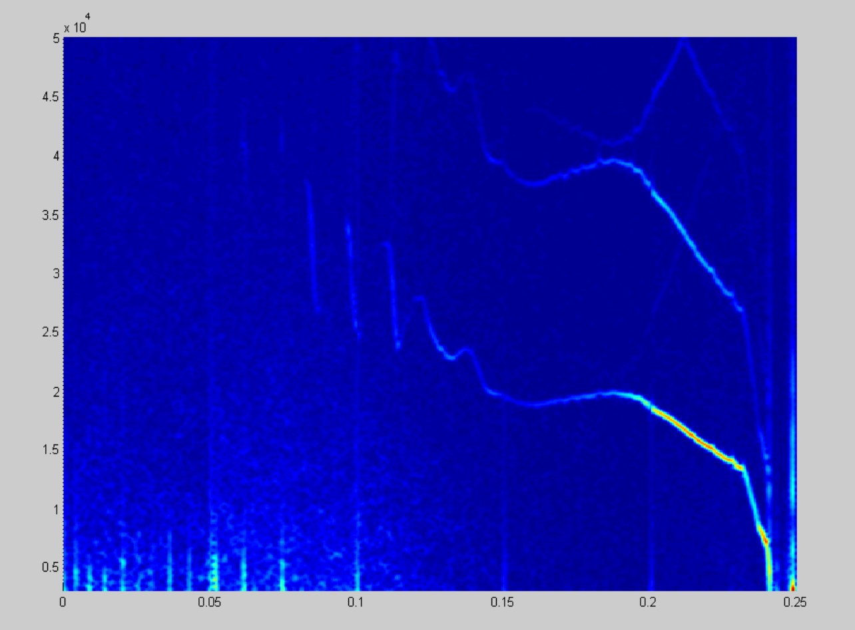
MAST shot 29994
We have produced spectrograms from the visible camera data which pick up most of the same modes that the magnetic spectrograms see.
We can then use EVM to target certain frequencies of interest to magnify the motion of the plasma for a given mode.
Magnetic spectrogram
Video spectrogram
Frequency, kHz
40
20
0
0.2
0.0
0.1
0.2
0.3
0.1
0.3
Time (s)
Time (s)

Slide 8
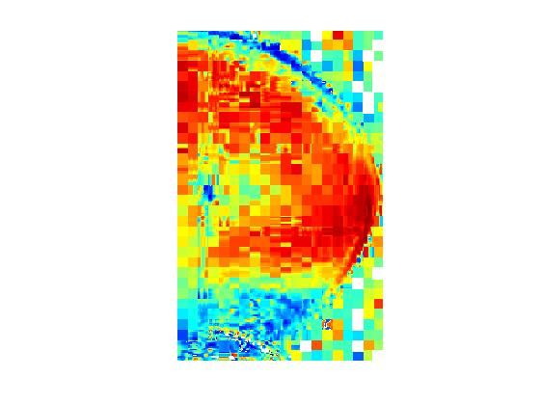
MAST shot 29994
We can do a correlation analysis. This involves picking one pixel and then finding the correlation of this pixel with each of the other pixels in the image.

Slide 9
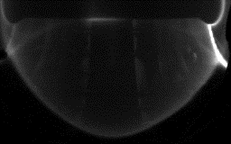
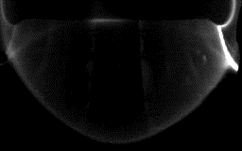
MAST shot 29994
Use EVM to look at LLM in this shot. We have focussed on the frequencies around the lowest frequency branch of the LLM
Raw video
With EVM

Slide 10
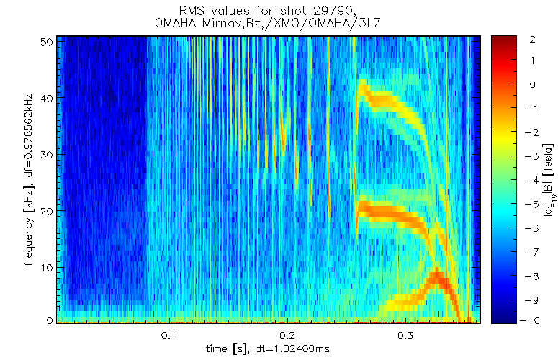
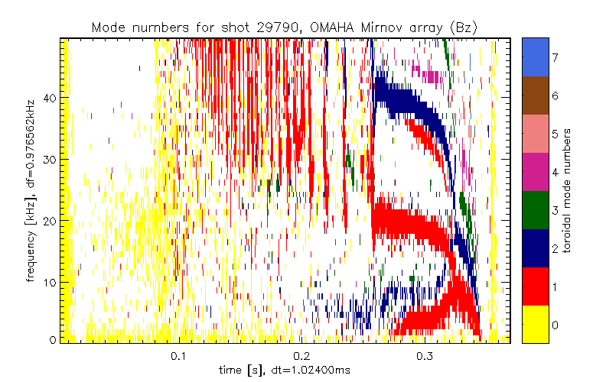
MAST shot 29790
Ip = 800kA, double null, two beams (~2.8MW), M9 campaign
H-mode at 250ms
This shot contains a long lived mode and a 2/1 tearing mode
Magnetics spectrograms below
7
6
5
4
3
2
1
0
Frequency, kHz
40
20
0
0.0
0.1
0.2
0.3
0.0
0.1
0.2
0.3
Time (s)
Time (s)

Slide 11
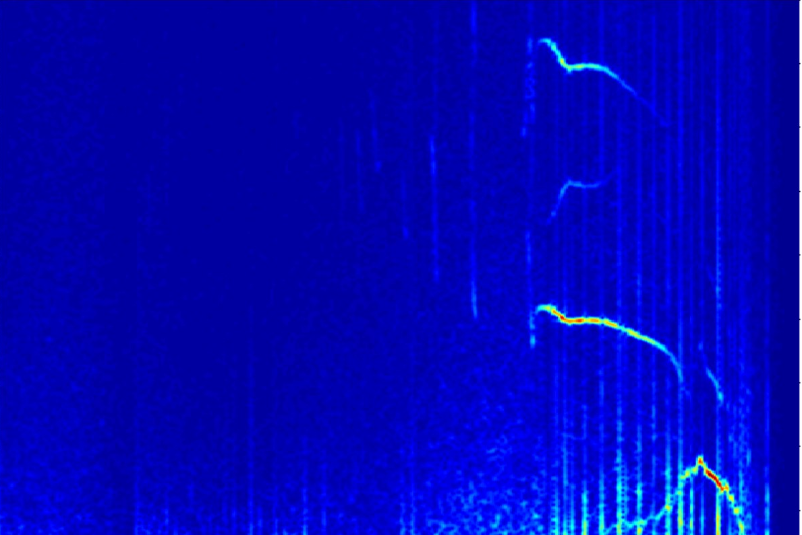
MAST shot 29790
We have produced spectrograms from the visible camera data which pick up most of the same modes that the magnetic spectrograms see.
We can then use EVM to target
Magnetic spectrogram
Video spectrogram
40
Frequency, kHz
20
0
0.0
0.1
0.2
0.3
0.0
0.1
0.2
0.3
Time (s)
Time (s)

Slide 12
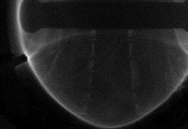
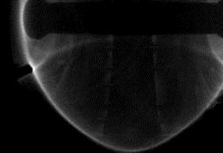
MAST shot 29994
Use EVM to look at tearing mode in this shot.
We focussed on the frequency of the coalesced mode at around 8kHz
Raw video
With EVM

Slide 13
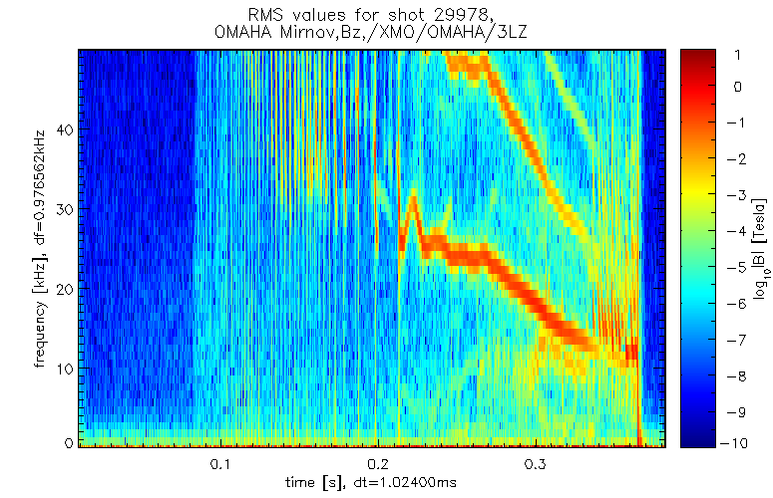
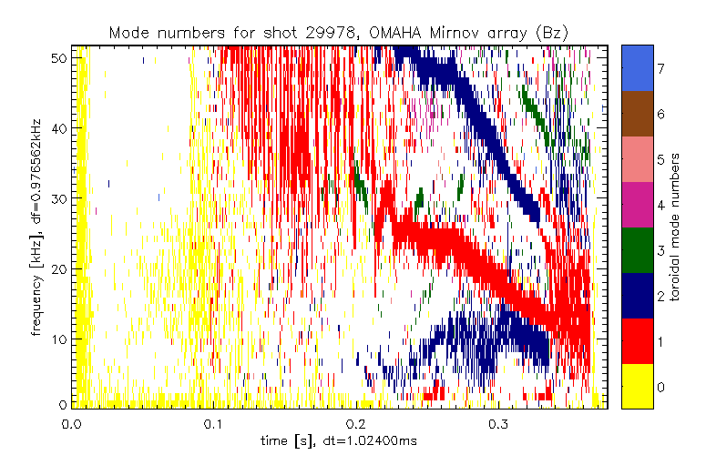
MAST shot 29978
Ip = 800kA, double null, two beams (~2.9MW), M9 campaign (Camera at 100kHz)
H-mode at 235ms
This shot contains a long lived mode and a 3/2 tearing mode and goes into fishbones at the end.
Magnetics spectrograms below
7
6
5
4
3
2
1
0
Frequency, kHz
40
20
0
0.0
0.1
0.2
0.3
0.0
0.1
0.2
0.3
Time (s)
Time (s)

Slide 14
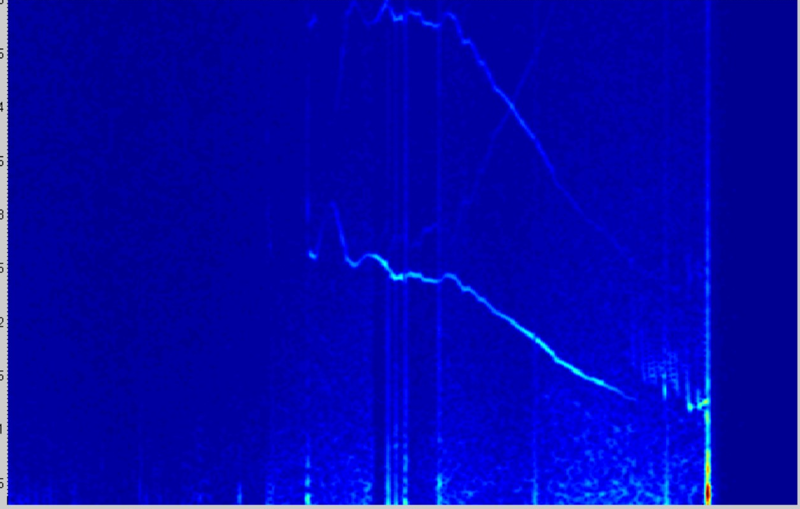
MAST shot 29978
We have produced spectrograms from the visible camera data which pick up most of the same modes that the magnetic spectrograms see.
Magnetic spectrogram
Video spectrogram
Frequency, kHz
40
20
0
0.0
0.1
0.2
0.3
0.0
0.1
0.2
0.3
Time (s)
Time (s)

Slide 15
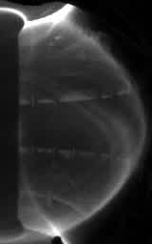
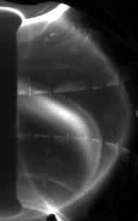
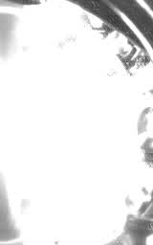
MAST shot 29978
This shot terminates via a filamentary eruption on ~10 microsecond timescale
Four consecutive frames (10 microseconds apart) are shown below

Slide 16
Disruptions caused by filamentary structures
Filamentary disruptions can happen on a very fast timescale.
Need to better understand the physics of these filamentary disruptions so that we can avoid them
These types of disruptions have been noted before on MAST, JET and TFTR
A Kirk et al (2004) IAEA FEC EX2/3 ‘The structure of ELMs and the distribution of transient power loads in MAST’

Slide 17
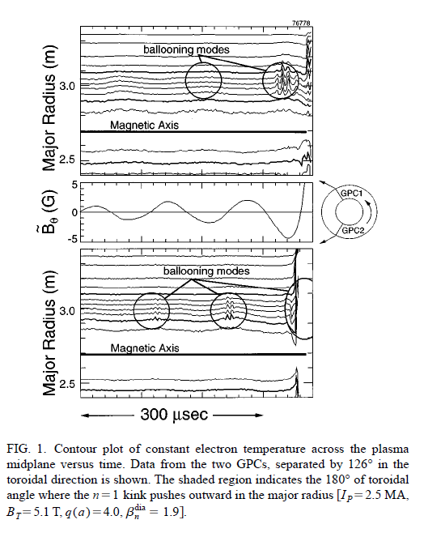
TFTR
Internal transport barrier (ITB) discharges had high pressure and confinement
TFTR experiments show ballooning modes appearing prior to ITB disruption
This is on top of n=1 mode activity
ECE diagnostic results shown in figure
This produces very fast disruptions (~100μs)
Fredrickson et al., Phys. Plasmas 3 2620 (1996)

Slide 18
JET
Similar ITB disruptions have been observed using the ECE diagnostic on JET
These grow on the 100 microsecond timescale and appear to be toroidally localized as in TFTR
J I Paley et al Journal of Nuclear Materials 337–339 (2005) 702–706

Slide 19
Nonlinear ballooning review
Initial work on early nonlinear state
Shows that the mode is expected to form narrow finger-like structure
Mode gets narrower as it grows
Explosive growth expected
Wilson & Cowley Phys Rev Lett 92 175006 (2004)

Slide 20
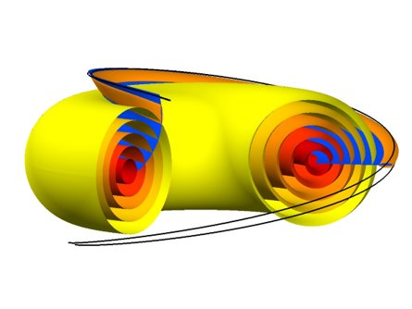
Nonlinear ballooning filaments
Consider a highly elliptical flux tube, δ₁<<δ₂​
Tube sufficiently narrow that the field and pressure outside are unperturbed​
Ham et al. Phys Rev Lett 116 235001 (2016)

Slide 21
Nonlinear ballooning filaments
The nonlinear dynamics of the ballooning flux tube can be modelled using a generalized Archimedes’ principle
This gives the force in the radial direction which can be balanced against viscosity to give a time dependent evolution of the flux tube or the equilibrium flux tube locations can be found
This has been done in a large aspect ratio calculation as well as in a numerical tokamak case.
This work shows that nonlinear ballooning flux tube with significant displacements can be energetically favourable.
Non-axisymmetry may well be important to the stability of these flux tubes and we plan to include this effect in future

Slide 22
Summary and further work
We have shown how high frequency camera data can be used to investigate instabilities and disruptions in MAST
We have calculated spectrograms and used Eulerian Video Magnification for three MAST shots. Further work on using the camera data to understand the instability modes may well be possible.
Fast camera data has been used to capture what appears to be a nonlinear ballooning filament and the consequent disruption
Filamentary disruptions on other tokamaks have been discussed as well as some theory of these nonlinear ballooning modes.
We aim to be able to calculate time dependent and saturated states of these nonlinear ballooning modes in realistic geometry and including non-axisymmetric, plasma flow and resistivity effects.
The speed of onset of these filamentary disruptions may be a challenge for disruption prediction and avoidance.

