Slide 1
Transfer Today’s Disruption Prediction Model to Future Tokamaks
Wei Zheng, Fengming Xue, Zhongyong Chen, Chengshuo Shen, Dalong Chen, Bihao Guo, Xinkun Ai, Ming Zhang, Nengchao Wang, Yonghua Ding, Zhipeng Chen, Zhoujun Yang, Yuan Pan, Biao Shen, Bingjia Xiao
With help from J-TEXT, EAST and HL-2A team

Slide 2
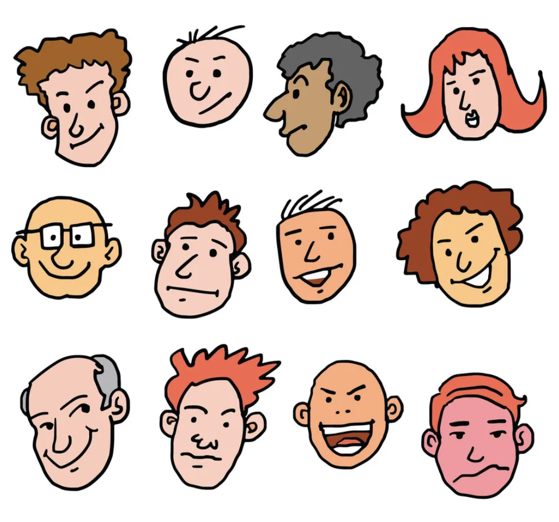
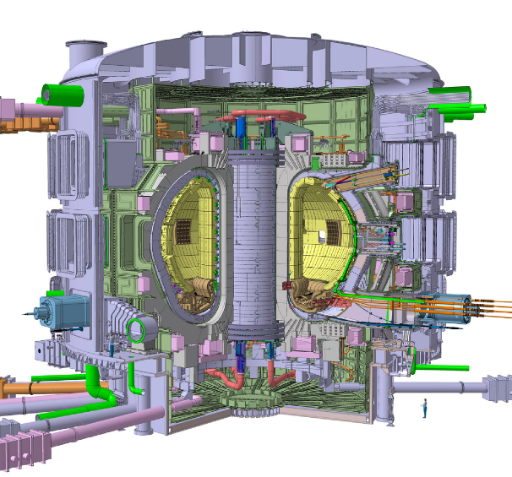
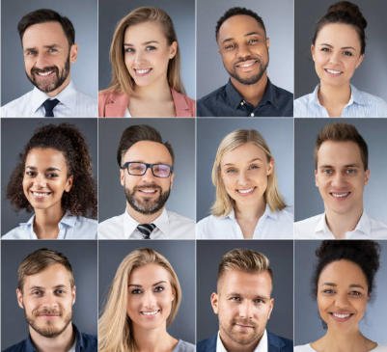
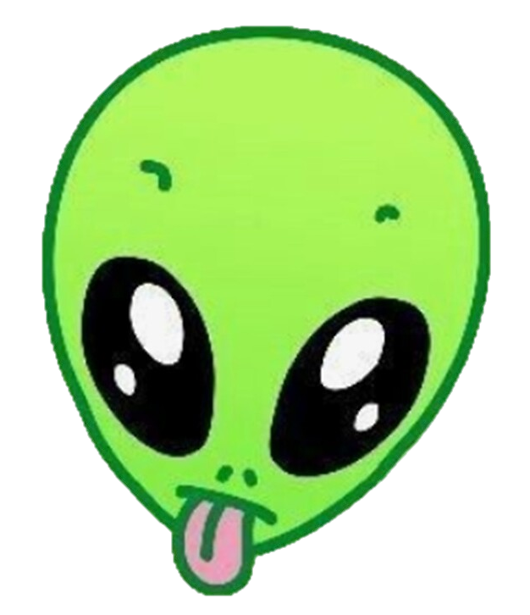
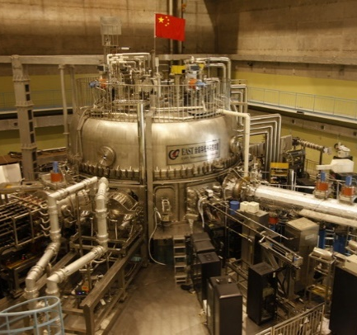
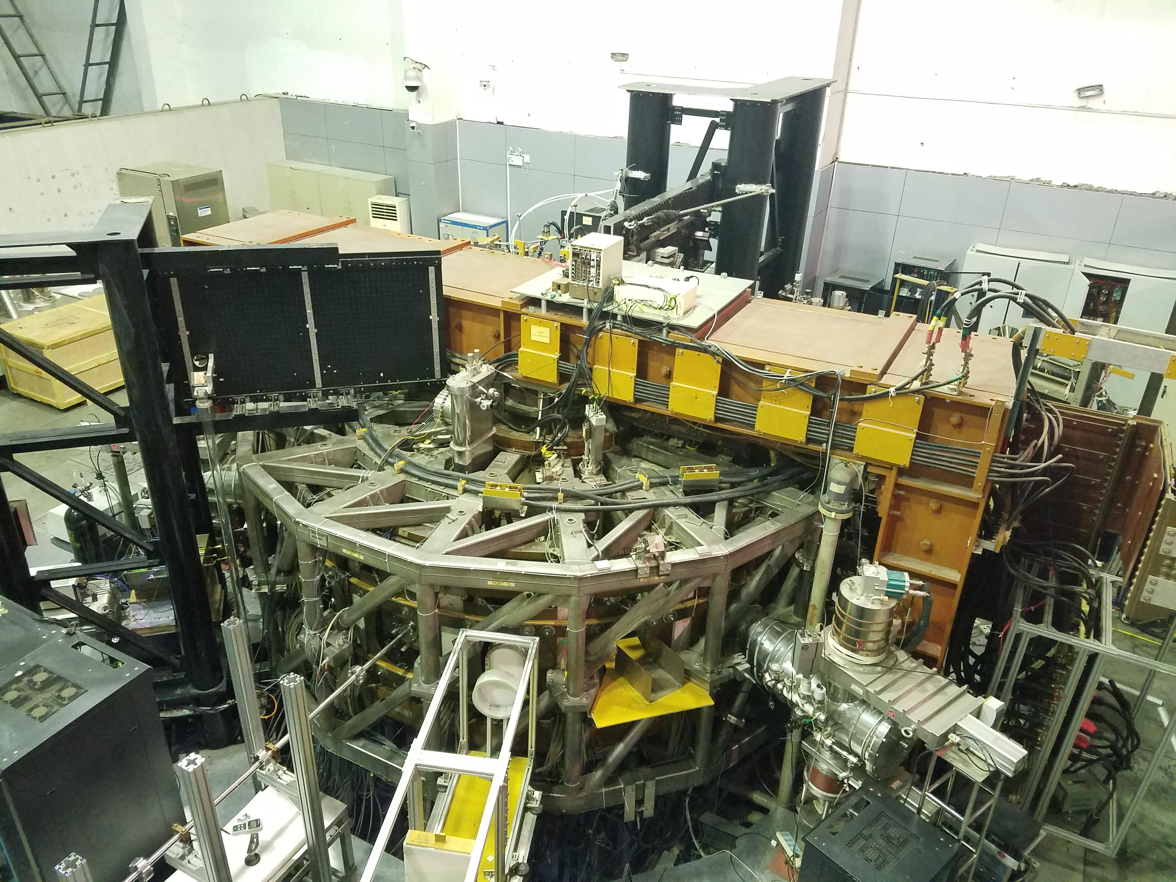
The Problem of ML Based Disruption Prediction
It need disruption data from the target machines
  Machine Learning is data driven.
  It need big amount of disruption data to train.
  For future tokamak reactors it’s hard to provide enough disruption data before it damages itself.
  How to use the existing tokamaks to build a model that works on future reactors?
One runaway discharge will do the job 😟
Disruption is not that big a deal
Disruption is everyday routine😀

Slide 3
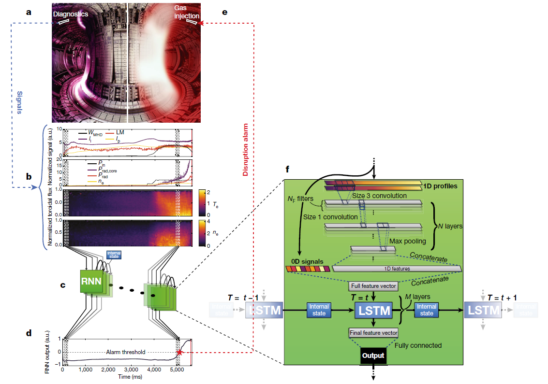
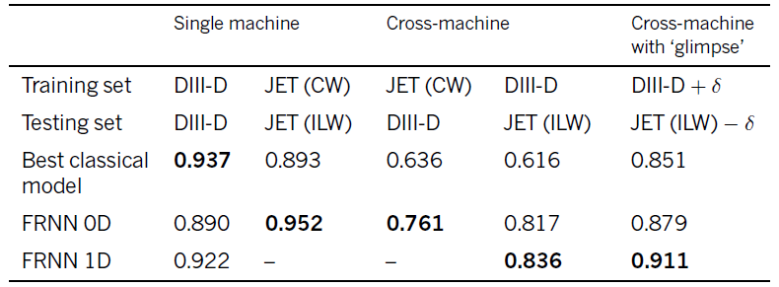
Previous Deep Learning Attempt on Cross Tokamak Disruption Prediction
FRNN
  CNN+LSTM trained on JET (AUC=0.952)
  With a ‘glimpse’ of DIII-D data, the model achieved AUC=0.879
  And works vice versa
  A glimpse = 7 disruption shots
J. Kates-Harbeck, et al., "Predicting disruptive instabilities in controlled fusion plasmas through deep learning," Nature, vol. 568, pp. 526-531, 2019.

Slide 4
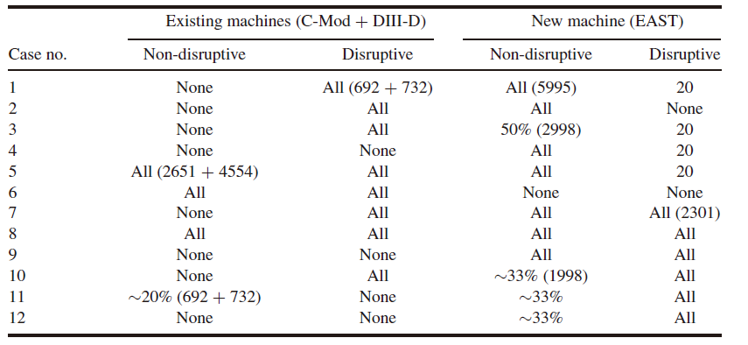
Previous Deep Learning Attempt on Cross Tokamak Disruption Prediction
Hybrid deep-learning architecture
  CNN+GRU trained on Mixing data set of existing machine and new machine
  Tested on different mixing methods
  Best case: disruptive from existing machines + All save shots from new+20 disruption from new
  Add non-disruption from existing machines harms the model performance
  The disruptive characteristics are machine-independent
J. Zhu, et al., "Scenario adaptive disruption prediction study for next generation burning-plasma tokamaks," Nucl. Fusion, vol. 61, 2021.
J. X. Zhu, et al., "Hybrid deep-learning architecture for general disruption prediction across multiple tokamaks," Nucl. Fusion, vol. 61, p. 026007

Slide 5
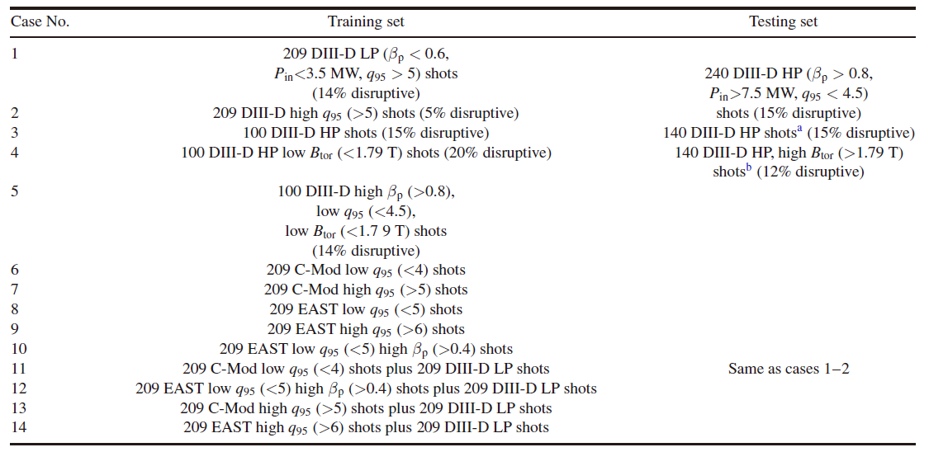
Previous Deep Learning Attempt on Cross Tokamak Disruption Prediction
Scenario adaptive disruption prediction
  Different mixing technique based on discharge scenario
  Base case: HP from existing machine + LP from target machine
  Existing machine can provide the HP disruptions, while target machine can withstand LP disruptions
J. Zhu, et al., "Scenario adaptive disruption prediction study for next generation burning-plasma tokamaks," Nucl. Fusion, vol. 61, 2021.
J. X. Zhu, et al., "Hybrid deep-learning architecture for general disruption prediction across multiple tokamaks," Nucl. Fusion, vol. 61, p. 026007

Slide 6
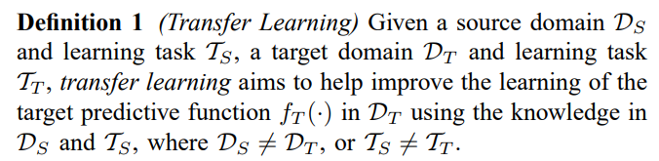
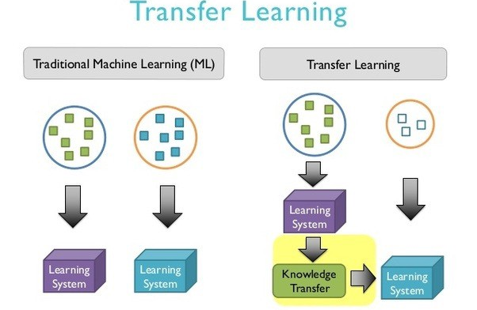
Transfer Learning
Mixing
-I think- Mixing is:
  Carefully designing a new data set to approximate the target data set
  Is a data augmentation technique.

Slide 7
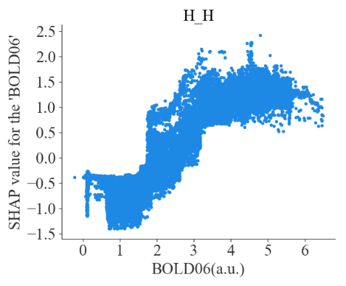
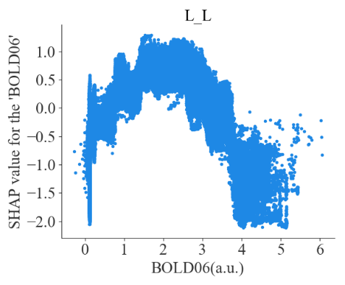
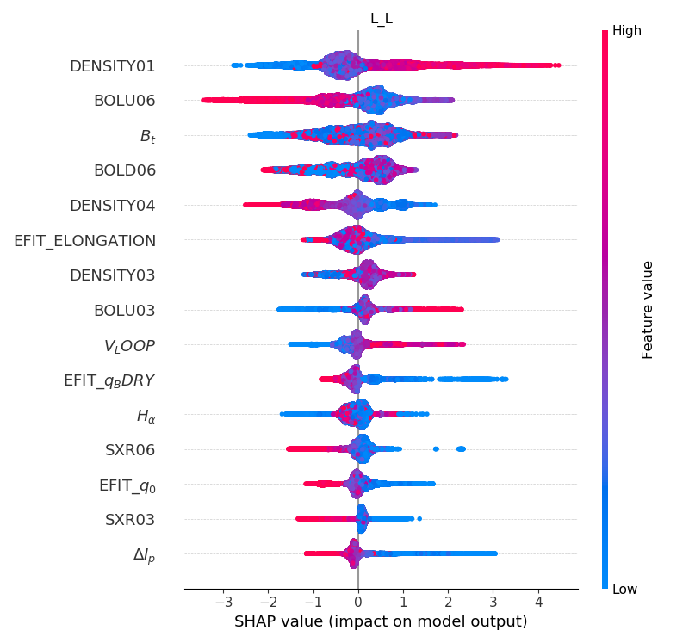
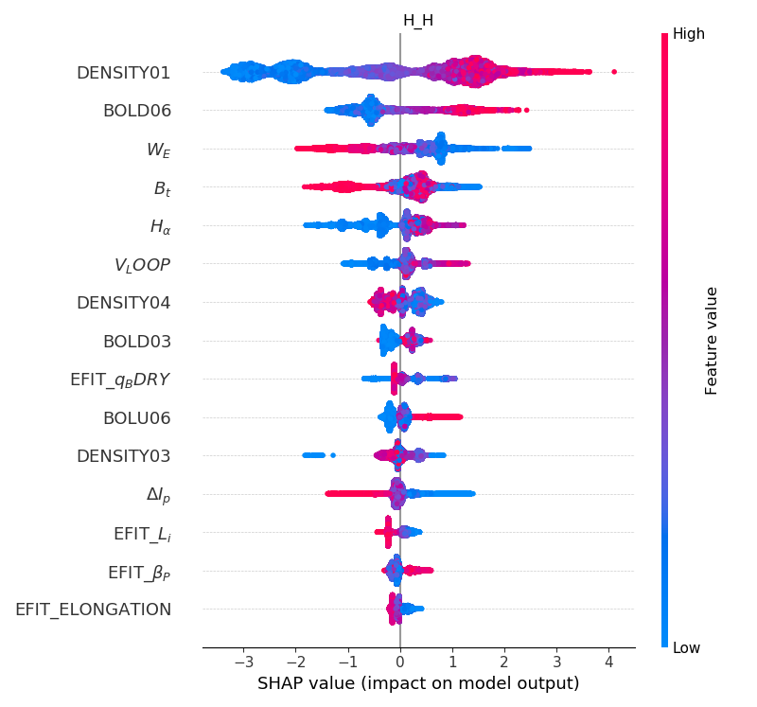
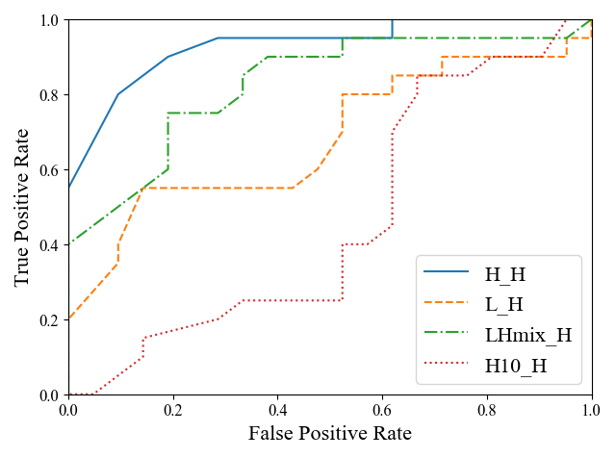
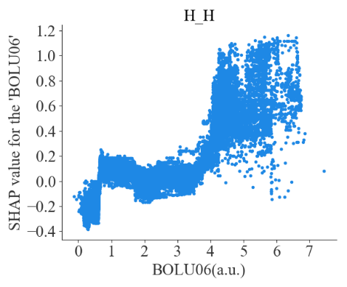
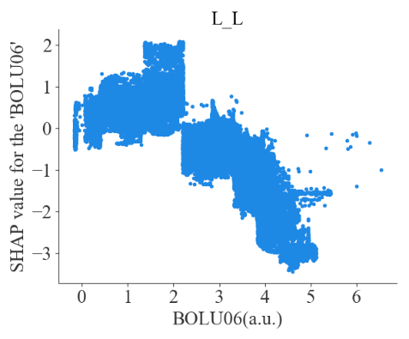
The more on mixing
Hp-Model
Lp-Model
Hp-Model
Lp-Model
  Mixing Large amount of LP data from HL-2A with a fraction of HP data (10 shots) did improve the performance on predicting HP disruption significantly
  But, the contributing features are different, some even contradict each other
  Mixing really requires carefully selected data to minimizing negative effect.

Slide 8
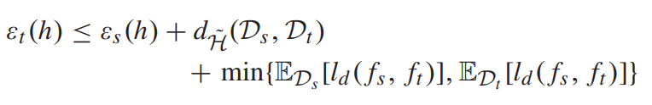
Transfer Based on Machine Independent features
To reduce the target domain error, need to reduce the source error, and divergence between source and target domain
Types of features | Feature tag | Impact on disruption
MHD instabilities related | mode_number_m, mode_number_n | 2/1 magnetic island growth; Multi-magnetic island overlap; Locked mode
 | n=1 amplitude
 | FFTMir_abs, FFTMir_fre
 | Mir_VV
Radiation related | P_rad, SXR_core, CIII | Edge cooling; MARFE
 | axuv_array_kurt(skew, var)
 | sxr_array_kurt(skew, var)
Density related | sum_ne | Density limit disruption
 | ne
 | ne_array_kurt(skew, var)
PCS related | bt, ip | Plasma current limit disruption
 | Ihfp, Ivfp, vl | VDE; Plasma out of control
 | Ihfp_diff, Ivfp_diff, ip_diff
 | dr, dz
10% training set could reach AUC = 0.93
First, feature engineering:
  Extract machine independent disruption related features
  Reduce amount of the data needed
  Reduce source domain error as well as source and target divergence
Great performance (TPR~97%, FPR~5%, AUC ~ 0.98)

Slide 9
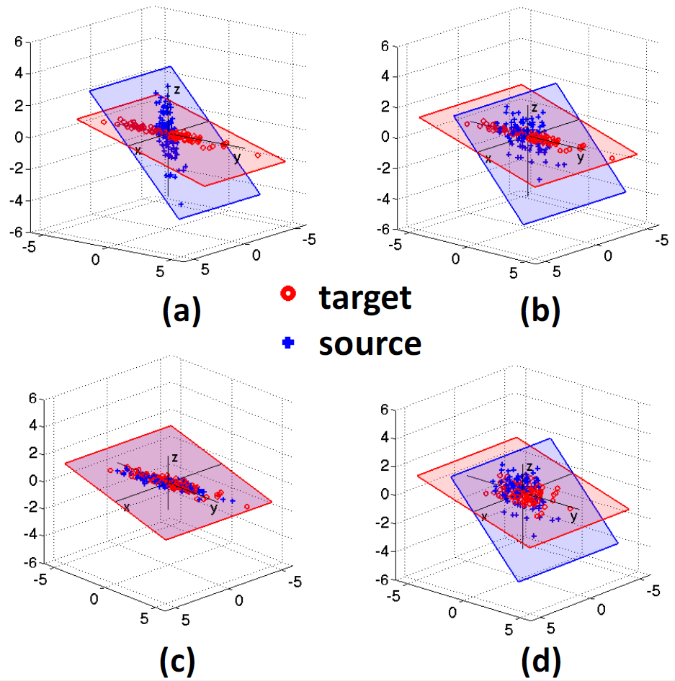
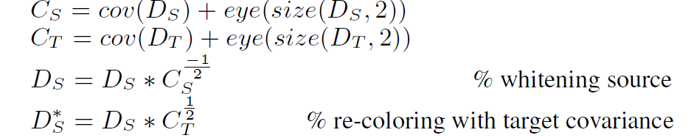
Transfer Based on Machine Independent features-CORAL
Further reduce the source target divergence via domain adaptation.
Algorithm original: CORAL for Unsupervised Domain Adaptation
Input | D_{S}, D_{T}
Output | D_{S}*
Algorithm expanded: CORAL for Supervised Domain Adaptation
Input | D_{S_dis}, D_{T_dis}, D_{S_non-dis}, D_{T_non-dis}
Output | D_{S_dis}*, D_{S_non-dis}*
Return of Frustratingly Easy Domain Adaptation，2016 AAAI
Notes:
(a-c) Illustration of CORrelation ALignment (CORAL) for Domain Adaptation: (a) The original source and target domains have different distribution covariances, despite the features being normalized to zero mean and unit standard deviation. This presents a problem for transferring classifiers trained on source to target. (b) The same two domains after source decorrelation, i.e. removing the feature correlations of the source domain. (c) Target re-correlation, adding the correlation of the target domain to the source features. After this step, the source and target distributions are well aligned and the classifier trained on the adjusted source domain is expected to work well in the target domain. (d) One might instead attempt to align the distributions by whitening both source and target. However, this will fail since the source and target data are likely to lie on different subspaces due to domain shift.

Slide 10
Transfer Based on Machine Independent features-CORAL
Reaching the best performance using only 10 EAST disruptive discharges with expended CORAL.
Best performance: TPR = 90 %, FPR = 30%, AUC = 0.833
Non-disruptive discharges could be decreased by the non-disruptive labeled data in disruptive discharges.
Case No. | EAST Data | Data Strategy | CORAL Strategy | AUC
1 | None | / | / | 0.642
2 | 1896 (355) | Mixing | / | 0.806
3 | 110 (10) | Mixing | / | 0.614
4 | 110 (10) | CORAL | Unsupervised | 0.657
5 | 110 (10) | CORAL | Supervised | 0.833
Notes:
FPR is acceptable in the early stages of discharge.

Slide 11
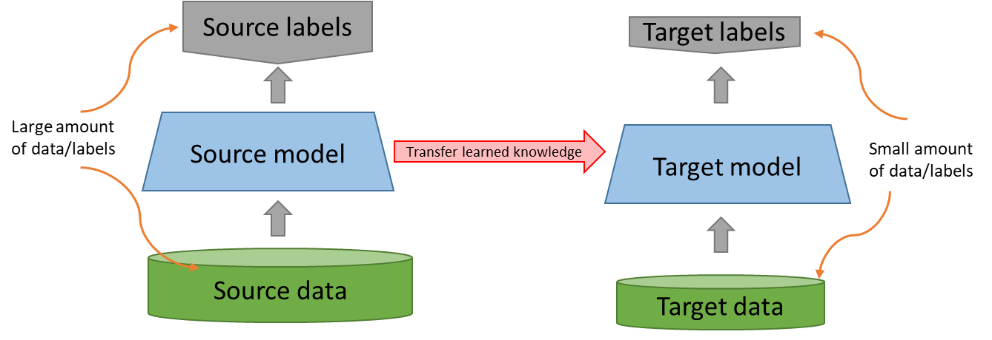
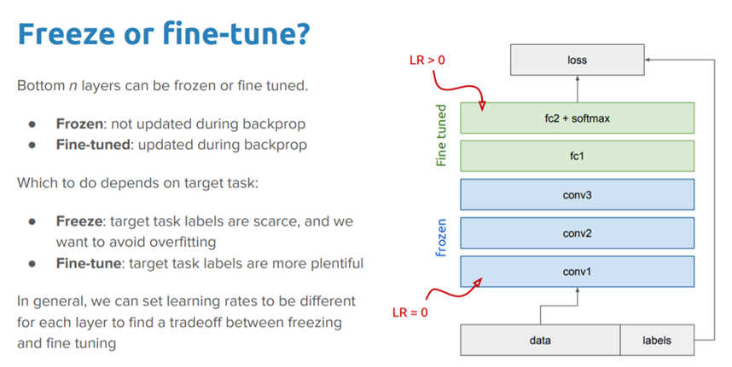
Deep Transfer Learning-Pre-train, Fine tune
Frozen: not updated during backpropagation
Fine-tuned: updated during backpropagation
A deep disruption prediction model can be seen as:
  A feature extractor and a classifier；
  Lower level layers extract low level features which is shared between tokamaks;
  Possible to pre-train a feature extractor on large existing machines.
  Then fine tune it on limited target machine data

Slide 12
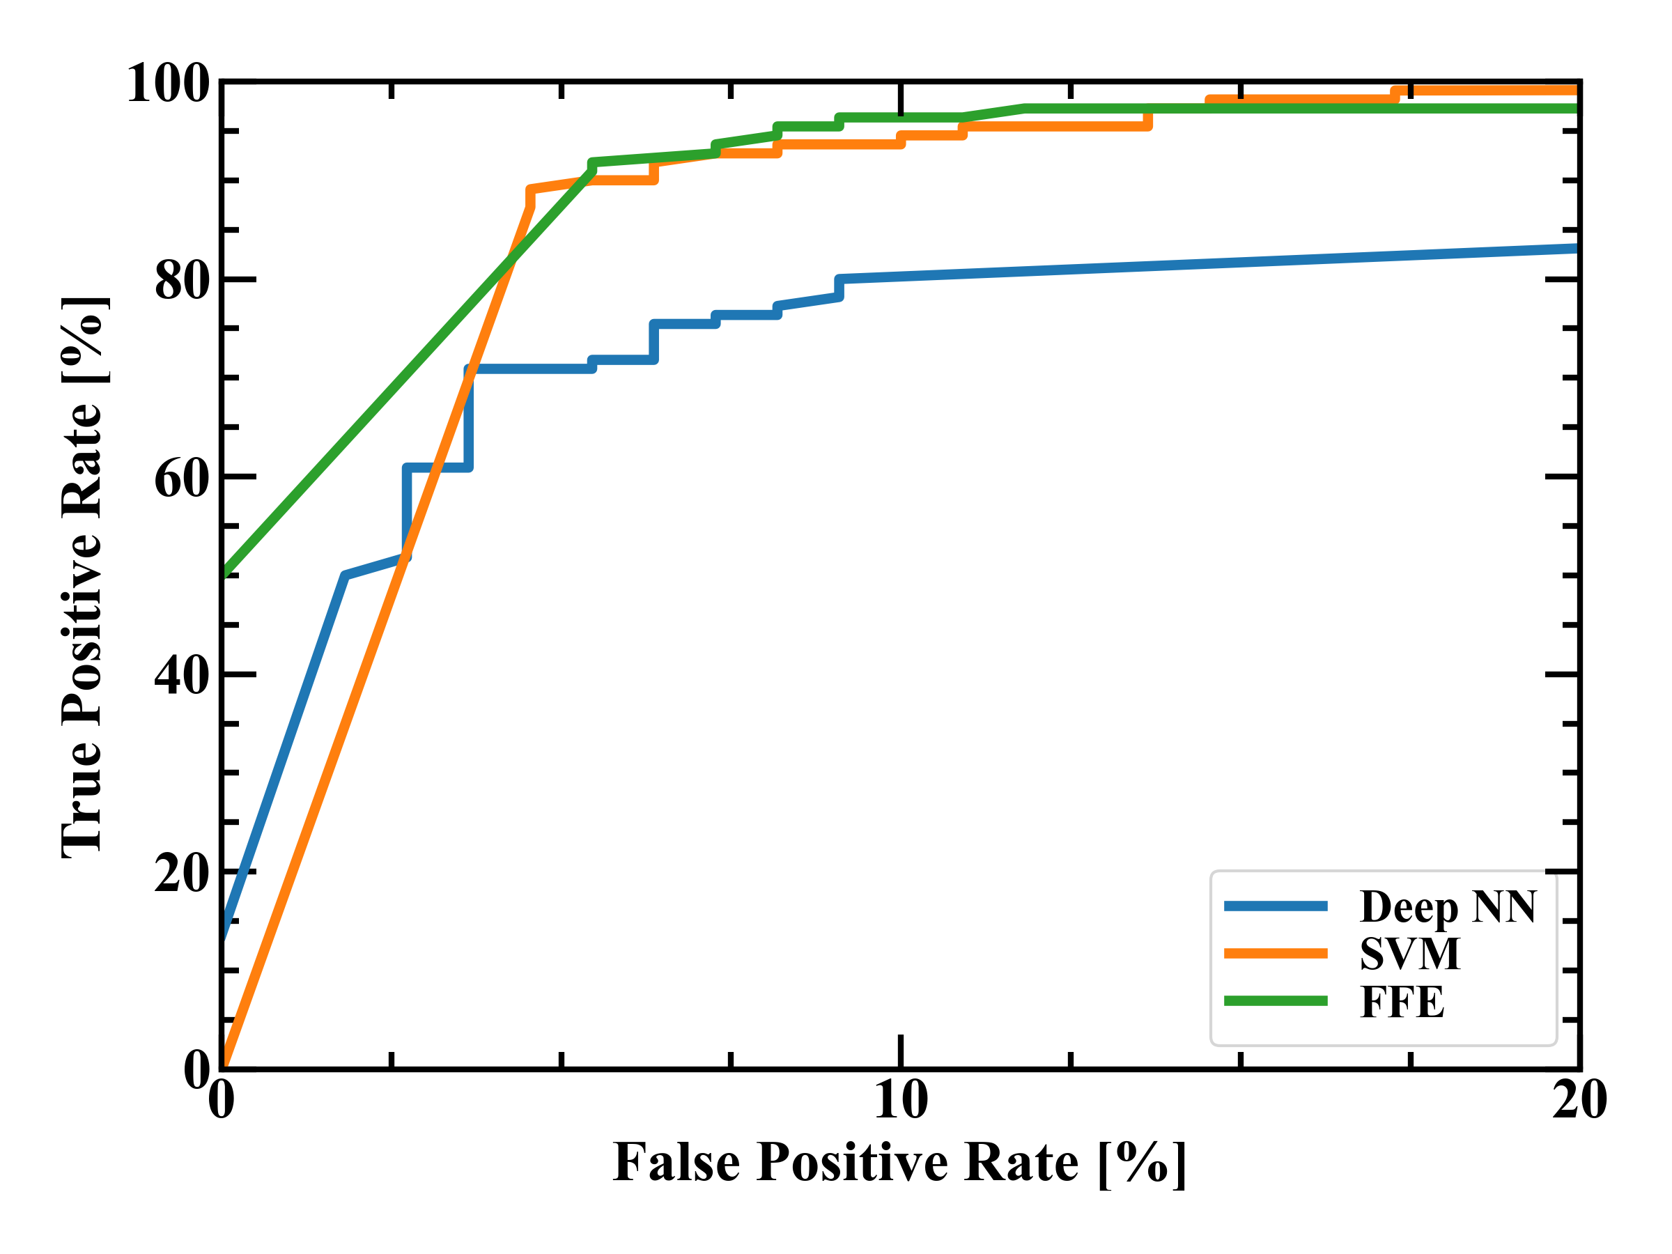
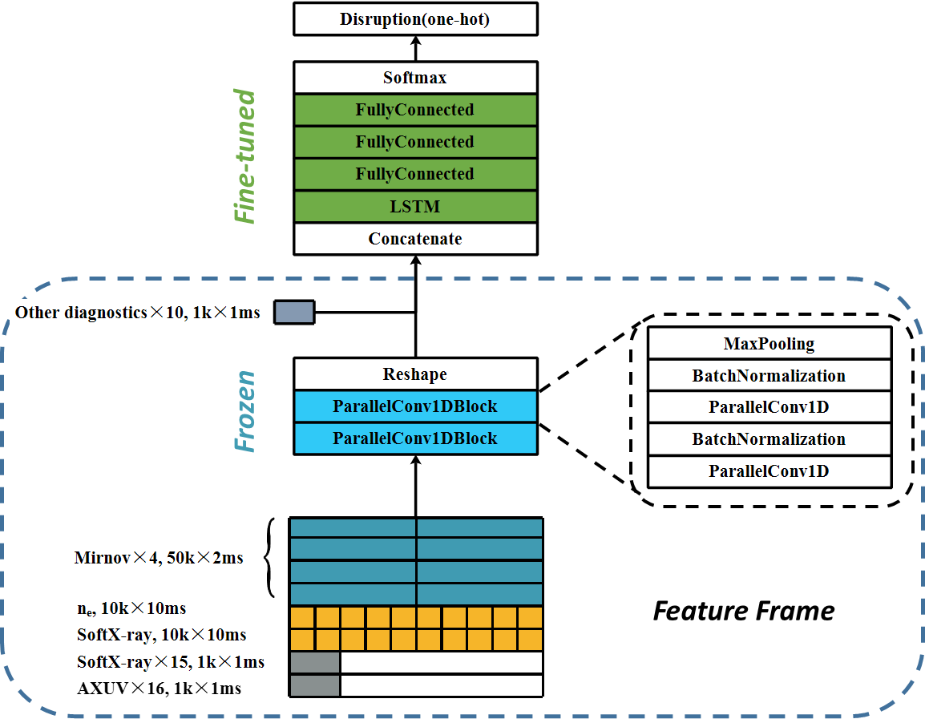
Deep Transfer Learning, Pre-train, Fine tune
Reaching TPR of 96.36% with FPR of 9.01%
Freeze layers for Frame feature extraction
Fine-tune layers for temporal feature extraction and classification
Transfer learned knowledge to new tokamak with limited data

Slide 13
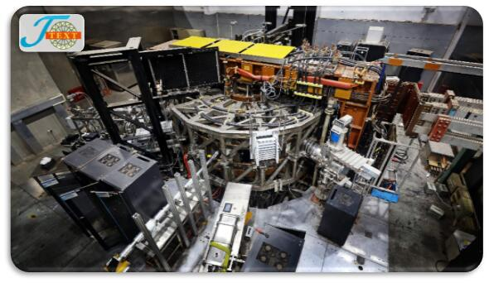
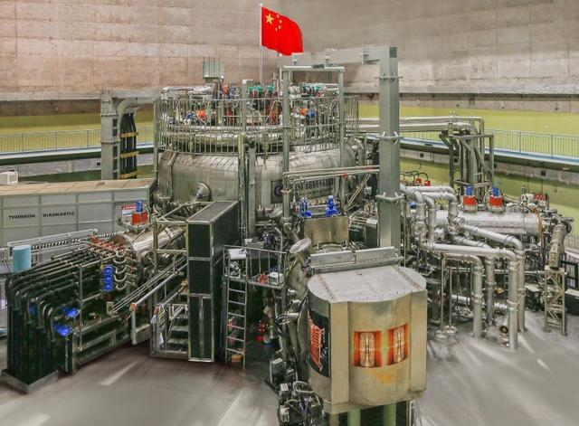
Dataset description
 | Training | Validation | Test
J-TEXT | 494 (189) | 140 (70) | 220 (110)
EAST (all data) | 1896 (355) | 120 (60) | 360 (180)
EAST (transfer) | 20 (10) | / | 360 (180)
J-TEXT
Channel(s) | Sample rate (kHz) | Physical meaning
I_{p} | 1 | Plasma current
B_{t} | 1 | Toroidal magnetic field
V_loop | 1 | Loop voltage
dr | 1 | Radial displacement
dz | 1 | Vertical displacement
CIII | 1 | CIII impurity
SXR(15) | 1 | Soft X-Ray array
AXUV/PXUV(16) | 1 | AXUV (PXUV in EAST) array
exsad(4) | 1 | Saddle coils
n_{e} | 10 | Plasma density
SXR_MID | 10 | Middle channel of SXR
Mirnov(4) | 50 | Two pairs of adjacent Mirnov coils, poloidal and toroidal
EAST

Slide 14
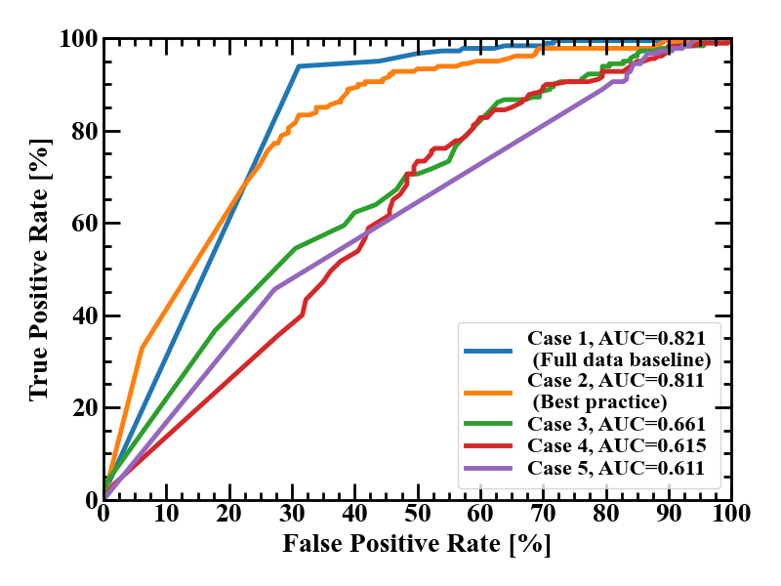
Deep Transfer Learning, Pre-train, Fine tune
Pre-trained model is J-TEXT-specific and performs poor on EAST
Reaching similar performance as EASAT full data baseline using only 20 EAST discharges with the pre-train & fine-tune
Other models perform much worse than baseline
Case No. | J-TEXT Data | EAST Data | Layers Frozen | Layers Replaced | Unfreeze | AUC | Remark
1 | None | 1896 (355) | / | / | / | 0.821 | EAST full data baseline
2 | None | 20 (10) | CNNs | / | No | 0.811 | Best practice
3 | 494 (189) | 20 (10) | / | / | / | 0.661 | Mixing J-TEXT and EAST
4 | None | 20 (10) | / | / | / | 0.615 | 20 discharges from EAST
5 | None | None | / | / | / | 0.611 | Only J-TEXT model

Slide 15
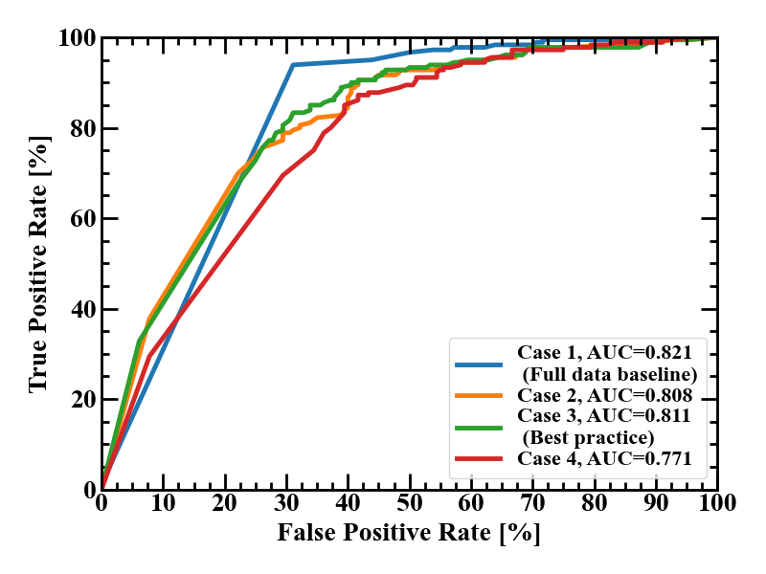
More in depth on transfer: Where to freeze?
Train at learning rate of 1e-4 for 10 epochs with some layers frozen
It is the best to freeze CNNs of the pre-trained model
Indicating that CNNs extract general features of disruption across tokamaks, while LSTMs are tokamak-specific
Case No. | J-TEXT Data | EAST Data | Layers Frozen | Layers Replaced | Unfreeze | AUC | Remark
1 | None | 1896 (355) | / | / | / | 0.821 | EAST full data baseline
2 | None | 20 (10) | CNN bottom | / | No | 0.808 | /
3 | None | 20 (10) | CNNs | / | No | 0.811 | Best practice
4 | None | 20 (10) | CNNs+LSTM | / | No | 0.771 | /

Slide 16
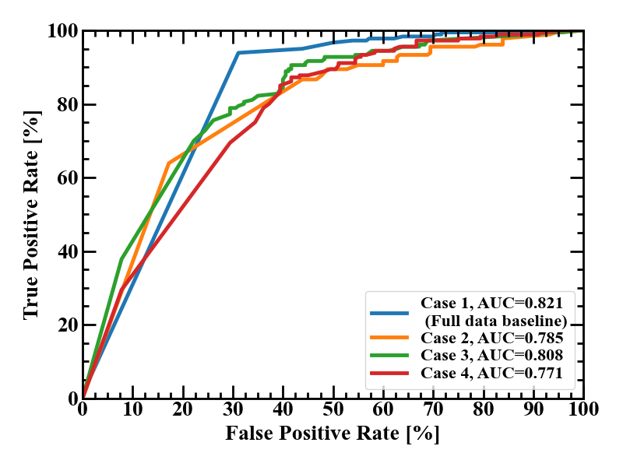
More in depth on transfer: Replacing?
Replace some layers of the pre-trained model with randomized initialization, also training at learning rate of 1e-4 for 10 epochs
Further proved that CNNs extract general features, while LSTMs are tokamak specific
Case No. | J-TEXT Data | EAST Data | Layers Frozen | Layers Replaced | Unfreeze | AUC | Remark
1 | None | 1896 (355) | / | / | / | 0.821 | EAST full data baseline
2 | None | 20 (10) | CNN bottom | LSTM+Classifier | No | 0.810 | 0.808 w/o replacing
3 | None | 20 (10) | CNNs | LSTM+Classifier | No | 0.810 | 0.811 w/o replacing
4 | None | 20 (10) | CNNs+LSTM | Classifier | No | 0.771 | 0.771 w/o replacing

Slide 17
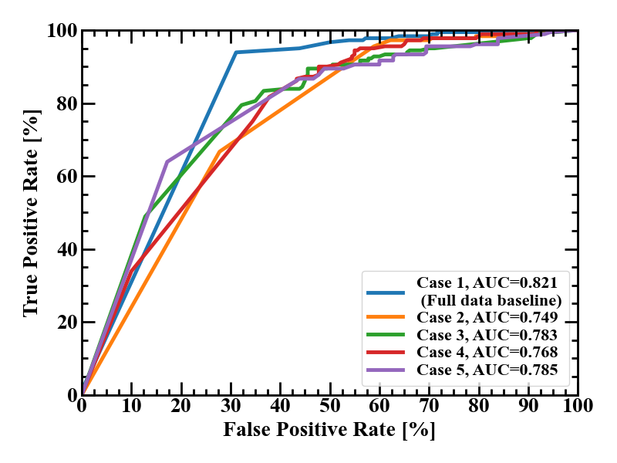
More in depth on transfer: Unfreeze?
Train at learning rate of 1e-4 for 10 epochs with some layers frozen, 1e-5 for another 10 epochs with the layers unfrozen
All cases perform worse, especially those with CNNs frozen
Even at learning rate of 1e-5, the models suffer from overfitting
Case No. | J-TEXT Data | EAST Data | Layers Frozen | Layers Replaced | Unfreeze | AUC | Remark
1 | None | 1896 (355) | / | / | / | 0.821 | EAST full data baseline
2 | None | 20 (10) | CNN bottom | / | Yes | 0.749 | 0.808 w/o unfreeze
3 | None | 20 (10) | CNNs | / | Yes | 0.783 | 0.811 w/o unfreeze
4 | None | 20 (10) | CNNs+LSTM | / | Yes | 0.768 | 0.771 w/o unfreeze
5 | None | 20 (10) | / | / | Yes | 0.785 | Fine-tune all layers

Slide 18
Summary & Future Plans
Summary
  Craft a data set to approximate the target data set by carefully mixing data works well, and improvement could be made
  CORAL, Pre-train & fine-tune, can transfer knowledge learned from existing machine to target the machine
Future plan
  Data augmentation and transfer learning can work together
  More data is needed for domain generalization.
  With data from more tokamaks, the pre-train model will learn more general knowledge of disruption, easier on transferring to target machine.
  More machine does not necessarily mean more data, as the model needs diagnostics that is present on all machines.

Slide 19
Thank for your attention

