Slide 1




Avoiding Sensor Induced Disruptions
With Use of Machine Learning
Egemen Kolemen (Princeton University, PPPL)
Josiah Wai (Princeton University)
Azarakhsh (Aza) Jalalvand (Ghent University, Princeton University)
Presented at the
ITER Technical Meeting
20 July 2022

Slide 2
Outline
Sensor failure types and mitigations
Use case
  DIII-D: Alfvén eigenmode detection using ECE sensors
  NSTX-U: Equilibrium reconstruction using magnetic sensor
Conclusion

Slide 3
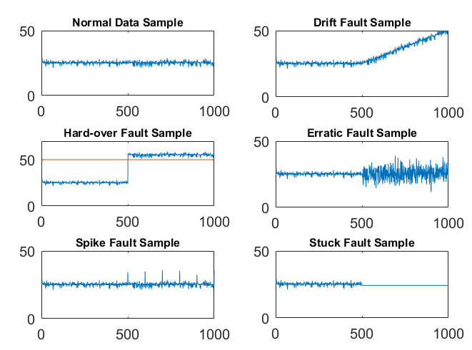
Sensor fault: types and mitigation
Cause of fault
  Material corrosion over time
  Physical damage
  Short circuits
  Calibration errors

Slide 4
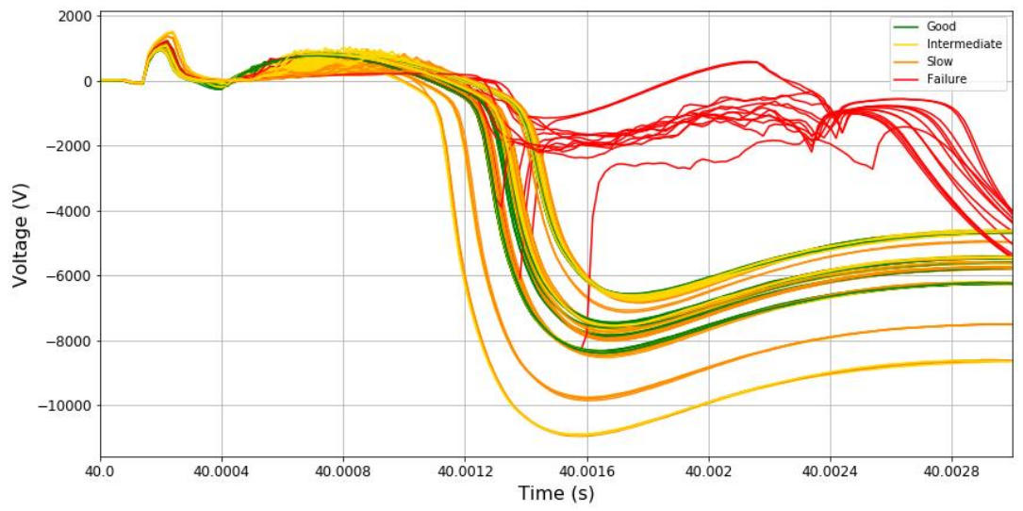
Sensor fault: types and mitigation
Circuit brakers of the Ohmic heating (OH) circuit in JET
Cause of fault
  Material corrosion over time
  Physical damage
  Short circuits
  Calibration errors
After
installation
Switch lifetime
End of life

Slide 5
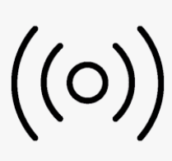
Sensor fault: types and mitigation
Avoid/control fault
  Sensor maintenance
    Reactive
    Preventive
    Predictive
  Data augmentation
  Estimate the faulty data based on available data
  Robust ML model
    Sparse networks
    Drop-out training
  Adaptive ML model
Sensors
Data
Neural Net.

Slide 6
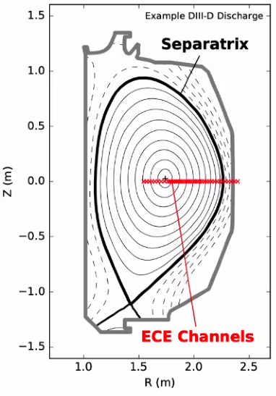
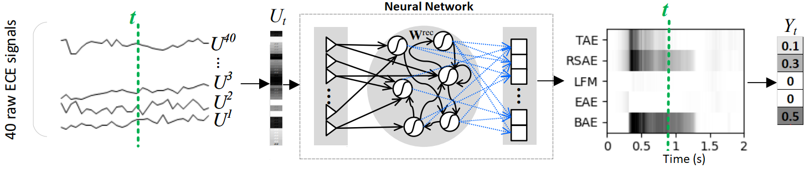
NN-based AE detector:
Detecting Alfvén Eigenmode Using ECE
Jalalvand et al 2022 Nucl. Fusion 62 026007
Input: 40 raw ECE signals (No preprocessing!)
Output: Score of five AE modes (LFM, BAE, EAE, RSAE, TAE) per time step
ML model: Reservoir Computing Network (RCN)
Notes:
“Model A” is supplied with RAW ece signals as they are collected from the sensors; no preprocessing, no cut-off, no denoising
The output of the model is “probability” of each AE mode at time t

Slide 7
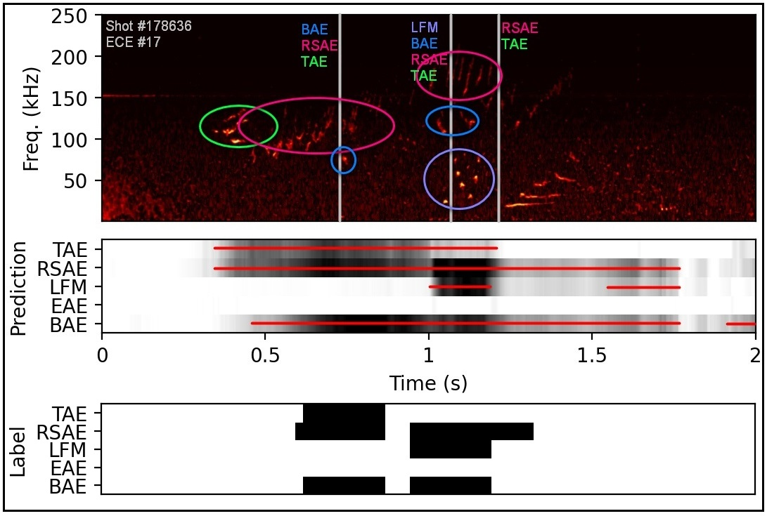
NN-based AE detector:
Detecting Alfvén Eigenmode Using ECE
Jalalvand et al 2022 Nucl. Fusion 62 026007
True Positive Rate: %91
False Positive Rate: %7
Notes:
Top: example of an ECE spectrogram just to show to the AE patterns to audience
Middle: The model’s output
Bottom: The rough labels used to train the model

Slide 8
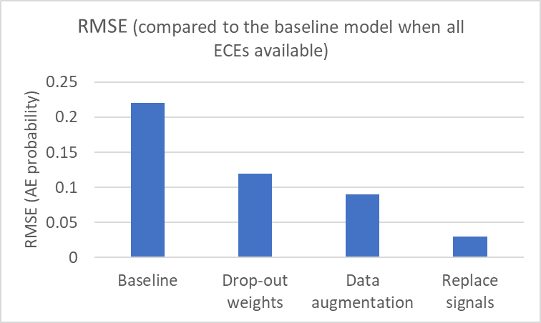
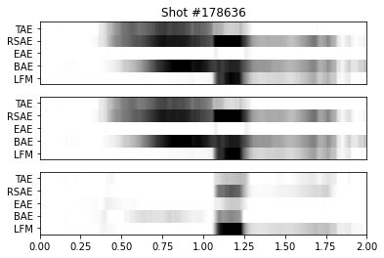
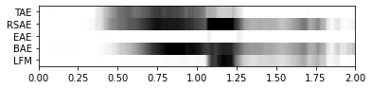
NN-based AE detector:
Robustness of the Models in Case of ECE Sensor Failure
What if an ECE signal drops?
The impact depends on the relative location of AE modes and the defective prob
Mitigation: Replace the lost ECE with the neighboring signals
Zero out ECE#17
(Replaced by ECE#16)
Zero out ECE#1
Zero out ECE#17
Notes:
To study the robustness, we zero out ECE signals and study how it influences the model’s output
For model A, the impact highly depends on which ECE signal is zerod out. Since most AE modes occur around core and middle, removing ECE#1 (near the core) does not change the output
But removing a middle ECE (e.g #17) highly influences the output
Mitigation: We can replace the corrupted signal witht the neighboring signals. The result is promising

Slide 9
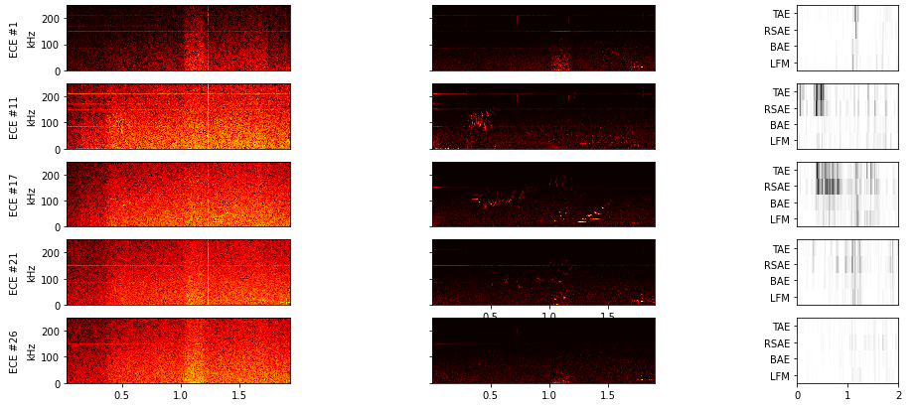
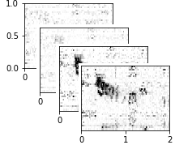
Kaptanoglu et. al., 2022
Nucl. Fusion (Accepted)
NN-based AE localizer:
Detecting and Locating Alfvén Eigenmode Using ECE
Input: Spectrogram of each ECE channel
Output: Probability of AE modes per ECE per time step
LFM
BAE
⍴
RSAE
TAE
Spectrogram Enhancement
RCN
Time (s)
Time (s)
Time (s)
Time (s)
Notes:
Model B is trained with each ECE spectrogram individually
By processing each ECE at each time step, the model provides the probability of AE modes in time and space

Slide 10
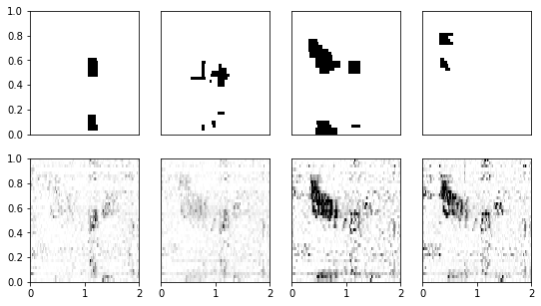
Kaptanoglu et. al., 2022
Nucl. Fusion (Accepted)
NN-based AE localizer:
Detecting and Locating Alfvén Eigenmode Using ECE
DIII-D discharge #178636
LFM BAE RSAE TAE
Label:
⍴
Ouput:
⍴
Time (s)
Time (s)
Time (s)
Time (s)

Slide 11
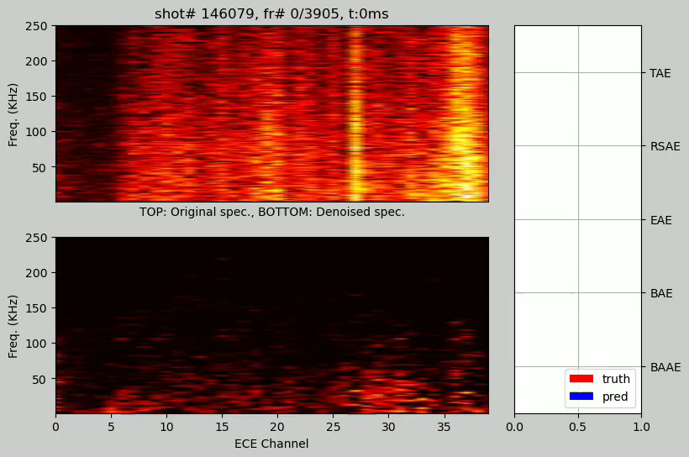
NN-based AE localizer:
Detecting and Locating Alfvén Eigenmode Using ECE
ECE spectrogram analysis
Edge → Core
Freq.
Position (ECE#)
Time

Slide 12
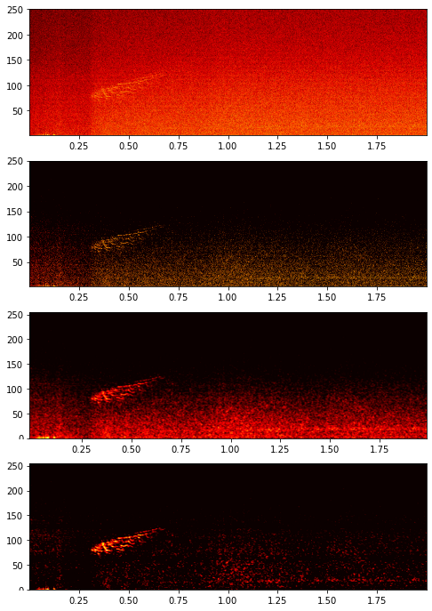
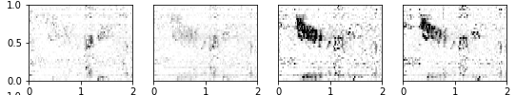
NN-based AE localizer:
Robustness of the Models in Case of ECE Sensor Failure
What if an ECE signal drops?
ECE spectrogram
(Enhanced)
RCN
AE mode probability
ECE spectrogram
ECE signal
Image enhancement
LFM BAE RSAE TAE
Every lost ECE signal results in a zero line in the probability space
Zero out
ECE#17
⍴
Time (s)
Time (s)
Time (s)
Time (s)

Slide 13
J.T. Wai et. al., 2022
Nucl. Fusion (Accepted)
EQNET:
a neural net equilibrium reconstructor
Trained with NSTX-U data from most recent campaign
Maps magnetic diagnostics to flux surfaces or equilibrium shaping parameters

Slide 14
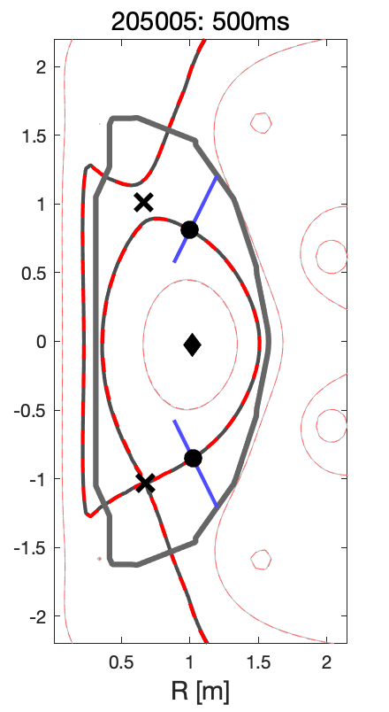

J.T. Wai et. al., 2022
Nucl. Fusion (Accepted)
EQNET:
Robust reconstruction needed for shape control
Shape controller relies on equilibrium reconstruction as input
standard tool is Real-Time EFIT (RTEFIT)
single iteration per equilibrium → less accurate than EFIT01
Neural nets also capable of performing this task within required time (<1ms)
Need robust real-time reconstruction to avoid control issues. E.g. wall collision and disruption

Slide 15
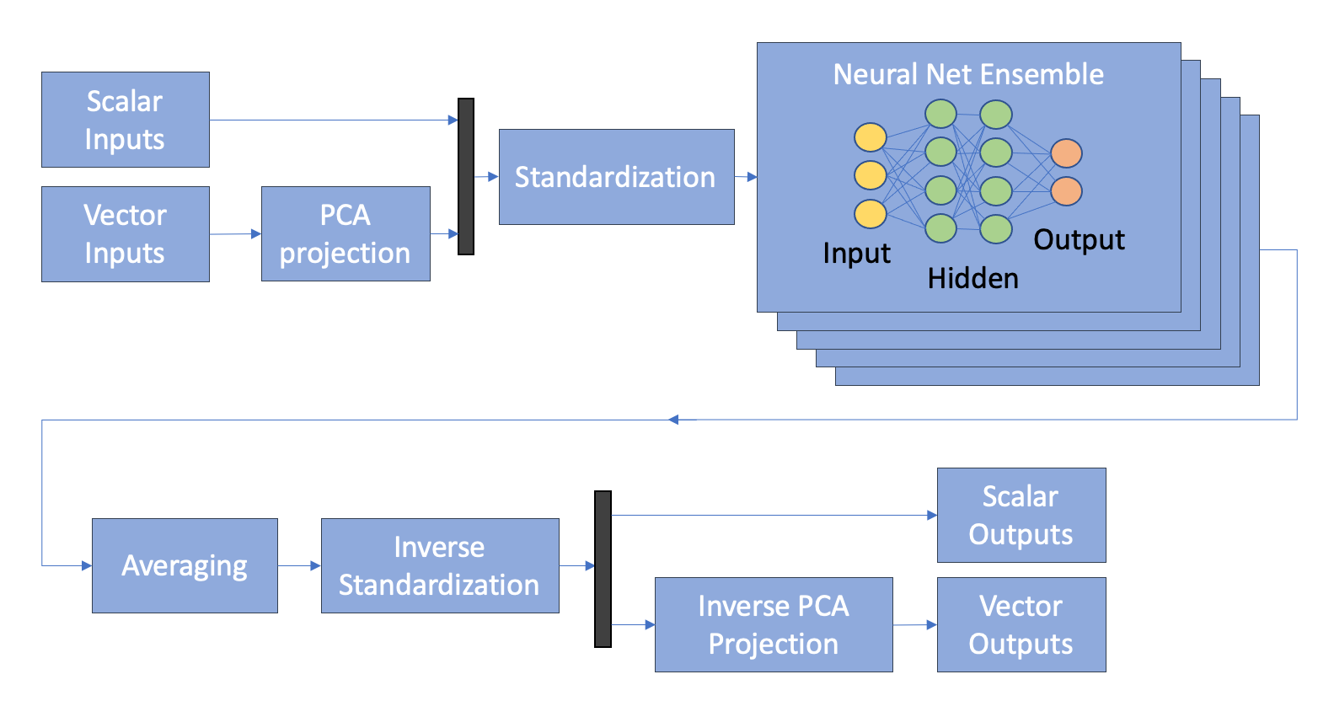
J.T. Wai et. al., 2022
Nucl. Fusion (Accepted)
EQNET:
The model is based on fully-connected network
Architecture based on fully-connected ANN with PCA data compression
220 shots = 25,000 equilibria from 2015-16 campaign
Use raw sensor data including bad and noisy data
Also add dropout (p=0.02) to magnetic sensor inputs

Slide 16
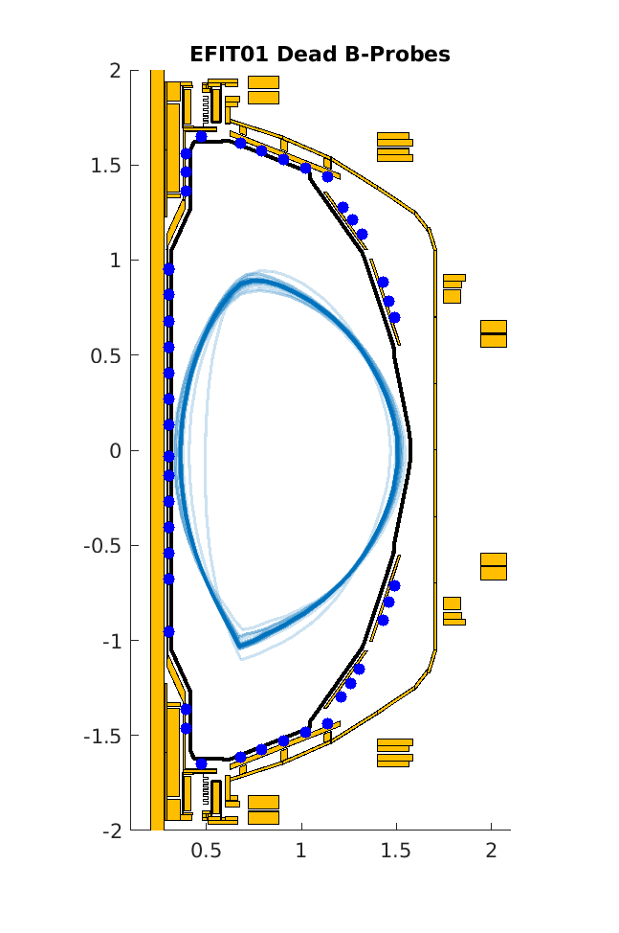
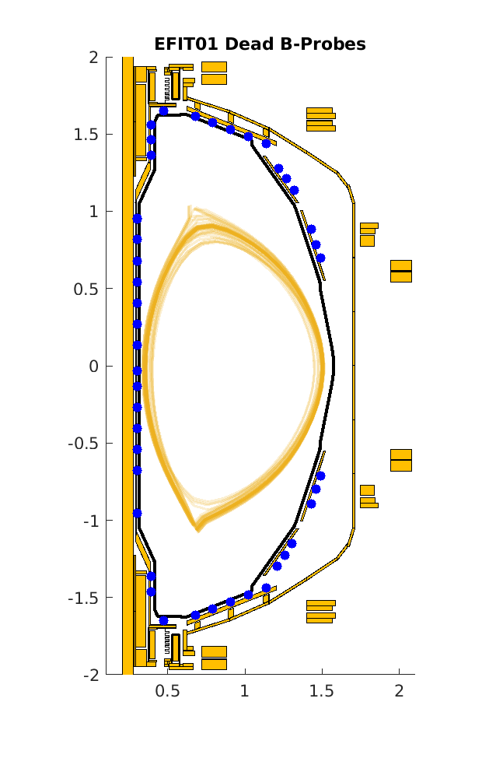
J.T. Wai et. al., 2022
Nucl. Fusion (Accepted)
EQNET:
Losing a sensor degrades prediction ~1cm
Boundary error increases by roughly 1.3cm, on par with RTEFIT
Degrades slightly more than EFIT01 degrades (0-1.1cm versus 0.5-1.85cm)
Losing specific sensors (upper) can cause upper-single-null prediction not seen with EFIT01.
EFIT01 Dead B-Probes
EQNET Dead B-Probes
205005 @ 500ms: effect of zeroing out each of the 75 B-probes

Slide 17
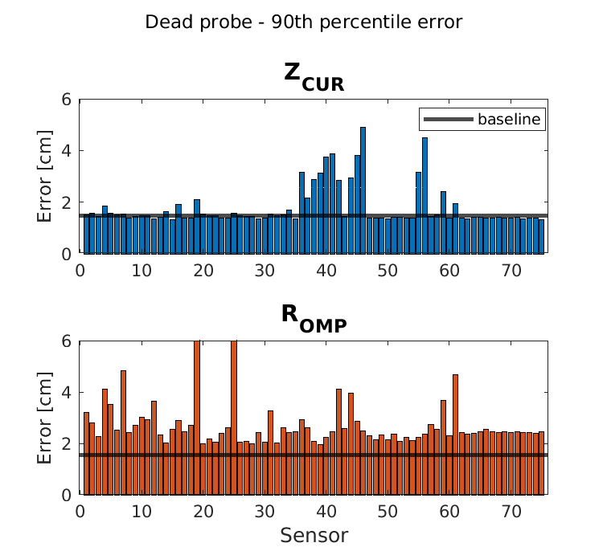
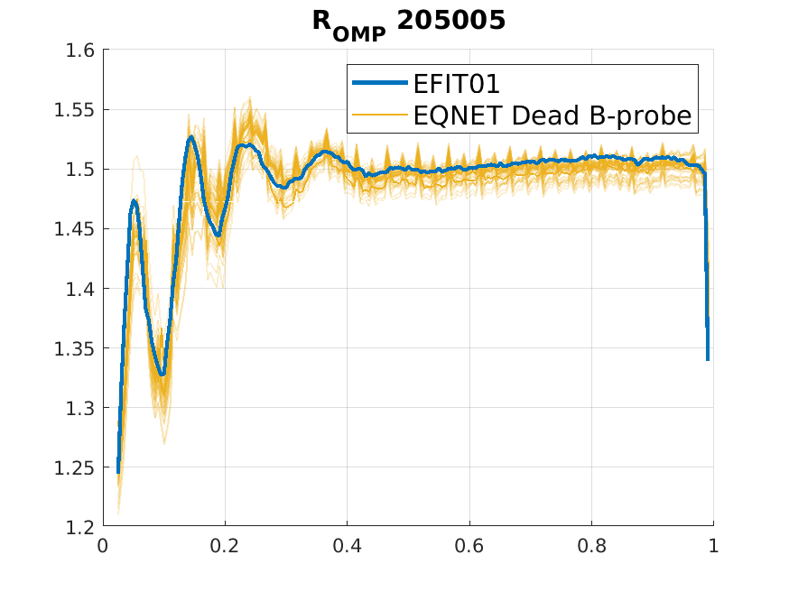
J.T. Wai et. al., 2022
Nucl. Fusion (Accepted)
EQNET:
Sensitivity is parameter and sensor-dependent
Parameter estimates are dependent on the sensor.
Z_{CUR} depends heavily on measurements from inner wall
R_{OMP} is one of the most sensitive, affected by most sensors and especially outer midplane/inner midplane

Slide 18
Conclusions and next steps
Training RCN with ECE signals is a robust approach for detecting Alfven Eignemodes
Losing an ECE signal causes manageable degradation in detection
The degradation depends on the relative location of AE mode and the lost ECE sensor
Next Steps
  Study predictive maintenance on DIII-D sensors
  Predicting and manipulating AE modes using ML approaches

Slide 19
Thank you!

Slide 20
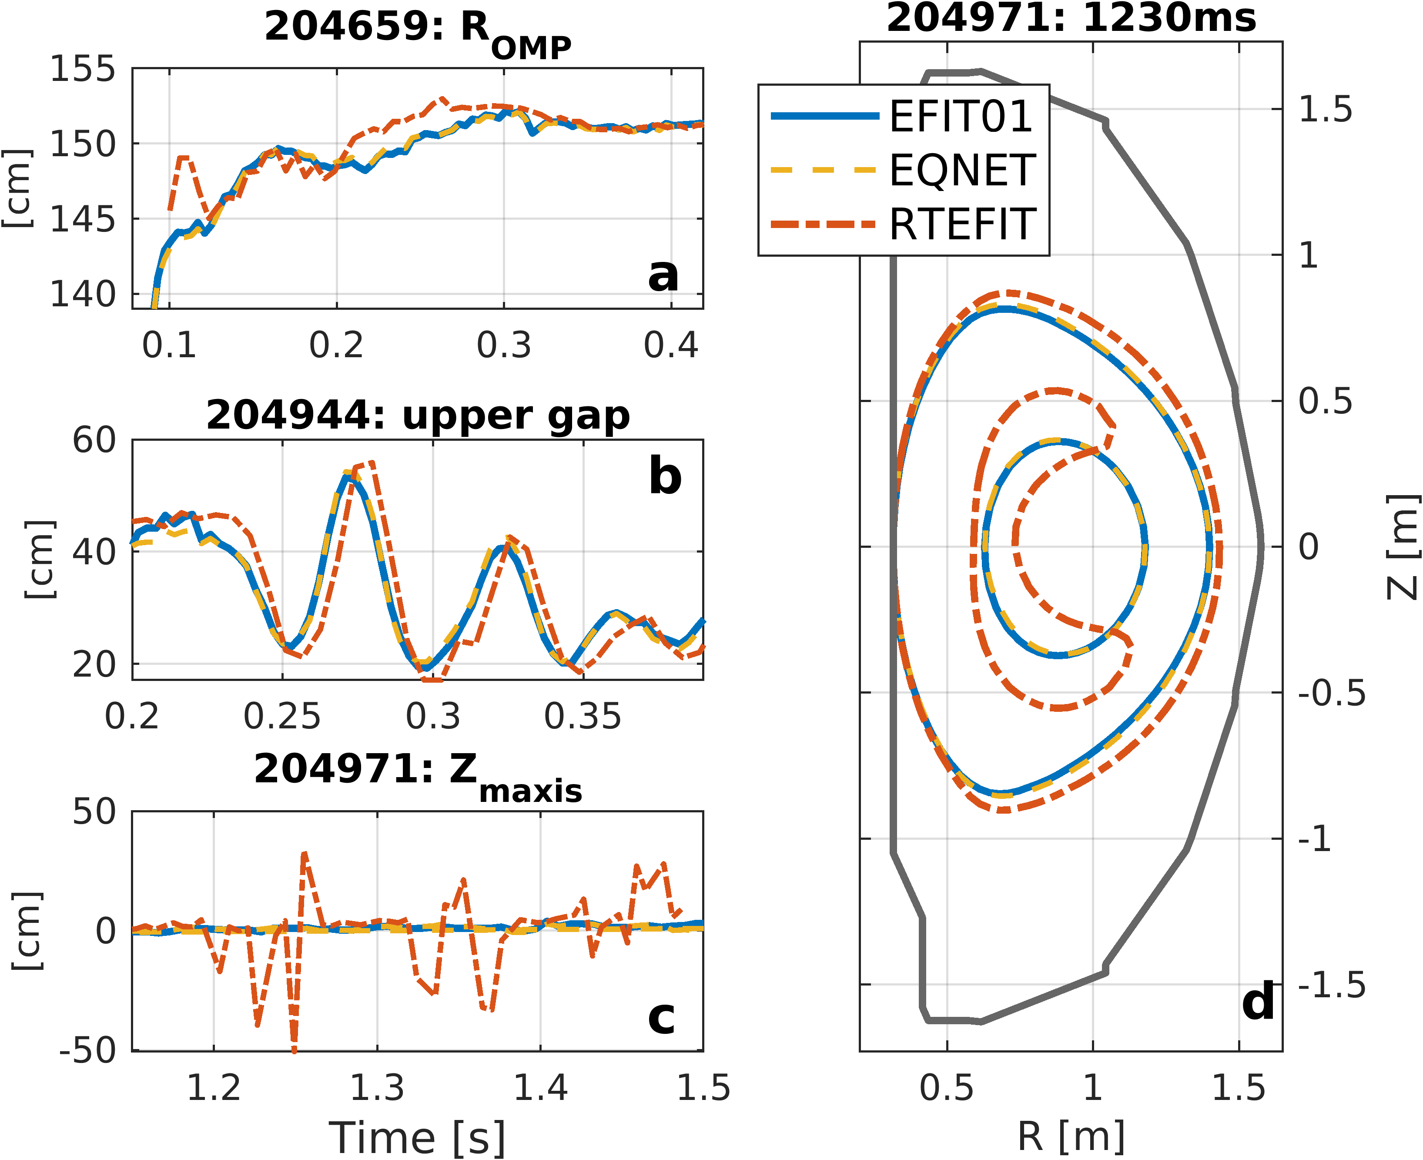
Eqnet compensates for dynamic changes and vessel currents
Plasma motion (limited→diverted) induces strong vessel currents
Neural net responds better to dynamic changes and induced vessel currents than online method
Removes 5ms phase delay during oscillations – improves controller chance for recovery
Does not suffer from convergence-related issues since NN is non-iterative
Notes:
Potential talking points:
Figure A: rtefit error from 0.2-0.25 is plasma motion (limited→ diverted) inducing vessel currents
Figure B: plasma is experiencing strong oscillations and motion which induces vessel currents. Eqnet compensates for these better, RTEFIT is 5ms phase-delayed
Figure C and D: RTEFIT errors due to lack of convergence (plasma was moving a lot)
If people get upset that RTEFIT errors look unrealistically big (figure C and D):
- This is a cherry-picked bad example of RTEFIT due to lack of convergence
- the internal measurements like Zmaxis are much worse than boundary measurements which is what the shape controller actually uses (the 50cm Zmaxis error only has a few cm boundary error)

Slide 21
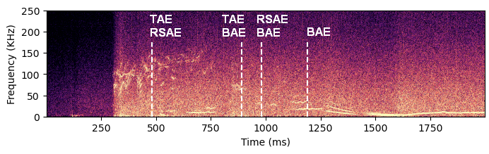
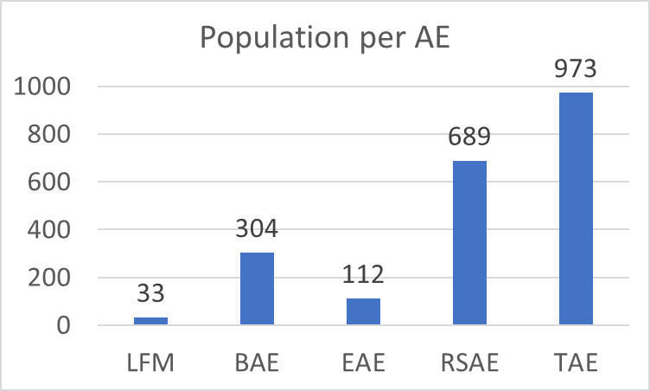
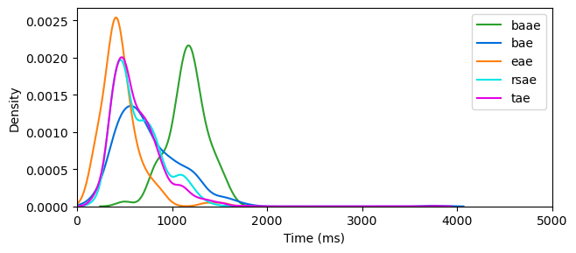
Alfvén Eigenmode Dataset
Shot 170670 - ECE15
AE labels for 1069 DIII-D shots
919 shots after removing uncertain labels
5 AE modes (BAAE/LFM, BAE, EAE, RSAE, TAE)
EAE
RSAE
TAE
BAE
LFM (BAAE)
Distribution of occurrences
over time
Notes:
Top right: Example of the imperfect labels we deal with; The timing of the AE modes are only roughly determined
Bottom left: Data is highly imbalanced

Slide 22
Enhancing spectrogram
Image processing techniques to enhance the spectrogram
Quantile-0.9 threshold
(per time step)
Step (1)
Freq. (KHz)
Original image
Gaussian blur filter
(window of 31x3)
Step (2)
Freq. (KHz)
Freq. (KHz)
Time (s)
Remove mean
(per frequency channel)
Step (3)
Freq. (KHz)
Time (s)

Slide 23
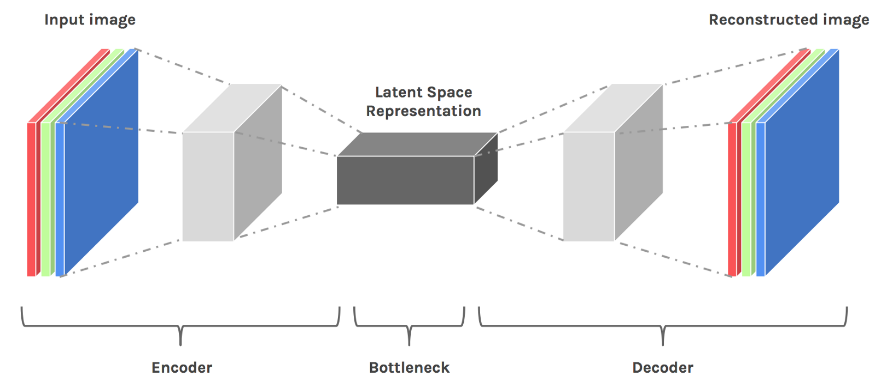
Original spectrogram
Autoencoder
Enhanced spectrogram

Slide 24
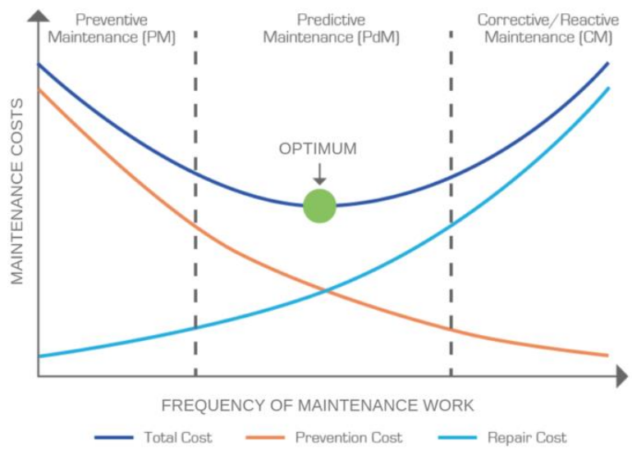

Slide 25
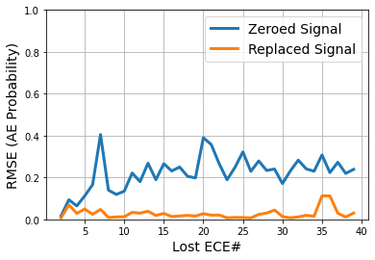
Robustness of the Models in Case of ECE Sensor Failure
Model A
What if an ECE signal drops?
Baseline
Zero out
ECE#1
The impact depends on the relative location of AE modes and the defective prob
Zero out
ECE#17
Mitigation: Replace the lost ECE with the neighboring signals
Zero out
ECE#17
(Replaced
by ECE#16)
Average RMSE = 0.22
Average RMSE = 0.03
Notes:
To study the robustness, we zero out ECE signals and study how it influences the model’s output
For model A, the impact highly depends on which ECE signal is zerod out. Since most AE modes occur around core and middle, removing ECE#1 (near the core) does not change the output
But removing a middle ECE (e.g #17) highly influences the output
Mitigation: We can replace the corrupted signal witht the neighboring signals. The result is promising

Slide 26
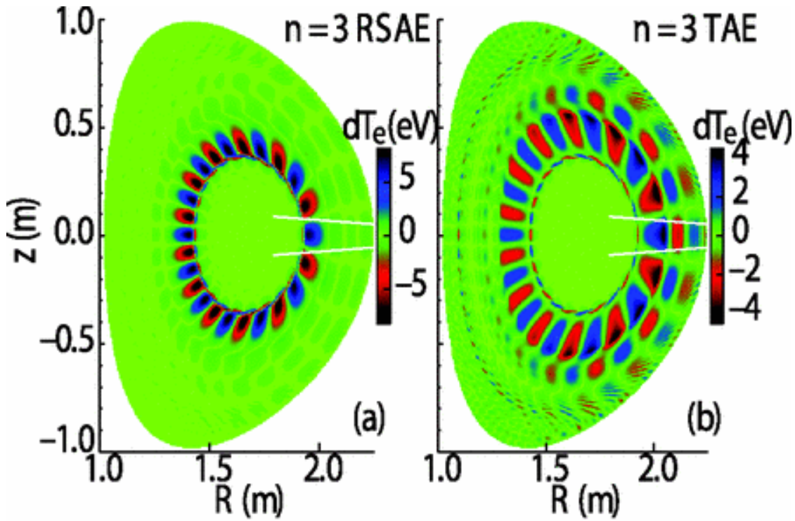
Use case 2: Alfvén Eigenmode Instabilities in DIII-D
US DOE Project:
  Machine Learning for Real-time Fusion Plasma Behavior Prediction and Manipulation (DE-SC0021275)
Tasks
  Detect/classify Alfvén eigenmode (AE)
  Detect the location and shape of AE in plasma
  Predict and control AE
Data
  40 ECE signals as inputs (ECEs provide spatial information)
  In progress: multi-diagnostic inputs
    ECE + BES + Interferometry + Magnetics

