Slide 1

Characterization of the ASDEX Upgrade shattered pellet injector
Paul Heinrich¹, G. Papp¹, M. Dibon¹, P. de Marné¹, T. Peherstorfer², S. Jachmich³,
M. Lehnen³, A. Bock¹ and the ASDEX Upgrade Team
¹Max Planck Institute for Plasma Physics, Garching, Germany
²Institute for Applied Physics, TU Wien, Austria
³ITER Organization, Saint-Paul-Lez-Durance, France

Slide 2
Outline
Motivation
How does the ASDEX Upgrade SPI system work?
What is special about the ASDEX Upgrade SPI?
Controlling pellet speed and successful pellet release
Differences between the different shatter heads
Preliminary results of the AUG SPI experiments
Summary

Slide 3
Motivation behind SPI experiments at ASDEX Upgrade
ITER DMS is based on the shattered pellet injection (SPI) technology¹
Soon final design decisions have to be made e.g. the shatter angle
Desire of a highly flexible system to study effects of different fragment distributions on disruptions
¹S. Jachmich 2nd IAEA TM Disruptions
Courtesy ITER DMS Team

Slide 4

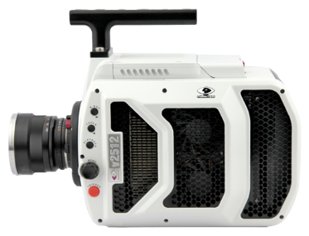


How does the ASDEX Upgrade SPI system work?
~ 3.5 m

Slide 5

How does the ASDEX Upgrade SPI system work?
~ 3.5 m

Slide 6
How does the ASDEX Upgrade SPI system work?
~ 3.5 m

Slide 7

























How does the ASDEX Upgrade SPI system work?
~ 3.5 m

Slide 8
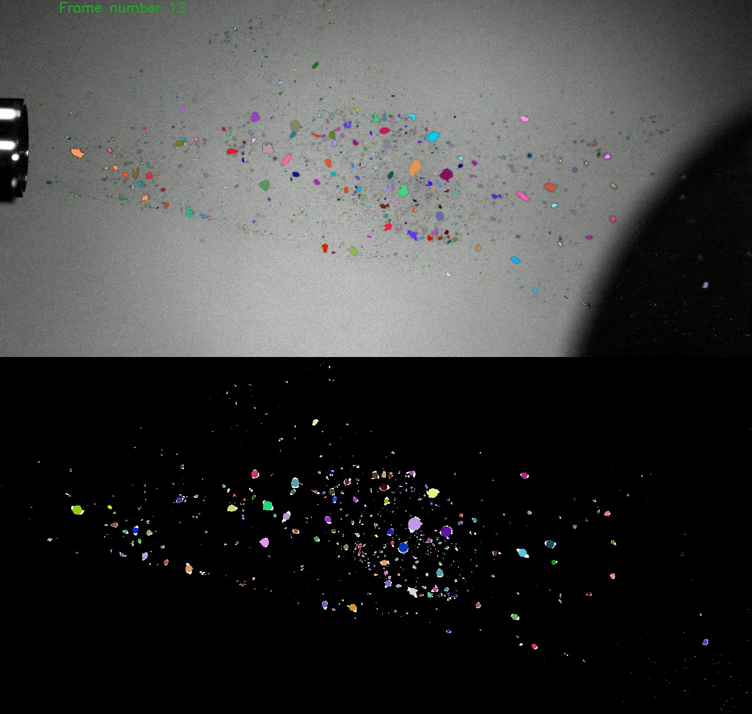
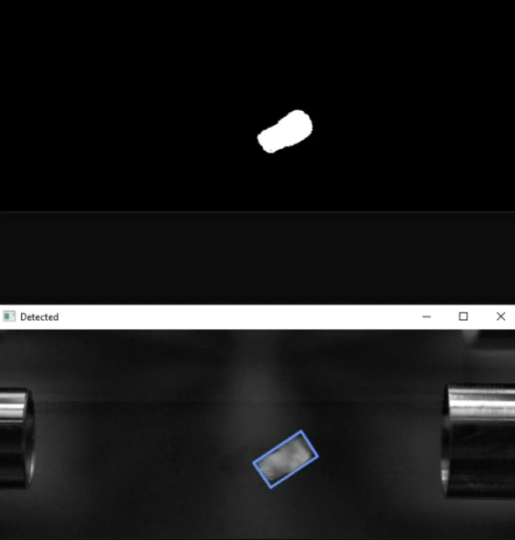
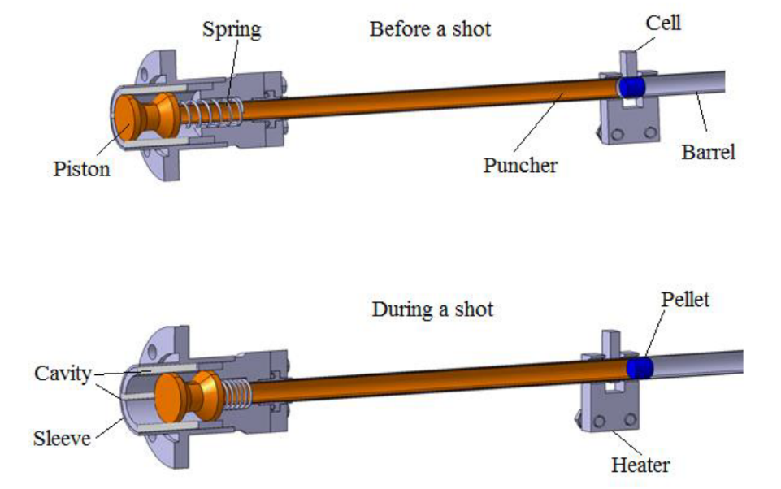
How does the ASDEX Upgrade SPI system work?
~ 3.5 m
fragment tracking after background substraction

Slide 9
What is special about the SPI system in AUG?
Different shatter head geometries
12.5°, 15°, 25° and 30° angles
Pellet speeds between
70 - 800 m/s
(top view)
~ 3.5 m

Slide 10
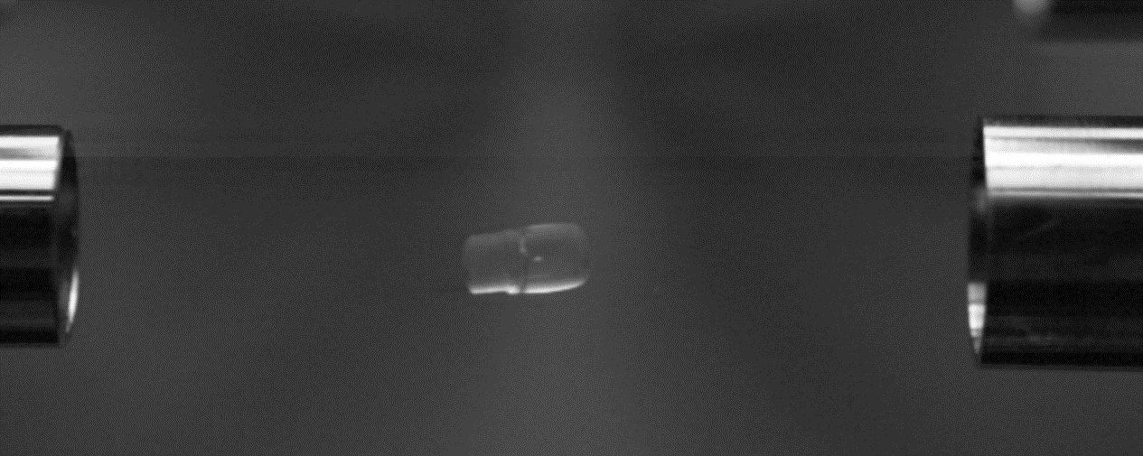
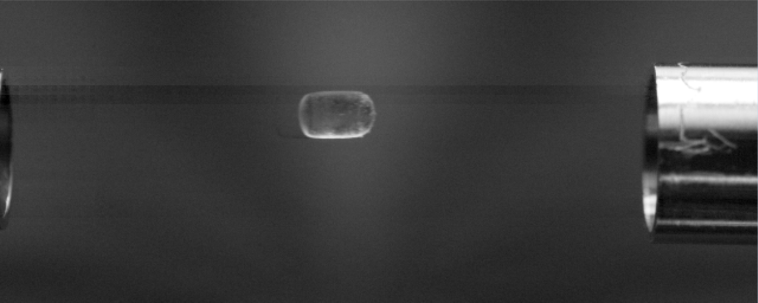
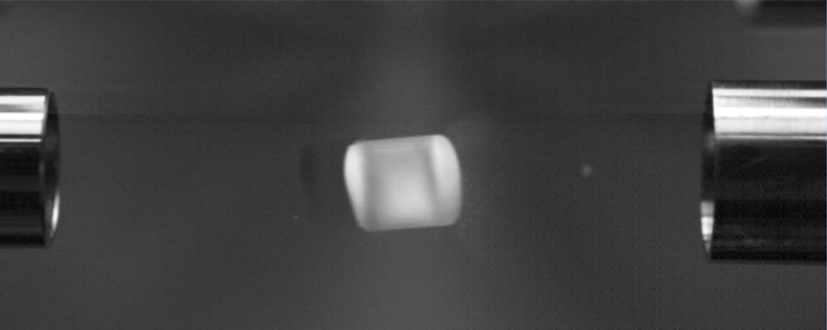
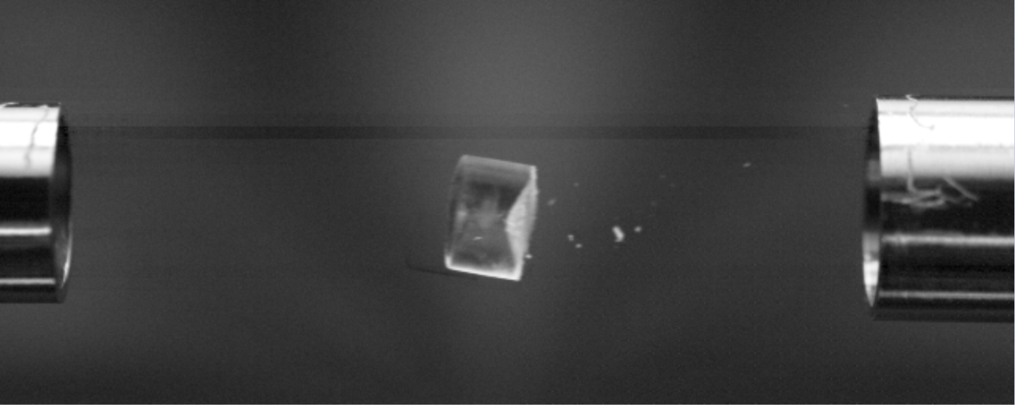
Examples for typical pellets after launch
#385 100% Ne
#1433 100% D₂
#938 10% Ne
#1199 100% D₂
flight direction

Slide 11
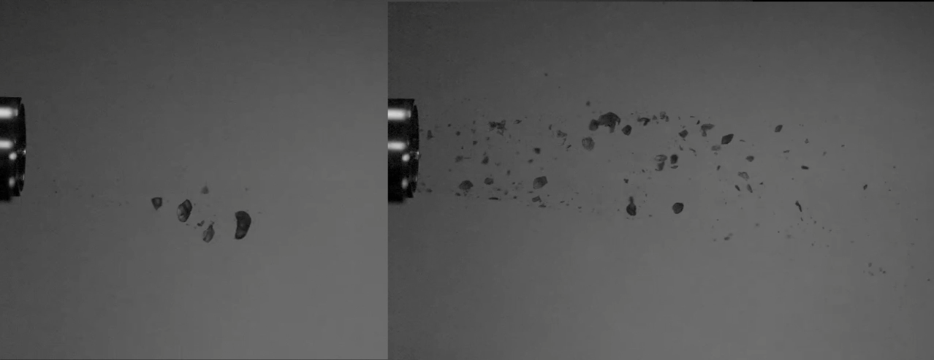
Effect of pellet speed on fragment distributions
~105 m/s
Both 100% neon pellets fired into a circular, long and 25° shatterhead
~150 m/s
#565
#563

Slide 12
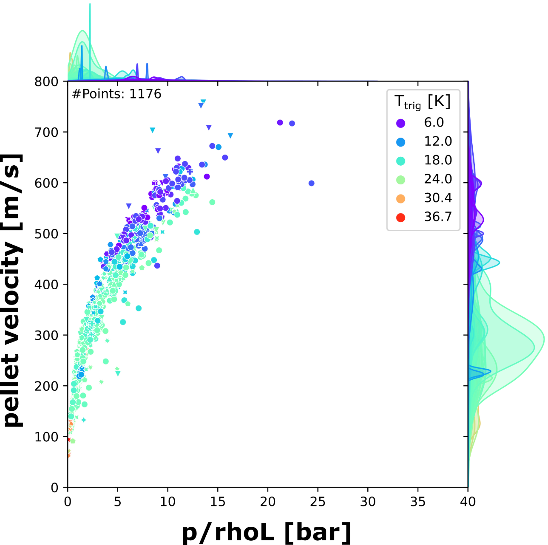
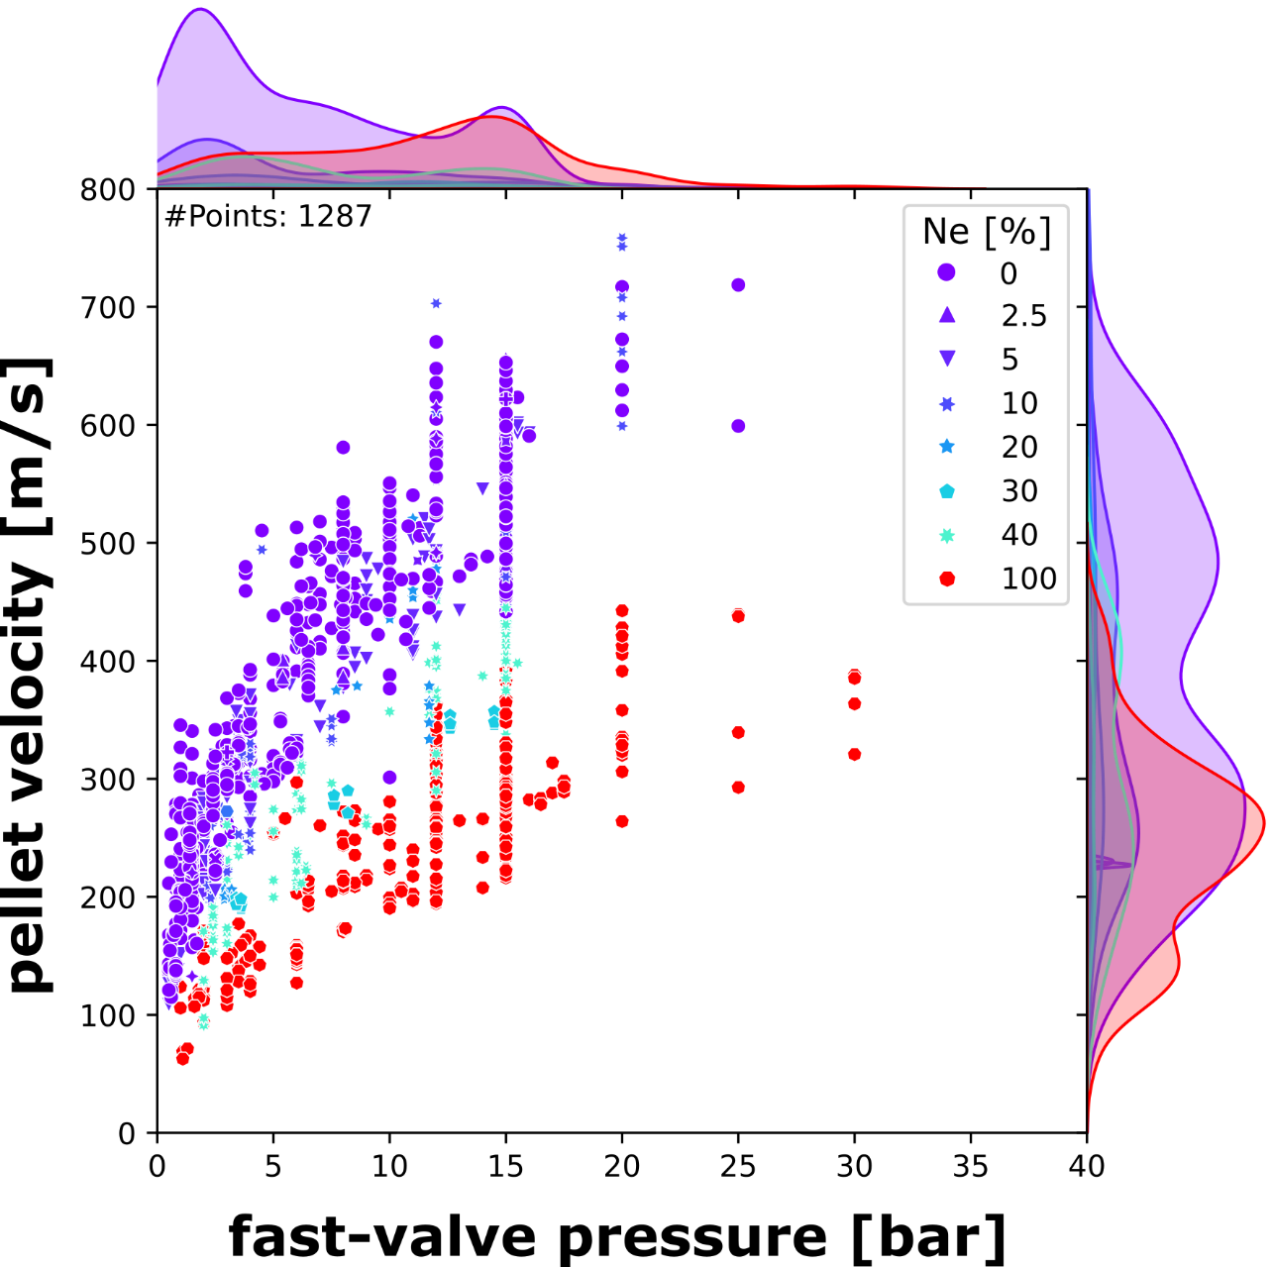
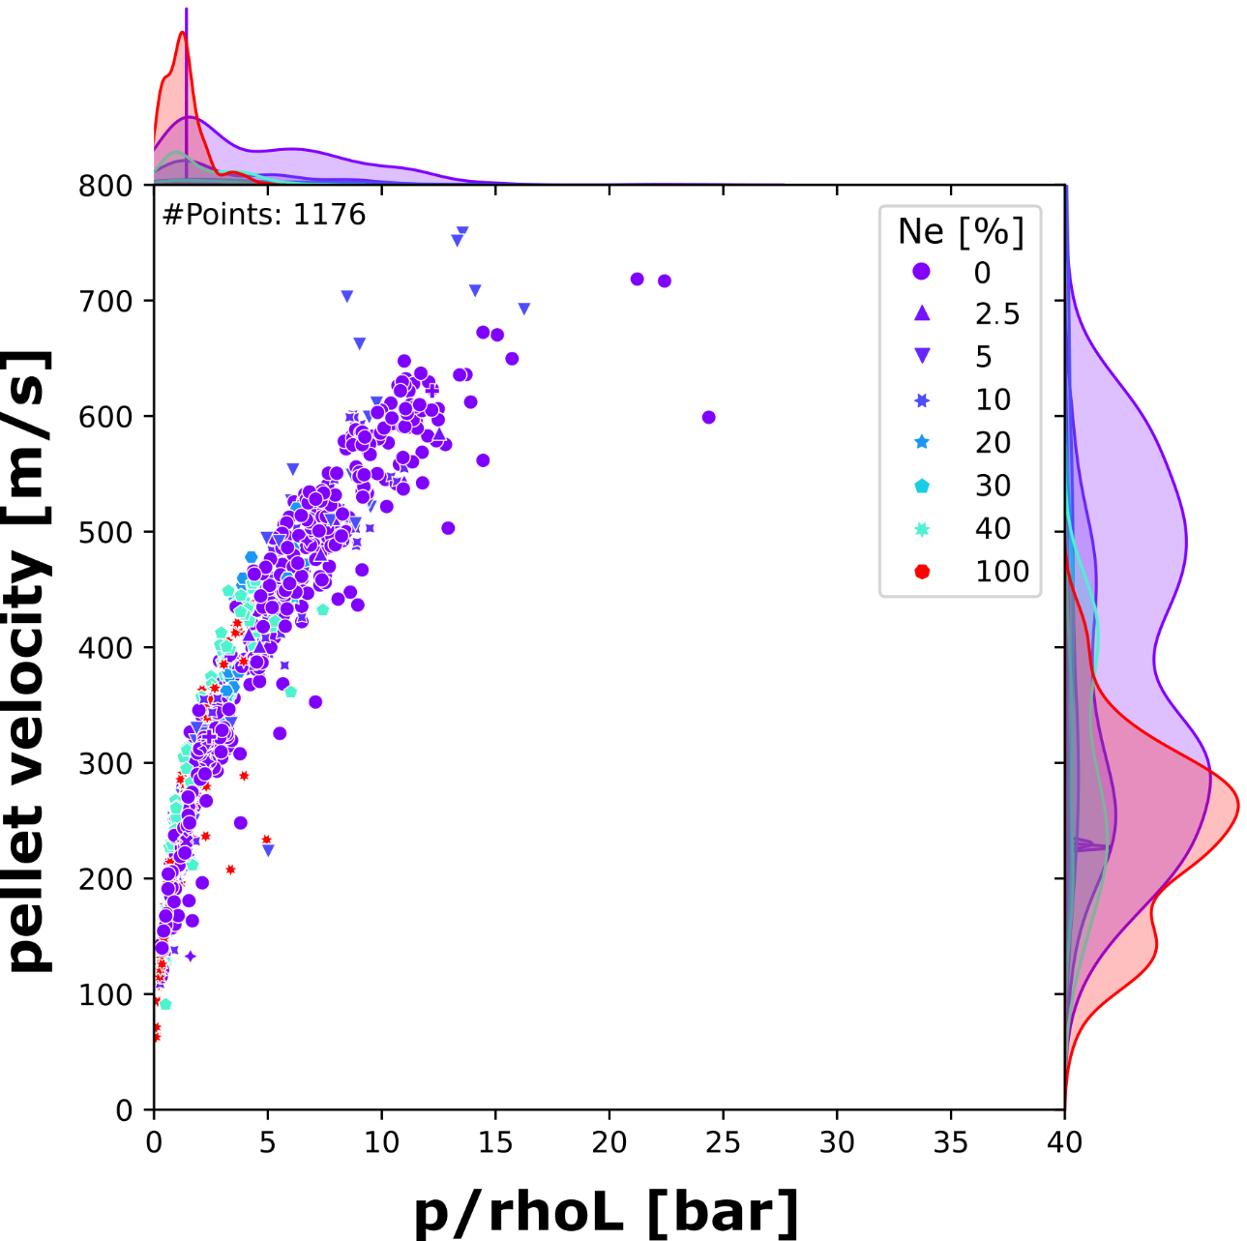

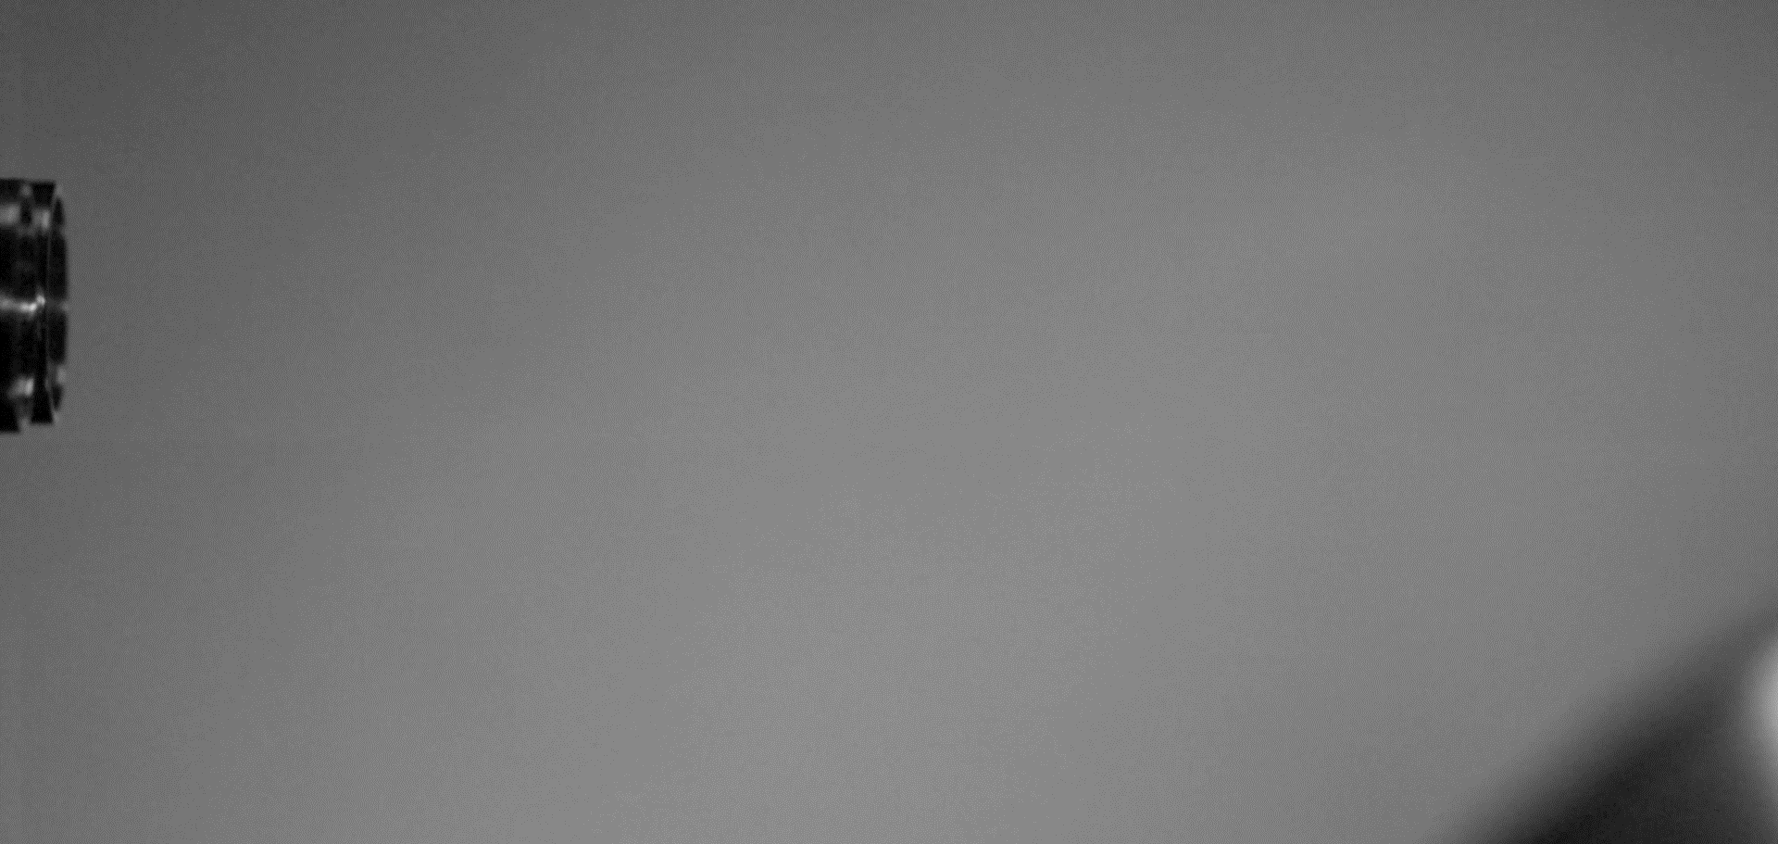
Controlling the pellet speed
#822 – 8mm 100% D2 ~ 500 m/s – 25° long rect
#238 – 4mm 100% Ne – 119 m/s – 15° long circ

Slide 13
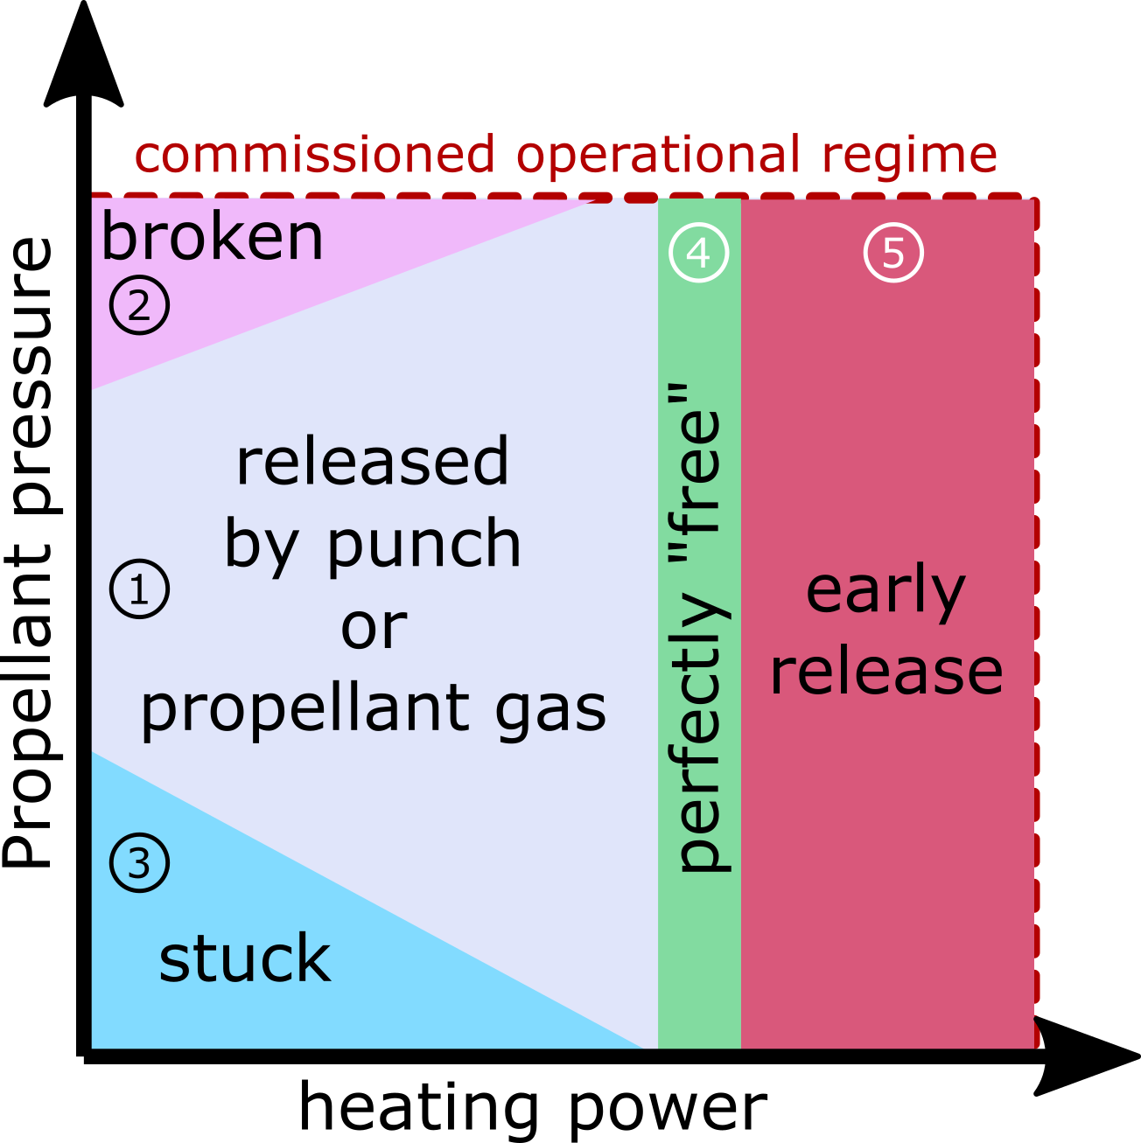
Pellet launching
Pellet release depends on
Pellet diameter (e.g. 4mm, 8mm)
Pellet material (D₂-Ne-mixture)
Propellant pressure pellet velocity
Which barrel is in use
Heating recipe applied to the other GTs
Tightness of the copper connection
State of the 200W integrity camera lamp

Slide 14
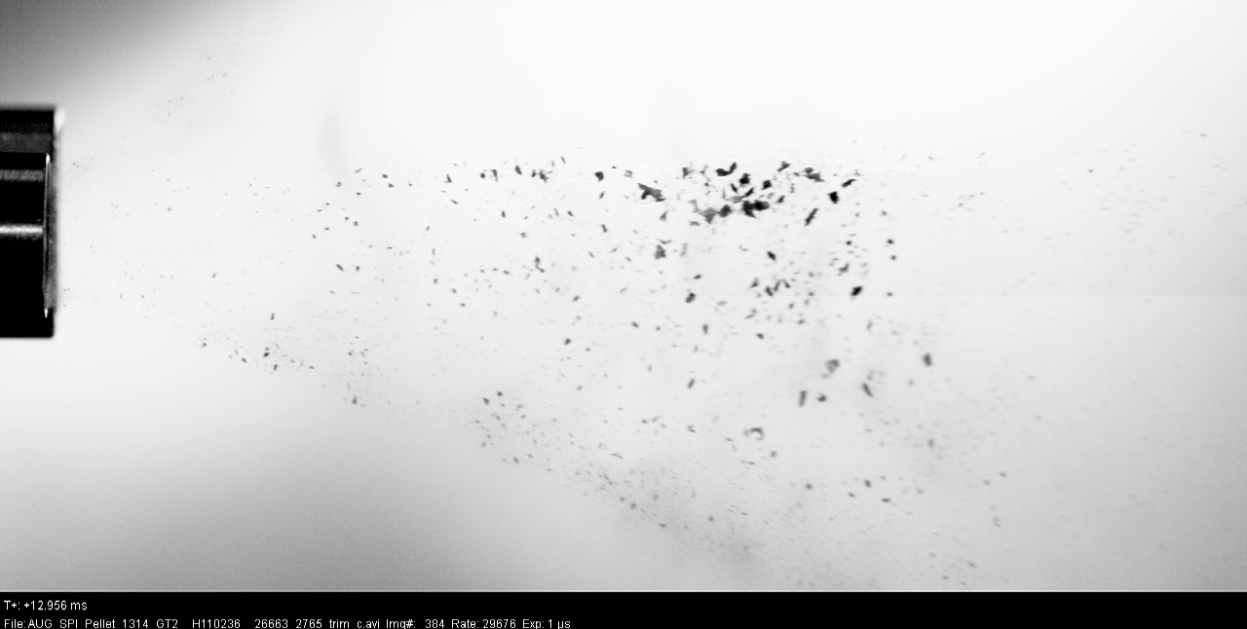
The circular, short, 25° shatter tube
pellet speed ~560 m/s

Slide 15
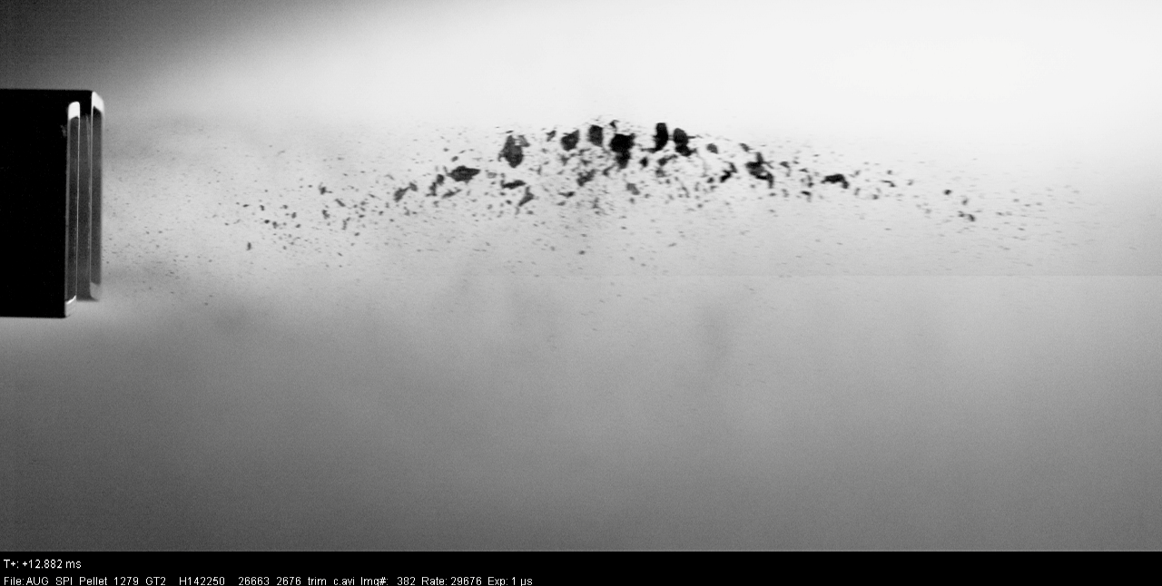
The rectangular, long, 12.5° shatter tube
pellet speed ~570 m/s

Slide 16
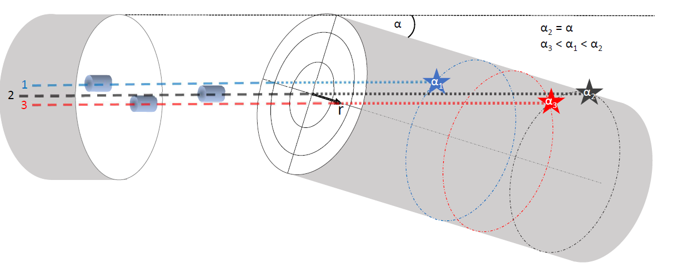

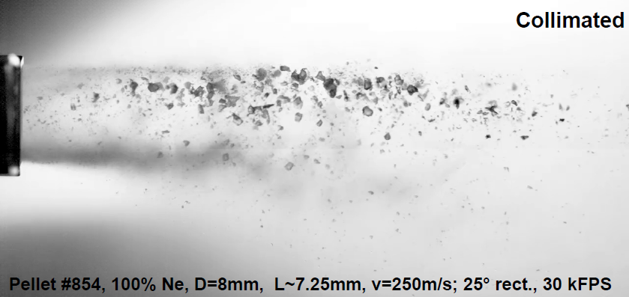

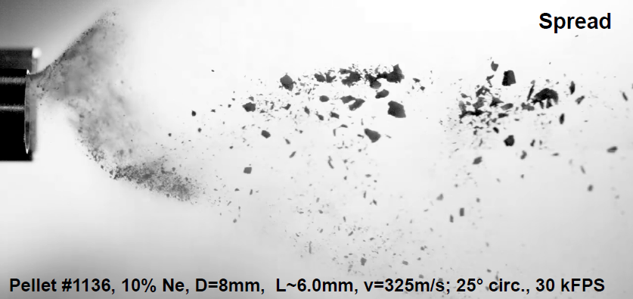
Rectangular vs circular shatter head
rectangular 25°
circular 25°

Slide 17
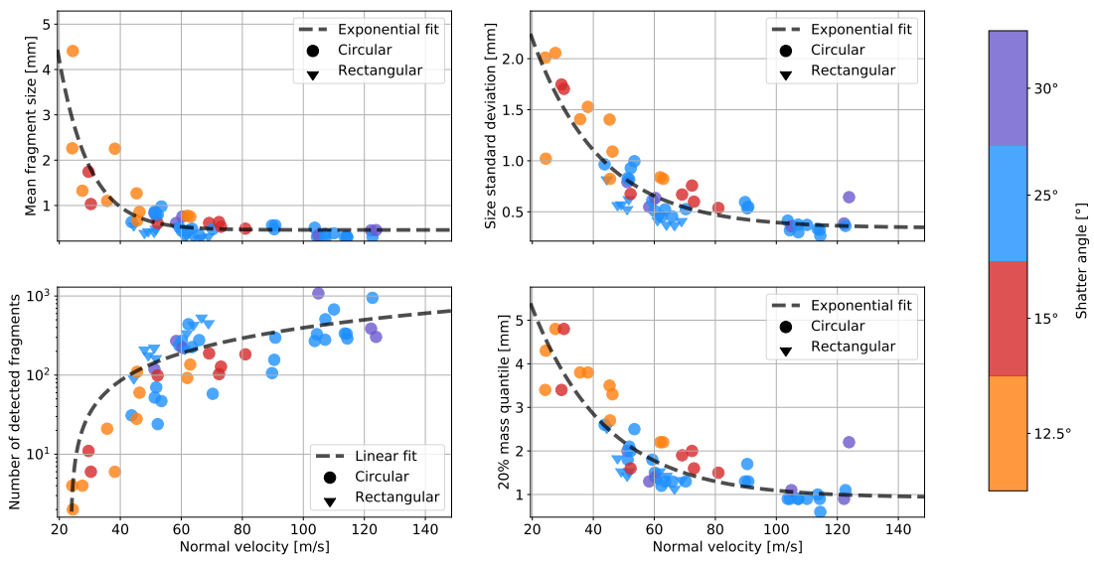
Experimental trends from shatter video analysis (4mm)
100% Neon pellets
Experimental results
T. Peherstorfer, 2022 REM meeting

Slide 18
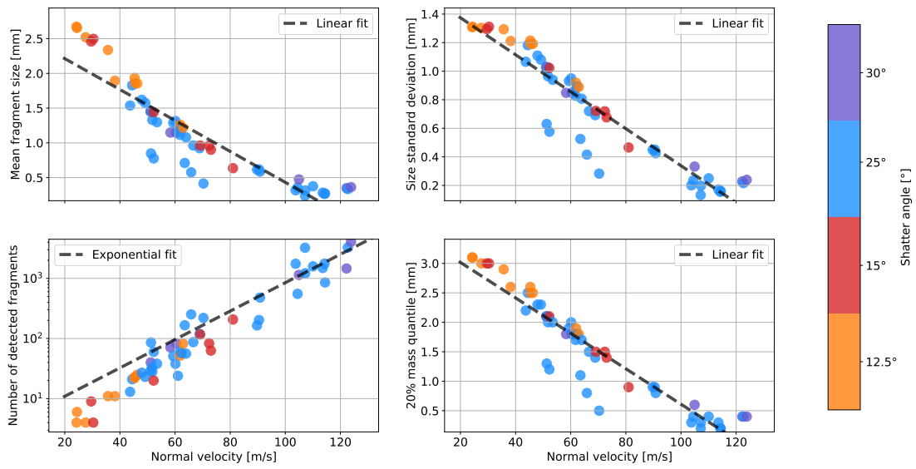
Trends extracted from statistical shatter formula¹ (4mm)
100% Neon pellets
Significantly different scaling from laboratory observation
¹Parks, 2016 General Atomics (technical report):
https://doi.org/10.2172/1344852

Slide 19
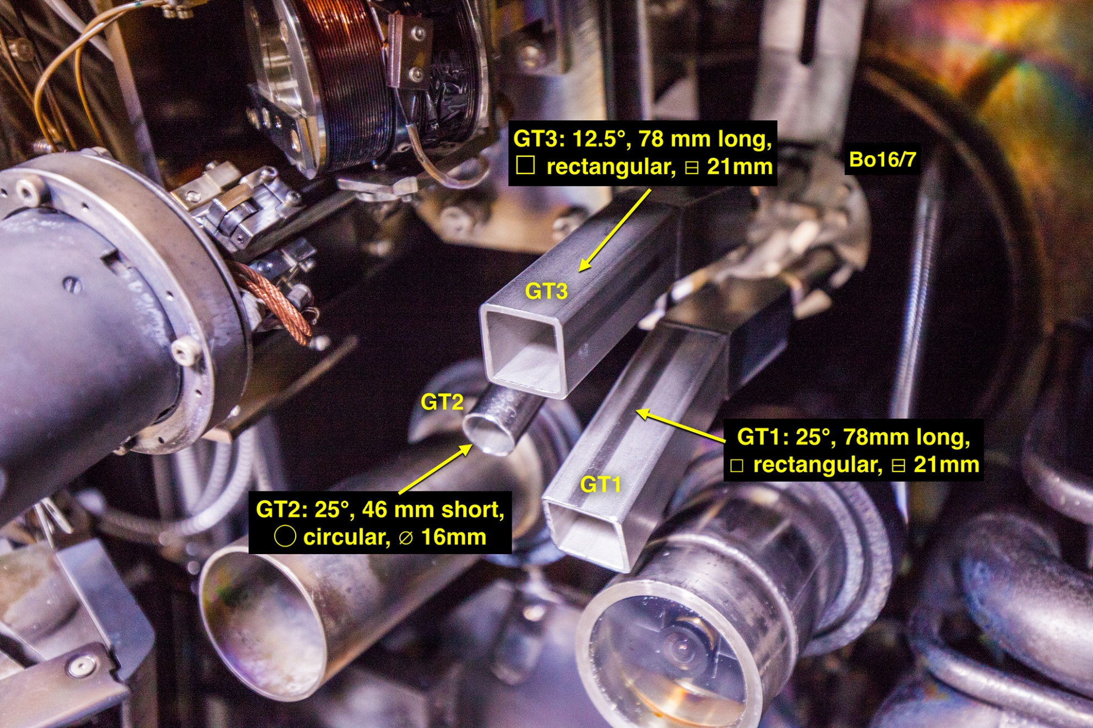
Current setup in ASDEX Upgrade

Slide 20

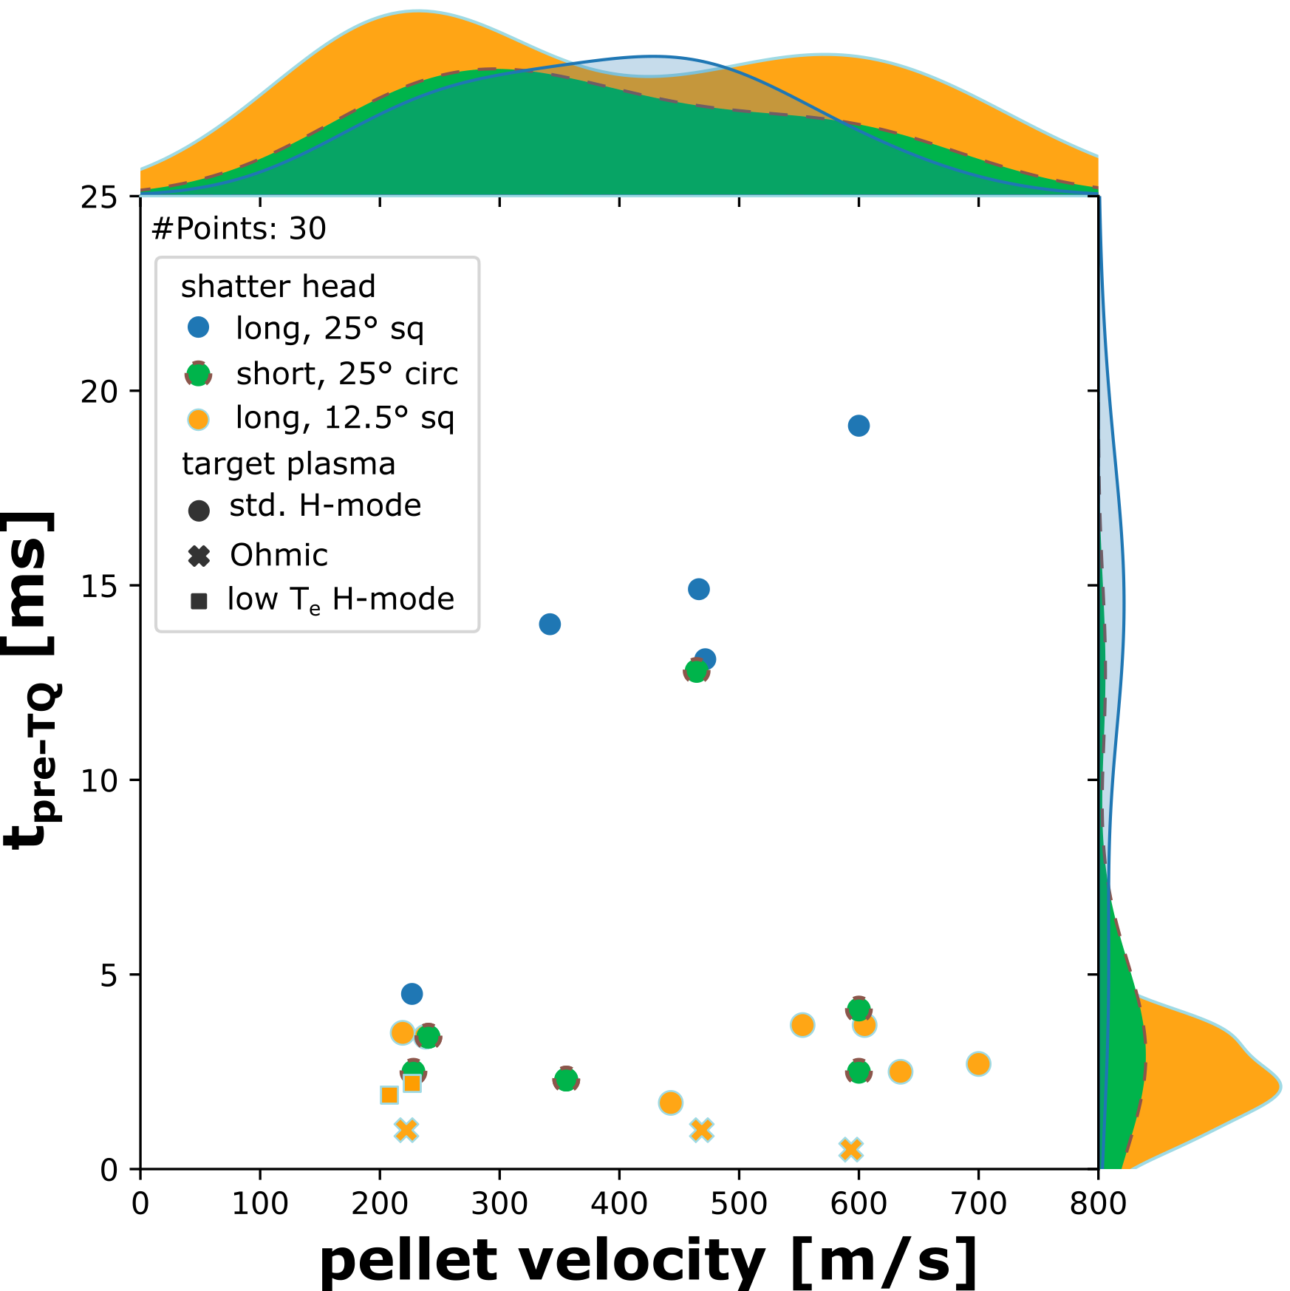
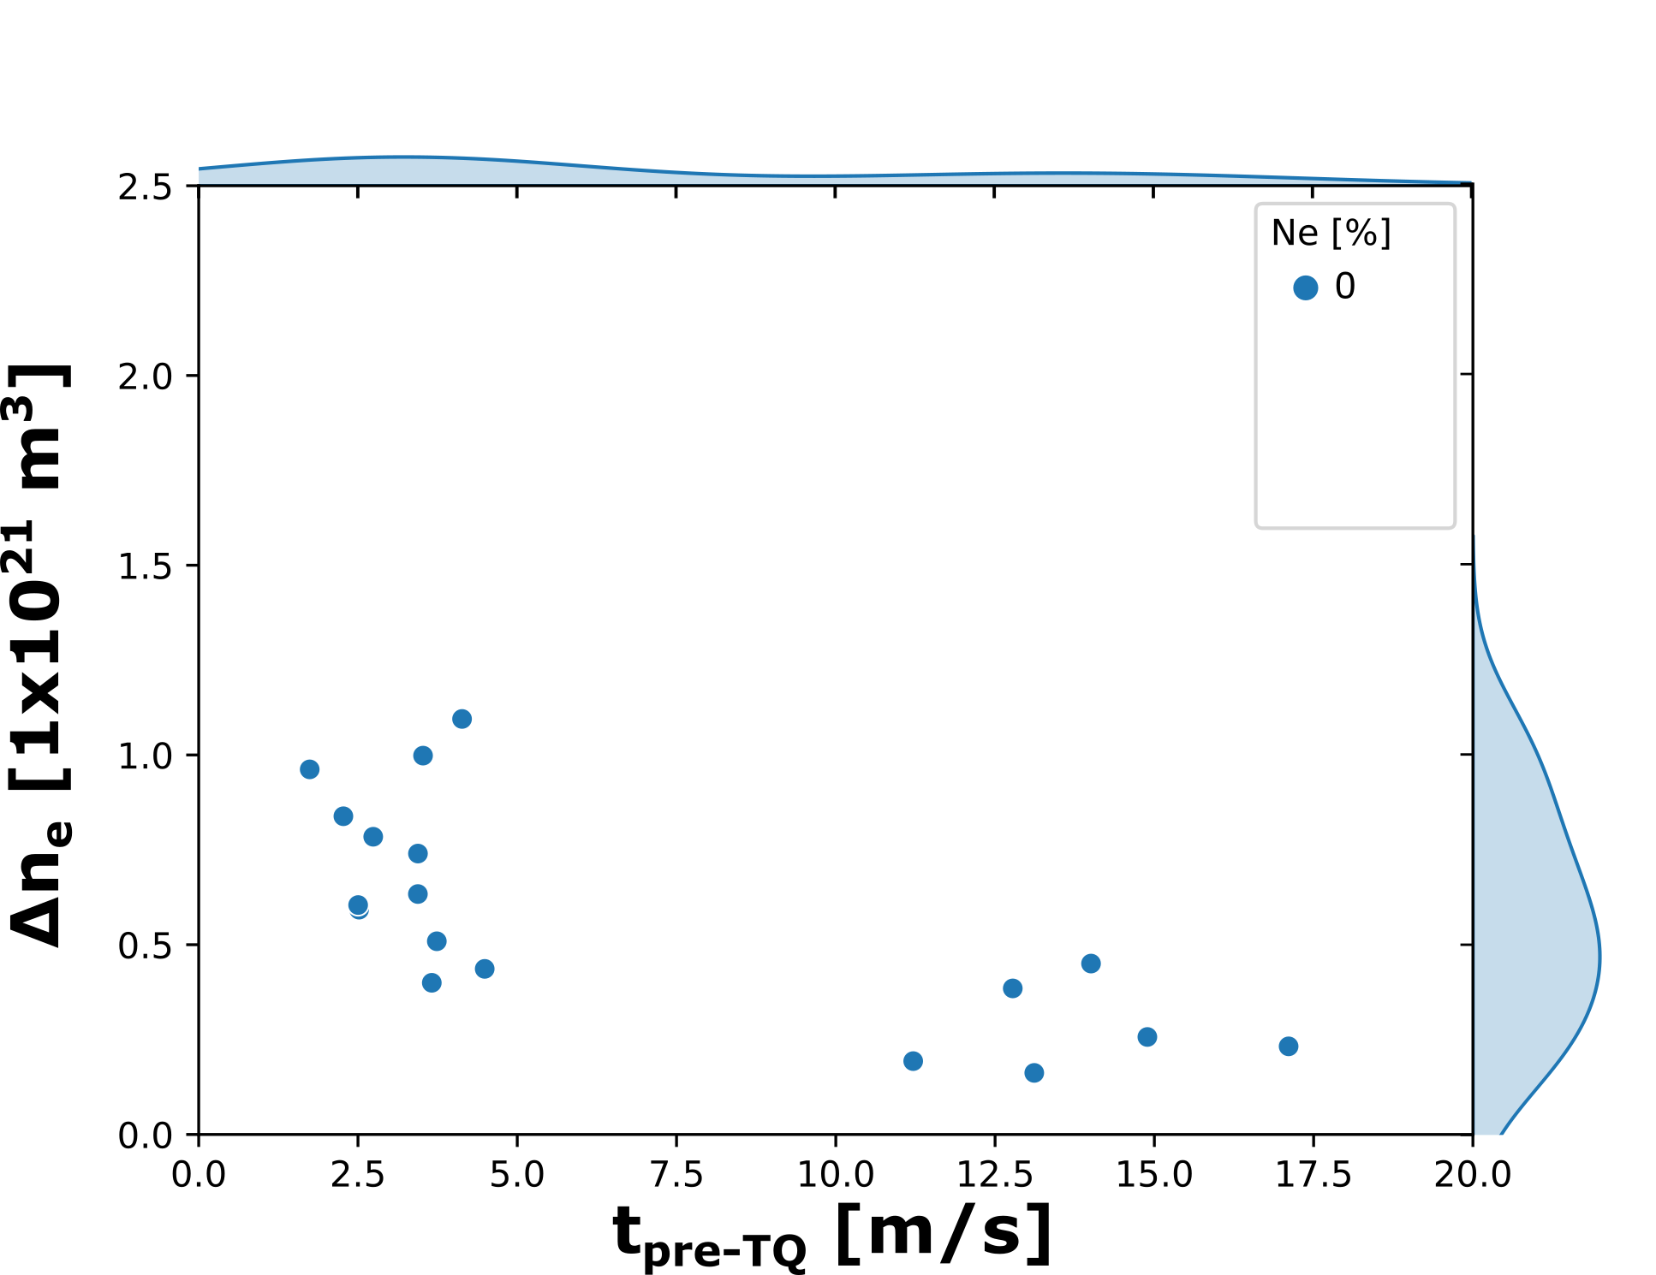
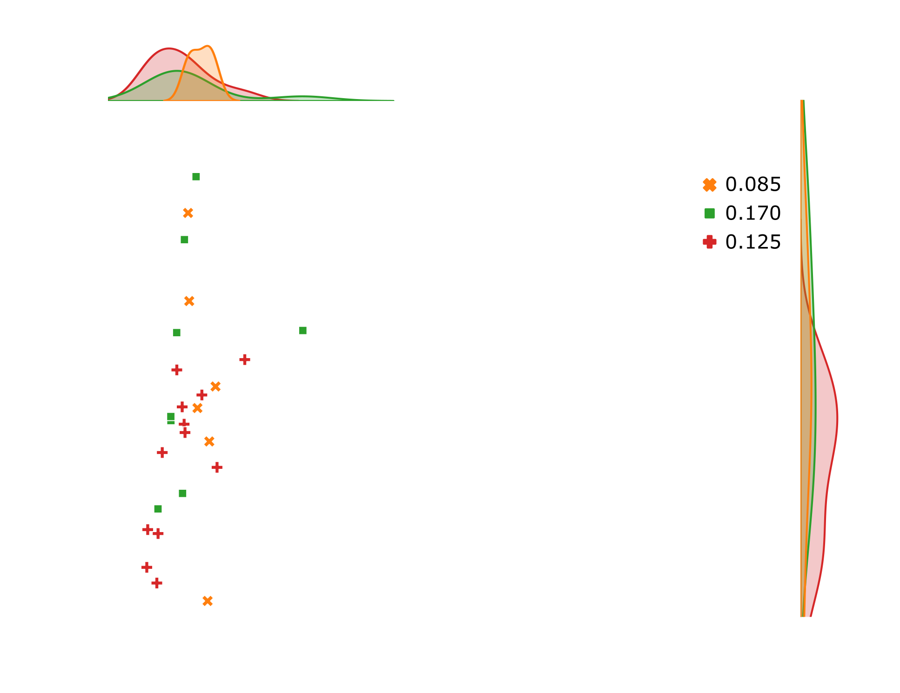
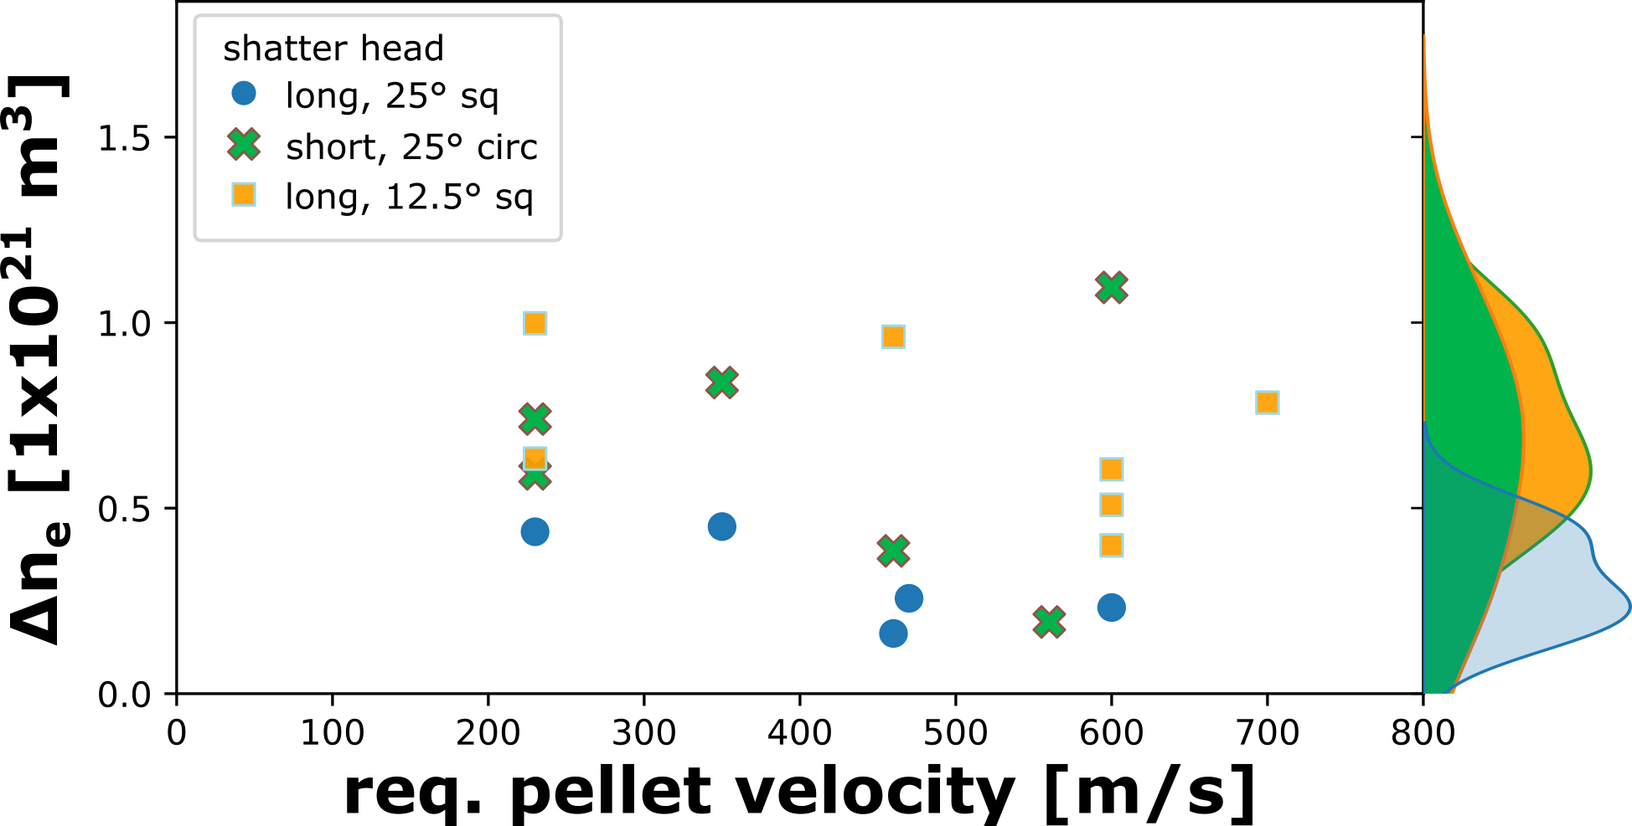
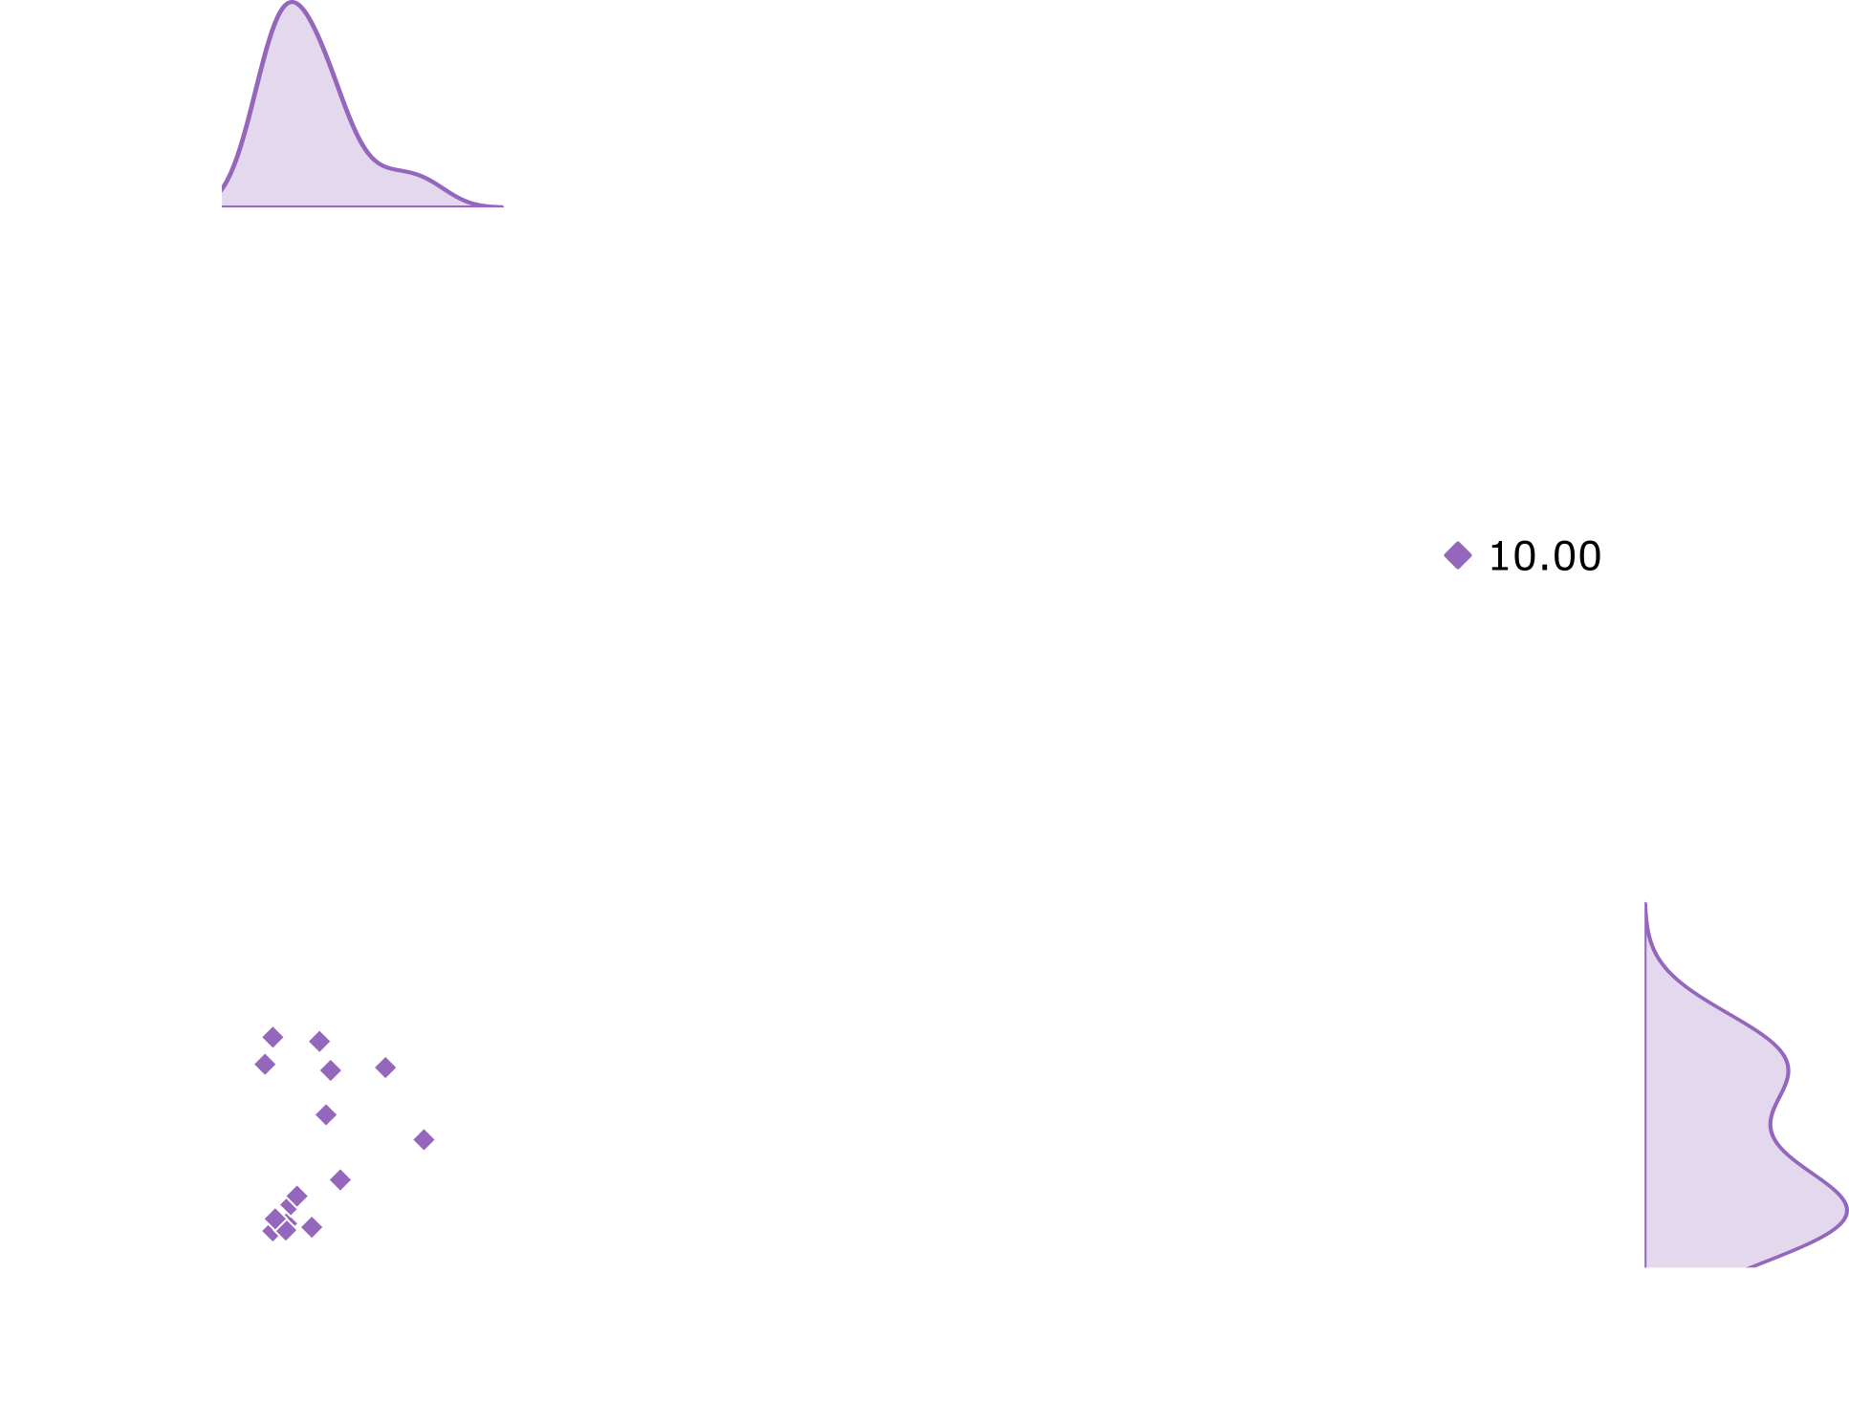
Preliminary results from the AUG experiments
In total 235 discharges executed with ~174 useful pulses (240 pellet injections)
Large database with different pellet diameters (4 and 8mm), lengths (L/D 0.5-1.5), pellet composition (Ne/D 0.086%-100%) and velocities (100-700 m/s)
Injections into target plasmas with W_{th} up to ~900kJ and few post-TQ plasmas
Injection schemes: single, dual and staggered
Density rise at plasma edge
100% D₂ pellets
100% D₂ pellets
preliminary data!
preliminary data!
preliminary data!
Indication: long, 12.5°, square (larger fragments & more collimated) shatter head shows the best material assimilation, but shortest pre-TQ times

Slide 21
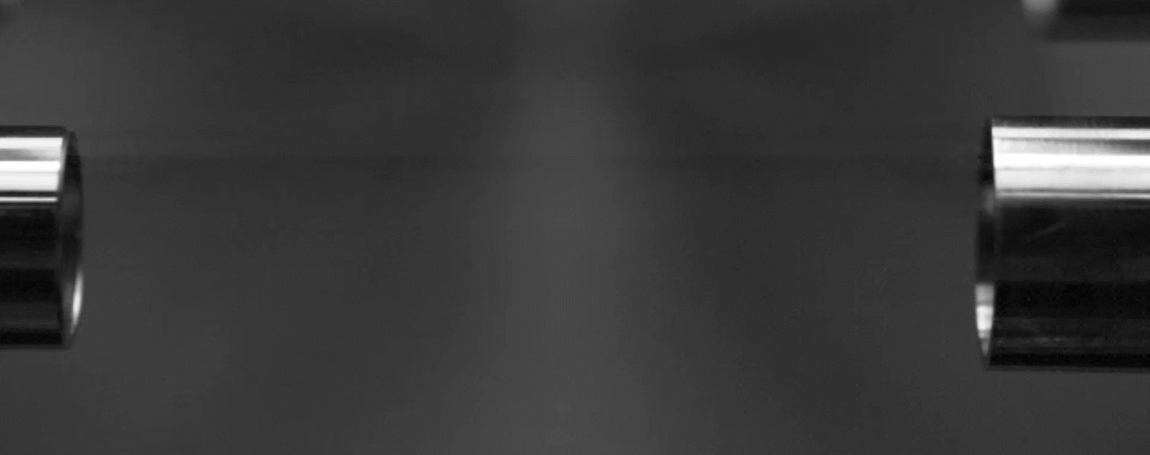
























Summary and Outlook
The SPI system in AUG has three independent guide tubes and freezing cells
At the end of all three guide tubes, different shatter heads were installed
About 2000 pellets fired so far:
    about 1400 pellets and fragment plumes characterized in the lab environment
    about 240 injections into plasma discharges (remaining pellets into the empty vessel)
Pellet release is assisted by a hollow punch and heating coils
The fragment plume is collimated for the rectangular shatter heads, while it is more spread out for circular heads
We observe different fragment distribution trends than expected from statistical fragmentation modelling
In total 235 AUG SPI discharges executed – analysis in progress
~ 3.5 m
100% D2 with 538 m/s - #1368
12.5° square, long - #1368
Top-down view!

