Slide 1
Self-Consistent Kinetic Simulations of Runaway Electron Termination Schemes
Chris McDevitt
University of Florida
Acknowledgements: Xianzhu Tang and the Tokamak Disruption Simulation (TDS) team
Work supported by DOE OFES

Slide 2
Motivation: Benign Termination of Runaway Electrons
Recent experiments on JET [Reux et al. 2021] and DIII-D [Paz-Soldan et al. 2021] have demonstrated the benign termination of a RE beam via massive low-Z (deuterium) material injection
  The injection of large quantities of deuterium lead to a “purge” of high-Z impurities
  Observations and MHD simulations [Bandaru et al. 2021] suggest a large scale MHD instability leads to the expulsion of the majority of REs over a large region of the vessel wall
  Avoids large localized heat loads even for substantial quantities of RE current

Slide 3
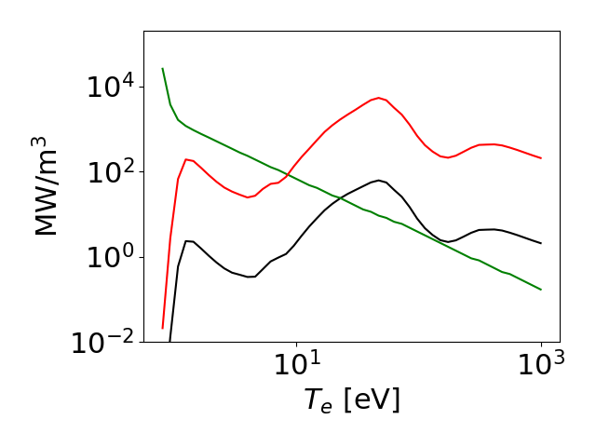
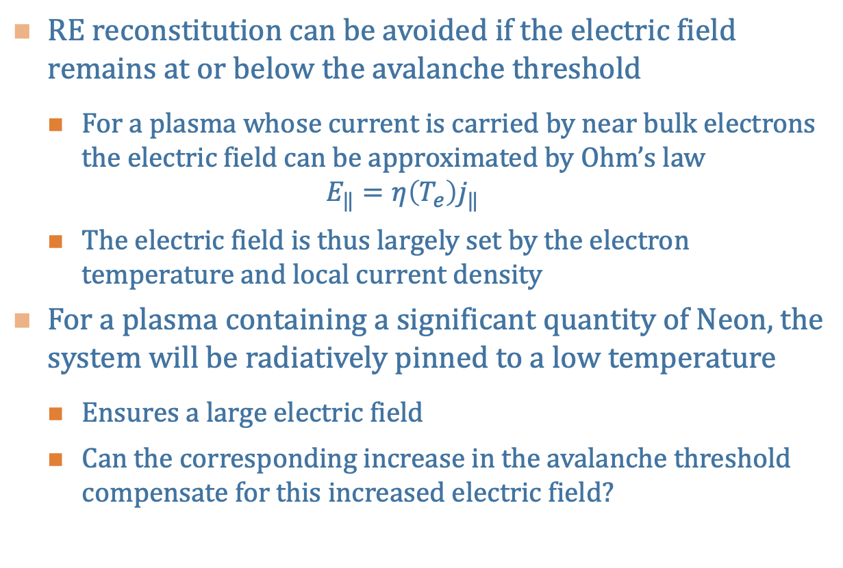




Runaway Termination: Power Balance
RE reconstitution can be avoided if the electric field remains at or below the avalanche threshold
  For a plasma whose current is carried by near bulk electrons the electric field can be approximated by Ohm’s law
  $$E_{‖}=η\left(T_{e}\right)j_{‖}$$
  The electric field is thus largely set by the electron temperature and local current density
For a plasma containing a significant quantity of Neon, the system will be radiatively pinned to a low temperature
  Ensures a large electric field
  Can the corresponding increase in the avalanche threshold compensate for this increased electric field?
Power Balance, 1% Neon
$j_{‖}=2$ [MA/m²]
$Ω$ heating
$$n_{D}={5×10}^{14} [cm^{−3}]$$
$$n_{D}={5×10}^{15} [cm^{−3}]$$

Slide 4
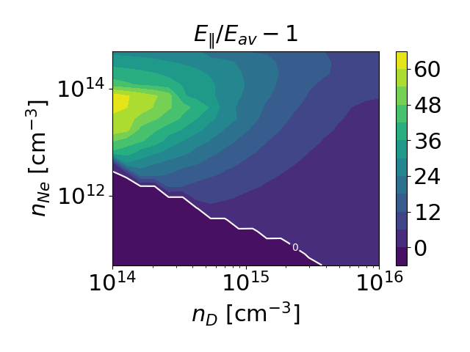

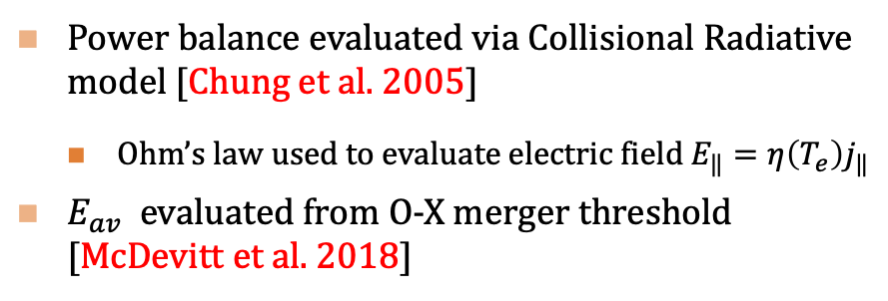


Runaway Reconstitution: Avalanche Threshold
The most robust means to avoid RE reconstitution is to remain below the avalanche threshold
$j_{‖}=2$ [MA/m²]
$j_{‖}=2$ [MA/m²]
Remaining below the avalanche threshold is challenging:
  At high Neon fractions, $\frac{E_{‖}}{E_{av}}≫1$ ⬄ Nearly complete purge of Neon is required
Power balance evaluated via Collisional Radiative model [Chung et al. 2005]
  Ohm’s law used to evaluate electric field $E_{‖}=η\left(T_{e}\right)j_{‖}$
$E_{av}$ evaluated from O-X merger threshold [McDevitt et al. 2018]

Slide 5
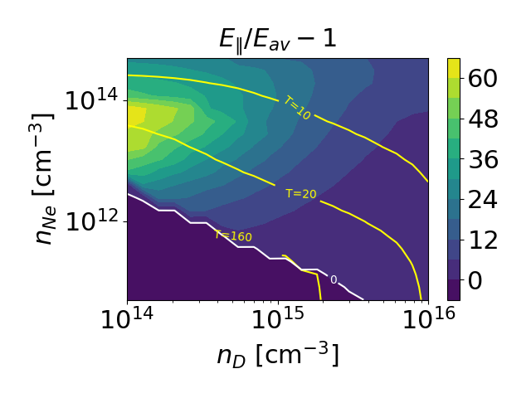
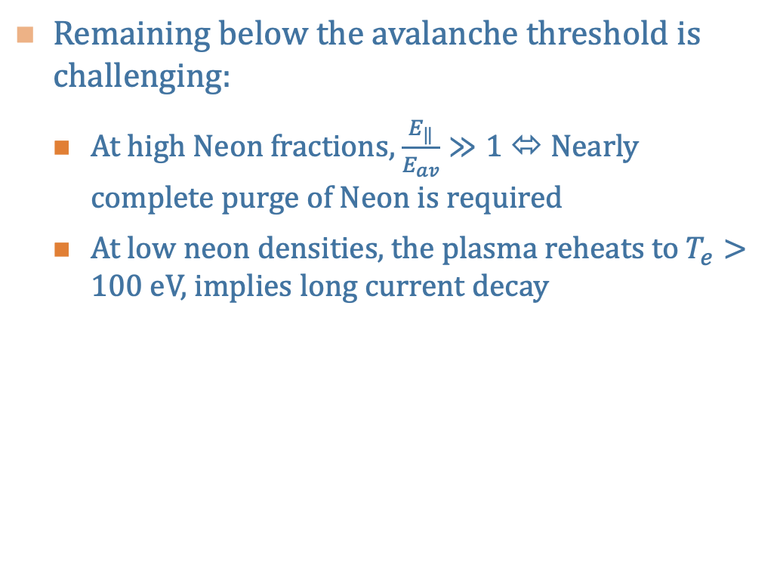
Runaway Reconstitution: Avalanche Threshold
The most robust means to avoid RE reconstitution is to remain below the avalanche threshold
$j_{‖}=2$ [MA/m²]
$j_{‖}=2$ [MA/m²]
Remaining below the avalanche threshold is challenging:
  At high Neon fractions, $\frac{E_{‖}}{E_{av}}≫1$ ⬄ Nearly complete purge of Neon is required
  At low neon densities, the plasma reheats to $T_{e}>100$ eV, implies long current decay
Power balance evaluated via Collisional Radiative model [Chung et al. 2005]
  Ohm’s law used to evaluate electric field $E_{‖}=η\left(T_{e}\right)j_{‖}$
$E_{av}$ evaluated from O-X merger threshold [McDevitt et al. 2018]

Slide 6


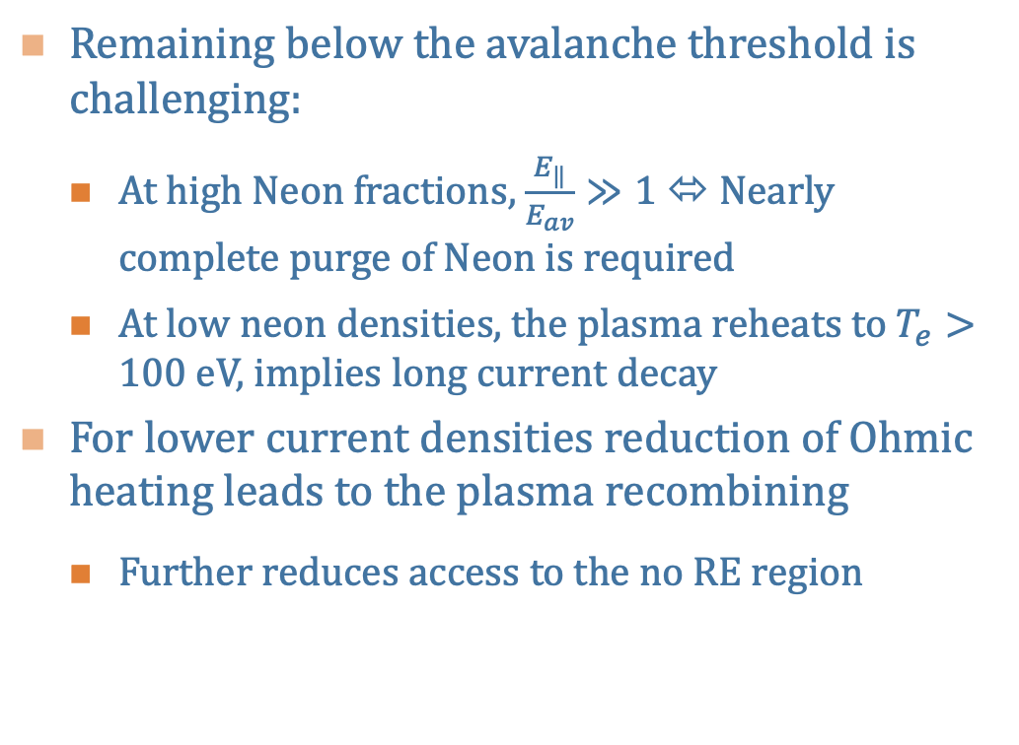
Runaway Reconstitution: Avalanche Threshold
The most robust means to avoid RE reconstitution is to remain below the avalanche threshold
$j_{‖}=2$ [MA/m²]
$j_{‖}=1.5$ [MA/m²]
Remaining below the avalanche threshold is challenging:
  At high Neon fractions, $\frac{E_{‖}}{E_{av}}≫1$ ⬄ Nearly complete purge of Neon is required
  At low neon densities, the plasma reheats to $T_{e}>100$ eV, implies long current decay
For lower current densities reduction of Ohmic heating leads to the plasma recombining
  Further reduces access to the no RE region
Power balance evaluated via Collisional Radiative model [Chung et al. 2005]
  Ohm’s law used to evaluate electric field $E_{‖}=η\left(T_{e}\right)j_{‖}$
$E_{av}$ evaluated from O-X merger threshold [McDevitt et al. 2018]

Slide 7
Runaway Reconstitution: Above the Avalanche Threshold
If the system remains above the avalanche threshold, RE reconstitution will be strongly impacted by:
Size of remnant seed:
  The true value of the number of energetic `seed’ electrons remaining in the plasma is difficult to evaluate ⬄ depends sensitively on MHD spectrum
  Here we seek to identify an energetic electron population that is robustly confined across a range of MHD perturbations
Plasma composition/properties of the MHD instability:
  Dependence on the plasma density
  Sensitivity to the duration of the MHD instability

Slide 8
Outline
Transport of relativistic electrons in stochastic magnetic fields
  Loss time as a function of the electron’s phase space location
The phase space evolution of REs during the current plateau
  Trapped remnant seed population
Conditions for the partial reconstitution of the RE plateau
  Depend on plasma composition/MHD mode properties

Slide 9
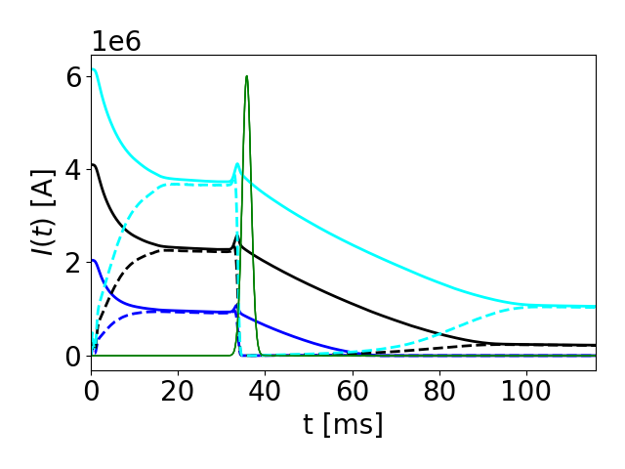
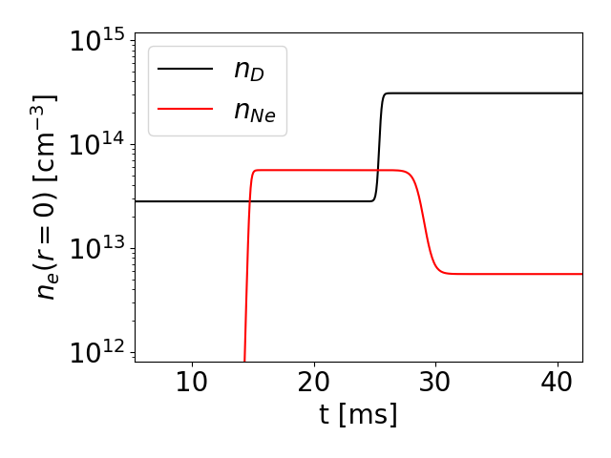




Runaway Beam Formation/Termination
$${\left|δB\right|}^{2}$$
$I_{p}≈6.2$ MA
$I_{p}≈4.1$ MA
Our focus will be on identifying the critical quantities that dictate the evolution of the RE beam during and after the MHD instability
We will thus impose an idealized thermal quench as a means of initializing a RE plateau
  The initial plasma current will be varied in order to generate RE beams of different magnitudes
Two injections of impurities will be introduced
  A pure Neon injection is performed early in the simulation
  A second injection of Deuterium is made later in the simulation
Shortly after the Deuterium injection, a large fraction of Neon is assumed to be “purged” from the plasma
$I_{p}≈2$ MA
Deuterium
injection
Neon
injection
Neon
purge

Slide 10
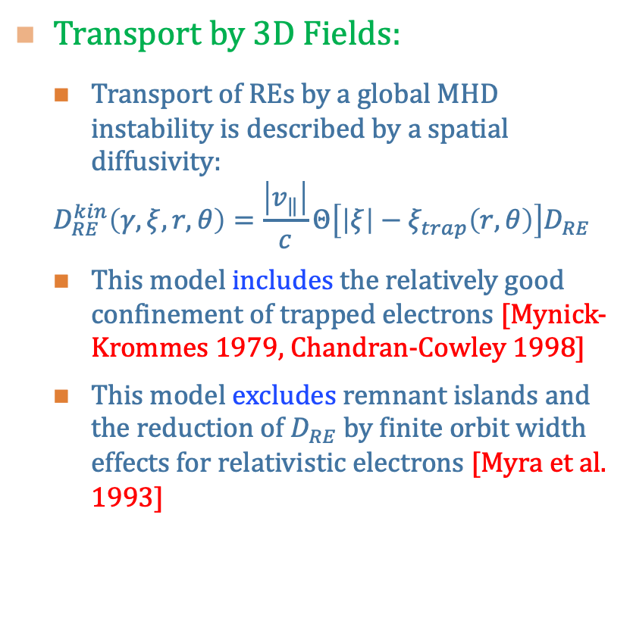
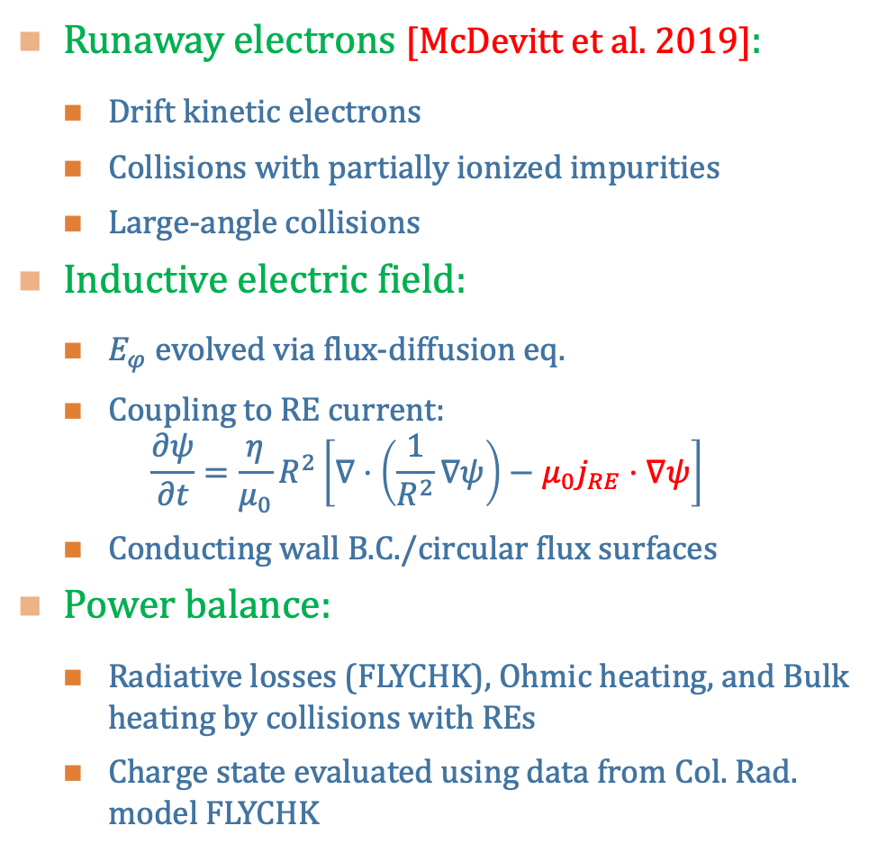
Kinetic Runaway Electron-Bulk Plasma Integration
Runaway electrons [McDevitt et al. 2019]:
  Drift kinetic electrons
  Collisions with partially ionized impurities
  Large-angle collisions
Inductive electric field:
  $E_{φ}$ evolved via flux-diffusion eq.
  Coupling to RE current:
  $$\frac{∂ψ}{∂t}=\frac{η}{μ_{0}}R^{2}\left[∇⋅\left(\frac{1}{R^{2}}∇ψ\right)−μ_{0}j_{RE}⋅∇ψ\right]$$
  Conducting wall B.C./circular flux surfaces
Power balance:
  Radiative losses (FLYCHK), Ohmic heating, and Bulk heating by collisions with REs
  Charge state evaluated using data from Col. Rad. model FLYCHK
Transport by 3D Fields:
  Transport of REs by a global MHD instability is described by a spatial diffusivity:
  $$D_{RE}^{kin}\left(γ,ξ,r,θ\right)=\frac{\left|v_{‖}\right|}{c}Θ\left[\left|ξ\right|−ξ_{trap}\left(r,θ\right)\right]D_{RE}$$
  This model includes the relatively good confinement of trapped electrons [Mynick-Krommes 1979, Chandran-Cowley 1998]
  This model excludes remnant islands and the reduction of $D_{RE}$ by finite orbit width effects for relativistic electrons [Myra et al. 1993]

Slide 11
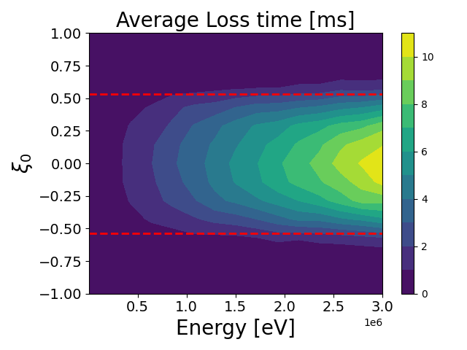

Transport of Relativistic Electrons in 3D Magnetic Fields
A test particle simulation of guiding center orbits in a stochastic magnetic field suggests:
  Magnetically trapped electron orbits are not directly impacted by the 3D magnetic fields
  Their loss rates are instead determined by a combination of slowing down, collisional detrapping and the Ware pinch
  Energetic trapped electrons can remain confined for several milliseconds
Test-Particles in 3D Field
Trapped-passing
boundary
$n_{D}=5×{10}^{14} \left[cm^{−3}\right], E/E_{c} =50$, r/a$=0.5$
For a dominantly deuterium plasma, the confinement time is largely set by the deuterium density and electric field strength

Slide 12
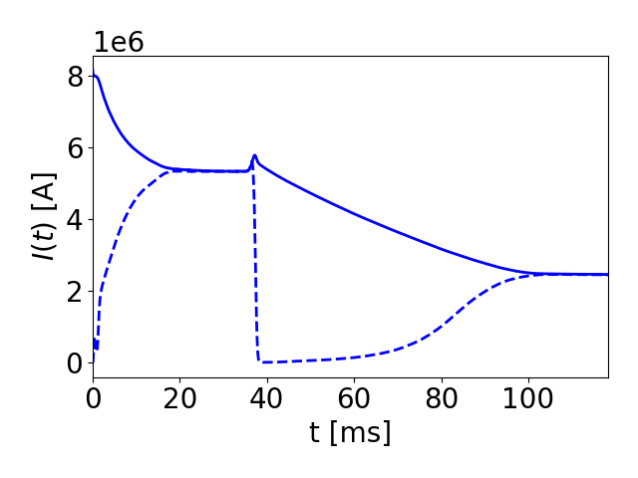
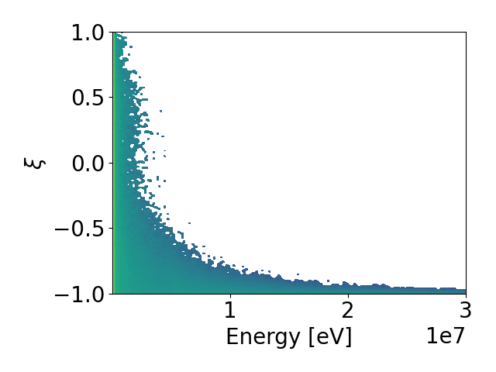
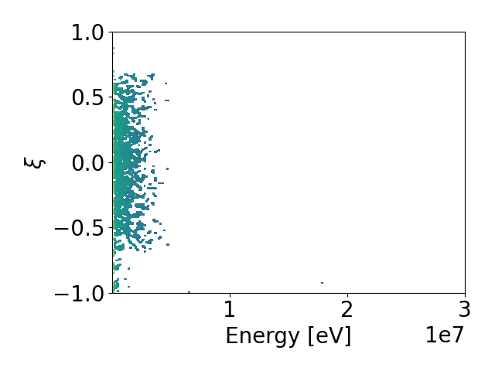
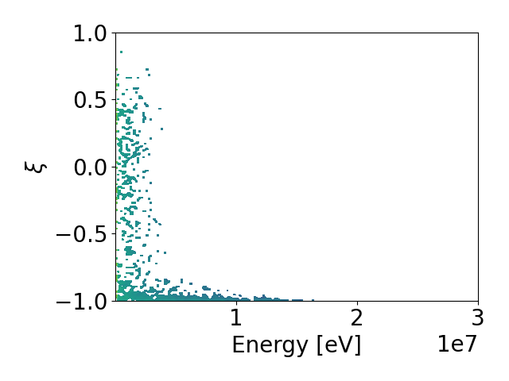







Phase Space Evolution of Energetic Electron Population
Current Evolution
$$t_{2}$$
$$t_{1}$$
$$t_{3}$$
The presence of a significant quantity of high-Z material leads to a broad pitch distribution of REs when near the threshold electric field [McDevitt et al. 2019]
  Such a distribution will contain a non-negligible number of trapped energetic electrons
  The number of such trapped energetic electrons increases with the amount of Neon in the plasma
Momentum Space Dist.
Momentum Space Dist.
Momentum Space Dist.
$$t_{1}≈33 [ms]$$
$$t_{2}≈39 [ms]$$
$$t_{3}=47 [ms]$$
Before MHD
event
During MHD
event
After MHD
event
$$n_{Ne}=5.6×{10}^{13} [cm^{−3}]$$
Remnant trapped
electrons

Slide 13
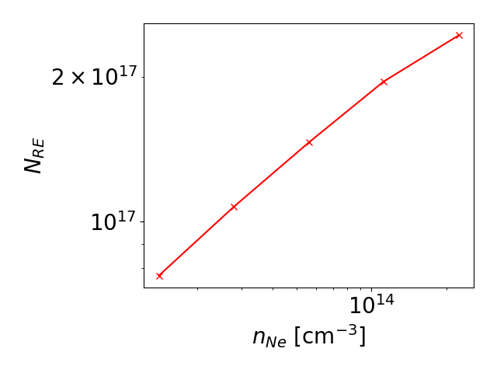
Phase Space Evolution of Energetic Electron Population
Number of Trapped
Electrons above 100 keV
The presence of a significant quantity of high-Z material leads to a broad pitch distribution of REs when near the threshold electric field [McDevitt et al. 2019]
  Such a distribution will contain a non-negligible number of trapped energetic electrons
  The number of such trapped energetic electrons increases with the amount of Neon in the plasma
Momentum Space Dist.
Momentum Space Dist.
Momentum Space Dist.
$$t_{1}≈33 [ms]$$
$$t_{2}≈39 [ms]$$
$$t_{3}=47 [ms]$$
Before MHD
event
During MHD
event
After MHD
event
$$n_{Ne}=5.6×{10}^{13} [cm^{−3}]$$
Remnant trapped
electrons

Slide 14
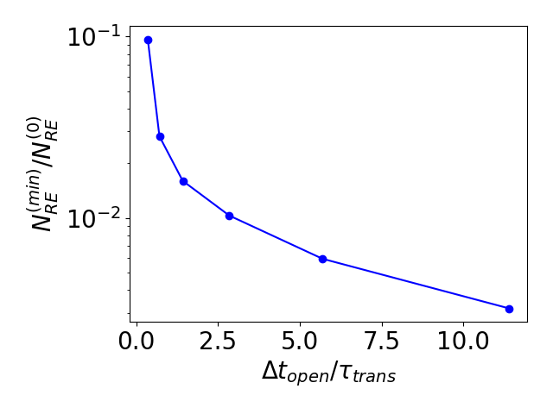
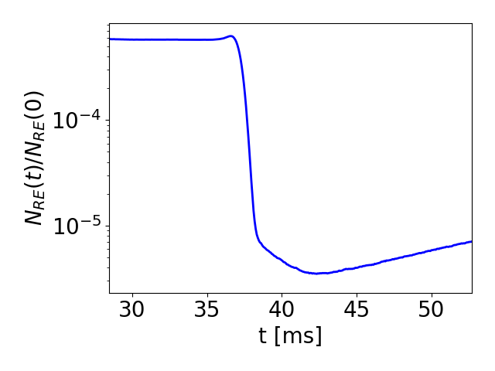
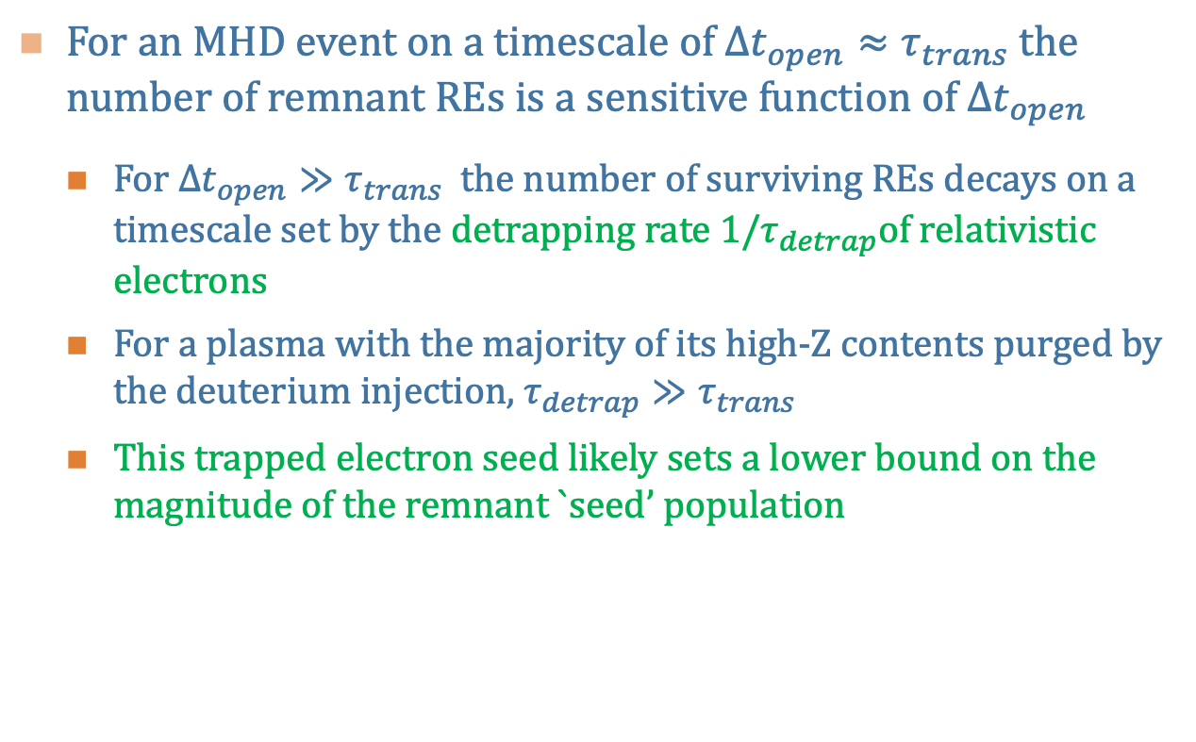
Remnant Seed Scaling with Duration the Flux Surfaces Remain Open
For an MHD event on a timescale of $Δt_{open}≈τ_{trans}$ the number of remnant REs is a sensitive function of $Δt_{open}$
  For $Δt_{open}≫τ_{trans}$ the number of surviving REs decays on a timescale set by the detrapping rate $1/τ_{detrap}$of relativistic electrons
  For a plasma with the majority of its high-Z contents purged by the deuterium injection, $τ_{detrap}≫τ_{trans}$
  This trapped electron seed likely sets a lower bound on the magnitude of the remnant `seed’ population
MHD event
loss of
trapped REs
loss of
passing REs

Slide 15
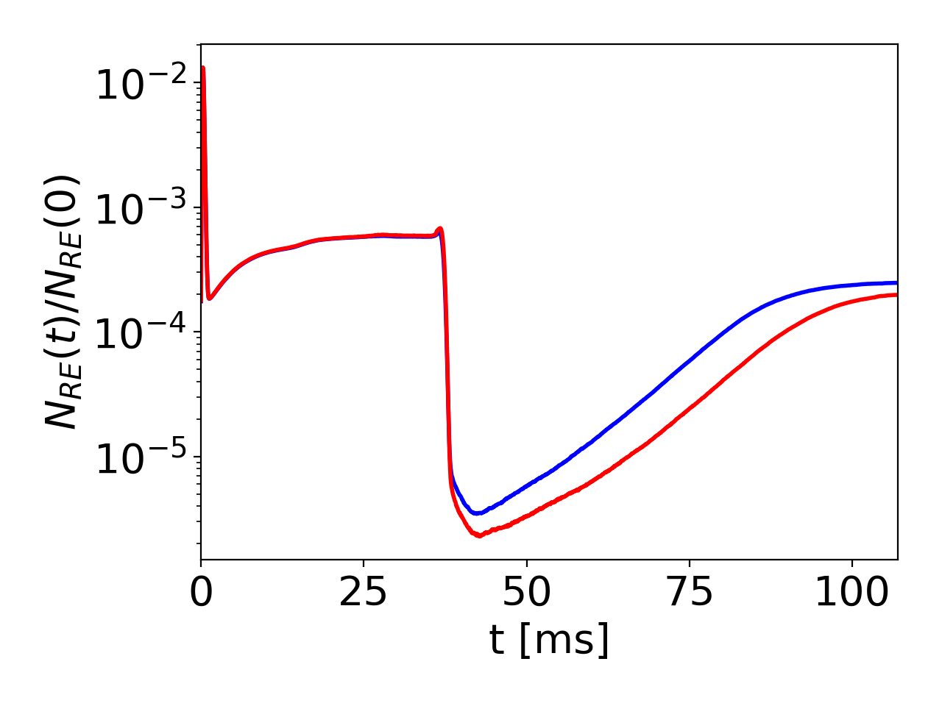
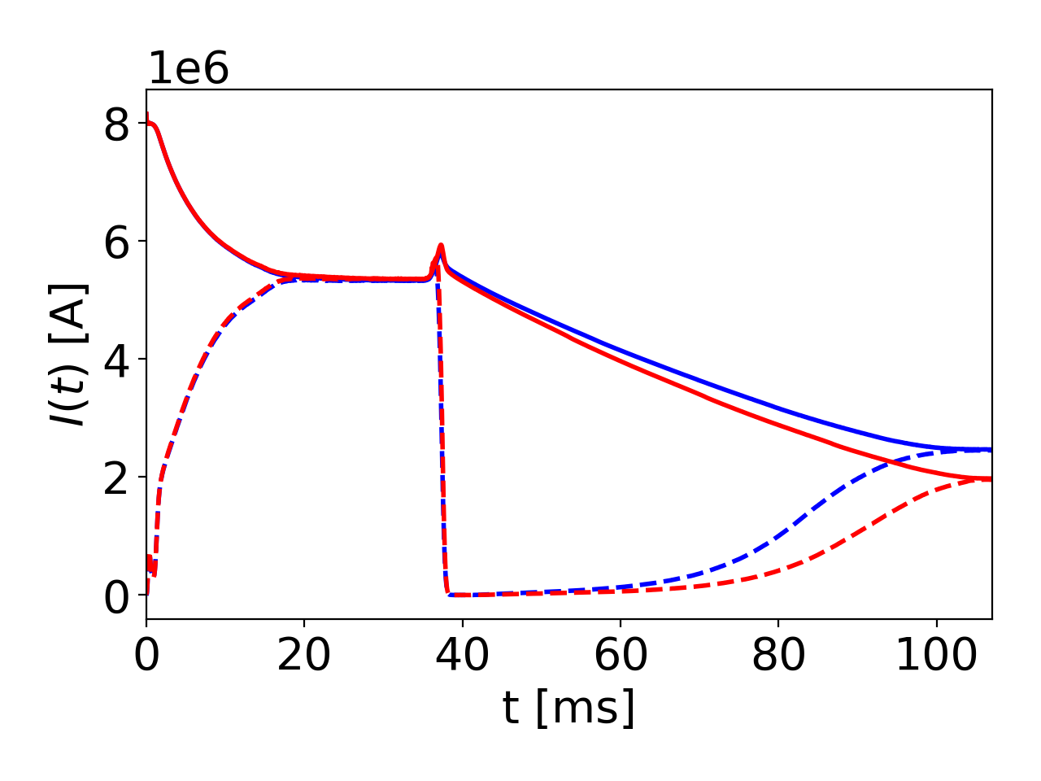


Impact of Deuterium Density on RE Reconstitution
$$n_{D}≈{3×10}^{14} [cm^{−3}]$$
Increasing the deuterium density leads to more efficient detrapping of electrons ⬄ reduces remnant seed
Higher deuterium density increases the:
  Slowing down/pitch scattering rate due to higher density
  Larger Ware pitch due to a moderately cooler plasma and hence a larger electric field
Increase of deuterium density by a factor of two leads to a 20% decrease in the reconstituted current
  Implies higher deuterium content optimal for removing trapped remnant seed
$$n_{D}≈{6×10}^{14} [cm^{−3}]$$

Slide 16
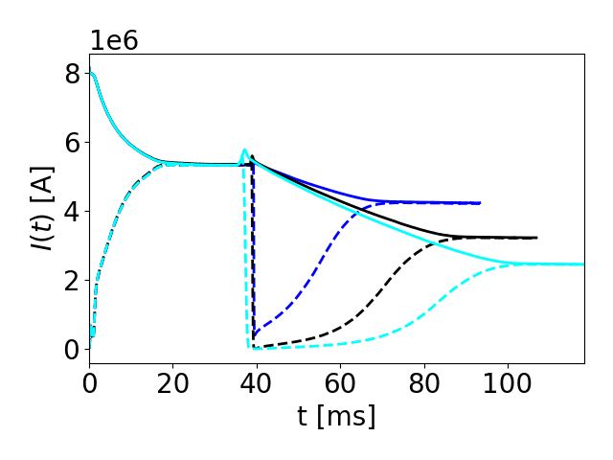
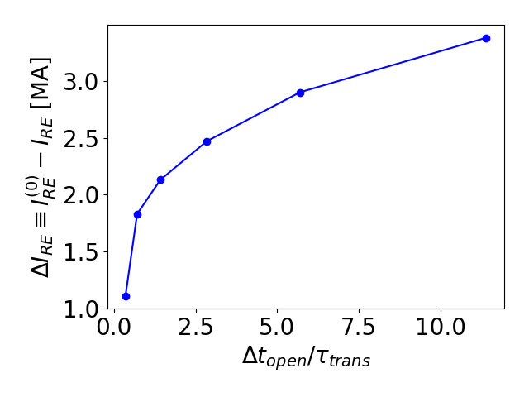


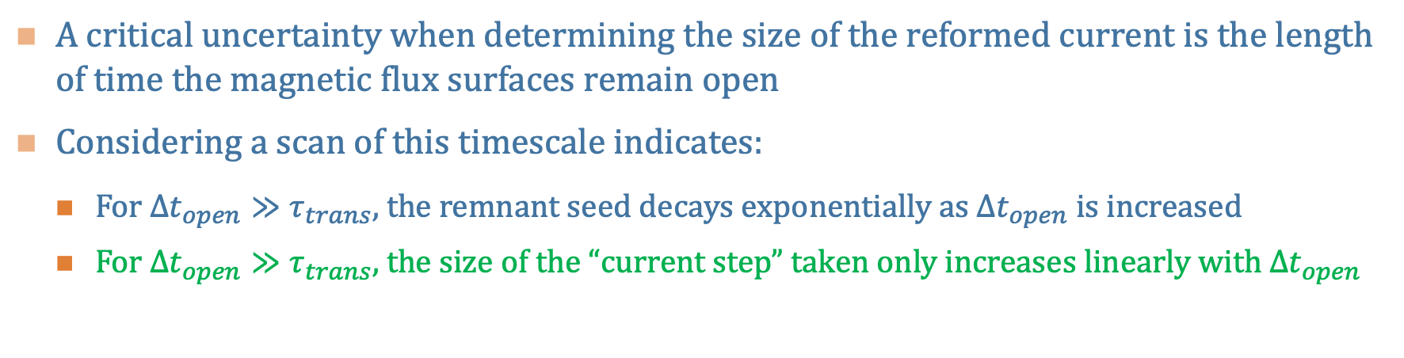


Impact of MHD Properties on RE Reconstitution
A critical uncertainty when determining the size of the reformed current is the length of time the magnetic flux surfaces remain open
Considering a scan of this timescale indicates:
  For $Δt_{open}≫τ_{trans}$, the remnant seed decays exponentially as $Δt_{open}$ is increased
  For $Δt_{open}≫τ_{trans}$, the size of the “current step” taken only increases linearly with $Δt_{open}$
Current Evolution
Size of Remnant Seed
Current Drop
$$Δt_{open}≈0.089 ms$$
$$Δt_{open}≈0.36 ms$$
$$Δt_{open}≈1.4 ms$$
$I_{RE}^{\left(0\right)}≈5.3$ [MA]

Slide 17
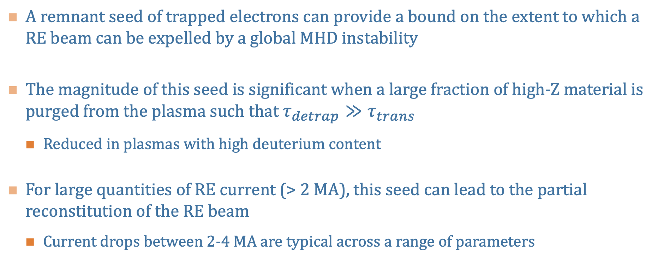
Summary
A remnant seed of trapped electrons can provide a bound on the extent to which a RE beam can be expelled by a global MHD instability
The magnitude of this seed is significant when a large fraction of high-Z material is purged from the plasma such that $τ_{detrap}≫τ_{trans}$
  Reduced in plasmas with high deuterium content
For large quantities of RE current (> 2 MA), this seed can lead to the partial reconstitution of the RE beam
  Current drops between 2-4 MA are typical across a range of parameters

Slide 19
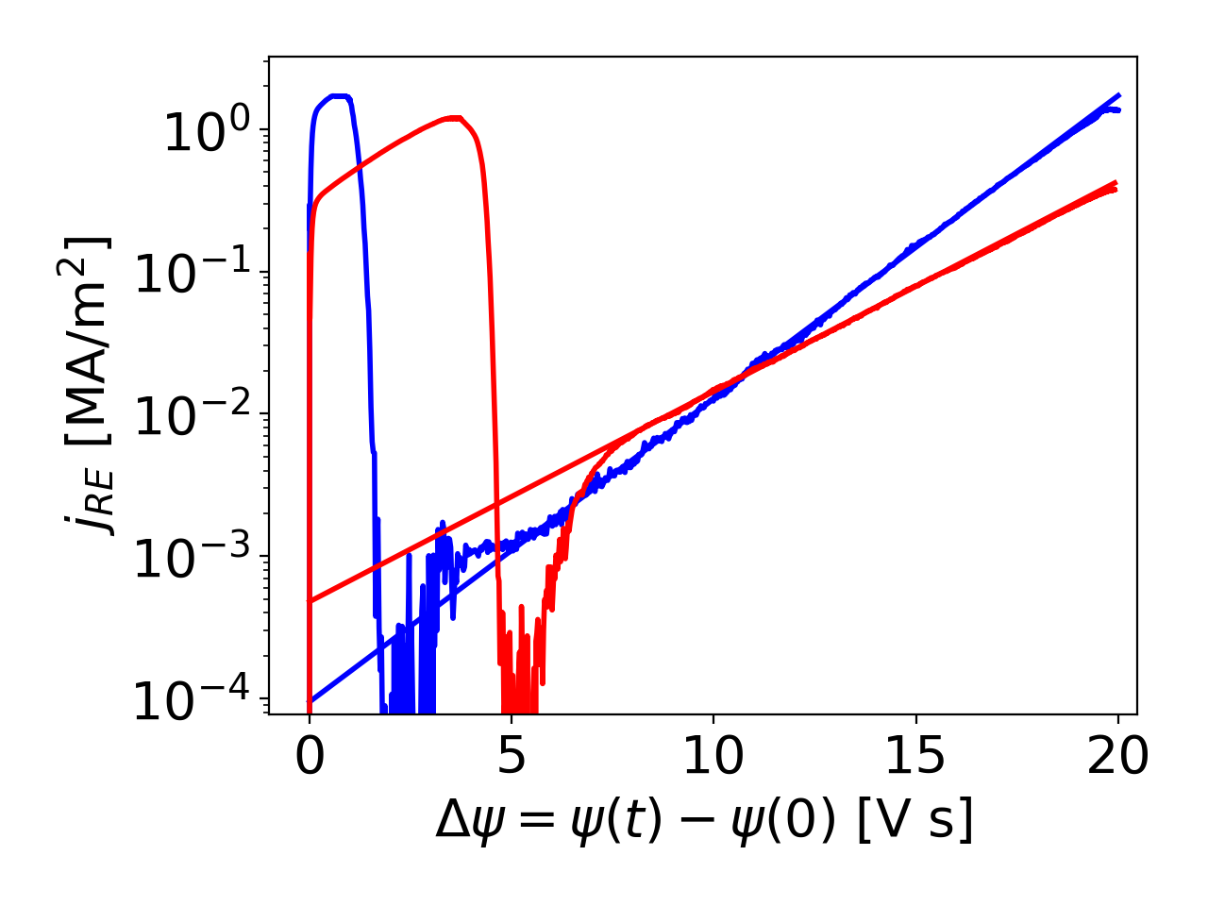
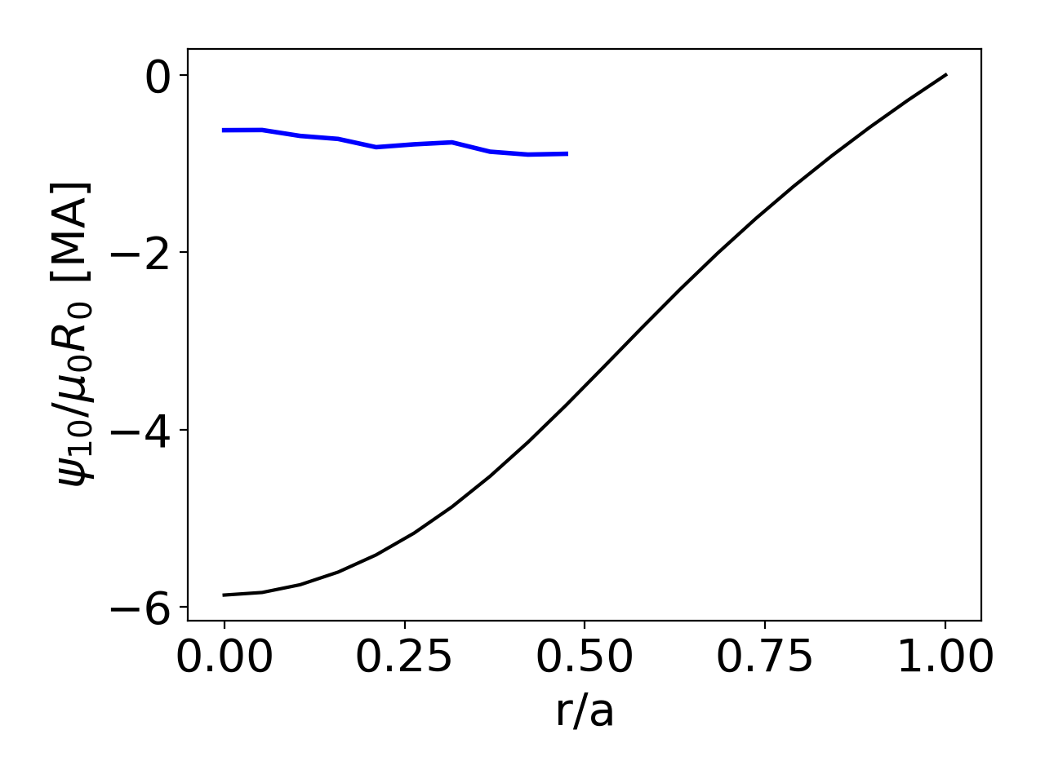

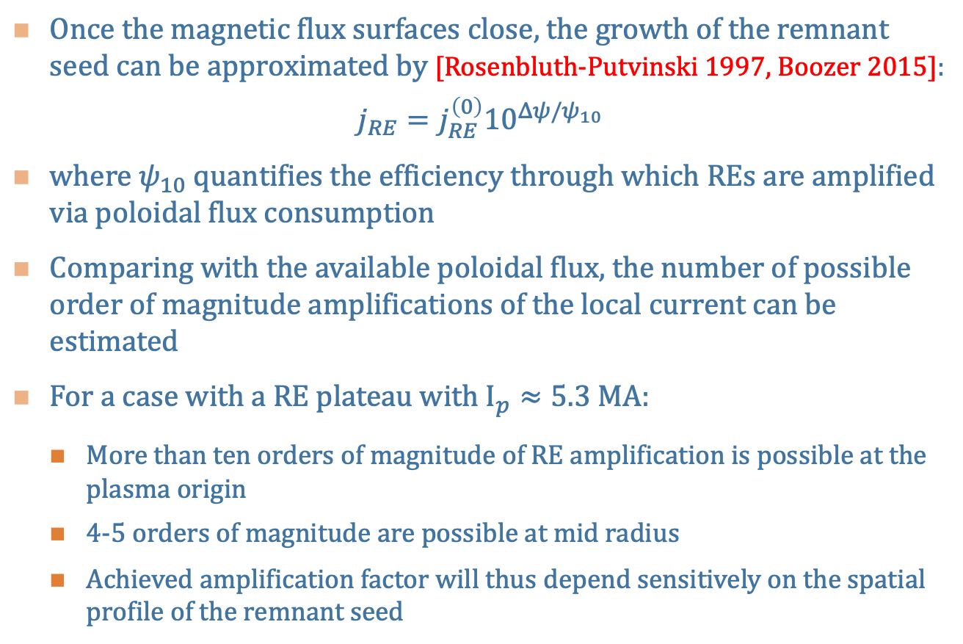




RE Reconstitution: Efficiency of Avalanche Mechanism
Once the magnetic flux surfaces close, the growth of the remnant seed can be approximated by [Rosenbluth-Putvinski 1997, Boozer 2015]:
$$j_{RE}=j_{RE}^{\left(0\right)}{10}^{Δψ/ψ_{10}}$$
where $ψ_{10}$ quantifies the efficiency through which REs are amplified via poloidal flux consumption
Comparing with the available poloidal flux, the number of possible order of magnitude amplifications of the local current can be estimated
For a case with a RE plateau with $I_{p}≈5.3$ MA:
  More than ten orders of magnitude of RE amplification is possible at the plasma origin
  4-5 orders of magnitude are possible at mid radius
  Achieved amplification factor will thus depend sensitively on the spatial profile of the remnant seed
$$r/a=0$$
$$r/a≈0.4$$
$$I_{plateau}^{\left(0\right)}≈5.3 [MA]$$
$$ψ_{10}/μ_{0}R_{0}$$
$$ψ_{init}/μ_{0}R_{0}$$

Slide 20
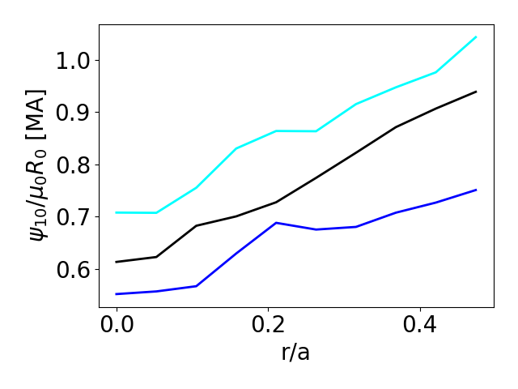
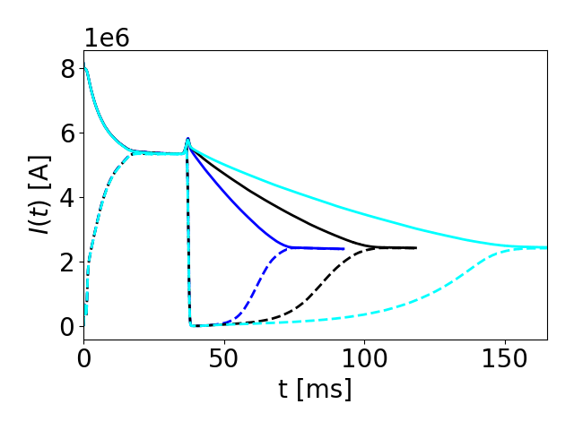
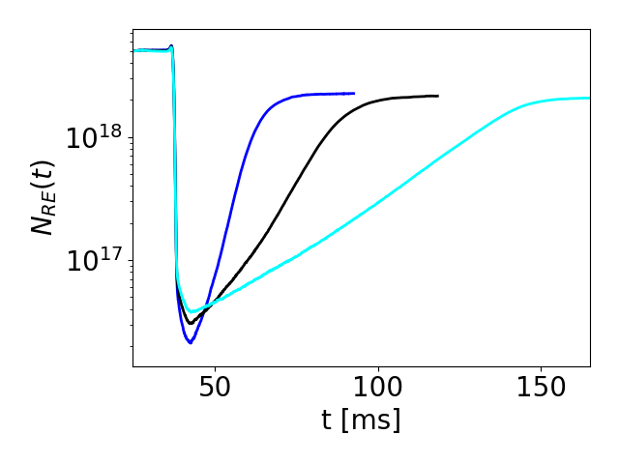

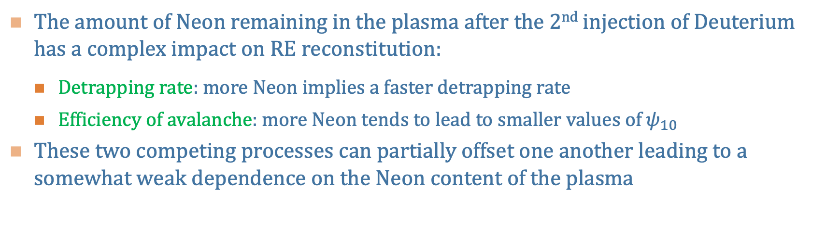


Impact of Impurity Composition on RE Reconstitution
The amount of Neon remaining in the plasma after the 2nd injection of Deuterium has a complex impact on RE reconstitution:
  Detrapping rate: more Neon implies a faster detrapping rate
  Efficiency of avalanche: more Neon tends to lead to smaller values of $ψ_{10}$
These two competing processes can partially offset one another leading to a somewhat weak dependence on the Neon content of the plasma
MHD event
$$n_{Ne}=1.4×{10}^{12} [cm^{−3}]$$
$$n_{Ne}=5.6×{10}^{12} [cm^{−3}]$$
More Neon remaining
in the plasma
$$n_{Ne}=2.24×{10}^{13} [cm^{−3}]$$

Slide 21
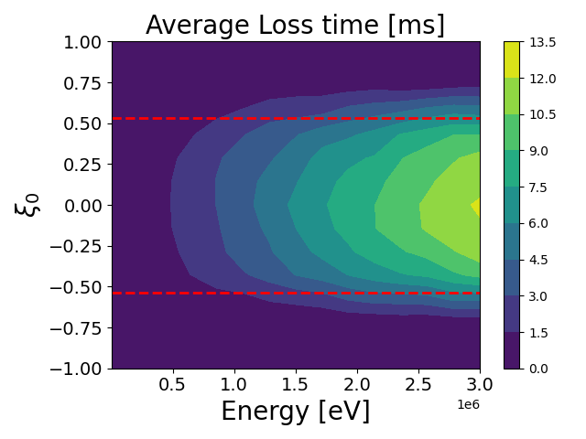
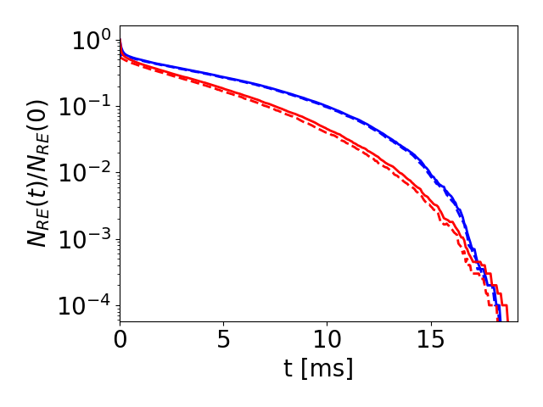
Comparison of Diffusive Approximation with Test-Particle Simulations in a Stochastic Magnetic Field
While the diffusive approximation reproduces several qualitative aspects of the test-particle simulations, detailed differences are evident:
  The diffusive approximation overestimates the confinement time of electrons near the trapped-passing boundary
  Does not include small population of confined passing runaways
Comparison of RE losses
Test-Particles in 3D Field
Diffusive approximation
of transport
Diff. Approx.
3D Field
Loss of passing
electrons
total REs
trapped REs

Slide 22
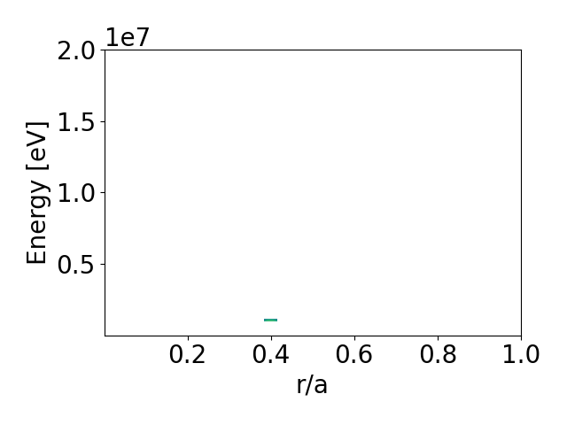
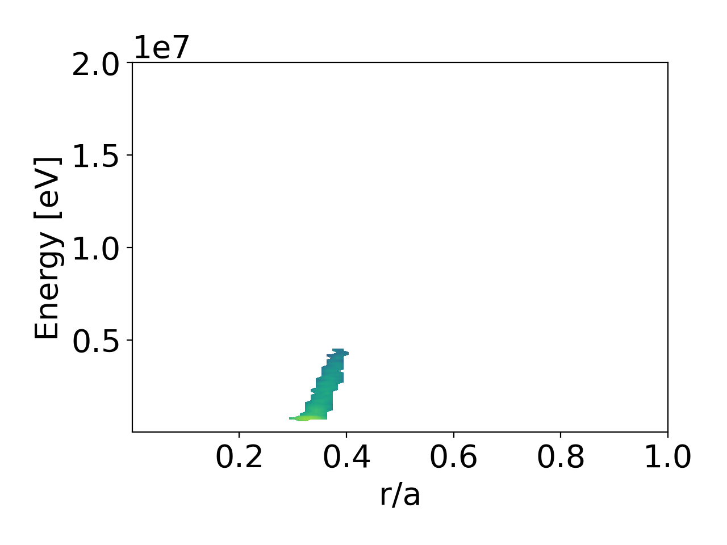
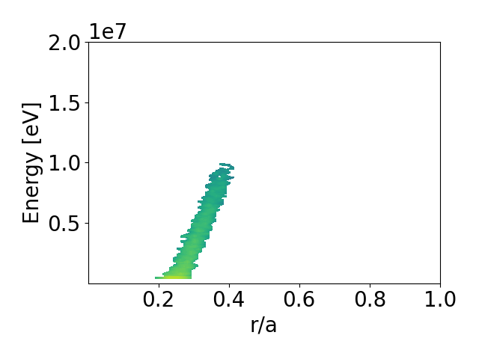



Transport of Remnant Seed by the Ware Pinch
The Ware pinch provides a means of convecting the trapped seed inward:
  A large inductive electric field is triggered after the expulsion of the majority of the RE current
  This large electric field drives a strong Ware pinch of the trapped electrons
  As the trapped electrons move inward, they are more easily collisionally and collisionlessly detrapped allowing for the RE seed to be distributed deeper into the plasma
$$t=0 [ms]$$
$$t=2 [ms]$$
$$t=4 [ms]$$

