Slide 1
Non-axisymmetric Radiation Modeling of JET SPI Discharges using Emis3D
B. Stein Lubrano¹, R. Sweeney¹, D. Bonfiglio², J. Lovell³, P. Carvalho⁴, L. Baylor³, R.S. Granetz¹, S. Jachmich⁵, E. Joffrin⁶, M. Lehnen⁵, C. Maggi⁴, E. Marmar¹, E. Nardon⁶, U. Sheikh⁷, D. Shiraki³, S. Silburn⁴, and JET Contributors⁸
¹MIT Plasma Science and Fusion Center, Cambridge, Massachusetts 01239, USA
²Consorzio RFX, Corso Stati Uniti 4, 35127 Padova, Italy
³Oak Ridge National Laboratory, Oak Ridge, Tennessee 37831, USA
⁴Culham Centre for Fusion Energy (CCFE), Culham Science Centre, Abingdon, UK
⁵ITER Organization, Route de Vinon sur Verdon, 13115 St Paul Lez Durance, France
⁶CEA, IRFM, F-13108 Saint-Paul-lez-Durance, France
⁷École Polytechnique Fédérale de Lausanne (EPFL), Swiss Plasma Center (SPC), Lausanne CH-1015, Switzerland
⁸See the author list of 'Overview of JET results for optimising ITER operation' by J. Mailloux et al published in Nuclear Fusion Special issue: Overview and Summary Papers from the 28th Fusion Energy Conference (Nice, France, 10-15 May 2021)

Slide 2
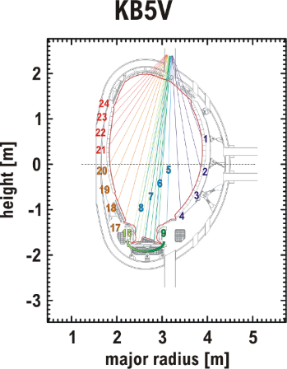
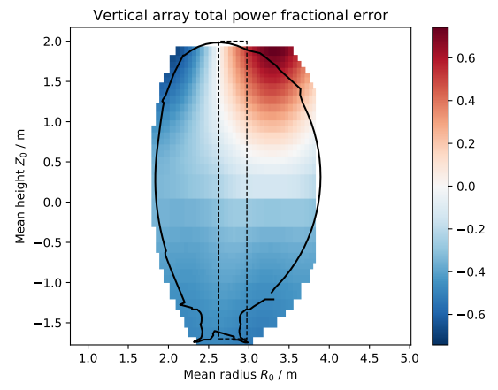
Disruption Bolometry Analysis is Challenged by Lack of Axisymmetry
Present disruption bolometry techniques can suffer from up to +/-50% errors
Bolometry diagnostics limited, optimized for flattop
Fractional error in radiated power of KB5 weighted sums, by radiation source location
[J. Lovell et al. Review of Scientific Instruments 92, 023502 (2021)]
High radiated fraction $f_{rad}={W_{rad}}/{W_{stored}}$, low peaking required in SPI/MGI mitigated discharges to prevent damage
ITER research plan for peak operation, SPARC Primary Reference Discharge (PRD) both expect damage to divertor if $f_{rad}<0.9$
Both machines require low toroidal peaking factors (TPFs) to avoid flash melting
A 3D tomography tool (Emis3D) is developed to validate these performances on present day experiments (e.g. JET)

Slide 3
Emis3D has undergone significant development; first application is two nominally identical JET discharges
JET SPI 96874
Nominally identical discharges (95709, 95711)
$I_{p}=2.5 MA$, $B_{T}=2.5 T$
$W_{th}=3.5, 3.6 MJ$; $W_{mag}=8.0, 8.1MJ$
Disrupted by identical Shattered Pellet Injection (SPI)
$2.46⋅{10}^{22}$ Ne atoms
$5.74⋅{10}^{21}$ D2 atoms
~35ms flight times
Different $f_{rad}$ according to TOPI (standard weighted average of bolometer channels): 0.80 vs 0.90
Question motivating this study: Why such different $f_{rad}$ for nominally identical mitigation attempts?

Slide 4
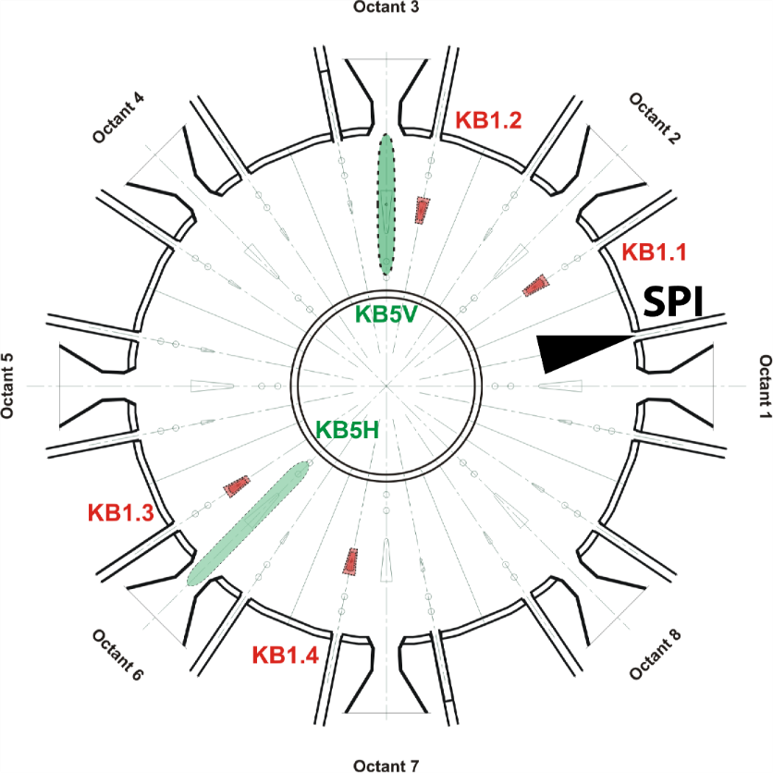
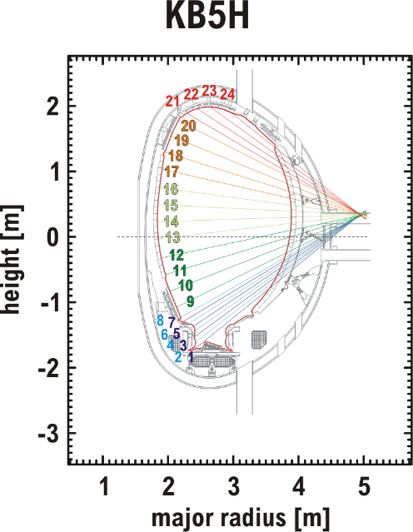
JET Bolometry in 2019-2020
Two toroidally separated bolometer fan arrays, KB5H & V
Injection Location
KB1s mostly not used;
noise/ slower time
resolution

Slide 5
Emis3D is a Rigorous Guess and Check Algorithm, Capable of Fitting 2D and 3D Structures
Library of Candidate Radiation Structures
Observation by Cherab
Synthetic Bolometry Data
Each Timestep
Each Structure
Experimental Bolometry Data
Calculate Reduced 𝜒_{r}²
Convert to P Value
Lowest P Value
$P_{rad}$(t)
Best Fit
Uncertainty Pool
Within 2$σ$
$W_{rad}$= $\int{P_{rad}}dt$
$$f_{rad}=\frac{W_{rad}}{W_{stored}}$$

Slide 6
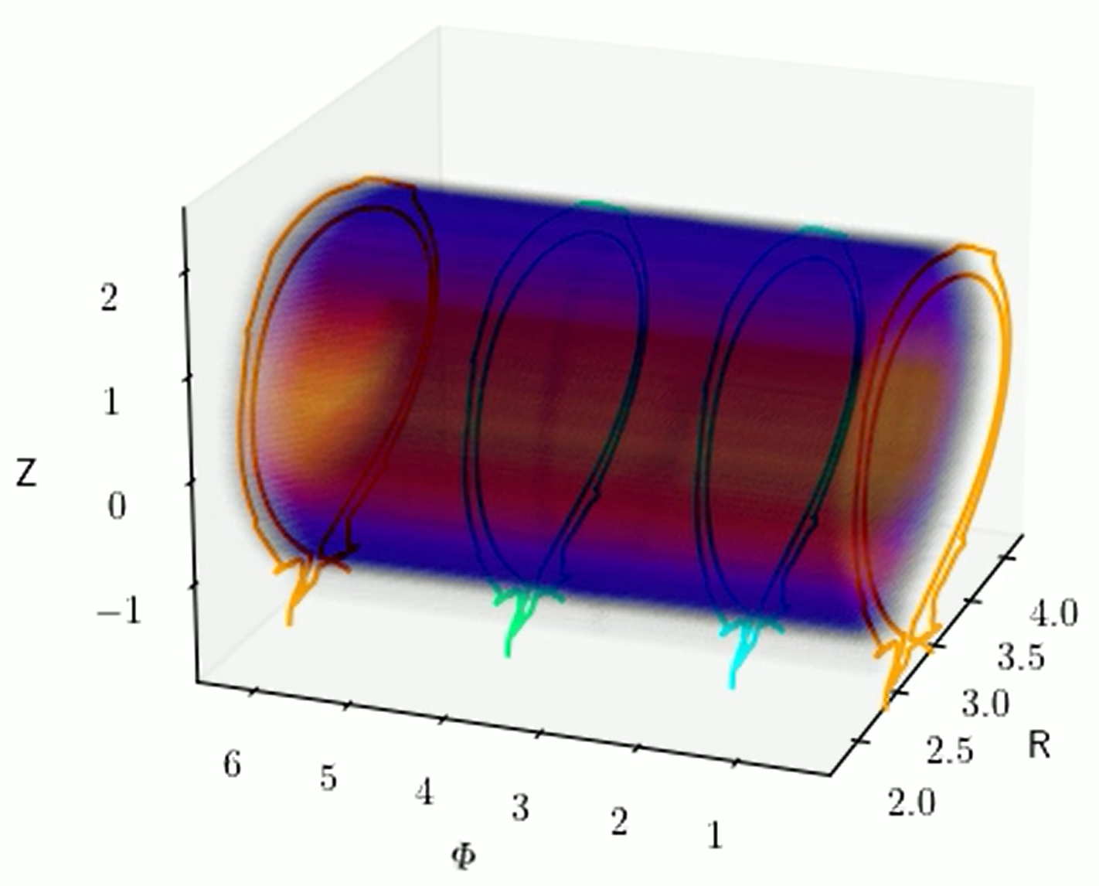
Candidate Radiation Distributions
“RadDist” object: a 3D function of local emissivity
$P_{rad}=f\left(r,z,φ\right)$ [W/m³]
Only shape; overall amplitude and toroidal distribution are determined in fitting
BOLT (Unwrapped)
[Pedro Carvalho]
Helical
JOREK Simulated

Slide 7
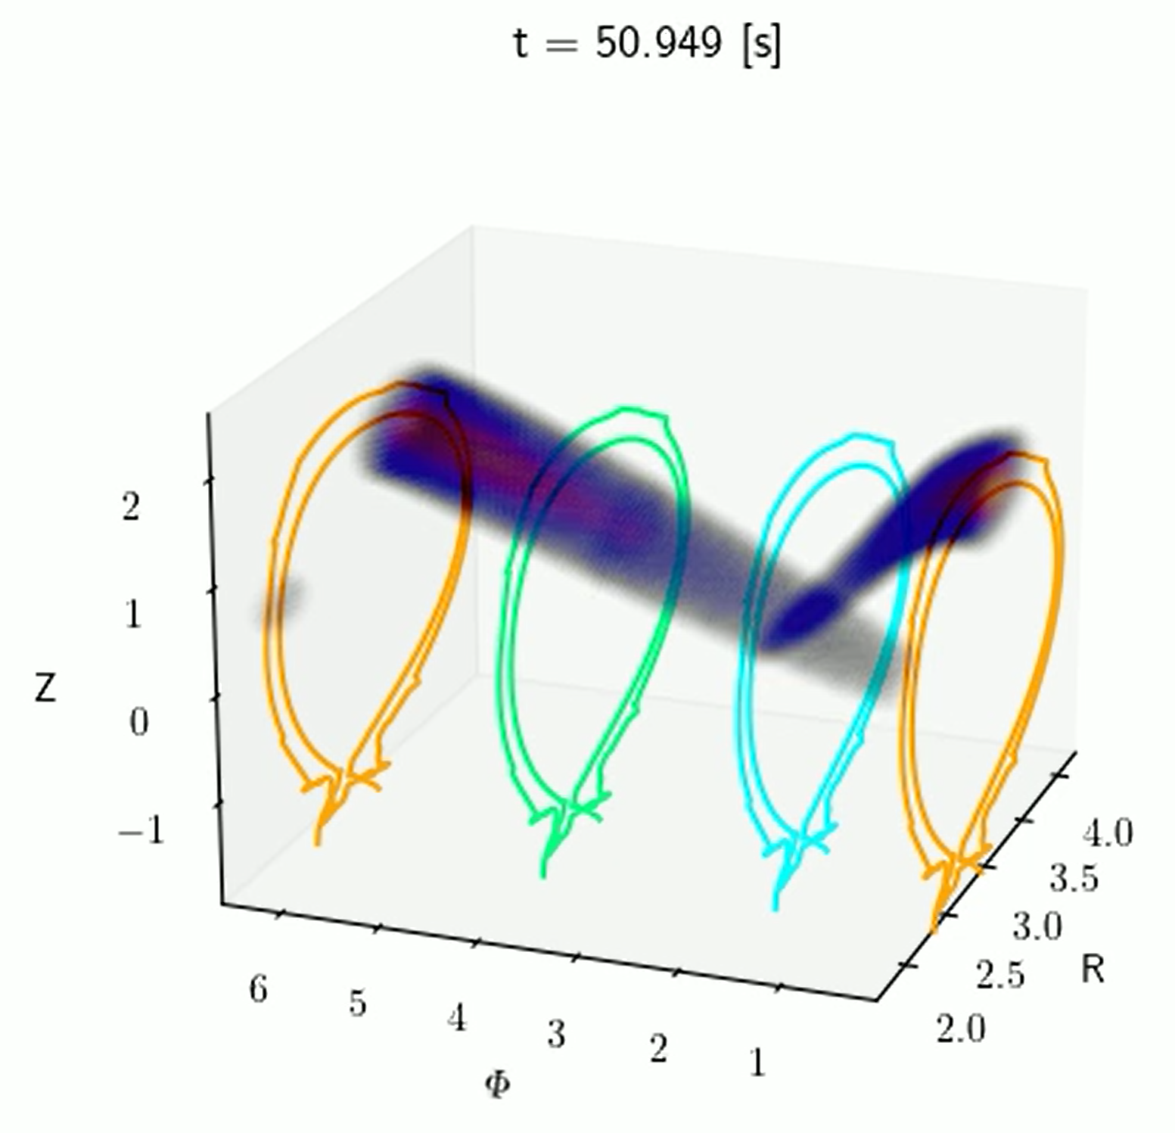
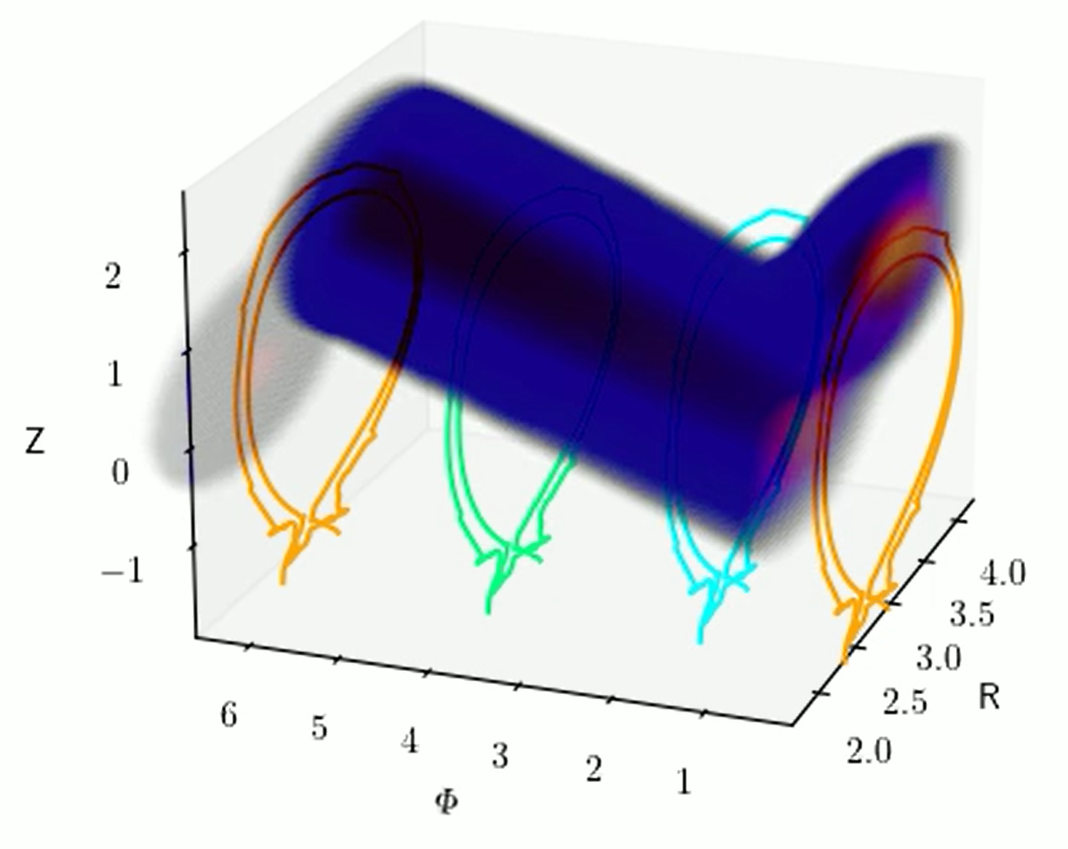
Candidate Radiation Distributions
Build many distributions of each type to sample
Centered on different field lines
Variation in poloidal width
Variation in helicity

Slide 8
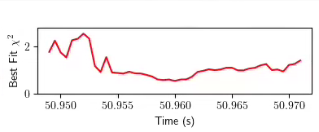
95709: Emis3D Finds Higher $W_{rad}$ Than TOPI
$W_{rad}=$10.95 MJ ($f_{rad}=0.95)$
Uncertainty range 0.68-1.0
Dominated by CQ, TQ Peak
TOPI
Emis3D
$I_{p}$ Spike Time
$W_{th}$
TOPI is not designed for disruption radiation
TOPI $W_{rad}$ is within error bars, but lower than best fits
CQ Best Fits are tomographic inversions
Helicals within the uncertainty during the CQ
Helical fits w/ toroidal peaking assumptions would lead to lower $P_{rad}$
Leads to lower, but not upper, error bars

Slide 9
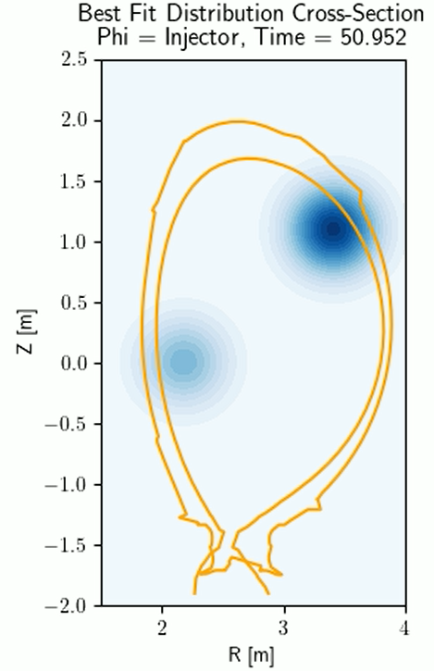
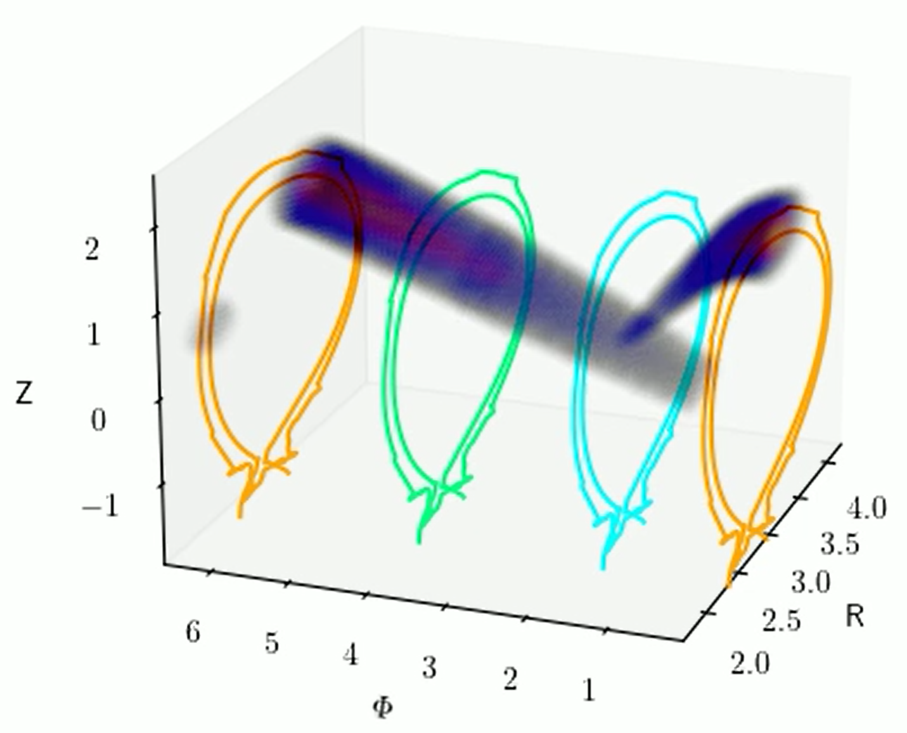
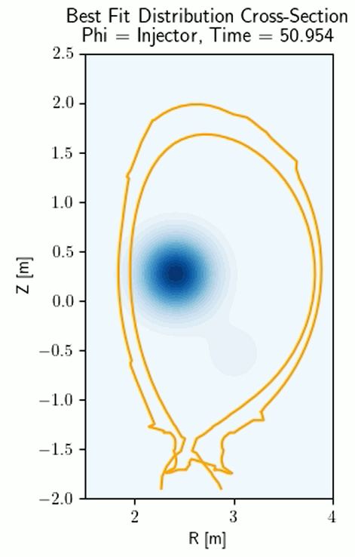
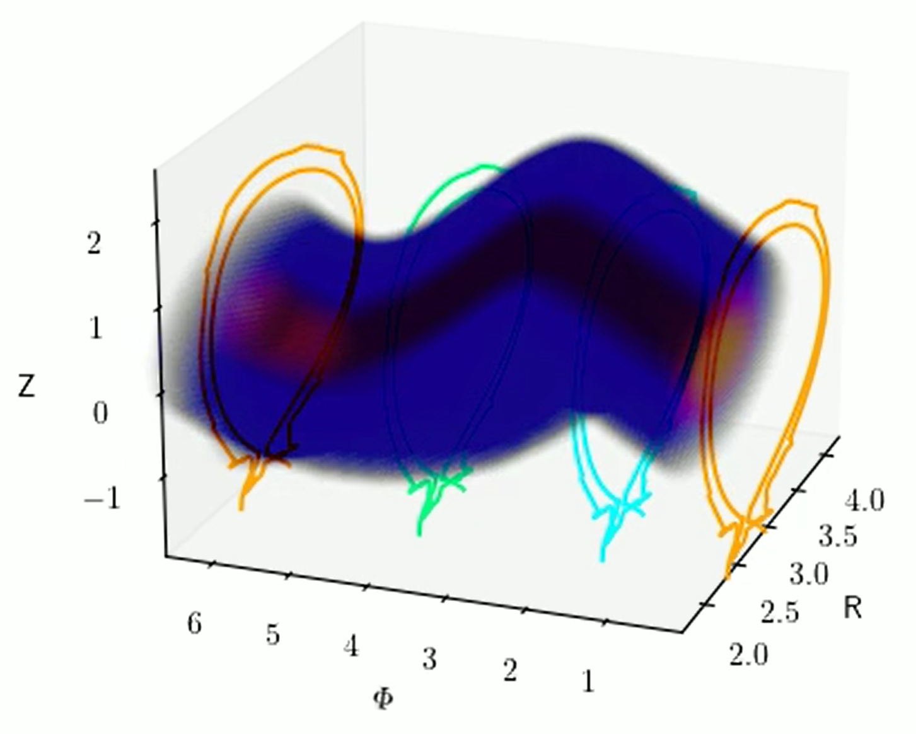
Shot 95709 Best Fits: Pre-TQ
Early radiation peaks near injector
Spreads toroidally from $φ_{injector}$
Spreads faster towards inboard side; magnetic nozzle effect?
Injection plane
Outboard
Inboard
Early Pre-TQ ($t\sim −5ms$)
Later Pre-TQ radiation is closer to plasma center
Possibly a more complicated structure than included in our pool
Injection plane
Late Pre-TQ ($t\sim −0.5ms$)

Slide 10
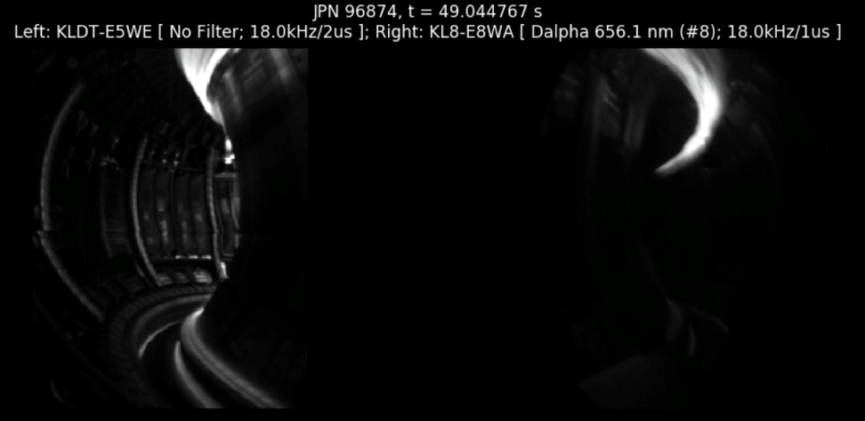
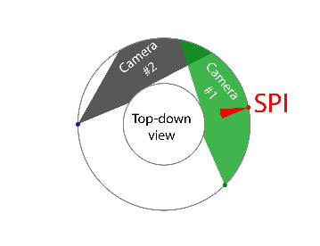
In the early pre-TQ, transport consistent with the magnetic nozzle effect is observed
Early Pre-TQ; impurities spread faster along field lines towards high-field (inboard) side
Proposed mechanism is particle flux conservation in a fluid mechanics model (?) See V.A. Izzo et al., NF 55 (2015)
Fast camera images of JET SPIs sometimes show this behavior (depends on filter)
Best fit helical distributions in Emis3D also support this model
Note Emis3D assumes radiation peak at $φ_{injector}$
Injection

Slide 11
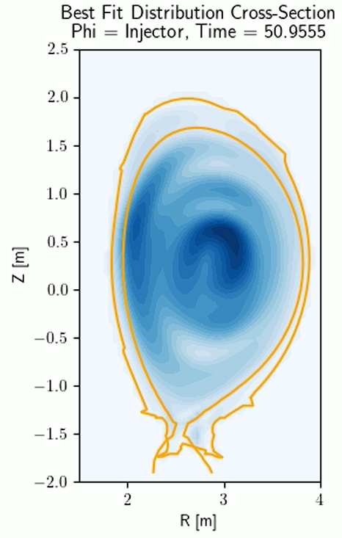
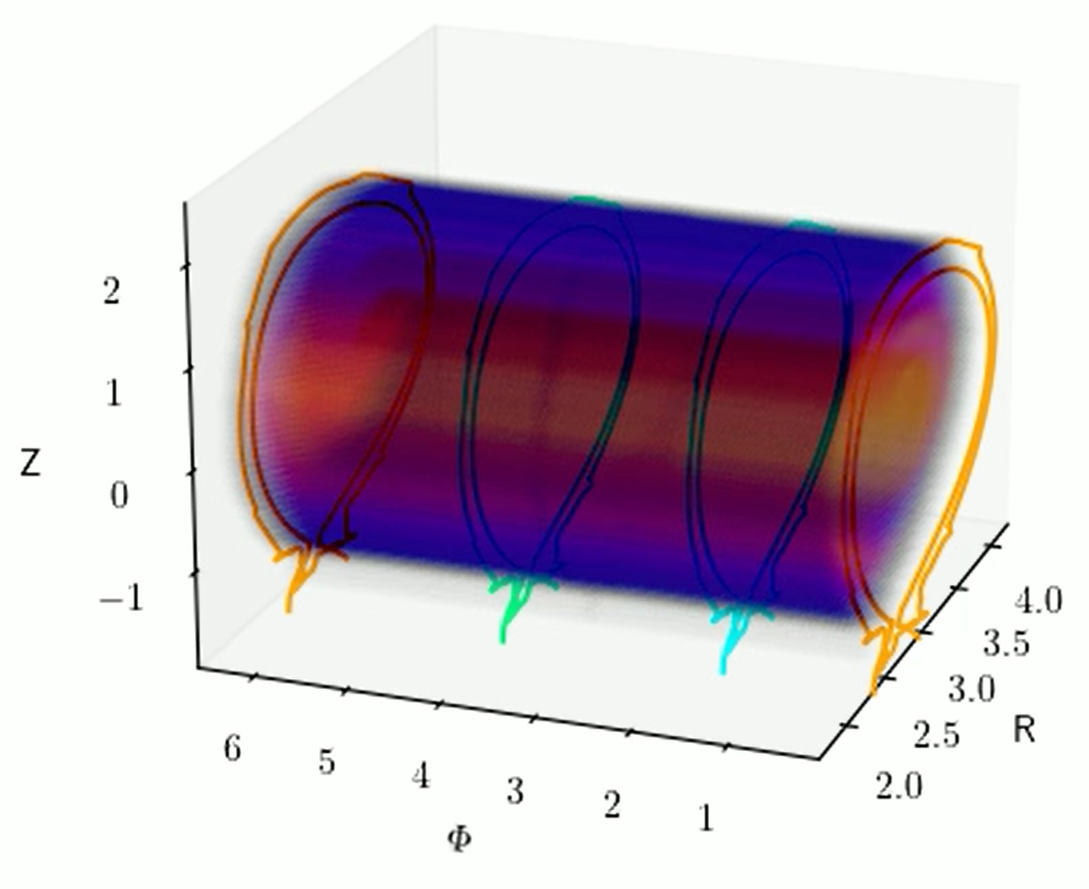
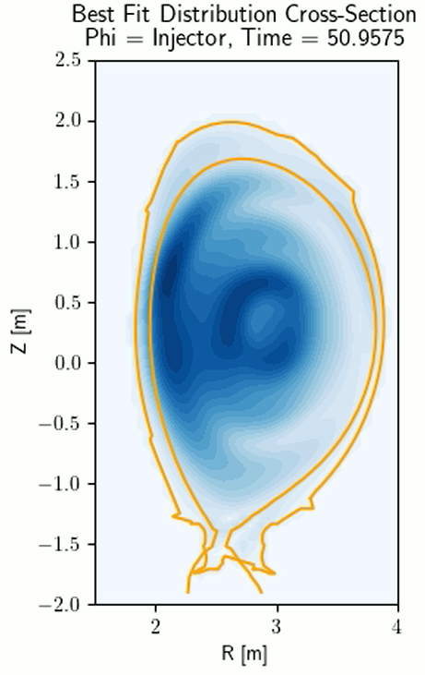
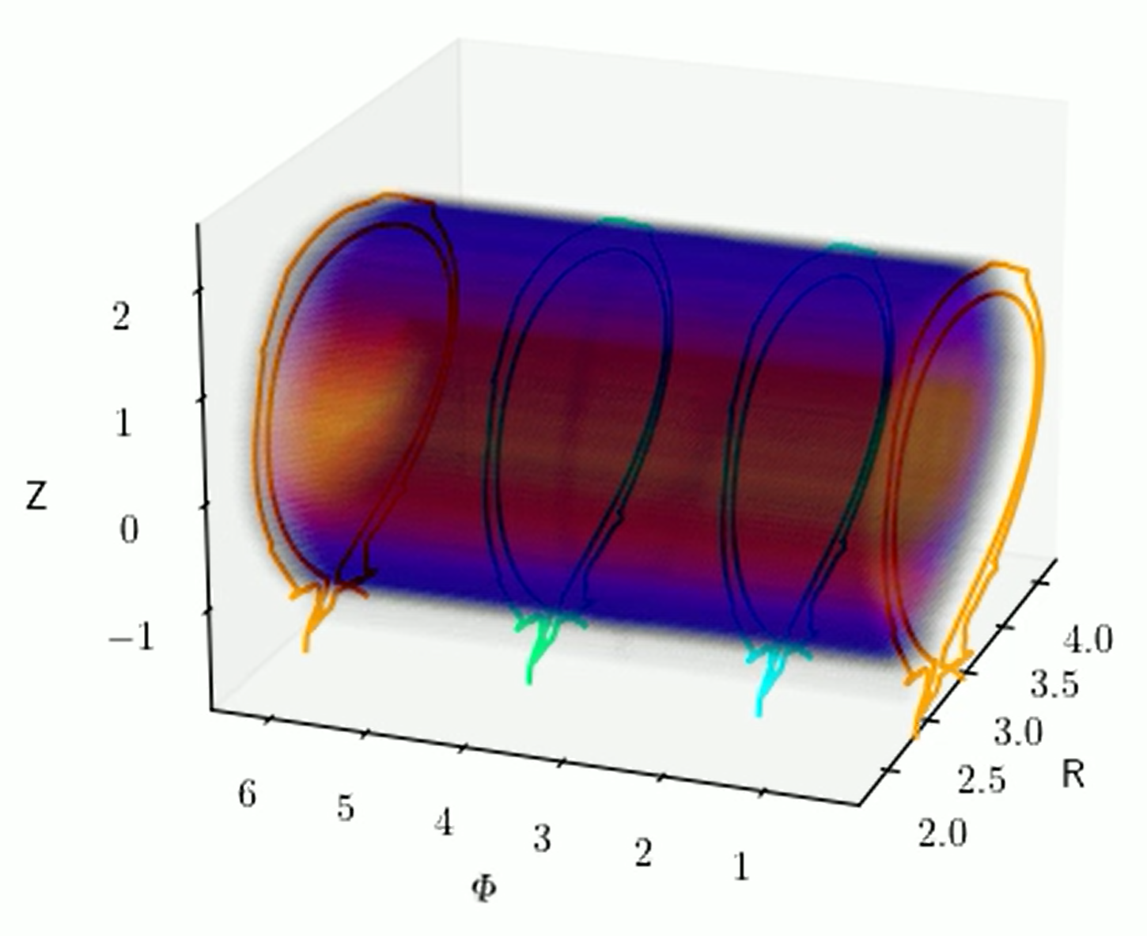
Shot 95709 Best Fits: TQ & CQ
Injection plane
Best fits for TQ and CQ are axisymmetric tomographies
[Credit: Pedro Carvalho]
Toroidally symmetric
Only CQ-specific distributions currently in pool
TQ, Rad Peak ($t=0ms$)
Injection plane
Mid CQ ($t\sim 2.5ms$)

Slide 12
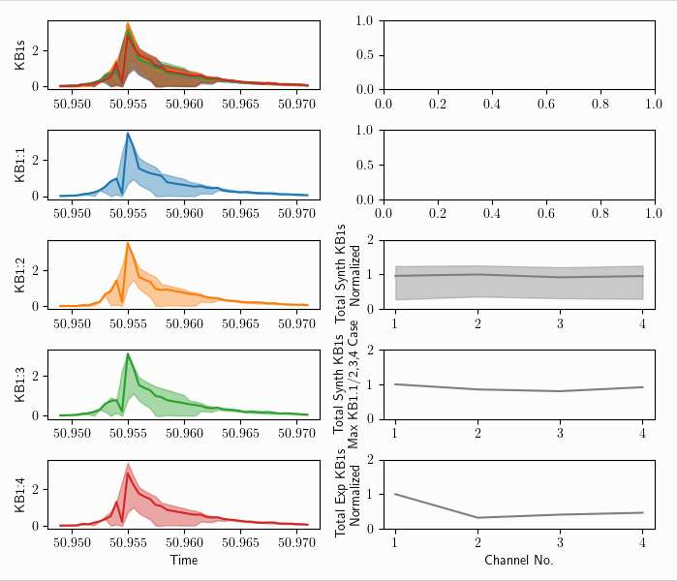
KB1s Suggest the Emis3D Best Fits are “Too Axisymmetric”
Four individual foil bolometer channels KB1.1-4
Located at different $φ_{toroidal}$ (~34°, 79°, 214°, 259°)
Otherwise identical views of plasma
Time-averaged over disruption; too noisy for fast time resolution
KB1.1 is nearest to $φ_{injector}$
In Emis3D, similar brightness predicted for all four channels
Experimentally, around 2x higher brightness seen in KB1.1 than 2-4

Slide 13
KB1s Suggest the Emis3D Best Fits are “Too Axisymmetric”
Possible resolutions:
The current quench radiation is more inboard than the tomographic inversions find, out of view of the KB1s
The thermal quench is more toroidally peaked AND the current quench radiation is less
Given f_{rad}~1, higher TQ peaking requires less radiation in the CQ for energy conservation
Four individual foil bolometer channels KB1.1-4
Located at different $φ_{toroidal}$ (~34°, 79°, 214°, 259°)
Otherwise identical views of plasma
Time-averaged over disruption; too noisy for fast time resolution
KB1.1 is nearest to $φ_{injector}$
In Emis3D, similar brightness predicted for all four channels
Experimentally, around 2x higher brightness seen in KB1.1 than 2-4

Slide 14
Emis3D suggests only two thirds of $W_{th}$is radiated before the Ip spike; the full thermal energy is radiated 0.5 ms after spike
If we separate TQ & CQ by current spike time:
Resulting $W_{rad, cq}$ is greater than stored magnetic energy
Resulting $W_{rad, tq}$ is $∼71\%$
($W_{th}=3.5MJ$, $W_{mag}=8.0MJ$)
For equal $f_{rad, tq}$, $f_{rad, cq}$, would have to separate $∼0.5ms$ after current spike
This is not a result of the standard bolometer time shift, which is already accounted for
Bolo time resolution is order 1ms

Slide 15
Emis3D suggests only two thirds of $W_{th}$is radiated before the Ip spike; the full thermal energy is radiated 0.5 ms after spike
Possible resolutions:
Just a time shift error
Consistent with the extended heat load deposition time found in G. Arnoux NF 2009
Or, just entirely due to bolometer time resolution
No time shift error, analysis is correct
$W_{rad,tq}$ is low
$W_{rad,cq}$ is over-estimated by toroidally symmetric fits. BOLTs possibly over-fit
If we separate TQ & CQ by current spike time:
Resulting $W_{rad, cq}$ is greater than stored magnetic energy
Resulting $W_{rad, tq}$ is $∼71\%$
($W_{th}=3.5MJ$, $W_{mag}=8.0MJ$)
For equal $f_{rad, tq}$, $f_{rad, cq}$, would have to separate $∼0.5ms$ after current spike
This is not a result of the standard bolometer time shift, which is already accounted for
Bolo time resolution is order 1ms

Slide 16
Magnetic Nozzle Effect
“To explain the asymmetry in the parallel flow of the ionized plume, we assume a steady state model for the ionization source. The source region coincides with the region localized in front of the injection port where the jet neutrals diffuse across the magnetic field and become ionized. The parallel flow of the ionized impurities away from the source region therefore obeys the continuity equation $ρAU=constant$, where $ρ$ is the mass density of the impurity ions, A is the cross sectional area of the flux tube, and U is the flow velocity. Since BA = constant, the differential form is
$$\frac{dρ}{ρ}+\frac{dU}{U}−\frac{dB}{B}=0$$
The impurity plume and background plasma are rapidly heated to some common equilibrium temperature reflecting the balance between ohmic heating and radiation losses. The momentum equation $ρUdU=−dρ$, can therefore be written as $pUdU=−(dp/dρ)$, where $dp/dρ=C_{s}^{2}$ is the square of the isothermal sound speed, $C_{s}^{2}=\left(1+Z\right)T/m$ with m and Z being the mass and mean charge state of the ions, respectively. Elimination of $dρ/ρ$ between this equation and equation (1) leads to a ‘nozzle’ flow equation
$$\frac{dU}{U}=\frac{1}{(1−M^{2})}\frac{dB}{B}$$
where $M=U/C_{s}$ is the isothermal Mach number, which is very small (M ≪ 1) near the source. The fluid speed therefore increases as it approaches the high field side ($dU/U$ is positive) and continues accelerating until it reaches M = 1 at the inboard side of the torus where $dB/B→0$. The flow towards the low field side is thwarted since $dU/U$ is negative. This simple nozzle model offers an explanation for the impurity flow asymmetry predicted by NIMROD. Experimental confirmation of this particular flow attribute remains to be seen. Previously, the effect of grad-B on radial transport of ablated pellet material has been considered by Parks [16]. Also in the context of pellet cloud expansion, a ‘magnetic nozzle’ effect has been previously discussed by Chang [17], but only as a consequence of local expansion of the magnetic field around the pellet cloud, not due to the global magnetic field gradient.”
[V.A. Izzo et al., NF 55 (2015)]

Slide 17
95711: Similar f_{rad} to 95709 and comparable to TOPI
$W_{rad}=$11.48 MJ ($f_{rad}=0.98)$
Uncertainty Range 0.81-1.0
TOPI
Emis3D
$I_{p}$ Spike Time
$W_{th}$
Overall similar trends to 95709
Smaller increase in $W_{rad}$
TOPI’s radiation peak was much higher for 95711 than 95709
Higher TPF at TQ time than 95709; peaked near KB5V?
Would explain TOPI overestimate

Slide 18
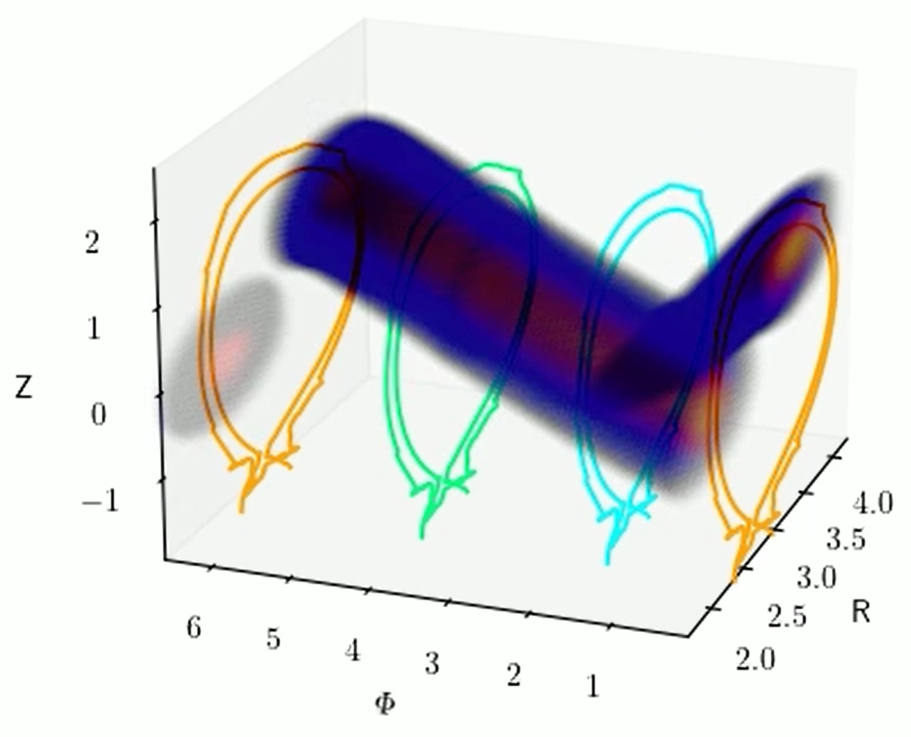
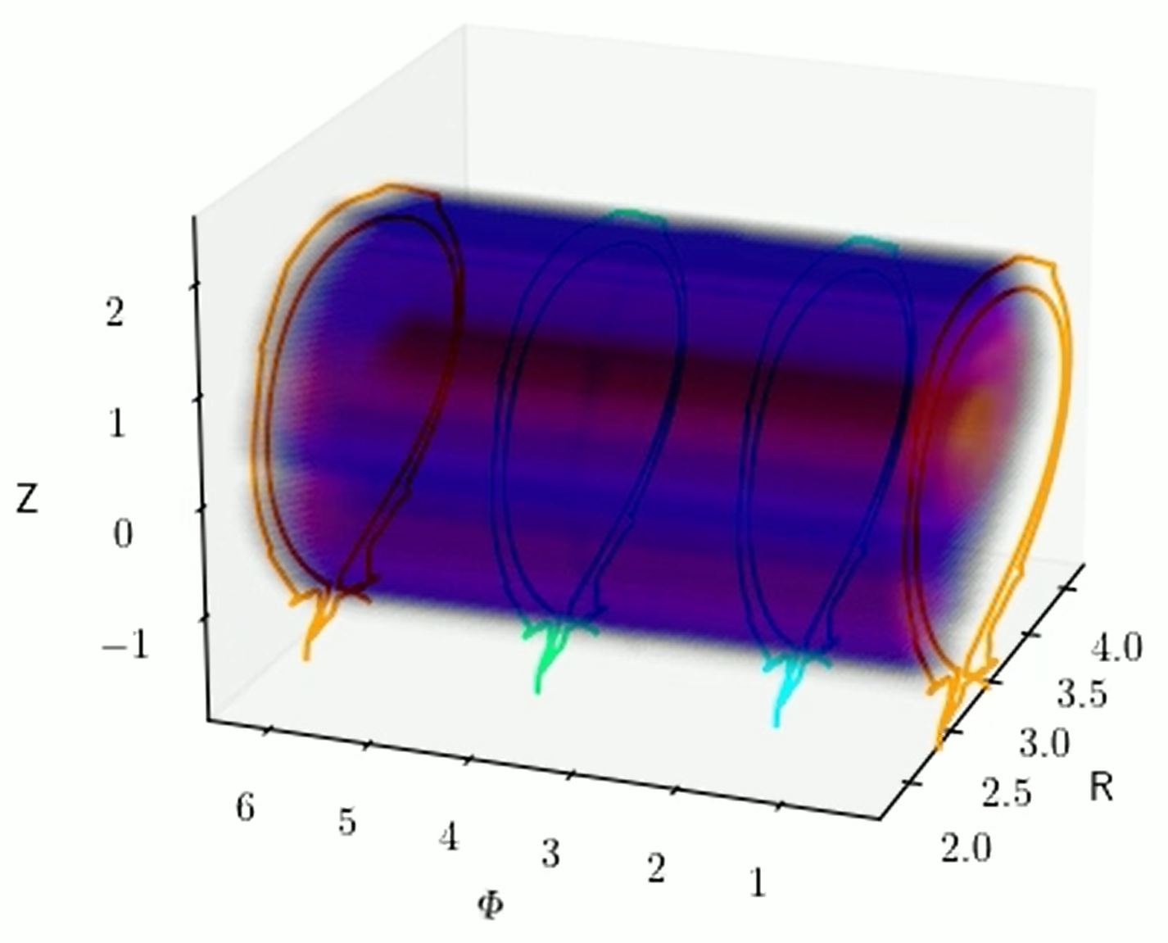
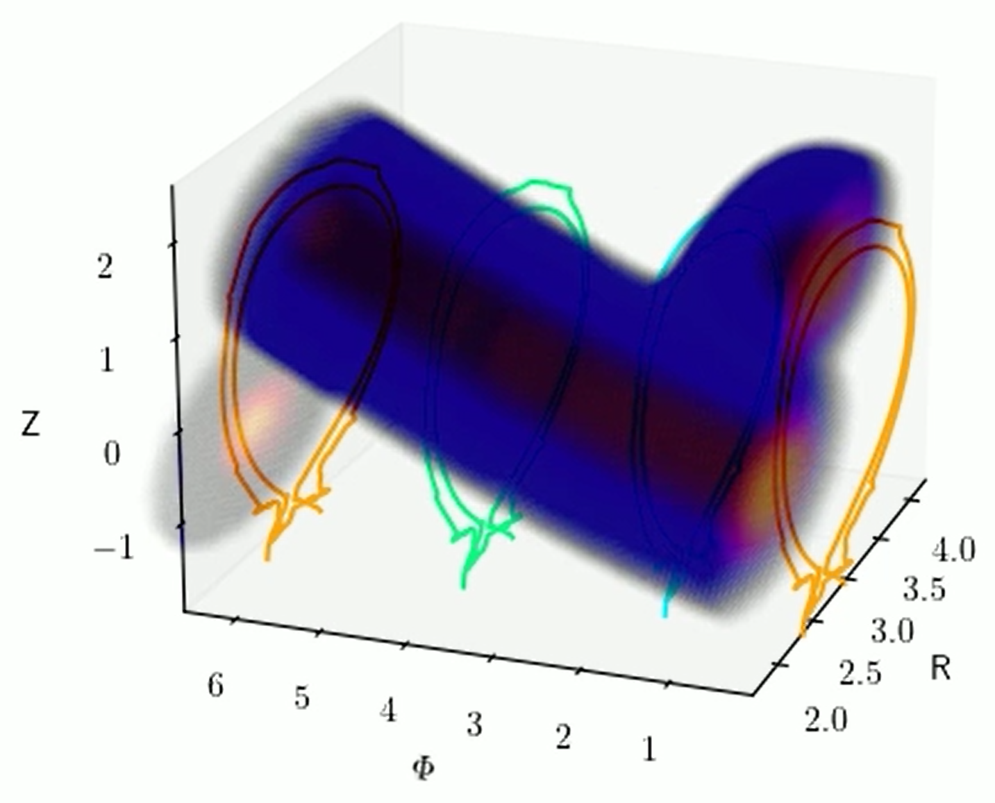
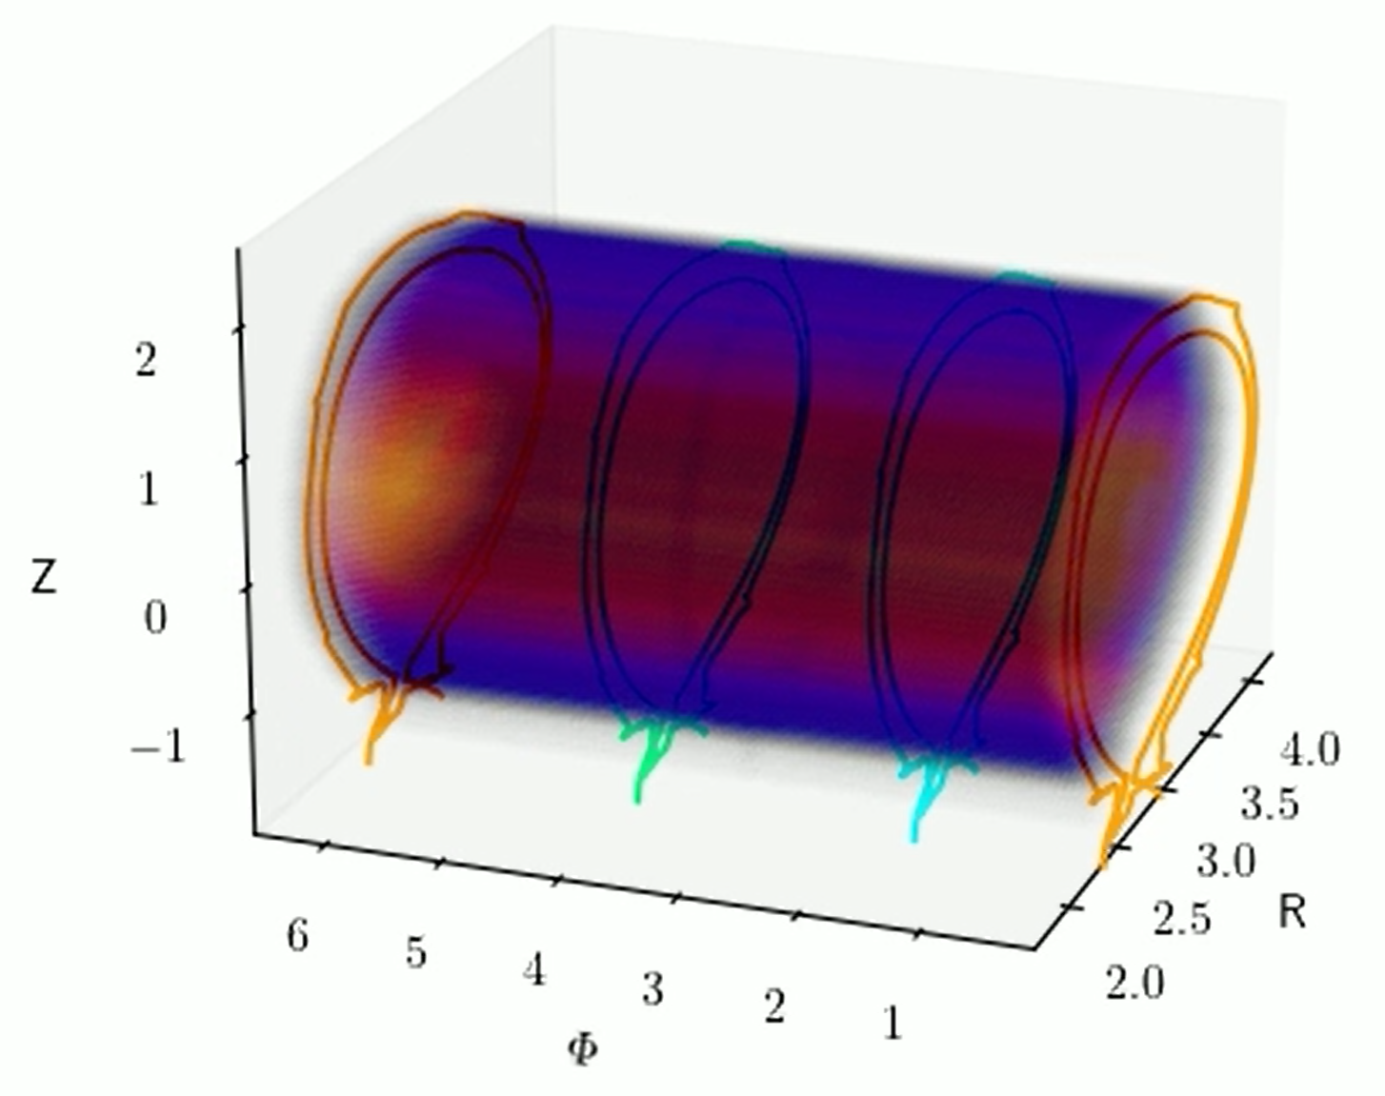
Shot 95711 Best Fits: Similar to 95709
Early Pre-TQ ($t∼−2.5ms$)
TQ, Rad Peak ($t∼0ms$)
Late Pre-TQ ($t\sim −1ms$)
CQ
($t∼3.5ms$)

Slide 19
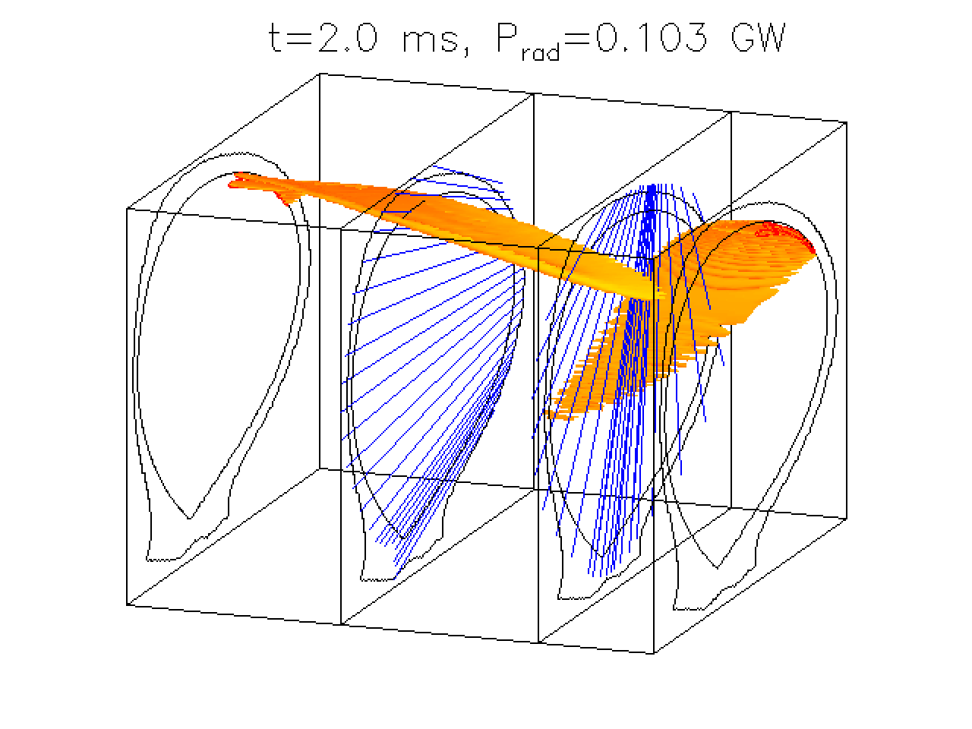
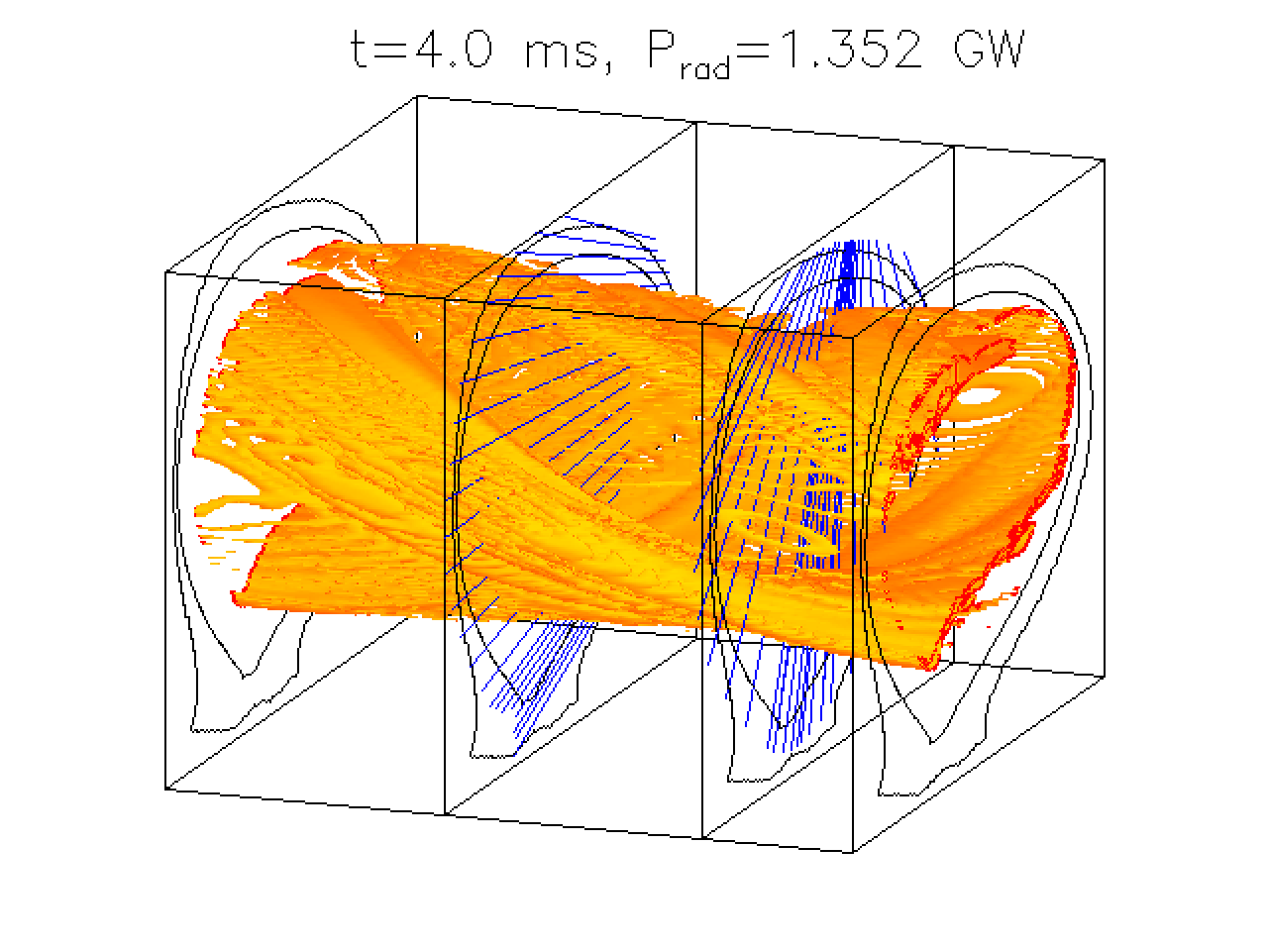
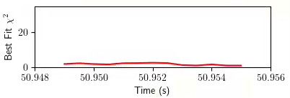
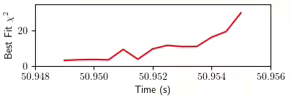
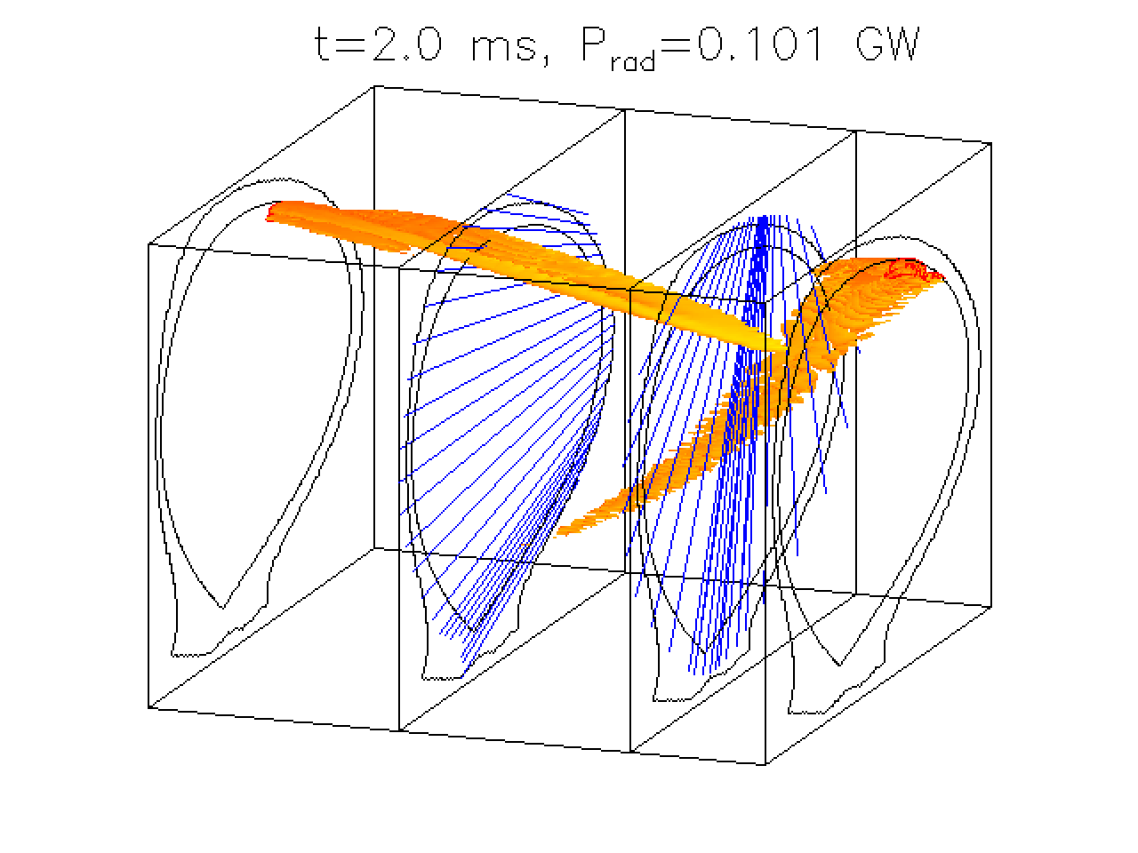
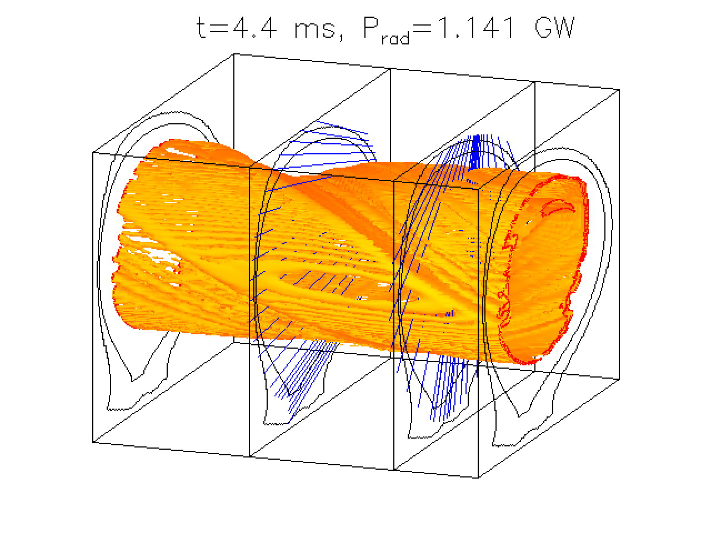
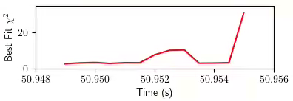
JOREK simulations exhibit some magnetic nozzle behavior and produce similar radiation structures to Emis3D best fits
Early Pre-TQ
Late Pre-TQ
Emis3D Best Fits
First Simulation
First Simulation
Second Simulation
Second Simulation

Slide 20
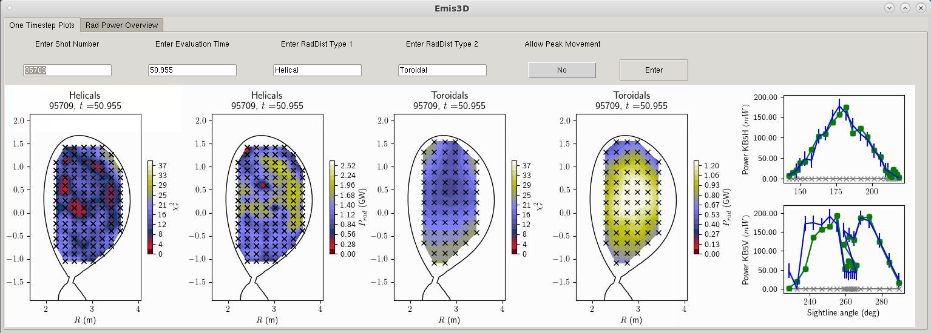
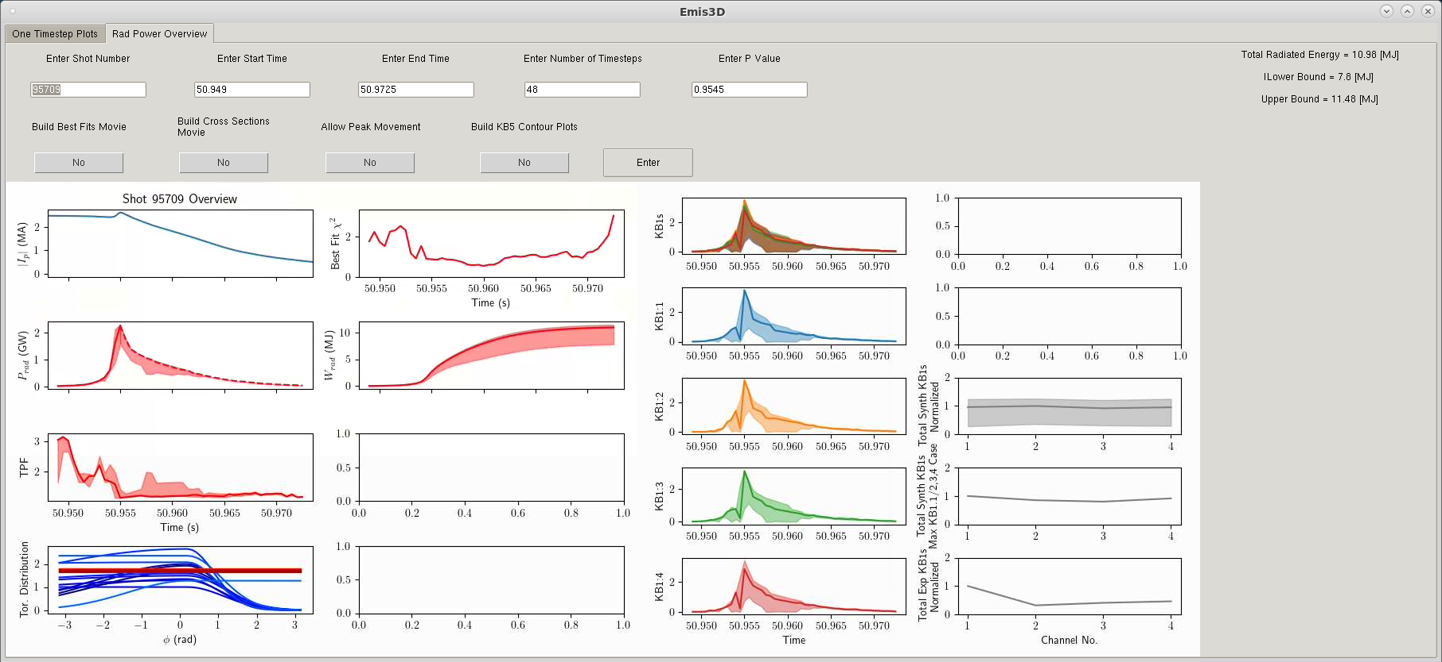
A GUI is developed and available for use on JET SPI experiments

Slide 21
Conclusions
Near full mitigation is predicted in discharges 95709 and 95711, but questions remain:
Why is only ~70% of the thermal energy radiated prior to the Ip spike?
Why is the asymmetry observed by the KB1s underpredicted?
Q: Why such different f_{rad} for nominally identical mitigation attempts?
A: TOPI overestimates TQ peak radiation for 95711 compared to 2D inversions
95711 TQ radiation is peaked near KB5V more than 95709
95711 has shorter pre-TQ; less impurity spreading -> more peaked?

Slide 22
Next Steps
Continued 95709 and 95711 analysis:
Remove the flux-aligned requirement for the CQ tomographies and make coarser to avoid overfitting
Entertain “designer solutions” to improve agreement with KB1s
Use Emis3D to qualify the SPARC disruption bolometer
With Emis3D fully developed and tested, re-evaluate the f_{rad} vs. f_{th} JET dataset
Clear differences in bolometry observable “by eye” across the SPI discharges, and Emis3D will help to understand this
Older MGI discharges exhibiting this trend will also be studied

Slide 23
Extra Slides

Slide 24
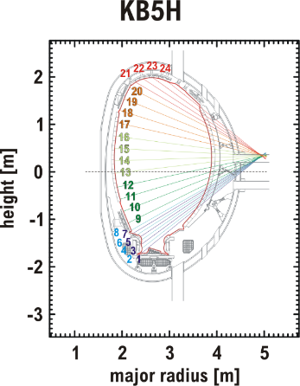
Cherab Overview
Ray-tracing, synthetic diagnostic framework
Raysect based (https://www.raysect.org/)
Traces bolometer sightlines, integrates emissivity
Fast Camera Image
Cherab Synthetic Camera
Produces synthetic bolometer brightnesses for each candidate radiation structure

Slide 25
Emis3D High Level Overview
Physics motivated “guess and check” tool for 3D emissivity structures
A library of emissivity structure “candidates” is constructed in advance
At each timestep:
Each candidate is tested against the bolometry data. Goodness of fit quantified by a reduced 𝜒_{r}² statistic: $χ_{ν}^{2}= \frac{1}{ν} \sum_{i}{\frac{{\left(O_{i}−C_{i}\right)}^{2}}{σ_{i}^{2}}}$
Bolometry data is compared to synthetic data associated with each candidate. Synthetic data is obtained using the Cherab synthetic diagnostic framework [M. Carr et al. EPS 2017]
The best fit out of the full library is identified
An “uncertainty pool” of candidates within 2 standard deviations of the best fit is identified
This process is repeated for every time step in the disruption
The result is a sequence of best fit radiation structures, which provide corresponding time-resolved radiated powers and toroidal peaking factors
Error bars are derived from the uncertainty pool
Does not assume toroidal symmetry: non-axisymmetric candidates permitted

Slide 26
Emis3D High Level Overview
Library of Candidate Radiation Structures
Observation by Cherab
Synthetic Bolometry Data
Each Timestep
Each Structure
Experimental Bolometry Data
Calculate Reduced 𝜒_{r}²
Convert to P Value
Lowest P Value
$P_{rad}$(t)
Best Fit
Uncertainty Pool
Within 2$σ$
$W_{rad}$= $\int{P_{rad}}dt$
$$f_{rad}=\frac{W_{rad}}{W_{stored}}$$

Slide 27
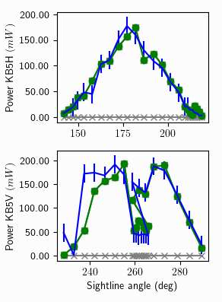
𝜒_{r}² Fitting of Candidates to Bolometry
Cherab observes radiation distribution, produces Synthetic Measurements
Compare to Experimental Measurements, produce a 𝜒_{r}² value for goodness of fit
Some variation in fitting by distribution type. “Helicals” can have up to two punctures
Signal magnitudes fit independently at each array
This provides more freedom for BOLTs, Joreks, Rings to fit the data; some risk of over-fitting

Slide 28
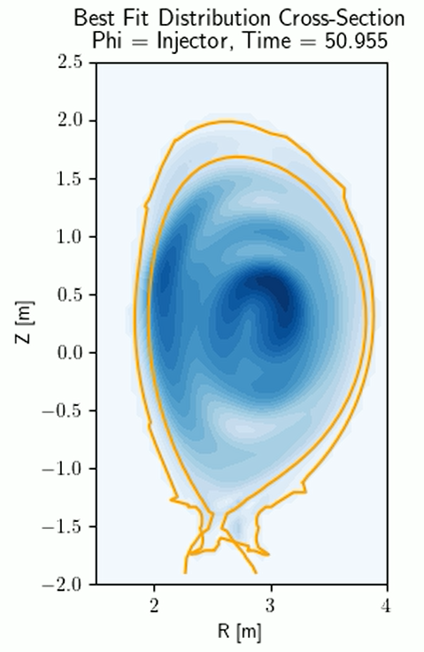
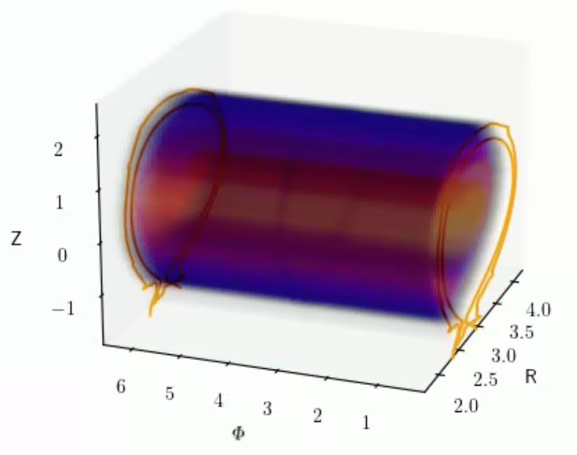
𝜒_{r}² Fitting of Candidates to Bolometry

Slide 29
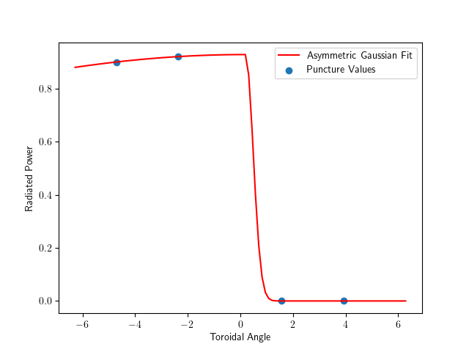
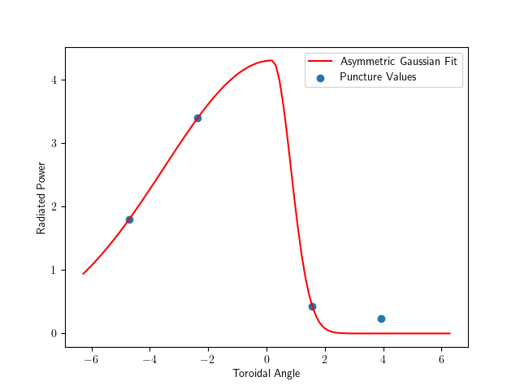
Toroidal Overlay for Helicals
Helical radiation structures follow field lines
Can wrap around tokamak multiple times
Multiple punctures through plane of each KB5 array
Emis3D follows up to 2 punctures
Best fit magnitudes of each puncture found in fitting process
Condition: $\left|Punc 2\right|<|Punc 1|$
Provides four toroidal data points
Toroidal distribution fit to these 4 points
We assume an asymmetric gaussian shape peaked at $θ_{injector}$
This choice affects $P_{rad}, TPF$ but not best fit

Slide 30
Emis3D High Level Overview
Library of Candidate Radiation Structures
Observation by Cherab
Synthetic Bolometry Data
Each Timestep
Each Structure
Experimental Bolometry Data
Calculate Reduced 𝜒_{r}²
Convert to P Value
Lowest P Value
$P_{rad}$(t)
Best Fit
Uncertainty Pool
Within 2$σ$
$W_{rad}$= $\int{P_{rad}}dt$
$$f_{rad}=\frac{W_{rad}}{W_{stored}}$$

Slide 31
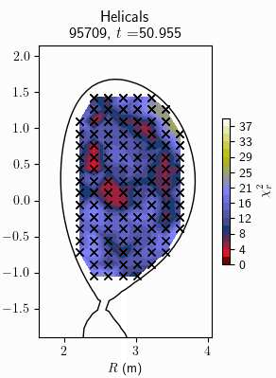
Workflow: Each Timestep
All distributions give a 𝜒_{r}² at each timestep
Lowest 𝜒_{r}² is Best Fit solution
𝜒_{r}² corresponds to P-value according to the formula [add formula here]
Candidates with $P≥(P_{best}⋅0.95)$ are in the “Uncertainty Pool” ($\sim 2$ std errors)
This is what we use to calculate error bars for total radiated power, peaking factor, etc.
Uncertainty pool definition has some trade-offs. See optional slide

Slide 32
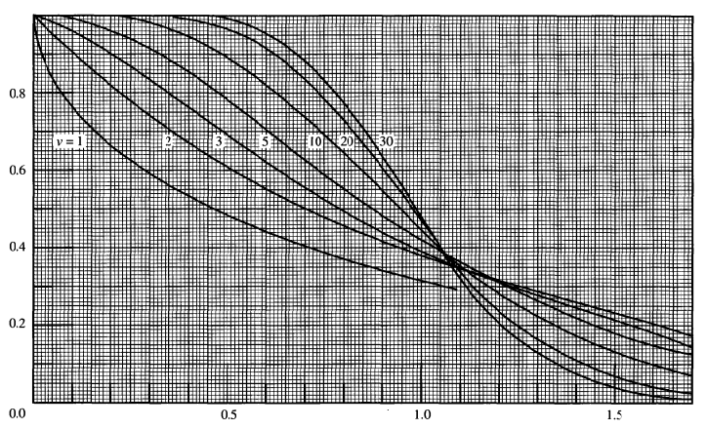
Uncertainty Pool and Error Bars
$χ_{ν}^{2}$ related to P value through $χ^{2}$ distribution
P value related to standard errors through 68-95-99.7 rule
Trade-offs
$σ_{bolo}$ not well known during disruptions
Size of error pool is dependent on available candidates. Worse $χ_{ν}^{2}→$ smaller pool
Current approach; cutoff at 2 std. errors above best fit
$$P_{cutoff}=\left(1 −0.95\right)⋅P_{best}$$
P Value
$${χ_{ν}^{2}}/ν$$
[Data Reduction and Error Analysis for the Physical Sciences, 3rd edition, Bevington & Robinson, pg 258]

Slide 33
95709 and 95711 Best Fit $χ^{2}$ Plots

Slide 34
Acknowledgements
The JET SPI project is a collaborative effort of EURATOM, the ITER Organization, and the US Department of Energy. It received funding from the ITER Organization.
The views and opinions expressed herein do not necessarily reflect those of the ITER Organization
This work was funded by the U.S. Department of Energy, Fusion Energy Sciences Agreement DE-SC0014264, the ITER Organization (TA C18TD38FU), and the EUROfusion Consortium framework, Euratom research and training programme under grant No 633053

