Slide 1

Magnetohydrodynamic Modeling of Shattered Pellet Injection and Runaway-Electron Dynamics
by
Brendan C. Lyons¹
C.C. Kim², J. McClenaghan¹, Y.Q. Liu¹, L.L. Lao¹, C. Akcay¹, T.A. Bechtel^{3,1}, N.M. Ferraro⁴, S.C. Jardin⁴, Yu. V. Petrov⁵, R.W. Harvey⁵, N.W. Eidietis¹, N. Hawkes⁶, G. Szepesi⁶, J. Kim⁷, S. Lee⁸, M. Lehnen⁹ and JET* & KSTAR contributors
¹General Atomics
²SLS2 Consulting
³Oak Ridge Institute for Science and Education
⁴Princeton Plasma Physics Laboratory
⁵CompX
⁶Culham Centre for Fusion Energy
⁷National Fusion Research Institute
⁸Seoul National University
⁹ITER Organization
*See the author list of E. Joffrin et al. 2019 Nucl. Fusion 59 112021
Presented at the
IAEA Second Technical Meeting on Plasma Disruptions and their Mitigation
July 21st, 2022

Slide 2
Many Grants Provide Opportunities of Synergistic Research
US DOE grants used for code validation & close collaboration with experiment
  GA Theory (DE-FG02-95ER54309) and DIII-D (DE-FC02-04ER54698)
  CTTS SciDAC for MHD modeling (DE-SC0018109)
  JET/KSTAR Disruption Mitigation Solution (DE-SC0020299)
  SCREAM SciDAC for runaway-electron modeling (DE-SC0016452)
National Energy Research Scientific Computing Center for high-performance computing

Slide 3
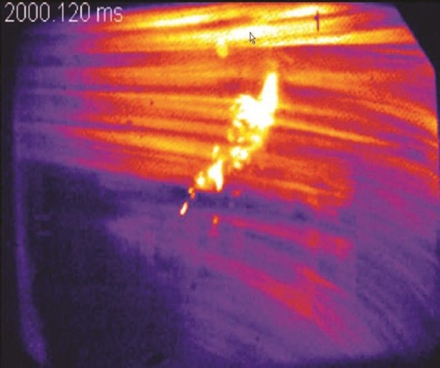
Studying of Disruption Dynamics and Mitigation Requires Multiphysics Models
Simulations validated against experiments are required to project mitigation techniques to future devices
Integrated model is required to capture all relevant physics
  Magnetohydrodynamics (MHD) for macroscopic evolution of disruption dynamics
  Atomic physics for impurity ionization/radiation
  Drift-kinetics for runaway-electron (RE) evolution
Disparate spatial and temporal scales make numerical modeling particularly challenging
M3D-C1¹, NIMROD^{2,3}, & MARS-F⁴ are rising to this challenge
  Different physics and numerical model provide robust verification opportunities
  Each coupled to reduced and high-fidelity models for non-MHD physics
  Multiple codes permit parallel research efforts
SPI
DIII-D shattered pellet injection (SPI)
D. Shiraki, IAEA presentation 2016
¹S. C. Jardin, et al., Comput. Sci. Discovery 5, 014002 (2012)
²C. R. Sovinec et al., J. Comput. Phys. 195, 355 (2004)
³C. Sovinec & J. King, J. Comput. Phys. 229, 5803 (2010)
⁴Y.Q. Liu & A. Bondeson, Phys. Plasmas 7, 3681 (2000)

Slide 4
Outline
Overview of key code capabilities
Benchmarking M3D-C1 and NIMROD SPI modeling
M3D-C1 & NIMROD simulations of SPI in JET
Initial M3D-C1 simulations of SPI in KSTAR
Coupled NIMROD-CQL3D modeling of runaway-electron dynamics
MARS-F modeling of runaway-electron dynamics

Slide 5
Outline
Overview of key code capabilities
Benchmarking M3D-C1 and NIMROD SPI modeling
M3D-C1 & NIMROD simulations of SPI in JET
Initial M3D-C1 simulations of SPI in KSTAR
Coupled NIMROD-CQL3D modeling of runaway-electron dynamics
MARS-F modeling of runaway-electron dynamics

Slide 6
M3D-C1 and NIMROD Extended-MHD Solvers are Coupled to Impurity Ionization/Radiation Models
Both codes solve full, nonlinear, 3D extended MHD equations
  M3D-C1 uses a complete C¹ finite-element representation
  NIMROD uses finite elements in poloidal plane and Fourier modes toroidally
Coupled to the KPRAD¹ impurity model
  Low-density, coronal non-equilibrium model based on ADPAK rate coefficients
  Impurity & electron densities evolve according to ionization and recombination
  Thermal energy lost from plasma due to ionization and radiation
  NIMROD uses single-temperature, M3D-C1 uses single or two-temperature
Ablation formula based on Parks model² (in reasonable agreement with Lagrangian particle code) with ability to model multiple pellets and plumes
¹D.G. Whyte, et al., Proc. of the 24th Euro. Conf. on Controlled Fusion and Plasma Physics, Berchtesgaden, Germany, 1997, Vol. 21A, p. 1137.
²P.B. Parks, Theory & Simulations of Disruptions Workshop, PPPL 2017.

Slide 7
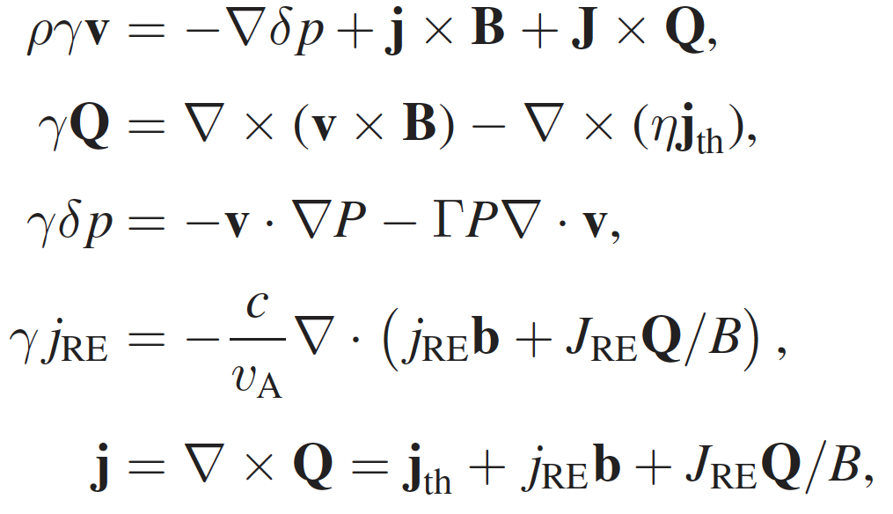
MARS-F Code has Been Updated to Study Runaway Electrons in Post-disruption Tokamak Plasmas
REORBIT module solves for test particle guiding center drift orbit tracing in presence of 3D perturbations
  RE suppression due to resistive kink in DIII-D post-TQ plasmas [1,2]
  RE mitigation due to RMP in COMPASS [3]
  RE loss due to MHD instabilities in ITER [4]
  Also applied for energetic ion orbits [5] and losses [6] due to 3D fields in ITER
Rosenbluth-Putvinski 2D avalanche model time-advanced together with n=0 MHD equations
  RE avalanche modeling for DIII-D [7]
  Model does not include partial screening due to bound electrons
Hybrid formulation where REs treated as a fluid species
  REs on tearing-mode stability with favorable curvature effect [8]
  Interaction between REs & 1/1 internal kink in post-TQ plasmas [9]
  Work in progress to add ExB drift of REs
C. Paz-Soldan, PPCF 61, 054001(2019)
Y.Q. Liu, NF 59, 126021 (2019)
Y.Q. Liu, PoP 27, 102507 (2020)
Y.Q. Liu, NF 62, 066026 (2022)
Y.Q. Liu, NF 61, 106209 (2021)
Y.Q. Liu, NF 62, 066011 (2022)
Y.Q. Liu, NF 61, 066038 (2021)
L. Li, NF 61, 096034 (2021)
Y.Q. Liu, NF 61, 116021 (2021)

Slide 8
Outline
Overview of key code capabilities
Benchmarking M3D-C1 and NIMROD SPI modeling
M3D-C1 & NIMROD simulations of SPI in JET
Initial M3D-C1 simulations of SPI in KSTAR
Coupled NIMROD-CQL3D modeling of runaway-electron dynamics
MARS-F modeling of runaway-electron dynamics

Slide 9
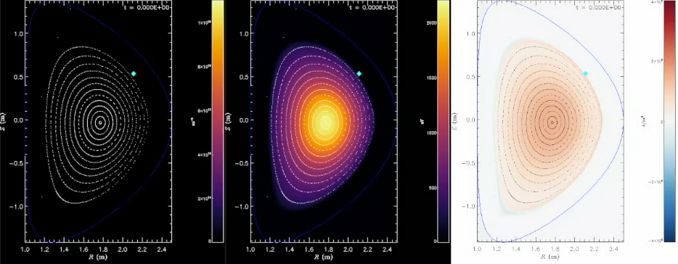
3D, Nonlinear Benchmark Between M3D-C1 & NIMROD for Realistic, Injected Pellet is Well-Underway
3D nonlinear MHD
  Fixed boundary
  Single-temperature equation
Pellet/deposition parameters
  3 mm radius, pure neon
  5 cm poloidal and 2.4 m toroidal half-width
  200 m/s with realistic trajectory
  Ablation by local electron density and temperature according to model by Parks
Work has motivated code development and provided insight into SPI physics
M3D-C1 Modeling of DIII-D 160606 @ 2990 ms:
0.7 MJ, 1.28 MA
Impurity
Density
Electron
Temperature
Toroidal
Current Density
bitly.com/C1bm715

Slide 10
M3D-C1 & NIMROD Show Decent Agreement, but Differ in Timing of Instability Onset
Early, radiation driven thermal quench in good agreement
NIMROD shows earlier spike in radiation, driven by earlier MHD instability onset
Progress made, but work ongoing to determine source of remaining differences

Slide 11
M3D-C1 & NIMROD Show Decent Agreement, but Differ in Timing of Instability Onset
Early, radiation driven thermal quench in good agreement
NIMROD shows earlier spike in radiation, driven by earlier MHD instability onset
Progress made, but work ongoing to determine source of remaining differences

Slide 12
Two-Temperature Modeling Shows Delayed Thermal Quench
M3D-C1 benchmark case re-run with two-temperature model
Early dynamics similar, but deviates as electrons cool faster than single-temperature model
  Less ablation and ionization
  Slower thermal quench
  Delayed instability
Single-temperature model may underpredict thermal-quench times and overpredict pellet assimilation

Slide 13
Outline
Overview of key code capabilities
Benchmarking M3D-C1 and NIMROD SPI modeling
M3D-C1 & NIMROD simulations of SPI in JET
Initial M3D-C1 simulations of SPI in KSTAR
Coupled NIMROD-CQL3D modeling of runaway-electron dynamics
MARS-F modeling of runaway-electron dynamics

Slide 14
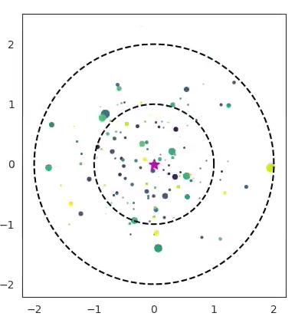
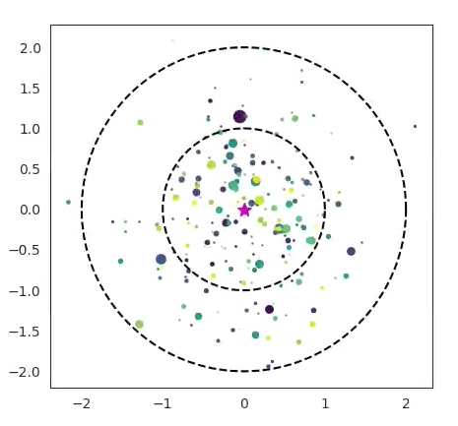
Multi-Fragment Modeling Uses Realistic Model for Shattered Plumes
Same parameters, different random plumes
Script created to generate shatter plumes based on fracture-threshold theory
T.E. Gebhart et al. IEEE 48, 6 (2019)
Various ordered or random spatial-distribution options
Easily generate random (but reproduceable) plumes for different pellet size, speed, and composition
Being used for reference plumes in JET & KSTAR modeling by M3D-C1, NIMROD, and JOREK

Slide 15
M3D-C1 Modeling with Realistic Plumes Performed for JET
Based on high-thermal-energy (Scenario 1) plasma with 8.1-mm cylindrical pellet
Equilibria reconstructed with kinetic profiles acquired for recent experiment
Two realistic pellets travel along nominal trajectory
  Plumes created with uniform shard sizes
    Perform many random shatterings for statistics
    Computer average shard size weighted by ablation rate of each fragment (r^{4/3})
  Pure Neon: 30, 1.71-mm shards at 150 m/s
  95% D: 85, 1.21-mm shards at 300 m/s
Also consider same plumes but swapped speeds
JET 95707
I_{p} = 2.4 MA
W_{th} = 3.4 MJ
(Scenario 1 High W_{th})

Slide 16
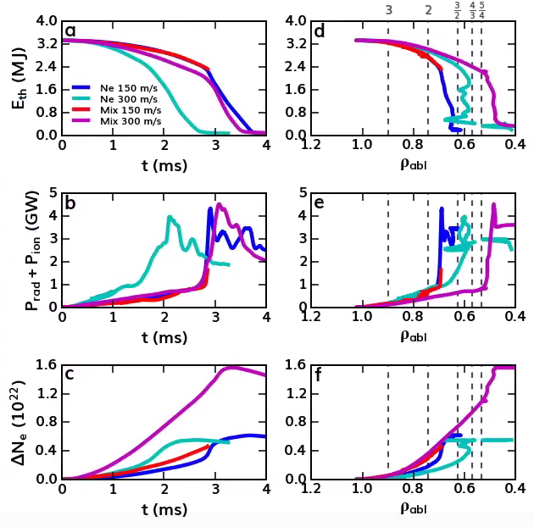
JET Modeling Shows Competition Between Rate of Travel and Rate of Radiative Dissipation
All plumes show similar peak radiated power
Dynamics versus time
  Fast neon has earliest TQ
  Others have similar TQ times
Dynamics versus penetration depth
  Shard position weighted by ablation rate
  Slow: both travel to same depth, radiation dominates
  Fast: mixed pellet travels deeper, doesn’t radiate fast enough to induce instability

Slide 17
JET Modeling Shows Competition Between Rate of Travel and Rate of Radiative Dissipation
All plumes show similar peak radiated power
Dynamics versus time
  Fast neon has earliest TQ
  Others have similar TQ times
Dynamics versus penetration depth
  Shard position weighted by ablation rate
  Slow: both travel to same depth, radiation dominates
  Fast: mixed pellet travels deeper, doesn’t radiate fast enough to induce instability

Slide 18
JET Modeling Shows Competition Between Rate of Travel and Rate of Radiative Dissipation
All plumes show similar peak radiated power
Dynamics versus time
  Fast neon has earliest TQ
  Others have similar TQ times
Dynamics versus penetration depth
  Shard position weighted by ablation rate
  Slow: both travel to same depth, radiation dominates
  Fast: mixed pellet travels deeper, doesn’t radiate fast enough to induce instability

Slide 19
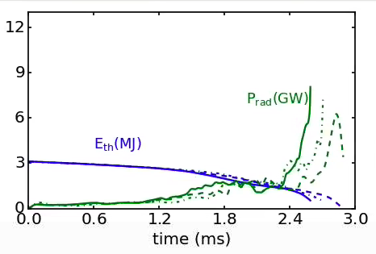
NIMROD JET Modeling Shows Reducing Viscosity Increases
MHD Activity and Speeds Up Thermal Quench
Single, un-shattered pellet injected into same JET equilibrium
Three viscosities considered to assess effect on thermal quench
  Qualitatively similar phenomenology
  Low viscosity simulations have stronger radiation peak
  2000 m²/s (dashed)
  1000 m²/s (dashdot)
  500 m²/s (solid)
Decreasing
viscosity

Slide 20
Outline
Overview of key code capabilities
Benchmarking M3D-C1 and NIMROD SPI modeling
M3D-C1 & NIMROD simulations of SPI in JET
Initial M3D-C1 simulations of SPI in KSTAR
Coupled NIMROD-CQL3D modeling of runaway-electron dynamics
MARS-F modeling of runaway-electron dynamics

Slide 21
Initial M3D-C1 KSTAR Modeling Shows Uncertain Benefits of Multiple Injection
Realistic plumes created for 7-mm, 10%-Ne pellet with new 12.5˚ shatter angle
Two, symmetrically injected pellets
  Appears better than two pellets at one angle
    Slower TQ 👍
    Lower peak radiation 👍
    Lower TPF 👍
  But not necessarily better than a single pellet
    Faster TQ
    Similar peak radiation, but longer duration
    Lower TPF
Future work
  20% Ne vs. 2x 10% Ne
  Time delays on dual injection
  Validation with 2022 KSTAR data

Slide 22
Initial M3D-C1 KSTAR Modeling Shows Uncertain Benefits of Multiple Injection
Realistic plumes created for 7-mm, 10%-Ne pellet with new 12.5˚ shatter angle
Two, symmetrically injected pellets
  Appears better than two pellets at one angle
    Slower TQ 👍
    Lower peak radiation 👍
    Lower TPF 👍
  But not necessarily better than a single pellet
    Faster TQ 👎
    Similar peak radiation, but longer duration
    Lower TPF 👍
Future work
  20% Ne vs. 2x 10% Ne
  Time delays on dual injection
  Validation with 2022 KSTAR data

Slide 23
Initial M3D-C1 KSTAR Modeling Shows Uncertain Benefits of Multiple Injection
Realistic plumes created for 7-mm, 10%-Ne pellet with new 12.5˚ shatter angle
Two, symmetrically injected pellets
  Appears better than two pellets at one angle
    Slower TQ 👍
    Lower peak radiation 👍
    Lower TPF 👍
  But not necessarily better than a single pellet
    Faster TQ 👎
    Similar peak radiation, but longer duration
    Lower TPF 👍
Future work
  20% Ne vs. 2x 10% Ne
  Time delays on dual injection
  Validation with 2022 KSTAR data

Slide 24
Outline
Overview of key code capabilities
Benchmarking M3D-C1 and NIMROD SPI modeling
M3D-C1 & NIMROD simulations of SPI in JET
Initial M3D-C1 simulations of SPI in KSTAR
Coupled NIMROD-CQL3D modeling of runaway-electron dynamics
MARS-F modeling of runaway-electron dynamics

Slide 25
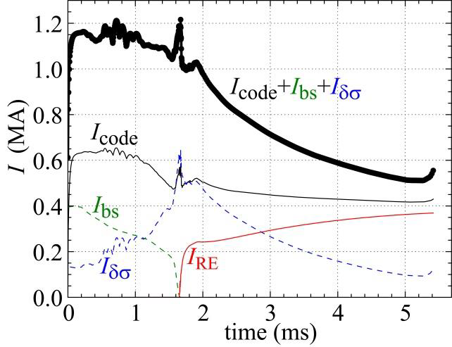
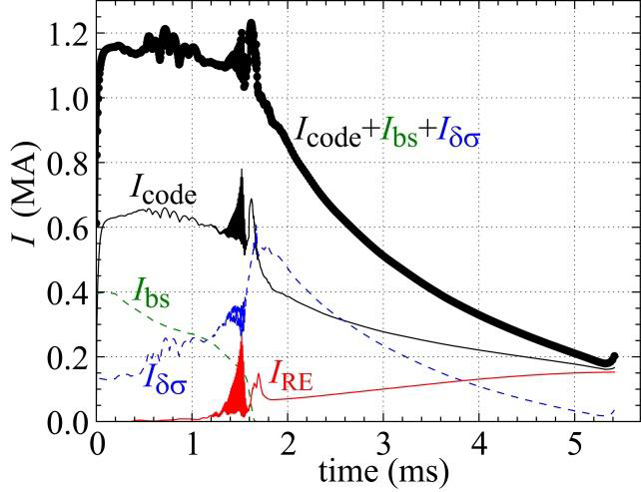
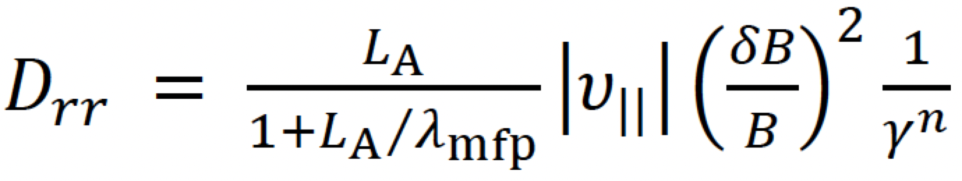
NIMROD-CQL3D Modeling of DIII-D Ne SPI Shows Negligible Runaway Production
CQL3D Predicted Current
Field data from each NIMROD time slice passed to CQL3D relativistic Fokker-Planck solver
Simulations with no radial transport show significant, RE current in DIII-D Ne SPI shot (not seen in experiment)
Inclusion of radial transport results in little RE production, consistent with experiment
No radial transport
With radial transport
Yu.V. Petrov et al. Nucl. Fusion 62, 096009 (2022)

Slide 26
Outline
Overview of key code capabilities
Benchmarking M3D-C1 and NIMROD SPI modeling
M3D-C1 & NIMROD simulations of SPI in JET
Initial M3D-C1 simulations of SPI in KSTAR
Coupled NIMROD-CQL3D modeling of runaway-electron dynamics
MARS-F modeling of runaway-electron dynamics

Slide 27
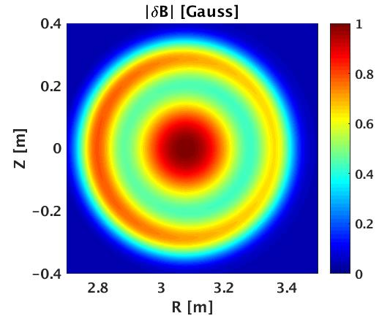
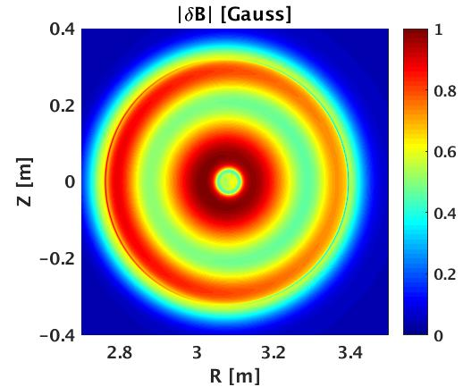
MHD-RE Hybrid Model Developed in MARS-F to Study Interaction Between Internal Kink and REs
Runaway electron contribution, with fluid approximation, is found to
  Destabilize n=1 ideal internal kink
  Modify eigenmode structure in plasma core
Internal kink perturbation does not produce significant RE loss unless perturbation field comparable to equilibrium field
With same perturbation amplitude, internal kink eigenfunction from hybrid model (--) produces less RE loss than fluid model (–)
fluid
hybrid
Liu, Nucl. Fusion 61, 116021 (2021)

Slide 28
MHD-RE Hybrid Model Developed in MARS-F to Study Interaction Between Internal Kink and REs
Runaway electron contribution, with fluid approximation, is found to
  Destabilize n=1 ideal internal kink
  Modify eigenmode structure in plasma core
Internal kink perturbation does not produce significant RE loss unless perturbation field comparable to equilibrium field
With same perturbation amplitude, internal kink eigenfunction from hybrid model (--) produces less RE loss than fluid model (–)
fluid
hybrid
σ=+1
σ=-1
Liu, Nucl. Fusion 61, 116021 (2021)

Slide 29
MHD-RE Hybrid Model Developed in MARS-F to Study Interaction Between Internal Kink and REs
Runaway electron contribution, with fluid approximation, is found to
  Destabilize n=1 ideal internal kink
  Modify eigenmode structure in plasma core
Internal kink perturbation does not produce significant RE loss unless perturbation field comparable to equilibrium field
With same perturbation amplitude, internal kink eigenfunction from hybrid model (--) produces less RE loss than fluid model (–)
fluid
hybrid
σ=+1
σ=-1
Liu, Nucl. Fusion 61, 116021 (2021)

Slide 30
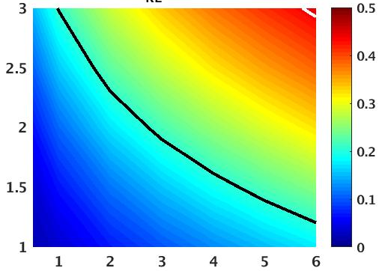
MARS-Q Code has Been Updated to Model RE Avalanche Dynamics in Shaped Tokamak Plasmas
Saturated I_{RE} (MA)
Rosenbluth-Putvinski RE avalanche model implemented into quasi-linear MARS-Q
DIII-D simulations initialized with several-% seed current
  Quantitative agreement with experiments for final RE current with ~2x multiplier on R-P
  Justification: lack of bound electron screening in R-P model
Effect of plasma shaping
  Elongation reduces RE avalanche due to reduction of electric field
  Minor effect from triangularity
R-P multiplier
DIII-D Expt.
Seed current %
Liu, Nucl. Fusion 61, 066038 (2021)

Slide 31
MARS-Q Code has Been Updated to Model RE Avalanche Dynamics in Shaped Tokamak Plasmas
Saturated I_{RE} (MA)
Rosenbluth-Putvinski RE avalanche model implemented into quasi-linear MARS-Q
DIII-D simulations initialized with several-% seed current
  Quantitative agreement with experiments for final RE current with ~2x multiplier on R-P
  Justification: lack of bound electron screening in R-P model
Effect of plasma shaping
  Elongation reduces RE avalanche due to reduction of electric field
  Minor effect from triangularity
R-P multiplier
DIII-D Expt.
Seed current %
Liu, Nucl. Fusion 61, 066038 (2021)

Slide 32
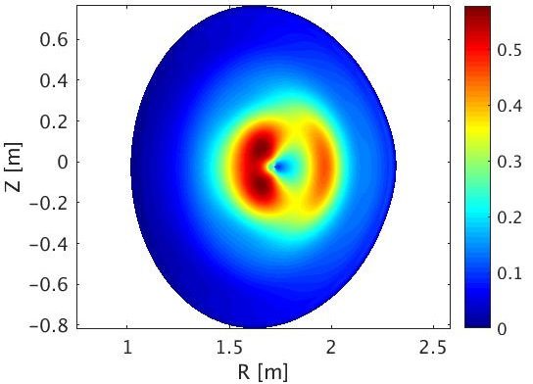
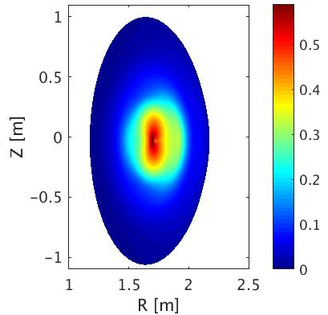
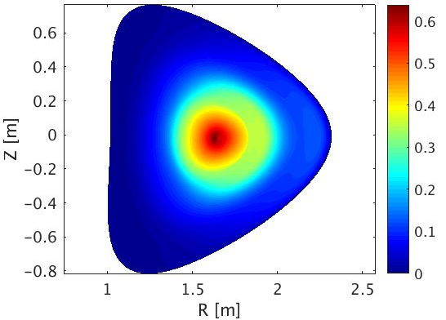
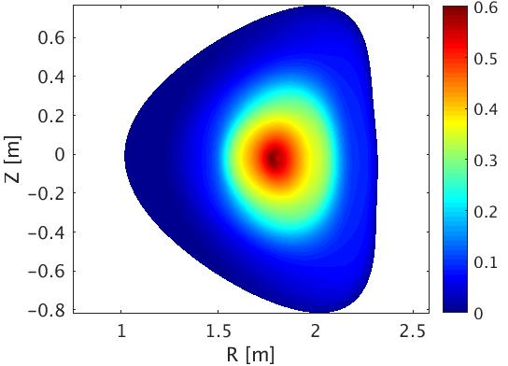
MARS-Q Code has Been Updated to Model RE Avalanche Dynamics in Shaped Tokamak Plasmas
Saturated I_{RE} (MA)
Rosenbluth-Putvinski RE avalanche model implemented into quasi-linear MARS-Q
DIII-D simulations initialized with several-% seed current
  Quantitative agreement with experiments for final RE current with ~2x multiplier on R-P
  Justification: lack of bound electron screening in R-P model
Effect of plasma shaping
  Elongation reduces RE avalanche due to reduction of electric field
  Minor effect from triangularity
R-P multiplier
DIII-D Expt.
Seed current %
J_{RE} (MA/m²)
Liu, Nucl. Fusion 61, 066038 (2021)

Slide 33
State-of-the-Art Modeling Capabilities Will Continue to Provide Greater Understanding of Disruption Mitigation
M3D-C1 and NIMROD
  Complete 3D benchmark this year
  Continue validation with DIII-D, JET, & KSTAR
  Begin simulations of ASDEX-Upgrade SPI
  Model upgrades
    Collisional-radiative impurity model (ADAS coupling?)
    Ablation rates improved by results from Lagrangian-particle code
All codes will make predictions for efficacy of ITER disruption-mitigation system
  Cross-machine, cross-code database will provide robust understanding of SPI dynamics
  High-fidelity modeling of relevant ITER scenarios

Slide 34
Acknowledgments and Disclaimers
This material is based upon work supported by the U.S. Department of Energy, Office of Science, Office of Fusion Energy Sciences, using the DIII-D National Fusion Facility, a DOE Office of Science user facility, under Awards DE-FG02-95ER54309, DE-FC02-04ER54698, DE-SC0018109, DE-SC0020299, and DE-SC0016452.
This research used resources of the National Energy Research Scientific Computing Center (NERSC), a U.S. Department of Energy Office of Science User Facility operated under Contract No. DE-AC02-05CH11231.
Disclaimer: This report was prepared as an account of work sponsored by an agency of the United States Government. Neither the United States Government nor any agency thereof, nor any of their employees, makes any warranty, express or implied, or assumes any legal liability or responsibility for the accuracy, completeness, or usefulness of any information, apparatus, product, or process disclosed, or represents that its use would not infringe privately owned rights. Reference herein to any specific commercial product, process, or service by trade name, trademark, manufacturer, or otherwise does not necessarily constitute or imply its endorsement, recommendation, or favoring by the United States Government or any agency thereof. The views and opinions of authors expressed herein do not necessarily state or reflect those of the United States Government or any agency thereof.

Slide 35
Additional slides

Slide 36
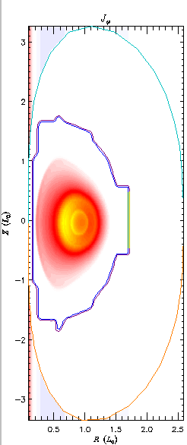
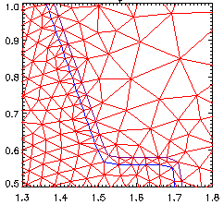
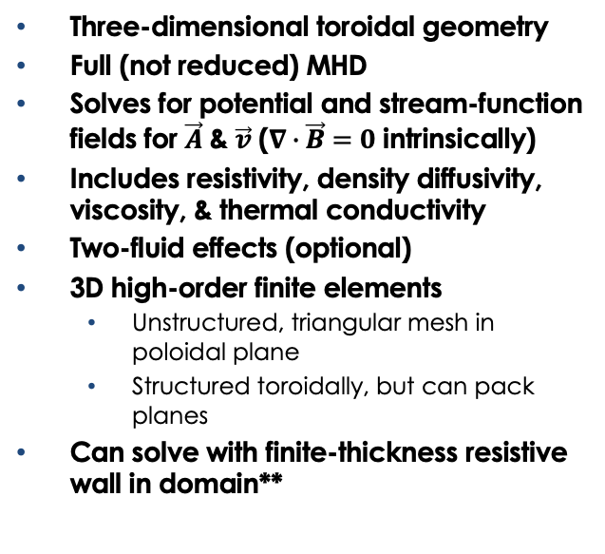
M3D-C1* Solves the Extended-MHD Equations
Three-dimensional toroidal geometry
Full (not reduced) MHD
Solves for potential and stream-function fields for $\vec{A}$ & $\vec{v}$ ($∇∙\vec{B}=0$ intrinsically)
Includes resistivity, density diffusivity, viscosity, & thermal conductivity
Two-fluid effects (optional)
3D high-order finite elements
  Unstructured, triangular mesh in poloidal plane
  Structured toroidally, but can pack planes
Can solve with finite-thickness resistive wall in domain**
Vacuum (J=0)
Plasma
(X-MHD)
RW ( E = η_{W} J )
*S. C. Jardin, et al., Comput. Sci. Discovery 5, 014002 (2012).
**N.M. Ferraro, et al. ,Phys Plasma23 056114 (2016).

Slide 37
M3D-C1 Solves the Extended-MHD Equations
Blue terms are 2-fluid

Slide 38
Ablation model for Ne-D2 pellets implemented in M3D-C1
Impurity Density
Practical, analytic expression fit to more complex ablation model (Parks)
is fitting function, depending on molar fraction of D2,
M3D-C1 implementation
  Advance pellet location in time
  Calculate number of particles ablated and pellet-surface recession at each time step
  Deposit main ion and/or impurities onto arbitrary spatial distribution (e.g. 2D or 3D Gaussian)

Slide 39
M3D-C1 & NIMROD Show Decent Agreement, but Differ in Timing of Instability Onset
Early, radiation driven thermal quench in good agreement
NIMROD shows earlier spike in radiation, driven by earlier MHD instability onset
M3D-C1 observes stabilization from density diffusivity

Slide 40
JET Modeling Shows Competition Between Rate of Travel and Rate of Radiative Dissipation
All plumes show similar peak radiated power
Dynamics versus time
  Fast neon has earliest TQ
  Others have similar TQ times
Dynamics versus penetration depth
  Shard position weighted by ablation rate
  Slow: both travel to same depth, radiation dominates
  Fast: mixed pellet travels deeper, doesn’t radiate fast enough to induce instability

