Slide 1
KORC Modeling of Wall Heating by Avalanche Runaway Electrons During a Final Loss Event in DIII-D
Matt Beidler¹
With much input from D. del-Castillo-Negrete¹, D. Shiraki¹, E. Hollmann², and L. Baylor¹
¹Oak Ridge National Laboratory
²University of California San Diego
This manuscript has been authored by UT-Battelle, LLC, under contract DE-AC05-00OR22725 with the US Department of Energy (DOE). The US government retains and the publisher, by accepting the article for publication, acknowledges that the US government retains a nonexclusive, paid-up, irrevocable, worldwide license to publish or reproduce the published form of this manuscript, or allow others to do so, for US government purposes. DOE will provide public access to these results of federally sponsored research in accordance with the DOE Public Access Plan (http://energy.gov/downloads/doe-public-access-plan).
This work was supported by the US DOE using the DIII-D National Fusion Facility, a DOE Office of Science user facility, under contract DE-FC02-04ER54698 and used resources of the National Energy Research Scientific Computing Center (NERSC), a US Department of Energy Office of Science User Facility operated under Contract No. DE-AC02-05CH11231.
Disclaimer: This report was prepared as an account of work sponsored by an agency of the United States Government. Neither the United States Government nor any agency thereof, nor any of their employees, makes any warranty, express or implied, or assumes any legal liability or responsibility for the accuracy, completeness, or usefulness of any information, apparatus, product, or process disclosed, or represents that its use would not infringe privately owned rights. Reference herein to any specific commercial product, process, or service by trade name, trademark, manufacturer, or otherwise does not necessarily constitute or imply its endorsement, recommendation, or favoring by the United States Government or any agency thereof. The views and opinions of authors expressed herein do not necessarily state or reflect those of the United States Government or any agency thereof.

Slide 2
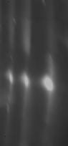
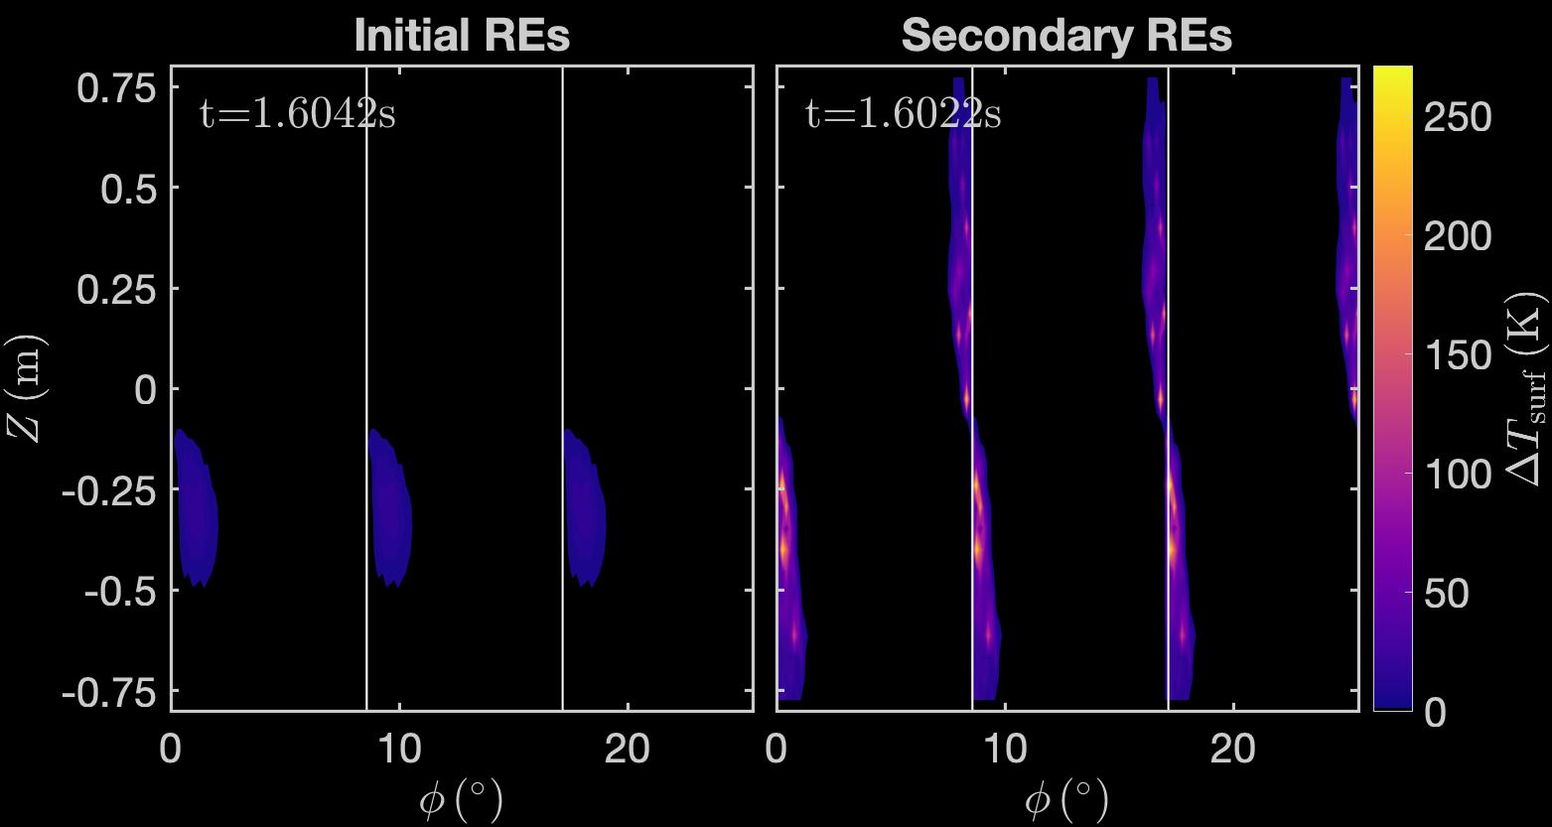

Secondary REs are the dominant contribution to large PFC surface heating in rapid loss event of DIII-D
Rapid RE final loss event in DIII-D induces large electric fields in open flux regions that increases generation of secondary REs
  Secondary REs rapidly deconfine when generated in open flux region by initial REs with large drift orbit effects
Secondary REs
have lower kinetic
energy and
deposit their energy
shallowly into PFCs
KORC modeling
indicates that
secondary REs
are dominant
contribution to
transiently large
PFC surface heating
$$t=1.6234s$$
Average surface heating
(in toroidal extent) from KORC
DIII-D infrared imaging

Slide 3
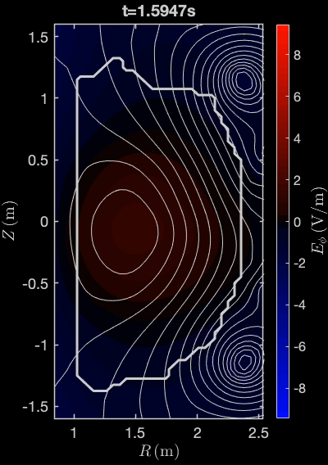

Looking at DIII-D shot 177031 with D2 injection into post-disruption RE beam [1]
$ψ_{p}$ contours with $E_{φ}$ colormap
Disruption triggered by primary injection of cryogenic Ar pellet
No impurity purge and recovery of electron density after secondary D2 injection
Central solenoid stops driving RE beam to trigger rapid final loss event
Ar pellet
D2 injection
solenoid stops
solenoid stops
[1]Unmitigated termination in Paz-Soldan et al., Nucl. Fusion (2021)

Slide 4
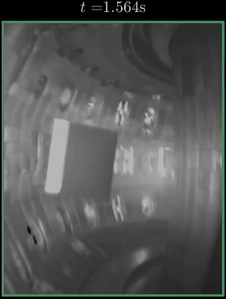
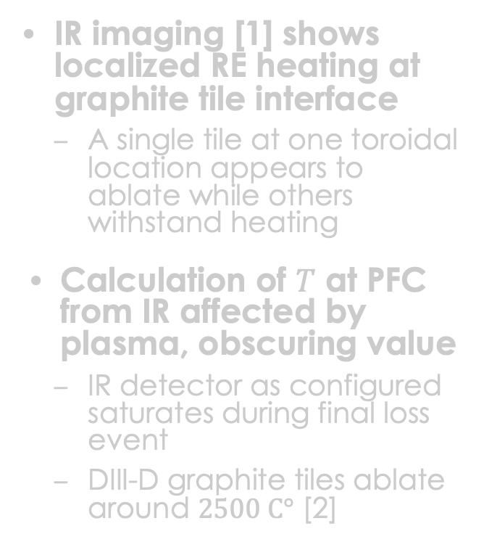
Infrared (IR) imaging shows final loss event localized at leading edge of graphite PFCs
IR imaging [1] shows localized RE heating at graphite tile interface
  A single tile at one toroidal location appears to ablate while others withstand heating
Calculation of $T$ at PFC from IR affected by plasma, obscuring value
  IR detector as configured saturates during final loss event
  DIII-D graphite tiles ablate around $2500 C°$ [2]
[1] Courtesy of C. Lasnier (LLNL) [2] Luxon, Nucl. Fusion (2002)

Slide 5
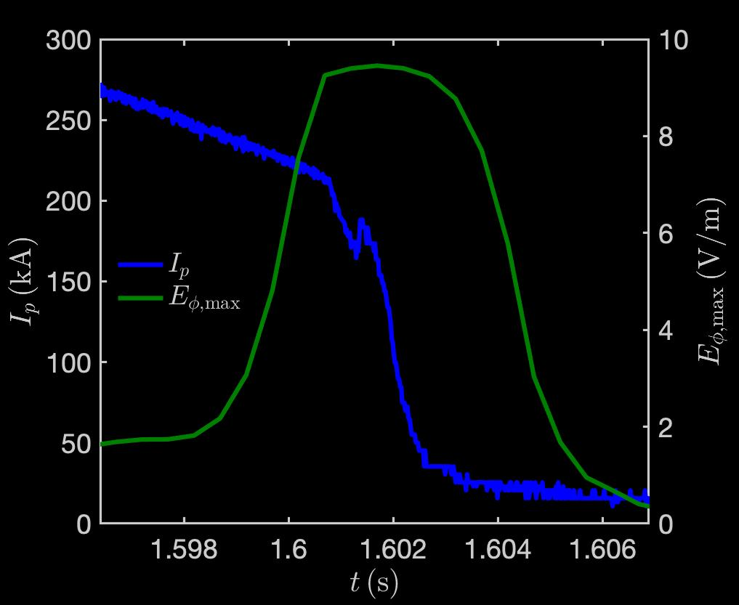
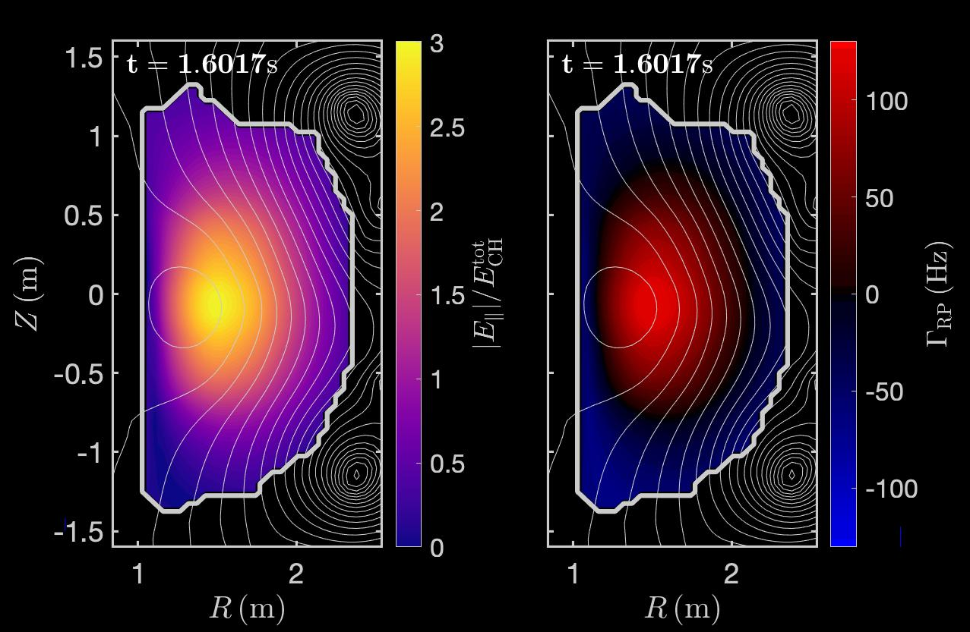
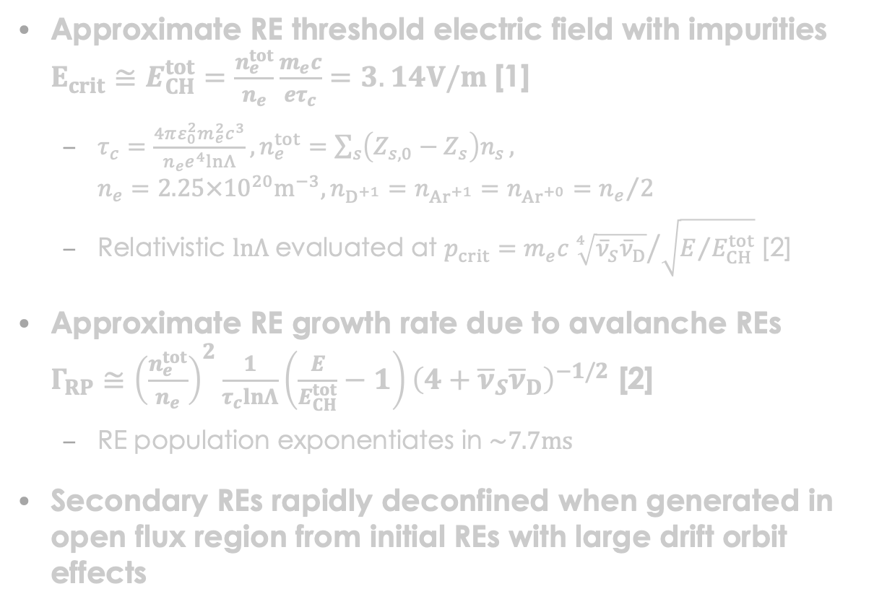
Rapid RE final loss event increases inductive electric fields and secondary electron generation via avalanche source
Approximate RE threshold electric field with impurities
$E_{crit}≅E_{CH}^{tot}=\frac{n_{e}^{tot}}{n_{e}}\frac{m_{e}c}{eτ_{c}}=3.14V/m$ [1]
  $τ_{c}=\frac{4πε_{0}^{2}m_{e}^{2}c^{3}}{n_{e}e^{4}lnΛ}, n_{e}^{tot}=\sum_{s}{\left(Z_{s,0}−Z_{s}\right)n_{s}},$
  $n_{e}=2.25×{10}^{20}m^{−3}, n_{D^{+1}}=n_{{Ar}^{+1}}=n_{{Ar}^{+0}}={n_{e}}/2$
  Relativistic $lnΛ$ evaluated at $p_{crit}=m_{e}c{\sqrt[4]{{\overline{ν}}_{S}{\overline{ν}}_{D}}}/{\sqrt{E/{E_{CH}^{tot}}}}$ [2]
Approximate RE growth rate due to avalanche REs $Γ_{RP}≅{\left(\frac{n_{e}^{tot}}{n_{e}}\right)}^{2}\frac{1}{τ_{c}lnΛ}\left(\frac{E}{E_{CH}^{tot}}−1\right){\left(4+{\overline{ν}}_{S}{\overline{ν}}_{D}\right)}^{−1/2}$ [2]
  RE population exponentiates in $\sim 7.7ms$
Secondary REs rapidly deconfined when generated in open flux region from initial REs with large drift orbit effects
[1] Hesslow et al., Plasma Phys. Control. Fusion (2018) [2] Hesslow et al., Nucl. Fusion (2019)
Notes:
$$n_{e}=2.25×{10}^{20}m^{−3}, n_{D^{+1}}=n_{{Ar}^{+1}}=n_{{Ar}^{+0}}=1.125×{10}^{20}m^{−3}$$

Slide 6
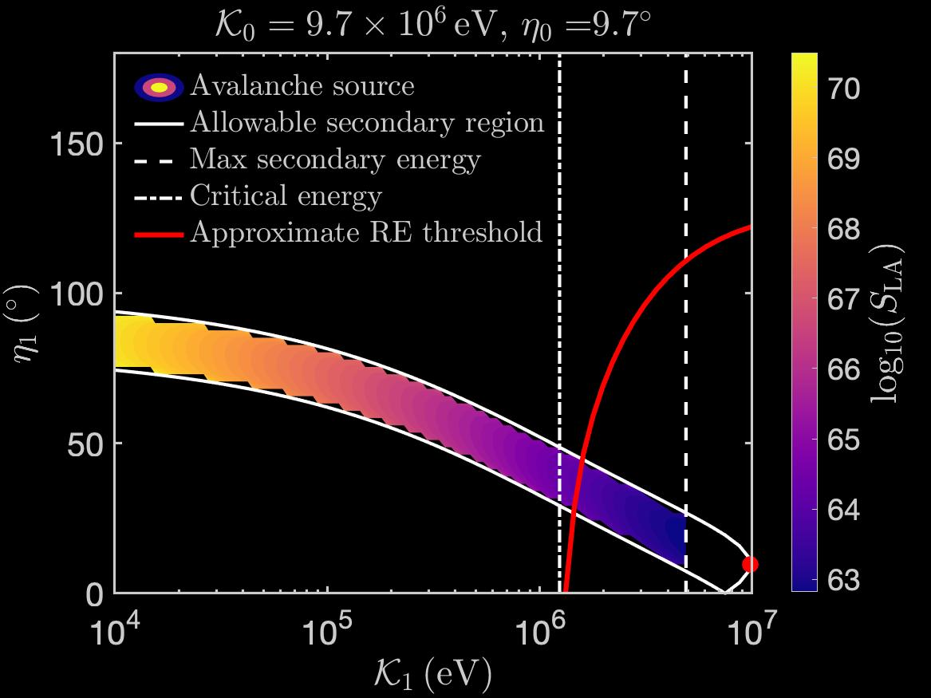
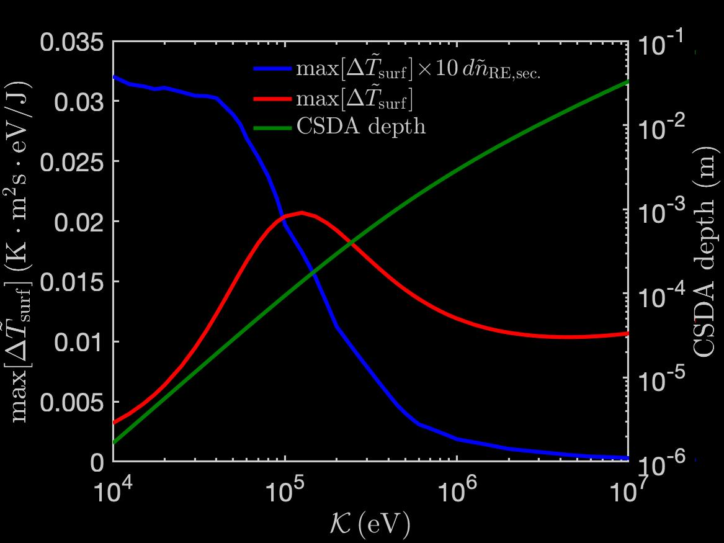
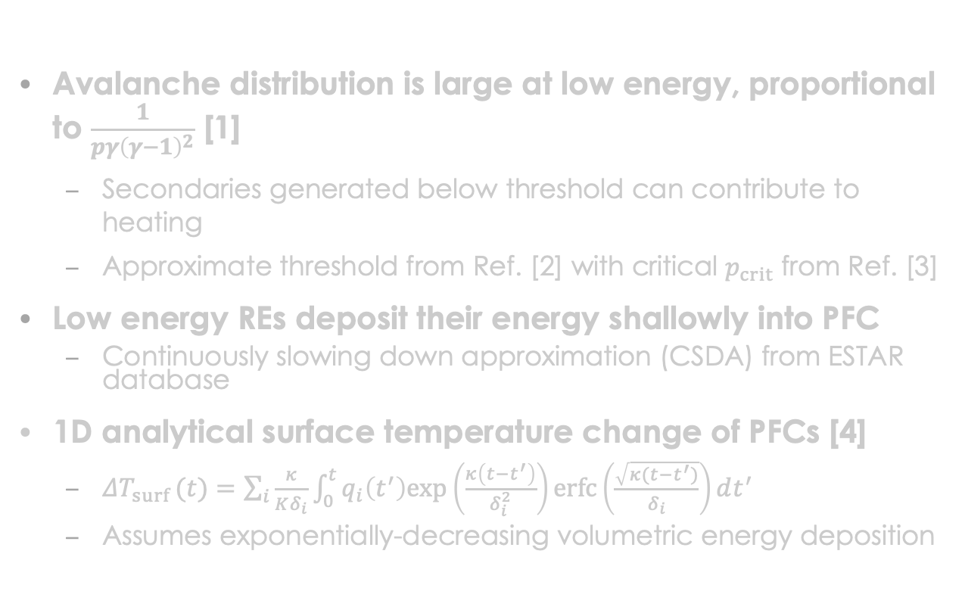
Avalanche RE distribution results in large surface heating
Avalanche distribution is large at low energy, proportional to $\frac{1}{pγ{\left(γ−1\right)}^{2}}$ [1]
  Secondaries generated below threshold can contribute to heating
  Approximate threshold from Ref. [2] with critical $p_{crit}$ from Ref. [3]
Low energy REs deposit their energy shallowly into PFC
  Continuously slowing down approximation (CSDA) from ESTAR database
1D analytical surface temperature change of PFCs [4]
  $ΔT_{surf }(t)=\sum_{i}{\frac{κ}{Kδ_{i}}\int_{0}^{t}{q_{i}\left(t^{′}\right)exp\left(\frac{κ\left(t−t^{′}\right)}{δ_{i}^{2}}\right)erfc\left(\frac{\sqrt{κ(t−t^{′})}}{δ_{i}}\right)dt^{′}}}$
  Assumes exponentially-decreasing volumetric energy deposition
[1] Aleynikov et al., IAEA FEC (2014) [2] Smith et al., Phys. Plasmas (2005)
[3] Hesslow et al., Nucl. Fusion (2019) [4] Martín-Solís et al., Nucl. Fusion (2014)
Notes:
Threshold from Smith et al., PoP (2005), likely inspired by Martin-Solis et al., PoP (1998) and Parks et al., PoP (1999)
Critical energy and threshold are plotted for plasma/impurities values used in KORC simulations $n_{e}=2.25×{10}^{20}m^{−3}, n_{{Ar}^{+1}}=n_{{Ar}^{+0}}=1.125×{10}^{20}m^{−3}$

Slide 7
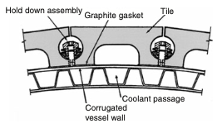
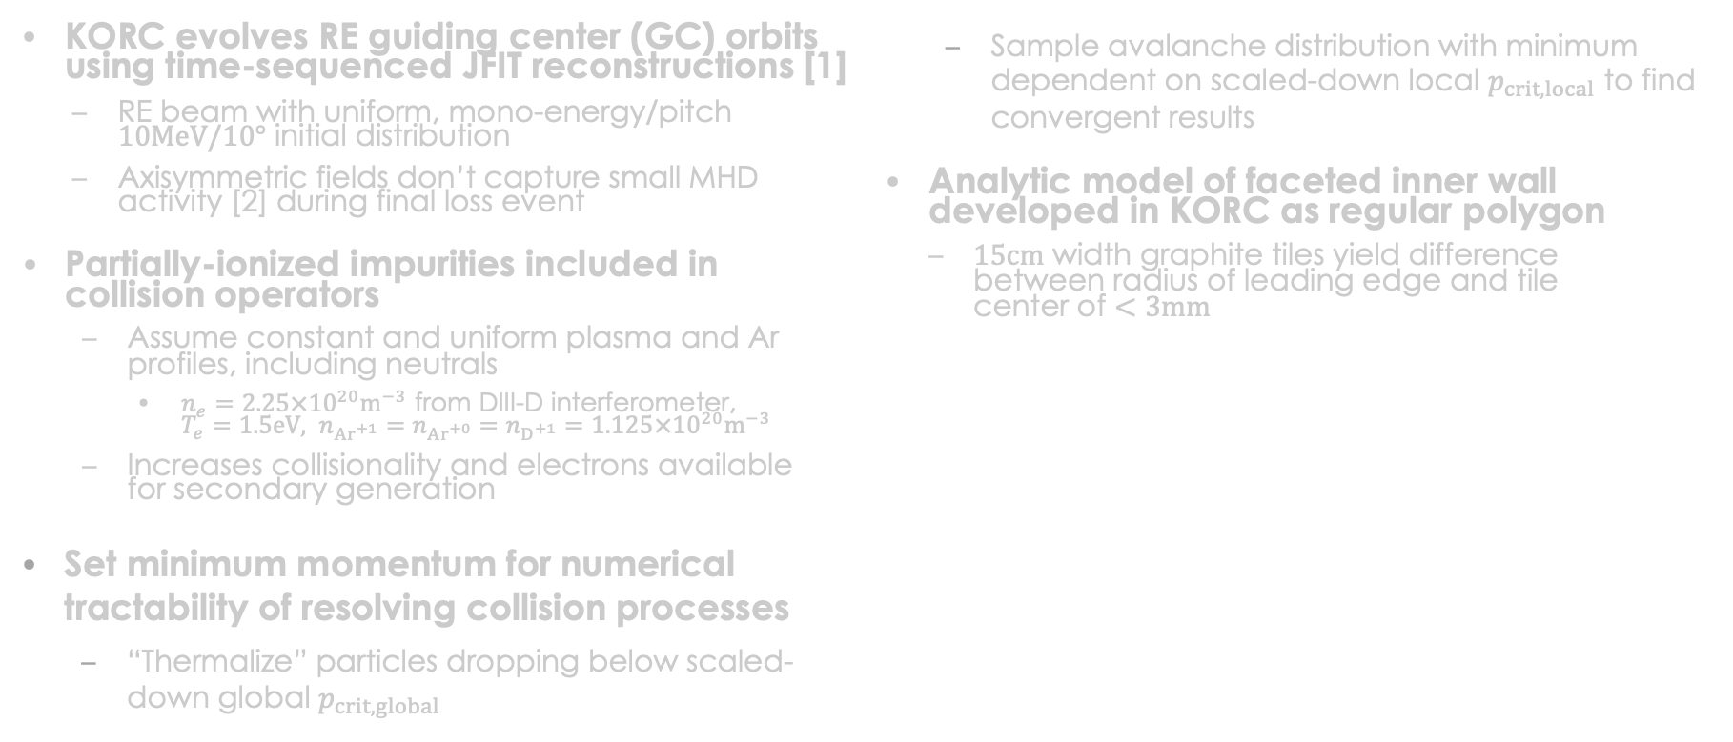
KORC modeling of RE final loss event uses evolving fields and constant/uniform density profiles
KORC evolves RE guiding center (GC) orbits using time-sequenced JFIT reconstructions [1]
  RE beam with uniform, mono-energy/pitch $10MeV/10°$ initial distribution
  Axisymmetric fields don’t capture small MHD activity [2] during final loss event
Partially-ionized impurities included in collision operators
  Assume constant and uniform plasma and Ar profiles, including neutrals
    $n_{e}=2.25×{10}^{20}m^{−3}$ from DIII-D interferometer,
    $T_{e}=1.5eV, n_{{Ar}^{+1}}=n_{{Ar}^{+0}}=n_{D^{+1}}=1.125×{10}^{20}m^{−3}$
  Increases collisionality and electrons available
  for secondary generation
Set minimum momentum for numerical tractability of resolving collision processes
  “Thermalize” particles dropping below scaled-down global $p_{crit, global}$
  Sample avalanche distribution with minimum dependent on scaled-down local $p_{crit, local}$ to find convergent results
Analytic model of faceted inner wall developed in KORC as regular polygon
  $15cm$ width graphite tiles yield difference
  between radius of leading edge and tile
  center of $<3mm$
Schematic of faceted graphite tiles [3]
[1] Beidler et al., Phys. Plasmas (2020) [2] Paz-Soldan et al., Nucl. Fusion (2021) [3] Luxon, Nucl. Fusion (2002)

Slide 8
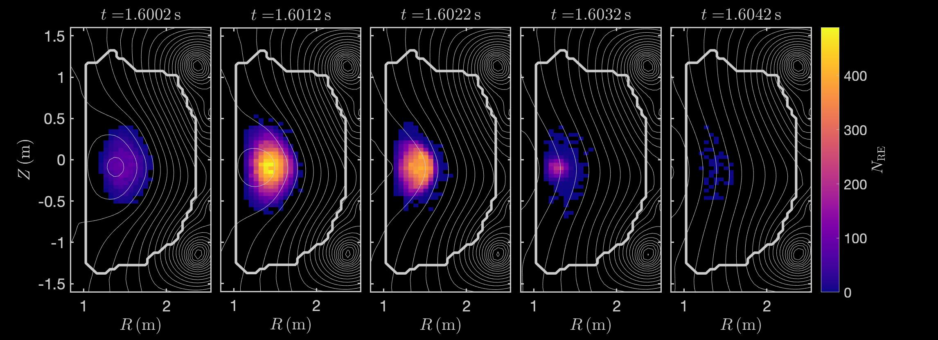

Secondary REs generated in open flux regions during final loss event are rapidly deconfined
Flux surfaces closed at beginning of final loss event
  Most secondary REs thermalize rapidly
Initial REs travel through open flux regions due to drift orbit effects at high energies
  Secondary REs at lower energy
  with no drift orbit effects are rapidly deconfined
  Number of deconfined secondaries converges below $0.035p_{crit,global}$ (not shown)
Secondary REs generated each $0.5ms$
Notes:
11K particles initially, 144K particles tracked at end of simulation (133K secondaries), 47K deconfined particles, 97K thermalized particles

Slide 9
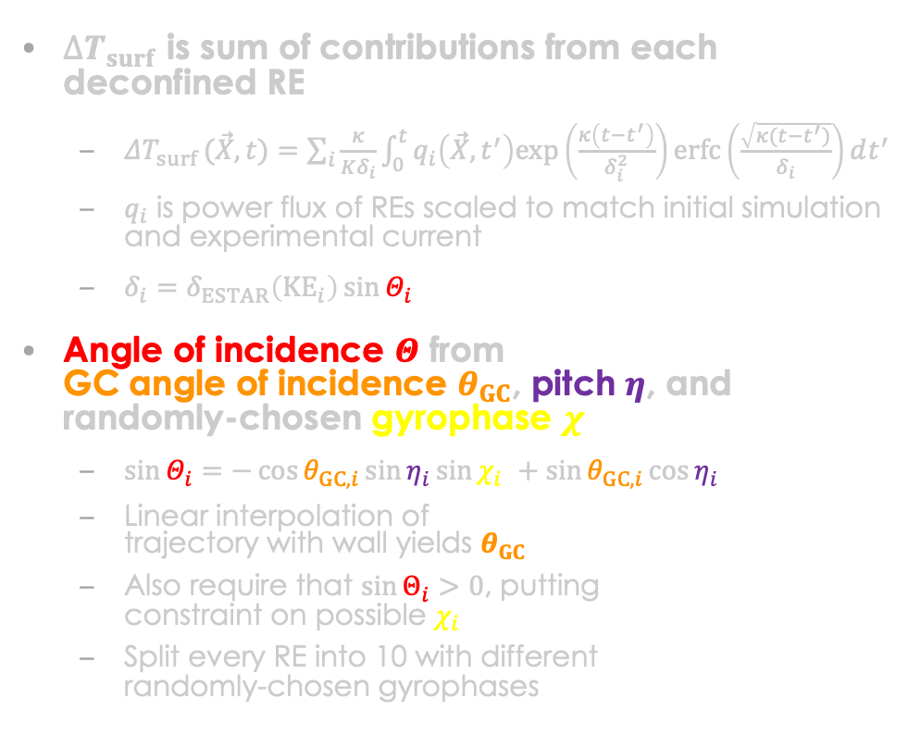

Estimate angle of incidence to PFC from guiding center angle of incidence
$$z′$$
$$z$$
$∆T_{surf}$ is sum of contributions from each deconfined RE
  $ΔT_{surf }(\vec{X},t)=\sum_{i}{\frac{κ}{Kδ_{i}}\int_{0}^{t}{q_{i}\left(\vec{X},t^{′}\right)exp\left(\frac{κ\left(t−t^{′}\right)}{δ_{i}^{2}}\right)erfc\left(\frac{\sqrt{κ(t−t^{′})}}{δ_{i}}\right)dt^{′}}}$
  $q_{i}$ is power flux of REs scaled to match initial simulation and experimental current
  $δ_{i}=δ_{ESTAR}\left({KE}_{i}\right)\sin{Θ_{i}}$
Angle of incidence $Θ$ from
GC angle of incidence $θ_{GC}$, pitch $η$, and
randomly-chosen gyrophase $χ$
  $\sin{Θ_{i}}=−\cos{θ_{GC,i}}\sin{η_{i}}\sin{χ_{i} }+\sin{θ_{GC,i}}\cos{η_{i}}$
  Linear interpolation of
  trajectory with wall yields $θ_{GC}$
  Also require that $\sin{Θ_{i}}>0$, putting
  constraint on possible $χ_{i}$
  Split every RE into 10 with different
  randomly-chosen gyrophases
$$y′$$
$$\vec{B}$$
$$θ_{GC}$$
$$y$$
$$Θ$$
$$⨀x$$
$$\vec{v}$$

Slide 10
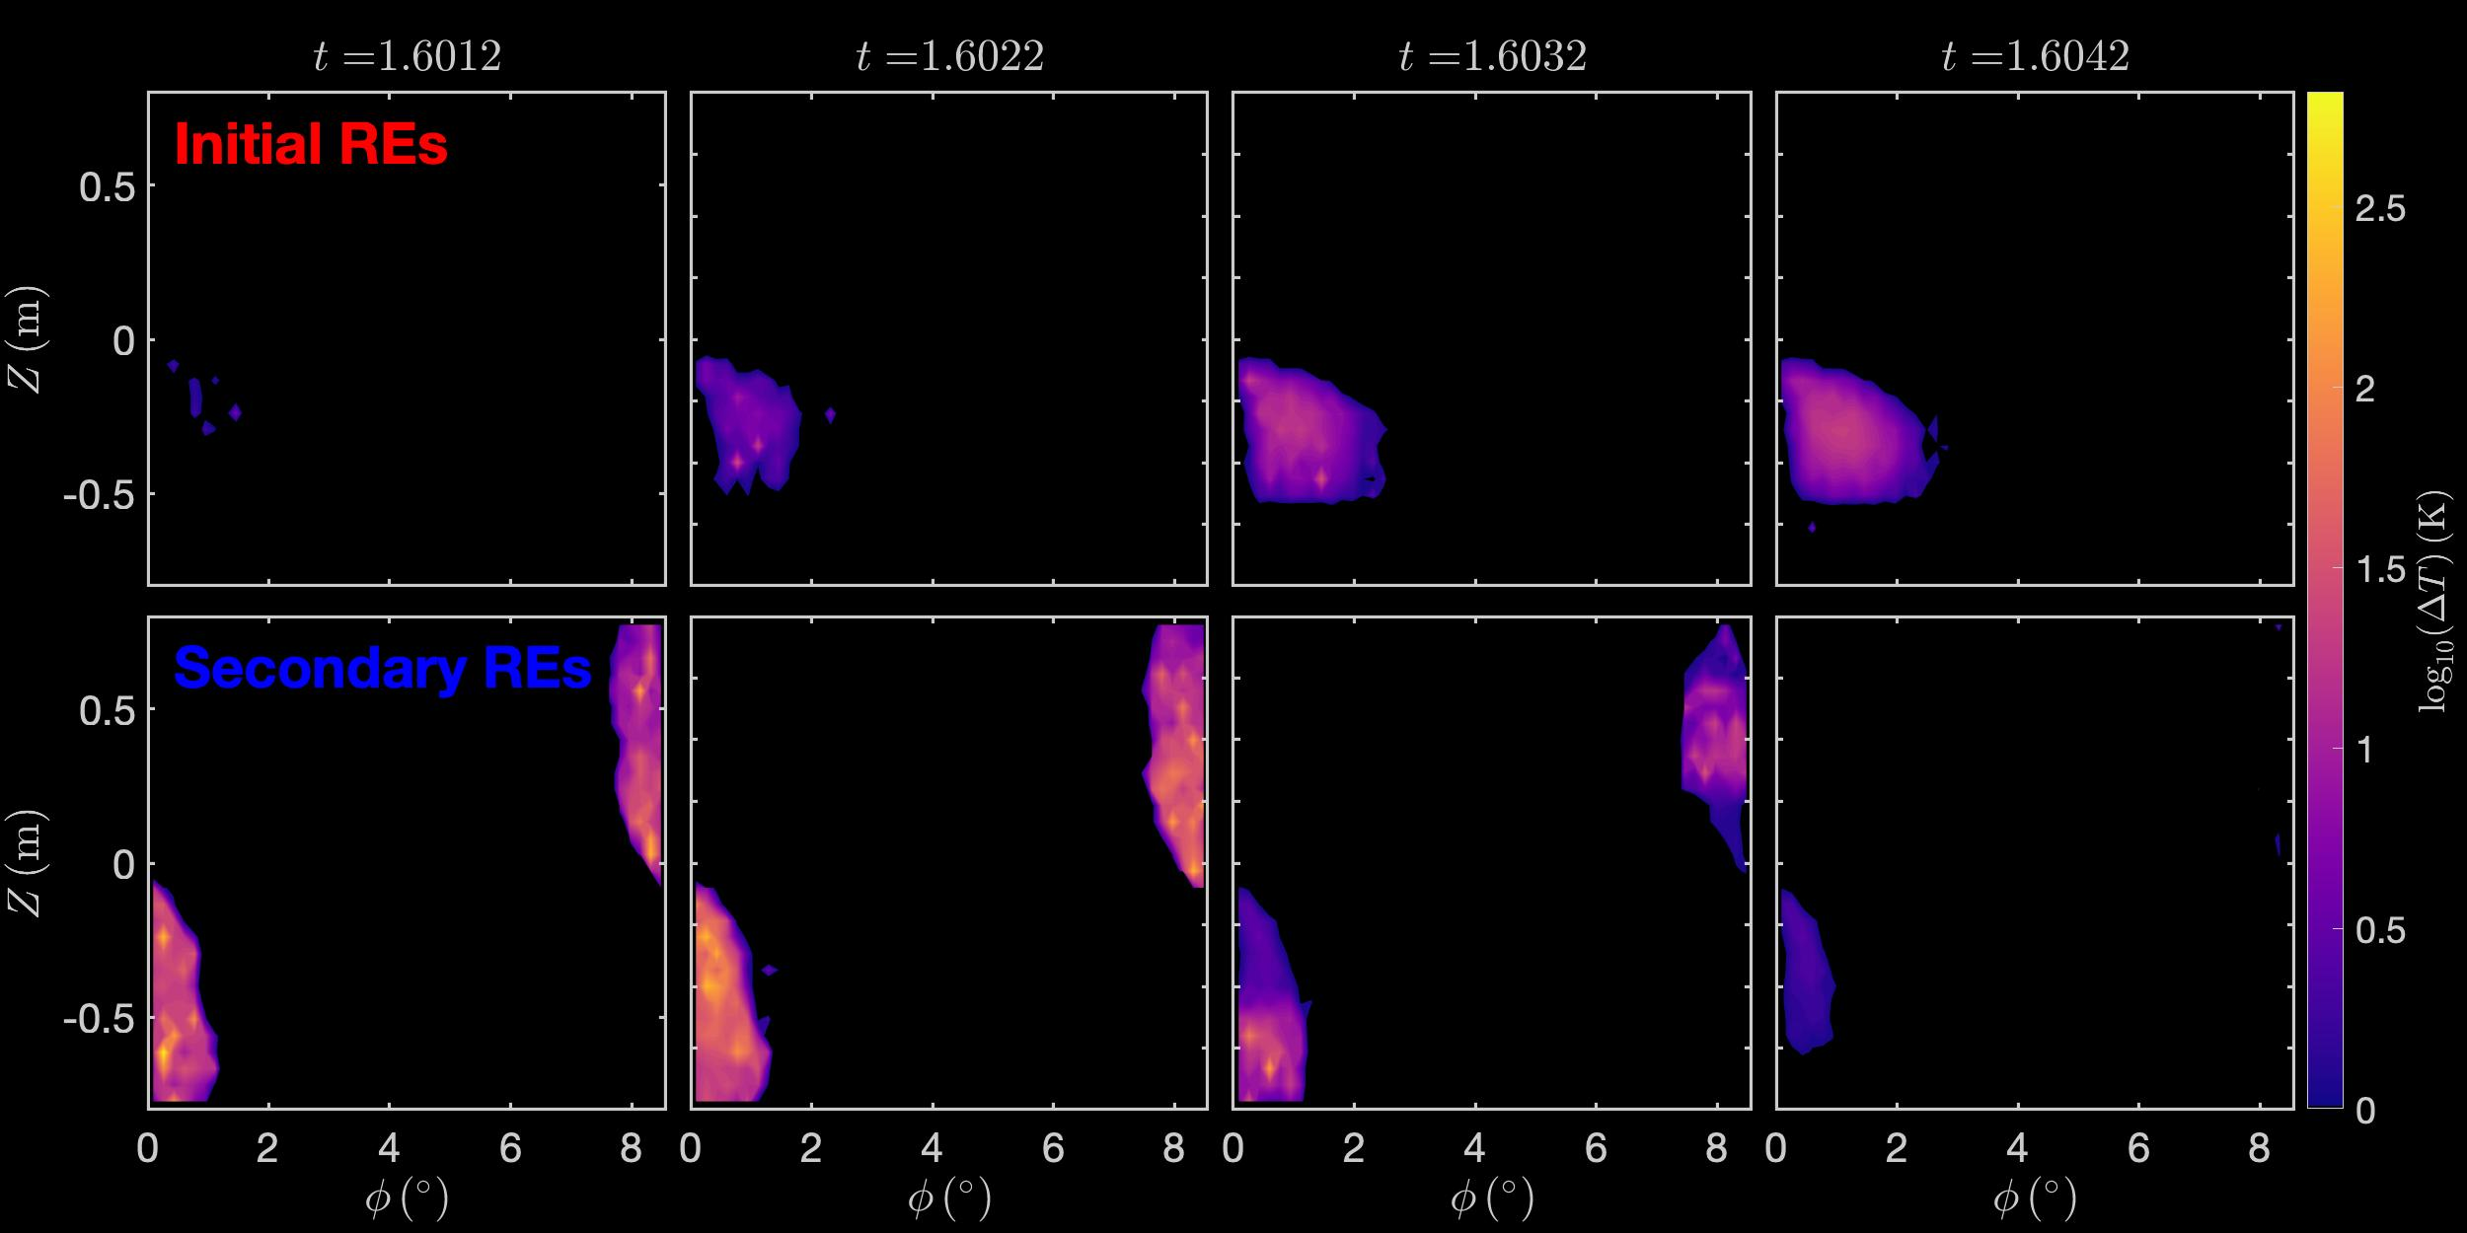
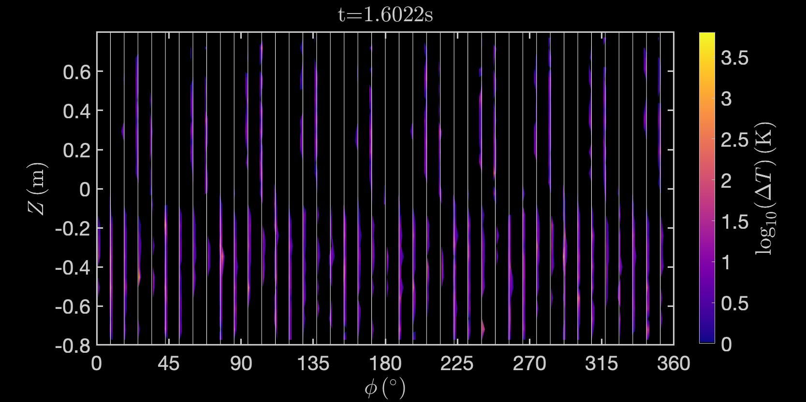

Secondary RE heating is on leading edge and required for qualitative agreement with experimental observations
Uniform toroidal spacing of tiles enables projecting all orbits onto a single tile
  Still many tiles in vertical direction
PFC surface heating due to secondary REs is order of magnitude and half larger than that due to initial REs
Initial REs have $η_{i}<90°$, secondary REs can have $η_{i}>90°$
All REs
Forward
Backward
Forward
Leading edge

Slide 11

Secondary RE heating is on leading edge and required for qualitative agreement with experimental observations
$$t=1.6234s$$
Backward
Backward
Forward
Leading edge
Forward
Average surface heating (in toroidal extent) from KORC
DIII-D infrared imaging
Notes:
Forward deposition will bleed across leading edge due to FO effects

Slide 12
Discussion
Future Work
Large electric fields induced on trailing side of advecting RE beam
  Induced electric field in region of open flux surfaces
Large-angle collisions will generate low-energy secondaries that lead to large wall heating, even if they don’t runaway
Wall heating of final loss events with 3D MHD (ITPA collaboration MDC-DSOL-1)
Explore how thermalized secondary REs contribute to wall heating
Explore how wall irregularities change
local heating
Couple with 1D diffusion model to
include experimentally-inferred plasma and impurity profiles
Use KORC results in more advanced
volumetric energy deposition and
heat transfer/fluid motion codes
Explore sensitivity to charging of wall
by deconfined REs and partially-ionized impurities
Self-consistent kinetic-MHD modeling to simulate RE beam scrape off and deconfinement due to 3D MHD modes
Short
Medium
Long

Slide 13
Secondary REs are the dominant contribution to large PFC surface heating in rapid loss event of DIII-D
Rapid RE final loss event in DIII-D induces large electric fields in open flux regions that increases generation of secondary REs
  Secondary REs rapidly deconfine when generated in open flux region by initial REs with large drift orbit effects
Secondary REs
have lower kinetic
energy and
deposit their energy
shallowly into PFCs
KORC modeling
indicates that
secondary REs
are dominant
contribution to
transiently large
PFC surface heating
$$t=1.6234s$$
Backward
Backward
Forward
Leading edge
Forward
Average surface heating
(in toroidal extent) from KORC
DIII-D infrared imaging

Slide 14
Extra Slides

Slide 15
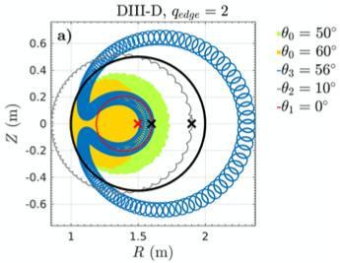
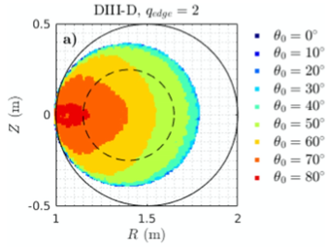
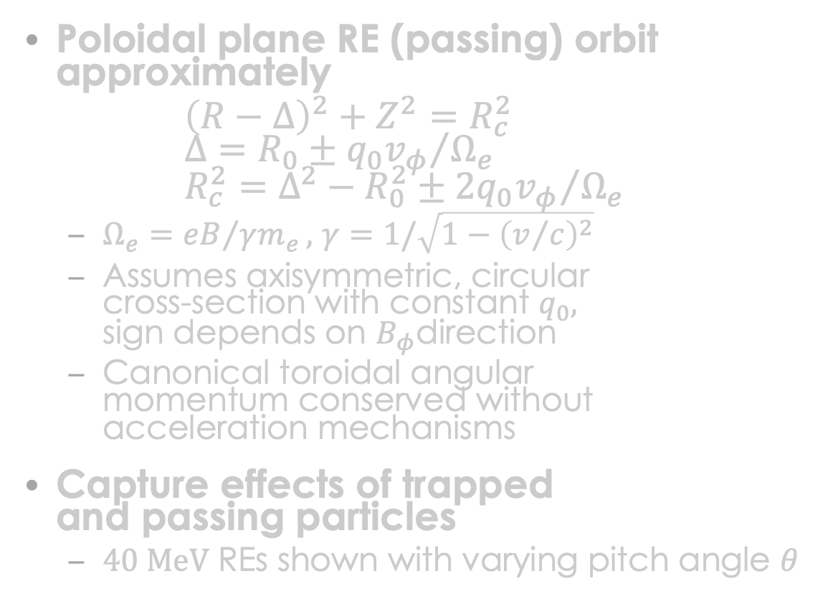
Orbit effects are necessary for accurate modeling of REs
Poloidal plane RE (passing) orbit approximately
${\left(R−Δ\right)}^{2}+Z^{2}=R_{c}^{2}$
$Δ=R_{0}±{q_{0}v_{φ}}/{Ω_{e}}$
$R_{c}^{2}=Δ^{2}−R_{0}^{2}±{2q_{0}v_{φ}}/{Ω_{e}}$
  $Ω_{e}={eB}/{γm_{e}},$ $γ=1/\sqrt{1−{\left(v/c\right)}^{2}}$
  Assumes axisymmetric, circular
  cross-section with constant $q_{0},$
  sign depends on $B_{φ}$direction
  Canonical toroidal angular
  momentum conserved without
  acceleration mechanisms
Capture effects of trapped
and passing particles
  $40 MeV$ REs shown with varying pitch angle $θ$
Carbajal et al., Phys. Plasmas (2017)

Slide 16
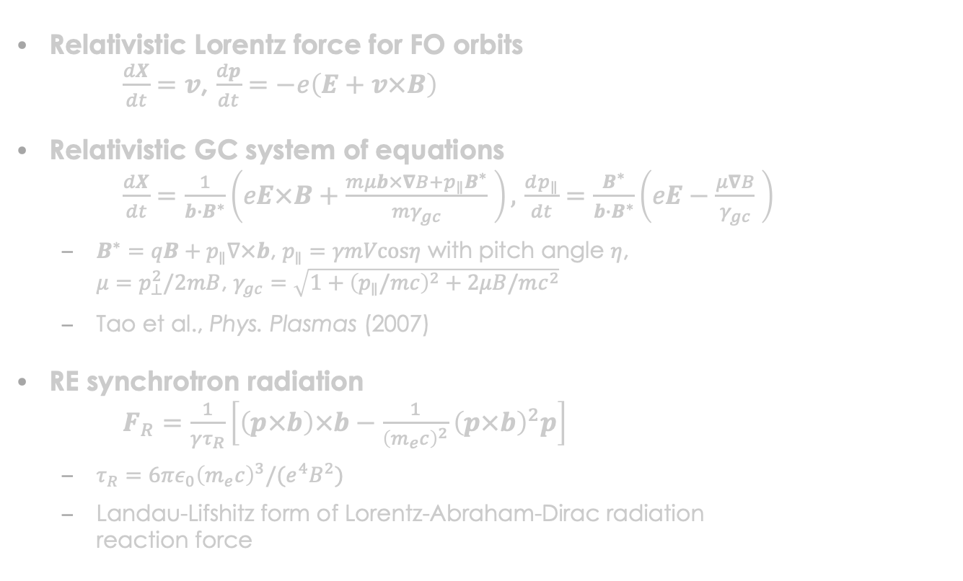
KORC evolves RE orbits with synchrotron radiation to accurately calculate RE transport
Relativistic Lorentz force for FO orbits
$\frac{dX}{dt}=v$, $\frac{dp}{dt}=−e\left(E+v×B\right)$
Relativistic GC system of equations
$\frac{dX}{dt}=\frac{1}{b∙B^{∗}}\left(eE×B+\frac{mμb×∇B+p_{∥}B^{∗}}{mγ_{gc}} \right),$ $\frac{dp_{∥}}{dt}=\frac{B^{∗}}{b∙B^{∗}}\left(eE−\frac{μ∇B}{γ_{gc}} \right)$
  $B^{∗}=qB+p_{∥}∇×b$, $p_{∥}=γmVcosη$ with pitch angle $η$,
  $μ=p_{⊥}^{2}/2mB$, $γ_{gc}=\sqrt{1+{\left(p_{∥}/mc\right)}^{2}+2μB/mc^{2}}$
  Tao et al., Phys. Plasmas (2007)
RE synchrotron radiation
$F_{R}=\frac{1}{γτ_{R}}\left[\left(p×b\right)×b−\frac{1}{{\left(m_{e}c\right)}^{2}}{\left(p×b\right)}^{2}p\right]$
  $τ_{R}=6πε_{0}{\left(m_{e}c\right)}^{3}/(e^{4}B^{2})$
  Landau-Lifshitz form of Lorentz-Abraham-Dirac radiation
  reaction force
10 MeV passing particle
Notes:
E. Hirvijoki et al., JPP (2015) developed GC transformation of the radiation-reaction force

Slide 17
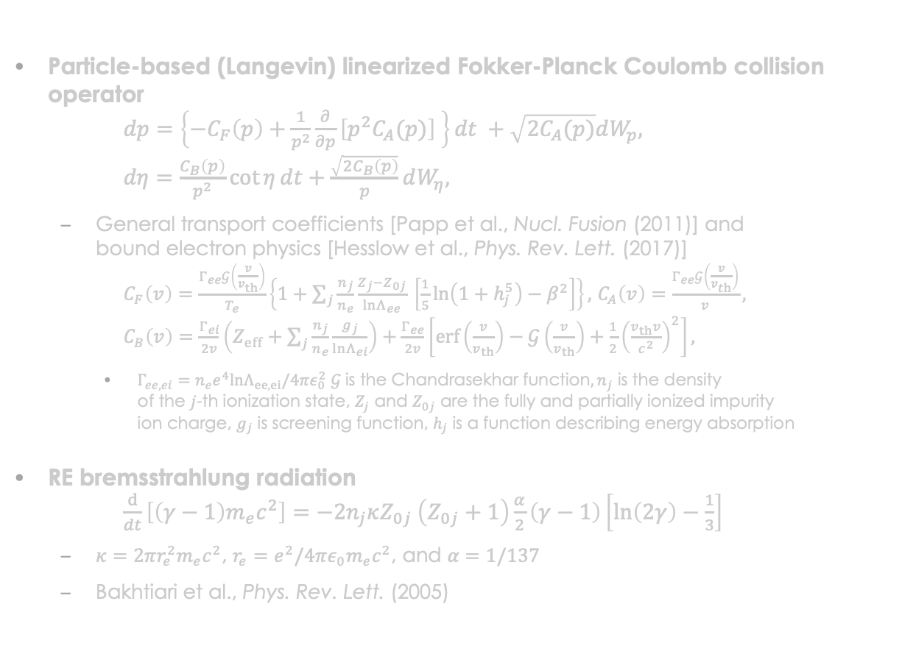
KORC includes Coulomb collisions with bound electrons
Particle-based (Langevin) linearized Fokker-Planck Coulomb collision operator
$dp=\left\{−C_{F}\left(p\right)+\frac{1}{p^{2}}\frac{∂}{∂p}\left[p^{2}C_{A}(p)\right] \right\}dt +\sqrt{2C_{A}(p)}dW_{p},$
$dη=\frac{C_{B}\left(p\right)}{p^{2}}\cot{η}dt+\frac{\sqrt{2C_{B}\left(p\right)}}{p}dW_{η},$
  General transport coefficients [Papp et al., Nucl. Fusion (2011)] and
  bound electron physics [Hesslow et al., Phys. Rev. Lett. (2017)]
  $C_{F}\left(v\right)=\frac{Γ_{ee}𝒢\left(\frac{v}{v_{th}}\right)}{T_{e}}\left\{1+\sum_{j}{\frac{n_{j}}{n_{e}}}\frac{Z_{j}−Z_{0j}}{lnΛ_{ee}} \left[\frac{1}{5}\ln\left(1+h_{j}^{5}\right)−β^{2}\right]\right\},$ $C_{A}\left(v\right)=\frac{Γ_{ee}𝒢\left(\frac{v}{v_{th}}\right)}{v},$
  $C_{B}\left(v\right)=\frac{Γ_{ei}}{2v}\left(Z_{eff}+\sum_{j}{\frac{n_{j}}{n_{e}}\frac{g_{j}}{lnΛ_{ei}}}\right)+\frac{Γ_{ee}}{2v}\left[erf\left(\frac{v}{v_{th}}\right)−𝒢\left(\frac{v}{v_{th}}\right)+\frac{1}{2}{\left(\frac{v_{th}v}{c^{2}}\right)}^{2}\right],$
    $Γ_{ee,ei}=n_{e}e^{4}lnΛ_{ee,ei}/4πε_{0}^{2}$ ${𝒢 \text{is} \text{the} \text{Chandrasekhar} \text{function}, n}_{j}$ is the density
    of the $j$-th ionization state, $Z_{j}$ and $Z_{0j}$ are the fully and partially ionized impurity
    ion charge, $g_{j}$ is screening function, $h_{j}$ is a function describing energy absorption
RE bremsstrahlung radiation
$\frac{d}{dt}\left[\left(γ−1\right)m_{e}c^{2}\right]=−2n_{j}κZ_{0j} \left(Z_{0j}+1\right)\frac{α}{2}\left(γ−1\right)\left[ln\left(2γ\right)−\frac{1}{3}\right]$
  $κ=2πr_{e}^{2}m_{e}c^{2}$, $r_{e}=e^{2}/4πε_{0}m_{e}c^{2}$, and $α=1/137$
  Bakhtiari et al., Phys. Rev. Lett. (2005)
Notes:
We note that O. Embréus, A. Stahl, and T. Fülöp, New Journal of Physics 18, 093023 (2016)
formulates a Boltzmann collision operator for bremsstrahlung radiation
Hesslow model uses mean excitation energy from Sauer et al., Advances in Quantum Chemistry (2015), which differs from Garland et al., PoP (2020) that includes relativistic effects

Slide 18
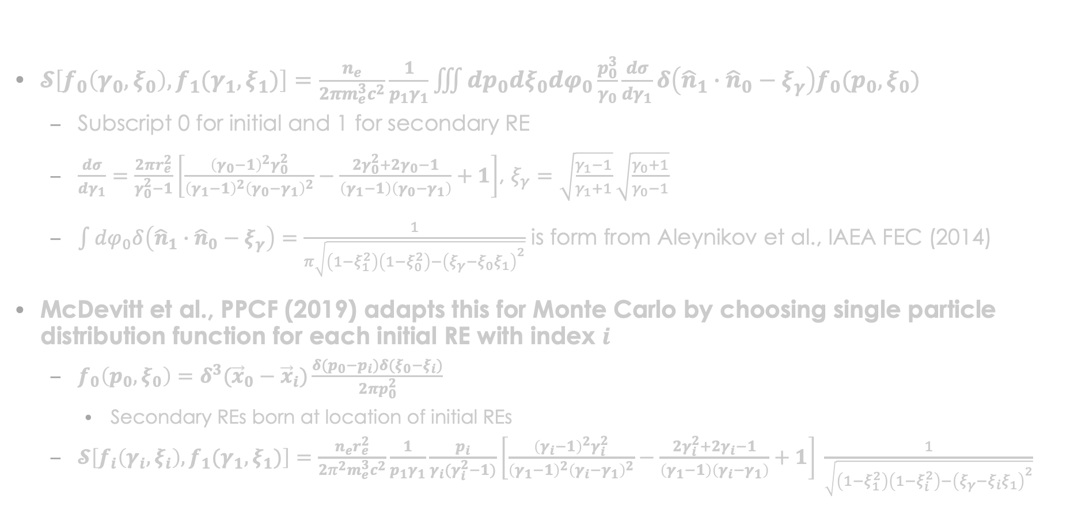
Aleynikov et al., IAEA FEC (2014) and Boozer, PoP (2015) developed a more accurate large-angle collision operator
$𝓢\left[f_{0}\left(γ_{0}, ξ_{0}\right),f_{1}(γ_{1},ξ_{1})\right]=\frac{n_{e}}{2πm_{e}^{3}c^{2}}\frac{1}{p_{1}γ_{1}}\iiint{dp_{0}dξ_{0}dφ_{0}}\frac{p_{0}^{3}}{γ_{0}}\frac{dσ}{dγ_{1}}δ\left({\hat{n}}_{1}∙{\hat{n}}_{0}−ξ_{γ}\right)f_{0}(p_{0},ξ_{0})$
  Subscript 0 for initial and 1 for secondary RE
  $\frac{dσ}{dγ_{1}}=\frac{2πr_{e}^{2}}{γ_{0}^{2}−1}\left[\frac{{\left(γ_{0}−1\right)}^{2}γ_{0}^{2}}{{\left(γ_{1}−1\right)}^{2}{\left(γ_{0}−γ_{1}\right)}^{2}}−\frac{2γ_{0}^{2}+2γ_{0}−1}{\left(γ_{1}−1\right)\left(γ_{0}−γ_{1}\right)}+1\right]$, $ξ_{γ}=\sqrt{\frac{γ_{1}−1}{γ_{1}+1}}\sqrt{\frac{γ_{0}+1}{γ_{0}−1}}$
  $\int{dφ_{0}δ\left({\hat{n}}_{1}∙{\hat{n}}_{0}−ξ_{γ}\right)}=\frac{1}{π\sqrt{\left(1−ξ_{1}^{2}\right)\left(1−ξ_{0}^{2}\right)−{\left(ξ_{γ}−ξ_{0}ξ_{1}\right)}^{2}}}$ is form from Aleynikov et al., IAEA FEC (2014)
McDevitt et al., PPCF (2019) adapts this for Monte Carlo by choosing single particle distribution function for each initial RE with index $i$
  $f_{0}\left(p_{0}, ξ_{0}\right)=δ^{3}({\vec{x}}_{0}−{\vec{x}}_{i})\frac{δ(p_{0}−p_{i})δ(ξ_{0}−ξ_{i})}{2πp_{0}^{2}}$
    Secondary REs born at location of initial REs
  $𝓢\left[f_{i}\left(γ_{i}, ξ_{i}\right),f_{1}(γ_{1},ξ_{1})\right]=\frac{n_{e}r_{e}^{2}}{2π^{2}m_{e}^{3}c^{2}}\frac{1}{p_{1}γ_{1}}\frac{p_{i}}{γ_{i}(γ_{i}^{2}−1)}\left[\frac{{\left(γ_{i}−1\right)}^{2}γ_{i}^{2}}{{\left(γ_{1}−1\right)}^{2}{\left(γ_{i}−γ_{1}\right)}^{2}}−\frac{2γ_{i}^{2}+2γ_{i}−1}{\left(γ_{1}−1\right)\left(γ_{i}−γ_{1}\right)}+1\right] \frac{1}{\sqrt{\left(1−ξ_{1}^{2}\right)\left(1−ξ_{i}^{2}\right)−{\left(ξ_{γ}−ξ_{i}ξ_{1}\right)}^{2}}}$

Slide 19
Benchmark implementation of large angle collision operator
Spatially-independent calculations, using electric field acceleration, collisional friction, pitch angle scattering, synchrotron radiation, and large angle collision source
  Left plot shows evolution of all (blue trace) and a subpopulation of active (red trace) REs included in a calculation
  Growth rates in center plot compare favorably with Liu et al., PPCF (2017) and McDevitt et al., PPCF (2019)
Toroidal and trapped particle effects on the avalanche growth rate are consistent with simulations in McDevitt and Tang, EPL (2019)
  Physical effects discussed in Nilsson et al., JPP (2015) and Nilsson et al., Nucl. Fusion (2015).

Slide 20
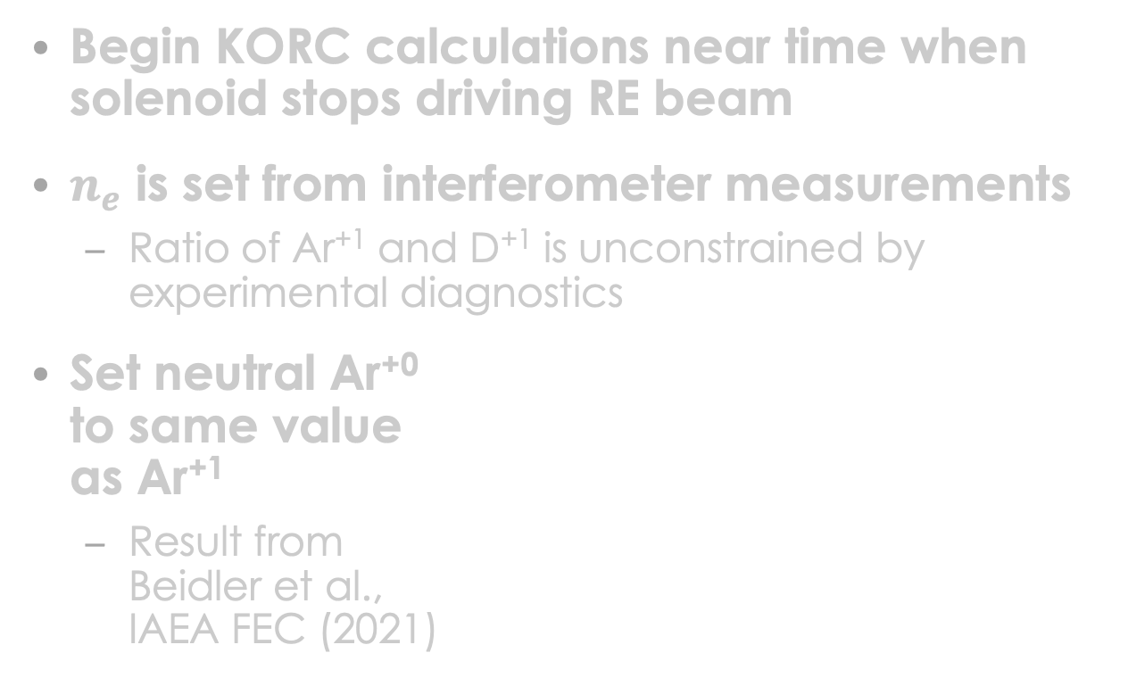
Approximate impurity content determined in simulations without large angle collision operator
Begin KORC calculations near time when solenoid stops driving RE beam
$n_{e}$ is set from interferometer measurements
  Ratio of Ar⁺¹ and D⁺¹ is unconstrained by experimental diagnostics
Set neutral Ar⁺⁰
to same value
as Ar⁺¹
  Result from
  Beidler et al.,
  IAEA FEC (2021)

Slide 21
Energy and pitch distribution of secondary REs reaches a quasi-steady state during final loss event

Slide 22
Angle of incidence calculated from GC angle of incidence, pitch, and randomly-chosen gyrophase
$\sin{Θ_{i}}=−\cos{θ_{GC,i}}\sin{η_{i}}\sin{χ_{i} }+\sin{θ_{GC,i}}\cos{η_{i}}>0$

