Slide 1
#Sakharov in Saint Tropez

Slide 2
CarMa0NL modelling of halo currents on COMPASS
V. Yanovskiy¹, E. Matveeva¹, A. Casolari¹, J. Cavalier¹, J. Havlicek¹, A. Iaiunese²,
N. Isernia², S. Leonov³ and F. Villone²
¹Institute of Plasma Physics of the CAS, Praha
²Consorzio CREATE, Napoli
³Haute École de musique de Genève
Acknowledgements: R. Paccagnella, V. D. Pustovitov
2nd IAEA TM on Plasma Disruptions and their Mitigation, July 19, 2022

Slide 3
Outline
Motivation (COMPASS-U)
COMPASS magnetics
Measured vessel currents for #19172
CarMa0NL modelling for #19172
Conclusions

Slide 4
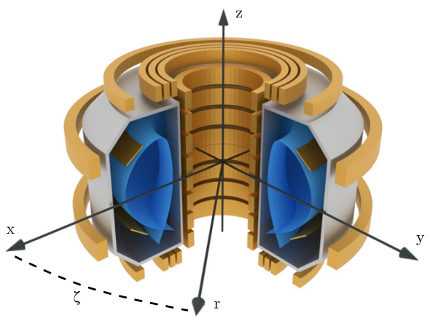
Motivation: design of COMPASS-U
to support the design of vacuum vessel, passive stabilizing plates, plasma facing components and magnetic diagnostics we perform disruption modelling on CarMa0NL.
COMPASS-U:
Magnetic field 5 T
Plasma current 2 MA
Major radius 0.9 m

Slide 5
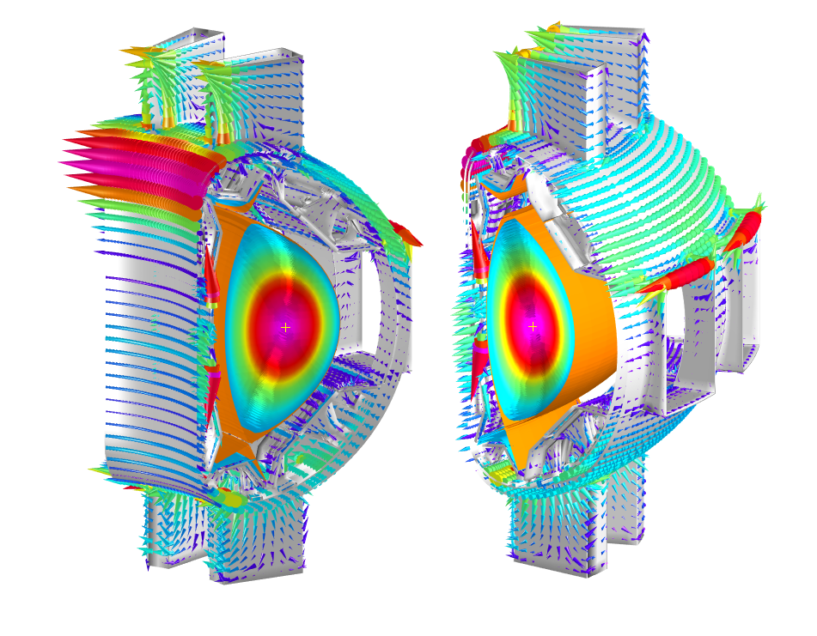
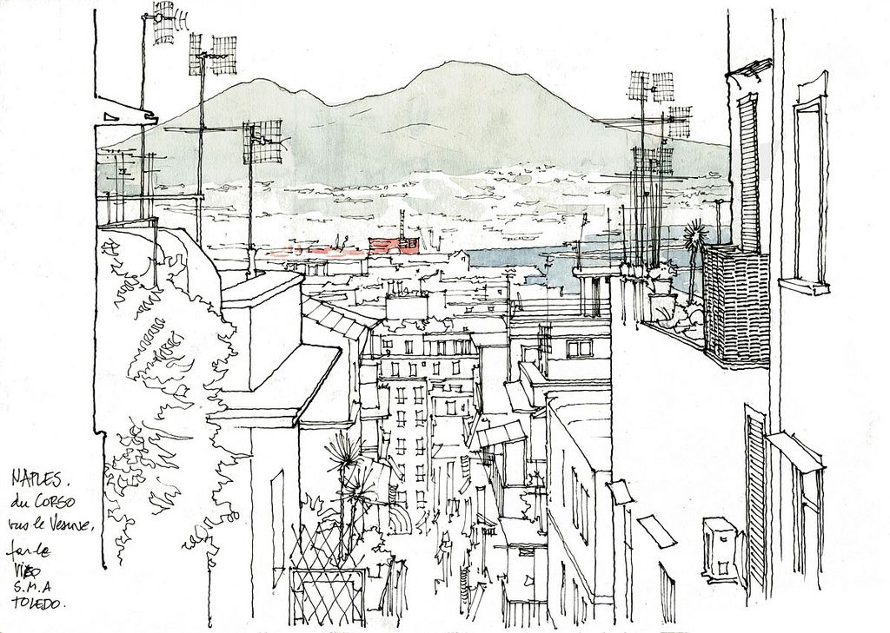
CarMa0NL: 2D plasma + 3D conductors
CarMa0NL describes the evolutionary equilibrium of axisymmetric plasmas in presence of 3D volumetric conducting structures
*F. Villone et al., Plasma Phys. Control. Fusion 55 095008 (2013)
**S. L. Chen, Nucl. Fusion 59 (2019) 106039

Slide 6
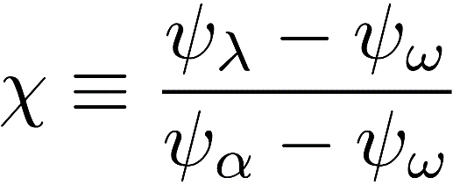
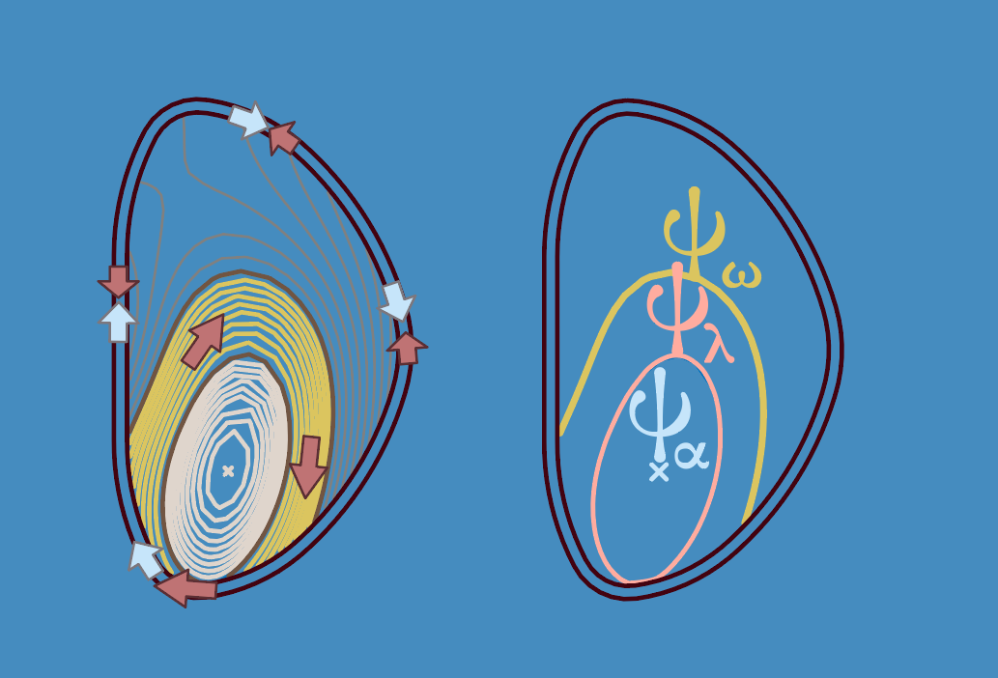
CarMa0NL code
INPUT
Time evolution of:
Toroidal plasma current and pressure profiles
Halo width (see definition on the right, in terms
of poloidal magnetic flux)
OUTPUT
Plasma radial and vertical motion
Eddy and halo currents in conducting structures
Related electromagnetic forces
APPLICABILITY
CarMa0NL allows performing multiple parameter scans in reasonable time, which makes it very convenient for design purposes.
Requires some physical insight for prescribed halo width dynamics.

Slide 7
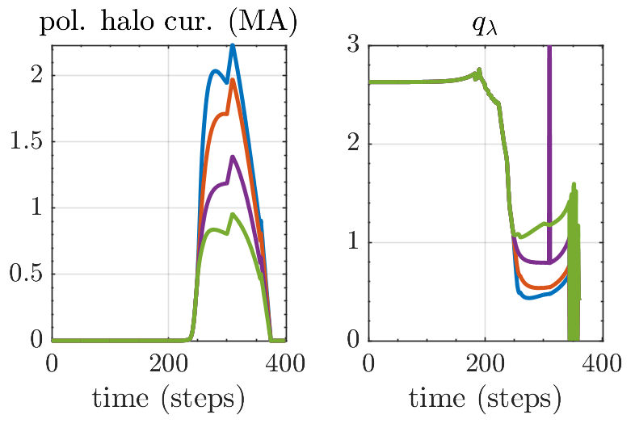
Observation from COMPASS-U simulations
Total poloidal halo current depends on q @ LCFS.
Is there a limit for q @ LCFS in real disrupting plasma?
We will use COMPASS data to answer this question.

Slide 8
Outline
Motivation
COMPASS magnetics
Experimental data for #19172
CarMa0NL modelling for #19172
Conclusions

Slide 9
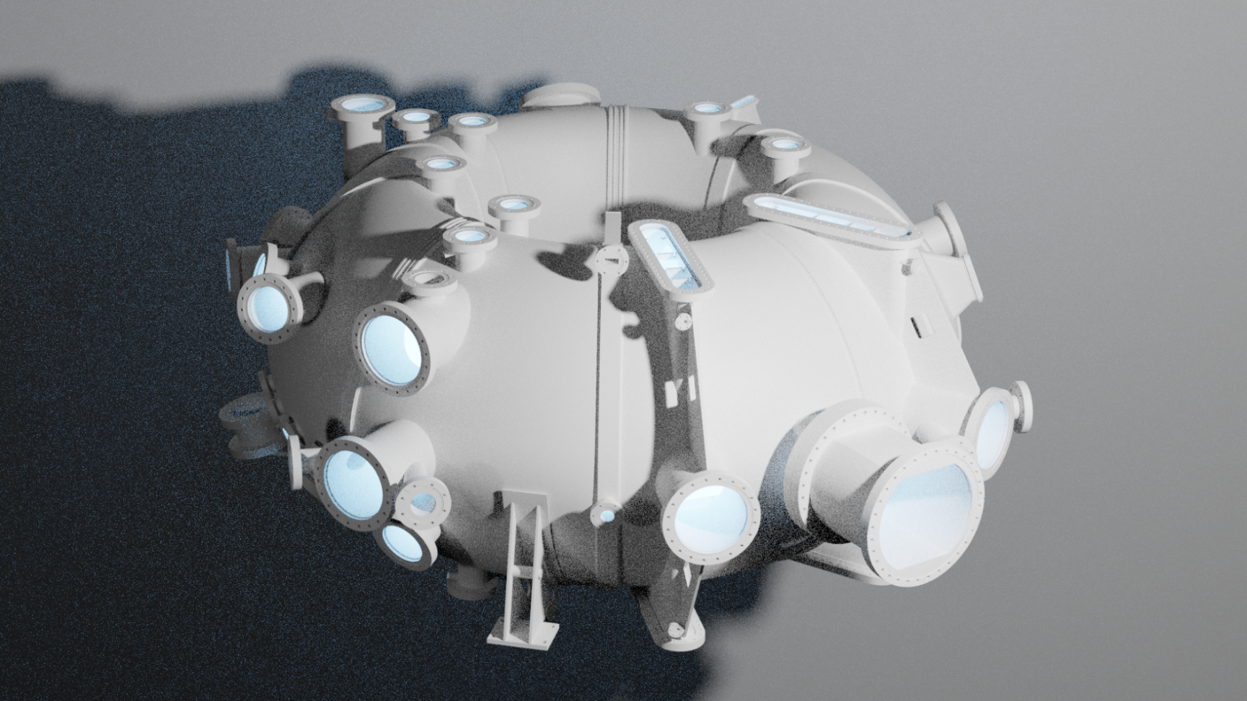
Vacuum vessel

Slide 10
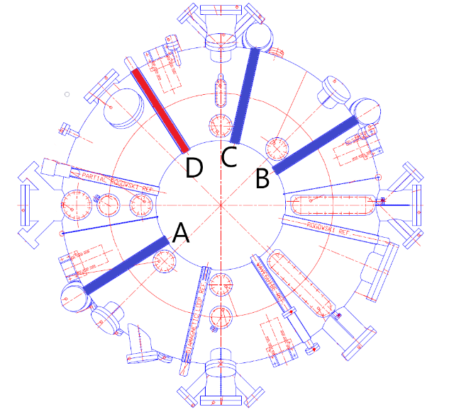
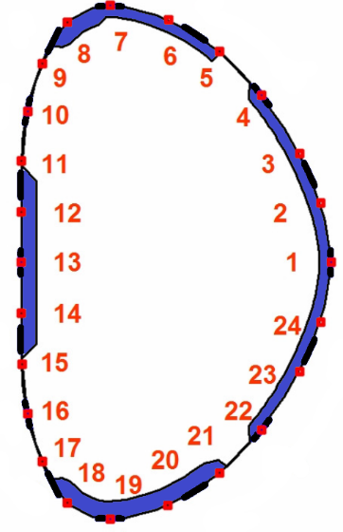
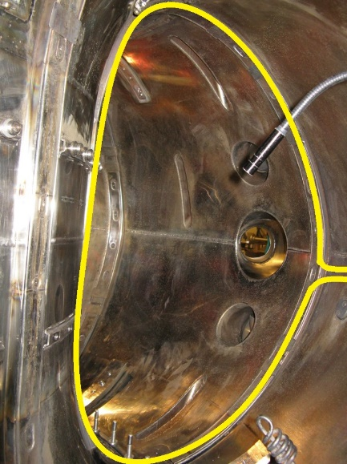
Magnetics
24x3 toroidal Mirnov coils at 3 toroidal angles (coil sets A, B and C) allow to estimate distribution of poloidal current (eddy+halo) using Ampere’s law.
Diamagnetic signal (D) allows to deduce poloidal eddy current (the fundamental harmonic of the poloidal current)*
*V. Yanovskiy et al, P4.1056, Proceeding of the 46th EPS 2019, Milan

Slide 11
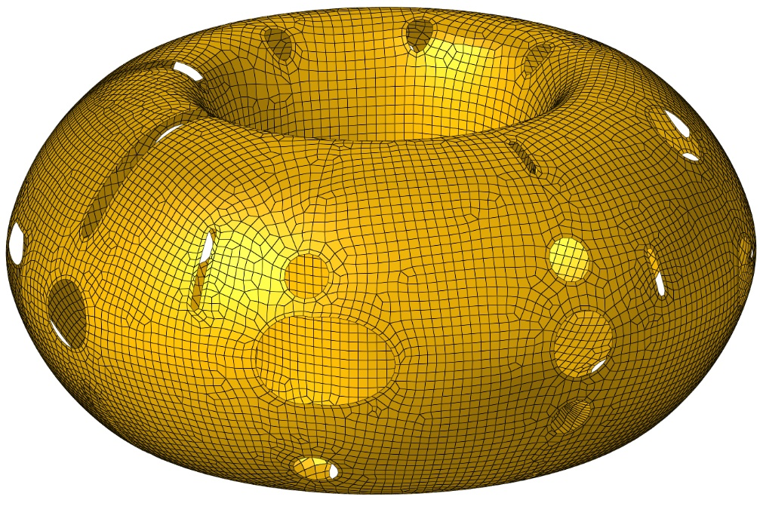
360 mesh with all port openings
CarMa0NL modelling of 2D plasma VDEs for 360 degree vessel with all port openings showed that Mirnov coils in the set B on LFS are affected by the wall asymmetries.

Slide 12
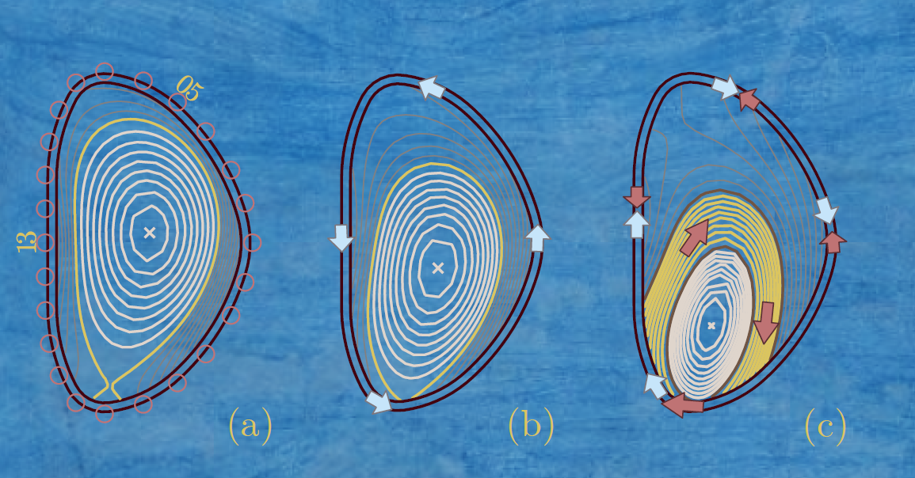
Poloidal vessel currents (eddy & halo)
Initial pre-disruption equilibrium for COMPASS #19172
Poloidal eddies during TQ (counter-clockwise)
Poloidal eddies during CQ (clockwise) + halo currents (in both directions)
Halo = Total – Eddy:

Slide 13
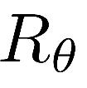
Mag. Diag. for total poloidal eddy current
Diamagnetic signal allow to deduce poloidal eddy current (the fundamental harmonic of the poloidal current) [1, 2]
- measured voltage
- poloidal vessel resistance
[1] Pustovitov V D 2019 Fusion Eng. Des. 138 53-58
[2] V. Yanovskiy et al, P4.1056, Proceeding of the 46th EPS 2019, Milan

Slide 14
Magnetic diagnostics for total poloidal current
24x3 toroidal Mirnov coils at 3 toroidal angles (coil sets A, B and C) allow to deduce poloidal eddy+halo current using Ampere’s law.
Toroidal symmetry assumed here.
Otherwise there is no simple way to
relate magnetic perturbation and the current.
*V. Yanovskiy et al, P4.1056, Proceeding of the 46th EPS 2019, Milan

Slide 15
Outline
Motivation
COMPASS magnetics
Experimental data for #19172
CarMa0NL modelling for #19172
Conclusions

Slide 16
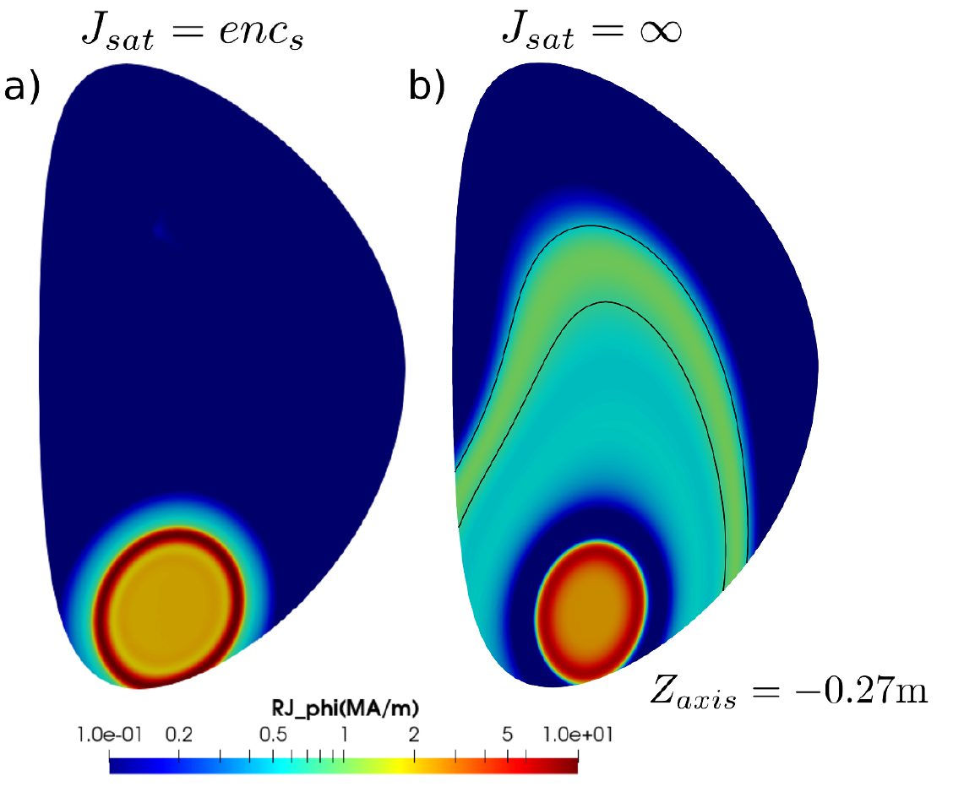
#19172
We will analyse a shot #19172 already modelled with JOREK (2D) [1]
[1] F J Artola et al 2021 Plasma Phys. Control. Fusion 63 064004

Slide 17
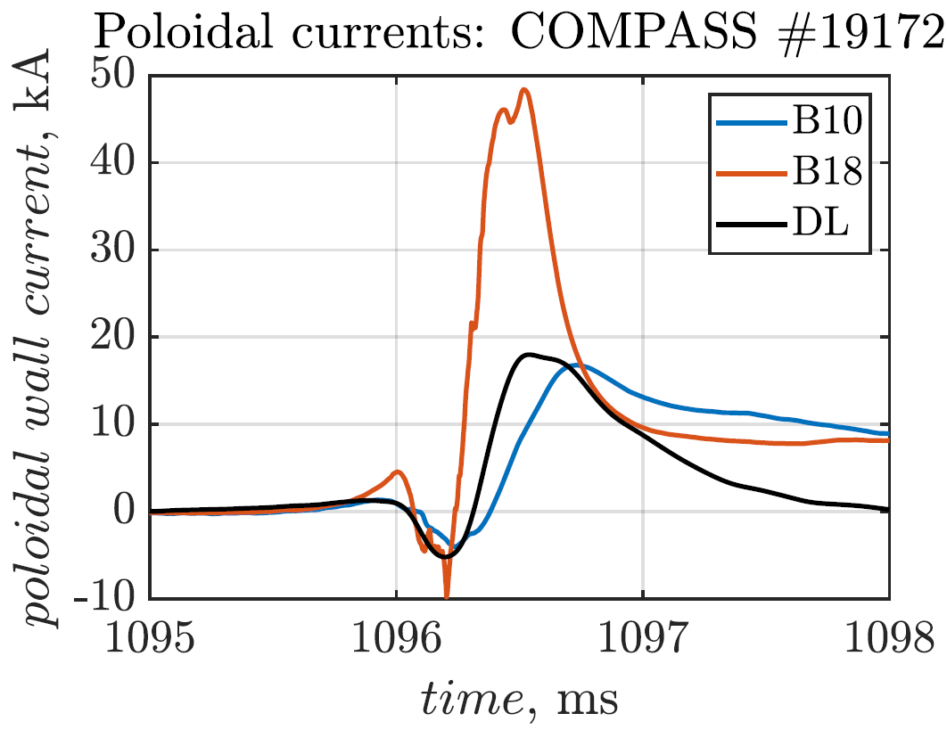
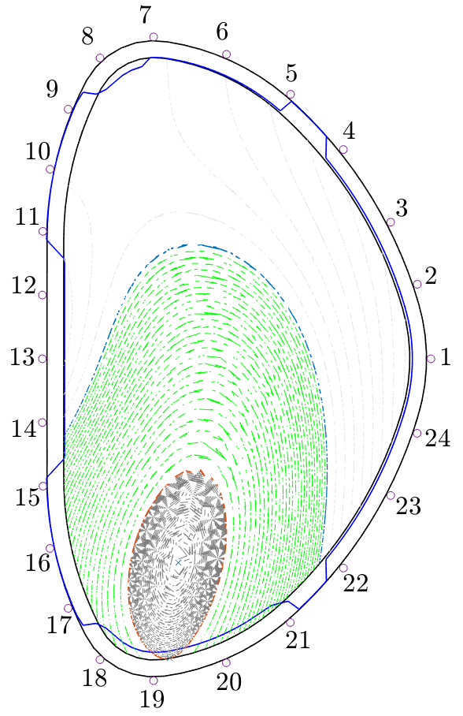
An example: two coils (from top and bottom)
For a downward disruption #19172 the coil 10 is not affected by halo and, therefore, gives the poloidal eddy current only (to compare with eddies deduced from diamagnetic loop (DL) signal).
In contrast, the coil 18 (inside the halo region) gives poloidal halo + poloidal eddy currents.

Slide 18
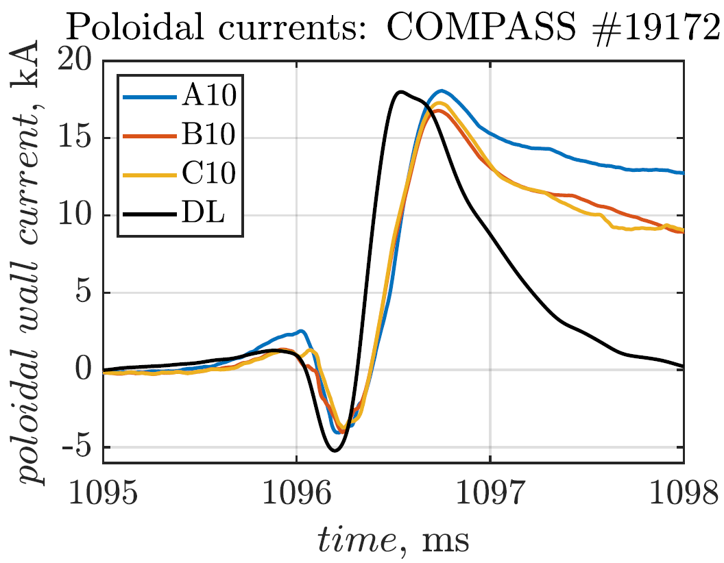
Poloidal eddy current (downward VDE)
Poloidal eddy current as measured by Mirnov coils A10, B10, C10 at three toroidal angles and by the diamagnetic loop (DL): good agreement.
Negative spike due to the TQ and the positive spike due to the CQ.

Slide 19
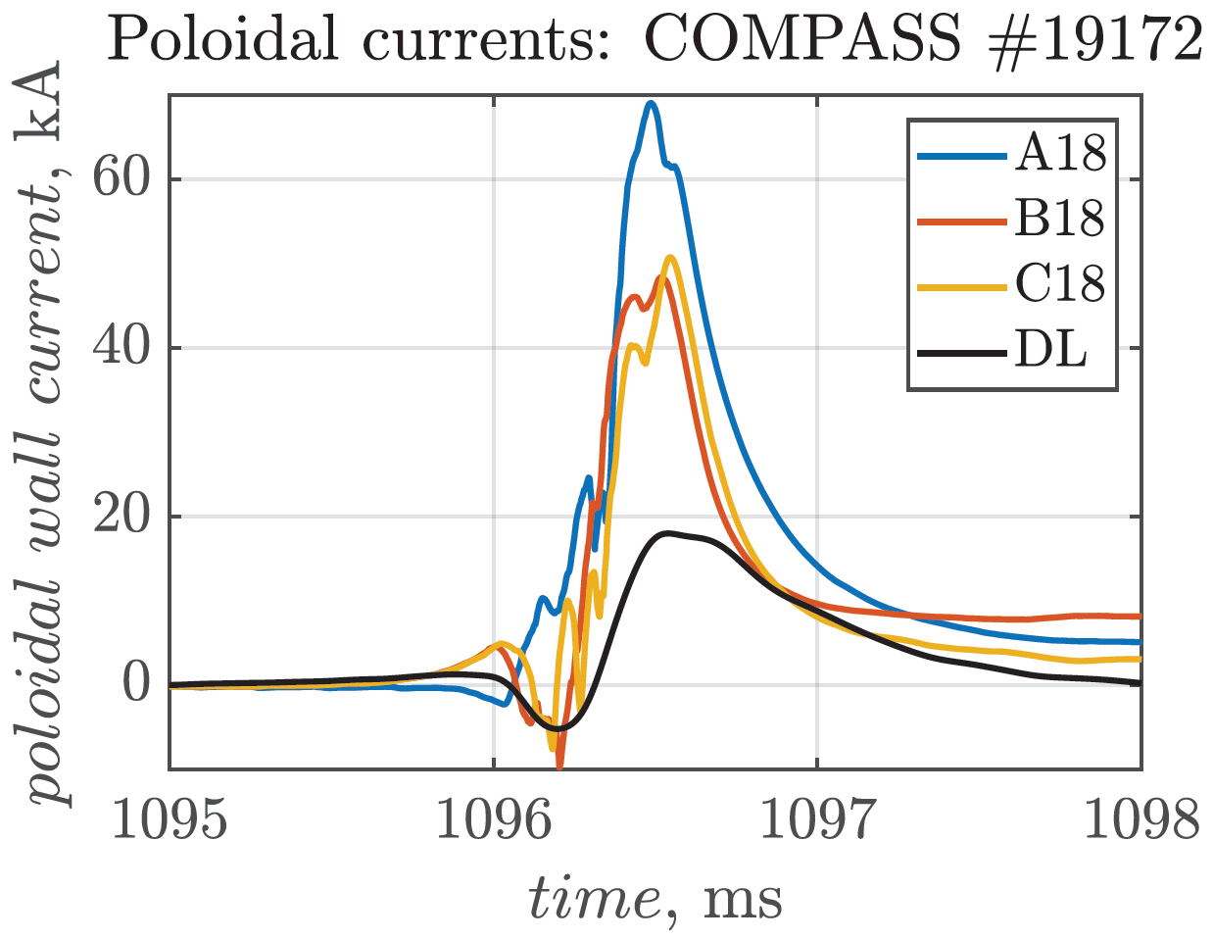
Poloidal halo+eddy current (downward VDE)
Poloidal halo+eddy current as measured by Mirnov coils A18, B18, C18 at three toroidal angles.
One can deduce the toroidal asymmetry of halo current.

Slide 20
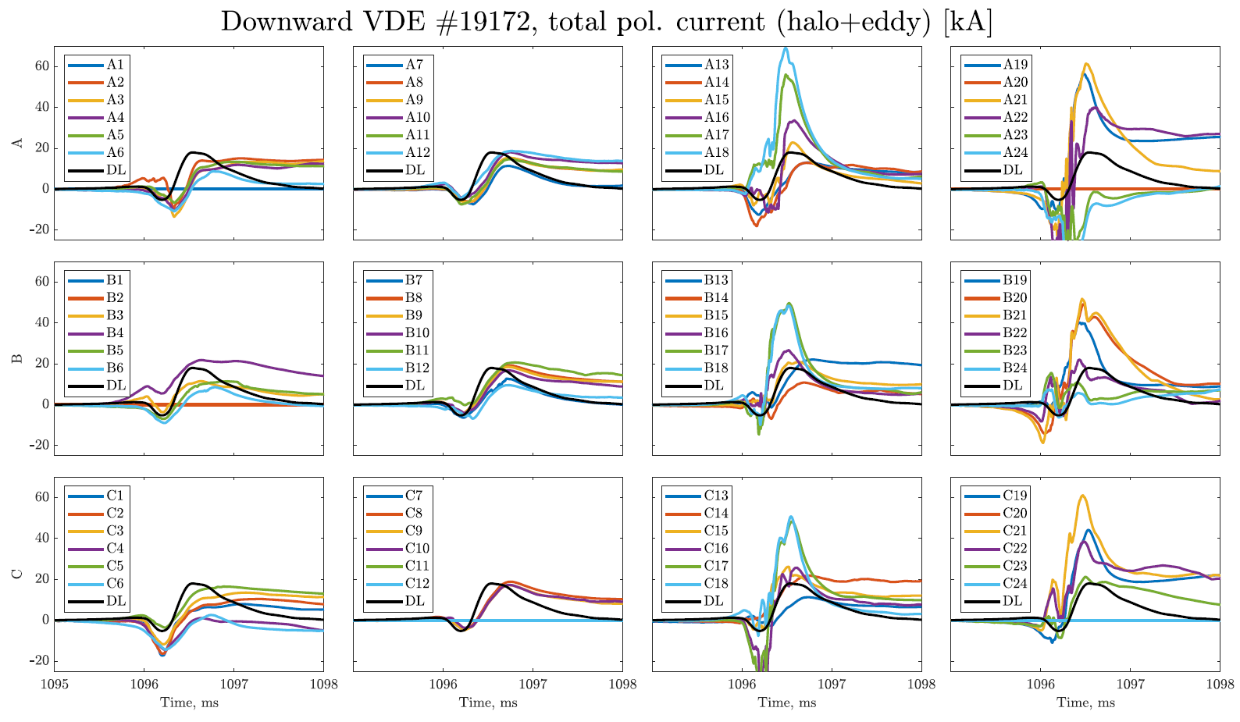
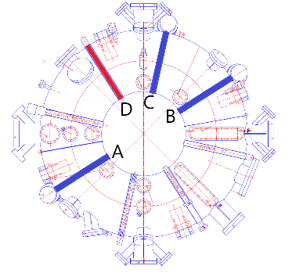
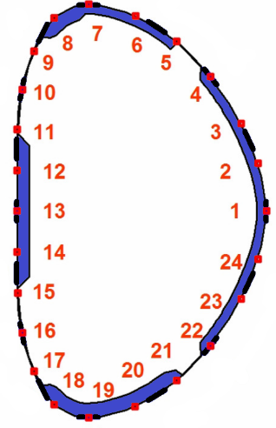
24x3 Mirnov coil signals + 1 diamagnetic loop signal

Slide 21
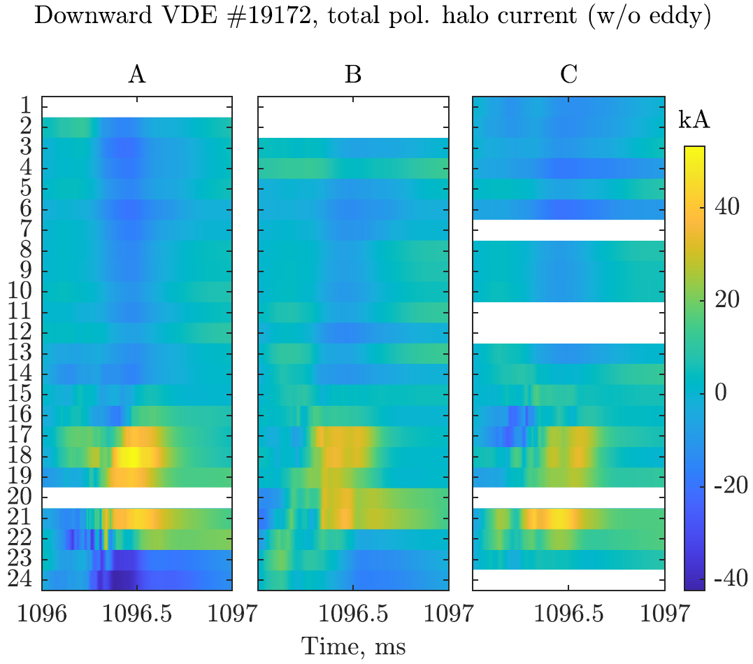
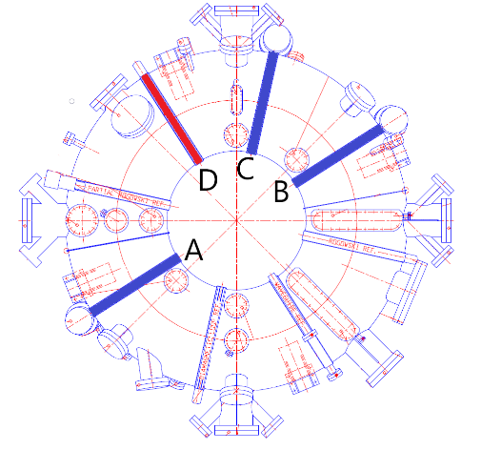
Poloidal current (halo only) dynamics at 3 tor. angles
Maximum halo amplitude is 50 kA
(15% of pre-disruption plasma current)

Slide 22
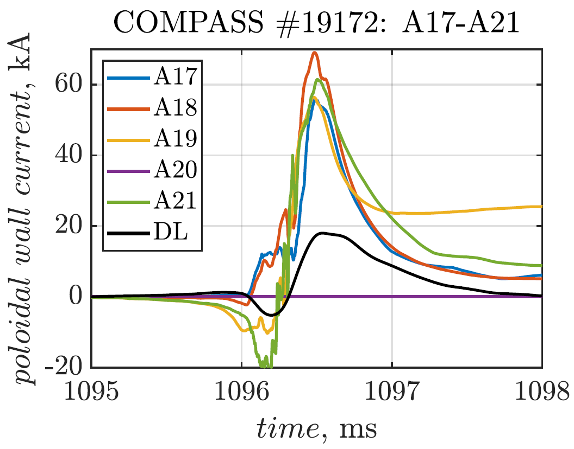
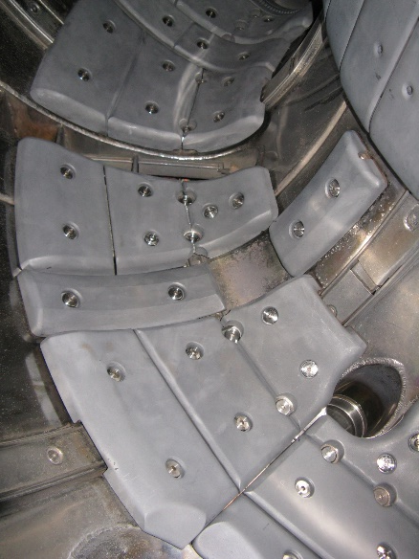
Constant halo amplitude over a wide area (coils 17-21)
Amplitude of the halo current is almost the same between coils 17 and 21.
Tiles cover coils on the bottom of the vessel.

Slide 23
Outline
Motivation
COMPASS magnetics
Experimental data for #19172
CarMa0NL modelling for #19172
Conclusions

Slide 24
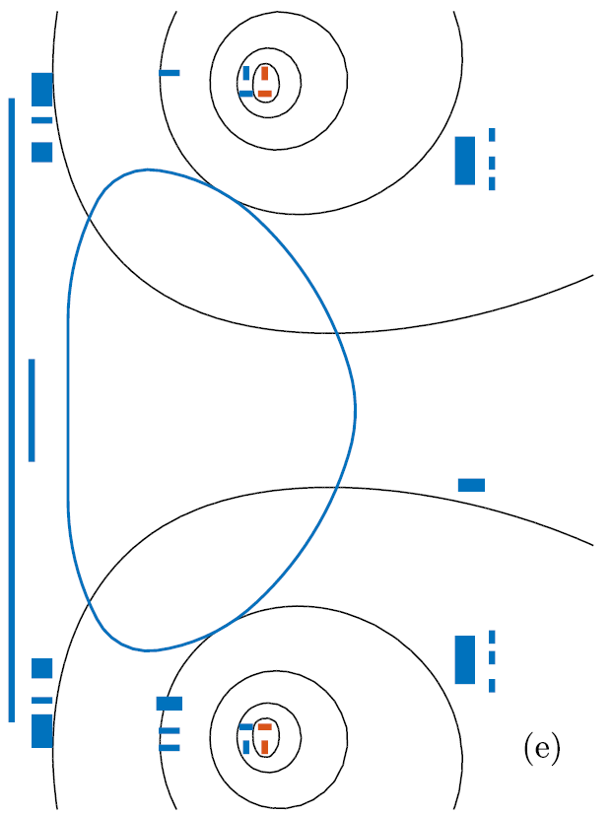
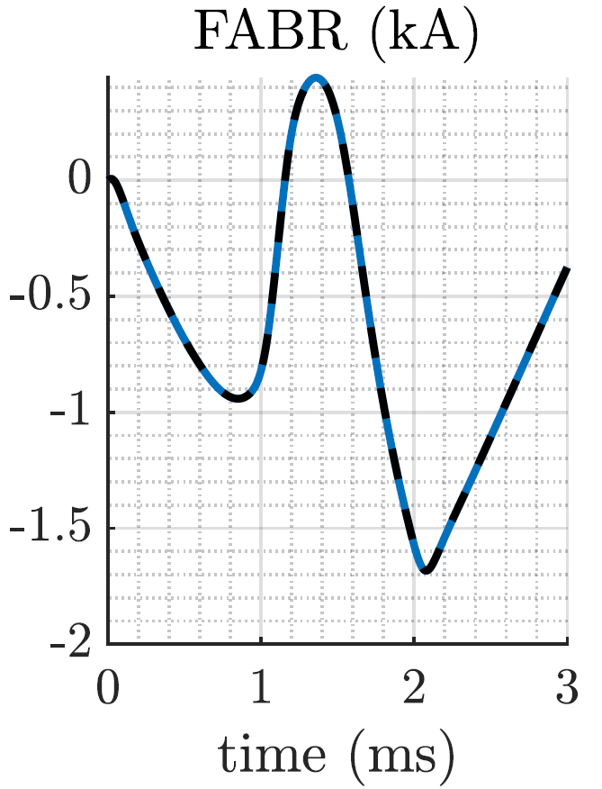
#19172 settings: current in FABR circuits
The VDE is triggered by the voltage kick in the circuit for radial field.
Used as input for CarMa0NL

Slide 25
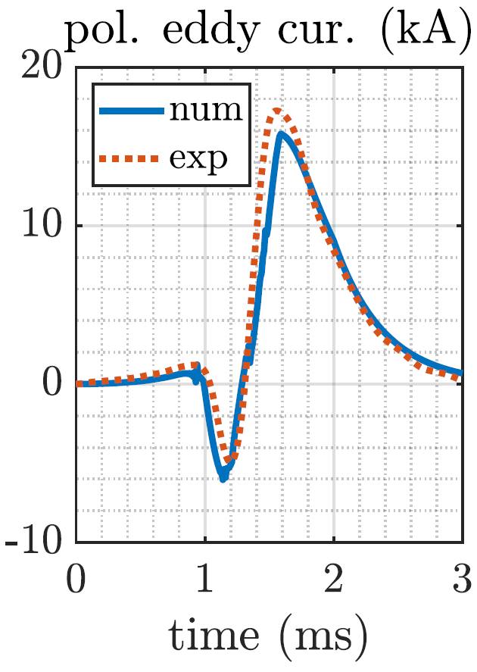
#19172 settings: poloidal beta and TQ duration
We fit pre-disruption poloidal beta (and TQ duration) to negative peak in the poloidal eddy current (measured with diamagnetic loop)
The TQ duration is determined also by SXR measurements

Slide 26
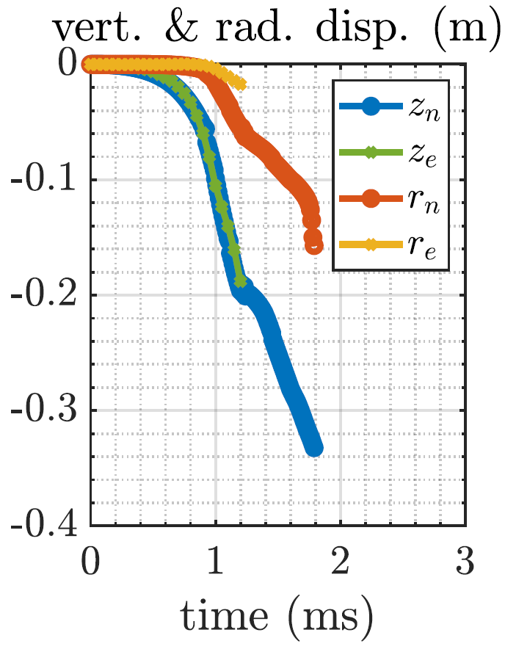
#19172 settings: internal inductance and dz/dt
We fit internal inductance (of pre-disruption equilibrium) to fit the dynamics of vertical displacement
Good agreement in dz/dt

Slide 27
We vary \chi to obtain the best fit of the halo footprint

Slide 28
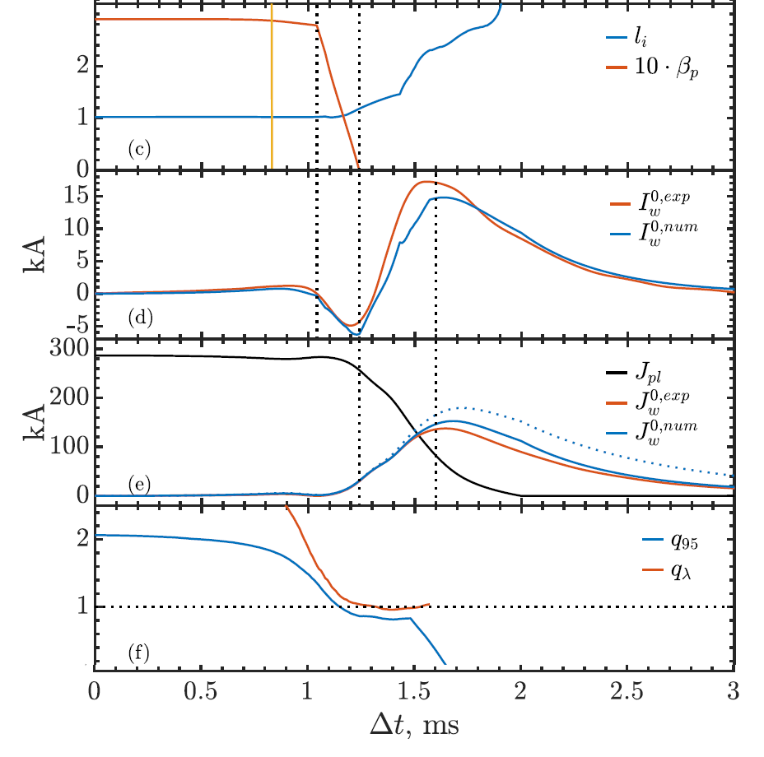
#19172 overview
TQ -> negative peak in poloidal eddy current.
CQ -> positive peak in poloidal eddy current.
Good agreement between measured and calculated pol. & tor. eddy currents.
The best fit of the measured halo footprint corresponds to the q @ LCFS around 1.

Slide 29
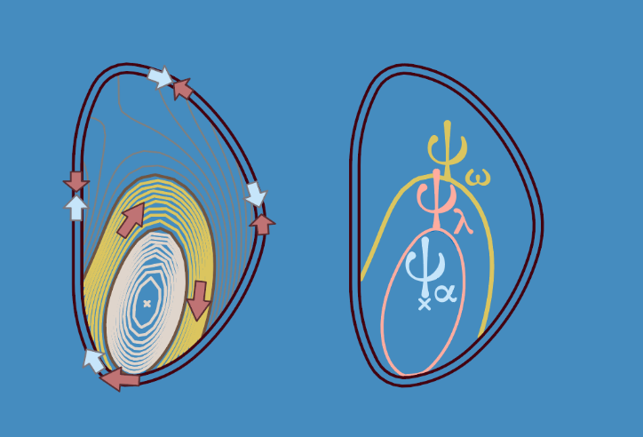
Best fit of the halo footprint
Best fit of the halo footprint is obtained for such chi(t), that leads to q@LCFS around 1.

Slide 30
Summary
The best fit with the measured halo footprint is obtained for such halo width (chi)
that leads to q@LCFS around 1.
This suggests that the role of m/n=1/1 mode might be dominant in defining the halo width.
Further studies will explore the sensitivity of the finding to plasma parameters, for example, current profile evolution.

Slide 31
#19172 with magnetic sound from Mirnov coil A3

