Slide 1
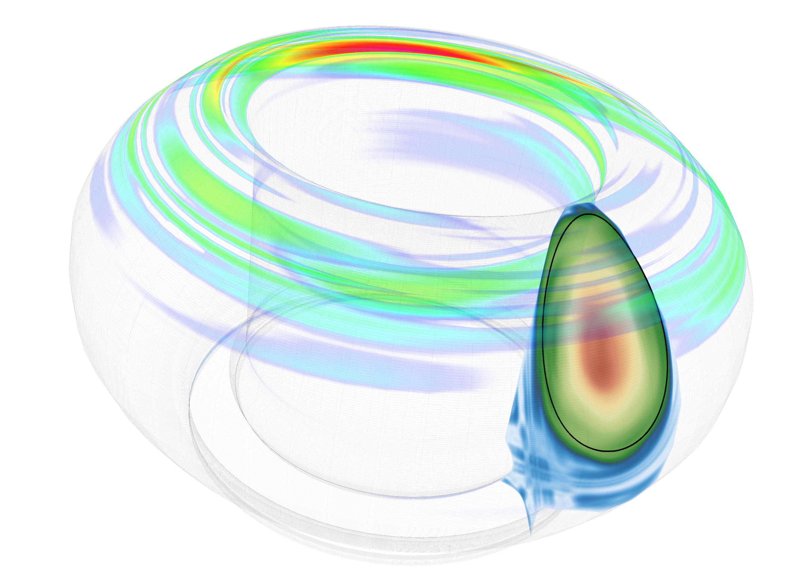
Present status and challenges of disruption load modelling
F.J. Artola¹, M. Lehnen¹, R.A. Pitts¹, M. Hoelzl², N. Schwarz², E. Nardon³
¹ITER Organization, Route de Vinon sur Verdon, 13067 St Paul Lez Durance Cedex, France
²Max Planck Institute for Plasmaphysics, Boltzmannstr. 2, 85748 Garching, Germany
³CEA, IRFM, F-13108 Saint-Paul-lez-Durance, France
The views and opinions expressed herein do not necessarily reflect those of the ITER Organization

Slide 2
Importance of disruption load modeling
Disruption loads cause
  Mechanical stresses in the tokamak components
  Deteriorate Plasma Facing Components (PFCs) by erosion, melting, material migration…
Thus they
  Constrain engineering design
  Determine disruption budget (allowable number of disruptions)
I. Jepu et al., NF 59 (2019) 086009
G. F. Matthews et al., Phys. Scr. T167 (2016) 014070
Be “waterfalls”
CQ-induced Be melting at JET

Slide 3
Outline
Thermal loads
Electromagnetic loads
Runaway Electron loads

Slide 4
Thermal loads

Slide 5
Thermal loads during the TQ
Depend on energy loss channels
  Line radiation → Plasma radiation loads
  Conduction on open field lines
  Convection (blobs, bubbles)
Thermal loads due to plasma-wall contact (localized)

Slide 6
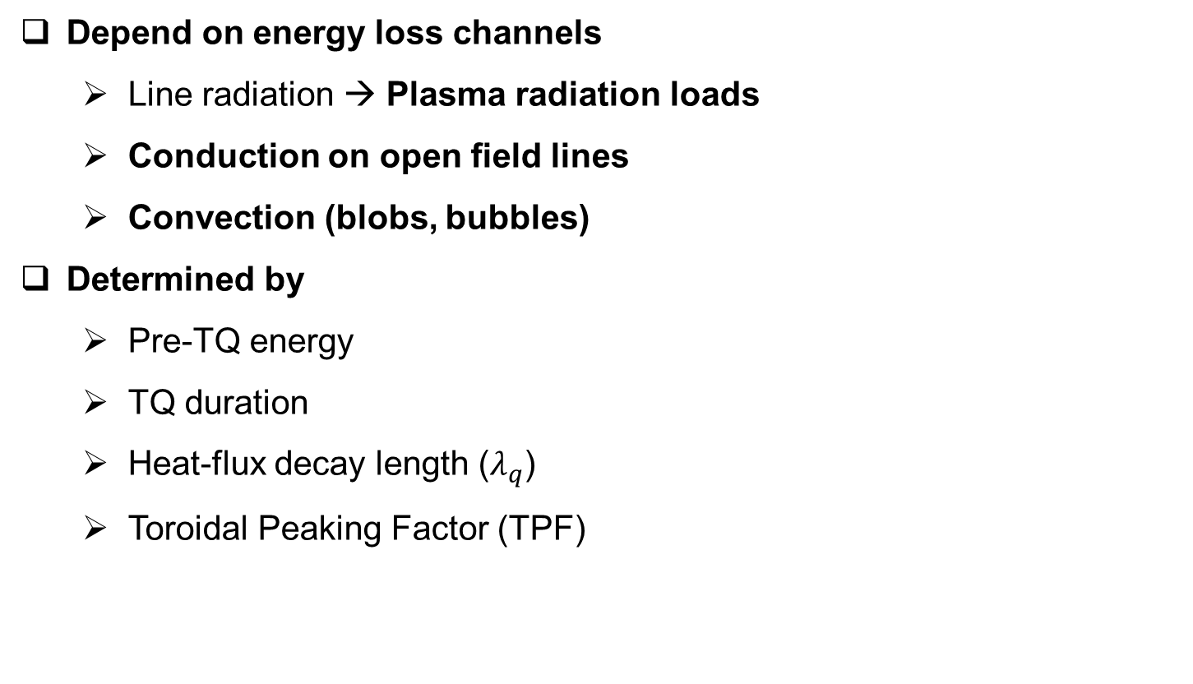
Thermal loads during the TQ
Depend on energy loss channels
  Line radiation → Plasma radiation loads
  Conduction on open field lines
  Convection (blobs, bubbles)
Determined by
  Pre-TQ energy
  TQ duration
  Heat-flux decay length ($λ_{q}$)
  Toroidal Peaking Factor (TPF)
Thermal loads due to plasma-wall contact (localized)
Not understood in present experiments and large uncertainties for future tokamaks

Slide 7
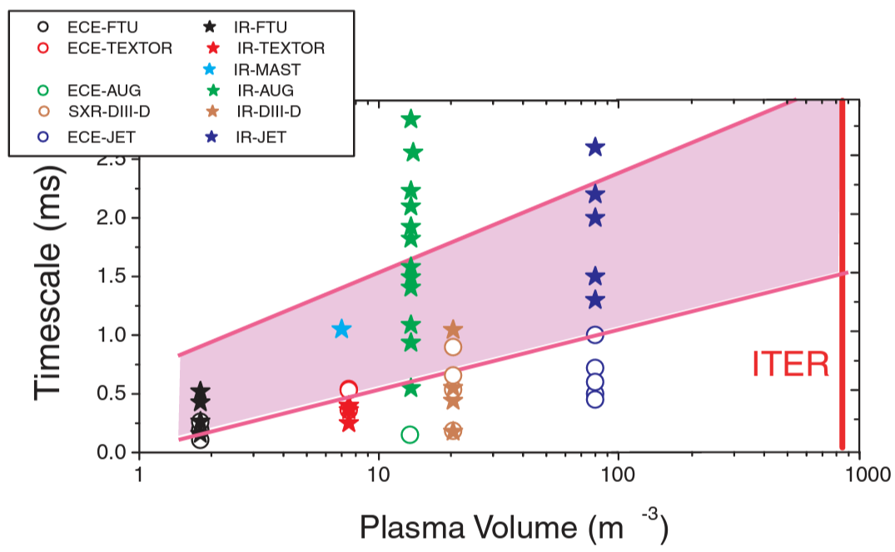
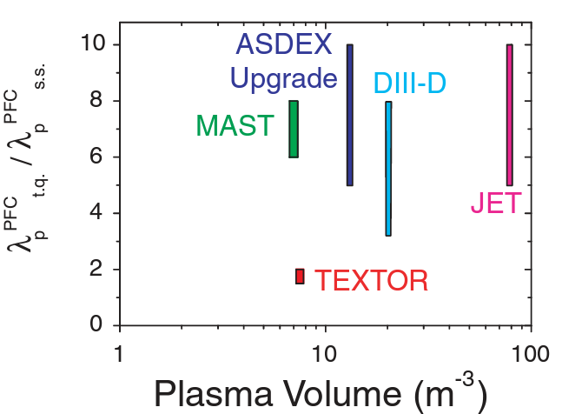
Thermal loads during the TQ
Extrapolation to new devices is based on experimental data
Heat-flux width broadening during the TQ
TQ duration measured with different diagnostics
A. Loarte, 20th IAEA, 2004

Slide 8
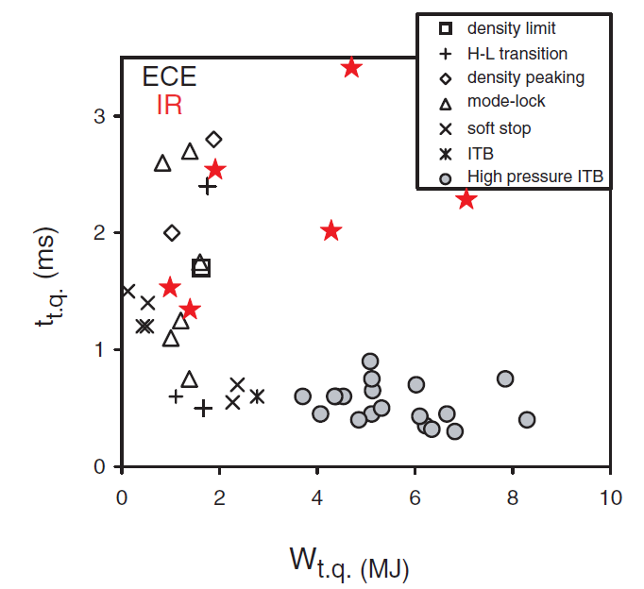

Thermal loads during the TQ
The TQ duration depends on the disruption cause
TQ duration
TQ is different for different disruption causes
Modeling and validation needed for each disruption type
TQ is faster for high-$β$ disruptions
A. Loarte, 20th IAEA, 2004

Slide 9
Literature for TQ simulations
Unmitigated TQ: 3D MHD simulations
Strauss, H. “Nonlinear, three-dimensional MHD of noncircular tokamaks”, Phys. Fluids 19 134 (1976)
White, “Simulation of Large Magnetic Islands: A Possible Mechanism for a Major Tokamak Disruption, Phys. Rev. Lett. 39 1618 (1977)
Waddell, et al, “Mechanism for Major Disruptions in Tokamaks”, Phys Rev. Lett 41 1386 (1978)
Carreras, “Nonlinear coupling of tearing modes with self-consistent resistivity evolution in tokamaks”, Phys. Fluids 23 1811 (1980)
A. Sykes and J. A. Wesson, "Major Disruptions in Tokamaks", Phys. Rev. Lett. 44, 1215 (1980)
J. F. Drake and R. G. Kleva, "Are Vacuum Bubbles a Cause of Major Disruptions in Tokamaks?", Phys. Rev. Lett. 53, 1465 (1984)
Bondeson, A. “Simulations of tokamak disruptions including self-consistent temperature evolution”, Nucl Fusion 26 929 (1986)
Bondeson, A., “MHD modelling of density limit disruptions in tokamak”, Nuclear Fusion 31 1695 (1991)
Kleva, R., “Density limit disruptions in tokamaks”, Phys. Fluids B, Plasma Physics 3, 372 (1991)
Persson, “Wall locking and multiple nonlinear states of magnetic islands”, Plasma Physics and Controlled Fusion 36 1775-1789 (1994)
Park, W., “High-β limit disruptions in tokamaks in Tokamaks”, Phys Rev Lett , 75 1763 (1995)
Kruger, S., “Dynamics of the major disruption of a DIII-D plasma”, Phys Plasmas 12, 056113 (2005)
Aydemir, et al, “Role of explosive instabilities in high-β disruptions in tokamaks”, Nucl. Fusion 56 054001 (2016)
Aydemir, et al, “Dynamics of an n=1 explosive instability and its role in high-β disruptions”, Nucl. Fusion 58 016026 (2018)
Strauss, “Effect of Resistive Wall on Thermal Quench in JET Disruptions”, Phys. Plasmas 28, 032501 (2021a)
Strauss, “Thermal quench in ITER locked mode disruptions”, Phys Plasmas 28 072507 (2021b)
Schwarz, “Hot VDE experiments and non-axisymmetric simulations with JOREK STARWALL”, 48th EPS 2022
Not a complete list, collected for ITPA Special Issue section 3.5 led by S. Jardin
Discuss TQ onset (e.g. island overlap) and qualitative dynamics
Low-Lundquist numbers (non-predictive)
Do not describe direct loads (heat fluxes to the first wall)

Slide 10
Literature for TQ simulations
Mitigated TQ with Massive Material Injection: 3D MHD simulations
V. Izzo, “MHD simulation of massive gas injection into Alcator C-Mod and DIIID’, Phys Plasmas 15 (2008)
V. Izzo, “Impurity mixing and radiation asymmetry in MGI simulations of DIII-D”, Phys Plasmas 20 (2013)
Fil, A., “Three-dimensional non-linear MHD modeling of massive gas injection triggered disruptions in JET”, Phys Plasmas 22 062509 (2015)
V. Izzo, “The role of MHD in 3D aspects of massive gas injection”, Nucl. Fusion 55 073032 (2015)
Nardon, E., “Progress in understanding disruptions triggered by massive gas injection via 3D non-linear MHD modelling with JOREK”, PPCF 59 014006 (2017)
Hu, “3D nonlinear MHD simulation of the MHD response and density increase as a result of shattered pellet injection”, NF 58, 126025 (2018)
Ferraro, et al, “3D two-temperature MHD modeling of fast thermal quenches due to injected impurities in tokamaks. Nuclear Fusion 59 016 (2019)
C. Kim, et al, “Shattered pellet injection simulations with NIMROD”, Phys. Plasmas 26 042510 (2019)
E. Nardon, D. Hu, et al, “Fast plasma dilution in ITER with pure deuterium shattered pellet injection”, Nuclear Fusion 60 126040 (2020)
M. Hoelzl, D. Hu, et al, “First predictive simulations for deuterium shattered pellet injection in ASDEX Upgrade”, Phys Plasmas 27 022510 (2020)
C. Clauser, S. Jardin, R. Raman, B. Lyons, N. Ferraro, “Modeling of carbon pellet disruption mitigation in an NSTX-U plasma”, Nuclear Fusion 61 116003 (2021)
D. Hu, E. Nardon, et al, “Radiation asymmetry and MHD destabilization during the thermal quench after impurity shattered pellet injection”, Nuclear Fusion 61 026015 (2021)
V. Izzo, “Dispersive shell pellet injection modeling and validation for DIII-D disruption mitigation”, Phys Plasmas 28 082502 (2021)
E. Nardon, “Thermal quench and current profile relaxation dynamics in massive-material-injection-triggered tokamak disruptions”, PPCF 63 115006 (2021)
F. Wieschollek, “On the role of pre-existing MHD activity for the plasma response to massive gas injection”, Physics of Plasmas 29, 032509 (2022)
Not a complete list, collected for ITPA Special Issue section 3.5 led by S. Jardin
Main focus during last decade (unmitigated TQ forgotten)
Approaching realistic Lundquist numbers and predictive capabilities
Direct comparisons with experiments
Do not describe heat fluxes to the first wall

Slide 11
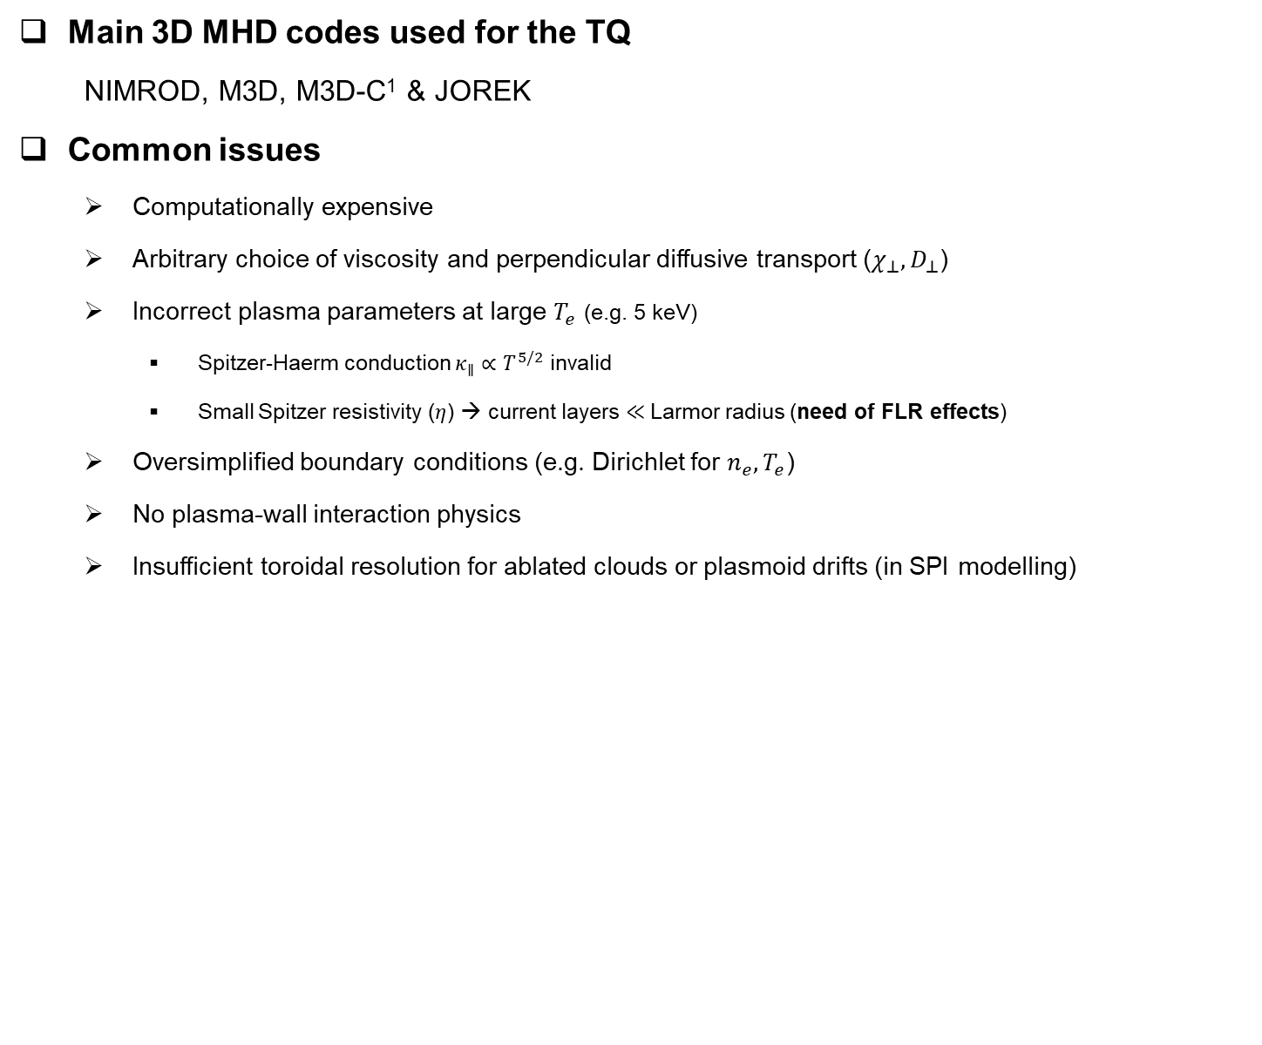
TQ modeling issues
Main 3D MHD codes used for the TQ
  NIMROD, M3D, M3D-C¹ & JOREK
Common issues
  Computationally expensive
  Arbitrary choice of viscosity and perpendicular diffusive transport ($χ_{⊥}, D_{⊥}$)
  Incorrect plasma parameters at large $T_{e}$ (e.g. 5 keV)
    Spitzer-Haerm conduction $κ_{∥}∝T^{5/2}$ invalid
    Small Spitzer resistivity ($η$) → current layers $≪$Larmor radius (need of FLR effects)
  Oversimplified boundary conditions (e.g. Dirichlet for $n_{e}, T_{e}$)
  No plasma-wall interaction physics
  Insufficient toroidal resolution for ablated clouds or plasmoid drifts (in SPI modelling)
Importance for heat flux modeling during the TQ?

Slide 12
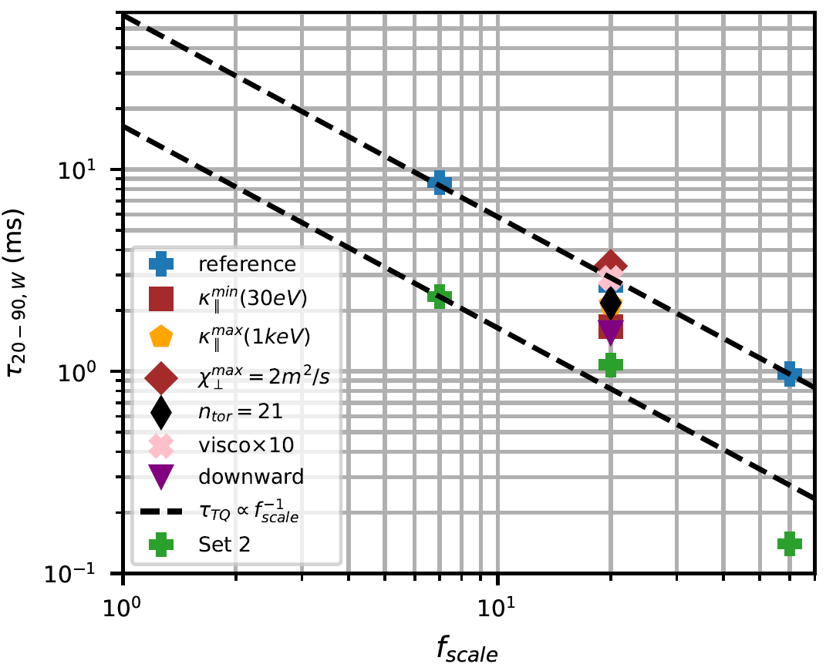
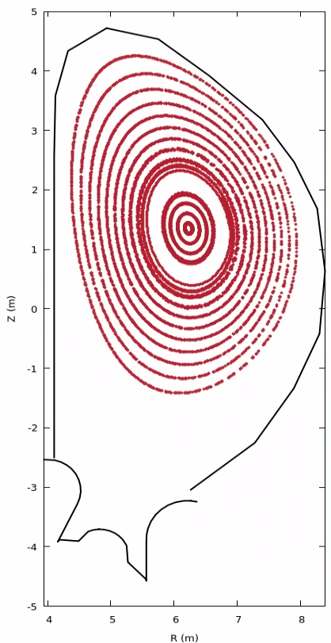
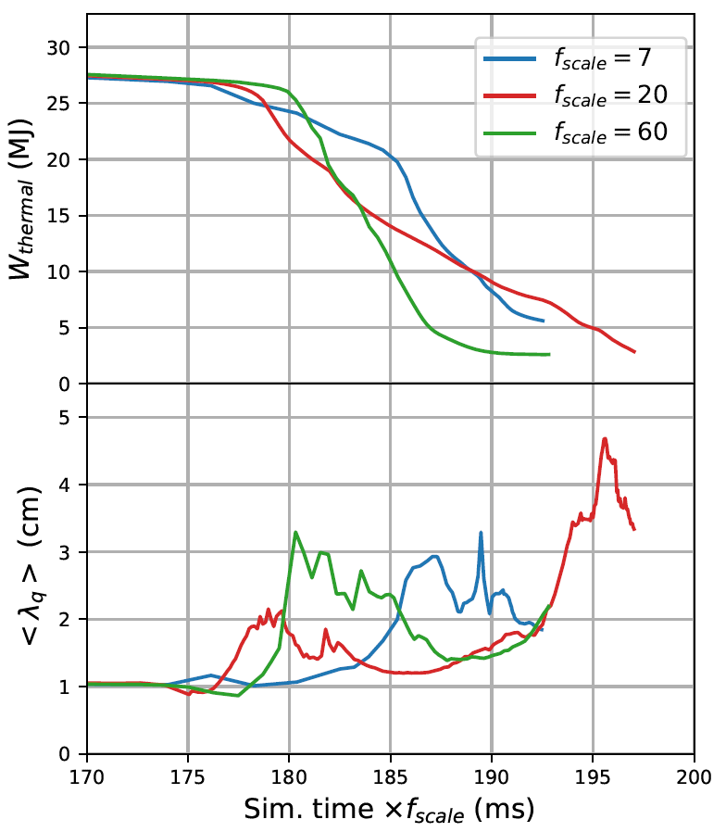
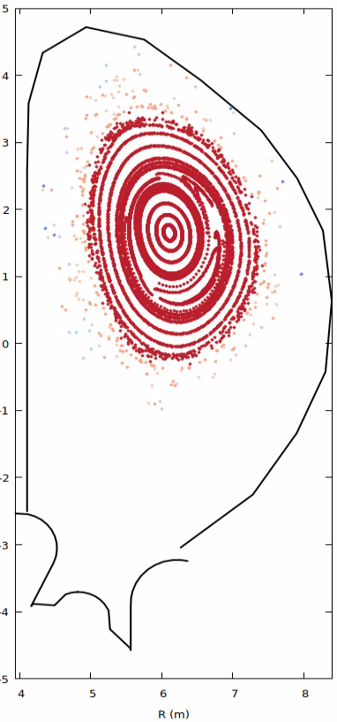
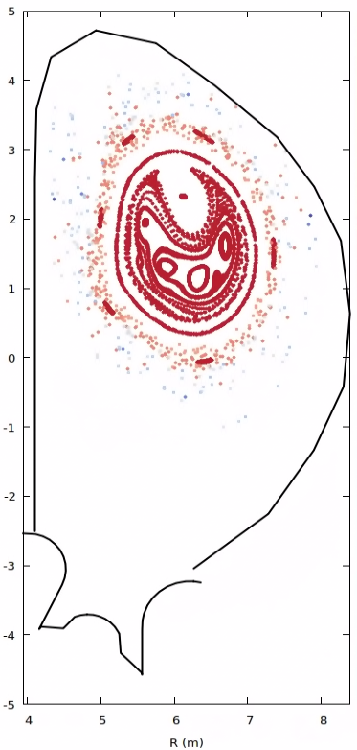
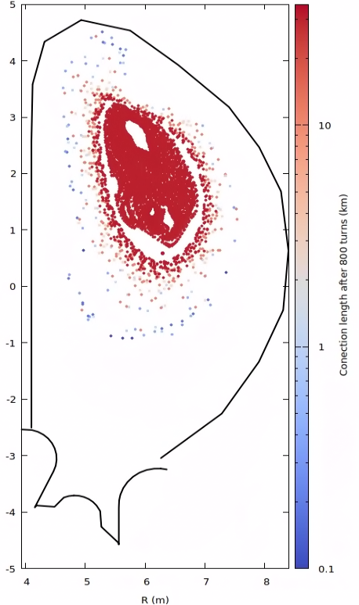

Thermal loads during the TQ
Recent modeling activities (Unmitigated TQ)
  TQ triggered by a VDE in an ITER 15 MA L-mode plasma (JOREK)
  Re-scaling procedure
  $$\left(D,χ_{∥},χ_{⊥},η,η_{w}\right)×f_{scale}$$
  Min TQ duration ~ 15 ms
    $τ_{TQ}∝{1/f}_{scale}$
  Average $λ_{q}∼2−3 cm$
ITER parameters
F.J. Artola, 48th EPS, 2022
9.0 ms
9.5 ms
10 ms
10.5 ms
TQ time using 90-20% of pre-TQ thermal energy decay

Slide 13
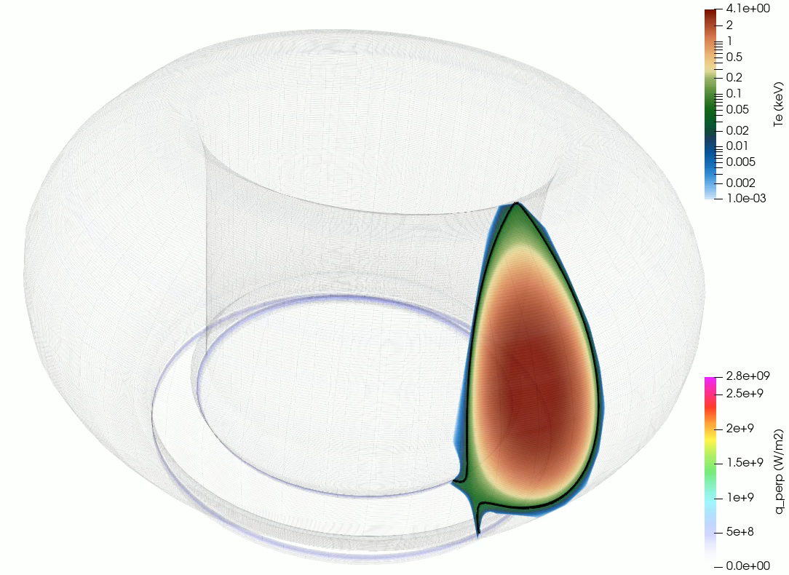
Thermal loads during the TQ
Recent modeling activities (Unmitigated TQ)
  TQ triggered by a VDE in an ITER 15 MA L-mode plasma (JOREK)
Rotation of wall heat fluxes
Max TPF ~ 4

Slide 14

Thermal loads during the TQ
Recent modeling activities (Unmitigated TQ)
  TQ in ITER, JET, DIII-D locked mode disruptions (M3D)
  Indicate that $τ_{TQ}∝η_{w}^{−4/9}η^{−1/3}$
  If VDE-TQ has same scaling → $τ_{TQ}∝f_{scale}^{−0.8}$ (similar to JOREK simulations)
    Further analysis needed
    Scaling with wall resistivity → Longer TQ for ITER than JET
  See talk of H. Strauss today “Thermal Quench in DIII-D locked mode disruptions”
H. Strauss, PoP 28, 032501 (2021)
H. Strauss, PoP 28, 072507 (2021)

Slide 15
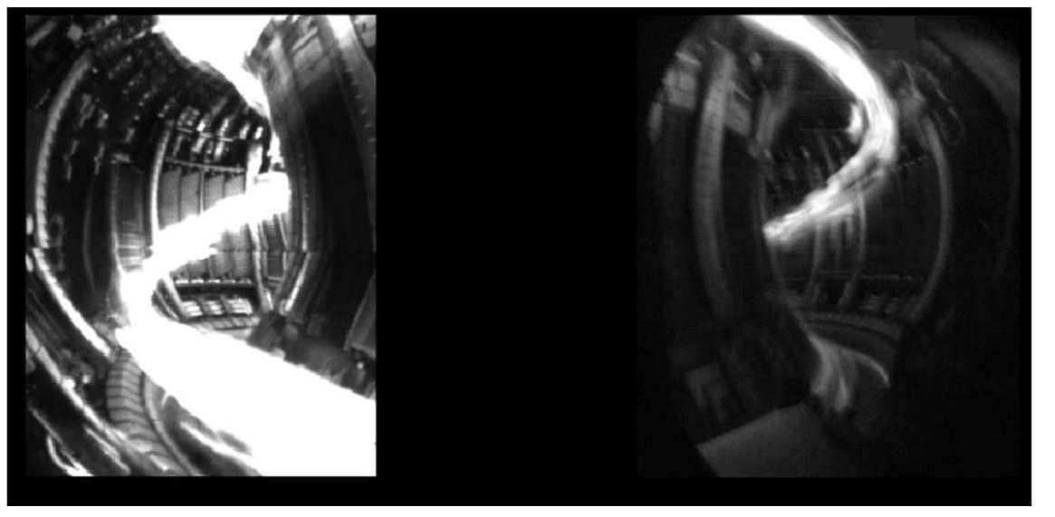
Thermal loads from plasma radiation (TQ)
Conductive/Convective thermal loads are mitigated by impurity radiation (ITER strategy)
In TQ: Radiation can be intense and localized (local nature of injection)
Mitigated disruption in JET
S. Jachmich et al, NF (2021)
Need to reduce radiation peaking
  Multiple injection locations
3D simulations → Assess peaking reduction & requirements for max. time delay in pellet arrival

Slide 16
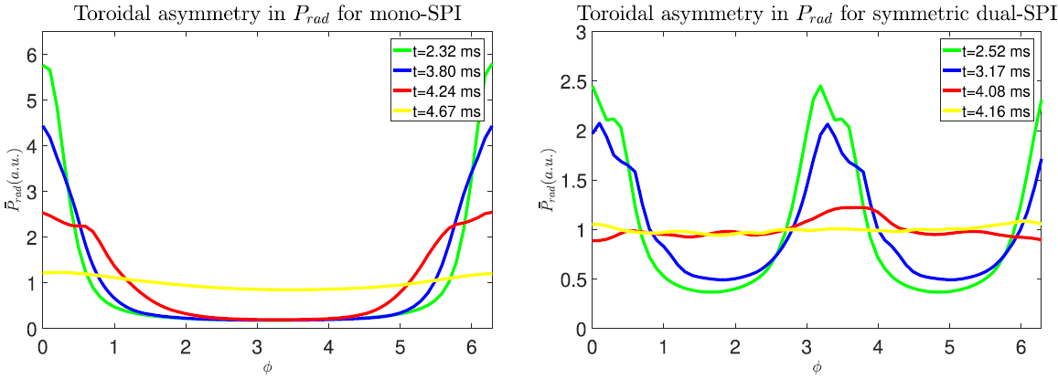
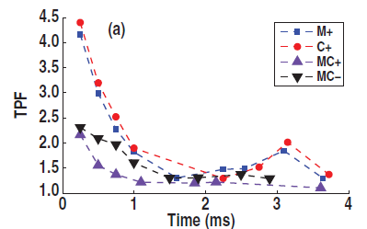
Thermal loads from plasma radiation (TQ)
NIMROD simulations of MGI driven radiation TPF in DIII-D
JOREK simulations of SPI driven radiation TPF in ITER
Single injection
Multiple injection
D. Hu et al 2021 NF 61 026015
V.A. Izzo et al 2015 Nucl. Fusion 55 073032
3D simulations show TPF reduction with multiple injection locations

Slide 17
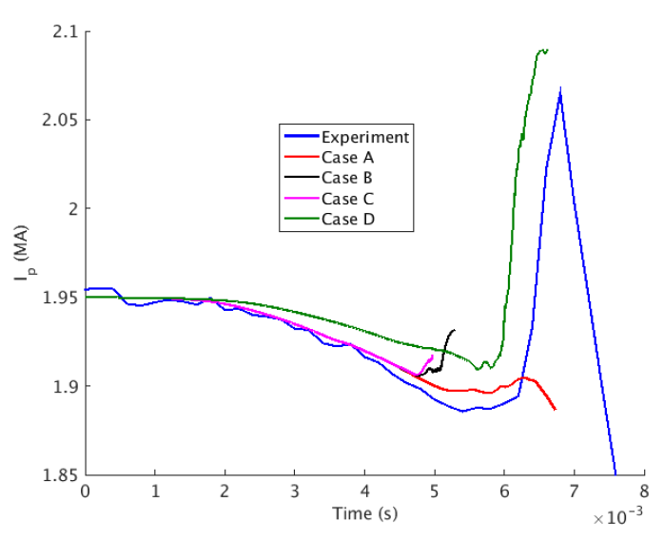
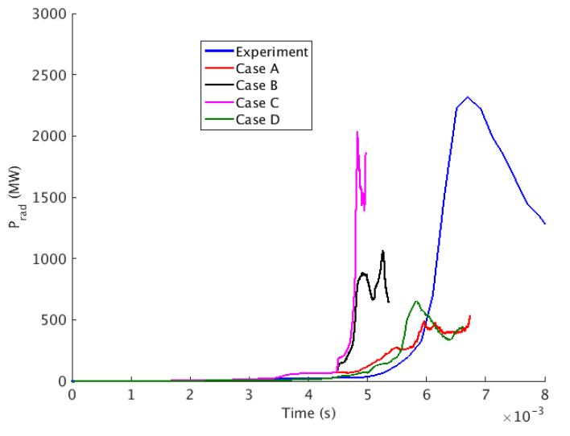
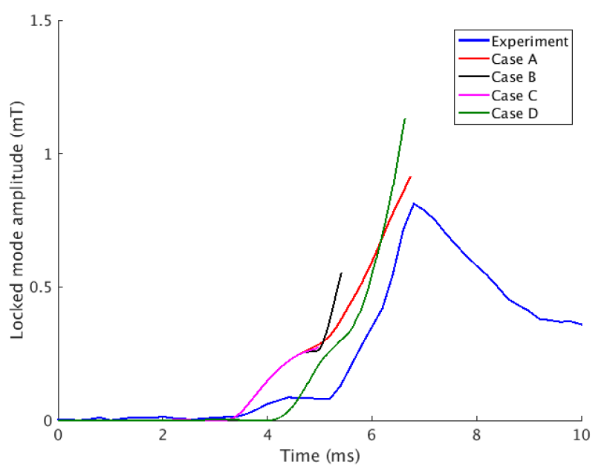


Validation activities (mitigated TQ)
JOREK simulations of JET Argon MGI
E Nardon et al 2021 PPCF 63 115006
3D MHD codes start implementing synthetic diagnostics to compare to experiments
Difficulties reproducing different experimental quantities simultaneously
Large uncertainties on gas dynamics treatment
$I_{p}$-spike difficult to reproduce (indicates global reconnection process)
D. Bonfiglio, 48th EPS, 2022
$I_{p}$-spike
Radiated power
Locked mode signal
Different Argon source settings

Slide 18
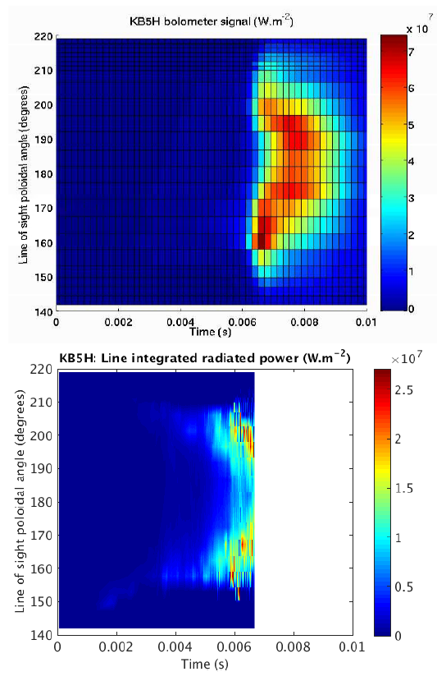
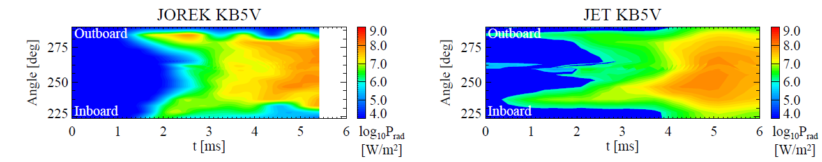
Validation activities (mitigated TQ)
JOREK simulation of JET Argon MGI
JOREK simulations of JET Ne-D2 SPI
Experiment
D. Bonfiglio, 48th EPS, 2022
Other validation activities
Pure D2 SPI in JET with JOREK [M. Kong, 48th EPS, 2022]
DIII-D validation with NIMROD (C. Kim)
KSTAR SPI modeling with JOREK (S.J. Kim), NIMROD (C. Kim), M3D-C1 (B. Lyons)
JOREK
E Nardon et al 2021 PPCF 63 115006

Slide 19
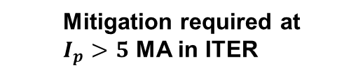
Thermal loads during the CQ
During the current quench (CQ) → large plasma resistivity
Magnetic energy
Thermal energy
Thermal loads
Radiation loads
Conduction Convection
Ohmic heating
  Mitigation required at $I_{p}>5$ MA in ITER
M. Lehnen, Journal of Nuclear Materials, 463, (2015)
Impurities
Well distributed in space and time (no expected issues)

Slide 20
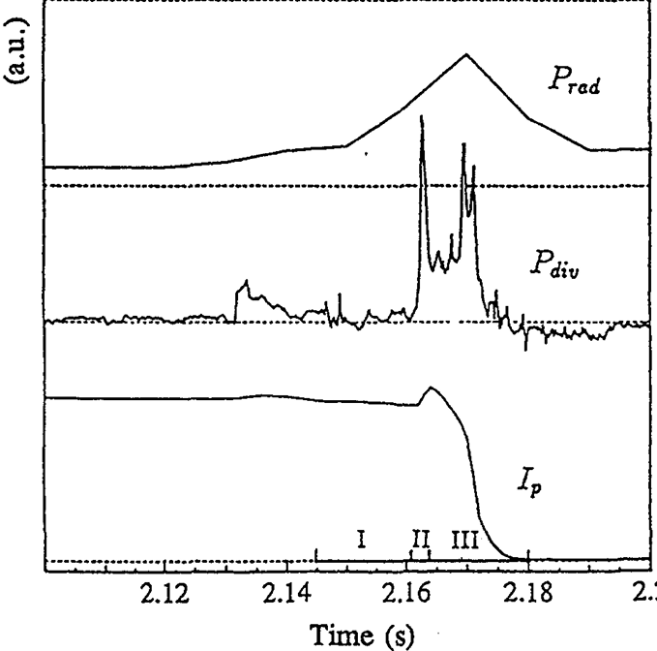
Thermal loads during the CQ
Example in AUG disruptions
TQ
CQ
Power reaching the divertor plates
G. Pautasso et al 1994 Nucl. Fusion 34 455

Slide 21
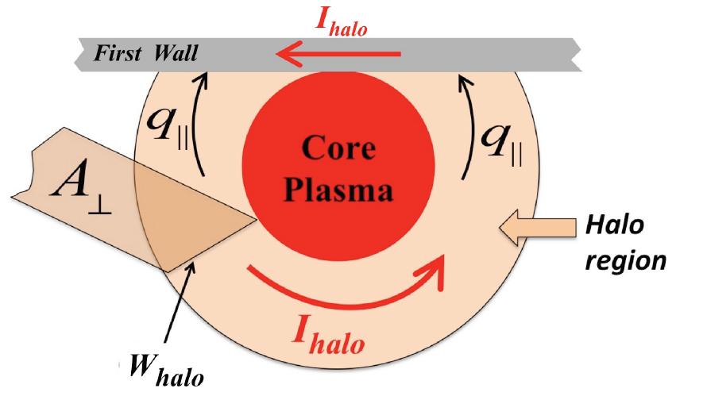
Thermal loads during the CQ
ITER CQ-induced thermal loads calculated with DINA (axisymmetric)
DINA/TSC model of energy balance in halo region
  Gives halo width and temperature self-consistently
  Main ion and impurity density prescribed
    DINA team currently testing neutral recycling and ion saturation current limitation models
Impurity Radiation
Parallel /Perp transport
Ohmic heating (from halo currents)
D. Kiramov, 43rd EPS, 2016

Slide 22
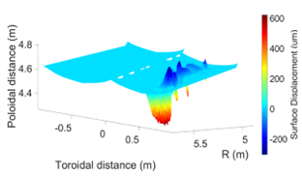
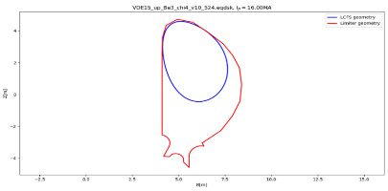
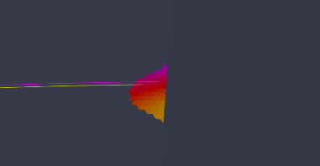
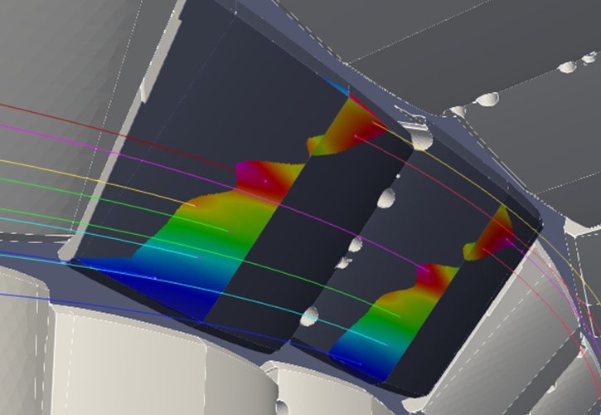
Thermal loads during the CQ
Simulation “workflow” developed at IO to assess plasma transient impact on PFCs
J. Coburn et al., NME 28 (2021) 101016 & NF 62 (2021) 016001
DINA
Time-dependent magnetic equil.
SMITER
  3D heat flux distribution & B-field impact angle
  Single time-step
MEMOS-U
  Time-dependent melt formation and motion

Slide 23
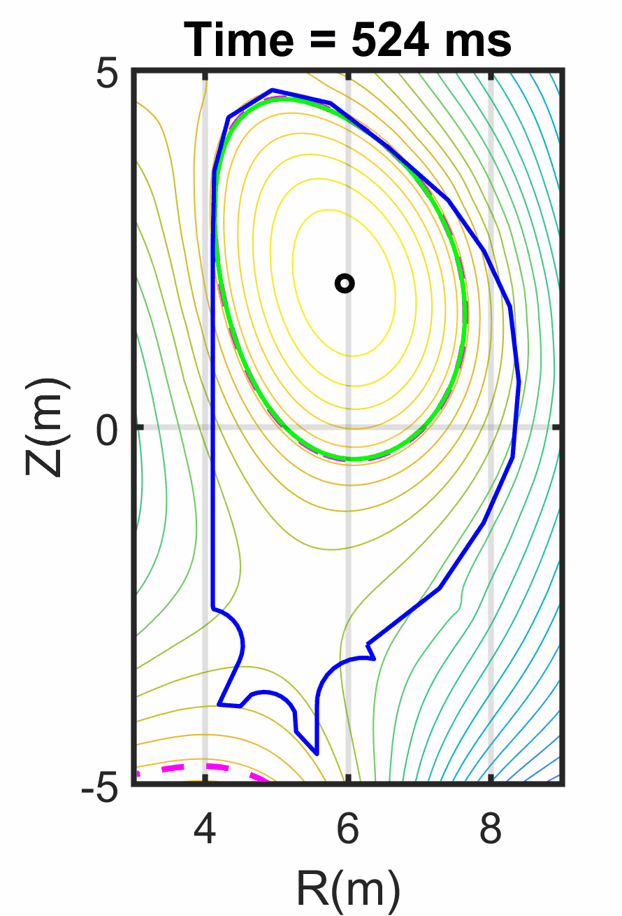
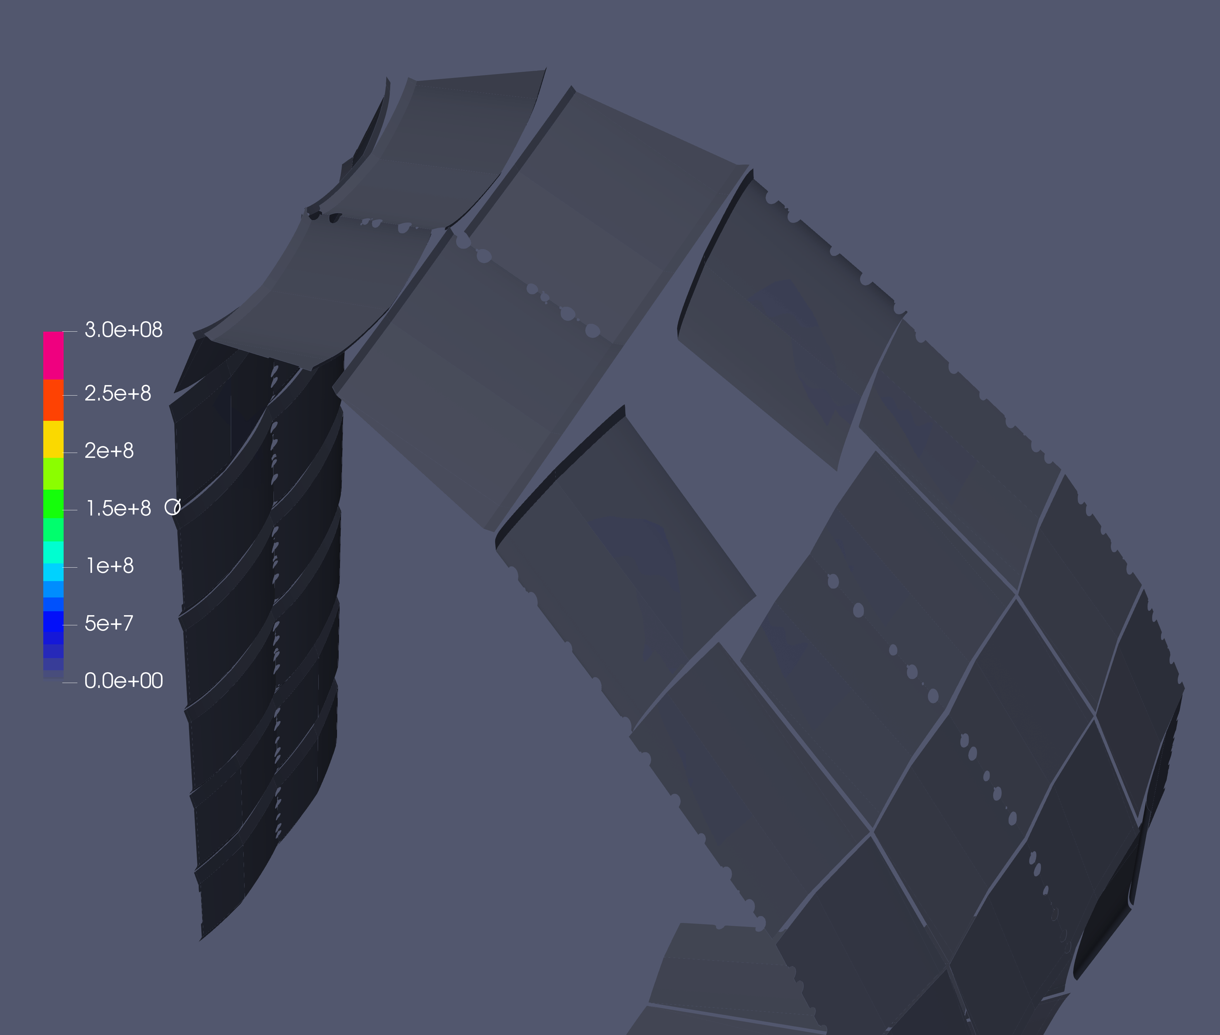
Thermal loads during the CQ
One of the worst possible cases: deposits ~600 MJ of magnetic energy over ~400 ms
  Long load duration → strong melt motion and surface erosion compared to TQ loads (few ITER unmitigated CQs allowed at high current)
3D simulations required to assess TPF and current profile evolution
J. Coburn et al. NF 62 (2021) 016001

Slide 24
Electromagnetic (EM) loads

Slide 25
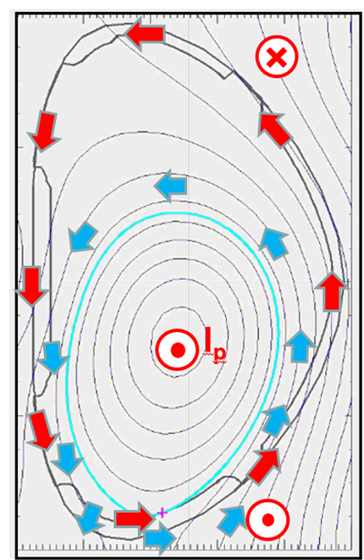



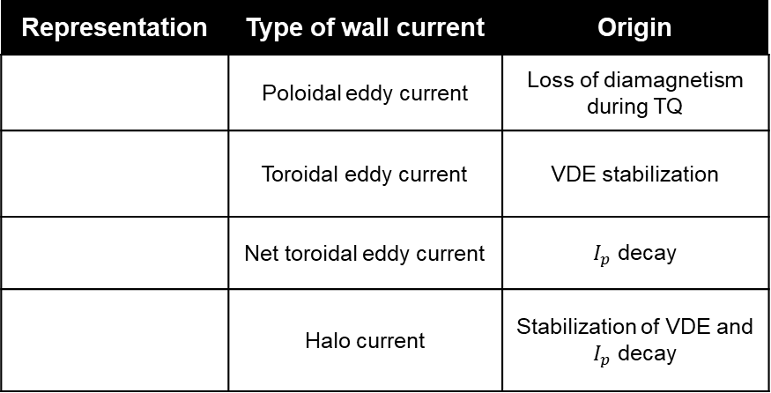
Origin of EM loads
$J×B$ forces in the tokamak components due to disruption induced currents
Representation | Type of wall current | Origin
 | Poloidal eddy current | Loss of diamagnetism during TQ
 | Toroidal eddy current | VDE stabilization
 | Net toroidal eddy current | $I_{p}$ decay
 | Halo current | Stabilization of VDE and $I_{p}$ decay
Figure from E. Matveeva,
WDS Proceedings of Contributed Papers, Physics, 93–99, 2019
→ Global and local forces

Slide 26
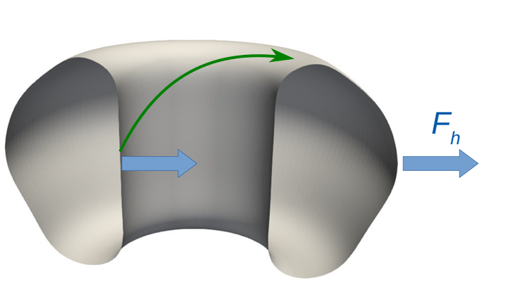
Current tools to model EM loads
Code/Framework | Plasma model | Wall model
DINA (ITER load reference code) | 2D evol EQ. + 1D transport | 2D Toroidal filaments
TSC | 2D MHD + 1D transport | 2D Toroidal filaments
CarMa0NL-CARIDDI | 2D evol EQ. | 3D volumetric
M3D | 3D full MHD | 2D thin
NIMROD | 3D full MHD | 2D thin
M3D-C¹ | 3D full MHD | 2D volumetric
M3D-C¹-CARIDDI ^{(1-way coupling)} | 3D full MHD | 3D volumetric
JOREK-STARWALL (upgrading to full MHD) | 3D reduced MHD | 2D thin
JOREK-CARIDDI (not complete) | 3D reduced MHD | 3D volumetric
Other tools: ANSYS, CREATE_NL, PROTEUS, MAXFEA, CEDRES++…
3D effects in the tokamak vacuum vessel lead to net horizontal forces
Still not understood, may require 3D plasma / 3D wall codes

Slide 27
Literature for 2D EM loads
Not a complete list, collected for ITPA Special Issue section 3.5 led by S. Jardin
Lukash, “Numerical simulation of halo currents in tokamaks”, Plasma Physics Reports 22 p91-96 (1996)
Sayer R.O., “TSC Plasma Halo simulation of a DIII-D Vertical Displacement Episode”. Nucl. Fusion 33 969 (1993)
Paccagnella R. et al “Vertical Displacement events simulations for tokamak plasmas”, Fusion Eng. Des. 75–79 589–93 (2005)
Bandyopadhyay, “TSC modeling of major disruption and VDE events in NSTX and ASDEX-Upgrade and predictions for ITER”, FEC2010, Daejeon, S. Korea, ITR/P1-16
Sugihara, M., et al. "Disruption scenarios, their mitigation and operation window in ITER." Nuclear Fusion 47.4 (2007): 337.
Miyamoto, et al, “Inter-code comparison benchmark between DINA and TSC for ITER disruption modelling”, Nucl. Fusion 54 083002 (2014)
Kiramov, D. I., et al. "ITER disruption simulations with improved power balance in the halo region." 43rd European Physical Society Conference on Plasma Physics, EPS 2016. 2016.
Clauser, C. and Jardin, S, “Vertical forces during vertical displacement events and the role of halo currents”, Nuclear Fusion 59 126037 (2019)
Isernia, N., et al. "Cross-validation of analytical models for computation of disruption forces in tokamaks." Plasma Physics and Controlled Fusion 61.11 (2019)
Bunkers, K. “The influence of boundary and edge plasma modeling in computations of axisymmetric vertical displacement”, Phys Plasmas 27 112505 (2020)
Krebs, “Axisymmetric simulations of vertical displacement events in tokamaks: A benchmark of M3D-C1, NIMROD, and JOREK”, Phys Plasma 27, 112505 (2020)
Artola, et al, “Simulations of COMPASS vertical displacement events with a self-consistent model for halo currents including neutrals and sheath boundary conditions” PPCF 63 064004 (2021)
Clauser, C. F., and S. C. Jardin. "ITER cold VDEs in the limit of perfectly conducting walls." Physics of Plasmas 28.1 (2021): 012511.
Atanasiu, C. V. et al, “Simulation of disruptions triggered by Vertical Displacement Events in tokamak and leading edge effect in plasma energy deposition to material surfaces” J. Phys Conf Series, 1391 012123
…
Benchmark activities
Experimental validation
Influence of sheath boundary conditions
Well established field, but 3D effects play a big role for n=0 profile evolution (e.g. q-profile)

Slide 28
Literature for 3D EM loads
Not a complete list, collected for ITPA Special Issue section 3.5 led by S. Jardin
Riccardo, “Forces between plasma, vessel and TF coils during AVDEs at JET”, Nucl. Fusion 40 1805 (2000)
Paccagnella, “3D MHD VDE and disruptions simulations of tokamaks plasmas including some ITER scenarios”, NF 49 035003 (2009)
Strauss, “Wall forces produced during ITER disruptions”, Phys. Plasmas 17, 082505 (2010)
Strauss, “Sideways wall force produced during tokamak disruptions”, Nucl. Fusion 53 073018 (2013)
Villone, F., "Coupling of nonlinear axisymmetric plasma evolution with three-dimensional volumetric conductors", Plasma Physics and Controlled Fusion, 55, 095008 (2013)
Strauss, “Toroidal current asymmetry in tokamak disruptions”, Phys. Plasmas 21, 102509 (2014)
Strauss, “Asymmetric wall force and toroidal rotation in tokamak disruptions”, Phys. Plasmas 22, 082509 (2015)
Roccella, R., et al. "Asymmetric toroidal eddy currents (ATEC) to explain sideways forces at JET." Nuclear Fusion 56.10 (2016): 106010.
Strauss, “Comparison of JET AVDE disruption data with M3D simulations and implications for ITER, Phys. Plasmas 24, 102512 (2017)
Pfefferle, “Modelling of NSTX hot vertical displacement events using M3D-C1”, Phys. Plasmas 28, 056106 (2018)
Strauss, “Reduction of asymmetric wall force in ITER disruptions with fast current quench”, Phys. Plasmas 25, 020702 (2018)
Yanovskiy, V. V., et al. "Comparison of approaches to the electromagnetic analysis of COMPASS-U vacuum vessel during fast transients." Fus. Eng. Des. 146 2338 (2019)
S. Chen, F. Villone, et al. “Disruptive plasma simulations in EAST including 3D effects” Nuclear Fusion 59 106039 (2019)
Sovinec, “Effects of asymmetries in computations of forced vertical displacement events”, Plasma Phys. Control. Fusion 61 024003 (2019)
Jardin, IAEA: Vessel forces from a vertical displacement event in JET and ITER (2021)
Artola, “3D simulations of vertical displacement events in tokamaks. A benchmark of M3D-C1, NIMROD and JOREK”, Phys Plasma 28 052511 (2021)
Artola, et al, “Non-axisymmetric MHD simulations of the current quench phase of ITER mitigated disruptions”, Nucl. Fusion 62 (2022) 056023
…
Benchmark activities
Experimental validation

Slide 29
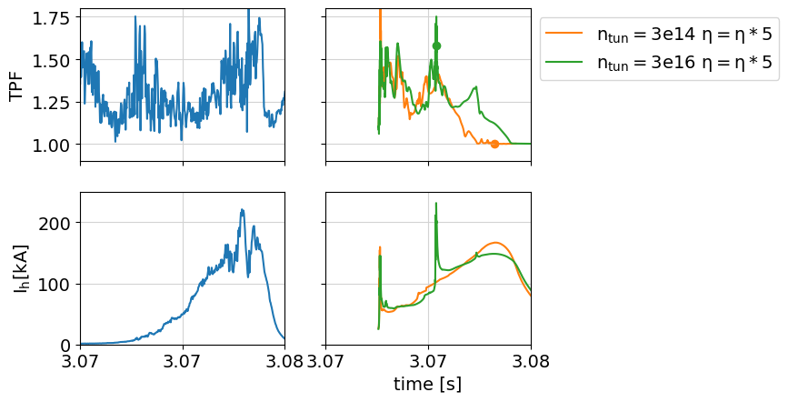
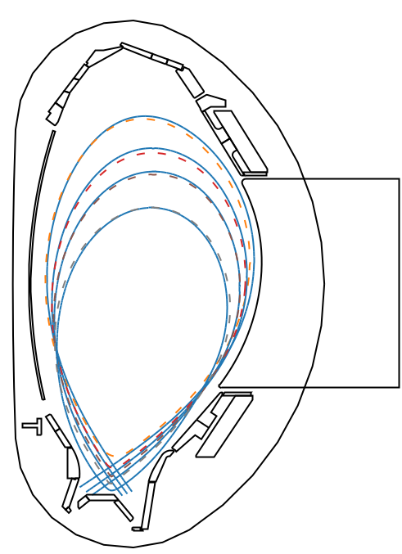
3D EM loads
On-going validation of 3D MHD simulations of AUG VDEs
experiment
JOREK
N. Schwarz et al, 48th EPS, 2022
- experiment
-- JOREK
Reproduce
Plasma movement
Halo current magnitude
TPF of halo currents
Small sideways forces

Slide 30
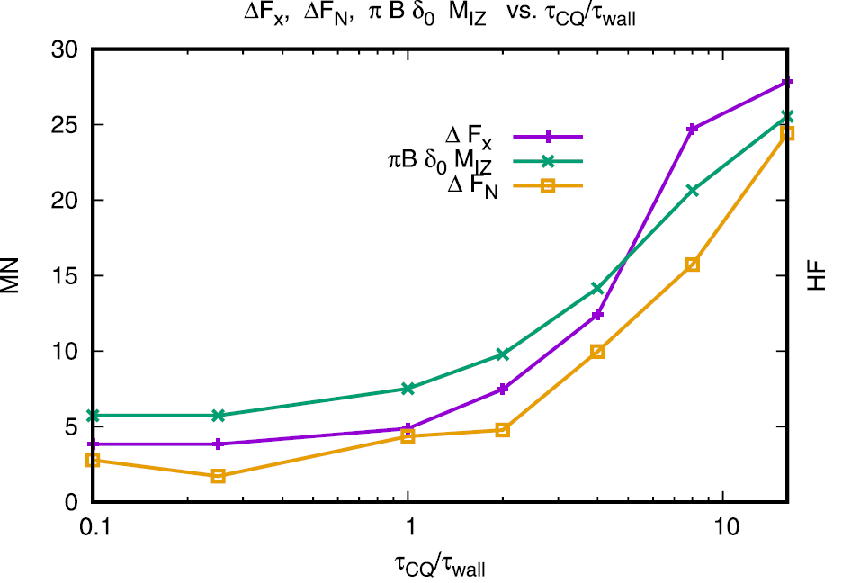
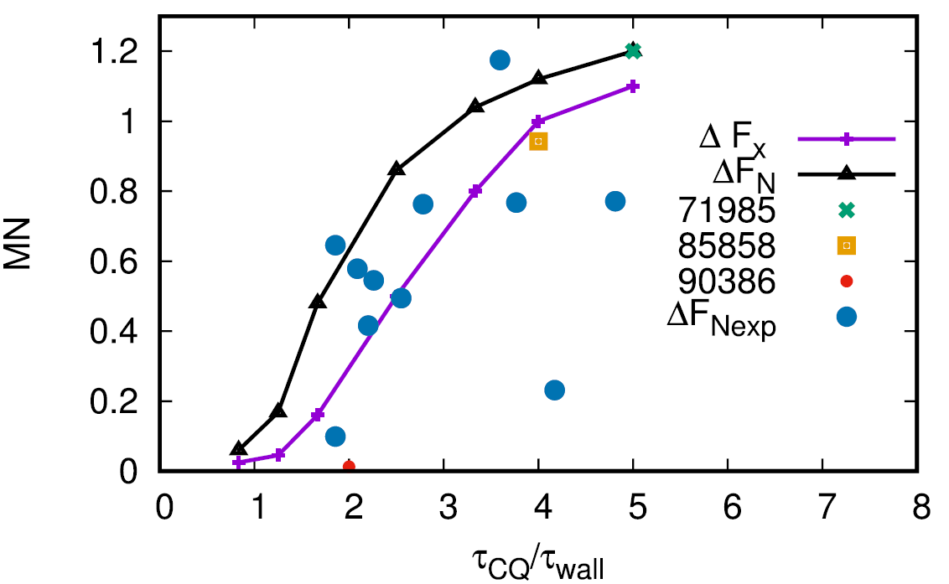

3D EM loads
JET and ITER 3D VDEs (M3D simulations)
  Calculation of global sideway force in the vessel
  CQ time < wall time → Force reduction
JET 2 MA
ITER 15 MA
Assumptions
Prescribed $I_{p}(t)$
Small Lundquist numbers (large $η$)
Unrealistic large wall resistivities
Present code capabilities insufficient for ITER worst cases at realistic Lundquist numbers
(re-scaling approaches)
Sideways force (MN)
Sideways force (MN)
H. Strauss et al, PoP 27, 022508, 2020

Slide 31
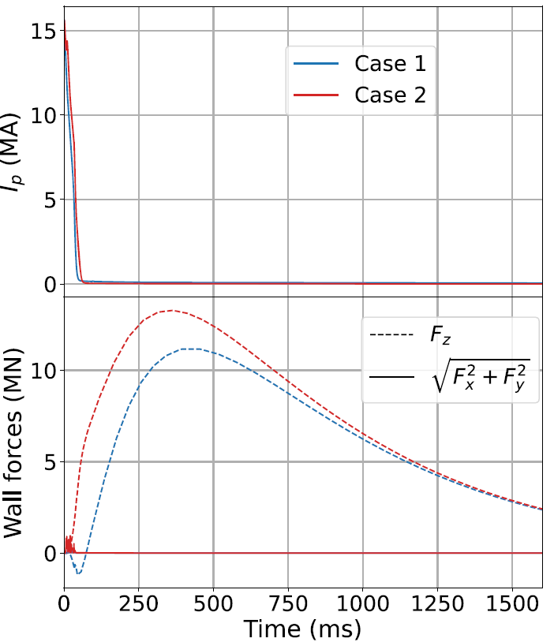


3D EM loads
Mitigated ITER 3D VDEs (JOREK simulations)
  Realistic Lundquist numbers
  Confirm CQ time < wall time → High $q_{95}$ → no 1/1 mode → Small sideways force
F.J. Artola et al 2022 Nucl. Fusion 62 056023
Assumptions
Initial condition: high density low-T plasma ($τ_{CQ}\sim 50 ms)$
No impurities or Ohmic heating
M3D-C1 simulations also reported sideway forces < 1 MN for fast CQ ITER VDEs
S.C. Jardin et al, FEC 2020
Vertical force
Almost no sideways force

Slide 32
Runaway Electron (RE) loads

Slide 33
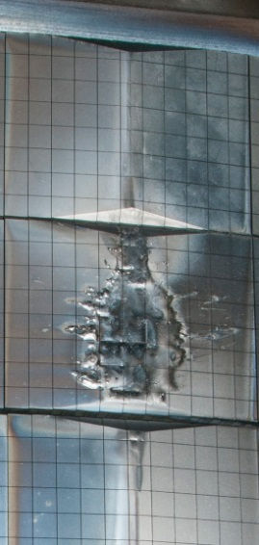
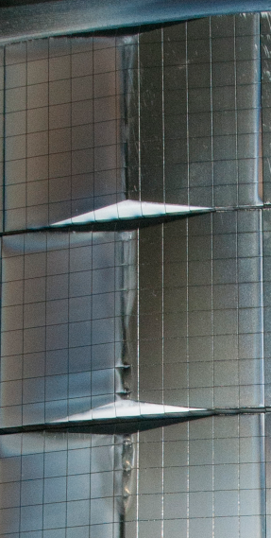
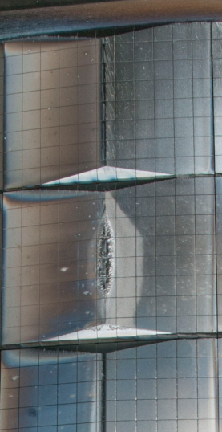
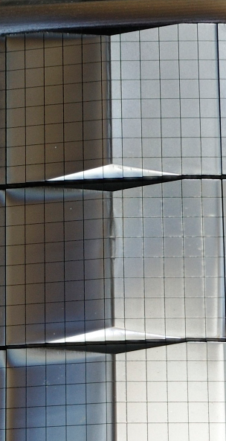
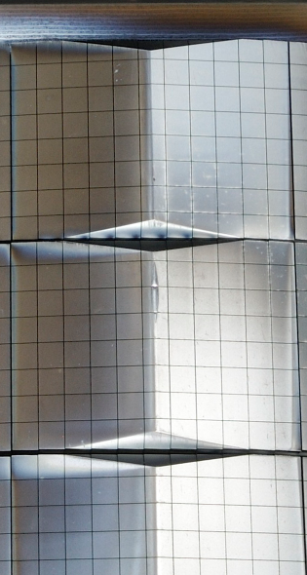
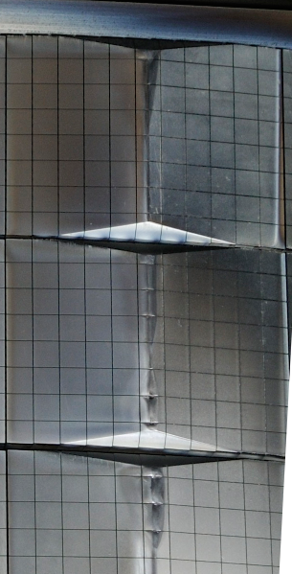










RE loads
RE beam currents of several MA could be formed during the CQ in ITER
Up to hundreds of MJ of magnetic energy can be converted to kinetic energy in ITER
The power deposition width can be as narrow as the Larmor radius
Toroidal deposition can also be localized
However enhanced MHD activity can cause benign termination of the beam and broaden energy deposition width (open question for ITER)
a single event #86801 in JET
Octant 1
Octant 2
Octant 3
Octant 4
Octant 5
Octant 6
Octant 7
Octant 8
G. F. Matthews et al., PFMC 2015
C.Reux et al., PRL 2021
C. Paz-Soldan et al, NF 2021

Slide 34

RE loads
Simulations by L. Chen on RE energy deposition in JET
  RE beam width 1-2 mm
DINA
Time-dependent magnetic equil.
SMITER
  3D heat flux distribution and RE footprint, B-field impact angle
  Single time-step
GEANT4
  Volumetric energy deposition
  Single time-step
MEMOS-U
  Time-dependent melt formation and motion
L. Chen / J. Coburn et al., NF 62 (2021) 016001
melt
boiling
Temperature rise on a JET tile due to RE impact

Slide 35



RE loads
Simulations of RE beam benign termination in JET with JOREK
  Fluid RE model coupled with MHD
Poloidal distance from limiter (cm)
V. Bandaru et al, 2021 PPCF 63 035024
RE flux at 1st wall
Broad toroidal distribution ~half torus
  Fluid result confirmed with test particles by K. Särkimäki
3D ITER simulations on-going
See V. Bandaru poster “RE formation and termination in mitigated ITER disruptions”

Slide 36


RE loads
Simulations of RE final loss event in DIII-D with M3D-C1
  Fluid RE model coupled with MHD
C. Liu et al 2021 PPFC 63 125031

Slide 37
RE loads
See other talks of RE modelling
  M. Beidler, “KORC Modeling of Wall Heating by Avalanche Runaway Electrons During a Final Loss Event in DIII-D”
  B. Lyons, “Magnetohydrodynamic Modeling of Shattered Pellet Injection and Runaway-Electron Dynamics”
  V. Izzo, “Mitigation of runaway electrons with a passive 3D coil”
  C. McDevitt, “Self-Consistent Kinetic Simulations of Runaway Electron Termination Schemes”

Slide 38

RE formation workflow
On-going ITER simulations of RE formation with SPI mitigated plasmas using DREAM (IO contract with Chalmer’s group)
DREAM
Kinetic (or fluid) bounce-averaged REs
1D equations for $ψ, T_{e}, T_{i}, n_{i}, n_{imp}$
Missing radial transport due to stochastic losses
M. Hoppe, Computer Physics Communications 268 (2021): 108098.
MHD codes
(TQ and 3D fields)
Radial transport coefficients for REs
(K. Särkimäki)
DREAM
(RE current and energy)

Slide 39

Conclusions
Simulations of disruption loads is a challenging and broad field (model integration activities are taking place)
Approaching predictive capabilities + synthetic diagnostics being implemented to compare to experiments
Unmitigated TQ simulations scarce (thermal loads missing)
    Influence of missing plasma-wall interaction physics?
    Need model improvements at large temperatures
Mitigated TQ simulations: Difficulties reproducing different experimental quantities simultaneously (e.g. $I_{p}$ spike) + uncertainties in material deposition (plasmoid drifts, gas penetration)
Unmitigated 3D CQ simulations at realistic Lundquist numbers still out of reach (need re-scaling approaches)

Slide 40
Backup

Slide 41

The fast CQ limit
The CQ time for 15 MA plasmas should not be faster than 50 ms
The limit is set by eddy current forces in the Blanket Modules (BMs)
Forces on the BMs parallel to the VV are the most critical for the “Keys”, which are attachments of the BMs to the VV
[M. Sugihara et al 2007 Nucl. Fusion 47 337]

Slide 42

The fast CQ limit
The most concerning forces (Fp) come for the radial current, given by the change of poloidal field. Radial moment
[ITER_EBUDW3]

Slide 43

Slits in BMs to reduce eddy currents
[ITER_EBUDW3]

Slide 44




The fast CQ limit
Linear CQ times of 36 ms approach allowable limits for Fp
Halo currents are distributed in ~2 BMs
Max HF calculated ~20%
[M. Sugihara et al 2007 Nucl. Fusion 47 337]

Slide 45


The fast CQ limit
But we should avoid this limit also for REs, since faster CQs produce larger E-fields and partially ionized Neon enhances avalanching
[T. Driessen]
[V. Bandaru]
5e18
1e19

Slide 46

The slow CQ limit
The ITER recommended maximum for the CQ time is 150 ms
50 ms
150 ms
Staying above 150 ms in DINA leads to HF > 30% for downwards VDEs
This means that global vertical forces on the VV can approach values of 50-110 MNs (see next slides)
[Lehnen 2015]

Slide 47

The slow CQ limit
ITER load specifications [ITER_222QG]
DINA
JET scalings and source/sink model from V. Riccardo

Slide 48

The slow CQ limit
Assumed halo distribution for EM analysis [ITER_222QG]
Typically the halo current is distributed over 2 BMs and including a TPF effect

Slide 49

The slow CQ limit
Although the VV should be able to withstand the loads, Cat III VDEs approach design margins [ITER_2F73RX]

Slide 50
The slow CQ limit
But most importantly, first dynamic analysis on resonant VV horizontal forces ~40 MN (cat III VDE) show major threats to the components attached to the VV due to acceleration (private communication)

Slide 51

EM loads induced by the TQ
Loss of thermal energy
Loss of plasma diamagnetism
Poloidal eddy currents in the wall
Net radial wall force
Analytical & Numerical force density
Pustovitov & Kiramov PPCF 60, 045011 (2018)
N. Isernia et al, PPCF 61 115003 (2019)

Slide 52
Conclusions
Avoid fast CQ limit due forces in the BMs (< 50ms) and REs
We want CQ times < 150 ms because
  If CQ time > 200 ms → Too little Neon → Plasma re-heating → Hot VDE (cat III slow VDE) → Approaching design margins (DINA, source/sink model, JET scaling…)
Most concerning is the dynamic amplification of the horizontal forces for the vessel attachments
  Waiting for better modeling and physics understanding to repeat structural analysis

