Slide 1
Research activities on the cyclotron-based production of innovative radionuclides: The experience at the Legnaro National Laboratories of INFN
IAEA-CN301-73
G. Pupillo¹, A. Andrighetto¹, M. Ballan¹,
S. Cisternino^{1,2}, S. Corradetti¹, L. De Dominicis^{1,3},
J. Esposito¹, M. Manzolaro¹, P. Martini⁴, A. Monetti¹,
L. Morselli^{1,4}, L. Mou^{1,4}, D. Scarpa¹, G. Sciacca¹
¹ Istituto Nazionale di Fisica Nucleare, Laboratori Nazionali di Legnaro (INFN-LNL), Legnaro, Padova, Italy
² Engineering Department, University of Padova, Italy
³ Physics and Astronomy Department, University of Padova, Italy
⁴ Physics and Earth Science Department, University of Ferrara, Italy
(gaia.pupillo@lnl.infn.it)

Slide 2
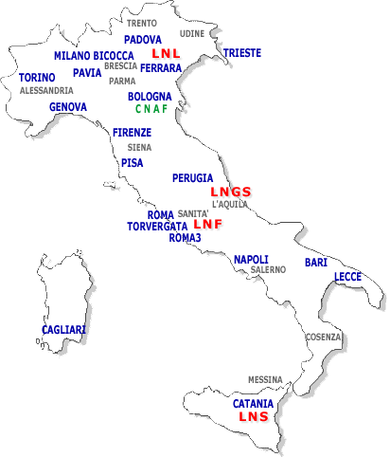
INFN-LNL are close to Padova and Venice
IAEA-CN301-73
Slide 1/15
Gaia Pupillo, INFN-LNL

Slide 3
The SPES project
SPES-α
The cyclotron and related infrastructure.
SPES-β
The ISOL facility and the acceleration of neutron-rich unstable nuclei.
SPES-γ
The production of radionuclides for applications.
SPES-δ
The multidisciplinary neutron sources.
IAEA-CN301-73
Slide 2/15
Gaia Pupillo, INFN-LNL

Slide 4
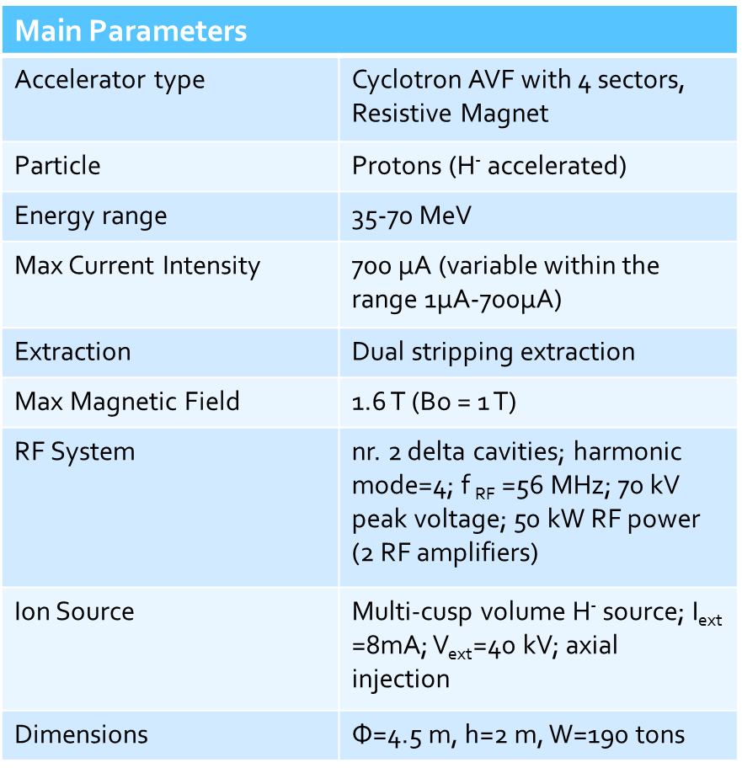
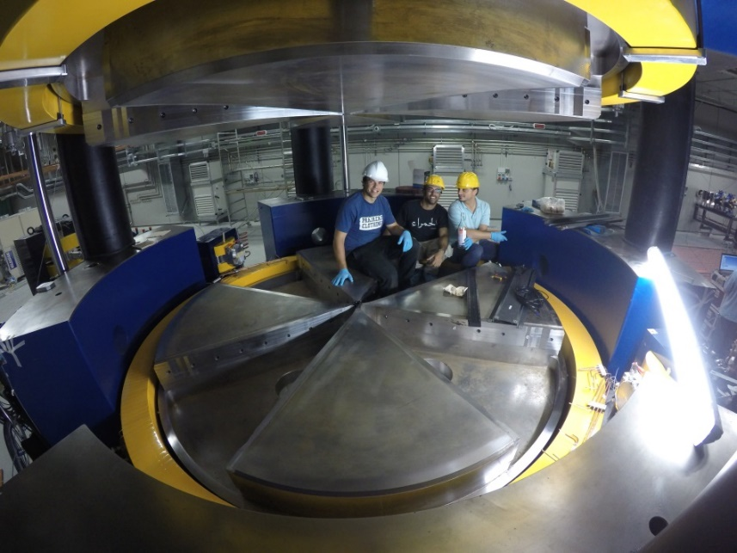
The SPES cyclotron
Tunable energy: 70 – 35 MeV
High output current: 500 µA
Dual extraction → Fundamental & Applied research
IAEA-CN301-73
Slide 3/15
Gaia Pupillo, INFN-LNL

Slide 5
Medical radionuclides production
SPES-γ
The production of radionuclides for applications.
ISOL technique
A. Andrighetto
Resp. ISOLPHARM
Direct activation
J. Esposito
Resp. LARAMED
https://isolpharm.pd.infn.it/web/
https://www.lnl.infn.it/en/spes-laramed-range
IAEA-CN301-73
Slide 4/15
Gaia Pupillo, INFN-LNL

Slide 6
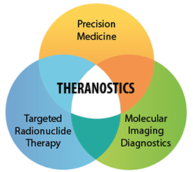
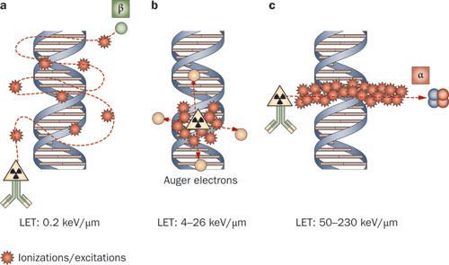
THERAPY
IAEA-CN301-73
Slide 5/15
Gaia Pupillo, INFN-LNL

Slide 7
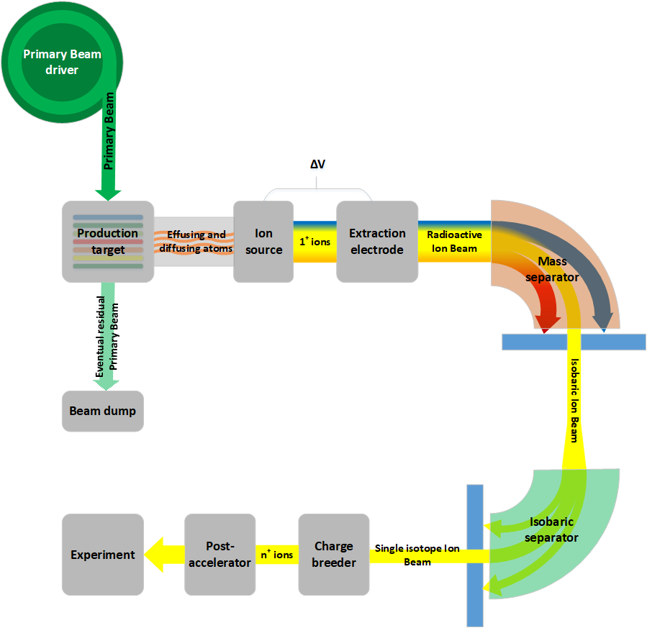
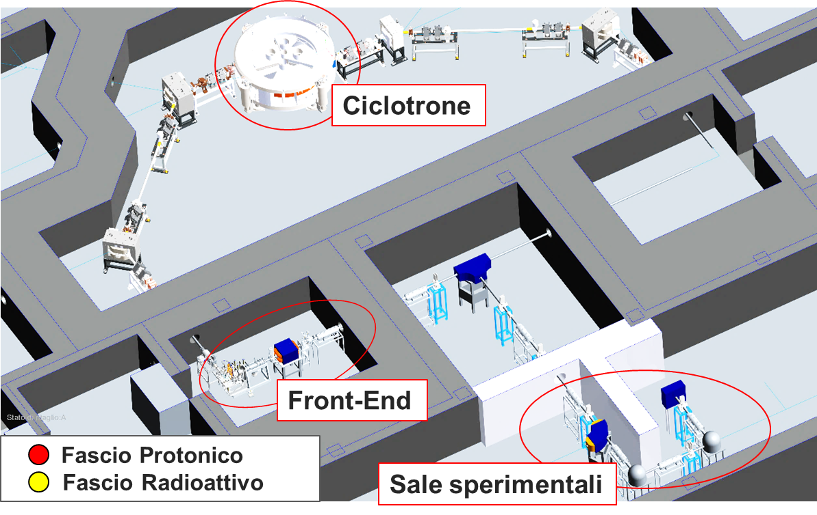
The ISOL facility
SPES-β
The acceleration of neutron-rich unstable nuclei.
ISOL: Isotope Separation On Line
from Cyclotron through Target to Experiment
Cyclotron
SPES-γ
SPES Target
Proton beam
Radioactive beam
Low Energy Exp.
IAEA-CN301-73
Slide 6/15
Gaia Pupillo, INFN-LNL

Slide 8
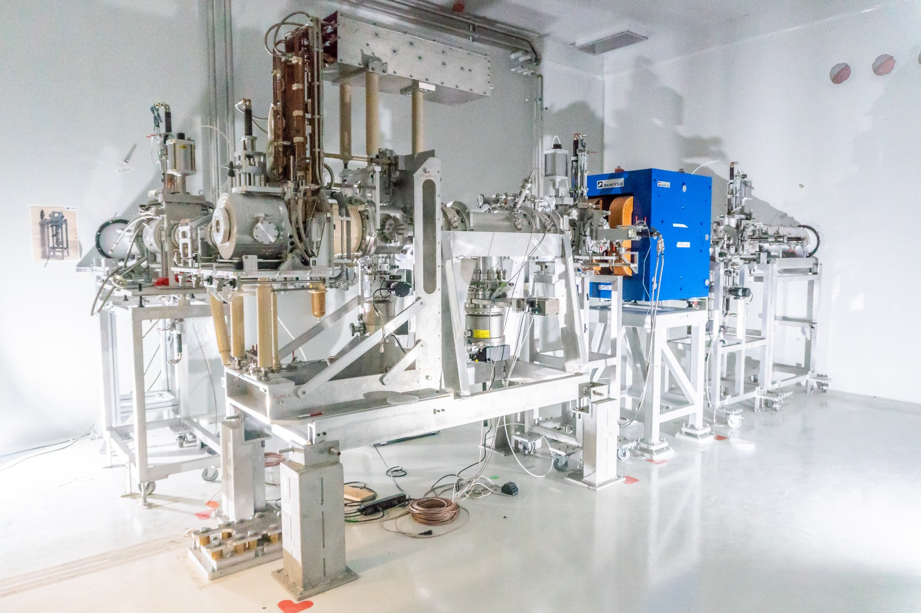
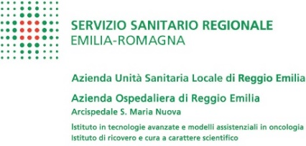
ISOLPHARM national collaboration
The ISOLPHARM method radiopharmaceuticals production is an INFN PATENT
The front end at SPES
IAEA-CN301-73
Slide 7/15
Gaia Pupillo, INFN-LNL

Slide 9
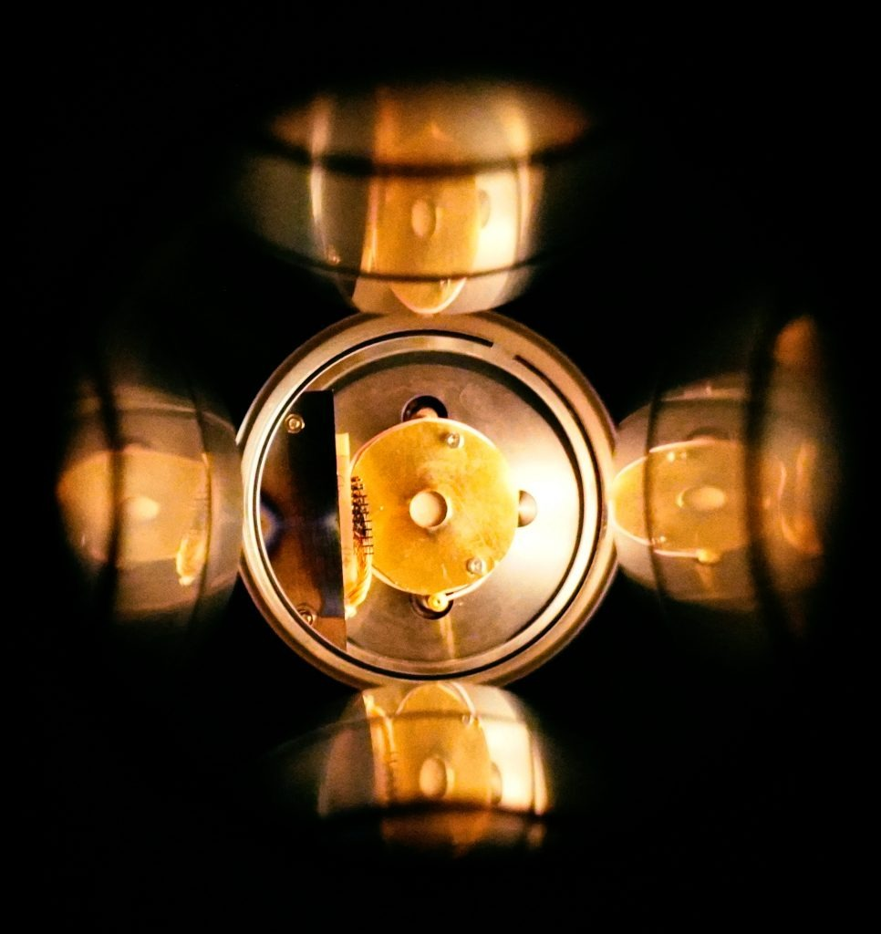
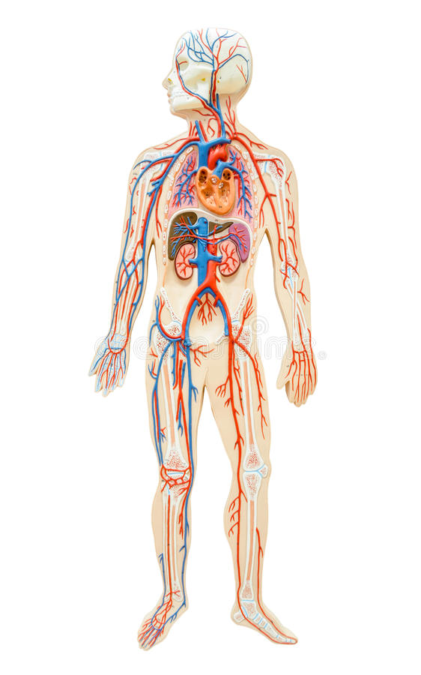
¹¹¹Ag production is
investigated with two INFN-csn5 projects
ISOLPHARM allows to produce unconventional medical radionuclides
¹¹¹Ag
⁶⁴Cu
⁶⁷Cu
⁴³Sc
⁴⁷Sc
(2018-2019)
¹⁵²Tb
¹⁴⁹Tb
¹⁵⁵Tb
(2020-2022)
The ISOLPHARM ion collection target
therapy
diagnostics
theranostics pairs
IAEA-CN301-73
Slide 8/15
Gaia Pupillo, INFN-LNL

Slide 10
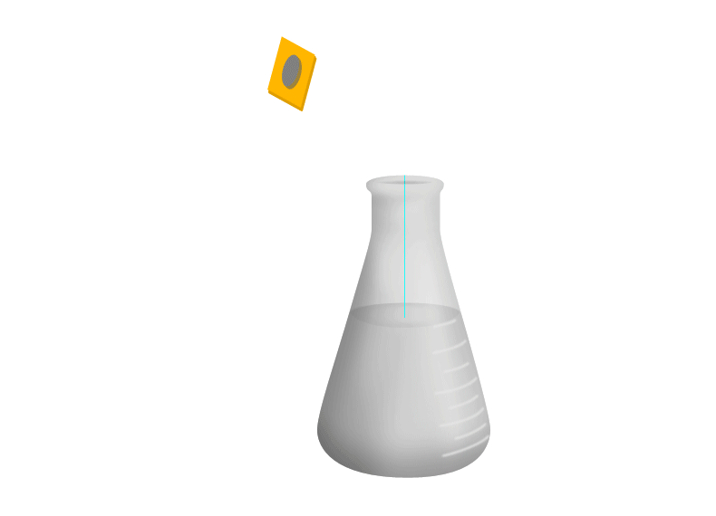
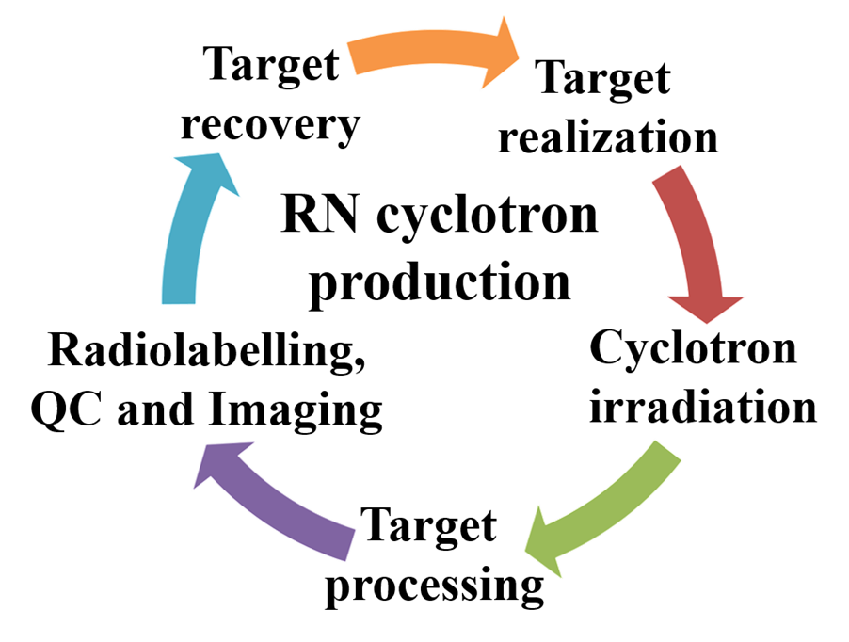
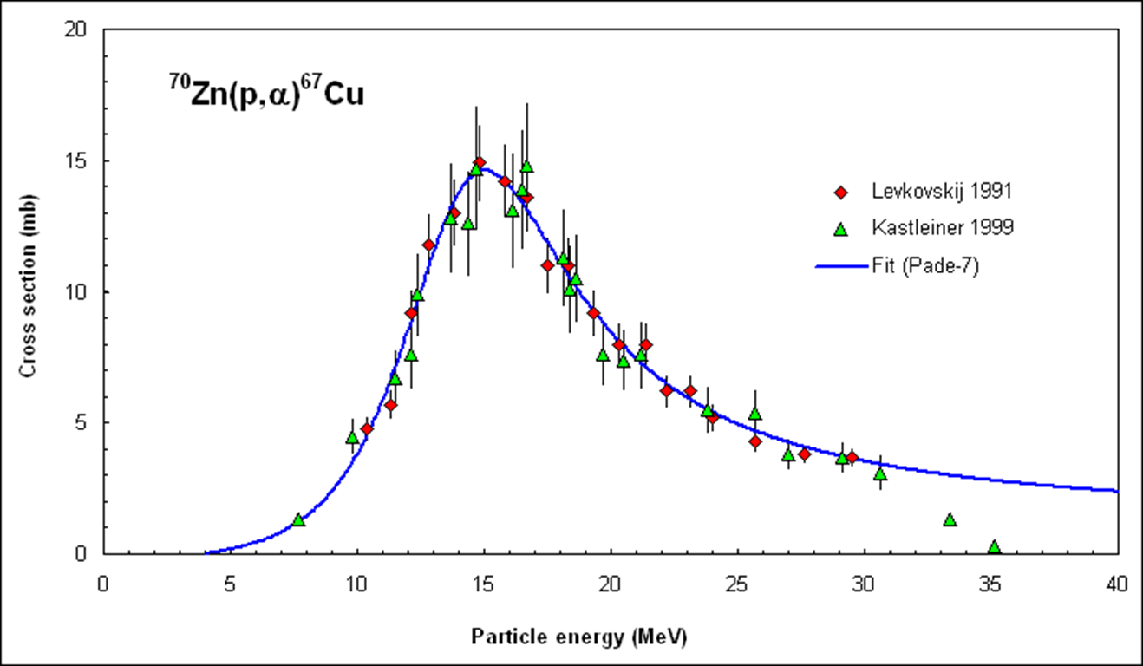
Cyclotron radiopharmaceutical production
Cyclotron Radioisotope production
Radiochemical processing
Quality controls
Target
Radioisotope of interest
Contaminants
Labelling
Irradiation
Pure radioisotope
Radio-
pharmaceutical preparation
Target activation
Dissolution
Nuclear physics
Extraction/
separation
Purification
IAEA-CN301-73
Slide 9/15
Gaia Pupillo, INFN-LNL

Slide 11
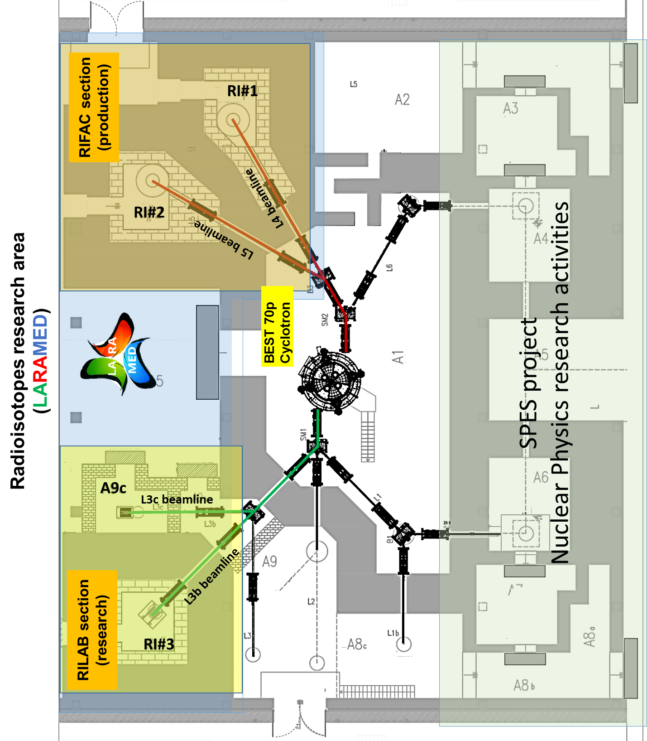
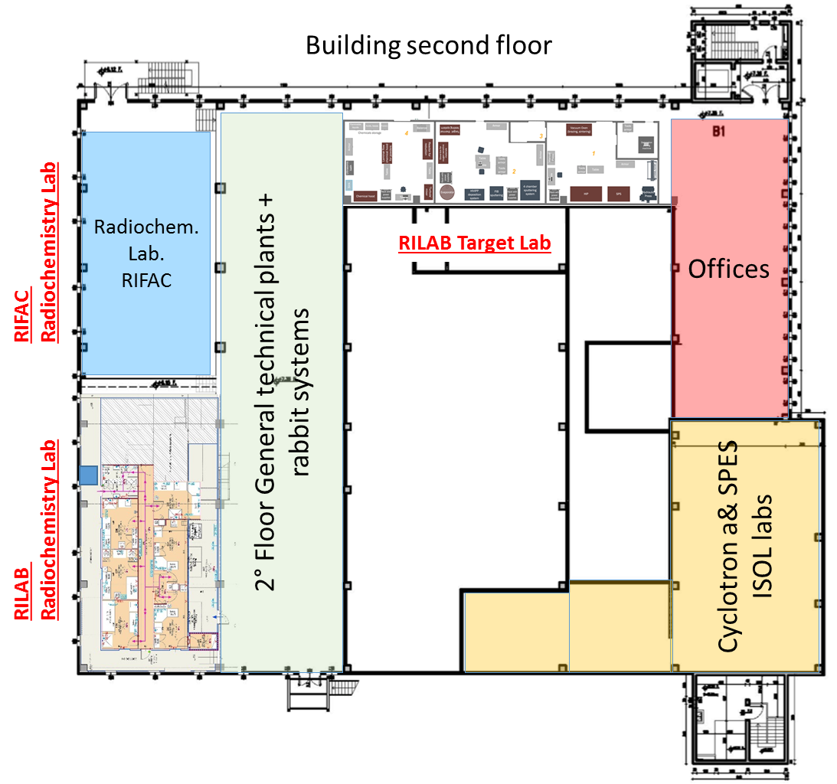
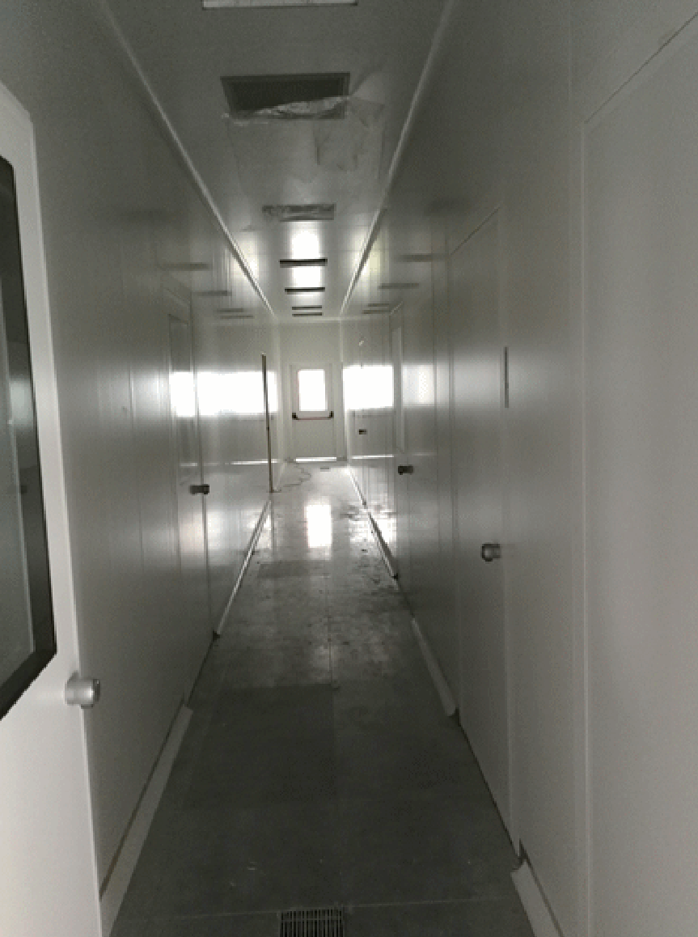
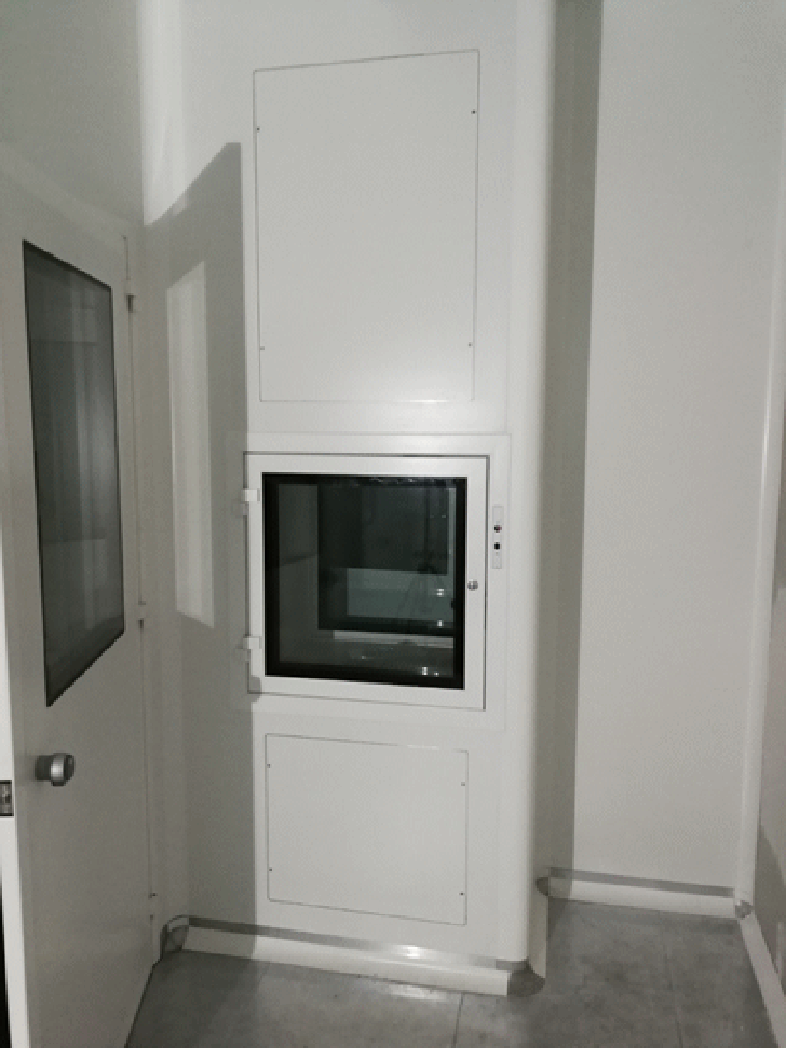
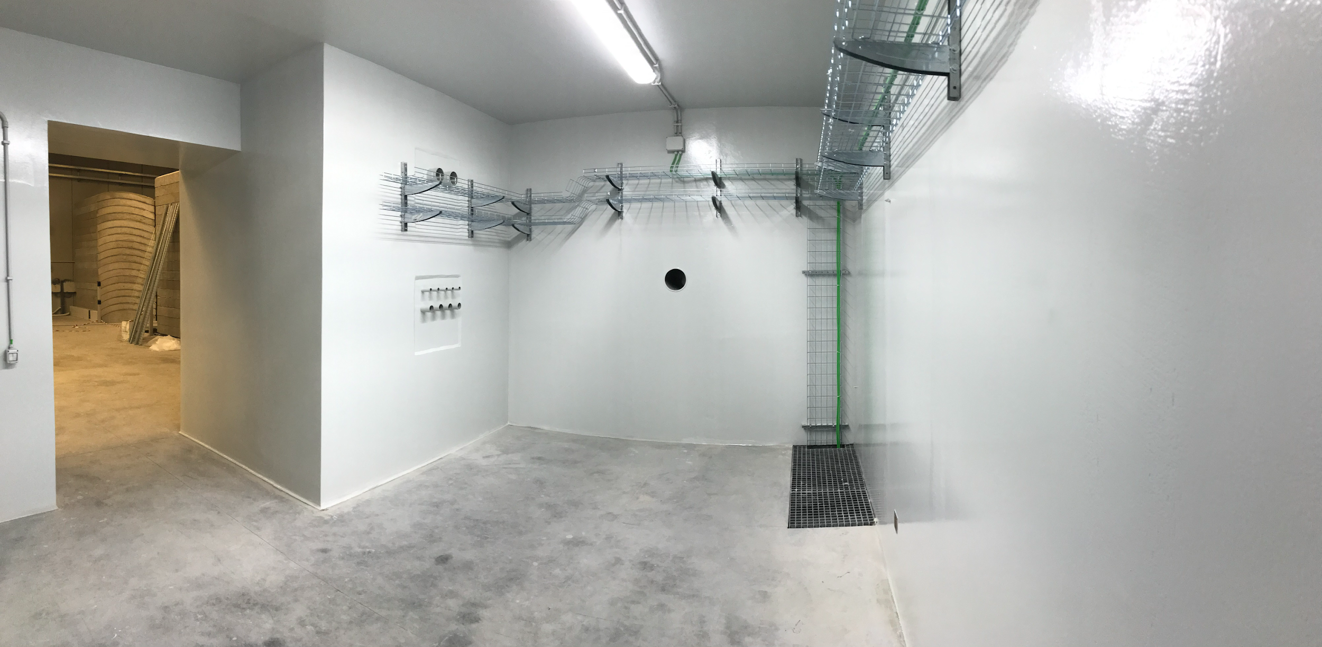
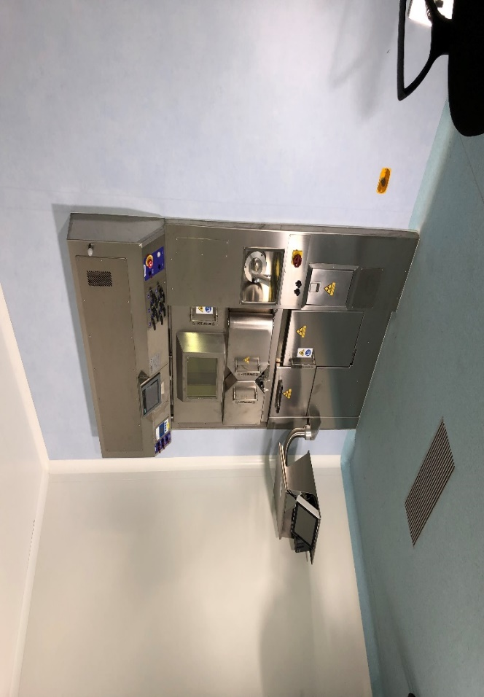
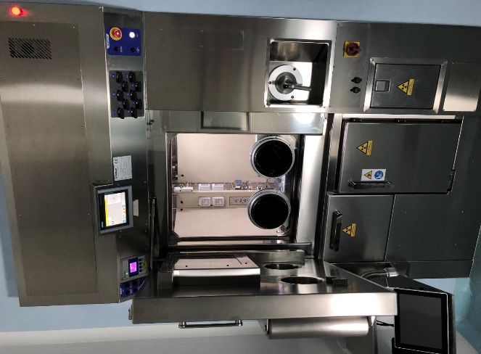
LARAMED facility @ LNL
RILAB chemistry / targetry labs
Pass box
Central corridor
RILAB Radiochemistry labs
J. Esposito et al., LARAMED: a LAboratory for Radioisotopes of MEDical interest, (2019) Molecules 24(1) 20
Cyclotron
Bunker A9c
Hot Cell
IAEA-CN301-73
Slide 10/15
Gaia Pupillo, INFN-LNL

Slide 12
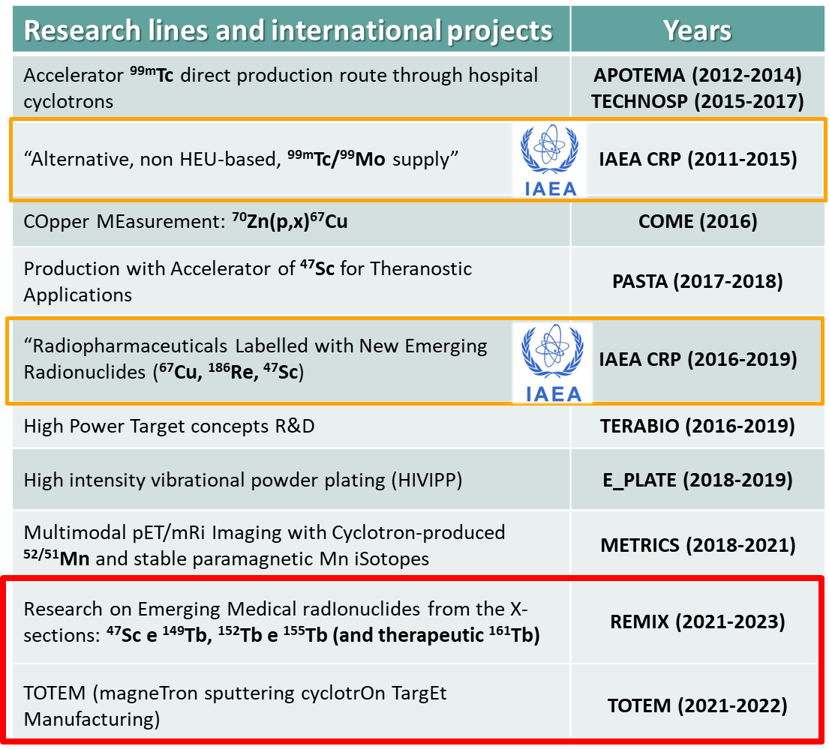
LARAMED research activities & network
National collaboration
International collaboration
Pavia Univ + INFN Pavia
ARRONAX
(Nantes, FRANCE)
LENA Laboratory (PV)
Univ. Winsconsin-MD (USA)
CNR Milan
IAEA
Ferrara Univ. /INFN-Fe
Padua Univ. /INFN-Pd
Milan Univ.
/INFN Mi
SC Hospital (VR)
St. Orsola Hospital (BO)
IAEA-CN301-73
Slide 11/15
Gaia Pupillo, INFN-LNL

Slide 13
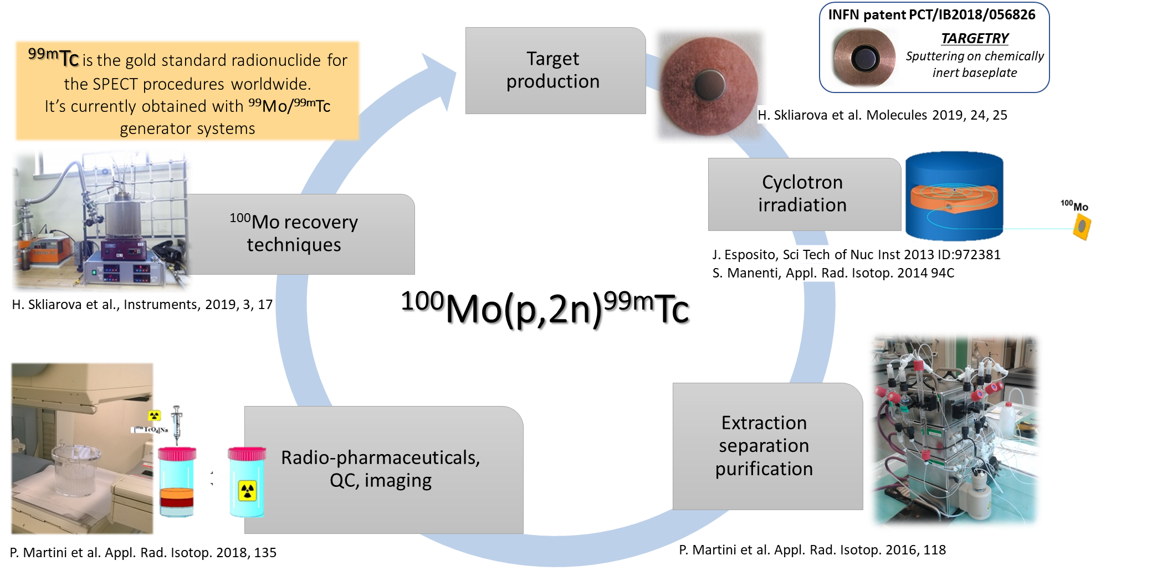
^{99m}Tc production cycle
CRP on ⁹⁹Mo/^{99m}Tc suppy (2011/2015)
IAEA-CN301-73
Slide 12/15
Gaia Pupillo, INFN-LNL

Slide 14
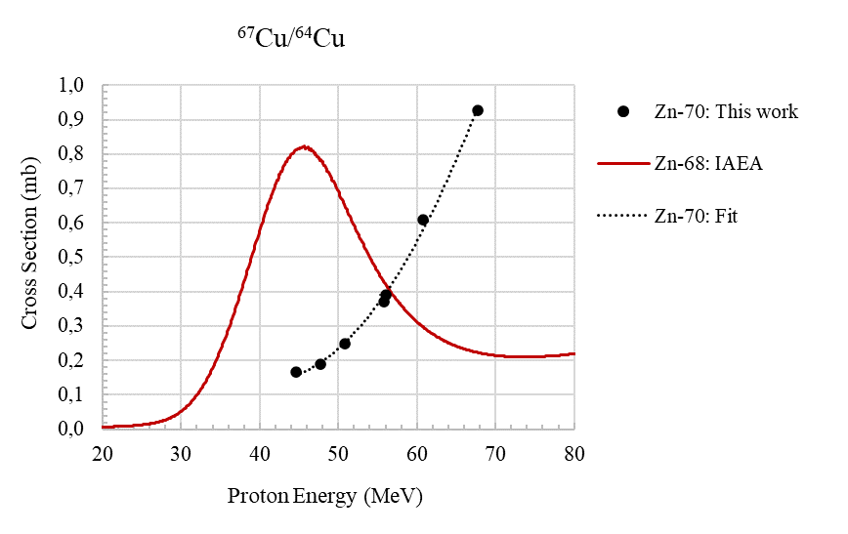
Theranostic radionuclides
Cross section ratio ⁶⁷Cu/⁶⁴Cu
SPECT
Cu-67 61.83 h | γ-ray [keV] | γ-ray [%]
β⁻ : 100 % | 184.6 | 48.7
(Zn-67)
Nuclear cross section measurements of the ⁷⁰Zn(p,x)⁶⁷Cu,⁶⁴Cu
a.d.u.
THERAPY
G. Pupillo, L. Mou et al., Production of ⁶⁷Cu by enriched ⁷⁰Zn targets…, Radiochim. Acta 108 (8) 2020
Mean β⁻ : 141 keV
COME (INFN, 2016)
SPECT
Nuclear cross section measurements of the ^{nat}V,⁴⁸Ti(p,x)⁴⁷Sc,^{xx}Sc
Sc-47 3.35 d | γ-ray [keV] | γ-ray [%]
β⁻ : 100 % | 159.4 | 68.3
(Ti-47)
PASTA (INFN, 2017-2018)
G. Pupillo, L. Mou et al., Preliminary results of the PASTA project (2019) Colloquia: EuNPC 2018, IL NUOVO CIMENTO 42 C 139
THERAPY
E_PLATE (INFN, 2018-2019)
Mean β⁻ : 162 keV
F. Barbaro et al., New results on proton induced reactions on Vanadium for ⁴⁷Sc production and the impact of level densities on t heoretical cross sections, Physical Review C 2021
CRP on ⁶⁷Cu, ⁴⁷Sc, ¹⁸⁶Re radiopharmaceuticals (2016/2020)
(INFN, 2021-2023)
Cross section measurements of ^{49,50}Ti(p,x)⁴⁷Sc & Tb-radionuclides
IAEA-CN301-73
Slide 13/15
Gaia Pupillo, INFN-LNL

Slide 15
Conclusions & perspectives
Young team of researchers with different expertise
(targetry, nuclear physics, engineering, radiochemistry, etc.)
High potential impact with the possibility to exploit both the ISOL and the DIRECT activation techniques at the INFN-LNL (70 MeV proton-cyclotron)
Wide national & international network of
collaboration (+ PRISMAP consortium)
IAEA-CN301-73
Slide 14/15
Gaia Pupillo, INFN-LNL

Slide 16
Acknowledgements to all the people and the Institutions inolved.
gaia.pupillo@lnl.infn.it

