Slide 1
IAEA – CN295 International Conference on Safety and Security of Radioactive Sources
Accomplishments and Future Endeavours, 20–24 June 2022, Vienna, Austria
Side Event on “The IAEA Legislative Assistance Programme: Addressing Member States’ Needs”
CAMEROON’S EXPERIENCE IN THE CONTEXT OF THE IAEA LEGISLATIVE ASSISTANCE PROGRAMME
Augustin Simo
National Radiation Protection Agency (NRPA)
Yaoundé, Cameroon E.mail: augsimo@yahoo.fr

Slide 2
CONTENT 1. Introduction 2. Cameroon’s Experience in the context of the IAEA assistance in legislation programme 3. Conclusion

Slide 3
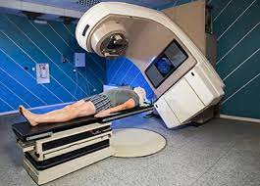
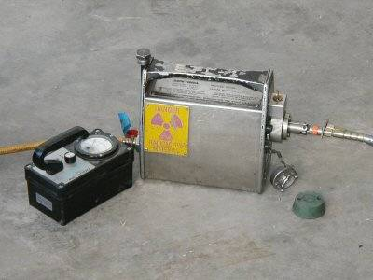
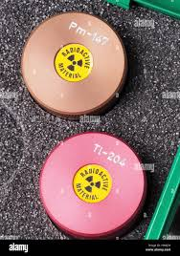
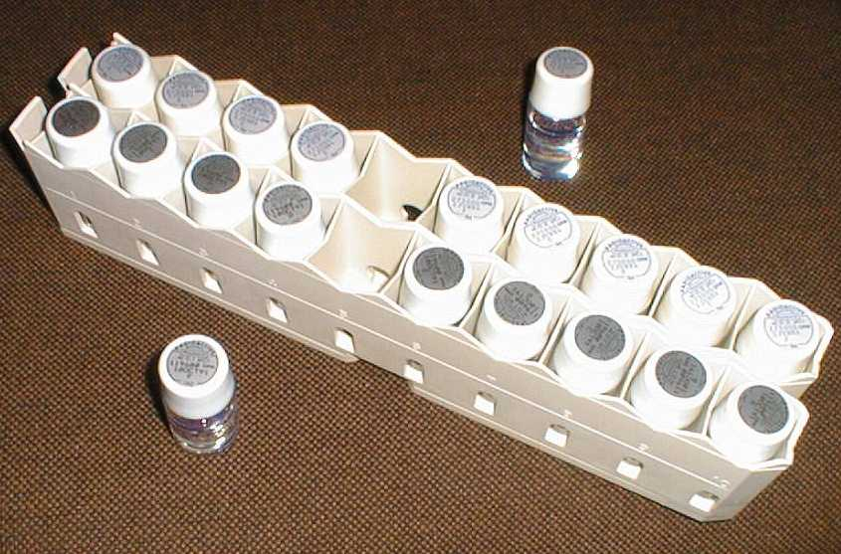
1. INTRODUCTION (1/2)
Radiotherapy
In Cameroon radioactive sources are used for
medical,
industrial, and
research and education purposes.
The country has no nuclear installation.
Industrial radiography
Radioisotopes

Slide 4
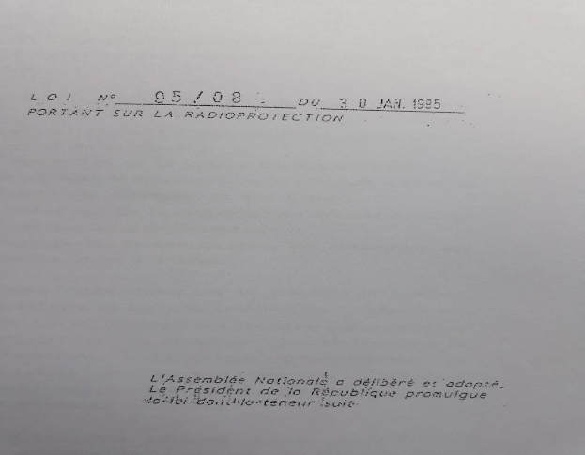
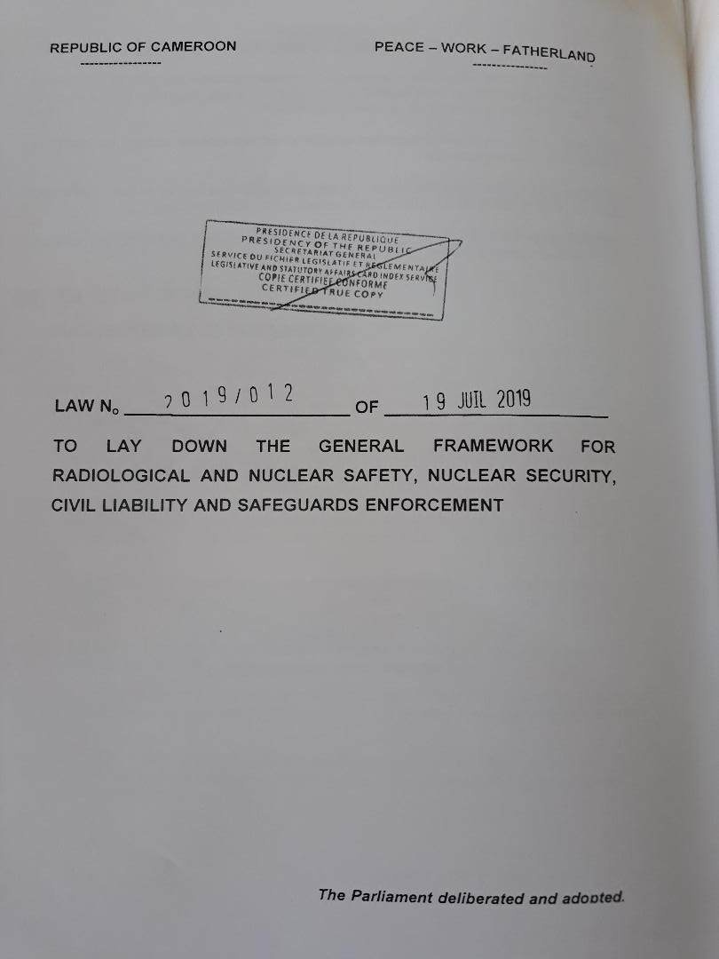
1. INTRODUCTION (2/2)
Pursuant to Law No. 95/08 on radiation protection, Decree N° 2002/250 created the National Radiation Protection Agency (NRPA) as the regulatory body.
The legal framework for the control of the utilizations of the ionizing radiation in Cameroon has been upgraded from Law No. 95/08 on Radiation Protection to Law No. 2019/012 of 19 July 2019 to Lay Down the General Framework for Radiological Protection and Nuclear Safety, Nuclear Security, Civil Liability and Safeguards Enforcement.

Slide 5
2. EXPERIENCE IN THE CONTEXT OF THE IAEA ASSISTANCE IN LEGISLATION (1/4)
Before 2019, Cameroon hosted 2 IRRS missions in 2007 and 2014.
Its hosted 1 INServ mission in 2014.
Its first INSSP was approved in 2013 and it hosted 2 INNP review missions in 2015 and 2018.
All these peer review missions organized by the IAEA provided recommendations to strengthening the national legal and regulatory framework for radiation safety and security and nuclear security.

Slide 6
2. EXPERIENCE IN THE CONTEXT OF THE IAEA ASSISTANCE IN LEGISLATION (2/4)
The new Law integrated the provisions of the international legal instruments to which Cameroon is party, namely the following:
 | Title | In Force | Status
VC | Vienna Convention on Civil Liability for Nuclear Damage | 1977-11-12 | accession: 1964-03-06
CPPNM | Convention on the Physical Protection of Nuclear Material | 2004-07-29 | accession: 2004-06-29
CPPNM/ACPPNM/A | Amendment to the Convention on the Physical Protection of Nuclear Material | 2016-05-08 | ratification: 2016-04-01
NOT | Convention on Early Notification of a Nuclear Accident | 2006-02-16 | Signature: 1987-09-25 ratification: 2006-01-17
ASSIST | Convention on Assistance in the Case of a Nuclear Accident or Radiological Emergency | 2006-02-16 | Signature: 1987-09-25 ratification: 2006-01-17
JP | Joint Protocol Relating to the Application of the Vienna Convention and the Paris Convention | 1992-04-27 | Signature: 1988-12-07 ratification: 1991-10-28

Slide 7
2. EXPERIENCE IN THE CONTEXT OF THE IAEA ASSISTANCE IN LEGISLATION (3/4)
For Safeguards Agreements
Reg.No | Title | In Force | Status
1780 | Agreement between the Government of the Republic of Cameroon and the International Atomic Energy Agency for the Application of Safeguards in connection with the Treaty on the Non Proliferation of Nuclear Weapons | 2004-12-17 | Signature: 1992-05-21
1981 | Protocol Additional to the Agreement between the Republic of Cameroon and the International Atomic Energy Agency for the Application of Safeguards in Connection with the Treaty on the Non-Proliferation of Nuclear Weapons | 2016-09-29 | Signature: 2004-12-16
Commitments to the Code of Conduct and two supplementary Guidance Documents (2006)

Slide 8
2. EXPERIENCE IN THE CONTEXT OF THE IAEA ASSISTANCE IN LEGISLATION (4/4)
To achieve this progress, Cameroon needed to have at the NRPA some staff trained in nuclear law to initiate the development of the first draft of the bill. No training facility in nuclear law exists in the country. The IAEA's legislative assistance programme was therefore an opportunity to be seized to meet that need.
During the period from 2011 to 2018, 6 NRPA’s staff were trained in nuclear law. Out of 6, 1 retired and 1 left the Agency.
A taskforce including nuclear law and radiation protection experts was set up at NRPA to develp the draft of the new law.
On Cameroon’s request, IAEA through OLA provided assistance to revise the draft law in order to ensure that all relevant provisions of international legal instruments were taken into account.
Finally the new law was promulgated on 19 July 2019.

Slide 9
CONCLUSION
The need to adapt national legislation on nuclear safety and security to technological developments and security challenges in a rapidly changing world recommends the support of ongoing legislative assistance programme and encouragement to the IAEA for its successful implementation through its Office of Legal Affairs.
It enables Member States to have a minimum of competence in nuclear law at the national level to assist the regulatory activities.

Slide 10
THANK YOU

